Slide 1
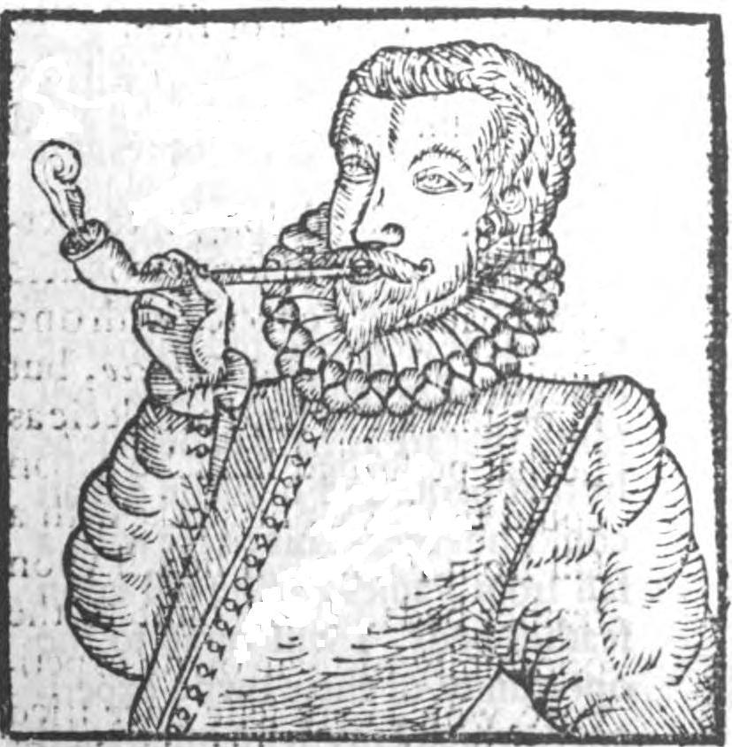
By way of summary. A beginning—the European adoption of tobacco as a hint of the North American sources of European Enlightenment
Indigenous North American ideas—from the advocacy of individual liberties to scepticism of revealed religion—certainly had an impact on th European Englightenment, even though, like pipe-smoking, such ideas underwent many transformations in the process. [DE, p.473]
Picture, Wikipedia: The earliest depiction of a European man smoking, from Tobacco by Anthony Chute, 1595. The English word tobacco originates from the Spanish word "tabaco".The precise origin of this word is disputed, but it is generally thought to have derived, at least in part, from Taíno, the Arawakan language of the Caribbean. In Taíno, it was said to mean either a roll of tobacco leaves (according to Bartolomé de las Casas, 1552), or to tabago, a kind of L-shaped pipe used for sniffing tobacco smoke (according to Oviedo, with the leaves themselves being referred to as cohiba).

Slide 2
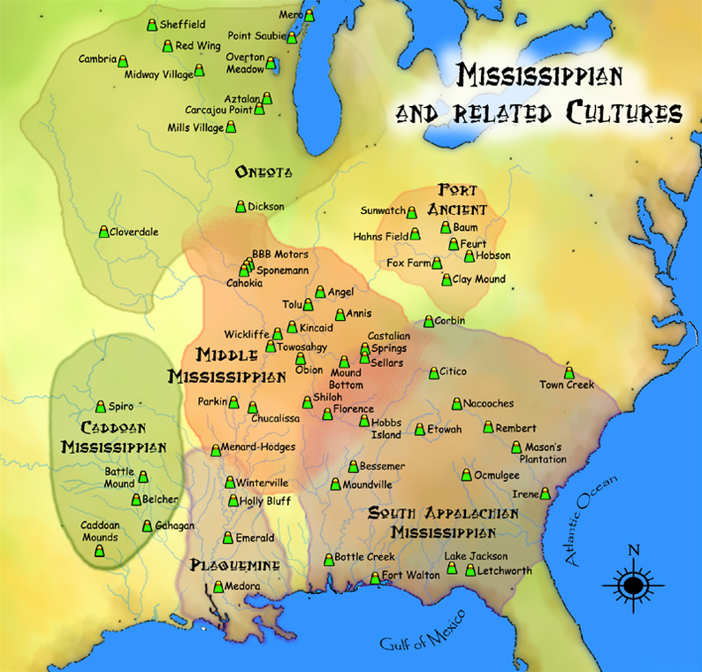
Cahokia—a veritable urban explosion around 1050 CE
Cahokia grew to more than six square miles, totalling (with satellite communities) a population in the order of 40,000. Soime of Cahokia’s pyramids were topped with palaces or temples, others with charnel houses or sweat lodges. From the summit of Monk’s Mound the city’s ruling elite enjoyed powers of surveillance over the planned residential zones. What’s so striking is an almost complete dismantling of any self-governing communities outside the city. Along with games and feasts, in the early decades of Cahokia’s expansion there were mass executions and burials carried out in public associated with the funerary rites of nobility. Around their shrouded bodies a surface of thousands of shell beads was surrounded by earthen mounds, their graves included the stacked bodies of mainly young women killed specifically for the occasion…Whatever happened in Cahokia, it appears to have left extremely unpleasant memories. Along with much of its bird-man mythology the place was erased from any later oral traditions. After 1400 CE the entire fertile expanse of the American Bottom along with the territory from Cahokia up to the Ohio River, became what’s referred to in the literature as the Vacant or Empty Quarter; a haunted wilderness of overgrown pyramids and housing blocks crumbling back into swamp, occasionally traversed by hunters but devoid of permanent human settlement…The Vacant Quarter implies a self-conscious rejection of everything the city of Cahokia stood for. Among the descendants of Cahokian subjects, migration is often framed as implying the restructuring of an entire social order, with the single project of emancipation, moving away, disobeying the previous regime and building a new social order, as we’ll see exemplified with the Osage, who originated in the Middle Ohio River valley before migrating to the Great Plains. To move to a new country can be seen as synonymous with “constitutional change.” [DE, pp. 465-469]. Certainly, the overall direction, in the wake of Cahokia, was a broad movement away from overlords of any sort and towards constitutional structures carefully worked out to distribute power in such a way that they would never return. [DE, p. 491]
Map, Wikipedia: A map showing approximate areas of various Mississippian and related cultures. Cahokia is located near the center of this map in the upper part of the Middle Mississippi area.

Slide 3
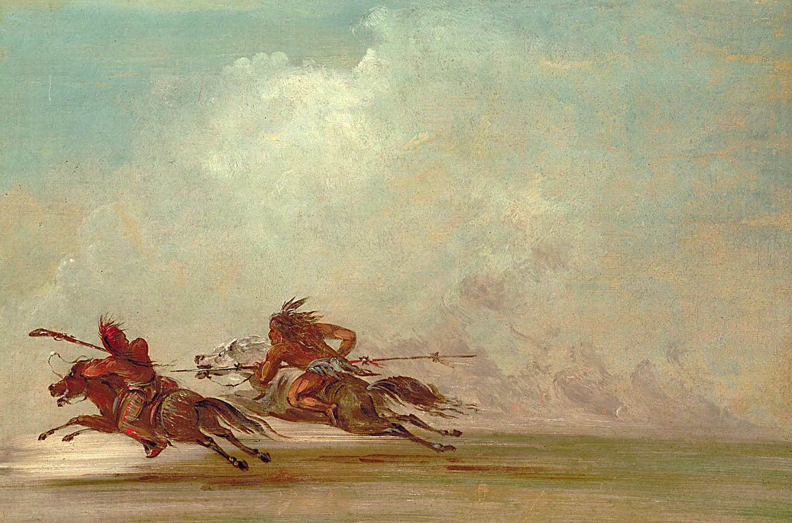
There were no difference among the Osage between officials, priests and philosophers
Among the Osage, all were title-bearing officials, including he soldiers assigned to help chiefs enforce their decisions, while Protectors of the Land assigned to hunt down and kill outsiders who poached game were also religious figures. [DE, p. 479].
Picture, Wikipedia: War on the plains. Comanche (right) trying to lance Osage warrior. Painting by George Catlin, 1834. The Osage Nation (/ˈoʊseɪdʒ/ OH-sayj) (Osage: 𐓁𐒻 𐓂𐒼𐒰𐓇𐒼𐒰͘ (Ni Okašką), "People of the Middle Waters") is a Midwestern Native American tribe of the Great Plains. The tribe developed in the Ohio and Mississippi river valleys around 700 BC along with other groups of its language family. They migrated west after the 17th century, settling near the confluence of the Missouri and Mississippi rivers, as a result of Iroquois invading the Ohio Valley in a search for new hunting grounds. The term "Osage" is a French version of the tribe's name, which can be roughly translated as "calm water". The Osage people refer to themselves in their indigenous Dhegihan Siouan language as 𐓏𐒰𐓓𐒰𐓓𐒷 (Wazhazhe), or "Mid-waters".[By the early 19th century, the Osage had become the dominant power in the region, feared by neighboring tribes. The tribe controlled the area between the Missouri and Red rivers, the Ozarks to the east and the foothills of the Wichita Mountains to the south. They depended on nomadic buffalo hunting and agriculture.The 19th-century painter George Catlin described the Osage as "the tallest race of men in North America, either red or white skins; there being ... many of them six and a half, and others seven feet."^{[5]} The missionary Isaac McCoy described the Osage as an "uncommonly fierce, courageous, warlike nation" and said they were the "finest looking Indians I have ever seen in the West".

Slide 4
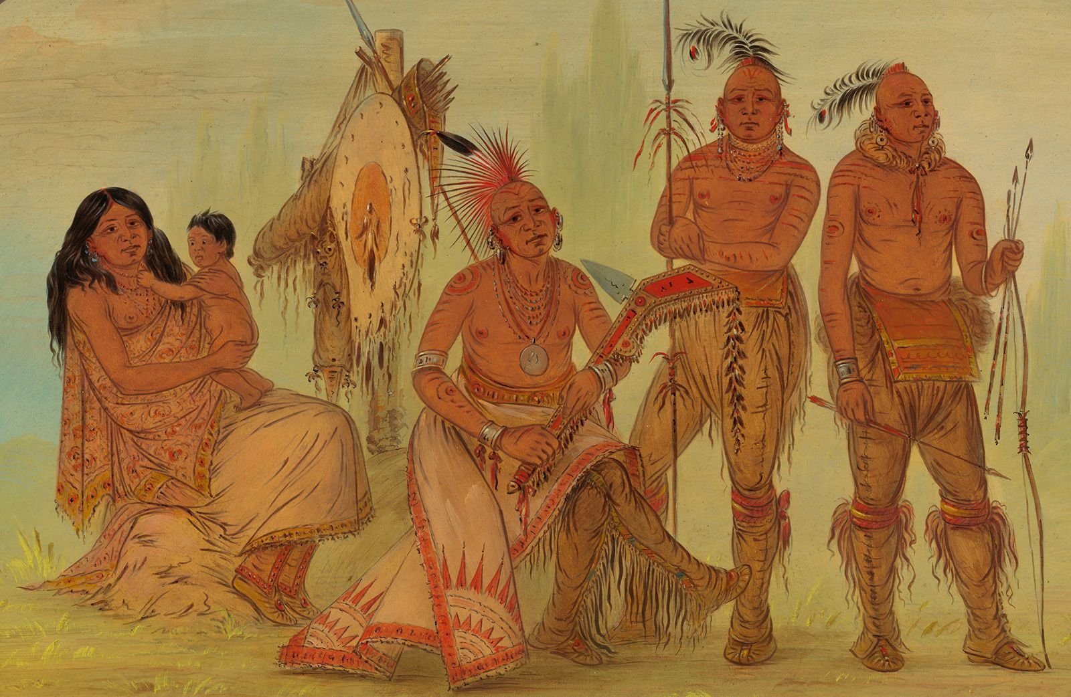
Osage mythology: A story about institutional reforms
In the beginning Sky People, Earth People and Water People descended into the world and set out in search of its indigenous inhabitants. These cannibals, the Isolated Earth People, were also powerful sorcerers, capable of using the four winds to destroy life everywhere. Only the chief of the Water People had he courage to enter their village, negotiate with their leader, and convince his people to abandon their murderous and unsanitary ways. In the end, he persuaded them to join the federation of Sky, Earth and Water People –to move to a new country, free from the pollution and decaying corpses. While the story proceeds through the creation of a decentralized clan-by-clan system, Graeber and Wengrow emphasize two elements of this origin saga. The first is that the narrative sets off from the neutralization of arbitrary power: the taming of the Isolated Earth People’s leader—the chief sorcerer—by according him some central position in a new system of alliances. This is a common story among the descendants of groups that had formerly come under the influence of Mississippian civilization. In the process of co-opting their leader, the destructive ritual knowledge once held by the Isolated Earth People was, eventually, distributed to everyone, along with elaborate checks and balances concerning its use. The second element is that even the Osage, who ascribed key roles to sacred knowledge in their political affairs, in no sense saw their social structure as something from on high but rather as a series of legal and intellectual discoveries—even breakthroughs. [DE, pp. 479-480]
Picture, Britannia: George Catlin, Osage Indians-- Osage, original name Ni-u-kon-ska (“People of the Middle Waters”), North American Indian tribe of the Dhegiha branch of the Siouan linguistic stock. The name Osage is an English rendering of the French phonetic version of the name the French understood to be that of the entire tribe. It was thereafter applied to all members of the tribe. The name Wa-zha-zhe (“Water People”), however, refers to only a subdivision of the Hunka (Hunkah; “Earth People”), one of the two ancient kin groups—the other was the Tzi-zho (Tzi-sho; “Sky People”)—from which the tribe descended.

Slide 5
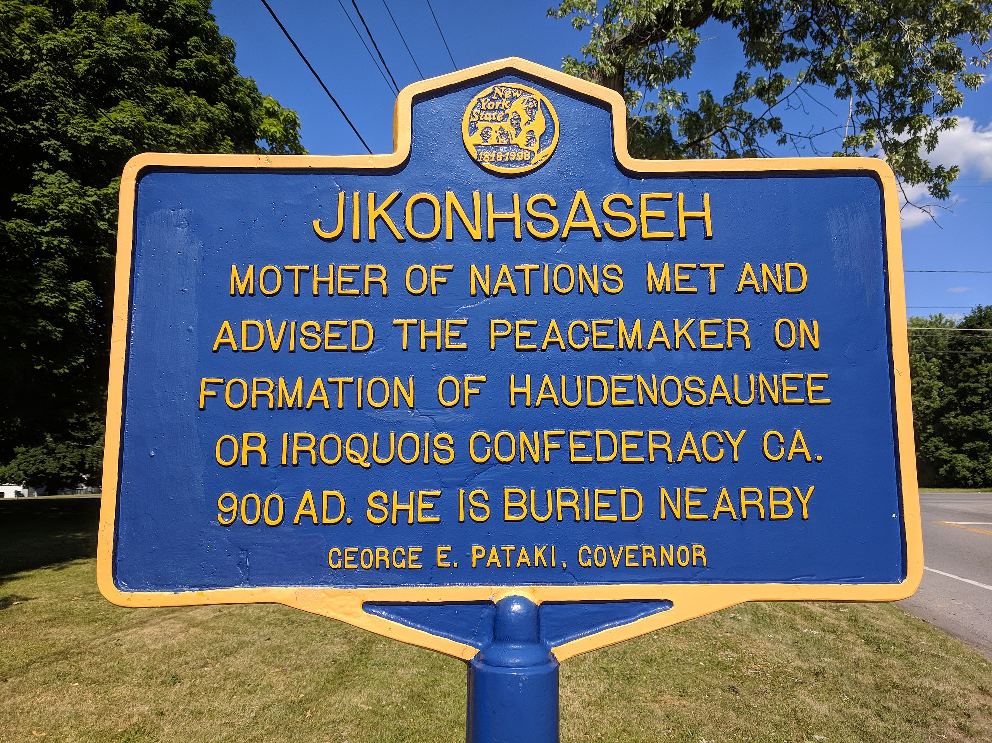
Jigonsaseh,figure of reconciliation;Nan DeBello Experience
The Jigonsaseh, Mother of Nations, the highest ranking woman official among the later Haudenosaunee, in their national epic, was in many ways the opposite ofkingship and self-aggrandizement. A holder of that title was incorporated into the Wolf Clan of the Seneca, one of the Five (Six) Nations, in 1650. Her successor of the same name or title, a greater military tactician than the Marquis de Denonville, the governor of New France (who had attempted to drive the Iroquois Confederacy from what is now upstate New York), defeated him near Victor, New York, and was at the point of entering Montreal when the French government sued for peace. She then demobilized her army and returned to the process of selecting new officials to reconstitute the Great Council of the Conferacy. It was precisely the Iroquoian penchant for prolonged political argument that lay behind what Graeber and Wengrow have called the indigenous critique of European society. The resulting ideas about liberty had a profound effect on the world. They developed political sensibilities that ultimately had a deep influence on Enlightenment thinkers, and through them, are still with us today. [DE, pp. 489-490]
Picture, Wikipedia: Jikonhsaseh Historic Marker near Ganondagan State Historic Site, a Native American historic site in Ontario County, New York in the United States. Location of the largest Seneca village of the 17th century, the site is in the present-day town of Victor. Ganondagan was once the largest Seneca town; the Seneca nation was considered to occupy the western gateway of Haudenosaunee (Iroquois Confederacy) territory. This site is at the center of the story of the Peacemaker, who unified the five major peoples and created the Haudenosaunee confederacy. It survives to this day. Seneca oral tradition tells of a Huron man who arrived among the Mohawk speaking of the Gayanesshagowa (aka The Great Law of Peace). This prophet is known today as The Great Peacemaker. The Mohawk, Oneida, and Cayuga pledged to join his proposed confederation and, following a dramatic interlude, the Seneca agreed also.The discussion about how to bring in the Onondaga took place in the Ganondagan house of Jikonsase (or Jikonhsaseh), a Seneca woman elder now known as the "Mother of Nations." She proposed a solution which eventually brought the Onondaga into the fold, for it gave them a prominent place in the confederacy. She lived in the vicinity of Ganondagan, and is buried nearby.

Slide 6
A reminder of the basic forms of social liberty which one might put into practice as can be derived the examples from Archeology and Anthropolgy by Wengrow and Graeber; the basic question of “The Dawn of Everything”
The freedom to move away or relocate from one’s surroundings.
The Freedom to ignore or disobey commands issued by others.
The Freedom to shape entirely new social realities, or shift back and forth between different one.
The basic question of “The Dawn of Everything, A New History of Humanity” is considering how these three freedoms over time gradually receded from people’s consciousness, so that the majority of people living today can barely comprehend what it might be like to live in a social order gased on them. How did it happen? How did we get stuck? And just how stuck are we really? [DE, p. 503].

Slide 7
Concluding Questions Raised by Graeber and Wengrow
Is there a positive correlation between what is usually called “gender equality” (which might better be termed, simply, “women’s freedom”) and the degree of innovation in a given society? [DE, kp. 501]
Why is there a close connection between patriarchal household and military might in such empires as the Han, Aztec, or Roman, and why have such capturing societies (those that accumulate slaves from warfare) , distorted (or at least controlled) our understanding of freedom? [DE, pp. 508-510].
Perhaps the most stubborn misconception we’ve been tackling has to do with scale. It does seem to be received wisdom… that structures of domination are the inevitable result of populations scaling up by orders of magnitude; that is, that a necessary correspondence exists between social and spatial hierarchies. Time and again we found ourselves confronted with writing which simply assumes that the larger and more densely populated the social group, the more “complex” the system needed to keep it organized. Complexity, in turn, is still often used as a synonym for hierarchy. Hierarchy, in turn, is used as a euphemism for chains of command (the “origins of the state”), which means that as soon as large numbers of people decided to live in one place or join a common project, they necessarily abandon the second freedom—to refuse orders—and replace it with legal mechanisms for, say, beating or locking up those who don’t do as they are told. Or, that there was some “original” form of human society; that its nature was fundamentally good or evil, that a time before inequality and political awareness existed; that something happened to change all this; that “civilization” and “complexity” always come at the price of human freedoms; that participatory democracy is natural in small groups but cannot possibly scale up to anything like a city or a nation state.
As we’ve seen, none of these assumptions are theoretically essential, many of them are myths, and history tends not to bear them out—from Upper Paleolithic mammoth hunters to the shifting coaltions and confederacies of sixteenth-century Iroquoia power was dispersed or distributed in flexible ways across different elements of society or at different scales of integration, or indeed across different times of of year within the same society. [DE, Chapter 12, fn. 15, p. 610]. Does our assumptions to the contrary, implies the 1995 work of Carole Crumley—she coined the term heterarchy for those systems other than hierarchy (she is a European Iron Age anthropologist), that complex systems don’t have to be organized top-down, either in the natural or in the social world, tell us more about ourselves than the people or phenomena we’re studying? [DE, pp. 515,525-526]
Note: The concept of heterarchy was first employed in a modern context by cybernetician Warren McCulloch in 1945. As Carole L. Crumley has summarised, "[h]e examined alternative cognitive structure(s), the collective organization of which he termed heterarchy. He demonstrated that the human brain, while reasonably orderly was not organized hierarchically. This understanding revolutionized the neural study of the brain and solved major problems in the fields of artificial intelligence and computer design.“
Subnote: Warren Sturgis McCulloch (November 16, 1898 – September 24, 1969) was an American neurophysiologist and cybernetician, known for his work on the foundation for certain brain theories and his contribution to the cybernetics movement. Along with Walter Pitts, McCulloch created computational models based on mathematical algorithms called threshold logic which split the inquiry into two distinct approaches, one approach focused on biological processes in the brain and the other focused on the application of neural networks to artificial intelligence. Walter Harry Pitts, Jr. (23 April 1923 – 14 May 1969) was an American logician who worked in the field of computational neuroscience. He proposed landmark theoretical formulations of neural activity and generative processes that influenced diverse fields such as cognitive sciences and psychology, philosophy, neurosciences, computer science, artificial neural networks, cybernetics and artificial intelligence, together with what has come to be known as the generative sciences.

Slide 8
Postscript by Graeber and Wengrow
Who knows? Perhaps if our species does endure, and we one day look backwards from this as yet unknowable future, aspects of the remote past that now seem like anomalies—say, bureaucracies that work on a community scale; cities governed by neighborhood councils; systems of government where women hold a preponderance of formal positions; or forms of land management based on care-taking rather than ownership and extraction—will seem like the really significant breakthroughs, and great stone pyramids or statues more like historical curiosities. [DE, p. 523]
If so it means we could have been living under radically different conceptions of what human society is actually about. It means that mass enslavement, genocide, prison camps, even patriarchy or regimes of wage labor never had to happen…It also suggests that, even now, the possibilities for human intervention are far greater than we’re inclined to think. [DE, p. 524]

