Slide 1
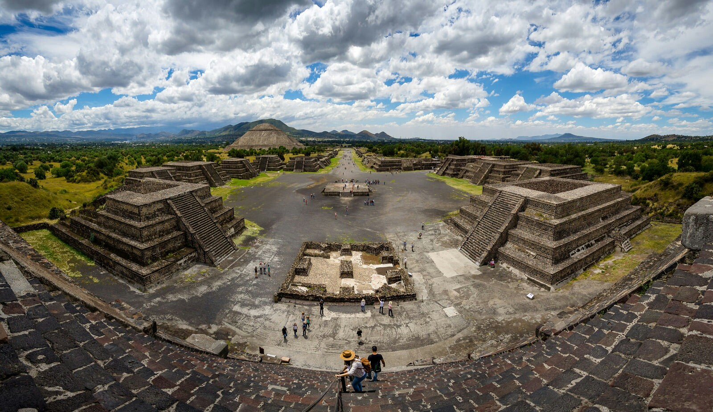
Teotihuacan: the people turn from monument building to social housing
After 300 CE the entire trajectory of Teotihuacan’s political development seems to have gone off on a remarkable tangent. Instead of building palaces and elite quarters, the citizens embarked on a remarkable project of urban renewal, supplying high-quality apartments for nearly all the city’s population, regardless of wealth or status. The Temple of the Feathered Serpent was desecrated and its stores of offerings looted. A large stepped-platform (the andosada) was then constructed to its west, which made what was left of the temple invisible from the main avenue. All new pyramid construction stopped permanently, and there is no further evidence of ritually sanctioned killing at the established Pyramids of the Sun and the Moon. Instead what we see after 300 CE is an extraordinary flow of urban resources into the provision of excellent stone built housing, not just for the wealthy or privileged, but for the great majority of Teotihuacan’s population. These impressive apartments are laid out in regular plots from one end of the city to the other. [DE, pp. 341-342].
Picture, Wikipedia: Panoramic view from the summit of the Pyramid of the Moon, with the Pyramid of the Sun on the center left in Teotihuacan, an ancient Mesoamerican city located in a sub-valley of the Valley of Mexico, which is located in the State of Mexico, 40 kilometers (25 mi) northeast of modern-day Mexico City. At its zenith, perhaps in the first half of the first millennium (1 CE to 500 CE), Teotihuacan was the largest city in the Americas, considered as the first advanced civilization on the North American continent, with a population estimated at 125,000 or more,making it at least the sixth-largest city in the world during its epoch. The city is thought to have been established around 100 BCE, with major monuments continuously under construction until about 250 CE.The city may have lasted until sometime between the 7th and 8th centuries CE, but its major monuments were sacked and systematically burned around 550 CE.

Slide 2
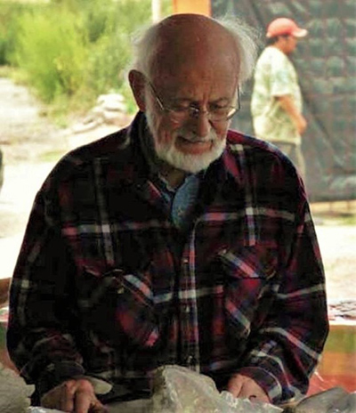
Rene Millon [1922-2016], the archeologist responsible for producing the first detailed map of Teotihuacan’s layout
He felt that the apartment compound was actually invented as a form of social housing, “designed for urban life in a city that was becoming increasingly crowded, kperhaps approaching the chaotic.” ..Many citizens enjoyed a standard of living that is rarely achieved across such a wide secgor of urban society in any period of urban history, including our own. [DE, p. 343} Representations of individual rulers and royal funerary cults were not present at Teotihuacán, in contrast to the Classic Maya and Egypt sites, they said, because such would have inconsistent with Teotihuacán’s corporate governance and ideology. René saw Teotihuacán as both a great commercial and religious center and the capital of an expansionist state, which, however, he deliberately did not characterize as an empire. He saw social stratification as a key in the growth of Teotihuacán. Although early in his career ideas about hydraulic agriculture’s role in state formation drew his interest, he rejected models of a centralized irrigation authority, given the lack of evidence (1973a: 48). I suspect he would have found the current theories of collective action more appealing. He eschewed neo-evolutionary models. “I venture to say that this type of archaeology changed the study of these societies, from a study just of the elites to include all the people of a city,” says Renato Perucchio, a professor of mechanical engineering and director of the University’s Archeology, Technology, and Historical Structures program. “There is no scholarly work on Teotihuacán that talks about its urban development without referring to his work.”

Slide 3
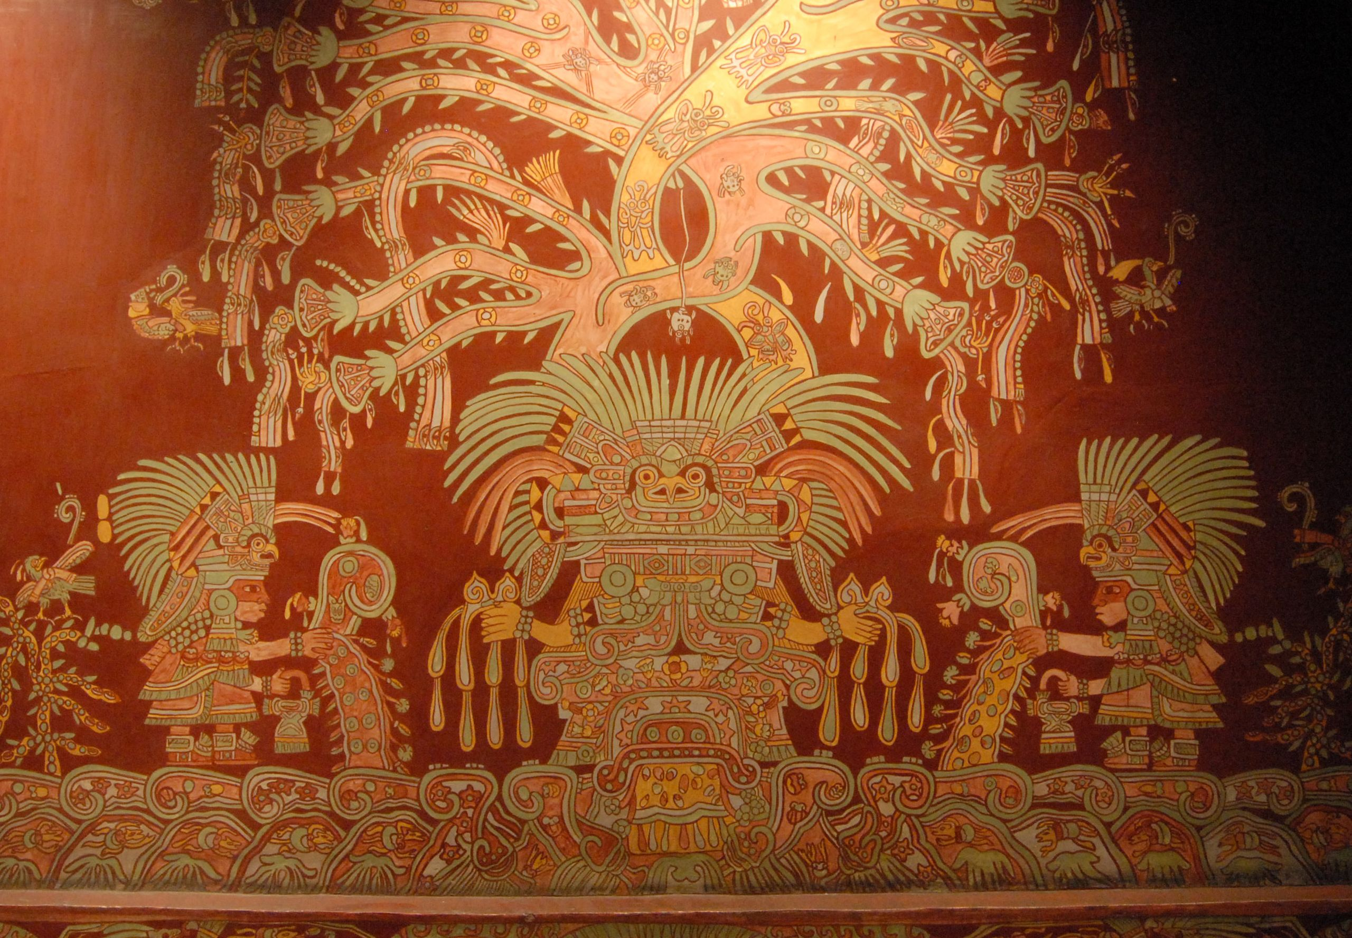
Teotihuacan’s civic identity revealed through its mural art
Despite efforts to see them as sombre religious iconography, these playful and ebullient pictorial scenes—as those painted on the interior walls of apartment compounds from around 350 CE—often seem veritably psychedelic. Streaming effigies emerge from clustered plant, human and animal bodies, framed by figures with elaborate costumes, sometimes grasping hallucinogenic seeds and mushrooms; and among the crowd scenes we find flower eaters with rainbows bursting from their heads. Such scenes often depict human figures all at roughly the same size, with no individual raised up over another. [DE, p. 344].
A mural showing what has been identified as the Great Goddess of Teotihuacan, the primary deity of Teotihuacan, the feathered serpent.

Slide 4
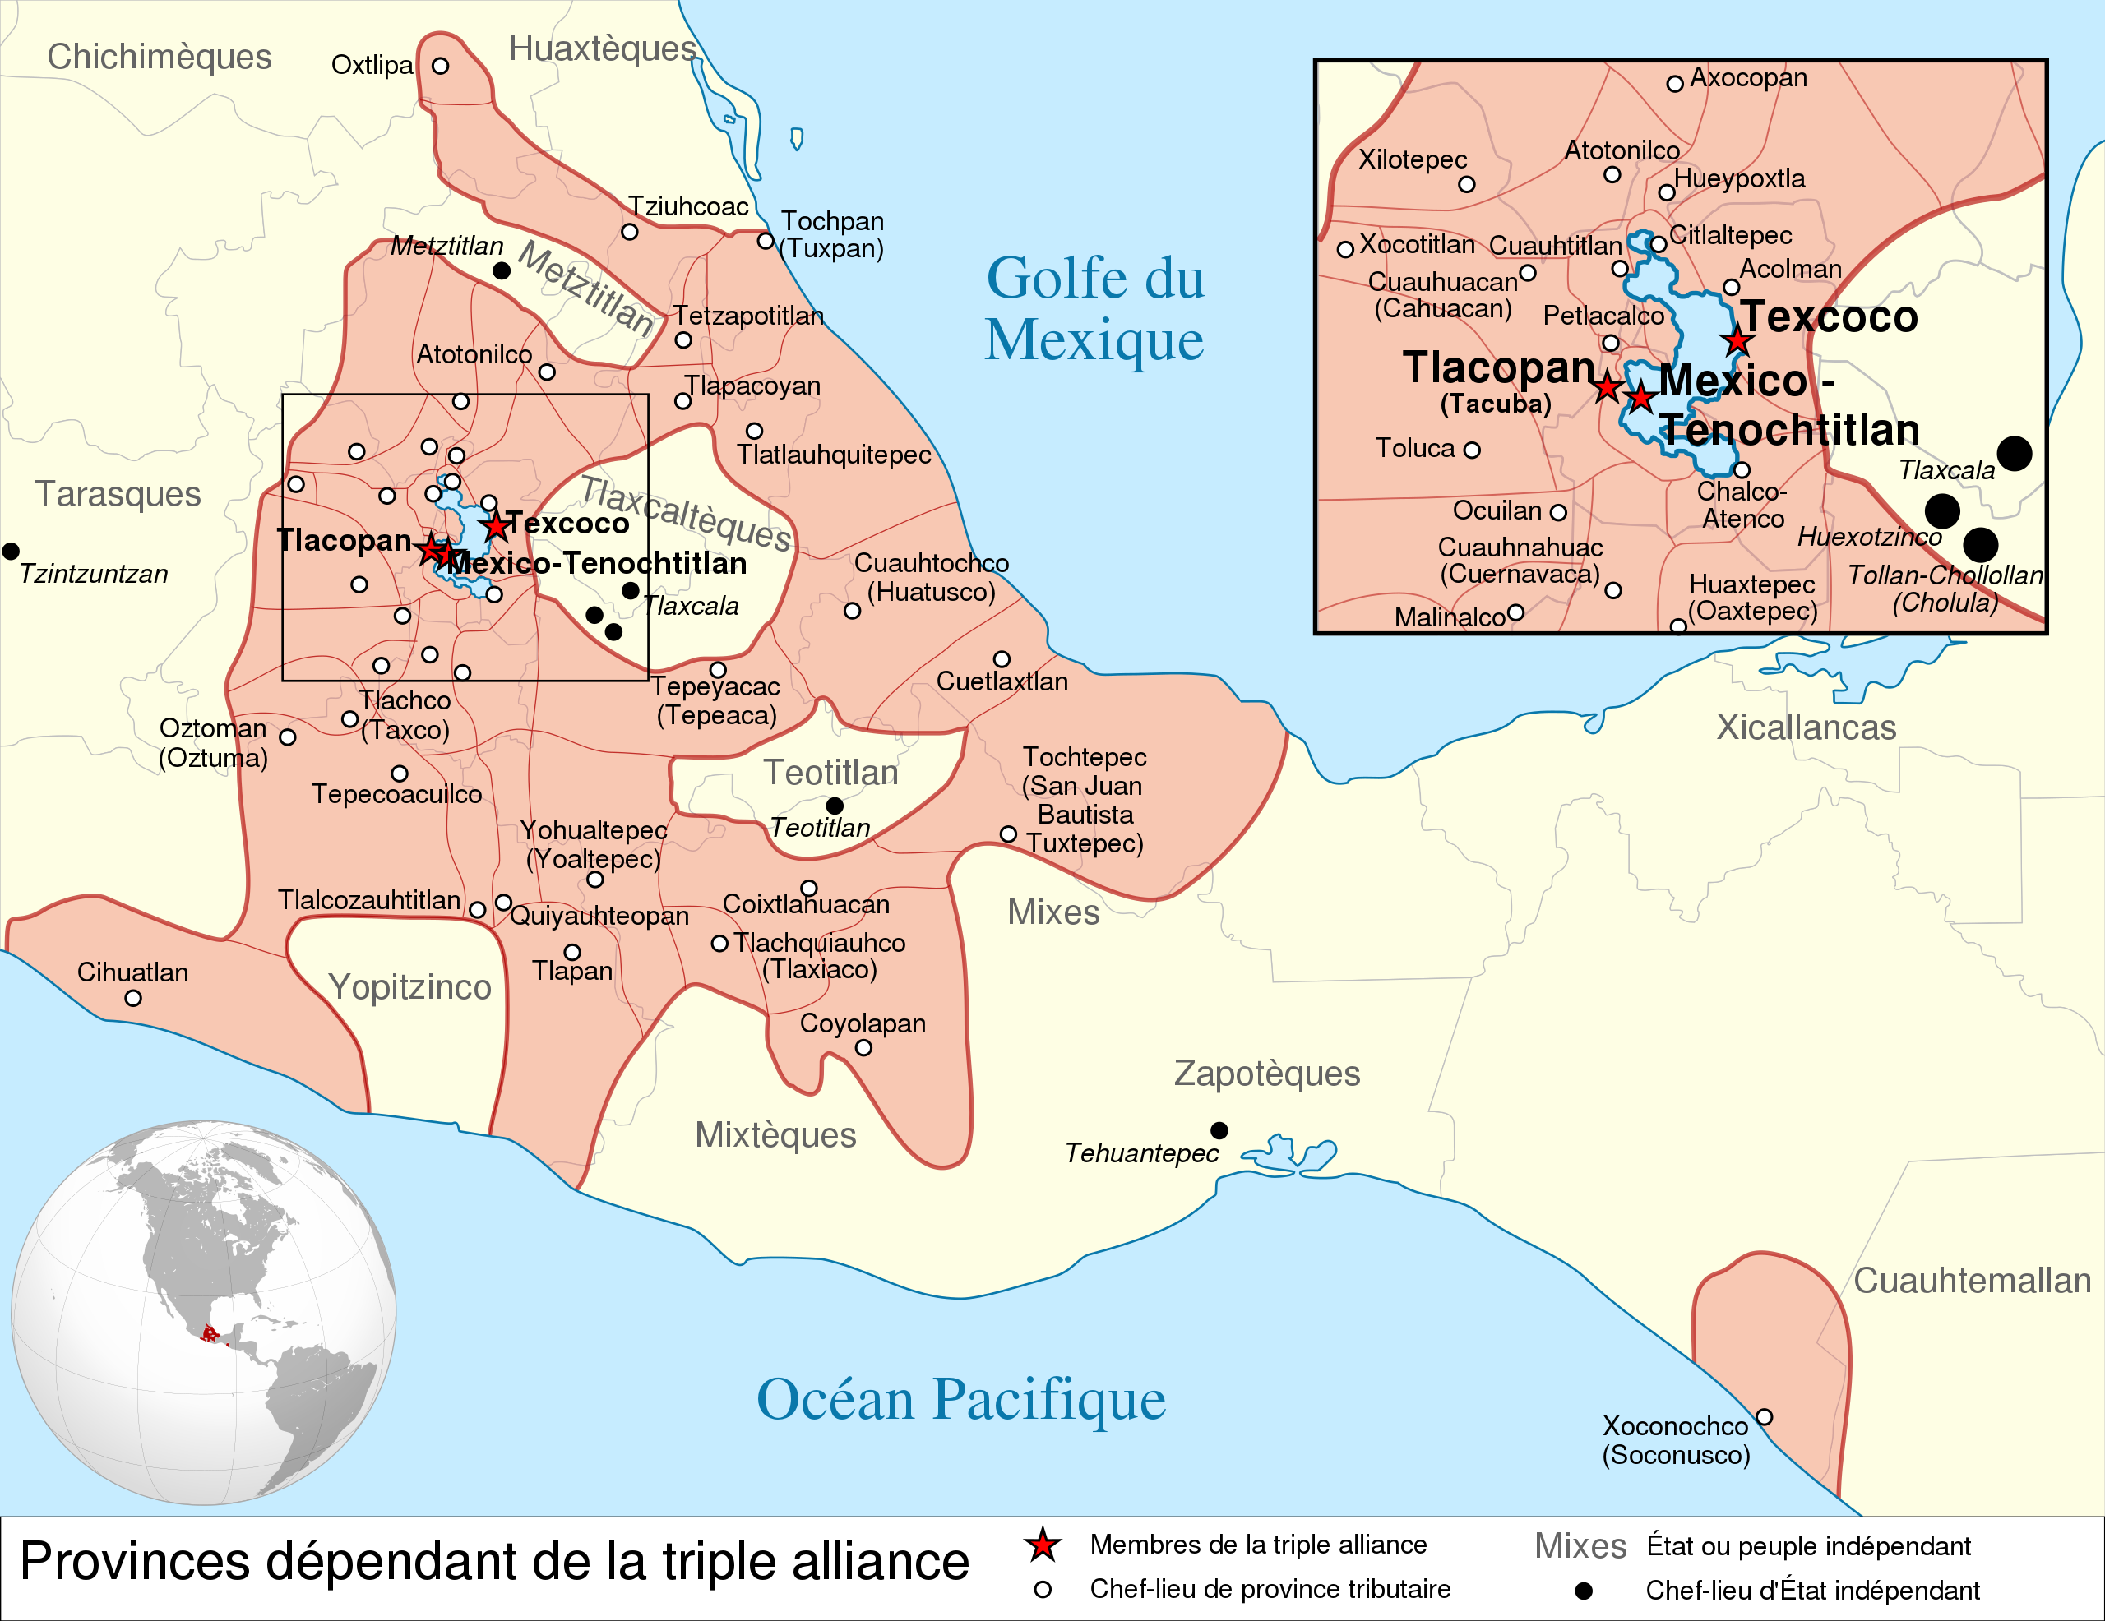
Tlaxcala, allied with Cortes to defeat the Aztecs
In his “Five Letters of Relation” (1519-11526) Hernan Cortes writes to King Charles V that the order of government so far observed among the Tlaxcala people resembles very much the republics of Venice, Genoa and Pisa, for there is no supreme overlord. After an initial clash with Tlaxcalteca warriors, Cortes foiund himself engaged with representatives of a popular urban council whose every decision had to be collectively ratified. [DE, pp. 347-348]
Map, Wikipedia: Tlaxcala was surrounded by the Aztec Empire in 1519. The pre-Columbian Tlaxcalan state developed roughly at the same time as another Nahua people, the Mexica, were building the vast Aztec Empire with its capital at Tenochtitlan. From the 14th century, these two nations were in near constant state of war. However, even though the Aztecs managed to build the largest empire in Mesoamerica, they never did conquer Tlaxcala.^{[9][36]} By the time the Spanish arrived in the 16th century, Tlaxcala was an independent enclave nearly completely surrounded by the Aztec Empire. This left Tlaxcala economically isolated, leaving it without goods such as cotton and salt. This and the constant warfare with the Mexica would give the Tlaxcalans reasons to ally with the Spanish

Slide 5
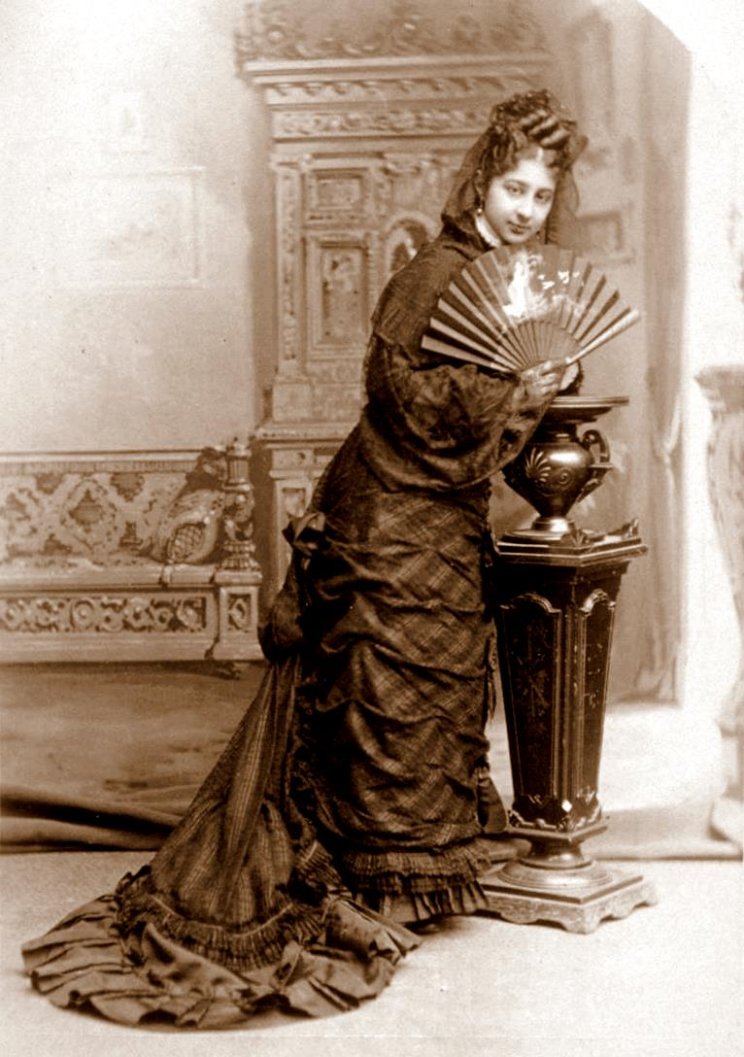
Zelia Maria Magdalena Nuttall, finder of lost codices
Zelia Nuttall rediscovered Cervantes de Salazar’s unfinished “Cronica de la Nueva Espana”, which she discovered in the Biblioteca Nacional in Madrid in 1911, also finding the details of his life and the circumstances of the Cronica’s composition, in the archives of the town council in the City of Mexico. Of special interest are the sections of the “Cronica” dealing directly with the governing council of Tlaxcala, and its deliberations over whether to ally with the Spanish invaders. [DE, p. 352]
Picture, Wikipedia:Zelia Nuttall (1857-1933), American archaeologist and anthropologist. She specialised in pre-Aztec Mexican cultures and pre-Columbian manuscripts. Her grandfather was John Parrott, one of San Francisco's richest bankers. Nuttall became an excellent linguist, fluent in four languages and conversant in others. In 1884 Nuttall made her first trip to Mexico where she spent five months with her mother's wealthy family [her Mexican-American mother was Magdalena Parrott]. During her stay she developed a life-long interest in Mexican history and archaeology. Frederic Putnam and German-American anthropologist Franz Boas saw her as an excellent mediator between Americanist circles in different countries because of her education and cosmopolitan relations. In his 1886 annual report for the museum, Putnam praised Nuttall as "familiar with the Nahuatl language, having intimate and influential friends among the Mexicans, and with an exceptional talent for linguistics and archaeology."[

Slide 6
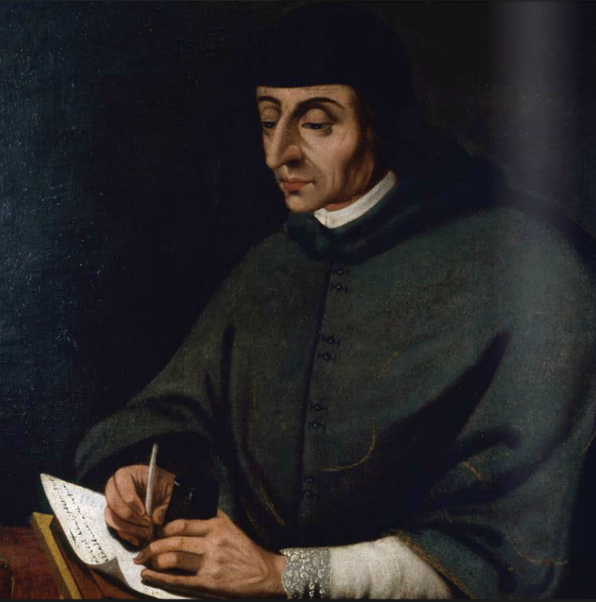
Tlaxcala Urban Parliament
What Salazar describes as the governing city council of Tlaxcala (Ayuntamiento) was a mature urban parliament, which sought consensus for its decisions through reasoned argument and lengthy deliberations—carrying on, when necessary, for weeks at a time. [DE, pp. 352-353].
Picture, Wikipedia: Portrait of Francisco Cervantes de Salazar (c.1515-1575) by José de Bustos, Museo Soumaya. He was a Spanish man of letters and rector of the Royal and Pontifical University of Mexico, founded in 1551. He left unfinished a chronicle of the Mexican conquest (Crónica de la Nueva España, about 1560), which remained unpublished until 1914. It narrates the conquest of Mexico, in addition to providing numerous data on the Aztec or Mexica culture.

Slide 7
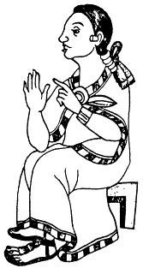
The argument of Xicotencatl
According to the account of Cervantes de Salazar of the debate in the governing council of Tlaxcala, Xicotencatl gave the most convincing argument, contradicting a previously persuasive speech by a lord named Maxixcatzin. He said, “Nothing is harder to resist than the enemy within, which is what the newcomers [the Spanish] were likely to become if welcomed into town. [They] seem more like ravenous monsters…gorging themselves on gold, silver, stones, and pearls…Why should we—who live without servitude, and never acknowledge a king—spill our blood to make ourselves slaves…”
Temilotecutl—one of the city’s four “senior justices”—stepped in with a cunning plan. To satisfy all sides of he debate, Cortes would be invited into the city, but as soon as he entered Tlaxcalteca territory the city’s leading general, Xicotencatl the Younger, would ambush him…
Records of the Spanish in the decades following the conquest affirm the oratorical skills of the indigenous politicians and their facility with principles of consensus decision-making and reasoned debate. [DE, pp. 153-154].
Picture, Wikipedia: Xicotencatl the Elder, was a long-lived tlatoani (king) of Tizatlan, a Nahua altepetl within the pre-Columbian confederacy of Tlaxcala, in what is now Mexico. At the time of the Spanish conquest of the Aztec Empire he was very old and of poor health. He was instrumental in aligning the Tlaxcala with Hernán Cortés' Spaniards.

Slide 8
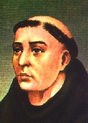
Tlaxcala was an indigenous republic
Motolinia confirms Cortes’s original observation that Tlaxcala was indeed an indigenous republic, governed not by a king, nor even by rotating office holders, but by a council of elected officials (teuctli), Spanish sources say varying in number from 50 to 200, perhaps depending upon the matter at hand, answerable to the citizenry as a whole. [DE, pp. 355-356].
Picture, Wikipedia: contemporary drawing of Fray Toribio of Benavente, known as Motolinia, “the afflicted one”,(for his ragged appearance), (1482 – 1565), was a Franciscan missionary who was one of the famous Twelve Apostles of Mexico who arrived in New Spain in May 1524. His published writings are a key source for the history and ethnography of the Nahuas of central Mexico in the immediate post-conquest period as well as for the challenges of Christian evangelization. An early chapter of Motolinia's history [“Historia de los Indios de la Nueva Espana”,1541] recounts what he considered the ten plagues afflicting New Spain, bringing the Biblical metaphor of the Ten Plagues into the unfolding events in early Mexico. He considered smallpox the first plague; the second, the number of those who died in the conquest; the third, famine following the fall of Tenochtitlan; the fourth, native and black labor bosses and tribute collectors; the fifth, the Indians' tax and tribute obligations; the sixth, Indians forced to labor in Spanish gold mines; the seventh, the building of Mexico City; the eighth, enslavement of Indians to work in the mines; the ninth, the labor in mines far from Indians' homes; and the tenth plague, the factionalism of Spaniards, particularly when Cortés left central Mexico for conquests in Honduras.^{[4]} With the exception of smallpox and factionalism among Spaniards, Motolinia considered Spaniards' deliberate oppression and exploitation of the Indians the worst afflictions.

Slide 9
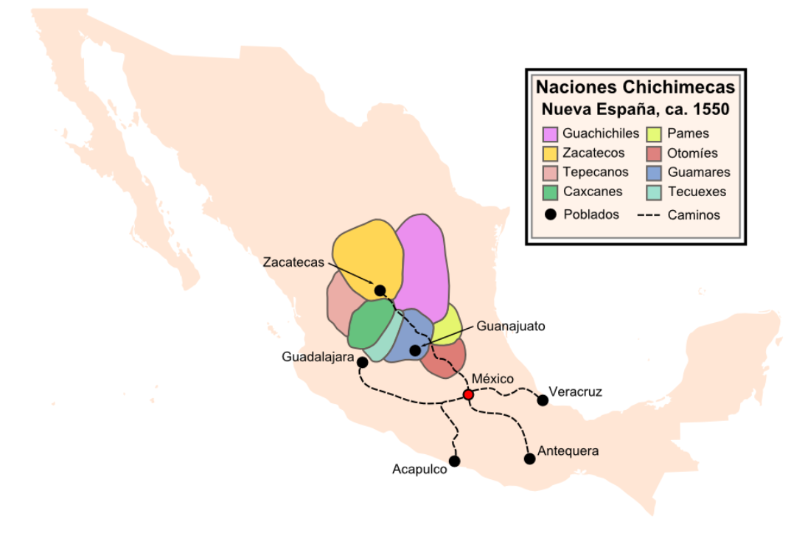
Chichimec Values
Cortes may have praised Tlaxcala as an agrarian and commercial arcadia but, as Motolinia eplains, when its citizens thought about their own political values, they actually saw those values as coming from the desert. Like other Nahuatl speakers, including the Aztecs, Tlaxcalteca liked to claim they were descended from Chichimec. These were considered the original hunter-gatherers who lived ascetic lives in deserts and forests, dwelling in primitive huts, ignorant of village or city life, rejecting corn and cooked food, bereft of clothing or organized religion, and living on wild things alone. The ordeals endured by aspiring councillors in Tlaxcala—e.g., mandatory public abuse and a long period of fasting, sleep deprivation and bloodletting-- were reminders of the need to cultivate Chichimec qualities. [DE, p. 356].
Map, Wikipedia: Chichimec Nations, the name of the Nahua peoples of Mexico generically applied to nomadic and semi-nomadic peoles who were established in preent day Bajio region of Mexico. For the Spanish, in the words of scholar Charlotte M. Gradie, "the Chichimecas were a wild, nomadic people who lived north of the Valley of Mexico. They had no fixed dwelling places, lived by hunting, wore little clothes and fiercely resisted foreign intrusion into their territory, which happened to contain silver mines the Spanish wished to exploit." They practiced animal sacrifice, and they were feared for their expertise and brutality in war. In the 16th c. Gonzalo de Las Casas' account was called Report of the Chichimeca and the Justness of the War Against Them. He described the people, providing ethnographic information. He wrote that they only covered their genitalia with clothing; painted their bodies; and ate only game, roots and berries. He mentioned, in order to prove their supposed barbarity, that Chichimec women, having given birth, continued traveling on the same day without stopping to recover.In the late 16th century, according to the Spanish, the Chichimeca did not worship idols as did many of the surrounding indigenous peoples. n the long-running Chichimeca War (1550–1590), the Spanish initially attempted to defeat the combined Chichimeca peoples in a war of "fire and blood", but eventually sought peace as they were unable to defeat them. Within a century, the Spanish and Chichimeca assimilated.

