Slide 1
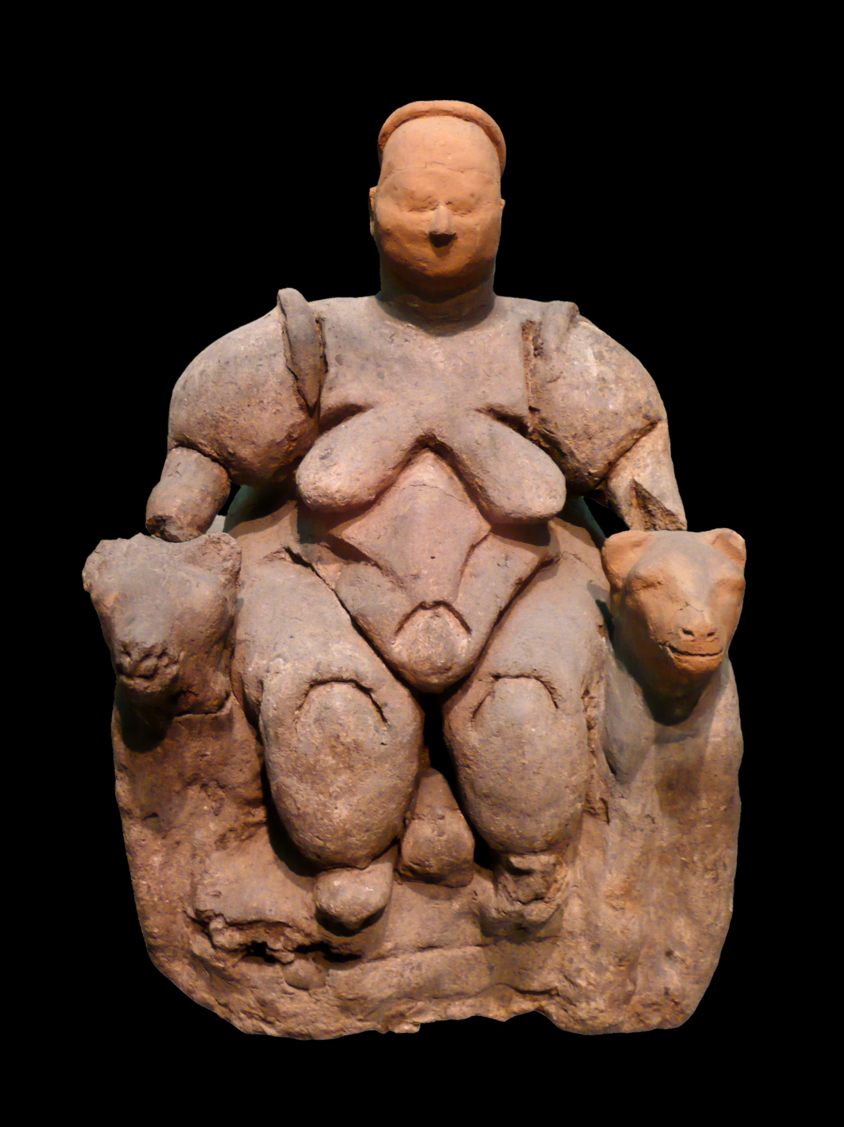
Catalhoyuk, the world’s oldest town
Settled 7,400 BCE-5,900 BCE [DE, pp. 212 ff.]. It is among the first large settlements we know of that practiced agriculture. Their cattle were not domestic, the skulls displayed on their walls were fierce, wild aurochs. What had been previously thought of as shrines were houses where domestic tasks such as cooking, eating and crafts took place. And what in a previous age might be interpreted as a fertility god [pictured at right] might now be more correctly interpreted as an elderly matriarch. No similarly elaborate or highly crafted depictions of male forms exis in ghe portable art of Catalhoyuk. Despite the considerable size and density of the built-up areas, there is no evidence for central authority. Each household appears more or less a world unto itself—a discrete locus of storage, production and consumption. Household rules were learned in the household itself; not just through its ceremonies, but also its micro-routines of cooking, cleaning floors, resurfacing walls with plaster, and so on. These Neolithic houses show no sign of being divided into ranks. [DE, pp. 212-214220-221].
Picture, Wikipedia: Seated goddess flanked by two felines, lionesses. “The figurine can be interpreted in a number of ways – as a woman turning into an ancestor, as a woman associated with death, or as death and life conjoined. It is possible that the lines around the body represent wrapping rather than ribs. Whatever the specific interpretation, this is a unique piece that may force us to change our views of the nature of Çatalhöyük society and imagery. Perhaps the importance of female imagery was related to some special role of the female in relation to death as much as to the roles of mother and nurturer." [Ian Hodder, Cambraidge archeologist, excavation chief 1993-2018] Çatal Hüyük; from Turkish çatal "fork" + höyük "tumulus" is a tell of a very large Neolithic and Chalcolithic proto-city settlement in southern Anatolia, which existed from approximately 7500 BC to 6400 BC, and flourished around 7000 BC.Çatalhöyük was composed entirely of domestic buildings, with no obvious public buildings. While some of the larger ones have rather ornate murals, the purpose of some rooms remains unclear.

Slide 2
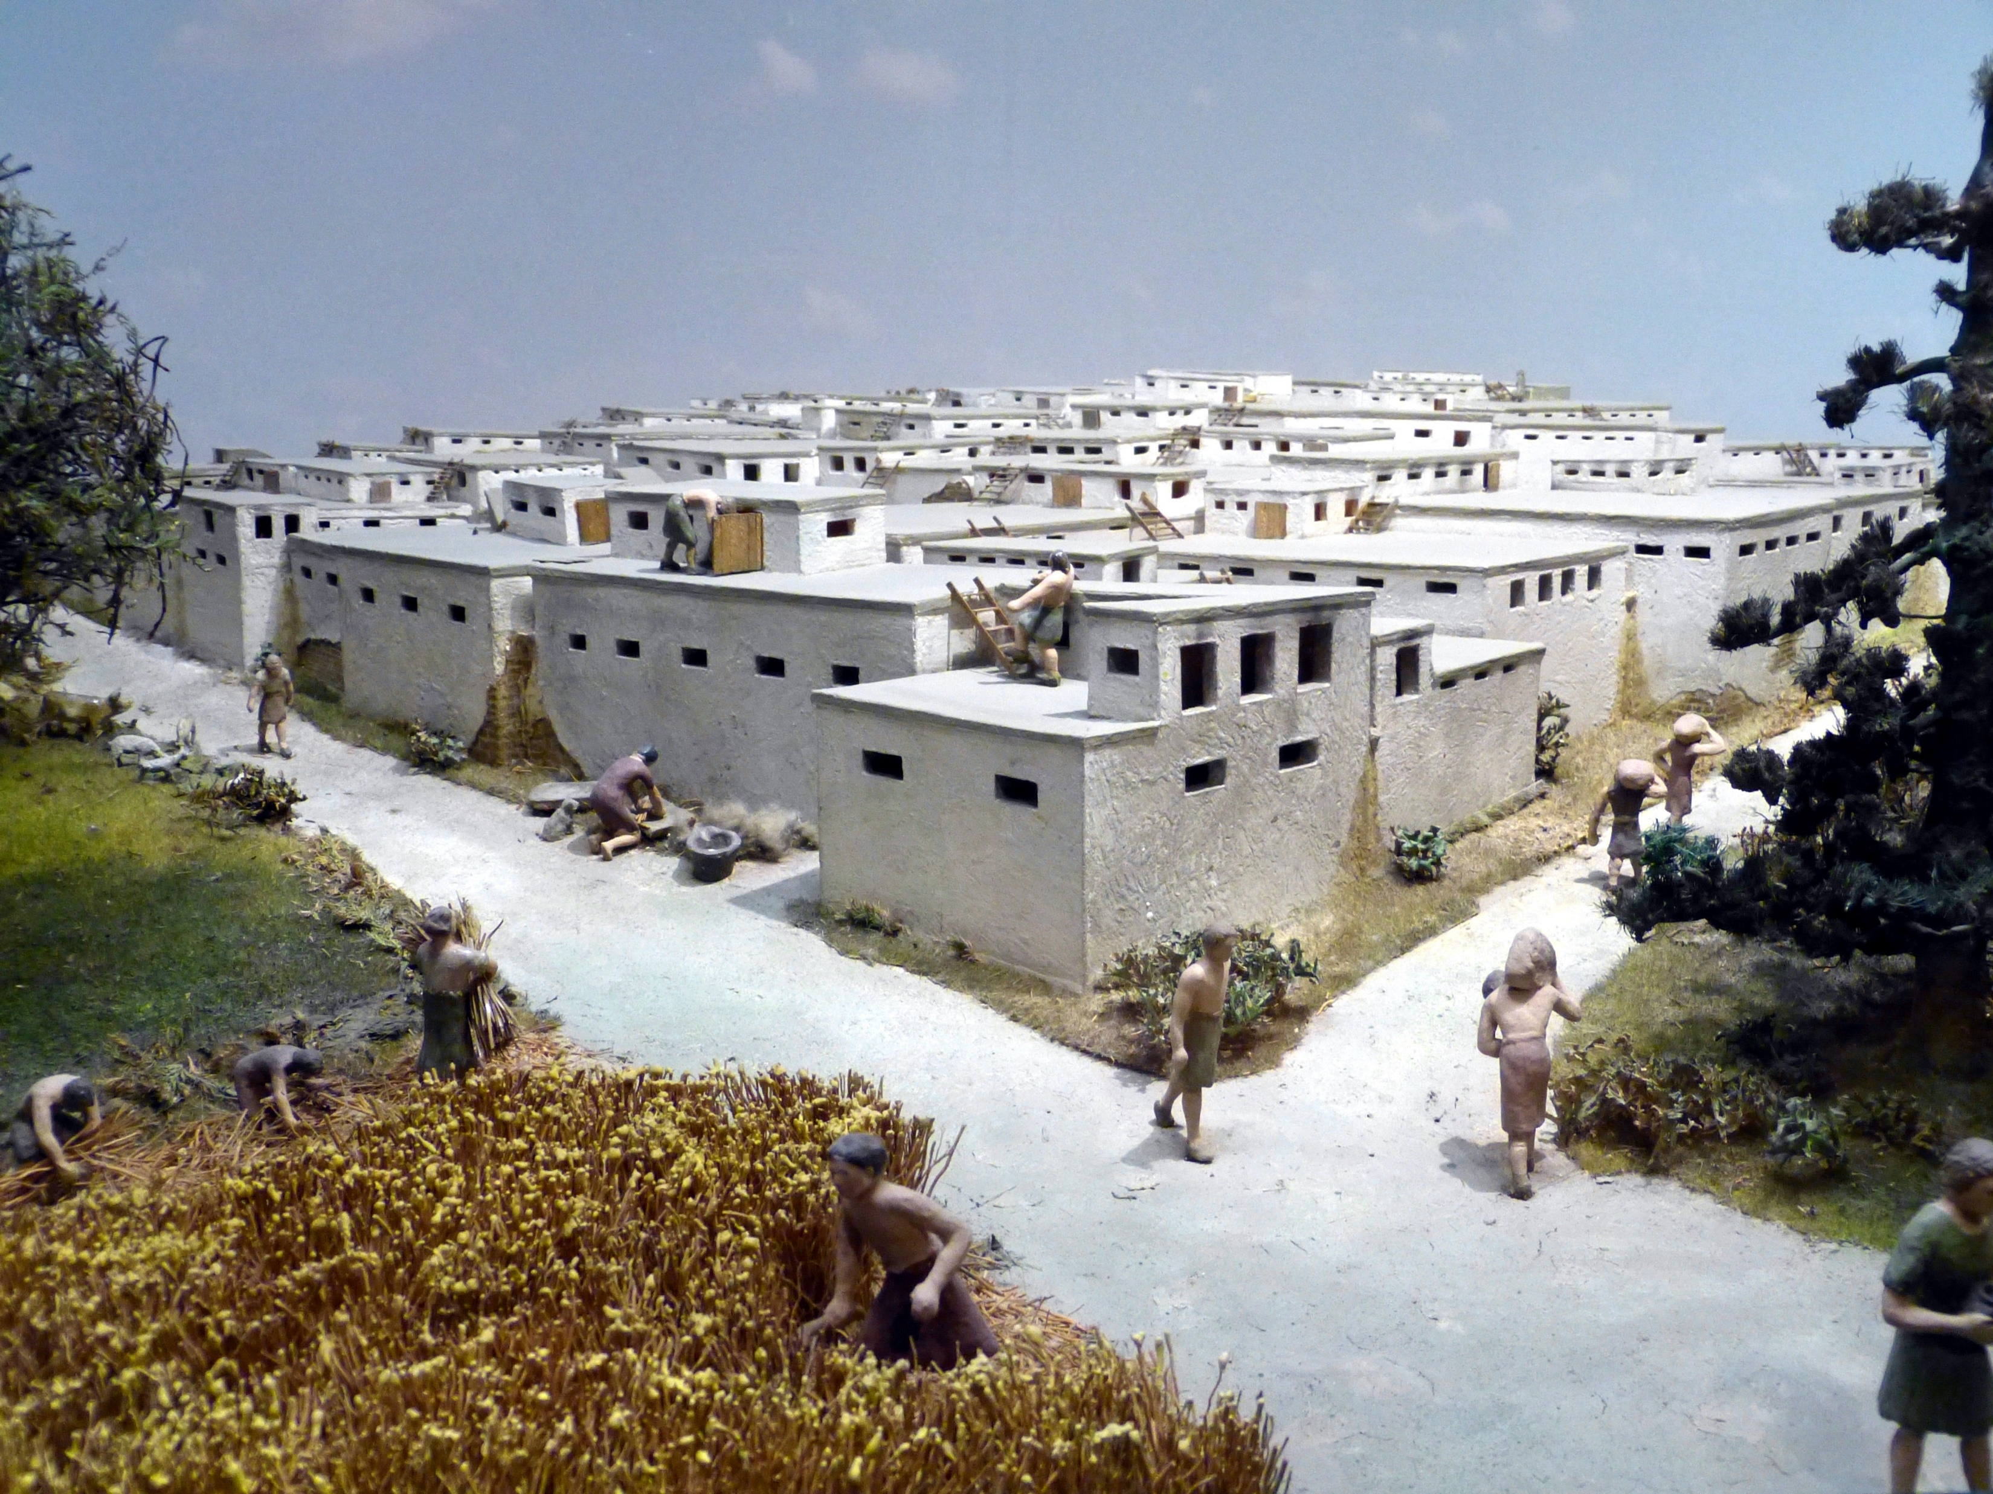
In Catalhoyuk there is no reference to agriculture
The authority of long-lived houses seems consistent with the idea that elders, and perhaps elder women in particular, held positions of influence. But the more prestigious households are distributed among the less, and do not coalesce into elite neighborhoods. In terms of gender relations, we can acknowledge a degree of symmetry, or at least complementarity. In pictorial art, masculine themes do not encompass the feminine, nor vice versa. If anything, the two domains seem to be kept apart, in different sectors of dwellings. Perhaps the most striking thing about all this art and ritual is that it makes almost no reference to agriculture. Domestic cereals (wheat and barley) and livestock (sheep and goats) were far more important than wild resources in terms of nutrition. Yet for 1,000 years the cultural life of this community remained stubbornly oriented around the worlds of hunting and foraging. [DE, pp. 222-223].
Picture, Wikipedia: Model of the neolithic settlement (7300 BCE) of Catal Höyük

Slide 3
Flood Recession, Flood retreat, or Decrue farming
To balance out their dietary needs and labor costs, [and in their desire to minimize the efforts involved in farming domestic cereals in order to maximize time available for hunting, wild food collection, craft production, marriages and any number of other things, not ot mention storytelling, gambling, travelling and organizing masquerades] early cultivators may have strategically chosen practices that worked against the morphological changes which signal the onset of domestication in plants. This balancing act involved a special kind of cultivation, as in Catalhoyuk and its wetland location. Called “flood retreat”, “flood recession” or “decrue farming”, it takes place on the marins of seasonally flooding lakes or rivers. Flood-retreat farming is a distinctly lackadaisical way to raise crops. The work of soil preparation is given over mostly to nature. Seasonal flooding does the work of tillage, annually sifting and refreshing the soil. As the waters recede they leave behind a fertile bed of alluvial earth, where seed can be broadcast. This was garden culti ation on a small scale with no need for deforestation, weeding or irrigation, except perhaps the construction of small stone or earthen barriers (“bunds”) to nudge the distribution of water this way or that. Areas of high groundwater, suh as the edges of artesian springs, could also be exploited in this way.
In terms of labor, flood-retreat framing is not only pretty light, it also requires little central management. Critically, such systems hae a kind of inbuilt resistance to the enclosure and measurement of land. Any given parcel of territory might be fertile one year, and then either flooded or dried out the next, so there is little incentive for long-term ownership or enclosure of fixed plots. It makes little sense to set up boundary stones when the ground itself is shifting underneath you. No form of human ecology is “Innately”egalitarian, yet these early cultibation systems did not lend themselves to the development of priate property (contrary perhaps to Rousseau’s assumption regarding the consequences of farming). If anything, flood-retreat farming was practically oriented towards the collective holding of land, or at least flexible systems of field reallocation. Flood- retreat was an especially important feature of Early Neolithic economies in the more arid, lowland sectors of the Fertile Crescent.[DE, pp. 235-236}

Slide 4
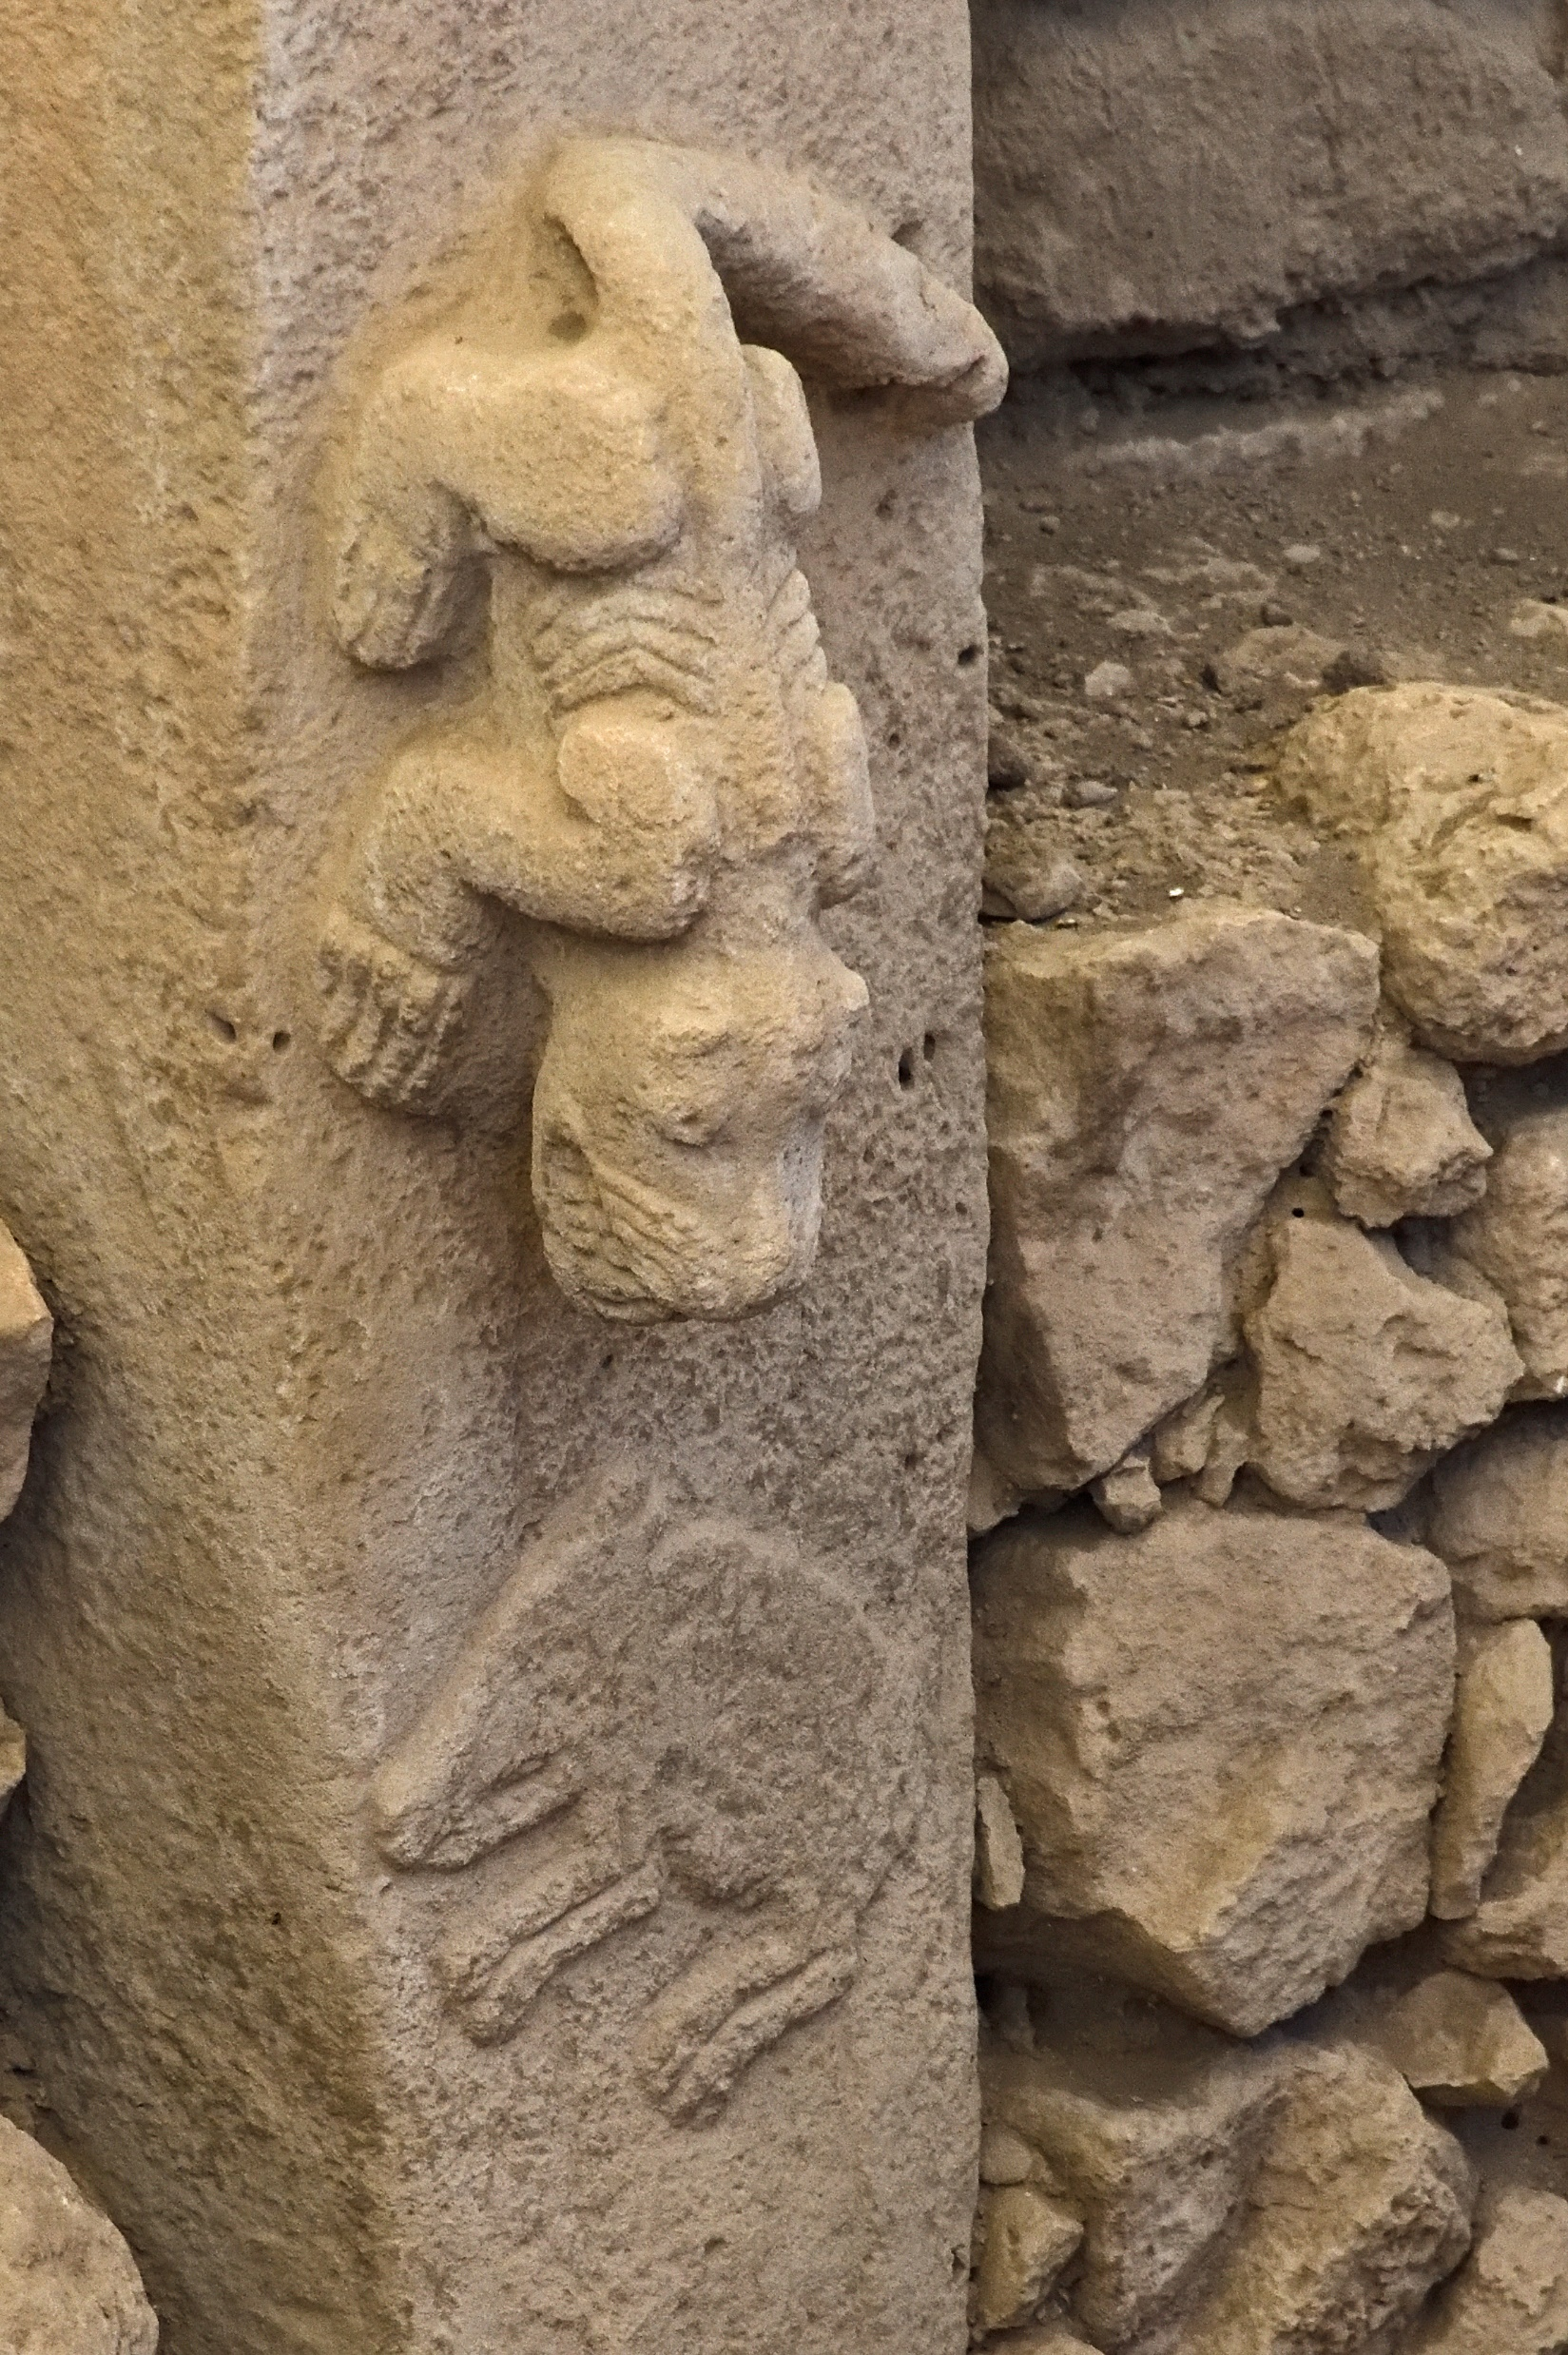
Gobekli Tepe in schismogenisis with Catalhoyuk
Considering the close proximity of the two cultural patterns [at Gobekli Tepe, with its hierarchical structure, and Catal Hoyuk, with its egalitarian social arrangements] and how the groups responsible for them exchanged goods and were keenly aware of each other’s existence, it is…plausible to see what happened as the result of mutual and self-conscious differentiation, or schismogenesis, akin to what we traced in the last chapter among the foraging societies of America’s West Coast. The more that uplanders came to organize their artistic and ceremonial lives around the theme of predatory male violence, the more lowlanders tended to organize theirs around female knowledge and symbolism—and vice versa. [DE, pp.242-246].
One thing to emerge clearly from the newer investigations at Catalhoyuk is the way in which household organization permeates almost every aspect of social life. Despite the considerable size and density of the built-up area, there is no evidence for central authority. Each household appears more or less a world unto itself—a discrete locus of storage, production and consumption. Each also seems to have held a significant degree of control over its own rituals…[DW, p.221].
In the Fertile Crescent it is—if anything—among upland groups, further removed from a dependence upon agriculture, that we find stratification and violence becoming entrenched; while their lowland counterparts, who linked the production of crops to important social rituals, come out looking decidedly more egalitarian; and much of this egalitarianism relates to an increase in th economic and social visibility of women, reflected in their art and ritual. [DE, p. 248].
Picture, Wikipedia: predator (possibly a felid or member of the cat family) in high relief, hunting prey in low relief at enclosure C in Gobekli Tepe, Neolithic, 9500-8000 BCE.

Slide 5
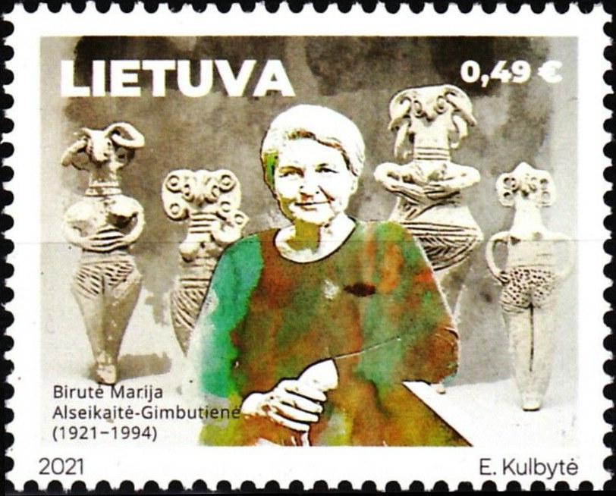
Marija Gimbutas, Lithuanian-American archeologist
Gimbutas was largely concerned with trying to understand the broad contours of a cultural tradition she referred to as “Old Europe”[7,000-35000 BCE), a world of settled Neolithic villages centering on the Balkans and eastern Mediterranean in which men and women were equally valued aand autonomous, differences in wealth were sharply circumscribed, and women had ritual priority. According to Gimbutas, “Old Europe” came to a catastrophic end in the 3rd millennium BCE when the Balkans were overrun by a migration of cattle-keeping people, the so-called kurgan folk—originating on the Pontic steppe north of the Black Sea. The incoming group were aristocratic, androcratic (i.e., patriarchal) and extremely warlike. They subordinated women and elevated warriors as a ruling class, spreading the Indo-European languages. Recent DNA analysis supports Gimbutas’ hypothesis of an expansion of herding peples from the Black Sea in the 3rd millennium BCE. [DE, pp. 216-218].
Marija Gimbutas [Gimbutienė] (1921-1994), Lithuanian archaeologist and anthropologist known for her research into the Neolithic and Bronze Age cultures of "Old Europe" and for her Kurgan hypothesis, which located the Proto-Indo-European homeland in the Pontic Steppe.on a 2021 stamp of Lithuania. In 1956 Gimbutas introduced her Kurgan hypothesis, which combined archaeological study of the distinctive Kurgan burial mounds with linguistics to unravel some problems in the study of the Proto-Indo-European (PIE) speaking peoples, whom she dubbed the "Kurgans"; namely, to account for their origin and to trace their migrations into Europe. This hypothesis, and her method of bridging the disciplines, has had a significant impact on Indo-European studies. Gimbutas gained fame and notoriety in the English-speaking world with her last three English-language books: The Goddesses and Gods of Old Europe (1974); The Language of the Goddess (1989), which inspired an exhibition in Wiesbaden, 1993–94; and the last of the three, The Civilization of the Goddess (1991), which, based on her documented archaeological findings, presented an overview of her conclusions about Neolithic cultures across Europe: housing patterns, social structure, art, religion, and the nature of literacy. The Goddess trilogy articulated what Gimbutas saw as the differences between the Old European system, which she considered goddess- and woman-centered (gynocentric), and the Bronze Age Indo-European patriarchal ("androcratic") culture which supplanted it. According to her interpretations, gynocentric (or matristic) societies were peaceful, honored women, and espoused economic equality.The androcratic, or male-dominated, Kurgan peoples, on the other hand, invaded Europe and imposed upon its natives the hierarchical rule of male warriors.

Slide 6

Defining Matriarchy
Matriarchy might refer to a situation in which the role of mothers in the household becomes a model for and economic basis of female authority in other aspects of life (which doesn’t necessarily imply dominance in a violent or exclusionary sense), where women as a result hold a preponderance of overall day-to-day power. Looked at this way, matriarchies are real enough. Kandiaronk himself arguably lived in one. In his day, Iroquoian-speaking groups such as the Wendat lived in towns that were made up of longhouses of five or six families. Each longhouse was run by a council of women—the men who lived there did not have a parallel council of their own—whose members controlled all the key stockpiles of clothing, tools and food. The political sphere in which Kandiaronk himself moved was perhaps the only one in Wendat society where women did not predominate, and even so there existed women’s councils which held veto power over any decision of the male councils. On this definition, the Pueblo nations such as Hopi and Zuni might also qualify as matriarchies, while the Minangkabau, a Muslim people of Sumatra, describe themselves as matriarchal for exactly the same reason. {DE, pp. 219-220].
Picture, Wikipedia: Minangkabau women clad in traditional Minang costumes. The Minangkabau are the largest matrilineal society in the world, with property, family name and land passing down from mother to daughter, while religious and political affairs are the responsibility of men, although some women also play important roles in these areas. This custom is called Lareh Bodi-Caniago and is known as adat perpatih in Malaysia. Today 4.2 million Minangs live in the homeland of West Sumatra.
As one of the world's most populous (as well as politically and economically influential) matrilineal ethnicities, Minangkabau gender dynamics have been extensively studied by anthropologists. The adat (Minangkabau: Adaik) traditions have allowed Minangkabau women to hold a relatively advantageous position in their society compared to most patriarchal societies, because though they do not rule, they are at the center of their society.

Slide 7

Alfred W. Crosby, American Geographer, and the Columbian Exchange
Crosby first pointed out the remarkable cross-over of non-human species set in motion by Europeans’ arrival in the Americas after 1492, and its transformative effect on the global configuration of culture, economy and cuisine. Tobacco, peppers, potatoes and turkeys flowed into Eurasia; maize, rubber and chickens entered Africa; and citrus fruits, coffee, horses, donkeys and livestock travelled to the Americas. Crosby went on to argue that the global ascendance of European economies since the sixteenth century could be accounted for by a process he called “ecological imperialism.” The ecological assault on native habitats included infections diseases, such as smallpox and measles, which originated in Old World environments where humans and cattle cohabited. While European plants thrived in the absence of pests, diseases brought with domestic animals (or by humans accustomed to living alongside them) wreaked havoc on indigenous populations, creating casualty rates as high as 95%, even in places where settlers were not enslaving or actively massacring the indigenous population—which of course, they often were.
Alfred W. Crosby Jr. (1931-2018) was professor of History, Geography, and American Studies at the University of Texas at Austin, and University of Helsinki. He was the author of books including The Columbian Exchange (1972) and Ecological Imperialism (1986). In these works, he provided biological and geographical explanations for the question why Europeans were able to succeed with relative ease in what he referred to as the "Neo-Europes" of Australasia, North America, and southern South America.

Slide 8
The Anthropocene Epoch has replaced the Holocene
The Holocene Epoch began approximately 11, 650 years before the Present, or 9701 BCE, after the last Glacial Period. The Holocene was preceded by the Pleistocene and they together from the Quaternary era. However, William Ruddiman [a palaeoclimatologist and Professor Emeritus at the University of Virginia] has argued that the Anthropocene began approximately 8,000 years ago with the development of farming and sedentary cultures. At that point, humans were dispersed across all continents except Antarctica, and the Neolithic Revolution was ongoing. During this period, humans developed agriculture and animal husbandry to supplement or replace hunter-gatherer subsistence.
However, our authors Gaeber and Wengrow argue that the Holocene modification of the world began with the foraging human population, who provided the context in which the first farmers set up shop. Scrub and forest replaced open steppe and tunda across much of this post-glacial world. As in earlier times, foragers used various echniques of land management to stimulate the growth of desired species, such as fruit and nut-bearing trees. By 8000 BCE tgheir effors had contributed to the extinction of roughly two-thirds of the world’s megafauna, which were ill-suited to the warmer and more enclosed habitats…Where forest took over from steppe, human hunting techniques shifted from the seasonal coordination of mass kills to more opportunistic and versatile strategies, focused on smaller mammals with more limited home ranges, among them elk, deer, boar and wild cattle.
Farmers fill in the territorial gaps left behind by foragers. Murray Bookchin 91921-2006), the pioneer social ecology and a principal figure in the American green movement, invented the phrase “ecology of freedom”, which describes the proclivity of human societies to move freely in and out of farming…to raise crops and animals without surrendering too much of one’s existence to the logistical rigors of agriculture; and retain a food web sufficiently broad as to prevent cultivation from becoming a mater of life and death….Such fluid ecological arrangements—combining garden cultivation, flood-retreat farming on the margins of lakes or springs, small-scale landscape management (e.g. by burning, pruning and terracing) and the corralling or keeping of animals in semi-wild states, combined with a spectrum of hunting, fishing and collecting activities—were once typical of human societies int many parts of the world. Often these activities were sustained for thousands of years, and not infrequently supported large populations. [DW, pp. 258-260].

Slide 9
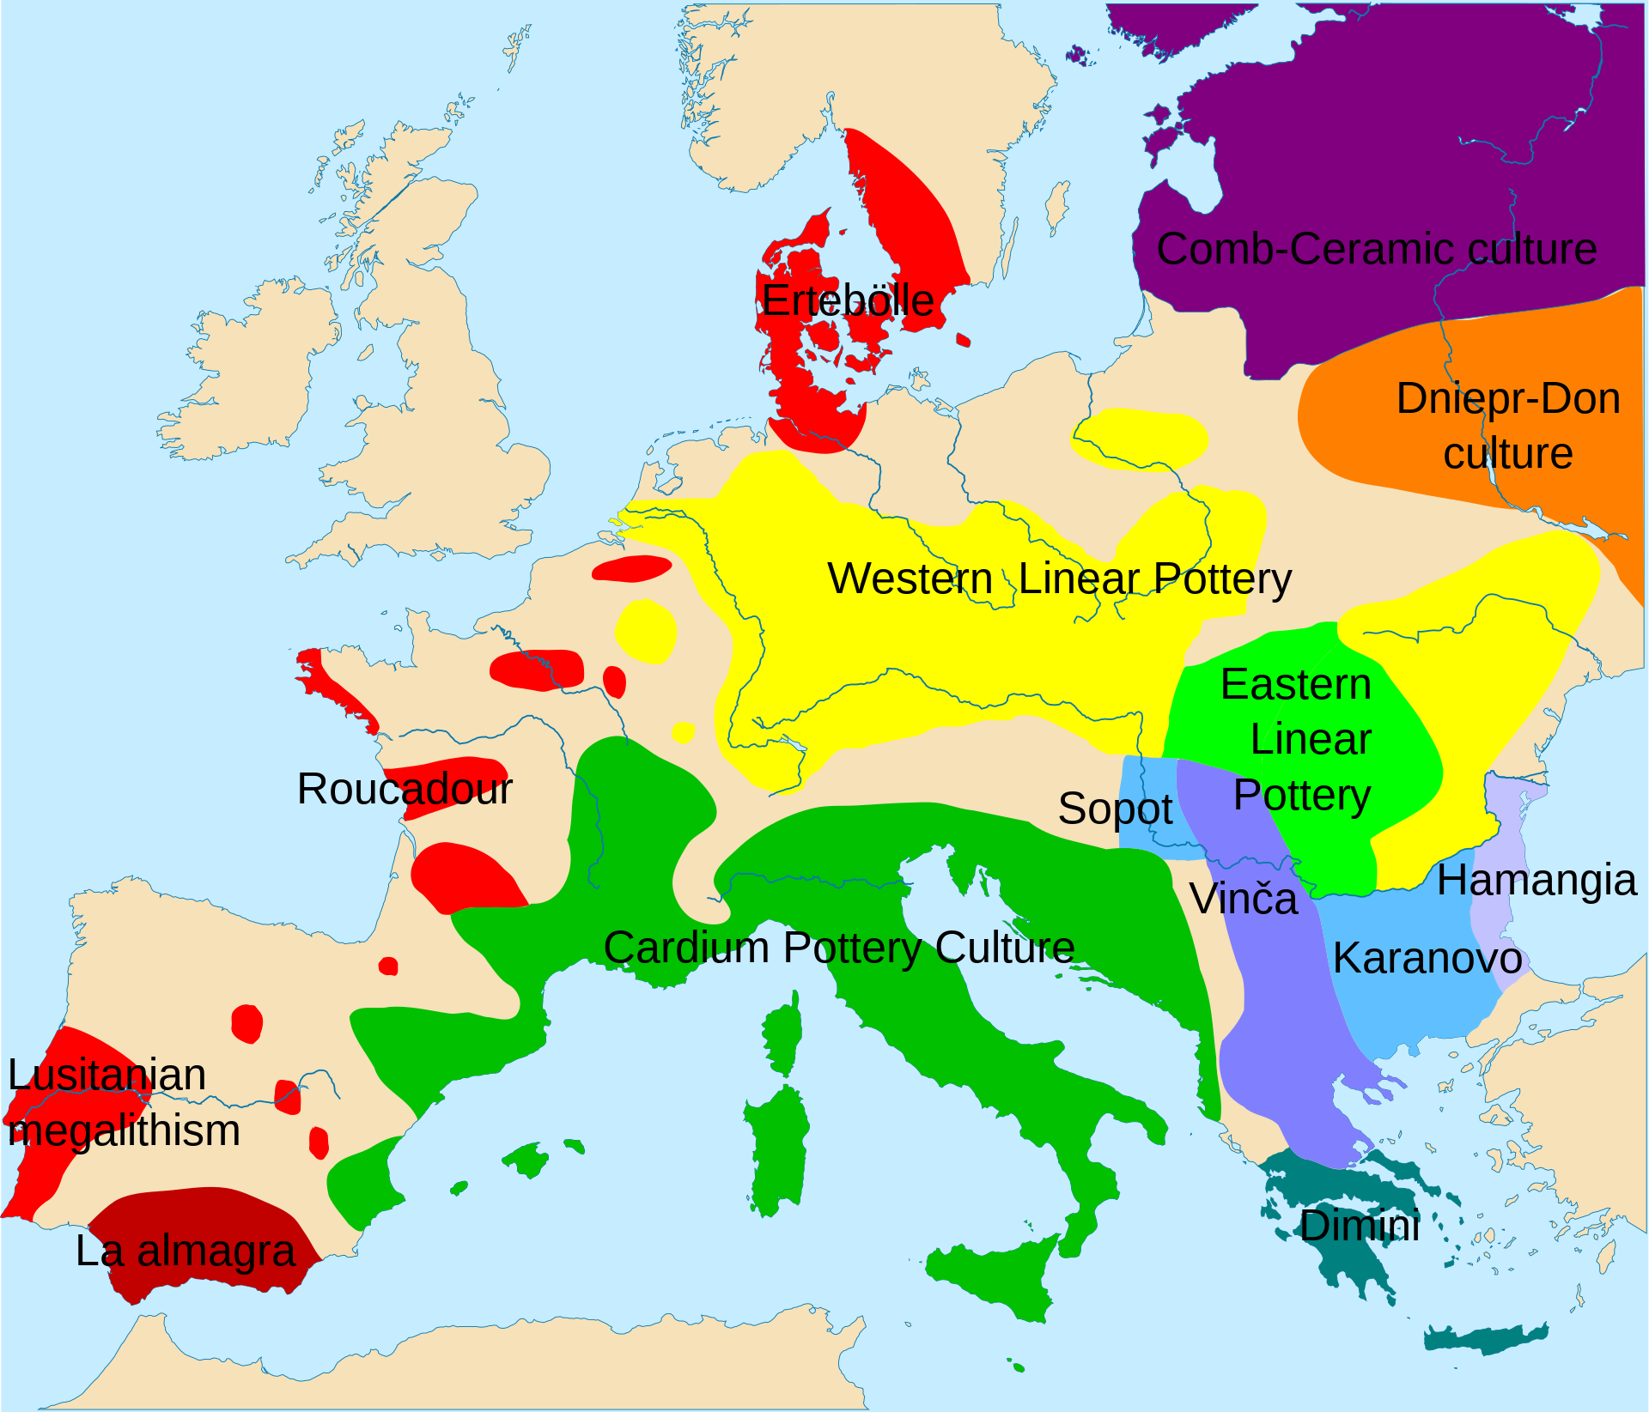
Linear Pottery Tradition
Around 5500 BCE villages of a similar cultural outlook—known as the Linear Pottery tradition—were established. They are among the villages of central Europe’s first farmers. But, unlike most other early farming settlements, each ended its life ina period of turmoil, marked by the digging and filling of mass graves. Their bones show the telltale marks of torture, mutilation and violent death—the breaking of limbs, taking of scalps, butchering for cannibalism. Around 5000 BCE people enclosed their settlements within large ditches, which yield evidence of warfare in the forms of arrows, axe heads and human remains. The arrival of farming in central Europe from the southeast was associated with an initial and quite massive upsurge in population…But what followed was not the anticipated up and up pattern of demographic growth. Instead came a disastrous downturn, a boom and bust, between 5000 and 4500 BCE, and something approaching a regional collapse. Only after a hiatus of roughly 1000 years did extensive cereal-farming take off again in central and northern Europe. This boom and bust pattern of early farming documented in temperate Europe raises the wider question about the viability of Neolithic economies in a world of foragers. [DE, pp. 261-262].
Map, Wikipedia: The Linear Pottery culture (LBK) is a major archaeological horizon of the European Neolithic period, flourishing c. 5500–4500 BC. Derived from the German Linearbandkeramik, it is also known as the Linear Band Ware, Linear Ware, Linear Ceramics or Incised Ware culture, falling within the Danubian I culture of V. Gordon Childe.

Slide 10
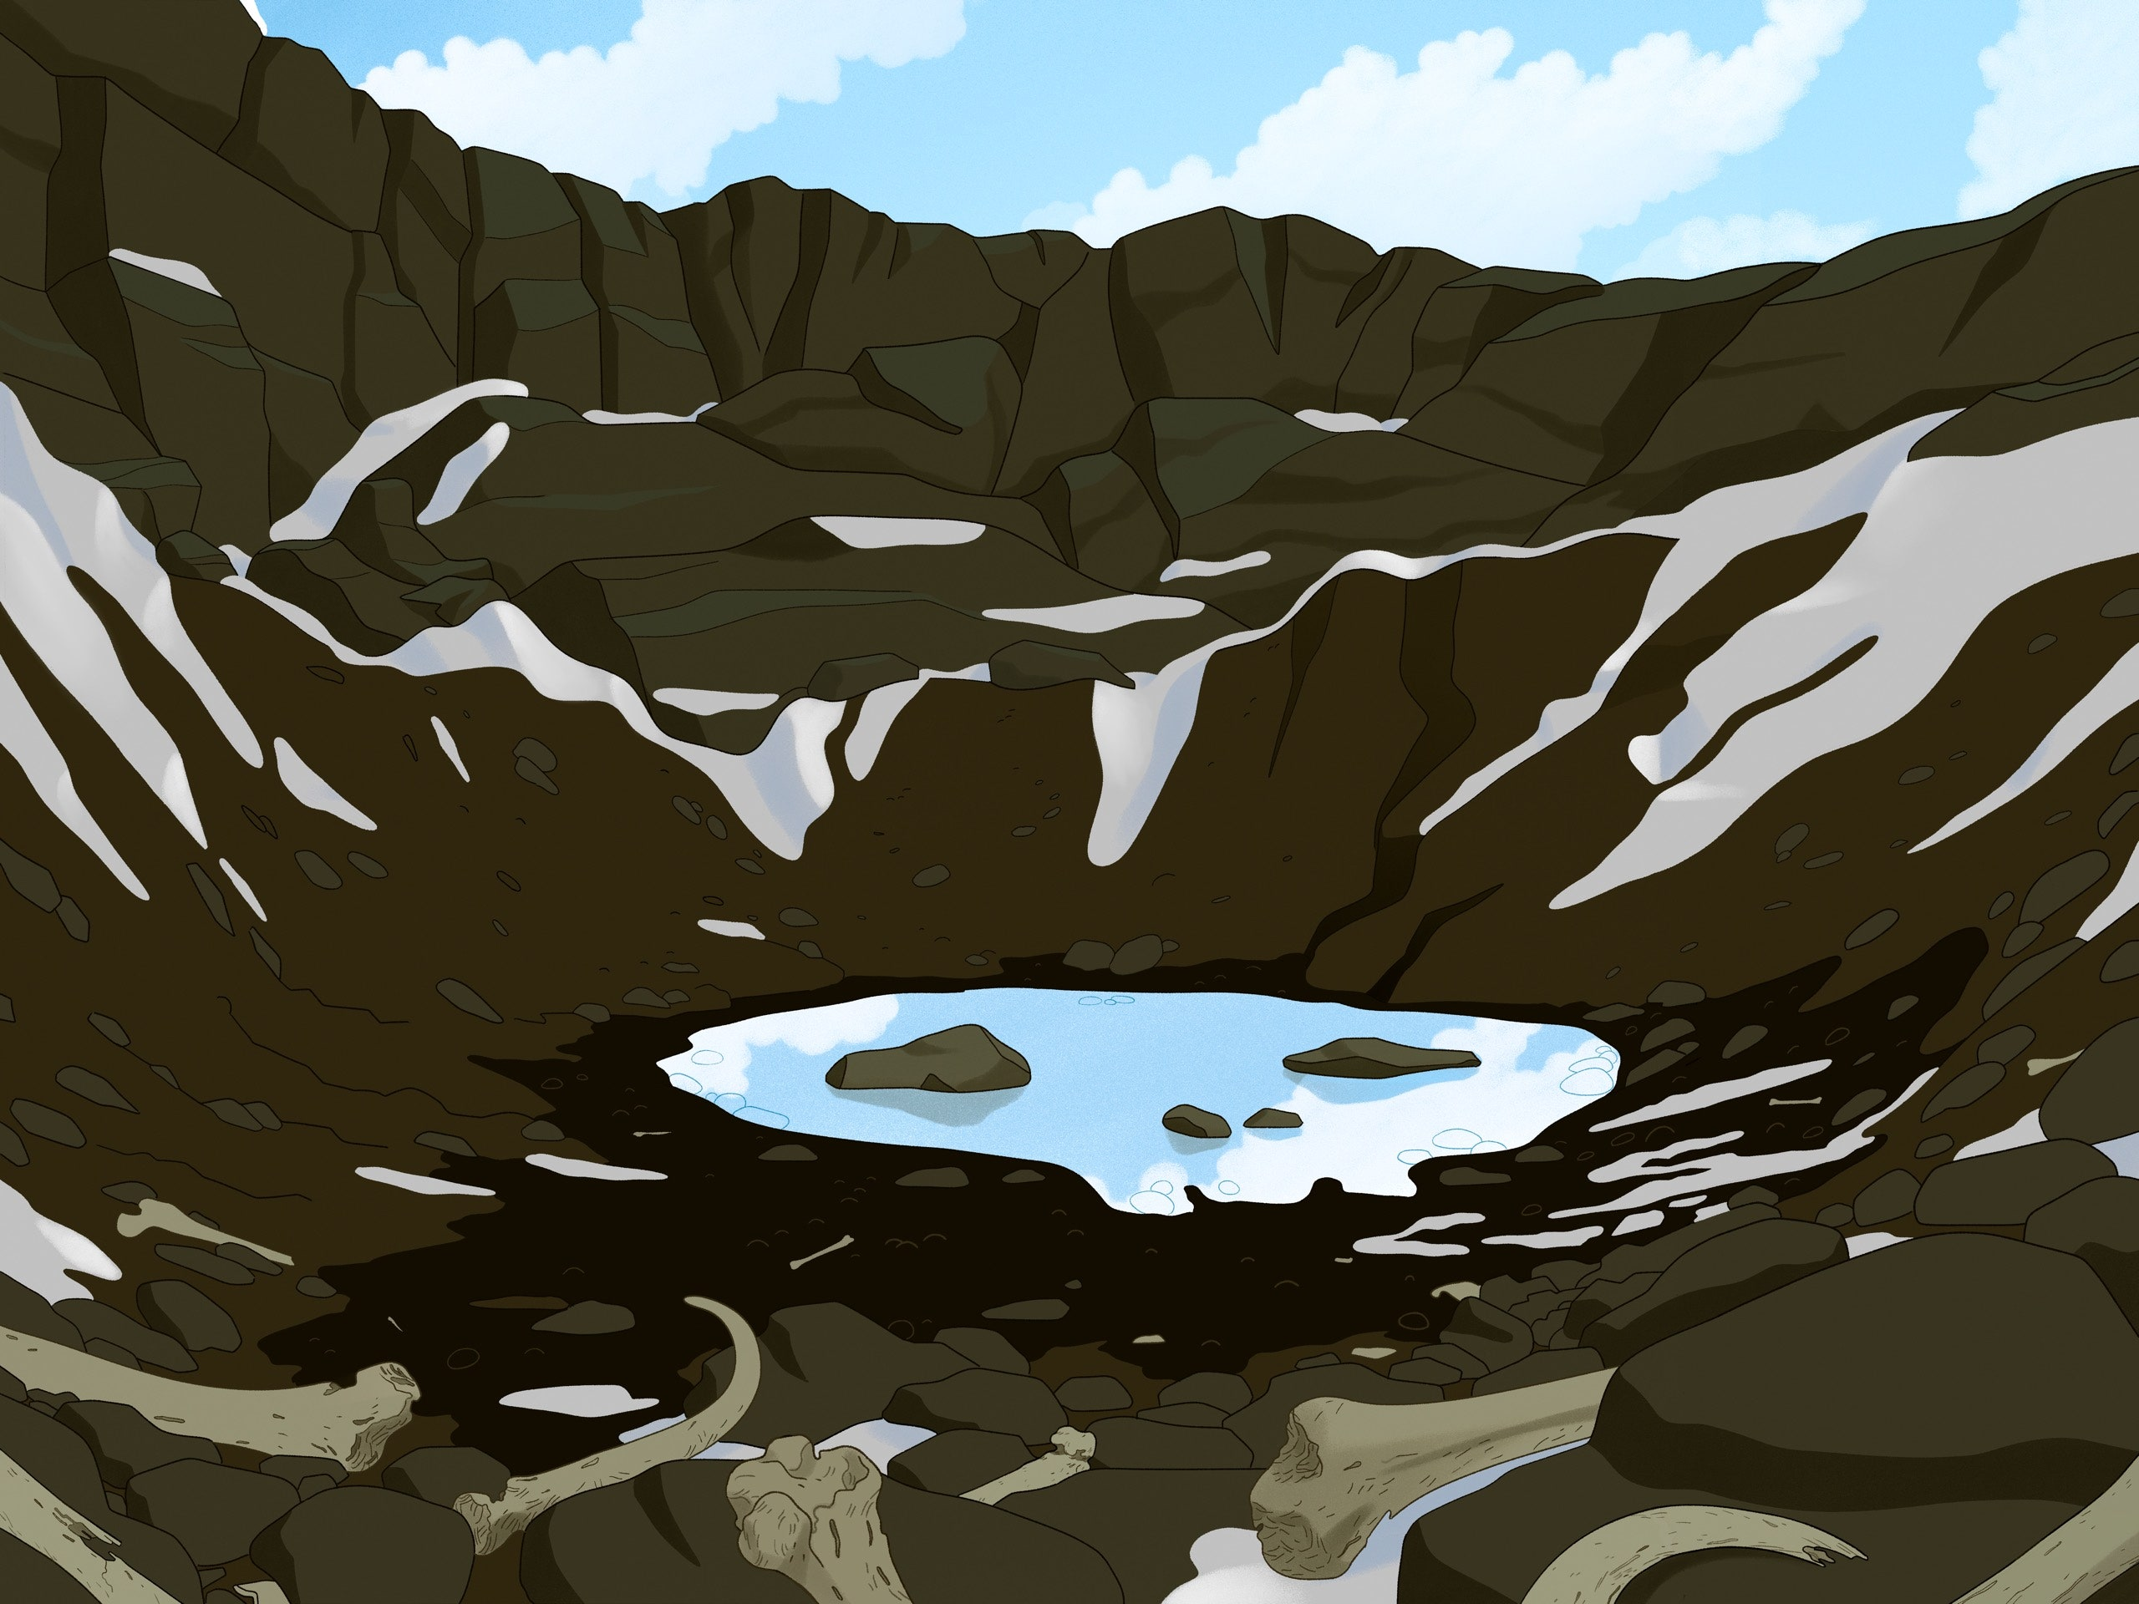
Skeletons at the Lake, by Dourglas Preston, from “The New Yorker”, 12/14/2020, sent by Glenn Carter—The Current limitations of interpretations of Genetic Testing
In the winter of 1942, on the shores of a lake high in the Himalayas, a forest ranger came across hundreds of bones and skulls, some with flesh still on them. When the snow and ice melted that summer, many more were visible through the clear water, lying on the bottom. The lake, a glacial tarn called Roopkund, was more than sixteen thousand feet above sea level, an arduous five-day trek from human habitation, in a mountain cirque surrounded by snowfields and battered by storms. Last year, however, Nature Communications published the baffling results of a new study conducted by sixteen research institutions across three continents. Genetic analysis and new carbon dating revealed that a significant proportion of the Roopkund remains belonged to people from somewhere in the eastern Mediterranean, most likely near Crete, and that they had perished at the lake only a couple of centuries ago. In 2008, David Reich, a geneticist at Harvard, made the first of many trips to the country, and visited a leading life-science research institution, the Centre for Cellular and Molecular Biology, in Hyderabad. While there, he discussed someday collaborating on a more detailed study of the Roopkund bones with the center’s director, Lalji Singh, and Kumarasamy Thangaraj, a geneticist who had headed up the previous DNA analysis. By the time work began, in 2015, the team, led by the Reich lab and the laboratory in Hyderabad, also included researchers at Pennsylvania State University, the Broad Institute of M.I.T. and Harvard, the Max Planck Institute for the Science of Human History, and the Anthropological Survey of India, where many of the Roopkund bones reside. The analysis of Roopkund bone collagen revealed that, in the last ten or so years of their lives, the Roopkund A people ate a varied C3 and C4 diet, typical for much of India; Roopkund B ate a mostly C3 diet, typical of the Mediterranean. A person who eats a diet of C3 plants, such as wheat, barley, and rice, will have isotope ratios of carbon in their bones differentWhen the carbon-dating results came back, there was another surprise: there appeared to have been multiple mass-death events at Roopkund. The Roopkund A individuals probably died in three or possibly four incidents between 700 and 950 A.D. The Roopkund B group—from the Mediterranean—likely perished in a single event a thousand years later. from those of a person eating a diet high in millets, which are C4. A hailstorm was probably involved in one mass death but that most people had likely just died of exposure.

Slide 11

3,000 Years Ago, Britain Got Half Its Genes From … France? By Franz Lidz, The New York Time,
Dec. 22, 2021, Provided by Nan DiBello, an example of DNA analysis in the service of archeology
Three years ago in the journal Nature, a vast international research team led in part by Harvard geneticist David Reich shined a torchlight on one of prehistoric Britain’s murkier mysteries.
By analyzing the degraded DNA from the remains of 400 ancient Europeans, the researchers showed that 4,500 years ago nomadic pastoralists from the steppes on the eastern edge of Europe surged into Central Europe and in some areas their progeny replaced around 75 percent of the genetic ancestry of the existing populations.
Descendants of the nomads then moved west into Britain, where they mixed with the Neolithic inhabitants so thoroughly that within a few hundred years the newcomers accounted for more than 90 percent of the island’s gene pool. In effect, the research suggested, Britain was almost completely repopulated by immigrants.
In a paper published Wednesday in Nature, Dr. Reich again targeted the genomic history of Britain, the country from which geneticists have mined more ancient samples than any other. The study, which has 223 co-authors, documents a subsequent and previously unknown major migration into Britain from 1,300 B.C. to 800 B.C.
Ian Armit, an archaeologist at the University of York who collaborated on the research, noted that archaeologists had long known about the trade and exchanges across the English Channel during the Middle to Late Bronze Age. “But while we may once have thought that long-distance mobility was restricted to a few individuals, such as traders or small bands of warriors,” he said, “the new DNA evidence shows that considerable numbers of people were moving, across the whole spectrum of society.”
Picture, The New York Times: David Reich, the Harvard geneticist, who in part led the 223-scientist team who authored the paper.

Slide 12
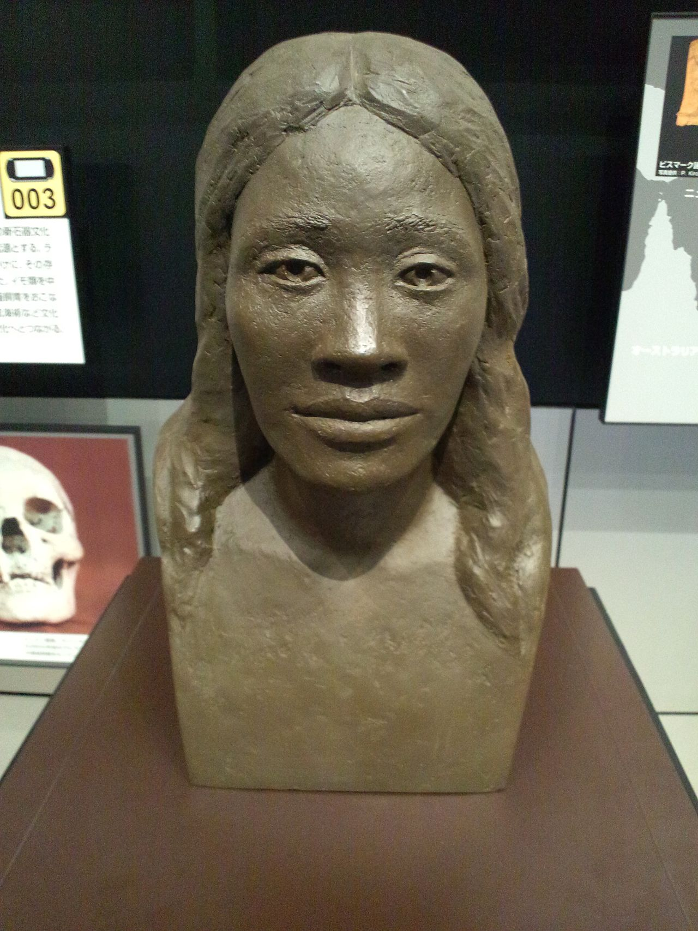
The Lapita Horizon—The Colonization of Island Oceania
Another of he world’s great Neolithic expansions took place in island Oceania [1600-500 BCE]. Its origins lay at the end of Asia, in the rice and millet-growing cultures of Taiwan and the Philippines (the deeper roots are in China). Around 1600 BCE a striking dispersal of farming groups took place, ending over 5,000 miles to the east in Polynesia. Known as the Lapita horizon, after the site in New Caledonia where its decorated pottery was first identified, this precocious expansion called into being the world’s first deep-ocean outrigger canoes. As the Lapita horizon advanced, the place of poorly adapted to tropical climates rice and millet was replaced by tubers such as taro and root crops, along with animal domesticates—pigs, dogs, and chickens—rats too hitched a ride. These species traveled with Lapita to previously uninhabited islands—such as Fiji, Tonga and Samoa. Like the Linear Pottery farmers of central Europe, Lapita groups seem to have avoided established centers of population. They gave a wide berth to the forager stronghold of Australia, and skirted largely clar of Papua New Guinea, where a local form of farming was already well-established in the Wahgi valley. With stone adzes, they cleared patches of forest to make gardens for their crops—taros, yams and bananas—which they supplemented with animal domesticates and a rich diet of fish, shellfish and marine turtles, wild birds and fruit bats. Voyaging eastwards, Lapita peoples left a trail of dsitinctive pottery. While their tattoos themselves did not survive, the impressed decorations of Lapita pots give some hint of their underlying schema. [DE, pp. 265-266].
Sculpture, Wikipedia: Reconstruction of the face of a Lapita woman. National Museum of Ethnology, Osaka. Reconstruction showed she had thick lips, wide nose, straight hair

Slide 13
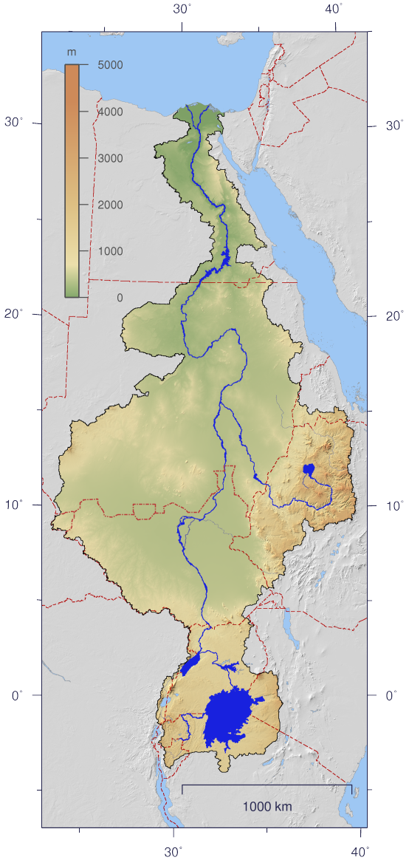
Variations of Neolithic farming and their choice of avoiding existing foraging popualtions
Three Neolithic variations—European, Oceanic, and African share to important features: a commitment to farming and a targeted spread of farming to lands largely uninhabited by existing populations. The highly mobile Neolithic of the Nile valley extended seasonally into the adjacent steppe-desert, but avoided regions that were already densely settled, such as the Nile delta, the Sudanese gezira [island farming areas] and the major oases (including the Fayum, where lakeside fisher-foragers prevailed), adopting and abandoning farming practices largely as it suited them. This new form of Neolithic economy [between 5000-4000 BCE] relied heavily on livestock-herding, combined with annual rounds of fishing, hunting and foraging on the rich floodlplain of the Nile, and in the oases and seasonal streams (wadis) of what are now the neighboring deserts, which were then still watered by annual rains. [DE, pp. 264-267].
Map, Wikipeida: The Nile's watershed.

Slide 14
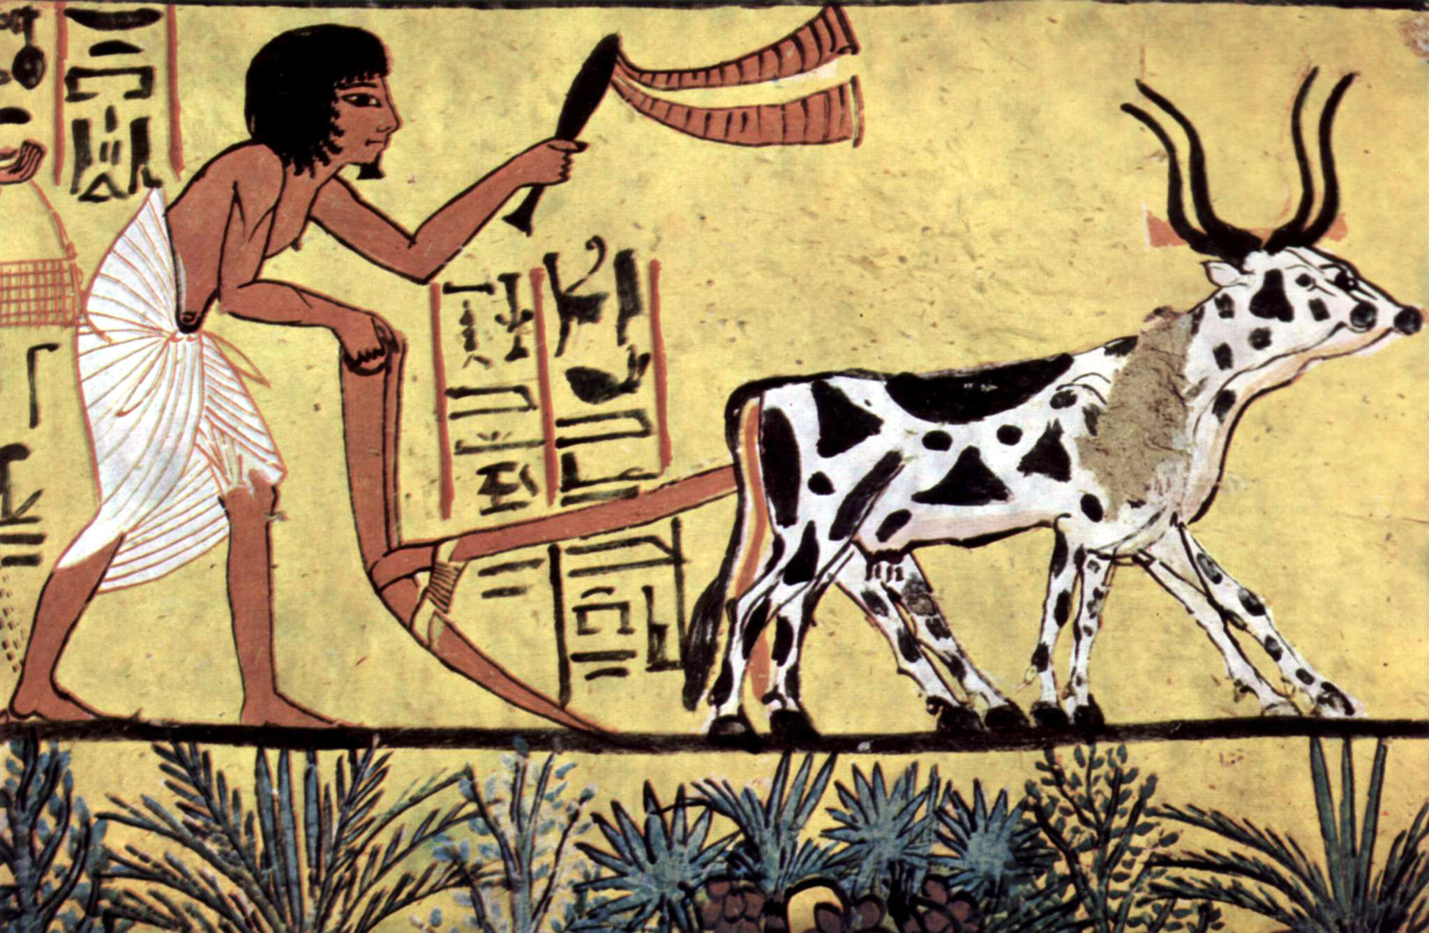
Why Could Neolithic Farming Experiments Fail?
Cereal-farming underwent important changes during its transfer from Southwest Asia to central Europe via the Balkans. Originally there were three kinds of wheat (einkorn, emmer and free threshing) and two kinds of barley (hulled and naked) under cultivation, but also five different pulses (pea, lentil, bitter vetch, chickpea and grass pea). By contrast, the majority of Linear pottery sites contain just glume wheats (emmer and einkorn) and one or two kinds of pulse. The Neolithic economy had become increasingly narrow and uniform, a diminished subset of the Middle Eastern original. The loess landscapes of central Europe offered little topographic variability. Almost everything came to revolve around a single food web. Most likely they were subject to not just periodic raiding from the outside, but also internal labor crunches, soil exhaustion, disease and harvest failure. Neolithic farming was an experiment that could fail. [DE, pp. 272-273].
Painting, Wikipedia: Painter of the burial chamber of Sennedjem

