Slide 1
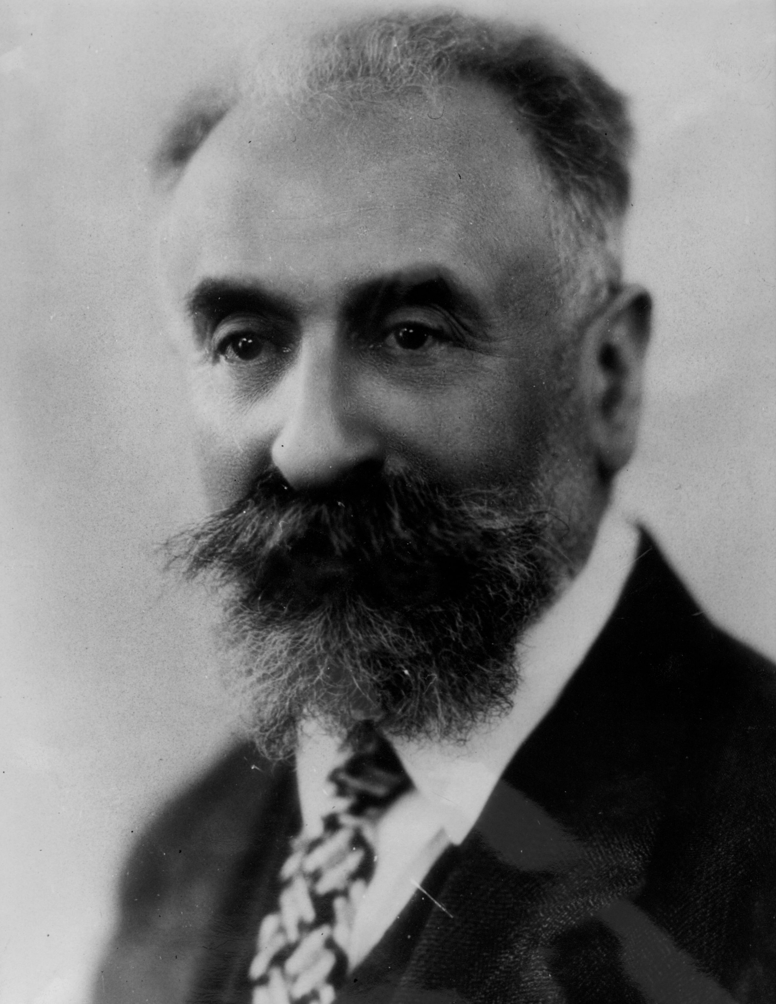
Cultural Differentiation: why are the California and Pacific Northwest nonagricultural peoples and the those of the Southwest so different?
.
Californians and Northwest Coast peoples both planted tobacco, springbank clover and Pacific silverweed for ritual purposes and special festivals. Yet they comprehensively rejected the idea of planting everyday foodstuffs or treating crops as staples, unlike the maize, beans and squash farmers of the Great Basin and the American Southwest. In other ways the northern and southern zones of Pacific North American peoples were profoundly different. The peoples of the Canadian Norhwest Cost relied heavily on fishing. Most Californians were proficient fishers and hunters, but many followed an ancient reliance on tree crops—especially nuts and acorns—as staple foods.
Marcel Mauss argued that people in past times appear to have traveled a great deal—more than they do today. He was convinced that the entire Pacific Rim had once been a single realm of cultural exchange. Therefore, Mauss’ answer to the question why some cultural traits do not spread, is that this is precisely how cultures define themselves against their neighbors. Cultures were, effectively, cultures of refusal. This process tends to be quite self-conscious. It extended even to technologies. Athabascans in Alaska refused to adopt Inuit kayaks; Inuit refused to adopt Athabascan snowshoes. “Societies,” wrote Mauss, “live by borrowing from each other, but they define themselves rather by the refusal of borrowing than by its acceptance.” [Nathan Schlanger,, “Marcel Mauss: Techniques, Technology, and Civilization,” 2006 in DE, pp. 273-278]
Photo, Wikipedia: Marcel Mauss (1872 –1950) was a French sociologist and anthropologist known as the "father of French ethnology". The nephew of Émile Durkheim, Mauss, in his academic work, crossed the boundaries between sociology and anthropology. Mauss had a significant influence upon Claude Lévi-Strauss, the founder of structural anthropology.

Slide 2
Chattel slavery among the Northwest Coast is absent among California societies
From the Klamath River northwards, there existed societies dominated by warrior aristocrats engaged in frequent inter-group raiding and in which, traditionally, a significant portion of the population consisted of chattel slaves. But none of this was the case further south. [DE, p. 177] The Northwest Coast group we know best are the Kwakwaka’wakw (Kwakiutl), among whom Franz Boas conducted fieldwork. They became famous for the exuberant ornamentation of their art. All the surrounding societies—including the Nootka, Haida and Tsimshian—appear to have shared the same broad ethos: similarly dazzling material cultures and performances. They also shared the same asic social structure, with hereditary ranks of nobles, commoners and slaves. Throughout the region, a 1,500 m. strip of land from the Copper River delta to Cape Mendocino, intergroup raiding for slaves was endemic, and had been for as long as anyone could recall. In all these societies of the Northwest Coast, nobles alone enjoyed the ritual prerogative to engage with guardian spirits, who conferred access to aristocratic titles, and the right to keep the slaves captured in raids. “Take good care of your people,” went the elder’s advice to a young Nuu-chah-nulth (Nootka) chief. “If your people don’t like you, you’re nothing.” Slaves in the Norhtwest Coast were hewers of wood and drawers of water, but they were especially involved in the mass harvesting, cleaning and processing of salmon and other anadromous fish. Perhaps a quarter of the indigenous Northwest Coast population lived in bondage—which is about equivalent to proportions found in the Roman Empire or classical Athens, or indeed the cotton plantations of the American South. What’s more, slavery in the Northwest Coast was a hereditary status; if you were a slave, your children were also fated to be so.
Current archeological and ethno-historical research suggests that the institution of slavery goes back a very long way indeed on the Northwest Coast, many centuries before European ships began dockng at Nootka Sound to trade in otter pelts and blankets. “Capturing societies” in the Americas considered slave-taking as a mode of subsistence in its own right, but not in the usual sense of producing calories. Raiders ialmost invariably insisted that slaves were captured for their life force or “vitality”.[DE, pp.182-183,185,189]
The most striking difference between the indigenous societies of California and the Northwest Coast is the absence, in California, of formal ranks and the institution of potlatch [lavish feast of ostentatious superabundance and status-gaining generosity]. In California there were feasts and festivals, but since there was no title system, these lacked almost all the distinctive features of potlach: the divisin between “high” and “low” forms of cuisine, the use of ranked seating orders and serving equipment, obligatory eating of oily foods, competitive gifting, self-aggrandizing speeches, or any other public manifestations of rivalry between nobles fighting over titular privilege. Insofar as feast sponsors could be seen as self-aggrandizing, they themselves went to great lengths to downplay their roles. There was an actual redistribution of resources that went on in California trade feasts and “deerskin dances”, and their well-documented importance kn promoting solidarity between groups from neighboring hamlets. [DE, pp. 184-185]

Slide 3
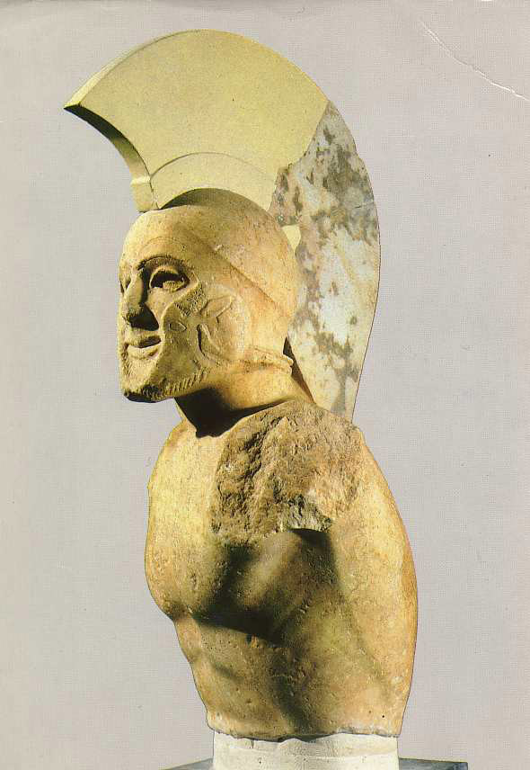
Schismogenesis between “Protestant* Foragers” and “Fisher Kings”
Schismogenesis, you’ll recall, describes how societies in contact with each other end up joined within a common system of differences, even as they attempt to distinguish themselves from one another. Perhaps the classic historical example would be the ancient Greek city-states of Athens and Sparta, in the fifth c. BCE. As Marshall Sahlins [2004] put it: “Dynamically interconnected, they were then reciprocally constituted…Athens was to Sparta as sea to land, cosmopolitan to xenophobic, commercial to autarkic, luxurious to frugal, democratic to oligarchic, urban to villageois, autochthonous to immigrant, logomanic to laconic: one cannot finish enumerating the dichotomies…Athens and Sparta were antitypes.” Each society performs a mirror image of the other. In doing so, tit becomes an indispensable alter ego, the necessary and ever-present example of what one should never wish to be. Might a similar logic apply to the history of foraging societies in California and on the Northwest Coast? [DE, p.180]
Picture, Wikipedia: The so-called Leonidas sculpture (5th century BC), Archaeological Museum of Sparta, Greece.
20th c. anthropologist Walter Goldschmidt [1913-2010] saw an uncanny resemblance between the Puritan attitudes described by Max Weber [1864-1920] in “The Protestant Ethic and the Spirit of Capitalism” [1904,1905] and the disapproval of wasteful pleasures and the glorification of work found among the northwest California indigenous peoples like the Yurok. [DE, pp. 177-178]

Slide 4
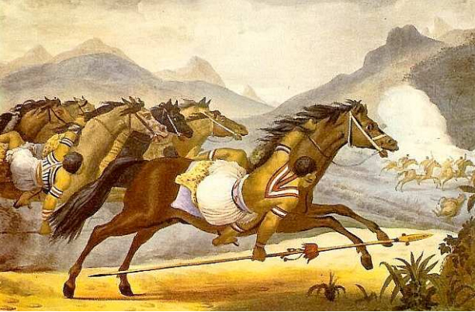
The profound ambivalence of Amerindian Caring Relationships.
Amerindian societies typically referred to themselves as “human beings”; whereas, for instance, Guaykuru means the equivalent of barbarian, given the Mbaya people by the Guarani. Almost all these societies took pride in their ability to adopt children or captives—even from among those whom they considered the most benighted of their neighbors—and, through care and education, turn them into what they consideredto be proper human beings. Slaves, it follows were an anomaly: people who were neither killed nor adopted, but who hovered somewhere in between; abruptly and violently suspended in the midpoint of a process that should normally lead from prey to pet to family . As such, the daptive as slave becomes trapped in the role of “caring for others” , a non-person whose work is largely directed towards enabling those others to become persons, warriors, princesses, “human beings” of a particularly valued and special kind. [DE, p. 191]
Pictue, Wikipedia: Debret's depiction of the Guaycuru cavalry during an attack. Guaycuru or Guaykuru is a generic term for several ethnic groups indigenous to the Gran Chaco region of South America, speaking related Guaicuruan languages. In the 16th century, the time of first contact with Spanish explorers and colonists, the Guaycuru people lived in the present-day countries of Argentina (north of Santa Fe Province), Paraguay, Bolivia, and Brazil (south of Corumbá). The Abipón Guaycuruans acquired horses from the Spanish in the late 16th century and within 50 years developed a horse culture similar to that of the Plains Indians of North America. The mobility afforded by the horse facilitated Guaycuruan control over other peoples in the Chaco and made raiding the Spaniards and their Indian allies a profitable enterprise.

Slide 5
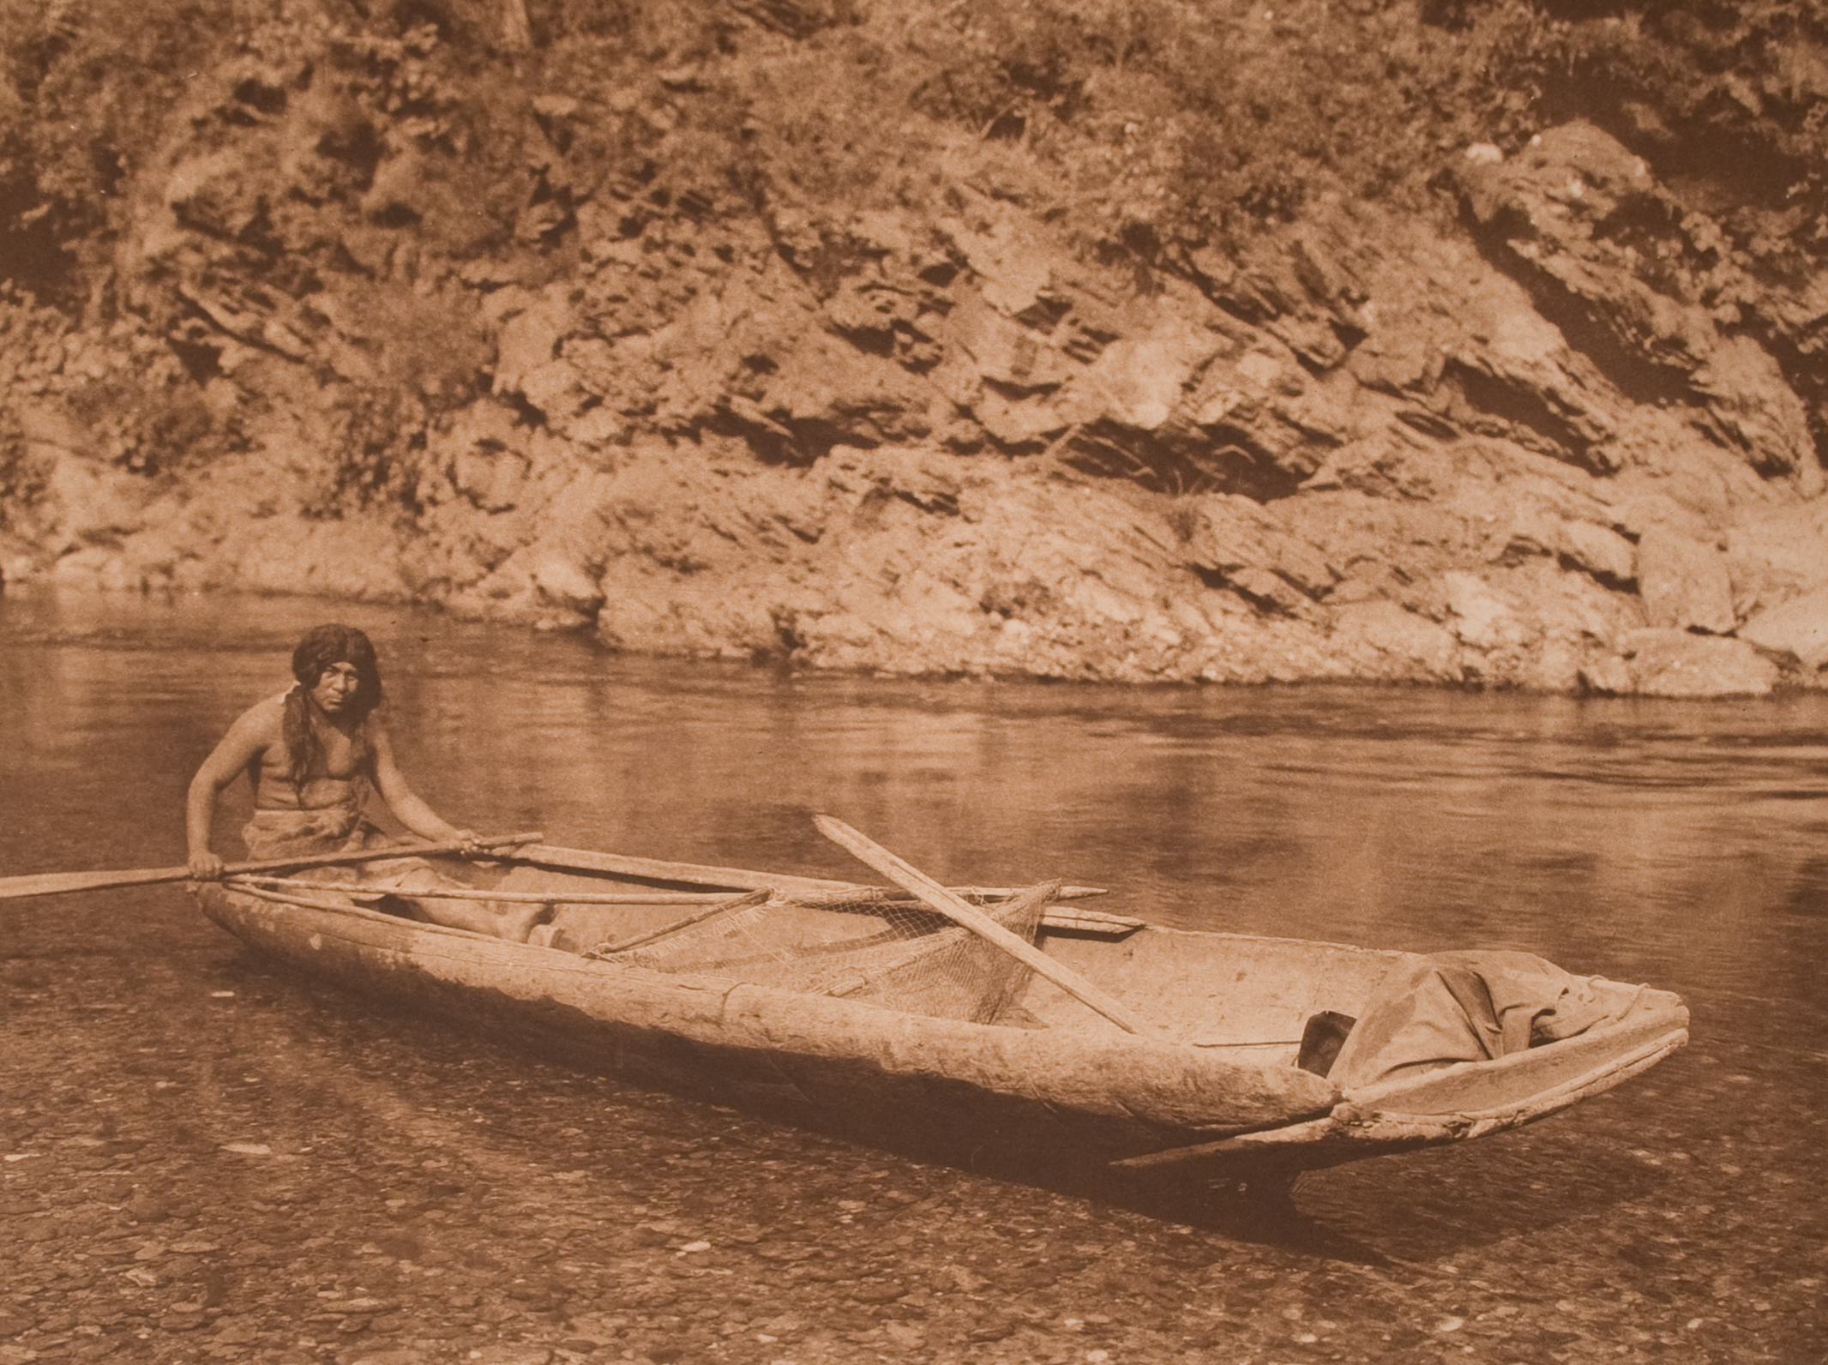
The rejection of slavery among groups between California and the Northwest Coast
A Yurok heroic protagonist maks his fame by defeating a maritime adventurer and brigand named “Le’mekwelolmei, who would pillage and enslave passing travelers. After defeating him in combat, our hero rejects his appeal to join forces: “No, I do not want to be like you, summoning boats to the shore, seizing them and their cargo, and making people slaves. As long as you live you will neve be tyrannous again, but like other men…Stay in your home and keep what is yours and leave people alone.” To the slaves who stood about nearly filling reh river bank, he said, “Go to your homes. You are free now.” The people who had been enslaved surrounded him, weeping and thanking him and wanting to drag his boat back into the water. “No, I will drag it myself,” he said, and then with one hand he lifed it to the river. So the freed people all scattered, some down-river and some upriver to their homes.”
Picture, Wikepedia: Yurok Canoe on Trinity River Artist: Edward Sheriff Curtis Artist Bio: American, 1868 – 1952. The Yurok (Karuk language: "downriver Indian”) are an Indigenous people from along the Klamath River and Pacific coast, whose homelands are located in present-day California stretching from Trinidad in the south to Crescent City in the north.
The Yurkok did hold a small number of slaves, mainly debt peons or captives not yet ransomed by their relatives. But their legends evince a strong disapproval.

Slide 6
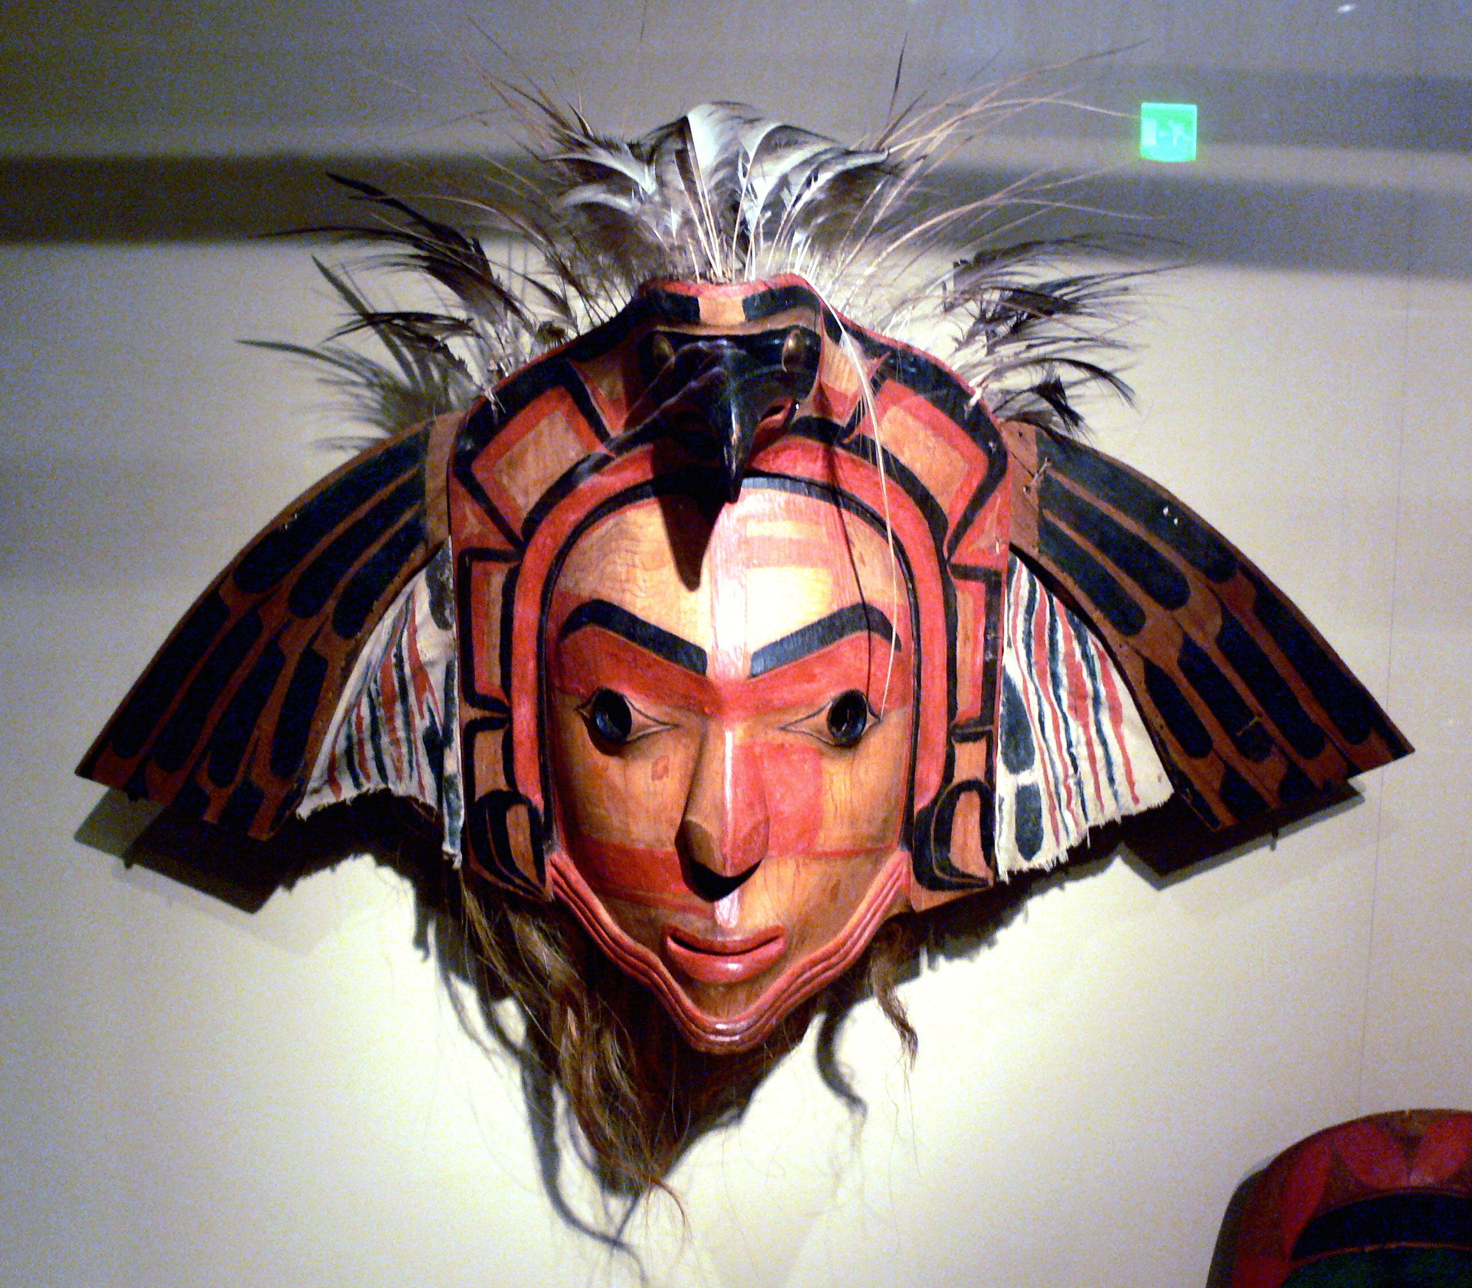
The Presence of Freedom Among the Commoners of the Nootka explains the existence of slavery among them
Title-holding aristocrats, locked in rivalry with one another, simply lacked the means to compel their own subjects to support their endless games of magnificence. They were forced to look abroad. One incident from Western Vancouver Island (Susan Golla, 1987 Ph. D. diss.]: High rank was a birthright but a noble could not rest on his laurels. He had to “keep up” his name through generous feasting, potlatching, and general open-handedness. Otherwise he ran the risk not only of losing face, but in extreme cases actually losing his position, or even his life. Swadesh tells of a despotic [Nootka] chief who was murdered for “robbing” his commoners by demanding all of his fishermen’s catch, rather than the usual tributary portion. His successor outdid himself in generosity, saying when he caught a whale, “You people cut it up and everyone take one chunk; just leave the little dorsal fin for me.” [DE, p. 198]
Picture, Wikipedia: Nootka eagle mask with moveable wings, Ethnological Museum, Berlin, Germany. The Nuu-chah-nulth, also formerly referred to as the Nootka, Nutka, Aht, Nuuchahnulth or Tahkaht,[The term Nuu-chah-nulth is used to describe fifteen related tribes whose traditional home is on the west coast of Vancouver Island] are one of the Indigenous peoples of the Pacific Northwest Coast in Canada.

Slide 7
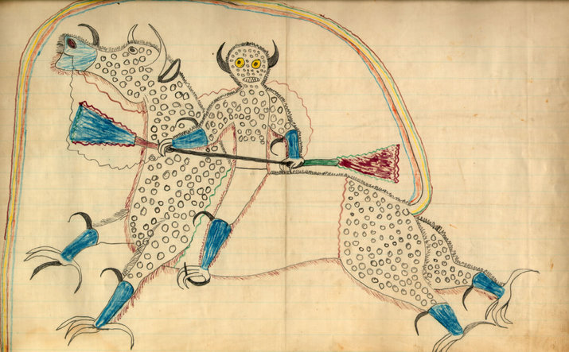
Schismogenesis among the Californian Indigenous People was Conscious
The California foragers were building their communities as a kind of mirror image, a conscious inversion of those of the on the Northwest Pacific Coast. Native Californians seem to have been well-aware of he kinds of values they were rejecting. They even institutionalized them in the figure of the clown, whose public antics of sloth, gluttony and megalomania..seem to parody the most coveted values of a prosimate civilization (natives of the nearby Northwest). In the previous slide we saw an example of a Nootka mask. Californian art entirely avoids the use of masks. Artistic traditions of the Northwest Coast are all about spectacle and deception. What mattered in California spirituality was the cultivation of the inner self through discipline, earnest training, and hard work. [DE, pp.. 200-201]
Picture, Wikipedia: Ledger artwork by Lakota artist Black Hawk representing a dream of a thunder being. c.1880. The heyoka (heyókȟa, also spelled "haokah," "heyokha") is a kind of sacred clown in the culture of the Sioux (Lakota and Dakota people) of the Great Plains of North America. The heyoka is a contrarian, jester, and satirist, who speaks, moves and reacts in an opposite fashion to the people around them. This will have to serve as an image of an indigenous clown, though the purposes which it served different indigenous societies varied.

