Slide 1
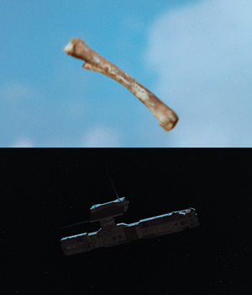
There was no Mitochondrial Eve—the putative common ancestor of our entire species
Because there was no Garden of Eden and no single Eve, insights into our distant past can be only partial, though sometimes helpful, such as feminist theories that see distinftly human sociability as originating in collective child-rearing practices.
One can infer that our earlies ancestor’s social organization was extraordinarily diverse. Early humans inhabited a wide range of natural environments, from coastlands and tropical forest to mountains and savannahs. They were far, far more physically diverse than humans are today; and presumably their social differences were even greater thantheir physical differences. In other words, the was no “original” form of human society. Searching for one can onl be a matter of myth-making—e.g., the “killer ape” fantasies of the 1960s, e.g. Kubrick’s film picture to right. [DE, p.81]
Picture, Wikepedia: A bone-club and orbiting satellite are juxtaposed in the film's famous match cut from Stanley Kubrick’s 2001: A Space Odyssey [1968]

Slide 2
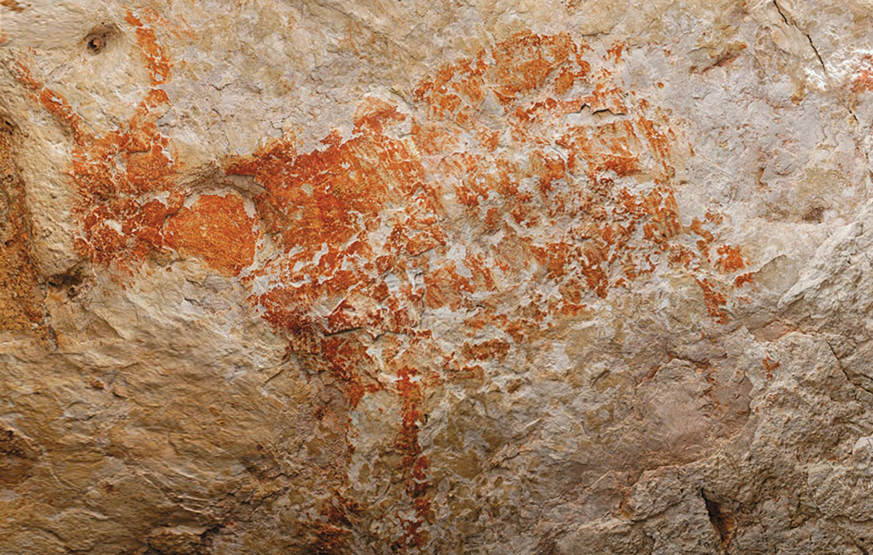
The sapient paradox, the idea of a Paleolithic Revolution, was an illusion; as soon as homo sapiens emerged, we started doing human things
Europe came late to the party. Even after its initial colonization by modern hmans—starting around 45,000 BCE—the continent was still thinly populated, and the new arrivals coexisted there, albeit fairly briefly, with more established Neanderthal populations. We have to picture our ancestors moving between relatively enclosed environments, dispersing and gathering, tracking the seasonal movements of mammoth, bison and deer herds. [DW, pp. 84-85].
Our current evidence is based on where the research has been funded, as well as where it is preserved. Currently rock shelters in South Africa containing hafted tools and expressive use of shell and ochre dates back to 80,000 BCE. [DE, p. 83
Picture, Wikepedia: One of the oldest known figurative paintings, a depiction of an unknown bovine, was discovered in the Lubang Jeriji Saléh cave, East Kalimantan, Indonesian Borneo,and dated to be more than 40,000 (perhaps as old as 52,000) years old.

Slide 3
What makes societies distinctively human is our ability to make the conscious decision not to engage in our inherited tendency to engage in dominance/submissive behaviors--Christopher Boehm
Boehm did field work with human societies such as the Navajo People and the Rovca Tribes of Montenegro or Upper Morača River Tribe, as well as primates such as wild chimpanzees, focusing on questions of morality in an evolutionary context.
After analyzing data from 48 human societies spread across the globe, ranging from small hunting and gathering bands sedentary chiefdoms, Boehm suggested that all human societies likely practiced egalitarianism before the domestication plants and animals, and that most of the time they did so very successfully.
Boehm wrote:
  "As long as followers remain vigilantly egalitarian because they understand the nature of domination and leaders remain cognizant of this ambivalence-based vigilance, deliberate control of leaders may remain for the most part highly routinized and ethnographically unobvious."
Boehm identified the following mechanisms ensuring the what he called a "Reverse Dominance Hierarchy": Public Opinion, Criticism and Ridicule, Disobedience, and Extreme Sanctions. Further characteristics include ambivalence towards leaders and anticipation of domination.
For instance, while gorillas do not mock each other for beating their chests, humans do so regularly…Boehm called counater-instinctual behavior “actuarial intelligence, as it indicated a society understanding what it might look like if they did things differently, if say, skilled hungers were not systematically ridiculed…This he concluded, was the essence of politics [Aristotle called us political animals]: the ability to reflect consciously on different directions one society could take. [DE, p. 86]
Christopher Boehm (1931–2021) was an American cultural anthropologist with a subspecialty in primatology, who researched conflict resolution, altruism, the evolution of morality, and feuding and warfare. He was also the Director of the Jane Goodall Research Center at University of Southern California, a multi-media interactive database focusing on the social and moral behavior of world hunter gatherers.

Slide 4
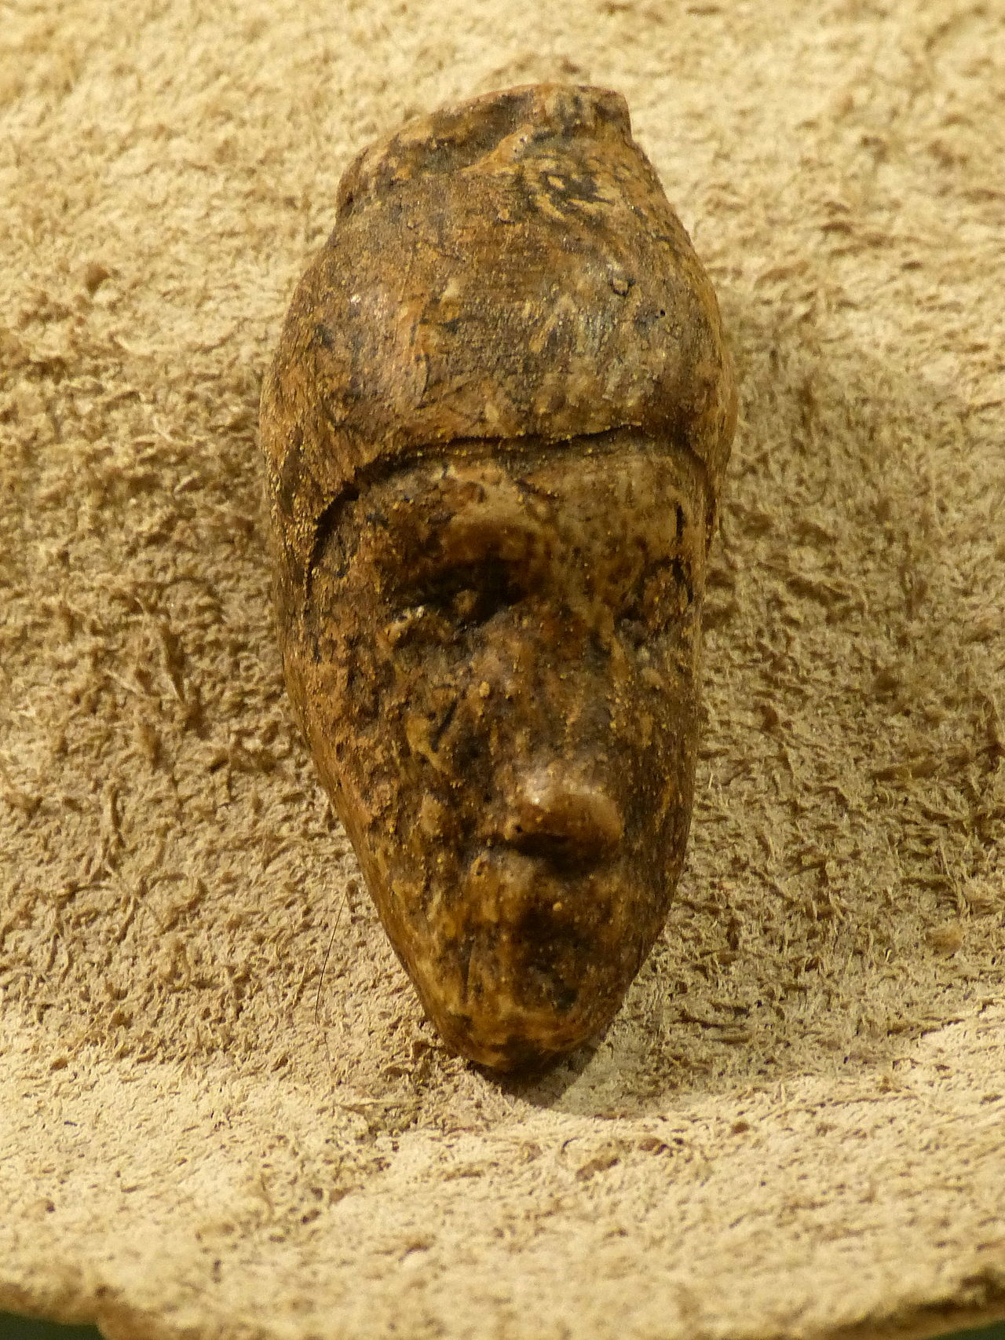
Hunter-Gatherer Lavish Burials from as early as 36,000 years ago suggests specialized craftspeople and some kind of inherited status.
The site is unique in that it has been a particularly abundant source of prehistoric artifacts (especially art) dating from the Gravettian period, which spanned roughly from 27,000 to 20,000 BC. In addition to the abundance of art, this site also includes carved representations of men, women, and animals, along with personal ornaments, human burials and enigmatic engravings.
Picture, Wikepedia: Carved female head from Dolní Věstonice, Krahuletz-Museum (replica), South Moravian Region, south of Brno, Czech Republic

Slide 5
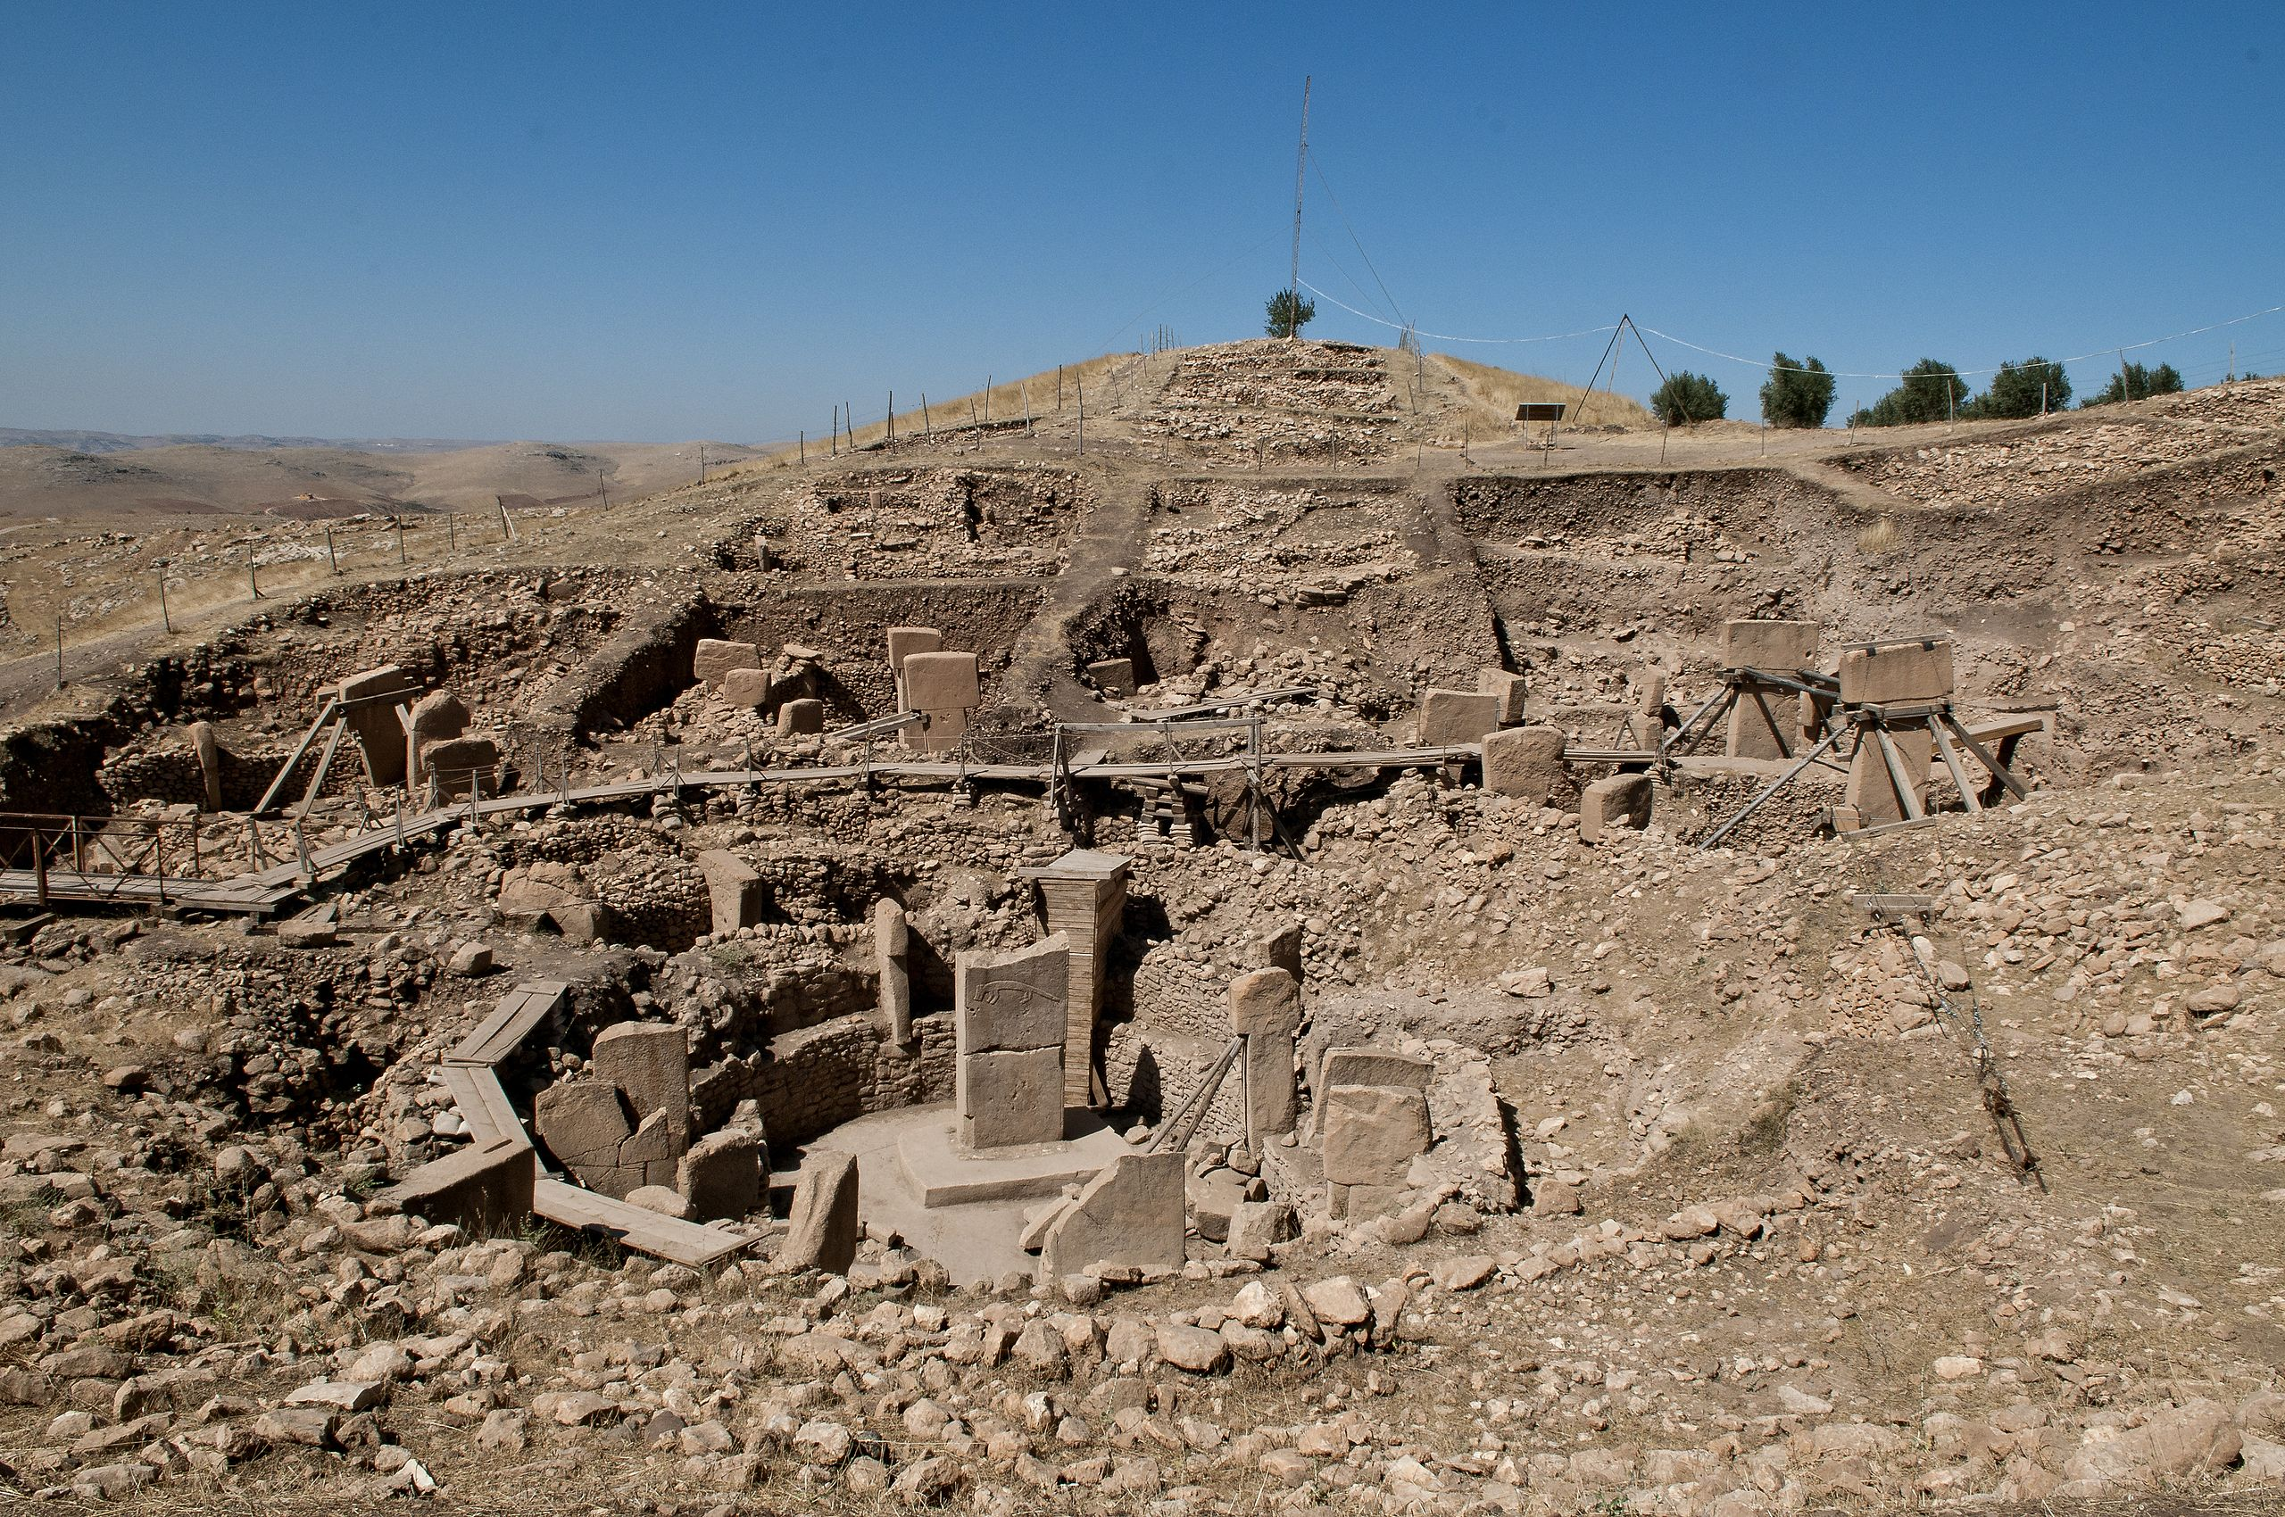
Evidence that hunter-gatherer societies supported major public works projects and a complex social hierarchy prior to the adoption of farming at Gobekli Tepe
The appearance of the oldest permanent human settlements anywhere in the world…The creation of these remarkable buildings imply strictly coordinated activity on a really large scale.
While the inhabitants harvested and processed wild cereals and other plants in season, there is no evidence that they had already begun farming.
Picture, Wikepedia: Göbekli Tepe, Şanlıurfa, “pot belly hill”, is a Neolithic archaeological site in the Southeastern Anatolia Region of Turkey. Dated to the Pre-Pottery Neolithic, between c. 9500 and 8000 BCE, the site comprises a number of large circular structures supported by massive 16 ft. high stone T-shaped pillars – the world's oldest known megaliths. Many of these pillars are richly decorated with figurative anthropomorphic details, clothing, and reliefs of wild animals

Slide 6

Lingering assumptions about hunter-gatherers and chimps in “Sapiens” (2014), by Yuval Noah Harari
Not only everyone living in bands until farming came along, but thee bands were basically apelike in character. Harari: The sociopolitical world of the foragers is another area about which we know next to nothing…scholars cannot even agree on the basics, such as the existence of private property, nuclear families and monogamous relationships. It’s likely that different bands had different structures. Some may have been hierarchical, tense and violent as the nastiest chimpanzee groups, while others were as laid-back, peaceful and lascivious as a bunch of bonobos. [“Sapiens”, quoted in DW, p. 93].

Slide 7
Instead of imagining what kinds of worlds hunter-gatherers were trying to create, we assume people blindly follow traditions.
All this would habe come as a great surprise to Kandiaronk, the 17th c. Wendat philosopher-statesman whose impact on European political thought we’ve discussed…Kandiaronk’s Wendat nation saw their society as a confederation created by conscious agreement; agreements open to continueal renegotiation…By the late 19th and early 20th c. many in Europe argued that someone like Kandiaronk never really existed…A primitive or savage operated with a pre-logical mentality, or lived ina mythological dreamworld. At best, they were mindless conformist, bound in the shackles of tradition; at worst, they were incapable of fully conscious, critical thought of any kind. [DW, pp. 94-95].
“…Over the course of the eighteenth and nineteenth centuries it was political self-consciousness that European philosophers came to see as some kind of amazing historical achievement; as a phenomenon which only really became possible with the Enlightenment itself…Before that, it was assumed, people blindly followed traditions…To Victorian intellectuals, the notion of people self-consciously imagining a social order more to their liking and then trying to bring it into being was simply not applicable before the modern age…

Slide 8
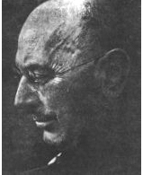
Paul Radin: “Primitive Man as Philosopher” [1927]—an anthropologist who considered indigenous people who analyze critically and are sceptical, imaginative, thoughtful
Radin noticed that the Winnebagos would never punish a religious sceptic or try to force him into cconformity by blaming a bad hunt on him and thereby refusing to share food with him until he performed the usual rituals. Radin rather observed that “primitive” societies tolerated eccentricity.
[DW, pp. 96-97]
Paul Radin (April 2, 1883 – February 21, 1959) was an American cultural anthropologist and folklorist of the early twentieth century specializing in Native American languages and cultures. The noted legal scholar Max Radin was his older brother. A son of the rabbi Adolph Moses Radin, Paul Radin was born in the cosmopolitan Polish city of Łódź in 1883. In 1884 his family moved to Elmira, New York. Between 1905 and 1907 Radin studied in Europe, first in Munich and then the University of Berlin. As a result, he became interested in anthropology. In 1907 he returned to the United States and became a student of Franz Boas at Columbia, where he counted Edward Sapir and Robert Lowie among his classmates. He engaged in years of productive fieldwork among the Winnebago (Hocąk) Indians, primarily from 1908-1912. Radin was monitored by the FBI, who believed him to be a communist. This monitoring continued until his death. In 1952 Radin moved to Lugano, Switzerland, where he worked for the Bollingen Foundation. In 1956 he returned to the US to take a position at Brandeis, where he was chairman of the Department of AnthropologyLate in his career he edited several anthologies of folk tales from different continents. His most enduring publication to date is The Trickster (1956), which includes essays by the pioneering scholar of Greek mythology, Karl Kerényi, and the prominent psychoanalyst C. G. Jung..
Picture, Wikepedia: American Anthropologist, 61, (1959) American Anthropological Association

Slide 9
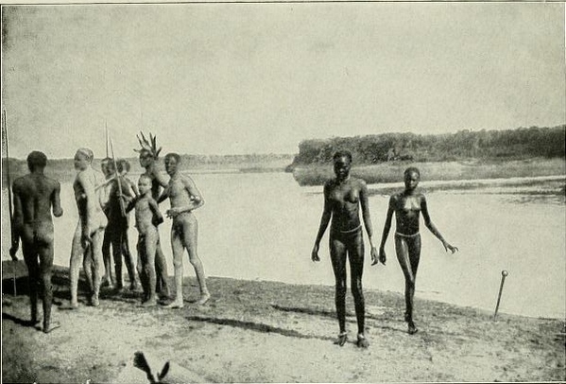
Thomas Beidelman, studing the Nuer, a cattle-keeping people in the S. Sudan, accept eccentrics as prophets
Biedelman noticed that the politicians were often unconventional—a woman whose parents had declared her a man for social purposes; the priests were always outsiders; and the prophets were altogether more extreme—they might dribble, drool, maintain a vacant stare, act like an epileptic, or engage in long, pointless tasks like arranging shells in designs for hours, speak in tongues, go into trances, fast, balance on their head, wear feathers in their hair, be active by night rather than by day, perch on rooftops, sit with tethering pegs up their anuses, cross-dress, or engage in unconventional sexual practices…Normally prophets were treated with bemused respect…As a result, whenever great calamities or unprecedented events occurred—it was amng this group that everyone looked for a charismatic leader…to propose entirely different visions of what Nuer society might be like. [DE, pp. 97-98].
Thomas Owen Biedelman, born on March 21, 1931 in Aurora, Illinois, was prof. at NYU now retired. Beidelman’s areas of research interest: Social anthropology, Africa, religion and symbolism, witchcraft and magic, history of colonialism, Christian missionaries, African literature, urban neighborhood and landscape preservation movements, history of British and European anthropology and sociology—in 2011 published a book on colonial rule in a district of Tanzania, East Africa, published an article on comparing secrecy in Ancient Greece and the Kaguru of East Africa, and continued to work on studies of the strategies of book reviewing in anthropology, on colonial courts in Tanzania, on the politics of historical landmarking in New York City, and on the use of Homeric studies for teaching introductory social anthropology.
Picture, Wikepedia: the Nuer people in 1906.

Slide 10

Claude Levi-Strauss learns of social structure seasonal variation among the Nambikwara in Brazil’s Mato Grasso
Claude Levi-Strauss took seriously that early humans were our intellectual equals. His “The Savage Mind” [1962, 1966] states that mythological thought is a kind of “neolithic science.” Writing on the Nambikwara, part-time hunters, part-time foragers, in 1944, he observed that the chiefs brokered between two entirely different social and ethical systems, which obtained at different times of the year. During the rainy season the Nambikwara occupied villages and practiced horticulture; during the rest of the year they dispersed into small foraging bands. In the latter the chiefs made their reputations giving orders during “nomadic adventures”. In the wet season of abundance the chiefs relied on gentle persuasion. They mediated disputes and never imposed anything on anyone. [DE, pp. 99-100].
Picture {2005], Wikepedia: Claude Lévi-Strauss [1908- 2009] was a French anthropologist and ethnologist whose work was key in the development of the theories of structuralism and structural anthropology. He held the chair of Social Anthropology at the Collège de France between 1959 and 1982.

Slide 11
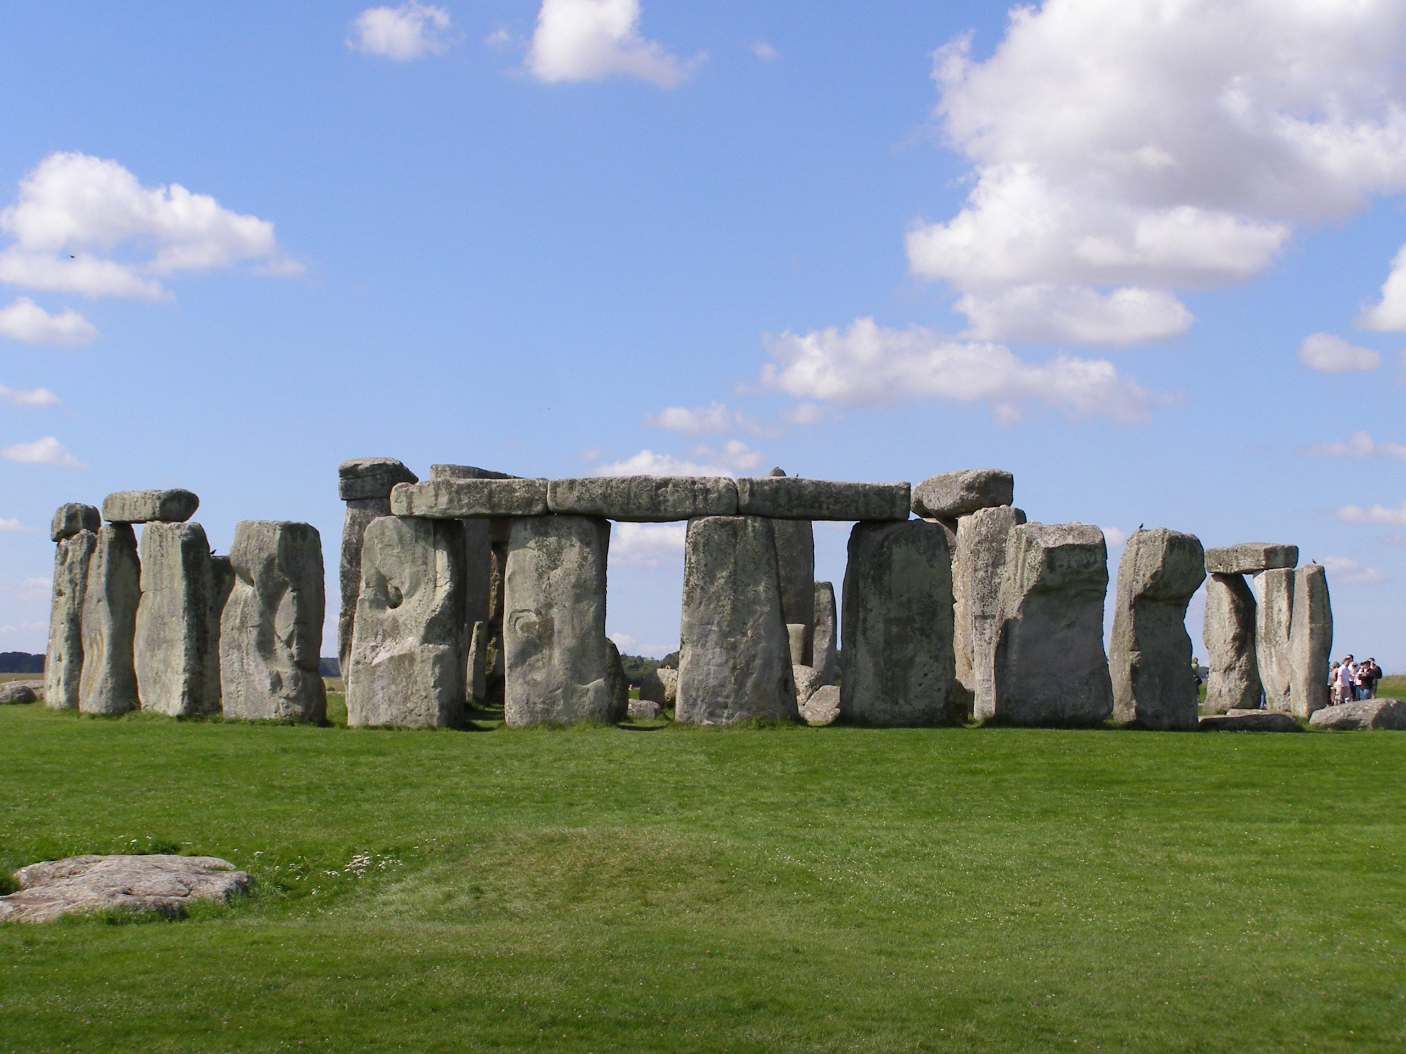
There is evidence for both “extreme individuals” and “seasonal variations of social life in the Paleolithic Period, in the Ice Age and Beyond in the Neolithic
In the great rock shelters of the French Kperigord and the Cantabrian coast [sites of the great cave rock art] there is a deep record of human activity which formed part of an annual round of seasonal congregation and dispersal.
Picture, Wikepedia: In the famous Neolithic monuments of Salisbury Plain in England, Stonehenge is the last in a long sequence of ceremonial structures in both wood and stone, erected over the course of centuries, as people converged on the plain from remote corners of the British Isles at significant times of the year. Plausibly many of these structures were monuments to the ancestors of a Neolithic aristocracy, and many were dismantled a few generations after construction. The builders of Stonehenge appeared to be neither forages nor herders, but something in between. If Stonehenge was a shrine to exalted founders of a ruling clan, they would have been kings of courts and kingdoms existing for only a few months of the year, otherwise dispersed into small communities of nut gatherers and stock herders. [DW, pp. 105-106]

Slide 12
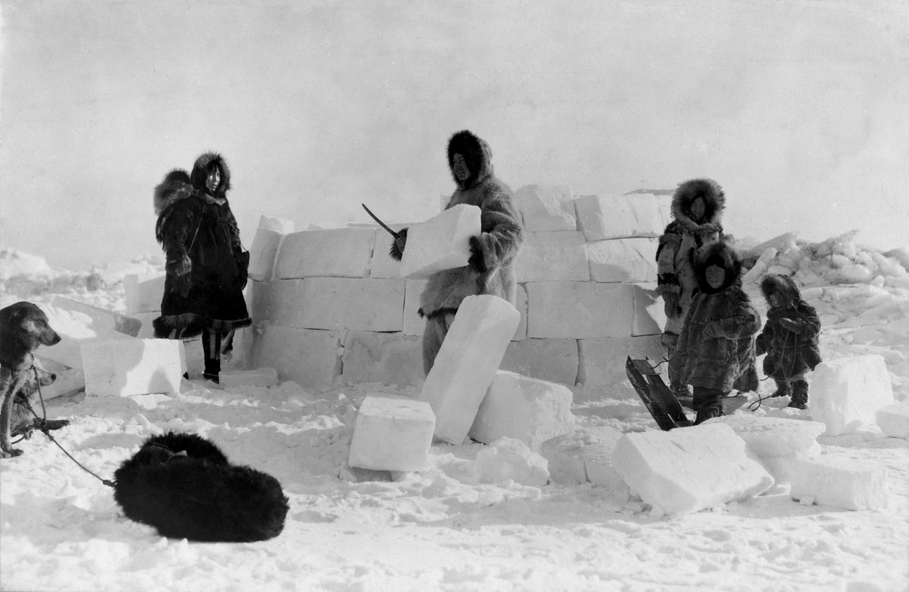
The Double Morphology of Marcel Mauss and Henri Beuchart in “Seasonal Variations of the Eskimo” [1903]
The circumpolar Inuit have two social structures, one in summer and one in winter, and that in parallel they have two systems of law and religion. In the summer tey disperse into bands to pursue fish, caribou and reindeer under the authority of of a single male elder…But in the abundant winter of seal and walrus they gather together in great meeting houses where the virtues of equality, altruism and collective life prevail.
Picture, Wikepedia: Group of Inuit building an igloo

Slide 13
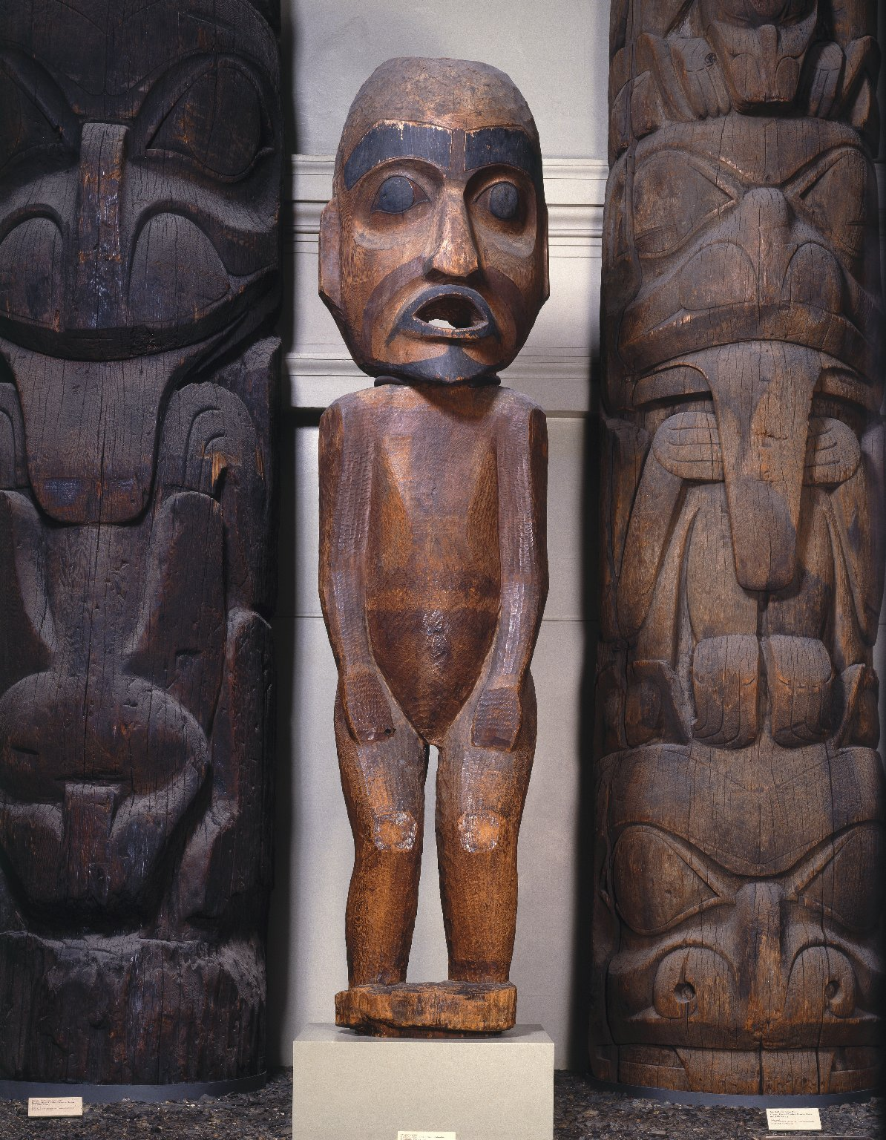
German-American ethnologist Franz Boas finds Kwakiutl, indigenous hunter-gatherers of Canada’s Northwest Coast most hierarchical in the winter
In winter plank-built palaces sprang to life along the coastline of British Columbia, with hereditary nobles holding court over compatriots classified as commoners and sales, and hosting the great banquets known as potlatch. Yet these aristocratic courts broke apart for the summer work of the fishing season, reverting to smaller clan formations—still ranked, but with entirely different and much less formal structures. In this case, people actually adopted different names in summer and winter—literally becoming someone else, depending on the time of year. [DE, p. 108].
Franz Uri Boas (July 9, 1858 – December 21, 1942) was a German-American anthropologist and a pioneer of modern anthropology who has been called the "Father of American Anthropology". His work is associated with the movements known as historical particularism and cultural relativism
Picture, Wikepedia: Speaker Figure, 19th century, Brooklyn Museum, the figure represents a speaker at a potlatch. An orator standing behind the figure would have spoken through its mouth, announcing the names of arriving guests.

Slide 14
Plains Indians, conscious political actors, were keenly aware of the possibilities and dangers of authoritarian power, Robert Lowie discovered
Plains nations were one-time farmers who had largely abandoned cereal agriculture after re-domesticating escaped Spanish horses and adopting a largely nomadic mode of life. In late summer and early autumn bands of Cheyenne and Lakota would congregate in large settlements to make logistical preparations for the buffalo hunt. At this most sensitive time of the year dthey appointed a police force that exercised full coercive powers. This unequivocal authoritarianism operated on a strictly sesonal and temporary basis. Once the hunting season—and the collective Sun Dance rituals that followed—were complete, such authoritarianism gae way to what he called “anarchic” forms of organization, smaller bands…They were also careful to rotate which clan or warrior clubs got to wield the coercive authority during the hunt: anyone holding sovereignty one year would be subject ot the authority of others in the next.
Robert Harry Lowie (born Robert Heinrich Löwe,1883–1957) was an Austrian-born American anthropologist. An expert on Indigenous peoples of the Americas, he was instrumental in the development of modern anthropology and has been described as one of the key figures in the history of anthropology…Lowie undertook several expeditions to the Great Plains and Montana and Wyoming, where he conducted ethnographic fieldwork at the Absarokee (Crow, 1907, 1910–1916, 1931), Arikaree, Hidatsa, Mandan and Shoshone (1906, 1912–1916).[
Lowie in “Social Organization [1948]: “In order to ensure a maximum kill, a police force—either coinciding with a military club, or appointed ad hoc, or serving by virtue of clan affiliation—issued orders and restrained the disobedient. IN most of the tribes they not only confiscated game clandestinely procured, but whipped the offender, destroyed his property, and, in case of resistance, killed him. The very same organization which in a murder case would merely use moral suasion turned into an inexorable State agency during a buffalo drive. However…coercive measures extended considerably beyond the hunt: the soldiers also forcibly restrained braves intent on sarting war parties that were deemed inopportune by the chief; directed mass migrations; surpervised the crowds at a major festival; and might otherwise maintain law and order.” [DE, pp. 108-110]

Slide 15
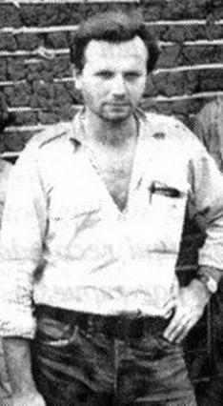
Pierre Clastres, anarchist anthropologist student of Claude Levi-Strauss
Clastres maintained that Amazonian chiefs were calculating politicians forced to manoeuvre in a social environment apparently designed to ensure that they could never exercise real political power…Even where they did have special privileges, like the Tupi and Nambikwara chiefs, who were the only men in their villages allowed to hage multiple wives, the prilege was distinctly double-edged. The wives were held to be necessary to prepare feasts for the village. If any of those wives looked to other lovers, which it appears they ordinarily did, there was nothing much the chie could do about it, since he had to keep himself in eberyone’s good graces to remain chief. [DE, p. 112].
Picture [Wikepedia]: French anthropologist Pierre Clastres [1934-1977] a French anthropologist, ethnographer, and ethnologist. He is best known for his contributions to the field of political anthropology, with his fieldwork among the Guayaki in Paraguay and his theory of stateless societies. An anarchist seeking an alternative to the hierarchized Western societies, he mostly researched Indigenous peoples of the Americas in which the power was not considered coercive and chieftains were powerless.

Slide 16
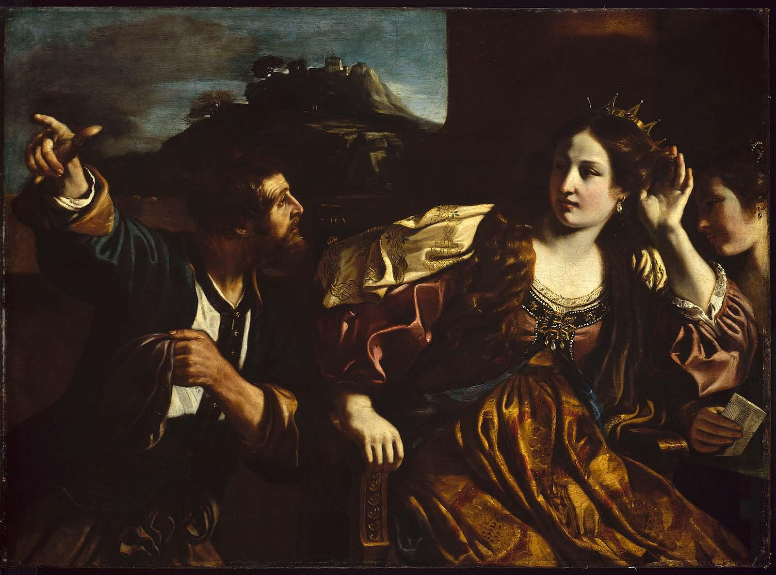
The only consistent phenomenon is the very fact of alteration, and the consequent awareness of different social possibilities [DE, p. 115]
In the popular Babylonian sory of Semiramis, the eponymous servant girl convinces the Assyrian king to let her be ‘Queen for a Day’ during some annual festival, promptly has him arrested, declares herself empress and leads her new armies to conquer the world. May Day came to be chosen as the date for the international workers’ holiday largely because so many British kpeasant rebolts had historically begun on that riotous festival. Villagers who played at turning the world upside would periodically decide they actually preferred the world upside down, and took measures to keep it that way…For a great many societies, the festive year could be read as a veritable encyclopaedia of possible political forms. [DE, pp. 117-118].
The real and historical Shammuramat (the original Akkadian form of the name) was the Assyrian wife of Shamshi-Adad V (ruled 824 BC–811 BC). She was the ruler of the Neo-Assyrian Empire as its regent for five years before her son Adad-nirari III came of age and took the reins of power. She ruled at a time of political uncertainty, which is one of the possible explanations for why Assyrians may have accepted the rule of a woman when it was not allowed by the cultural tradition. She conquered much of the Middle East and the Levant and stabilized and strengthened the empire after a destructive civil war. It has been speculated that being a woman who ruled successfully may have made the Assyrians regard her with particular reverence and that her achievements may have been retold over the generations until she was turned into that legendary figure.
[Picture, Wikepedia]: Semiramis hearing of the insurrection at Babylon by Giovanni Francesco Barbieri, 1624 (Museum of Fine Arts, Boston)

Slide 17
The proliferation of separate social and cultural universes—confined in space and relatively bounded—must have contributed..to the emergence of more durable and intransigent forms of domination.
The mixed composition of so many foraging societies clearly indicates that the individuals were routinely on the move for a plethora of reasons, including taking the first available exit route if one’s personal freedoms were threatened at home. Cultural porosity is also necessary for the kind of seasonal demographic pulses that made it possible for societies to alternate periodically between different political arrangements, forming massive congreegations at one time of year, then disipersing into a multitude of smaller units for the remainder…It is difficult to exercise arbitrary power in, say, January over someone you will be facing on equal terms again come July. The hardening and multiplication of cultural boundaries can only have reduced such possibilities. [DE, p. 125]
Beginning in 12,000 BCE, during the postglacial Mesolithic huge areas with cultural differences begin to emerge. The Neolithic continues these areas of cultural difference, which were still considerably larger than most modern nation states. Only much later do we begin to encounter the kind of situation familiar to anthropologists of Amazonia and or Papua New Guinea, where a single river valley might contain speakers of half a dozen different languages, with entirely distinctive economic systems or cosmological beliefs…Overall the direction of history, -at least until very recently—would seem to be the very opposite of globalization. It is one of increasingly local allegiances: extraordinary cultural inventiveness, but much of it aimed at finding new ways for people to set themselves off against each other. [DE, pp. 123-124]

Slide 18
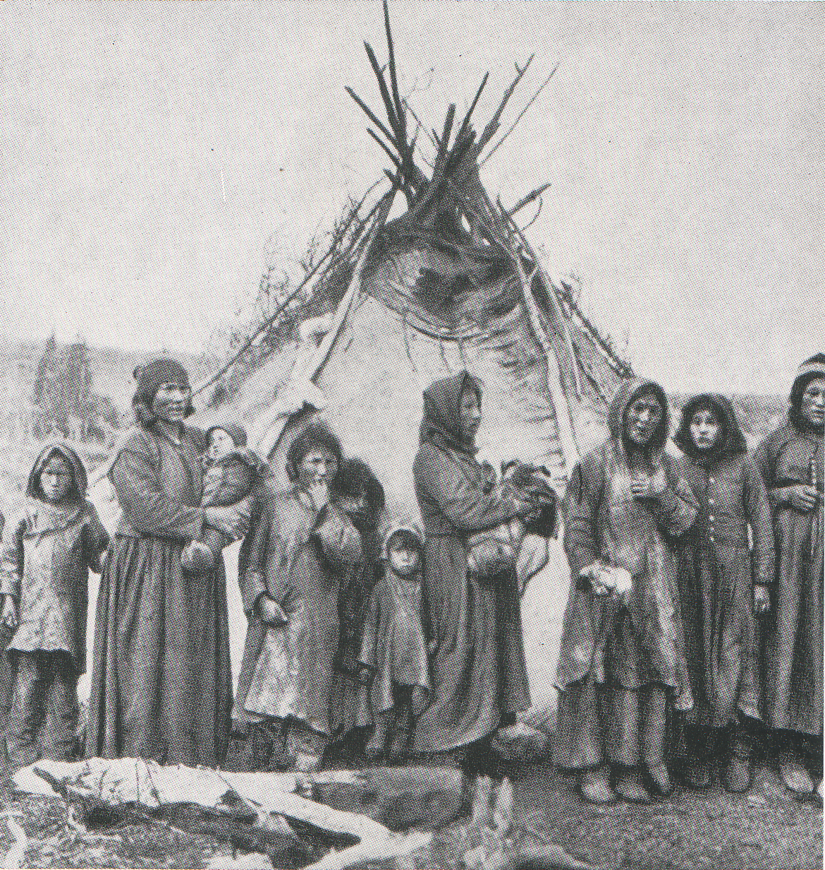
What we call egalitarian societies are more interested in autonomy, says Eleanor Leacock, a feminist anthropologist
Eleanor Burke Leacock (1922 – 1987) was an anthropologist and social theorist who made major contributions to the study of egalitarian societies, the evolution of the status of women in society, Marxism, and the feminist movement.
What matters to Montagnais-Naskapi women, for instance, is not so much whether men and women are seen to be of equal status but whether women are, individually and collectively, able to live their lives and make their own decisions without male interference. In other words, if there is a value these women feel should be distributed equally, it is precisely what we would refer to as freedom.
Picture [Wikepedia] Naskapi women, wearing woolen and deerskin clothing, 1908. The Naskapi (Nascapi, Naskapee, Nascapee) are an Indigenous people of the Subarctic native to the historical country St'aschinuw (ᒋᑦ ᐊᔅᒋᓄᐤ, meaning 'our [inclusive] land'), which is located in northern Quebec and Labrador, neighbouring Nunavik. They are closely related to Innu Nation, who call their homeland Nitassinan. Innu people are frequently divided into two groups, the Neenoilno (called Montagnais by French people) who live along the north shore of the Gulf of Saint Lawrence, in Quebec, and the less numerous Naskapi who live farther north.

Slide 19

Distinguishing formal from substantive freedom
Charles Lallemant (or Lalemant), (November 17, 1587 – November 18, 1674) was a French Jesuit. He was born in Paris in 1587 and later became the first Superior of the Jesuit Missions amongst the Huron in Canada. His letter to his brother, dated 1 August 1626, inaugurated the series Relations des Jésuites de la Nouvelle-France about the missionary work in the North American colonies of New France. Father Lallemant wrote his brother that the Wendat, the Montagnais-Neskapi’s neighbors, were a free people, each of whom “considers himself of as much consequence as the others,and tey submit to their chiefs only in so far as it pleases them” [chiefs among the Wendat had no power other than persuasion, hence Kandiaronk’s prodigious rhetorical skills referred to earlier]. Equality in societies such as the Wendat was a direct consequence of individual liberty. However, liberties are not really liberties if one cannot act on them…In the United States, for instance, the freedoms which form our moral basis are largely formal freedoms. American citizens hae the right ot tragel wherever they like—provided, of course, they hage the money for transport and accommodation. They are ree from ever having to obey the arbitrary orders of superiors—unless, of course, they have to get a job…What the Wendat and Nuer are concerned with were not so much formal freedoms as substantive ones. They were less interested in the right to travel than in the possibility of actually doing so (hence the matter was typically framed as an obligation to provide hospitality to strangers). Mutual aid—what contemporary European obserbers often referred to as “communism”—was seen as the necessary condition for individual autonomy. [DE, p. 130-131]. [Picture, Wikepedia].

Slide 20
For feminist British anthropologist Kathleen Gough, among the Nuer, freedom was assumed for women and men
Eleanor Kathleen Gough Aberle (1925 –1990) was a British anthropologist and feminist who was known for her work in South Asia and South-East Asia… In addition, some of her work included campaigning for: nuclear disarmament, the civil rights movement, women's rights, the third world and the end of the Vietnam War. She was known for her Marxist leanings and was on an FBI watchlist…Gough critiqued E.E. Evans-Pritchard’s 1940s assessment of the South Sudanese Nuer as paradigm of egalitarian societies.k In the 1960s she showed that you couldn’t really speak of equality of status when males among the Nuer were divided between “aristocrats” (with ancestral connections to the territories where they lived) and “strangers” and lowly war captives taken by force in raids on other communities. Gough noted that differences in rank implied differential access to women. Only the aristocrats could easily assemble enough cattle to arrange what Nuer conserved a “proper” marraige, thereby allowing the male to claim paternity and thus be remembered after death as an ancestor.
While in everyday affairs, Gough found, women operated with much the same independence s men, the marriage system did efface women’s freedom to a degree. If a man paid the forty cattle typically required for bridewealth, this meant above all that he not only had the right to claim paternity over a woman’s children but also acquired exclusive sexual access, which in turn usually meant the right to interfere in his wife’s affairs in other respects as well. However, most Nuer women were not “properly” married. In fact, the complexities of the system were such that a large proportion found themselves officially married to ghosts, or to other women (who could be declared male for genealogical purposes)—in which case, how they went about becoming pregnant and raising their children was nobody’s business but their own. Een in sexual life, then, for women as for men, individual freedom was assumed unless there was some specific reason to curail it.
The freedom to abandon one’s community, knowing one will be welcomed in faraway lands; the freedom to shift back and forth between social structures, depending on the time of year; the freedom to disobey authorities without consequence—all appear to have been simply assumed by our distant ancestors. [DE, pp. 131-133]

Slide 21

Marshall Sahlin’s 1968 Rousseauian essay of speculative prehistory, “The Original Affluent Society”
Published in Jean-Paul Satre’s journal “Les Temps modernes”, Sahlin’s essay made the argument that, at least when it comes to working hours, the Victorian narrative of continual improvement is simply backwards. Technological evolution has not liberated people from material necessity. People are not working less. All the evidence, he argued, suggests that over the course of human history the overall number of hours most people spend working tended instead to increase…People in earlier ages were not necessarily poorer than modern-day consumers…True, a forager might seem extremely poor by our standards—but to apply our standards was obviously ridiculous. “Abundance” is not an absolute measure. It refers to a situation where one has easy access to everything one feels one needs to live a happy and comfortable life. By these standards, Sahlins argued, most knwn foragers are rich. The fact that many hunter-gatherers, and even horticulturalists, only seem to have spent somewhere between two and four hours a day doing anything that could be construed as “work” was itself proof of how easy their needs were to satisfy. [DE, pp. 135-136].
Picture [Wikepedia]: Marshall David Sahlins, Scotland, University of St Andrews, June 2003. Marshall David Sahlins (1930 – 2021) was an American cultural anthropologist best known for his ethnographic work in the Pacific and for his contributions to anthropological theory. He was the Charles F. Grey Distinguished Service Professor Emeritus of Anthropology and of Social Sciences at the University of Chicago…. Stone Age Economics (1972) collects some of Sahlins's key essays in substantivist economic anthropology. As opposed to "formalists," substantivists insist that economic life is produced through cultural rules that govern the production and distribution of goods, and therefore any understanding of economic life has to start from cultural principles, and not from the assumption that the economy is made up of independently acting, "economically rational" individuals. Perhaps Sahlins's most famous essay from the collection, "The Original Affluent Society," elaborates on this theme through an extended meditation on "hunter-gatherer" societies. Stone Age Economics inaugurated Sahlins's persistent critique of the discipline of economics, particularly in its Neoclassical form.

Slide 22
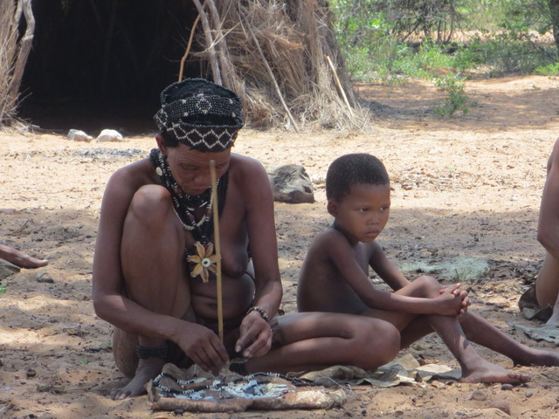
A !Kung informant: “Why should we plant when there are so many mongogngo nuts in the world?”
Marshall Sahlins concluded that what some prehistorians had assumed to be technical ignorance [about farming] was really a conscious social decision: such foragers had “rejected the Neolithic Revolution in order to keep their leisure.”[Robert Braidwood, “Prehistoric Men”, 1957, p. 22, in DE, p. 138]
However, Sahlins acknowledges that, just as there might hae been many ways for free peoples to be free, there might have been more than just one way for (original) affluent societies to be affluent. Not all modern hunter-gatherers value leisure over hard work, just as not all share the easy-going attitudes towards personal possessions of the !Kung [of the Kalahari] or the Hadza [of Tanzania]. Foragers in northwestern California, for instance, were notorious for their cupidity, organizing much of their lives around the accumulation of shell money and sacred treasures and adhering to a stringent work ethic in order to do so. The fisher-foragers of the Canadian Northwest Coast, on the other hand, lived in highly stratified societies where commoners and slaves were famously industrious. [DE, p. 139]
Picture [Wikepedia]: ǃKung woman making jewelry next to a child. The ǃKung are one of the San peoples who live mostly on the western edge of the Kalahari desert, Ovamboland (northern Namibia and southern Angola), and Botswana. The names ǃKung (ǃXun) and Ju are variant words for 'people', preferred by different ǃKung groups. This band level society used traditional methods of hunting and gathering for subsistence up until the 1970s.Today, the great majority of ǃKung people live in the villages of Bantu pastoralists and European ranchers.

Slide 23
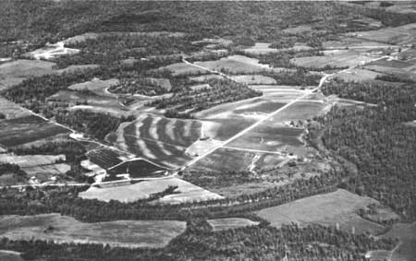
Poverty Point
Lack of an agricultural base does not seem to have stopped those who gathered on Poverty Point from creating something that to us would appear very much like little cities which, at least during certain times of year hosted a rich and influential intellectual life….John Edward Clark [(born 1952) is an American archaeologist and academic researcher of pre-Columbian Mesoamerican cultures. As of 2008 he holds a position as professor of anthropology at Brigham Young University (BYU), and is also the director of the New World Archaeology Foundation], an authority on the re-Columbian societies of Mesoamerica, published in 2004 findings that indicated that the various configurations of the mounds and ridges throughout the great valley of the Mississippi adhered to strikinging uniform geometric principles.
Picture,Wikepedia: Aerial view of the Poverty Point earthworks, built by the prehistoric Poverty Point culture, located in present-day Louisiana [Wikepedia]. The Poverty Point culture is the archaeological culture of a prehistoric indigenous peoples who inhabited a portion of North America's lower Mississippi Valley and surrounding Gulf coast from about 1730 – 1350 BC. Preceding the Poverty Point Culture is the Watson Brake site in present-day Ouachita Parish, Louisiana, where eleven earthwork mounds were built beginning about 3500 BC. Crude human figures, forming another category of artifacts, are thought to have been used for religious purposes. Points made of imported gray Midwestern flint were also found. In addition, plummets were fashioned out of heavy iron ore imported from Hot Springs, Arkansas; they served as weights for fish nets. Many of the raw materials used, such as slate, copper, galena, jasper, quartz, and soapstone, were from as far as 620 miles (1,000 km) away, attesting to the distant reach of the trading culture.[The Poverty Point culture developed a tradition of making high-quality, stylized, carved and polished miniature stone beads. Other early cultures in eastern North America rarely used stone to make their beads, opting for softer materials such as shell or bone. The beads depict animals common to the Poverty Point culture's environment, such as owls, dogs, locusts, and turkey vultures. Poverty Point culture was followed by the Tchefuncte and Lake Cormorant cultures of the Tchula period, a local manifestation of the Early Woodland period. These descendant cultures differed from Poverty Point culture in trading over shorter distances, creating less massive public projects, completely adopting ceramics for storage and cooking, and lacking a lapidary (stone-carving) industry.
The lack of agricultural base did not seem to hae stopped those who gathered on Poverty Point from creating something that to us would appear very much like little cities which at least during certain times of the year, hosted a ridh and influential intellectual life., including the knowledge of geometric and mathematical techniques for making accurate spatial measurements. DE, p. 144]

Slide 24
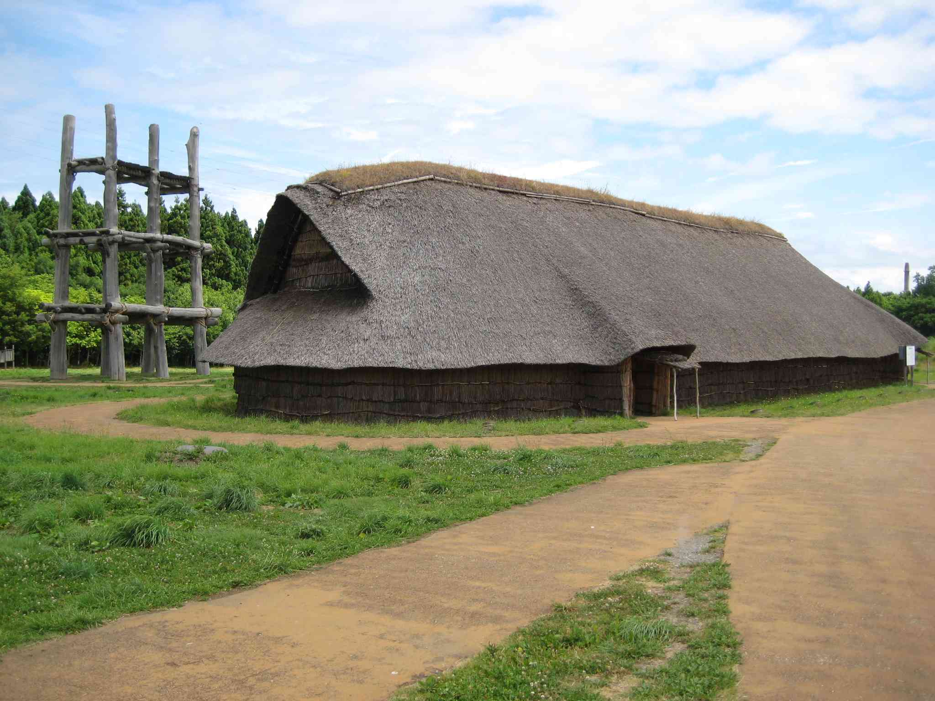
Jomon Period Japan, Pre-rice cultivation introduction from Korea, 14,000-300 BCE, at Sannai Maruyama
Across the Japanese archipelago, between 14,000 and 300 BCE, centennial cycles of settlement nucleation and ispersal came and went; monuments shot up in wood and stone, and then were pulled down again or abandoned; elaborate ritual traditions, including opulent burials, flourished and declined; specialized crafts waxed and waned, including remarkable accomplishments in the arts of pottery, wood and lacquer. [DE, kp. 146].
Picture, Wikipedia: Reconstruction of a Jōmon period longhouse at Sannai-Maruyama. Only a few longhouses were found; they may have been meeting halls or workshops…The Sannai-Maruyama settlement was occupied from the middle of the Early Jōmon period to the end of the Middle Jōmon period (3900 – 2200 BC), and is the largest the Jōmon settlement yet discovered in Japan. It is located on a 20 meter high fluvial terrace on the right bank of the Okidate River, at the tip of a ridge extending southwest from the Hakkōda Mountains…For the first 1,000 years the area was inhabited by hunter-gatherers eating nuts, fish and plants. Around 2900 BC, the inhabitants became more sedentary. They began to store food above ground in elevated buildings rather than in pits. Also, longhouses began showing up around this time. Long houses were large, oval-shaped structures. The longest one found at the site was 32 meters (105 feet) long. Scholars believe longhouses were used for meeting places, workshops, or living space…The settlement of Sannai-Maruyama ended around 2300 BC due to unknown reasons. Its abandonment was likely due to the population's subsistence economy being unable to result in sustained growth, with its end being spurred on by the reduced amount of natural resources during the neoglaciation… A decrease in temperature by 2.6 °C (4.7 °F) influenced the collapse of the settlement and civilizations in other parts of the world.
Japanese arhceologists, surveying thousands of years worth of Jomon sites, have discovered all sorts of treasures, but they are yet to find indisputable evidence that those treasures were monopolized by any sort of aristocracy, or ruling elite. [DE, p. 157]

Slide 25
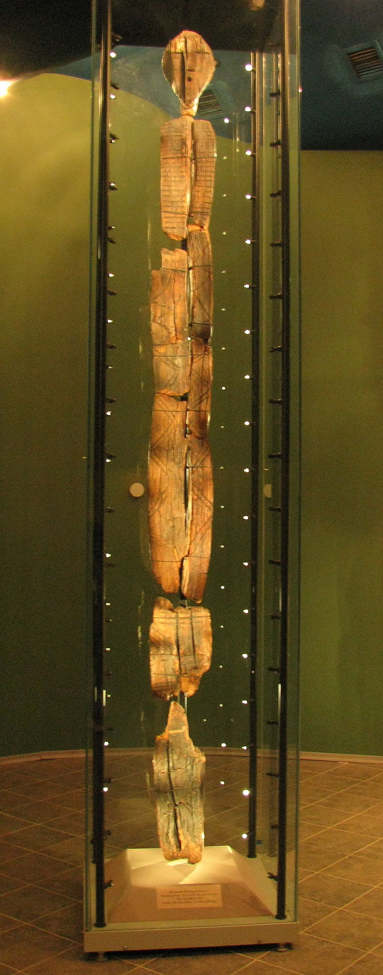
Shigir Idol, 17 ft. sculpture, c. 8000 BCE, Example of tradition of large-scale wooden forager art preserved in a peat-bog off Lake Shigirskoe in the middle Urals
The discovery upended scholars' views on when humans began making ritual art, as opposed to the kind of realistic art seen in the Lascaux caves. Scientists had previously believed that complex art comparable to the Shigir Idol began in sedentary farming populations in the Middle East around 8,000 years ago. Regardless of whether the people who made such objects were ruled by kings or without them, such finds illustrate how forager monumentality preceded Neolithic farmers. [DE, p. 147
Picture, Wikipedia: The sculpture, dated to 11,500 years ago, may have stood more than 5 m (16 ft) high. It is is the oldest known wooden sculpture in the world, made during the Mesolithic period, shortly after the end of the last Ice Age. The geometric decorations, such as simple lines and zigzags of the Idol are commonly found in Late Palaeolithic and Early Mesolithic decorations. The body is flat and rectangular. Geometrical motifs decorate its surface, including zigzag lines and depictions of human faces and hands. The arrangement resembles a totem pole. Thus, various elements of the Shigir sculpture are consistent with the record of Late Glacial to Early Mesolithic art in Eurasia. The wood it was carved from is approximately 12,000 years old. A decorated antler was found near the Shigir Idol and dated to the same period, giving credence to the estimated age of 11,500 years. In 2021 dates the Idol close to the beginning of the Holocene (c. 10,000 cal BCE) or about 12 000 years before present. This dating makes it the oldest known monumental wooden sculpture in the world.

Slide 26
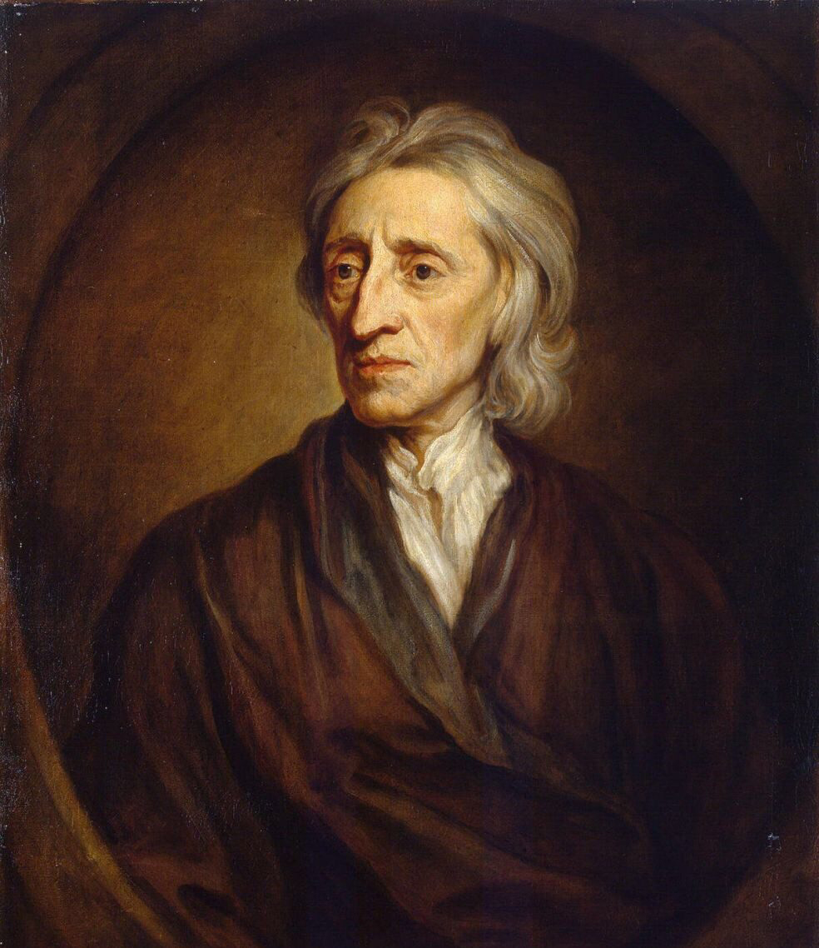
The legal argument, based on a myth that foragers live(d) in a state of Infantile simplicity, is based on John Locke’s “Second Treatise of Government (1690)
John Locke (1632 –1704) was an English philosopher and physician, widely regarded as one of the most influential of Enlightenment thinkers and commonly known as the "father of liberalism". Considered one of the first of the British empiricists, following the tradition of Francis Bacon, Locke is equally important to social contract theory. His work greatly affected the development of epistemology and political philosophy. His writings influenced Voltaire and Jean-Jacques Rousseau, and many Scottish Enlightenment thinkers, as well as the American Revolutionaries. His contributions to classical republicanism and liberal theory are reflected in the United States Declaration of Independence.
Unfortunately, Locke’s argument stated below that property rights necessarily derive from labor, that in working the land, one “mixes one’s labour” with it, and in this way, it becomes an extension of one’s self. Locke’s disciples felt that “lazy natives” were not “improving landlords”, but simply made use of the land to satisfy their basic needs with a minimum of effort. Locke, himself, argues that property is a natural right that is derived from labor. In Chapter V of his Second Treatise, Locke argues that the individual ownership of goods and property is justified by the labor exerted to produce such goods—"at least where there is enough [land], and as good, left in common for others" (para. 27)—or to use property to produce goods beneficial to human society.
Locke states in his Second Treatise that nature on its own provides little of value to society, implying that the labour expended in the creation of goods gives them their value. From this premise, understood as a labour theory of value, Locke developed a labour theory of property, whereby ownership of property is created by the application of labour. In addition, he believed that property precedes government and government cannot "dispose of the estates of the subjects arbitrarily". Karl Marx later critiqued Locke's theory of property in his own social theory.
This argument was the excuse of colonialists forcing natives to work. It is wrong, in many ways including an erroneous understanding of how native peoples modified the landscape through channeling water, modifying crops they foraged and adopting prey anmals as pets, among many other practices that imposed the stamep of the human upon Nature. [DE, p. 149]
Picture, Wikipeida: Portrait of Locke by Godfrey Kneller [1697].

Slide 27
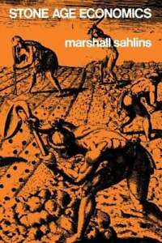
We should stop speaking of “foraging” altogether and refer instead to a different form of farming
What to a (European) settler’s eye seemed savage, untouched wilderness usually turns out to be landscapes actively managed by indigenous populatios for thousands of years through controlled burning, weeding, coppicing, fertilizing and pruning, terracing estuarine plots to extend habitat of particular wild flora, building clam gardens in intertidal zones to enhance the reproduction of shellfish, creating weirs to catch salmon, bass and sturgeon, and so on. Such procedures were often labour intensive, and regulated indigenous laws governing who could access groves, swamps, root beds, grasslands and fishing grounds, and who was entitled to exploit what species at any given time of year. In parts of Australia, those indigenous techniques of land management were such that according to one recent study, we should stop speaking of “foraging” altogether, and refer instead to a differening sort of farming. [DE, p. 150 based on an essay by Sahlins first presented at the “Man the Hunter” symposium, included in Marshall D. Sahlins, “Stone Age Economics” [1972].
Sometimes these indigenous property systems formed the basis for differential access to resources, with the result that something like social classes emerged. Usually, though, this did not happen, because people made sure tha it didn’t, much as they made sure chiefs did not develop coercive power. [DE, kp. 150]

Slide 28
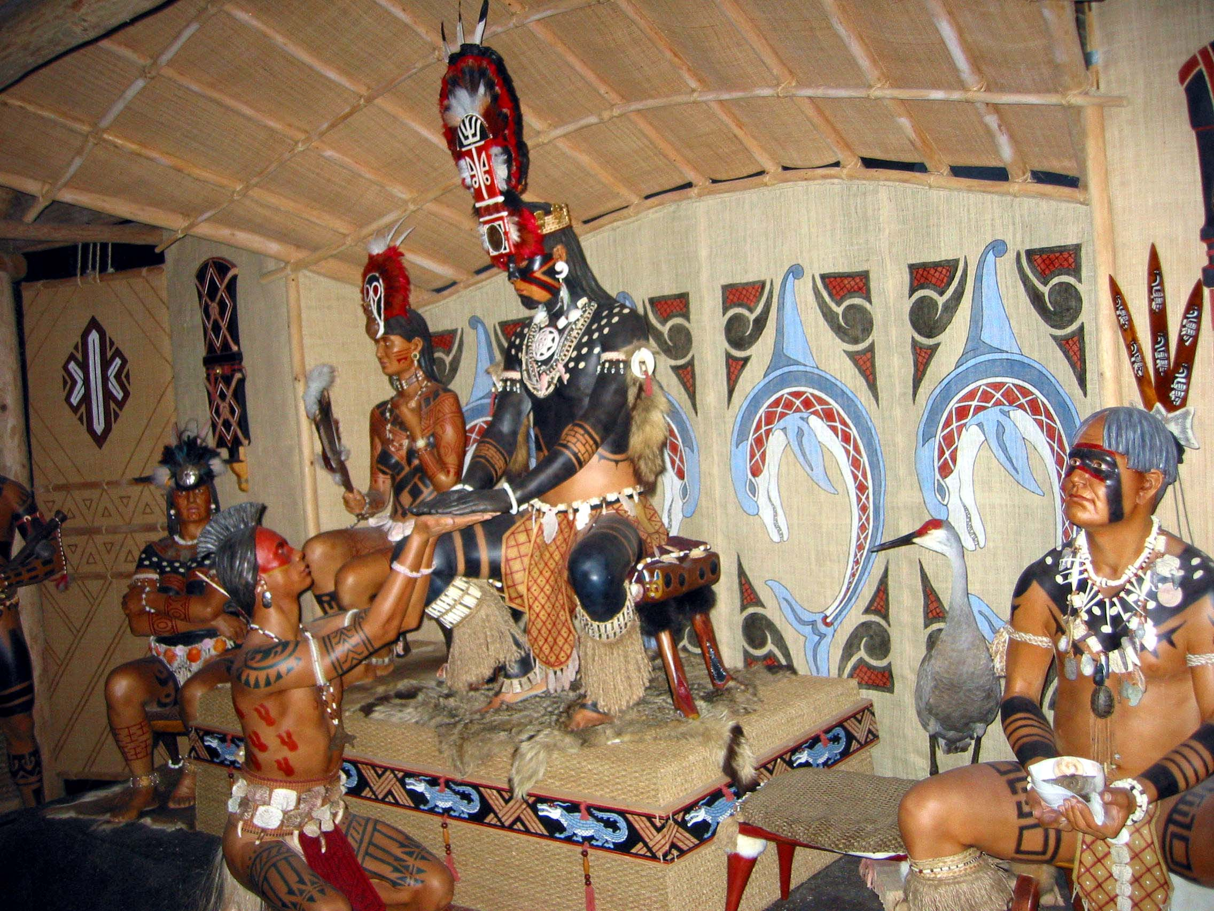
Calusa: inequality in a society that does no farming
The ruler--the king or paramount chief--wore a gold diadem and beaded leg bands and sat on a wooden throne—and crucially he was the only Calusa allowed to do so. His powers seemed absolute. His will was law, and insubordination was punishable by death. He was also responsible for performing secret rituals that ensured the renewal of nature. His subjects always greeted him by kneeling and raising their hands in a gesture of obeisance, and he was typically accompanied by representatives of of the ruling class of warrior nobles and priests, who, like him, devoted themselves largely to the business of government. [DE, p.151]
Picture, Wikepedia: Diorama of a Calusa chief at the Florida Museum of Natural History. Calusa society developed from that of archaic peoples of the Everglades region. Previous indigenous cultures had lived in the area for thousands of years. They developed a complex culture based on estuarine fisheries rather than agriculture. Paleo-Indians entered what is now Florida at least 12,000 years ago. By around 5000 BC, people started living in villages near wetlands. Favored sites were likely occupied for multiple generations. Florida's climate had reached current conditions and the sea had risen close to its present level by about 3000 BC. People commonly occupied both fresh and saltwater wetlands. Because of their reliance on shellfish, they accumulated large shell middens during this period. Many people lived in large villages with purpose-built earthwork mounds, such as those at Horr's Island. People began creating fired pottery in Florida by 2000 BCE. Undecorated pottery belonging to the early Glades culture appeared in the region around 500 BC. Pottery distinct from the Glades tradition developed in the region around AD 500, marking the beginning of the Caloosahatchee culture. This lasted until about 1750, and included the historic Calusa people. By 880, a complex society had developed with high population densities. The Calusa were descended from people who had lived in the area for at least 1,000 years prior to European contact, and possibly for much longer than that. The Calusa had a stratified society, consisting of "commoners" and "nobles" in Spanish terms. While there is no evidence that the Calusa had institutionalized slavery, studies show they would use captives for work or even sacrifice. The Calusa resisted physical encroachment and spiritual conversion by the Spanish and their missionaries for almost 200 years.
After suffering decimation by disease, the tribe was destroyed by Creek and Yamasee raiders early in the 18th century. All things being equal, those living off wild resources would tend to cleave to places where they were abundant. They were also among he first Native American societies to be destroyed since, for obvious reasons, coasts and estuaries were the first spots where Spanish colonizers landed.

Slide 29
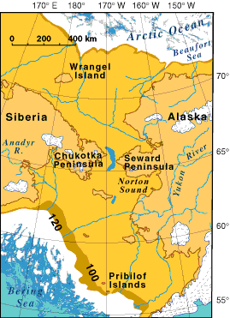
“Maybe some other guys came over like that , but us Navajos came a different way”
The slide title refers to what one Navajo informant put it when faced with an archaeological map of the terrestrial route via Berengeria. [Peter Nabokov, “Native views of history”, in The Cambridge History of Native Peoples of the Americas, 1996].
In fact, Eurasian populations made a much earlier entry to what was then a genuinely “New World”, some 17,000 years ago. What was more, they did indeed think to build boats, following a coastal route that passed around the Pacific Rim, hopping between offshore islands and linear patches of kelp forest and ending somewhere on the southern coast of Chile, often forming dense and stable settlements in such locations.
Map, Wikepedia: Bering land bridge – Wisconsin glaciation. The term Beringia was coined by the Swedish botanist Eric Hultén in 1937, from the Danish explorer Vitus Bering. During the ice ages, Beringia, like most of Siberia and all of North and Northeast China, was not glaciated because snowfall was very light. It was a grassland steppe, including the land bridge, that stretched for hundreds of kilometres into the continents on either side.

Slide 30
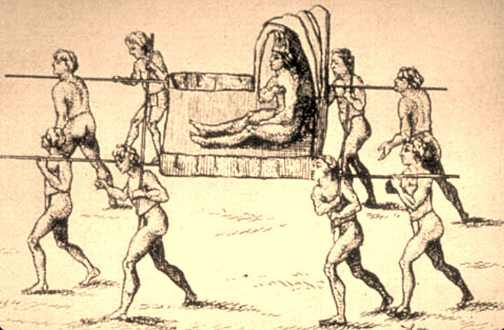
Some “Absolute” Monarchs in Indigenous Societies May in fact, not be so Absolute
The Natchez were an agricultural people. It appeared that their Sun King had unlimited power. His every movement was greeted by elaborate rituals of deference, bowing and scraping; he could order arbitrary executions, help himself go any of his subjects/ possessions, do pretty much anything he liked. Still, his powers were limited by his own physical presence, which in turn was largely confined to the royal village itself. Most Natchez did not live in the royal village; outside it, royal representatives were treated not more seriously than Montagnais-Naskapi chiefs in French Canada. If subjects weren’t inclined to obey these representatives’ orders, they simply laughed at them. [DE, pp. 156-157]
Picture, Wikipedia: "The Great Sun, Paramount Chief of the Natchez People" in Louisiana, in a 1758 drawing by Antoine-Simon Le Page du Pratz

Slide 31

In “free societies” there is a profound formal similarity between the notion of private property and the notion of the sacred. Both are essentially structures of exclusion
Woodburn noticed there was one striking exception to the rule that no adult should ever presume to give diredt orders to another, and that individuals should not lay private claim to property among immediate return hunter-gatherers. This exception came in the sphere of ritual, of the sacred. In Hadza religion and the religions of many Pygmy groups, initiation into male (and sometimes female) cults forms the basis of exclusive claims to ownership, usually of ritual privileges, that stand in absolute contrast to the minimization of exclusive property rights in everyday, secular life…Much of this is implicit in David Emile Durkheim’s [1858-1917, French sociologist] classic definition of “the sacred”, as that which is “set apart”, removed from the world, and placed on a pedestal, at some times literally and at other times figuratively, because of its imperceptible connection with a higher force or being. Daukheim argued that the clearest expression of the sacred was the Polynesian term tabu, meaning “not to be touched”. But when we speak of absolute, private property, are we not talking about something very similar—almost identical in fact, in its underlying logic and social effects. As British legal theorists like to put it, individual property rights are held, notionally at least, “against the whole world”, that is you can keep everyone out of your car, your house [unless they have a legal search warrant, of course]. That is what C. B.Macpherson [1911-1987], Canadian political scientist, means by “possessive individualism”,--just as eevery man’s home is his castle, so so your right not be killed, tortured or arbitrarily imprisoned rests on th idea that you won your own body.
Picture: James Woodburn (1934-2022), one of the best-known researchers and writers on hunter-gatherer and egalitarian societies. He conducted fieldwork in (then) Tanganyika, graduating in 1964 with a thesis entitled ‘Social organisation of the Hadza of North Tanganyika’. The Hadza remained his long-term field project; it was on the basis of this research that he developed his renowned insights into immediate- “immediate-return economic systems are characterized by a behavior and attitude which rejects the notion of surplus,” while “delayed-return systems, in contrast, allow for planning ahead.”

Slide 32
Ownership in Totemic Systems vs. Roman Law
It is not unusual for ethnographers working with indigenous Amazonian societies to discover that almost everything around them has an owner, or could potentially be owned, from lakes and mountains to cultivars, liana groves and animals. Such ownership always carries a double meaning of domination and care. To be without an owner is to be exposed, unprotected. In a totemic system such as in Austalia or North America, the responsibility of care takes on a particularly extreme form. Each human clan is said to “own” a certain species of animal—thus making them the “Bear clan”, “Elk clan”, Eagle clan” and so forth—but what this means is precisely that members of that clan cannot hunt, kill, harm or otherwise consume animals of that species. In fact, they are expected to take part in rituals that promote its existence and make it flourish.
What makes the Roman Law conception of property—the basis of almost all legal systems today—unique is that the responsibility to care and share is reduced to a minimum, or een eliminated entirely. In Roman Law there are three basic rights relating to possession: usus (the right to use), fructus (the right to enjoy the products of a property, for instance the fruits of a tree), and abusus (the right to damage or destroy). If one has only the first two rights this is referred to as usufruct, and is not considered true possession under the law. The defining feature of true legal property, then, is that one has the option of not taking care of it, or even destroying it at will. [DE, p. 161].

Slide 33
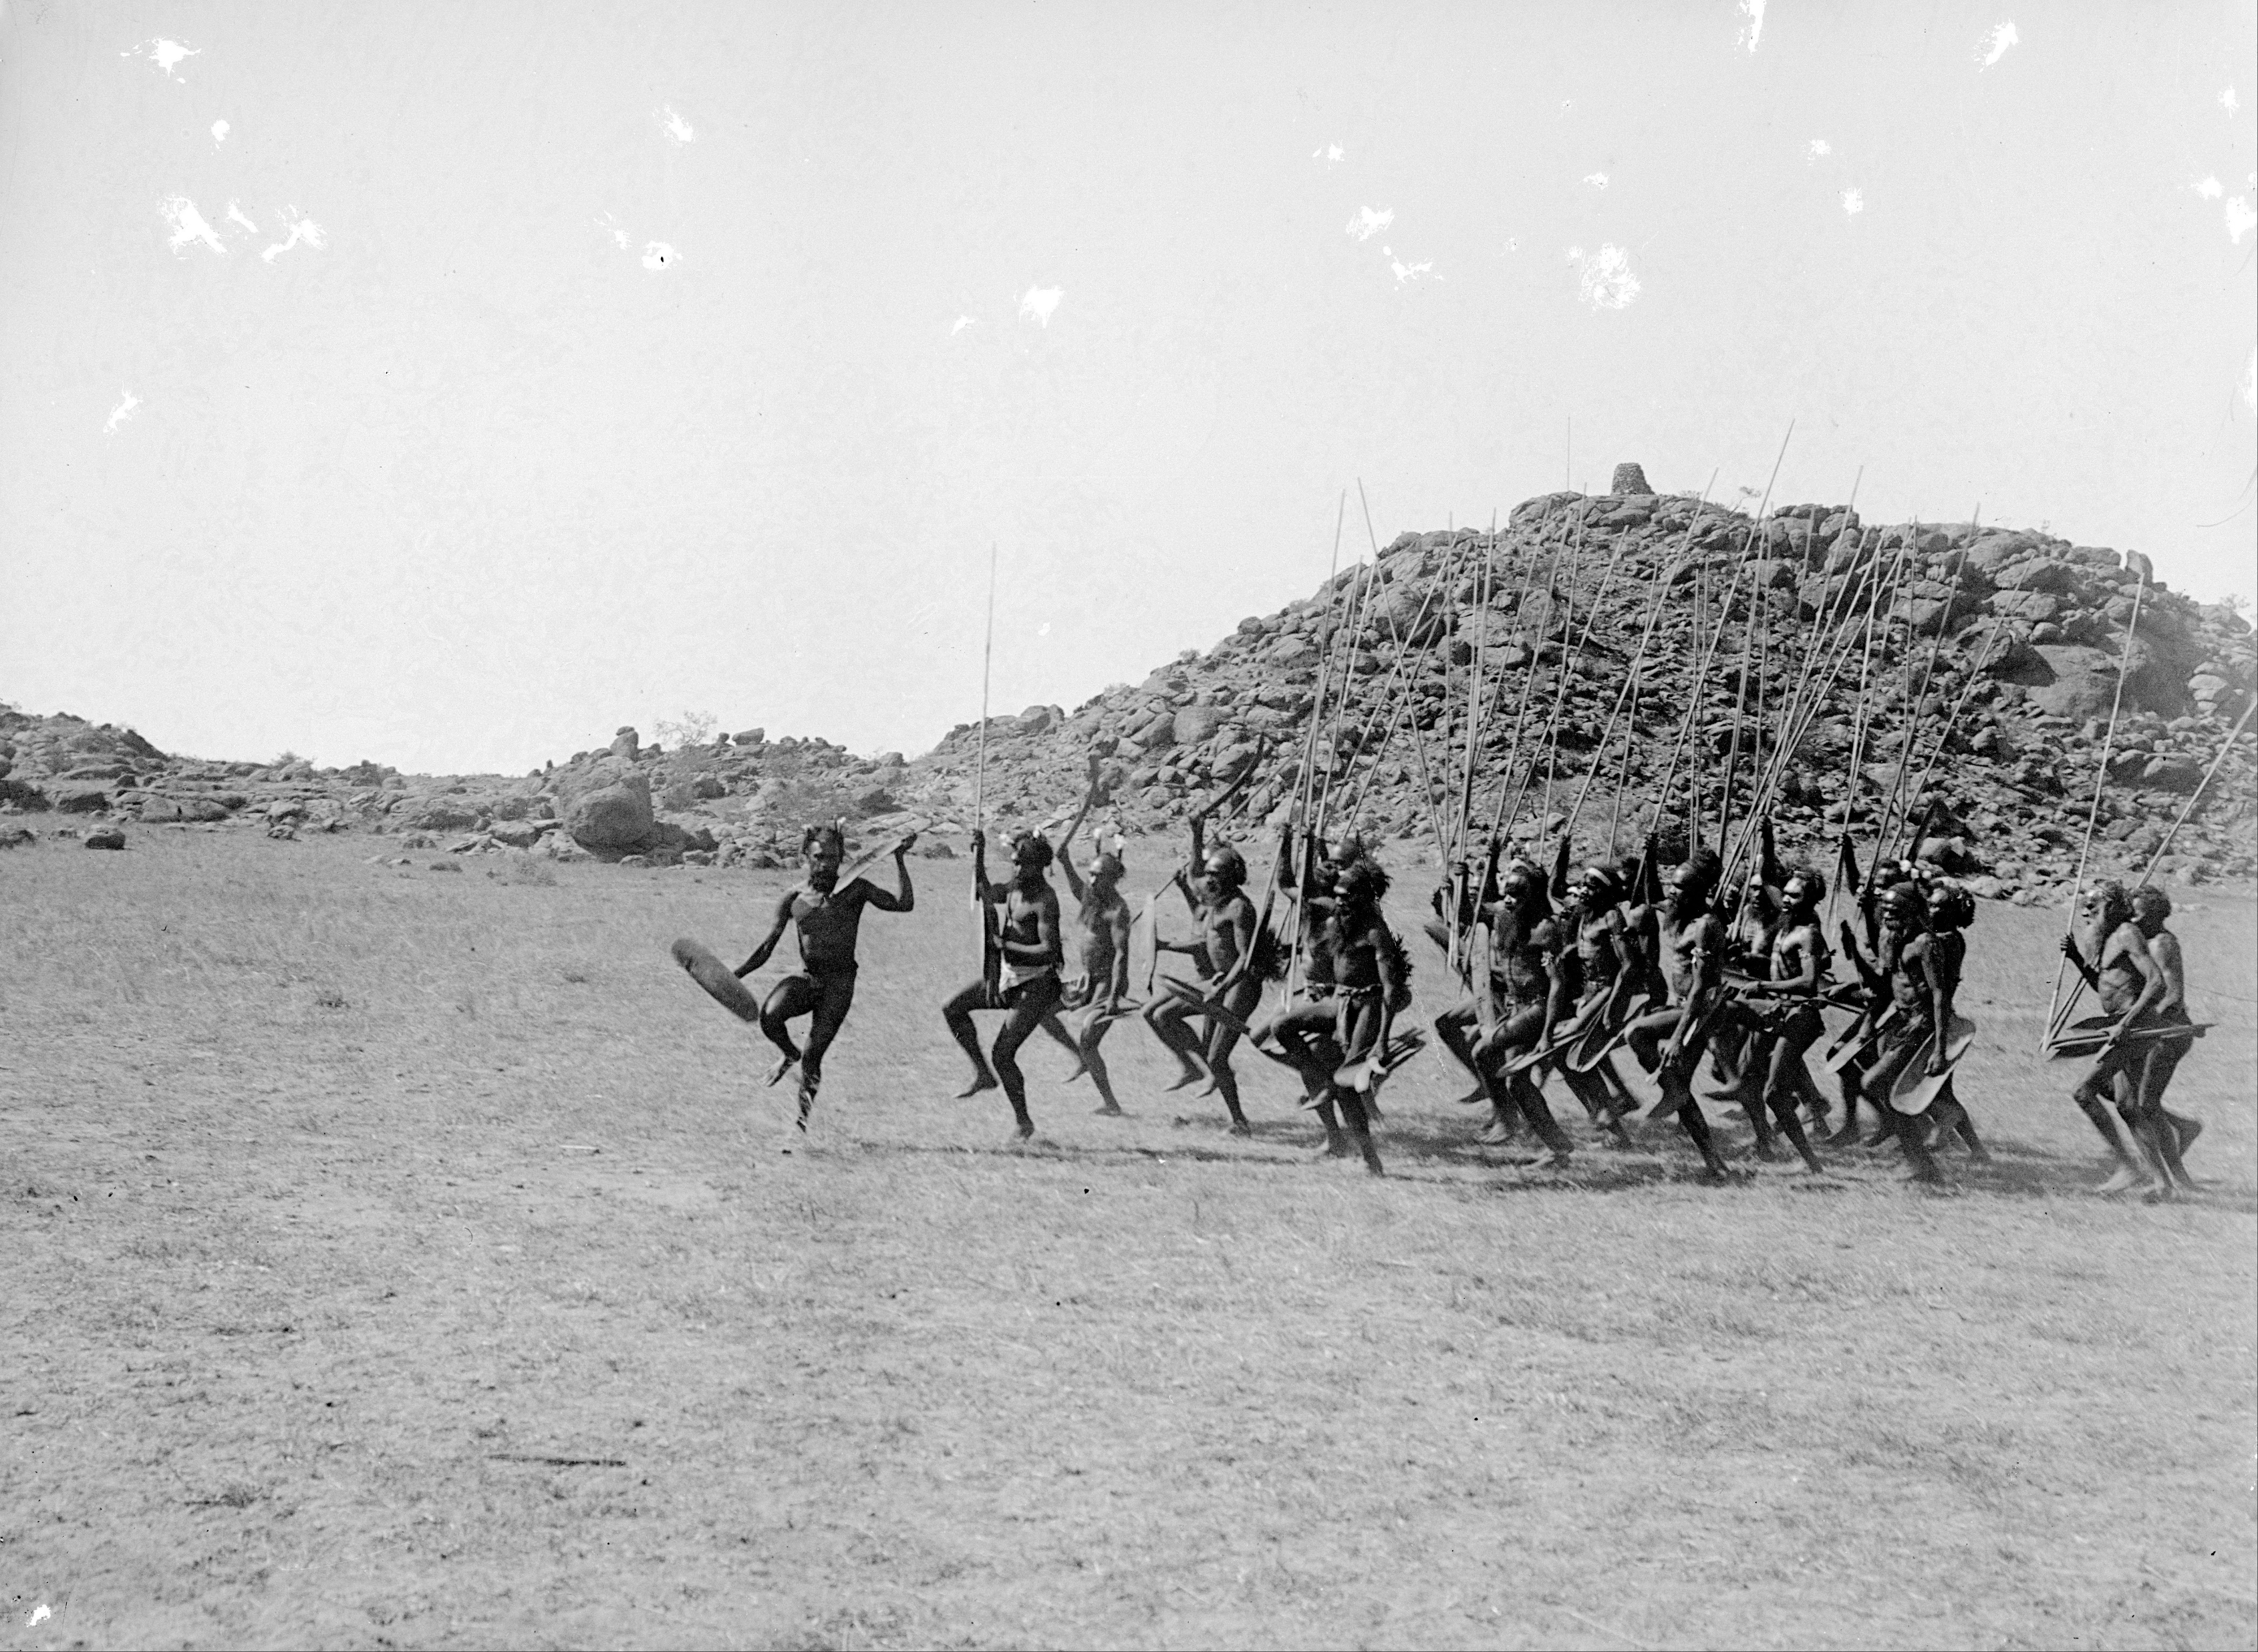
Behavior in ritual contexts takes the opposite form to free and equal relations in ordinary life among the Aranda
In the Aranda initiation rituals adult males of each clan act as guardians or custodians of particular territories. There are certain sacra, known as churinga or tsurinja by the Aranda, which are relics of ancestors who effectively created each clan’s territory in ancient times. During periodic rites of initiation, new cohorts of male Aranda youths are taught about the history of the land and the nature of its resources. The are also charged with the responsibility of caring for it…T. G. H. Strehlow [1908-1978], an anthropologist and foremost non-Aranda authority, observed that the weight of duty is conveyed through terror, torture and mutilation: “The deliberate cruelty with which the traditional initiation rites are carried out at a later age is carefully calculated to punish insolent and lawless boys for their past impudende and to train them into obedient, dutiful ‘citizens’ who will obey their elders without a murmur, and be fit heirs to the ancient traditions of their clan.” [Strehlow, “Aranda Traditions”, 1947]. Here is a painfully clear example of how behavior observed in ritual contexts takes exactly the opposite form to the free and equal relations that prevail in ordinary life. It is only within such contexts that exclusive (sacred) forms of property exist, strict and top-down hierarchies are enforced, and where orders given are dutifully obeyed. [DE, p. 162]
Photograph, Wikipedia: Arrernte welcoming dance, entrance of the strangers, Alice Springs, Central Australia, 9 May 1901. The Arrernte people, sometimes referred to as the Aranda, Arunta or Arrarnta, are a group of Aboriginal Australian peoples who live in the Arrernte lands, at Mparntwe (Alice Springs) and surrounding areas of the Central Australia region of the Northern Territory.

