Slide 1
The molecular history of life
Fall 2023

Slide 2
A short recap (session 1)
Earth is 4.5 billion years (Ga) old
about 4.4 Ga, the moon-forming impact turned the Earth into a ball of boiling lava
temperatures over 2,000°K forced all water from early accretion into the gas phase and converted all early accreted carbon to atmospheric carbon dioxide (CO₂)
By 4.2 to 4.3 Ga, the Earth had cooled sufficiently enough that there was liquid water
first oceans were about twice as deep as today’s
The first signs of life appear as carbon isotope signatures in rocks 3.95 billion years of age
Thus, somewhere on the ocean-covered early Earth and in a narrow window of time of only about 200 million years, the first cells came into existence

Slide 3
A short recap (session 2 and 3)
Prebiotic synthesis of organic compounds
The makings of the “rna world”
Rna inside lipid vesicles
Evolution of these vesicles into “protocells”
Bringing in proteins
The protoribosome
Emergence of the universal genetic code
The move towards more stable dna-based genomes

Slide 4
Where on earth is all this happening?
Prebiotic synthesis of the constituents of proteins, nucleic acids and membranes
Polymerization of nucleic acids and formation of fatty acid vesicles are driven by wet-dry cycles In environments of low salinity
Warm Little ponds: hot springs and fluctuating freshwater pools are plausible candidates for prebiotic sites supporting the assembly of protocells
Also, Membrane assembly occurs most readily in solutions with minimal content of salt, which suggests that cellular life began in fresh water pools associated with volcanic islands rather than submarine hydrothermal vents.
And this happens in numerous pools all over the planet and over many millions of years

Slide 5
The advantages of being small
Pools on land have access to multiple potential sources of biologically relevant organic compounds: meteorites, prebiotic synthesis
Whatever the source, if the organic compounds fall and are dispersed into the oceans, they would form a very dilute solution
In contrast, those same compounds falling on or synthesized at volcanic land masses exposed to the atmosphere would become concentrated on the mineral surfaces and then would be flushed into pools
Carbon dioxide and sulfur dioxide are major components of volcanic gases and are weak acids when dissolved in water. Therefore, the circulating water in hydrothermal fields is moderately acidic
Most phosphorus on earth is in the form of very stable and hard calcium phosphate (apatite, think teeth). But phosphates can leach out of apatite in acidic conditions
This would have made phosphate available for synthesis of nucleotides

Slide 6
Spreading (go west, young protocell)
Interconnected hot spring pools on mountainous volcanic landscapes have the obvious advantage that there is a continuous downhill flow from pool to pool driven by gravity, so that protocell populations can spread to other pools with distinct characteristics
Dehydrated films can also undergo windborne distribution, a mechanism still used today by microbial and algal mat communities
Droplets can also become airborne
Innovations developed in one pool can be shared with populations occupying another
Different environments put different sets of selective pressure to drive evolution of specific traits
Colonization becomes widespread

Slide 7
The protocell lifestyle
Protocells were fluid structures
forming, falling apart, reforming, fusing with one another
No hard boundaries with the environment: membranes were porous, fragile
Ribosomes were present but not fully developed → protein-making was sloppy
Genetic material was evolving into “useful” coding
Eventually solidifying in the universal genetic code
These protocells, in order to maintain structure, had to develop ways to harness energy (remember, metabolism to counteract entropy)

Slide 8
Harnessing energy
In this early environment, possible sources of energy:
Thermal energy → although theoretically it is possible to use thermal energy to link phosphate groups into more energetically dense compounds, so far this has not been ascertained as plausible in early earth scenarios
Sun → requires the evolution of pigments able to capture photons leading to an excited state; when this energy is released, it is used to form chemical bonds
Chemical energy in inorganic compounds → sulfur compounds, iron
Chemical energy in organic substrates → especially sugars (synthesized in abiotic conditions or released from protocells)
When it comes to harnessing energy, life is diversifying by leaps and bounds!

Slide 9
Atp: The energy currency of life
Whatever the source of energy (as in the previous slide), it is used to synthesize atp
Every reaction that requires energy in a living system uses atp as its primary energy source
Fun fact: the human body uses about its weight in ATP daily (we don’t eat it, we turn it over → synthesis and utilization). It’s not an energy bank deposit; it’s energy cash

Slide 10
Membranes are evolving
The simple lipid vesicles did not allow the movement of charged and/or large molecules
pores allow nutrient solutes to diffuse into the intracellular volume
First simple proteins (even a 15-amino acid polypeptide) could act as a pore
These provide the site for insertion of added domains to add substrate specificity etc. (again, the kludge factor)
Pores can move more than one compound
These channels coupled with atpases to allow active (i.e. energy-dependent) movement across the membrane

Slide 11
Biochemical capabilities are evolving
Metabolic Pathways for the Synthesis of nucleotides, amino acids, membrane components, etc.
Ribosomes are accruing domains resulting in more accurate protein synthesis
Rna Transcription and transcription initiation get more accurate
Dna genomes are stabilized and getting bigger
Proteins are evolving to package the larger dna genomes to fit into the protocell
Mechanisms for dna replication and proper segregation into daughter cells evolve

Slide 12
Is this an omnipotent ancestor???
Sounds too much like a miracle for comfort
All these inventions happen in parallel
It’s a Time of rampant innovation
These innovations are shared
The “omnipotent ancestor” is actually a community of cells freely exchanging information
This is a web of cells, pervading the biosphere, sharing the success stories!

Slide 13
What makes this sharing possible
Universal genetic code
Non-isolating, ‘permeable’ cell boundaries
Fusion of protocells
Picking up exogenous dna from the environment
The tangled roots of horizontal sharing through communal protocells can now support the growth of multiple interwoven branches as the tree of life begins to form

Slide 14
Crossing the Darwinian threshold (or picking from the pool)
As protocells become more complex, “communal living” becomes less tenable
The tangled web of protocells tend to coalesce into defined branches
Eventually, individual cells would become sufficiently advanced to survive and reproduce freely in solution, detached from their original communal complexes.
Rampant horizontal gene transfer is restricted
Vertical inheritance starts to predominate

Slide 15
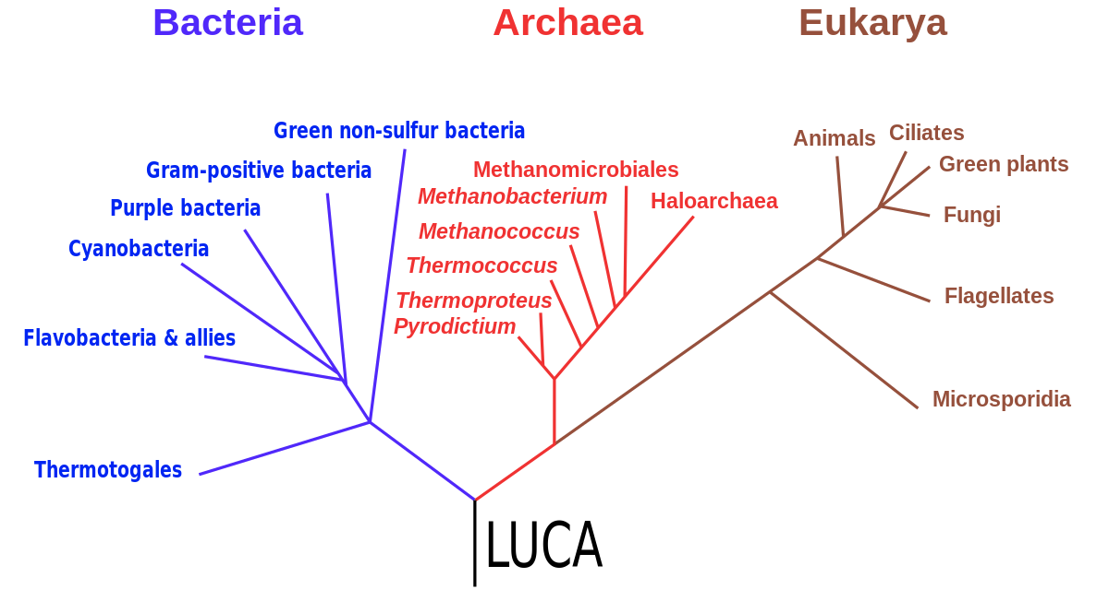
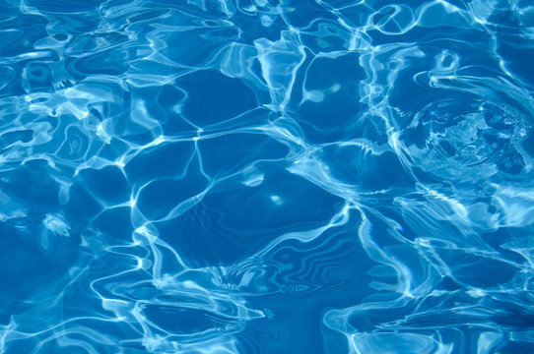

Slide 16
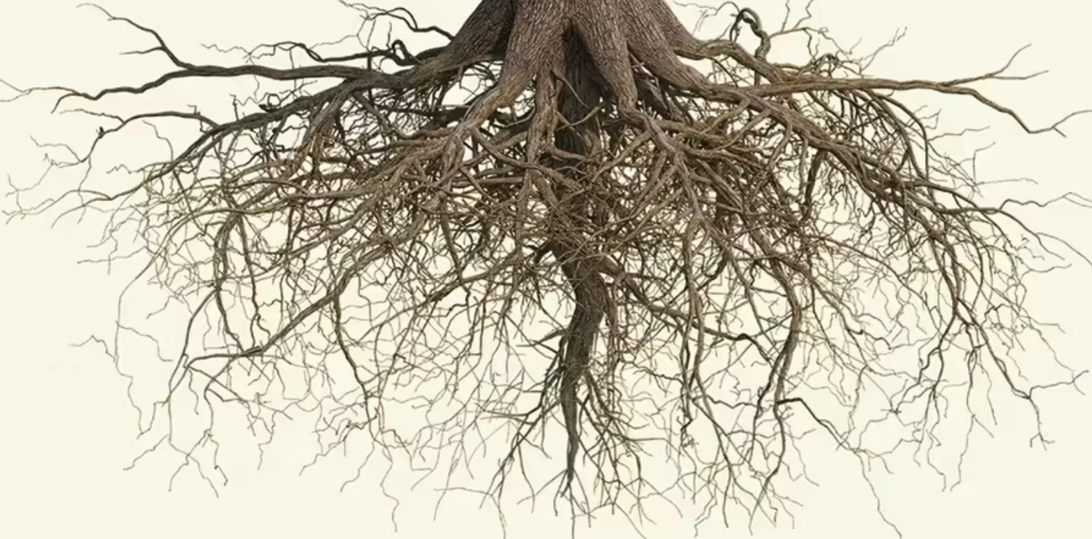
DARWINIAN THRESHOLD

Slide 18
Becoming a…
bacterium
Developing a robust cell wall
Defining the start points of rna synthesis (i.e. genes)
Dna packaging
Defining the bacterial membrane
Archaeum/eukaryote
Multiple solutions to the cell wall
Completely different transcription start machinery
Completely different dna packaging
Completely different membrane
Notes:
You need point B before you can consolidate a genome in pieces

