Slide 1
OLLI SPRING 2022 TRIUMVIRATE: America, Russia, and China As Global Actors and Rivals
Tuesday, March 22
Lecture 8
Winning International Hears, Minds, and Eyeballs
The Russia-Ukraine War

Slide 2
War reporter and UIUC alumnus Terrell Jermaine Starr will be visiting our campus in the week of April 18 https://www.politico.com/search?q=Terrell+Starr

Slide 3
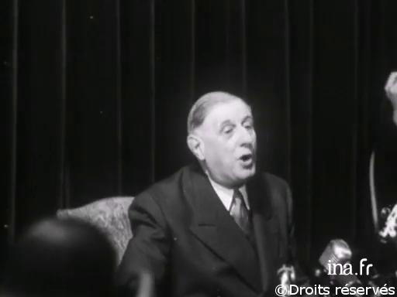
Charles de Gaulle speaking at a May 16, 1958 press conference during his assumption of power
“Why would I want to begin a career
as a dictator at the age of sixty-seven?”

Slide 4
Four days ago President Vladimir Putin, 69, spoke in Moscow’s Olympic stadium at a mass rally celebrating the seventh anniversary of Russia’s annexation of the Crimea

Slide 5
As is his charismatic practice, Putin kept the crowd of enthusiastic supporters at a distance while sporting a Loro Piana quilted down jacket priced at $6,195. In his address, he referred to Russian opponents of the war as national traitors

Slide 6
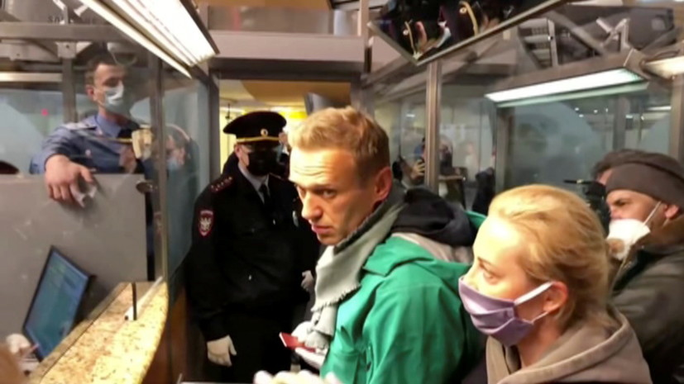
Alexei Navalny, the opposition leader incarcerated in a Russian labor camp, has been sentenced to an additional nine years in prison

Slide 7
Possible escalation of economic sanctions against Russia (Btw, currently more than a third of the world’s population is living under sanctions of various kinds)
Removing Russia’s most favored nation trade status in the United States
Excluding Russia from the G20 group of major economies
Banning Sberbank and Gazprombank from the SWIFT system
Embargo on delivery of Russian gas and oil to Europe
Complete ban on trade with Russia

Slide 8
Admiral James Stavridis on MSNBC’s Morning Joe: We are “one killer video away” from NATO intervention

Slide 9
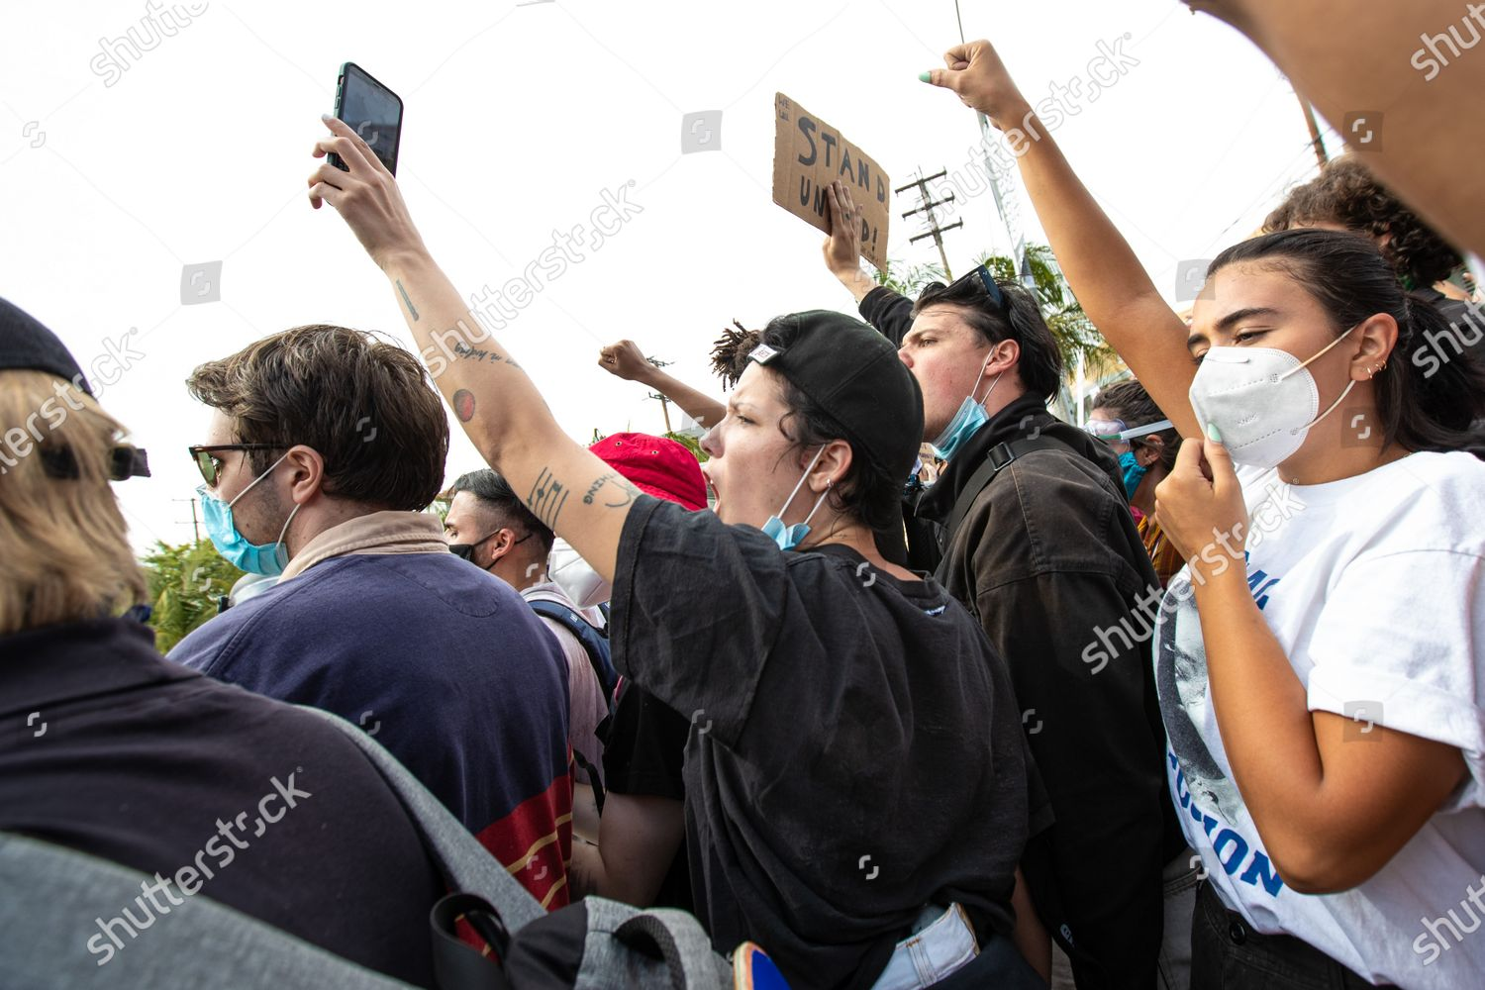
In the United States, protesters on the left and right use smart phones to record and disseminate. So do the anti-Russian demonstrators in the occupied territories of Ukraine

Slide 10
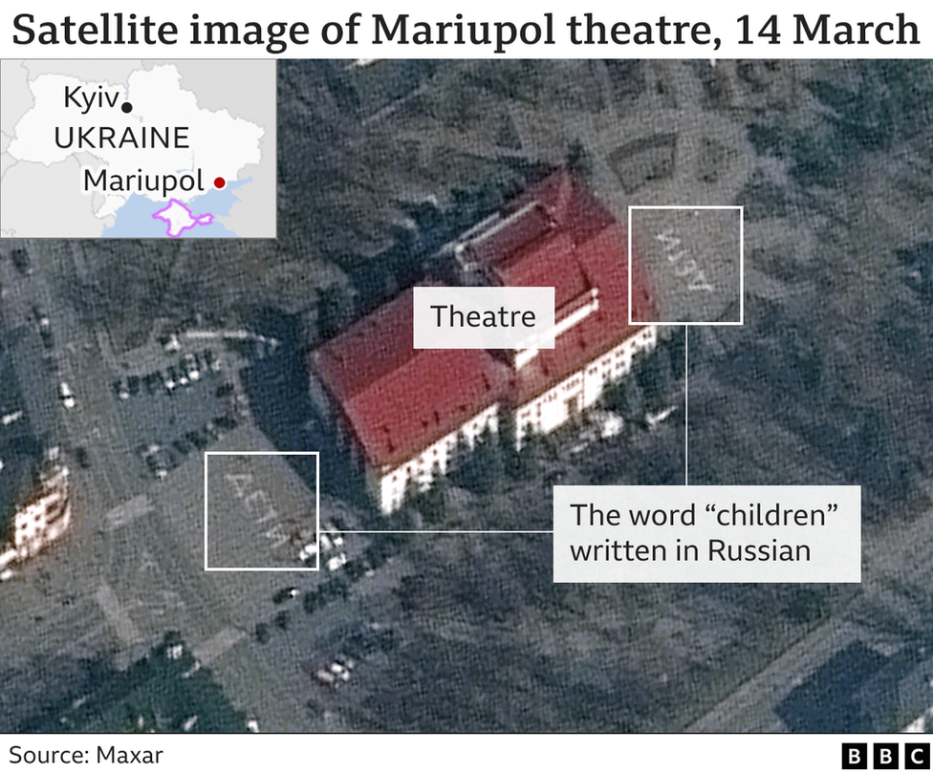
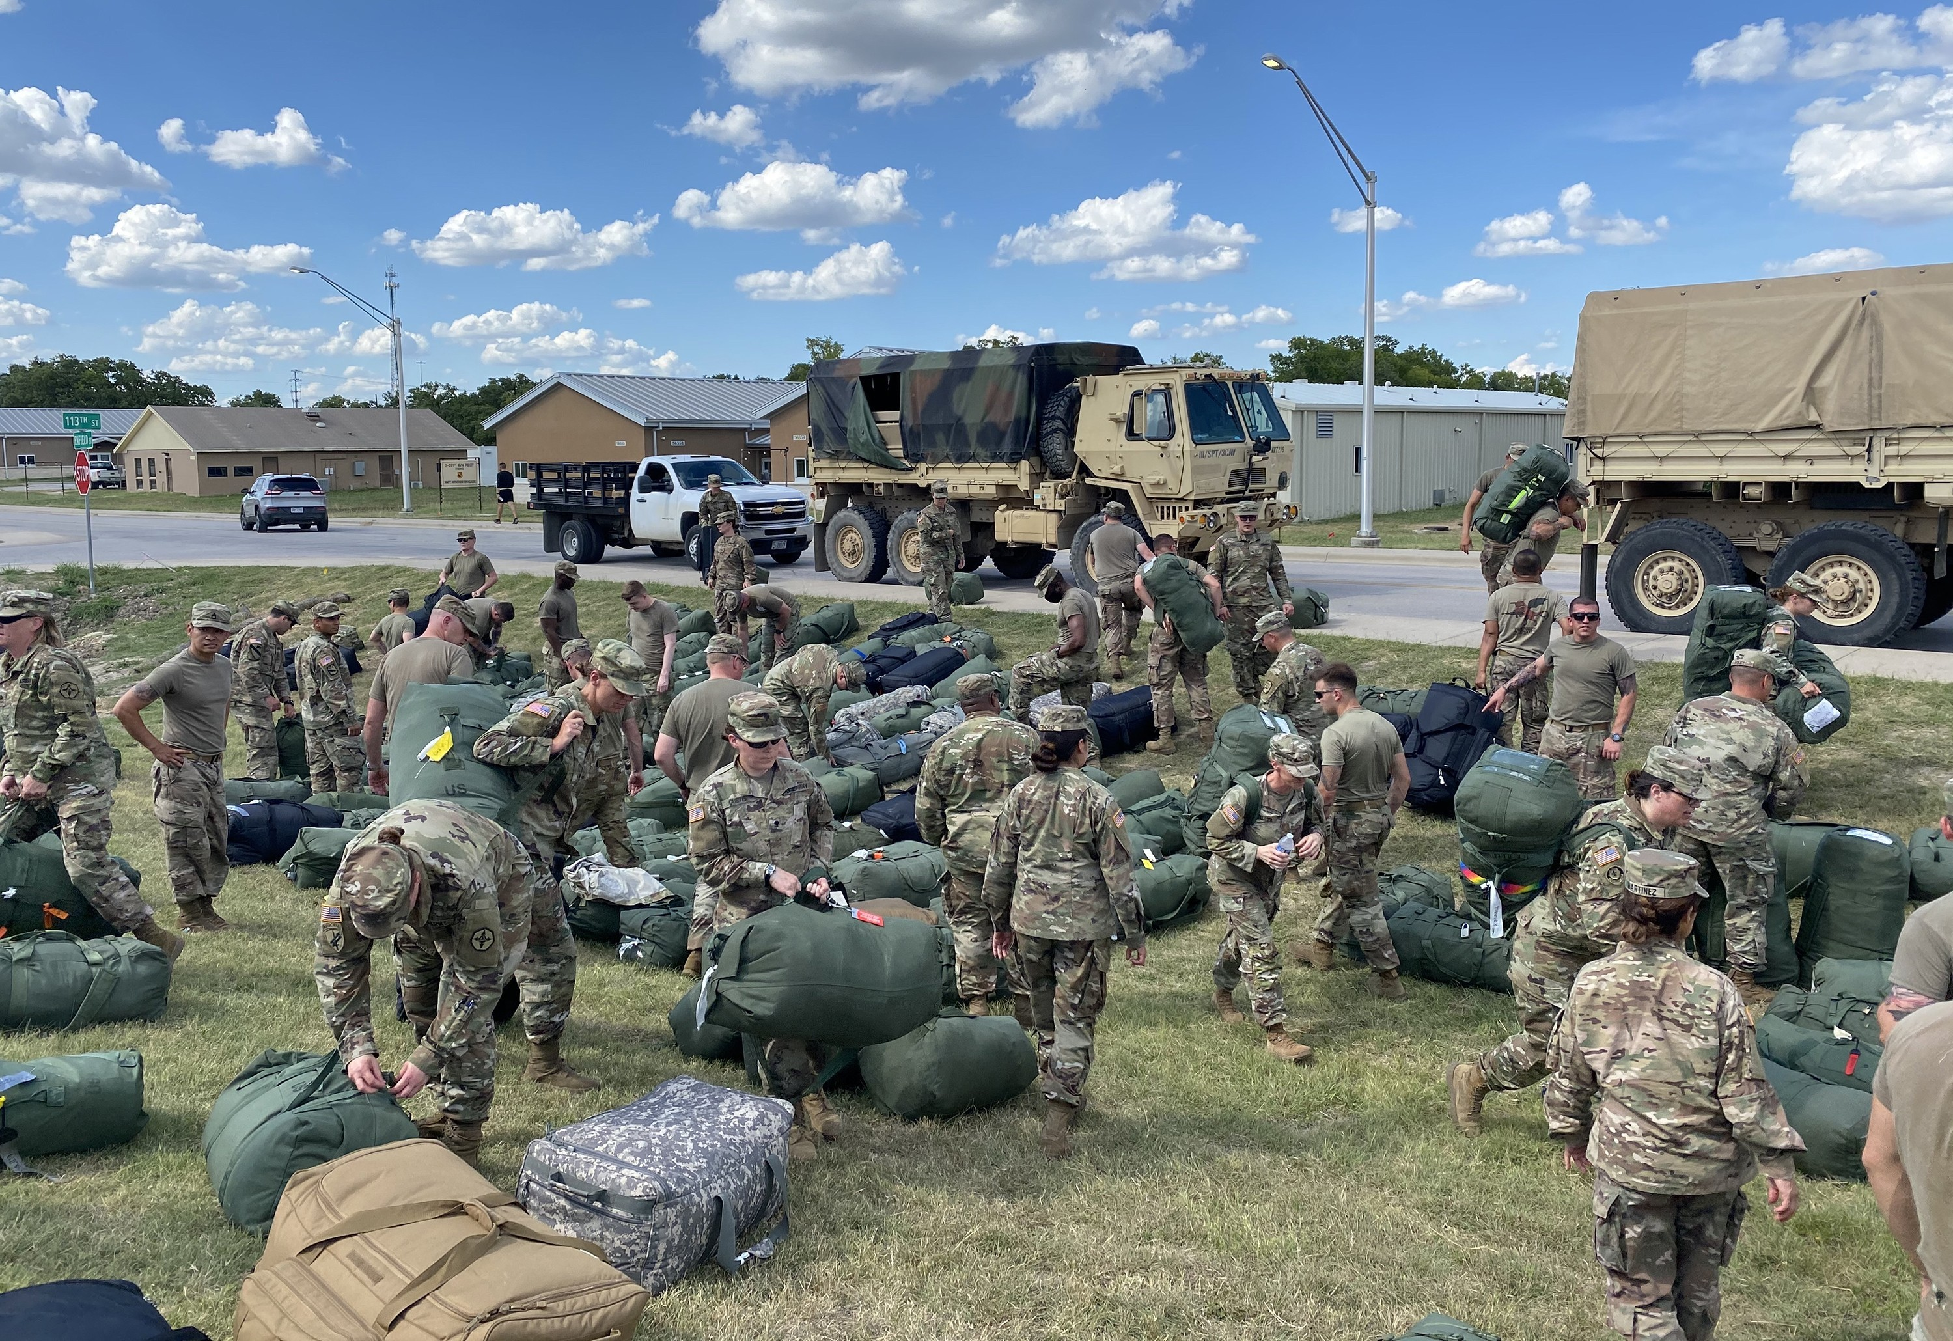
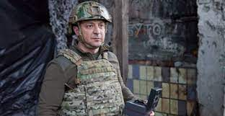
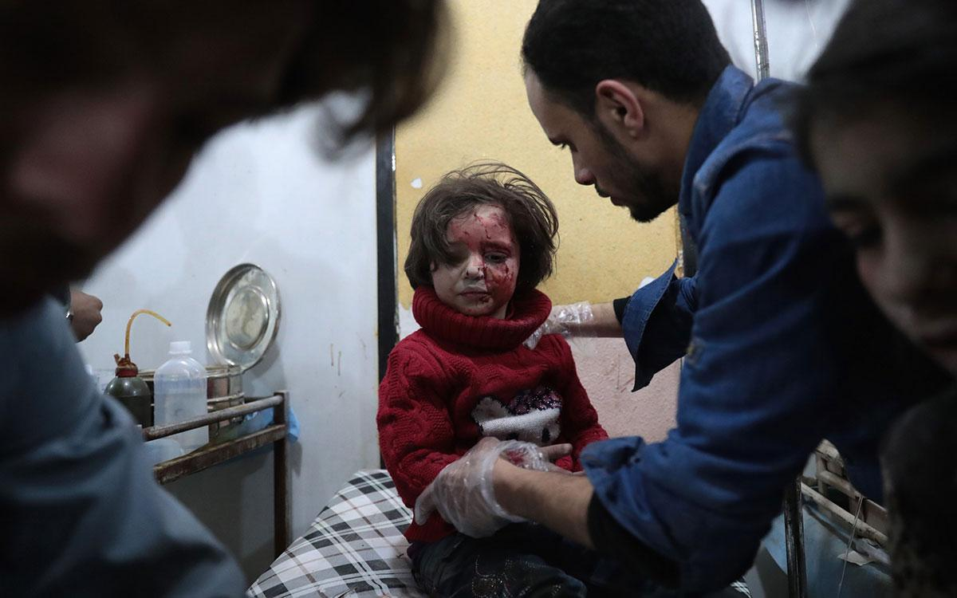
Triggers? From left to right: the Mariupol drama theater, which served as a shelter for 1500 civilians, Russian troops using stun grenades against protesters in Kherson, US troops at a military base in Poland, a young victim of a chemical attack in Syria, President Zelensky in helmet and flack jacket

Slide 11
The Sum of All Fears (2002) offers a frightening scenario for a nuclear confrontation between the United States and Russia
Military measures that the West may take
Offensive weapons supplied to Ukraine
A sea blockade (or quarantine) of Russia
A no-fly zone over part of Ukraine or the entire country
NATO troops as “peacekeepers” on Ukrainian territory

Slide 12
Another preemptive move by the United States: Yesterday President Biden warned American private business of the likelihood of Russian cyber attacks (check out the story of the NotPetya virus, released by Russia in 2017 to attack Ukrainian government agencies, transport networks, and cash machines. It also knocked out the radiation monitors at Chernobyl and led to a $1.4B lawsuit by pharmaceutical giant Merck against its insurers, who had refused to pay up. See The Economist, February 19, 2022, p. 54)

Slide 13
On March 17, Mariupol’s mayor’s office stated that 80% of the city’s living space had been destroyed

Slide 14
Okhtyrka train station

Slide 15
Boris Romantschenko, 96, a survivor of the Nazi concentration camps at Buchenwald, Peenemunde, Dora, and Belsen-Belsen, killed in Kharkiv on March 21 by a Russian shell. He was the vice-chairman of the International Committee Buchenwald-Dora

Slide 16
The fighting in Ukraine is now of a positional and attritional nature

Slide 17
Captain Andrei Palii, deputy commander of Russia’s Black Sea fleet, killed on March 21 near Mariupol. Earlier Palii served as deputy commander of Russian forces in Syria

Slide 18
Interim president Assimi Goïta of Mali, the West African nation that is facing a growing jihadist rebellion. The charismatic strongman took power, for the second time, on May 24, 2021. When his coup was condemned by the African Union and Western countries, he invited Russia’s Wagner group of military contractors into Mali, a move that proved popular with many Malians (photo on right)

Slide 19
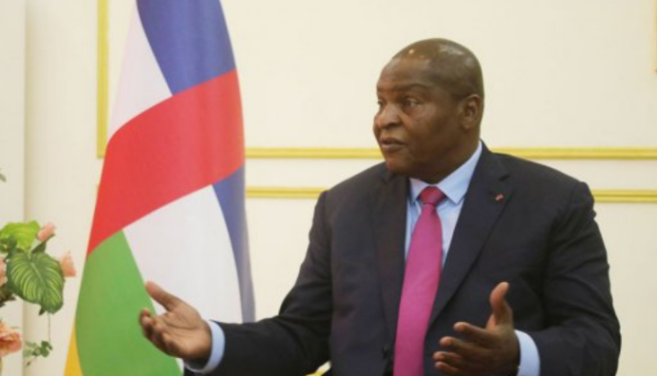
On March 1, Russian mercenaries started leaving the Central African Republic for the Ukrainian front. On left: A member of the SEWA security company, which is associated with the Wagner group, serving as bodyguard to CAR President Faustin-Archange Touadéra

Slide 20
Russia’s share of world GDP is projected to decline to 1.5% and its per capita GDP will fall below that of China for the first time in three centuries

Slide 21
Hunter Biden: son, entrepreneur, artist

Slide 22
Yelena Baturina, the construction magnate who has been ranked as Russia’s richest woman for the last fourteen years, allegedly paid $3.5M into a bank account associated with Hunter Biden and his business partner Devon Archer. Baturina’s business dealings and political standing have been the subject of much speculation. We should note that unlike other Russian oligarchs, so far she has not been sanctioned by the US government

Slide 23
Putin comforts Baturina at the funeral service for her husband, former Moscow mayor Yuri Luzhkov, in the Cathedral of Christ the Savior in December 2019. That year Forbes magazine estimated her fortune at $1.2B

Slide 24
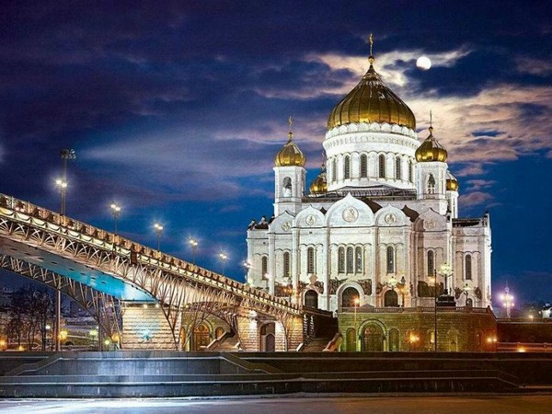
After the fall of the Soviet Union, Luzhkov and his wife were closely associated with the rebuilding of the cathedral, which was blown up by the communists in 1931

Slide 25
“The friendship between the Russian Federation and China knows no limits”

Slide 26
A solitary Putin watching the opening of the Beijing Winter Olympics

Slide 27
Presidents Biden and Xi conferring by video on March 18

Slide 28
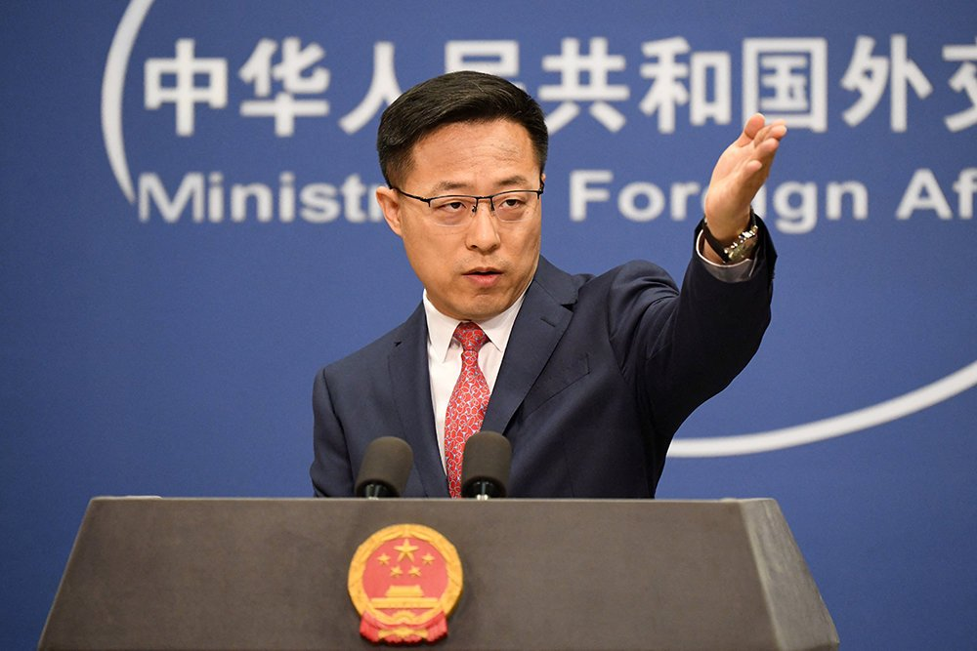
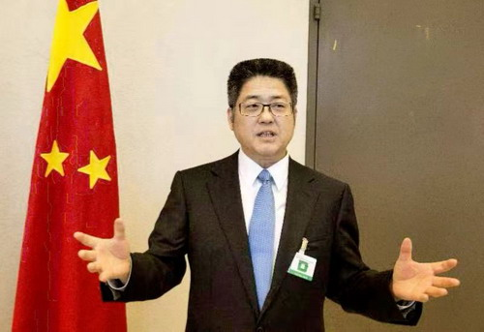
Following the video conversation between Biden and Xi, China’s foreign minister Wang Yi (on left) declared that his country stands “on the right side of history” and “will never accept any external coercion or pressure.” For his part, Vice Foreign Minister Le Yucheng (center) called Western sanctions on Russia “outrageous” (both statements dated March 19). Earlier, however, Yi said that “China is not a party to the crisis in Ukraine and wishes to prevent [Western] sanctions from impacting China.” And foreign ministry spokesman Zhao Lijiang (on right) voiced support for the words of China’s ambassador to Kyiv who had said that his country “will never attack Ukraine”

Slide 29
On March 1, Gazprom stated that it had signed a contract for the construction of a pipeline to China capable of delivering up to 1.8 trillion cubic feet of gas via Mongolia

Slide 30
On March 11, Russia was told by China it will not be supplying spare parts for its Western-made civilian aircraft

Slide 31
With a 70% decline in activity at Moscow’s Sheremetevo airport, 20% of its personnel have been furloughed (March 21)

Slide 32
Vlogger Wang Jixiang, 36, a resident of Odessa, is giving the Chinese mainland audience a different perspective on the war in Ukraine

Slide 33
“I don’t understand where all these military analysts come from, after all, they used to be ordinary virologists”

Slide 34
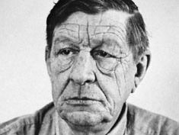
W.H. Auden, “September 1, 1939” (excerpt)
I sit in one of the dives On Fifty-second Street Uncertain and afraid As the clever hopes expire Of a low dishonest decade: Waves of anger and fear Circulate over the bright And darkened lands of the earth, Obsessing our private lives; The unmentionable odour of death Offends the September night.
Accurate scholarship can Unearth the whole offence From Luther until now That has driven a culture mad, Find what occurred at Linz, What huge imago made A psychopathic god: I and the public know What all schoolchildren learn, Those to whom evil is done Do evil in return.
Exiled Thucydides knew All that a speech can say About Democracy, And what dictators do, The elderly rubbish they talk To an apathetic grave; Analysed all in his book, The enlightenment driven away, The habit-forming pain, Mismanagement and grief: We must suffer them all again.
Into this neutral air Where blind skyscrapers use Their full height to proclaim The strength of Collective Man, Each language pours its vain Competitive excuse: But who can live for long In an euphoric dream; Out of the mirror they stare, Imperialism's face And the international wrong.
Faces along the bar Cling to their average day: The lights must never go out, The music must always play, All the conventions conspire To make this fort assume The furniture of home; Lest we should see where we are, Lost in a haunted wood, Children afraid of the night Who have never been happy or good.

Slide 35
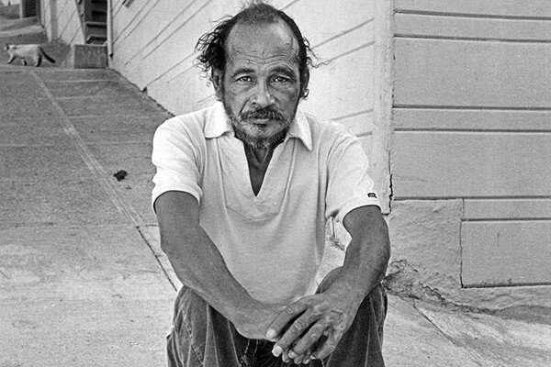
Bob Kaufman, “Believe, Believe”
Believe in this. Young apple seeds, In blue skies, radiating young breast, Not in blue-suited insects, Infesting society’s garments. Believe in the swinging sounds of jazz, Tearing the night into intricate shreds, Putting it back together again, In cool logical patterns, Not in the sick controllers, Who created only the Bomb. Let the voices of dead poets Ring louder in your ears Than the screechings mouthed In mildewed editorials. Listen to the music of centuries, Rising above the mushroom time.

