Slide 1
OLLI SPRING 2022 TRIUMVIRATE: America, Russia, and China As Global Actors and Rivals
Tuesday, March 15
Lecture 7
Winning International Hears, Minds, and Eyeballs
The Russia-Ukraine War

Slide 2
Remarks to the press by UN secretary general António Guterres on March 14, 2022 included these two statements about the Russia-Ukraine conflict, “It keeps getting worse” and “Whatever the outcome, this war will have no winners, only losers”

Slide 3
Among the EU’s 27 member states, the presidents of Bulgaria, Czechia, Estonia, Latvia, Lithuania, Poland, Slovakia, and Slovenia recently called for the immediate admission of Ukraine. Germany and the Netherlands, on the other hand, have been especially reluctant to speed up the application process

Slide 4
Prime ministers Mateusz Morawiecki (Poland), Petr Fiala (Czechia), and Janez Jansa (Slovenia) traveling today to Kiev to meet with President Volodymyr Zelensky and Prime minister Denys Shmyhal

Slide 5
…while Zelensky is scheduled to deliver a virtual address a joint session of the US Congress on Wednesday, March 16

Slide 6
Pope Francis preaching against the war in St. Peter’s Square on Sunday, March 14, 2022

Slide 7
…when he said
Faced with the barbarity of the murder of children, innocents and civilians, there are no strategic reasons that can be upheld. All that remains is to stop the unacceptable armed aggression before it reduces cities to cemeteries.
With pain in my heart, I join my voice to those of the common people who implore the end of the war. In the name of God, may the cry of the suffering be heard, and an end be put to the bombings and attacks.

Slide 8
Earlier, on March 6, Patriarch Kirill of the Russian Orthodox Church…

Slide 9
…preached in support of the invasion in Moscow’s Cathedral of Christ the Savior
For eight years efforts have been in train to destroy that which exists in Donbas [a reference to the two pro-Russian separatist enclaves]. In Donbas we have seen a principled refusal to accept the so called values that are being advanced by those who strive for global power. Today that power offers a loyalty test, an entry ticket into the happy world of excessive consumption and seeming freedom. This test is a very simple and very terrible one: a gay pride parade.

Slide 10
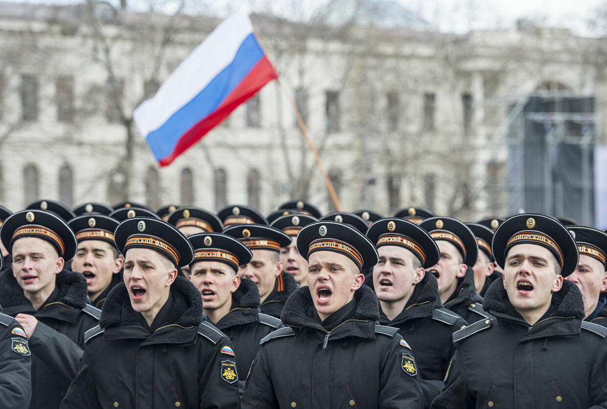
…or translated into different terms…

Slide 11
Operation Punishment, April 6, 1941

Slide 12
The martyrdom of Mariupol

Slide 13
Military situation as of March 14, 2022 For further information about the war, go to https://www.criticalthreats.org/ and https://www.bellingcat.com/

Slide 14
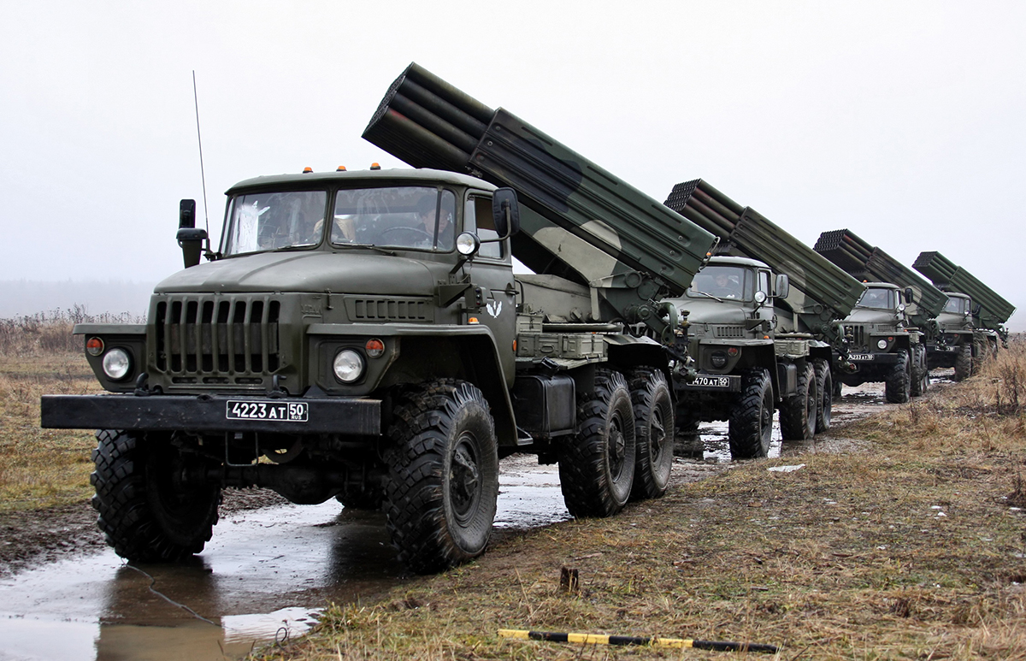
Russian superiority is telling in air power, armor, artillery, and short- and medium-range missiles. On left: camouflaged Iskander short-range mobile launch system (carries two missiles, max. range 30 miles). On right: Grad 122 mm multiple rocket launchers (max. range 28 miles). So far the West has refused to supply Ukraine with offensive weapons

Slide 15
Russia has confirmed the death of Major General Andrei Kolesnikov (center), commander of 29th army. On right: Major General Andrei Sukhovetsky, deputy commander of 41st army, reportedly killed on 02.28.2022. On left: Major General Vitaly Gerasimov, another deputy commander of the 41st, reportedly killed on 03.07.2022. Kolesnikov would be the third Russian general (out of an estimated 20) to lose his life in Ukraine. Such a high attrition rate is indicative of the savagery of the fighting

Slide 16
Military base close to Polish border attacked on March 13

Slide 17
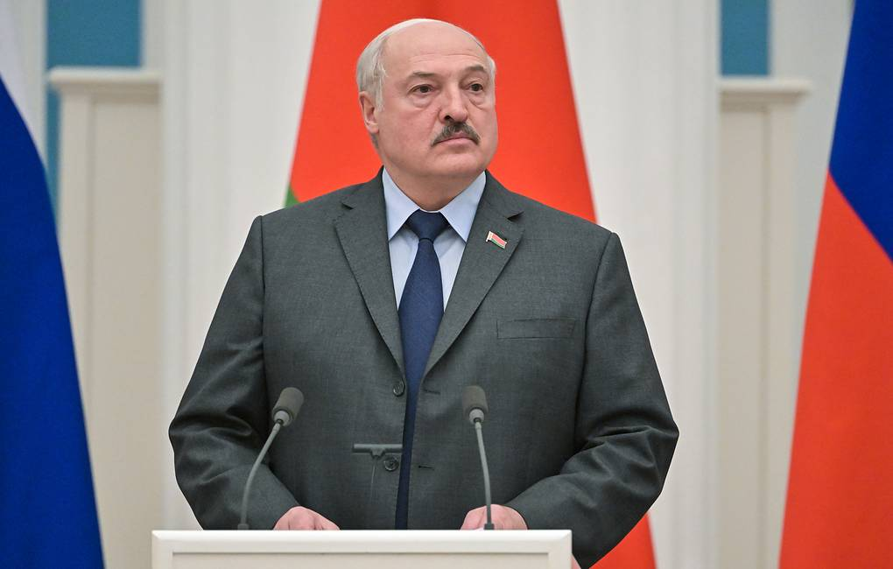
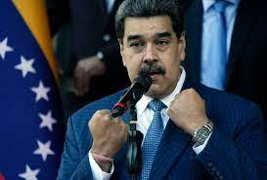
Hour of the Moustache

Slide 18
Francis Fukuyama’s take on the Russia-Ukraine war, published on March 10, 2022. For the full text, go to https://www.americanpurpose.com/articles/preparing-for-defeat/
Russia is heading for an outright defeat in Ukraine. Russian planning was incompetent, based on a flawed assumption that Ukrainians were favorable to Russia and that their military would collapse immediately following an invasion. Putin at this point has committed the bulk of his entire military to this operation. Russian troops are stuck outside various Ukrainian cities where they face huge supply problems and constant Ukrainian attacks.
The collapse of their position could be sudden and catastrophic, rather than happening slowly through a war of attrition.
There is no diplomatic solution to the war possible prior to this happening.
The United Nations Security Council has proven once again to be useless. The only helpful thing was the General Assembly vote, which helps to identify the world’s bad or prevaricating actors.
The Biden administration’s decisions not to declare a no-fly zone or help transfer Polish MiGs were both good ones. It is much better to have the Ukrainians defeat the Russians on their own, depriving Moscow of the excuse that NATO attacked them, as well as avoiding all the obvious escalatory possibilities.
Putin will not survive the defeat of his army. The invasion has already done huge damage to populists all over the world, who prior to the attack uniformly expressed sympathy for Putin.
The war to this point has been a good lesson for China. Like Russia, China has built up seemingly high-tech military forces, but they have no combat experience. The miserable performance of the Russian air force would likely be replicated by the People’s Liberation Army Air Force. We may hope that the Chinese leadership will not delude itself as to its own capabilities the way the Russians did when contemplating a future move against Taiwan.
Hopefully Taiwan itself will wake up as to the need to prepare to fight as the Ukrainians have done, and restore conscription.
Turkish drones will become bestsellers.
A Russian defeat will make possible a “new birth of freedom,” and get us out of our funk about the declining state of global democracy.

Slide 19
The Russian army appears to have violated most of Sun Tzu’s or Napoleon’s principles of wise generalship

Slide 20
How Ukraine won the global information war
Publicized its cause in simple, clear terms accessible not just to a national but global audience. Russian propaganda, on the other hand, is aimed at the generic pro-Putin voter. Even when it is broadcast in English
In Zelensky, found its man of the moment: an inspirational, charismatic leader
With Western help, kept preempting the Russian narrative
Welcoming to Western news media
Cleverly intertwined its own narrative with the Western one, presenting Ukraine as a plucky European democracy fighting against a sinister, backward tyranny on behalf of the free world

Slide 21
The policy of diplomatic preemption: at every step of the conflict, the United States has used its intelligence not just to send public and private signals to Russia and China, but to impact their diplomatic and military decisions. Photo shows National Security Advisor Jake Sullivan, who believes in a policy of managing the US-China relationship (“competition as a condition to be managed rather than a problem to be solved,” he wrote in 2019) through a judicious mix of confrontation and cooperation

Slide 22
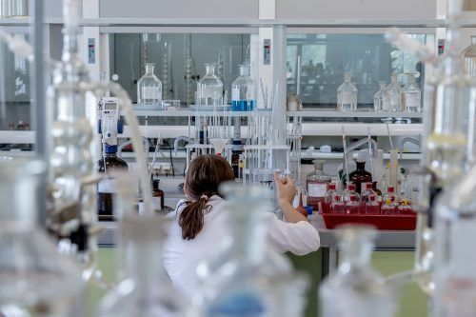
Ukraine may be winning the information war globally, but inside Russia the Ukrainians-are-Nazis narrative continues to dominate. On left: Ukrainian president Volodymyr Zelensky addressing the British House of Commons. On right: photograph in Kopeiskii rabochii, a local Russian newspaper, purporting to show a Ukrainian bioweapons lab

Slide 23
Z is for Zombie

Slide 24
The number of antiwar demonstrators arrested in Russia has reportedly reached 14,000. Below: Antiwar protester Marina Ovsyannikova disrupting a live TV news broadcast as anchor Ekaterina Andreeva articulates the Kremliln line

Slide 25
Russian POWs at a press conference in Kiev

Slide 26
Ukrainian POWs shown on Russian state television

Slide 27
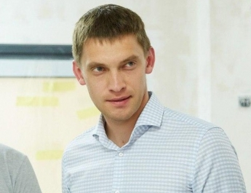
Melitopol mayor Ivan Fedorov (on left) has been apparently abducted by Russian forces. Galina Danilchenko, the city’s new Russian-installed mayor, is a member of a pro-Russian opposition party

Slide 28
Russian foreign minister Sergei Lavrov tearing up an innocent earphone cable (on left) after meeting his Ukrainian counterpart, Dmytro Khaleba in Antalya, Turkey on March 10. Lavrov may have been worrying about his Columbia-educated daughter Ekaterina (center) as well as the fate of his mistress Svetlana Polyakova and stepdaughter Polina, who reside in Britain (on right). On a more diplomatic note, Russia’s foreign minister took the opportunity to declare that his country had never attacked Ukraine

Slide 29
“Putin can bring his bear”

Slide 30
The Taiwan Semiconductor Manufacturing Company, with a market capitalization of $514B (as of today), is the chief supplier of the world’s most sophisticated semiconductors. The three great power triumvirs are heavily depended on this source of microchips

Slide 31
The geopolitical attractions and moral perils of geometric diplomacy

Slide 32
Chinese statements on Russia-Ukraine war have shown a shift in tone, as has state media reporting of the conflict. In recent days Chinese media, previously reluctant to reach out to the Ukrainian leadership, have been requesting interviews with President Zelensky and his advisors including Alexei Arestovich (see Lecture 6). Nonetheless, China still refuses to call Russia’s actions in Ukraine an invasion and continues to denounce Western sanctions against Russia. Below: President Xi Jinping, shown during a virtual meeting with French President Macron and German Chancellor Scholz on March 9

Slide 33
China’s calculus
Near Term
Managing relationship with its fellow-triumvirs, which includes nailing down status as the United States’ indispensable interlocutor and trying to secure position at apex of this diplomatic triangle
Dealing with Covid (major outbreak of Omicron happening right now with 5000 new cases confirmed today; lockdown in Jilin province; Beijing, Shanghai, Shenzen affected)
Reputational gain/loss globally
Long Term
Reassessing and improving combat readiness of People’s Liberation Army in light of weaknesses in Russian military performance
Continuing economic growth, which requires international stability and expansion of foreign trade
Guaranteeing full employment
Common Prosperity policy
Soft-power component of foreign policy (Belt and Road initiative)
Enhancing presence in East and South-East Asia as well as ex-Soviet Central Asia
Reducing Russia to junior partner status. Access to Russian territory in Far East and Siberia, as well as Russian natural resources
Recovery of Taiwan

Slide 34
Anarchist squatters occupy Oleg Deripaska’s London home in Belgrave Square

