Slide 1
OLLI SPRING 2022 TRIUMVIRATE: America, Russia, and China As Global Actors and Rivals
Tuesday, March 8
Lecture 6
States of Laws vs States of Rules
The Russia-Ukraine War

Slide 2
“Looking out for a Hero.” From a moderately popular head of state destined perhaps to be another one-time president, former comedic actor Volodymyr Zelensky has morphed into a charismatic symbol of Ukrainian resistance and, indeed, statehood

Slide 3
…while Vladimir Putin continues his sequence of unusual TV appearances, including this luncheon with a group of (newly unemployed) flight attendants around that famous mile-long table.

Slide 4
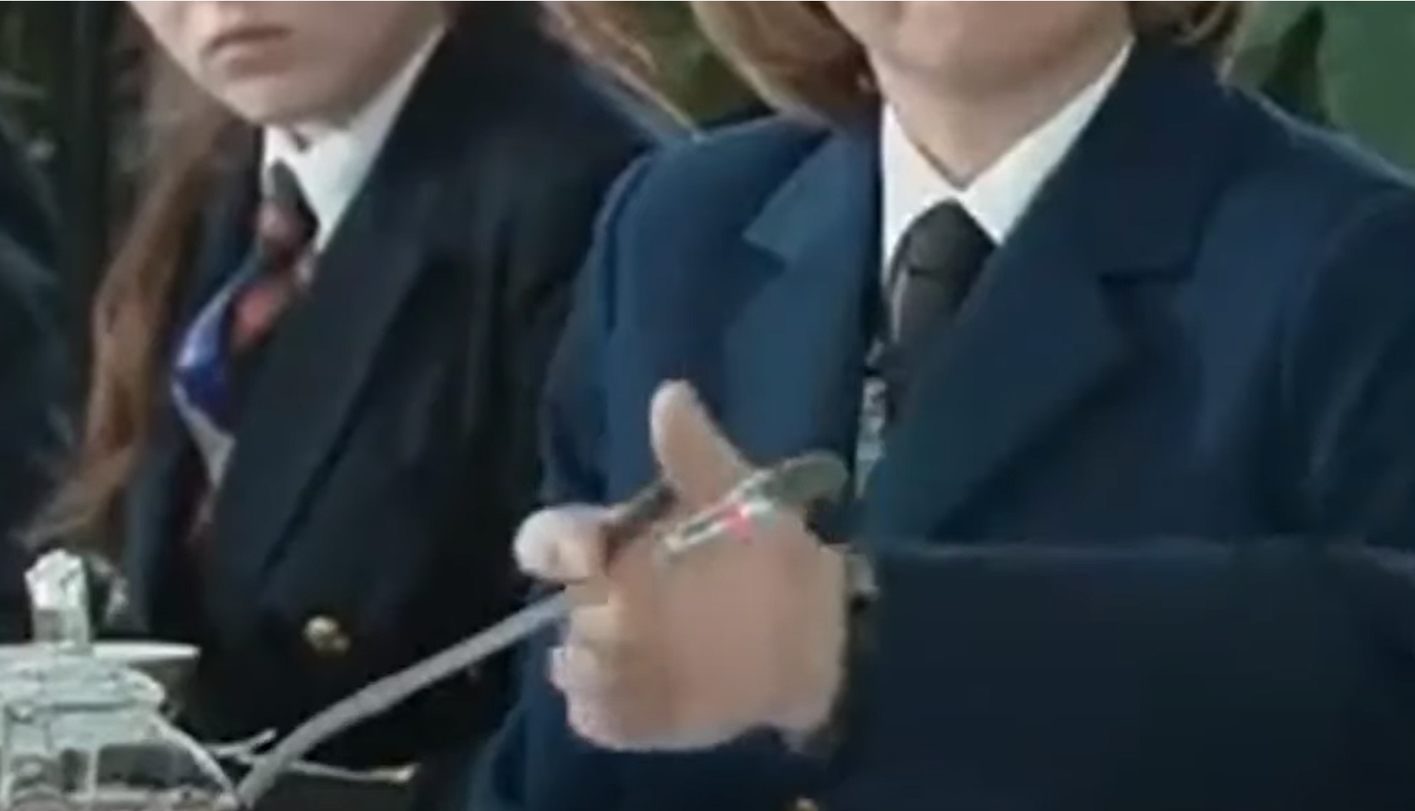
Putin’s Paw

Slide 5
Former British foreign secretary David Owen, who holds a medical degree with a specialization in neurology, has speculated about Putin’s physical and mental health. Quotes from Owen interviews on February 27 and March 3, 2022
Look at his face, see how that has changed — he now has an oval face. People who said, oh, it's plastic surgery or Botox, I don't believe that at all. He's on either anabolic steroids as a bodybuilder — and he's very proud of his muscles and strips to the waist and everything like that — or he's on corticosteroids.
I think his immunity is compromised, either by cortical steroids given him for some other ailment or he is on the steroids you give to people with body lifting and weightlifting.
Those steroids, anabolic steroids, are very dangerous because you can get addicted to them, it's very difficult to get off it and it definitely brings out aggression and it really does make a personality change.

Slide 6
Basketball player Britney Griner arrested in Russia on drug smuggling charges

Slide 7
Ex-marines Trevor Reed and Paul Whelan are serving long prison terms in Russia

Slide 8
One of the most disturbing images to come from this war

Slide 9
News from the front Among the major takeaways: the Russian offensive stalled, Ukraine receiving growing amounts of military aid, Belarus unable or unwilling to join in the fighting

Slide 10
March 5, Novokuznetsky, Siberia. Governor Sergei Tsivilyov of Kemerovo region confronted by family members of a local police unit that was sent to fight in the war

Slide 11
Ukrainian presidential advisor Oleksiy Arestovych combines the online presence of an actor and vlogger with deep knowledge of military affairs

Slide 12
Banker Denis Kireev, a member of Ukraine’s negotiating team at the talks with Russia, shot by the Ukrainian Security Service on March 5

Slide 13
This is not a convoy, but a 30-mile traffic jam

Slide 14
A thermobaric (vacuum bomb) rocket system driving across the Russian-Ukrainian border

Slide 15
Vinnitsa airport struck by Kaliber cruise missiles

Slide 16
Ukraine claims to have sunk one of Russia’s newest naval vessels, the Vasil Bykov

Slide 17
…and to have killed major general Vitaly Gerasimov, deputy commander of Russia’s 41st Army

Slide 18
The Zaporizhzhia nuclear power plant attack

Slide 19
Ukrainian refugees given the right of residency in the European Union

Slide 20
Meanwhile in Moscow. Shoppers waiting to enter an IKEA store in Moscow after the Swedish furniture store announces it is withdrawing from Russia

Slide 21
That’s What I Like + Real Magic = bad PR

Slide 22
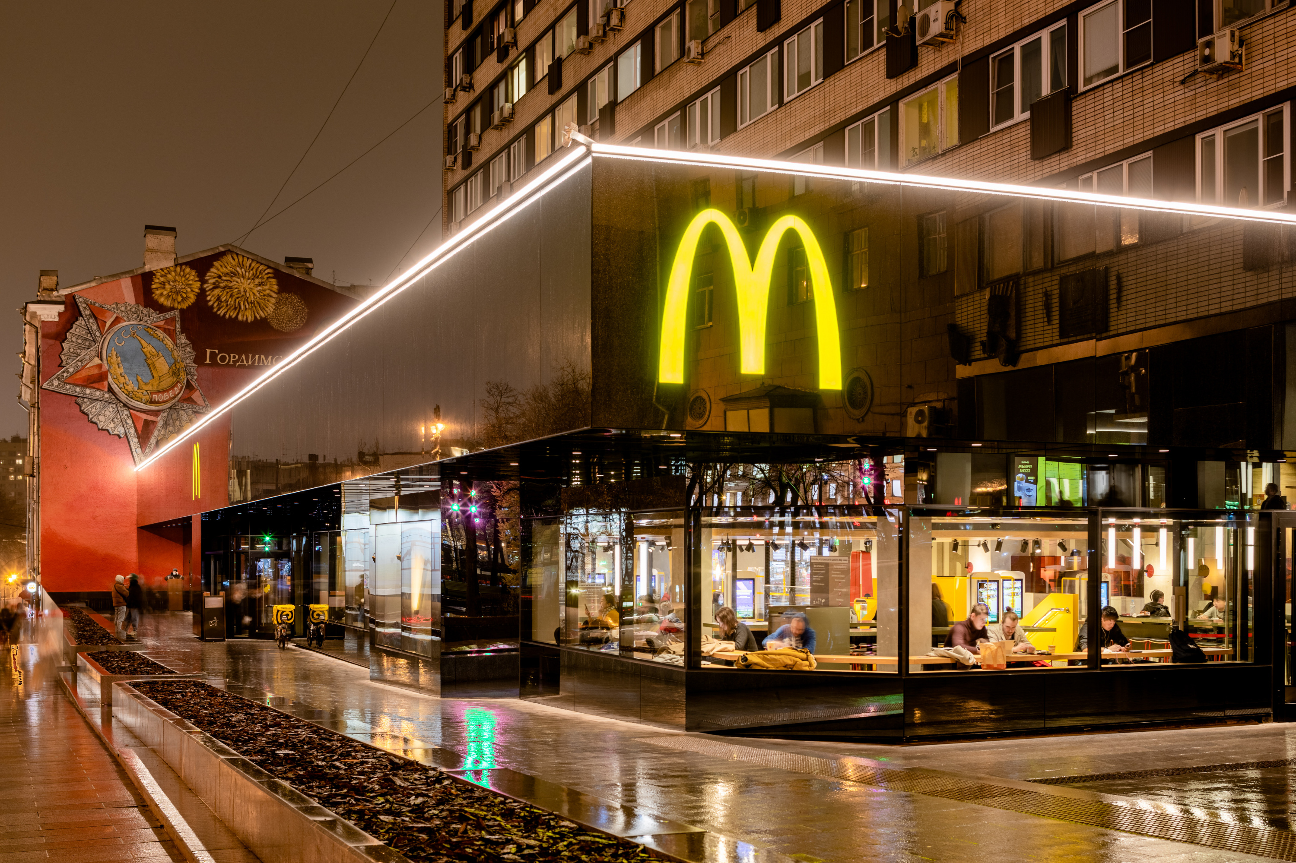
Russia’s first McDonald’s opened on January 31, 1990 in Moscow’s Pushkin Square. With seating for 900 customers, it is the company’s second largest restaurant in the world. Currently there are almost 850 MacDonald’s restaurants operating in Russia. Most are owned not by franchisees, but the company itself

Slide 23
An oil and gas embargo by the entire West?

Slide 24
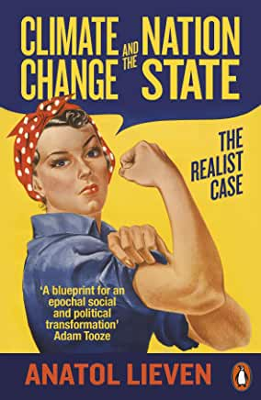
Anatol Lieven

Slide 25
Is it too late for a diplomatic settlement? Article by Anatol Lieven in The Guardian, March 4, 2022: https://www.theguardian.com/commentisfree/2022/mar/04/what-would-ukraine-russia-peace-deal-look-like Lieven’s ideas are not ideal, but then politics is the art of the possible. And so is geopolitics. So let’s not be surprised if the resolution of the conflict happens to look something like this (modified Lieven plan). With the military facts on the ground shifting in Ukraine’s favor and Russia’s economic position weakening by the hour, the window of opportunity is closing
The West lifts sanctions
Russia withdraws troops
Ukraine a neutral state. No NATO accession ever, but Russia obligated to renounce any claims on Ukraine
West agrees not to station troops in Ukraine
Ukrainian constitution guarantees rights of Russian-speaking minority. Still a unitary state?
Internationally supervised plebiscites in Crimea and the two separatist regions in the east (think Serbia’s loss of Kosovo)
Ukraine gets path to EU membership and massive Western investment

Slide 26
China continues to bide its (diplomatic and economic) time, but there are straws in the wind that suggest it may be distancing itself from Russia

Slide 27
China’s power structure (source: Yuan Associates, 2020). The People’s Republic is not a state of laws but state of rules. This does not mean it lacks in political and geopolitical sophistication

Slide 28
And I beheld, and lo, a black horse; and he that sat on him had a pair of balances in his hand (Revelation 6:5)

Slide 29
The Russia-Ukraine war is a threat to global food security Data 03-03-2022 from Reuters at https://www.reuters.com/business/russia-ukraine-conflict-highlights-wheat-supply-vulnerability-2022-03-03/
Together the two countries account for 29% of global wheat exports
Military operations are taking place across Ukraine’s most productive agricultural areas
Middle Eastern nations such as Egypt and Saudi Arabia are especially reliant on wheat from the war zone
China estimated to have 131M tons of wheat = 47% of global inventories

Slide 30
Well into the Ukraine-Russia conflict, Georgia’s ruling Georgia Dream party maintained its traditional pro-Russian stance. With large antiwar demonstrations taking place in the capital, Tbilisi, daily (photo below), the government changed its position and on March 3 submitted a formal application to join the European Union. Another post-Soviet republic, Moldova, has also requested membership

Slide 31
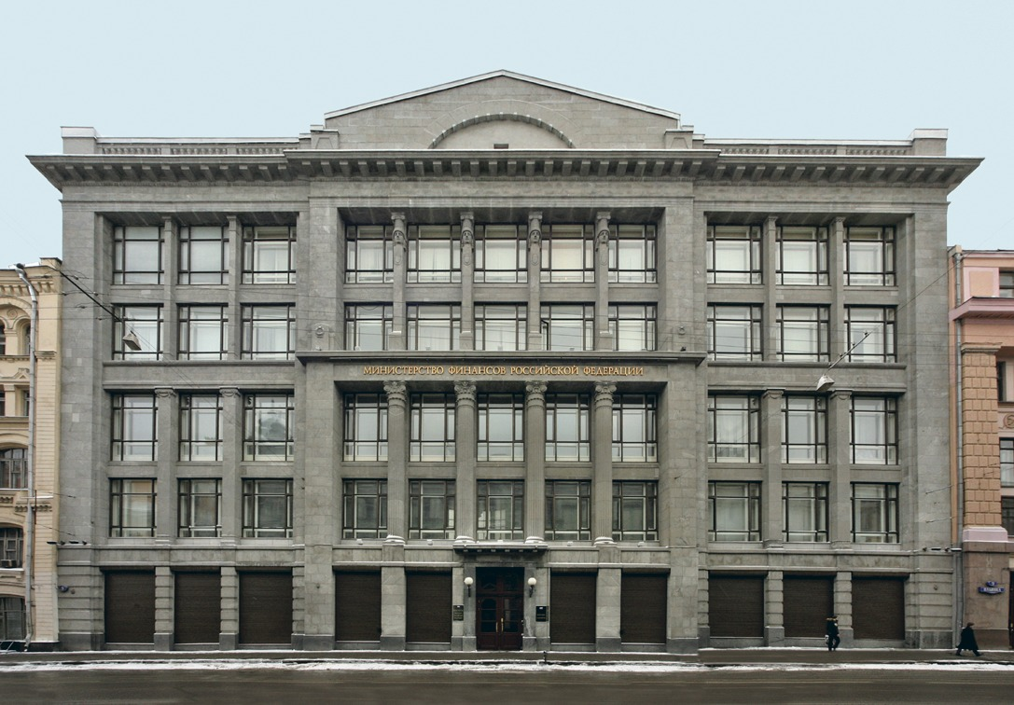
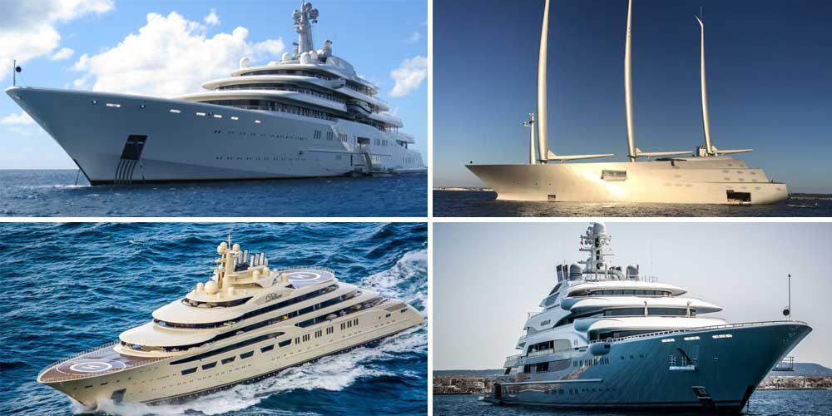
Russia has been a state of rules (or poniatiia = “understandings”) since the late 1990s. It has now completed its transition from a soft or hybrid authoritarianism to a dictatorship with no ifs, buts, or postmodern conceits. The Putin regime continues to rest on a constantly shifting balance between the siloviki, or power men, oligarchs, and technocrats, with Putin presiding over this dynamic from his actual or figurative bunker

Slide 32
Even now, Putin’s administration shows a fundamental continuity with the Russia of the 1990s. Let us recall Napoleon’s formula, “A revolution is 10,000 vacancies”

Slide 33
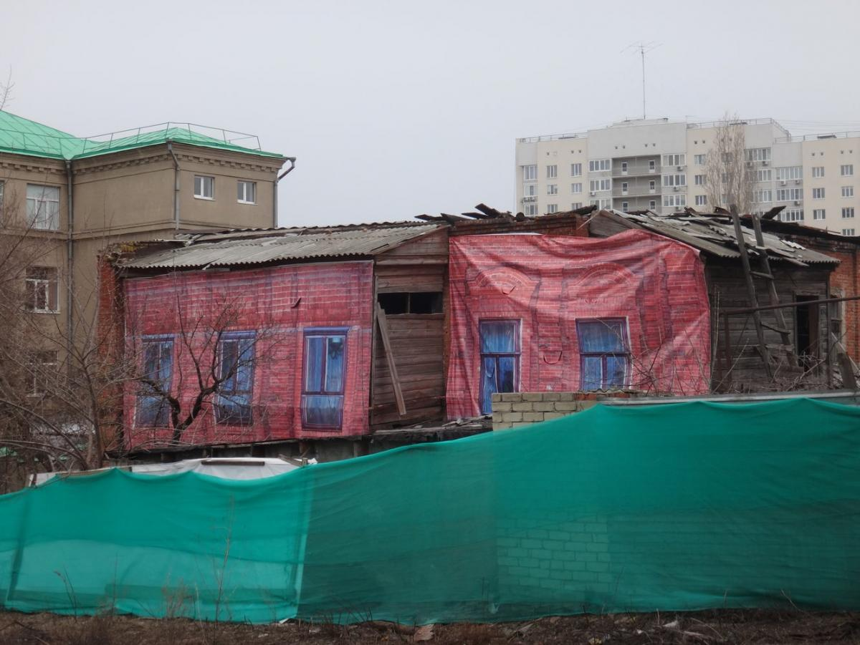
Russian army’s poor battlefield performance is partly explained by politico-cultural factors. Among these is the practice of pokazukha and the Potyemkin village syndrome. On left: a can of spray paint of the kind used to beautify lawns on military bases during visits by Putin. On right: fake façades erected in Saratov in anticipation of the arrival of then prime minister Dmitry Medvedev (March 2016)

Slide 34
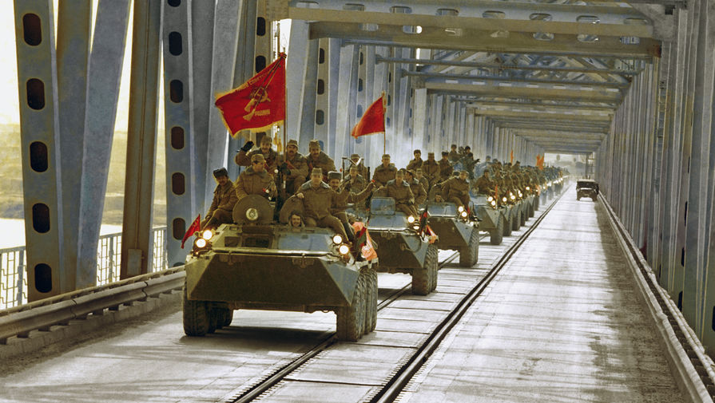
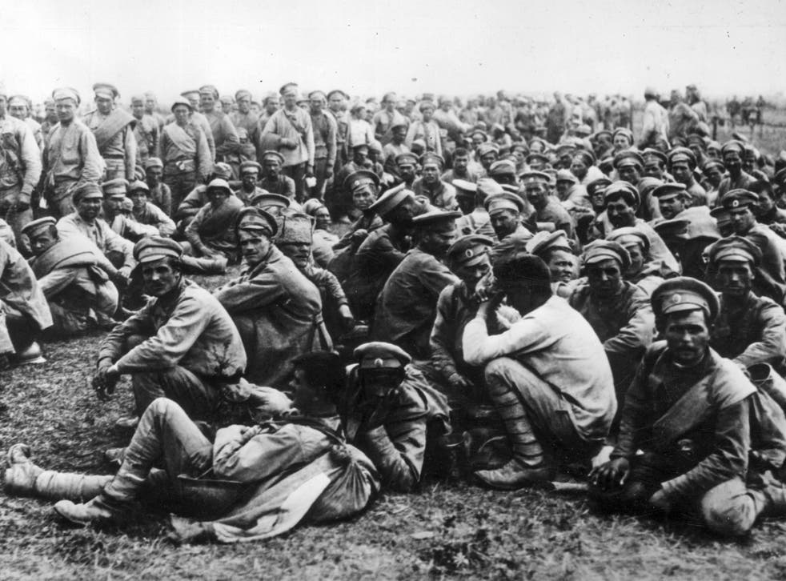
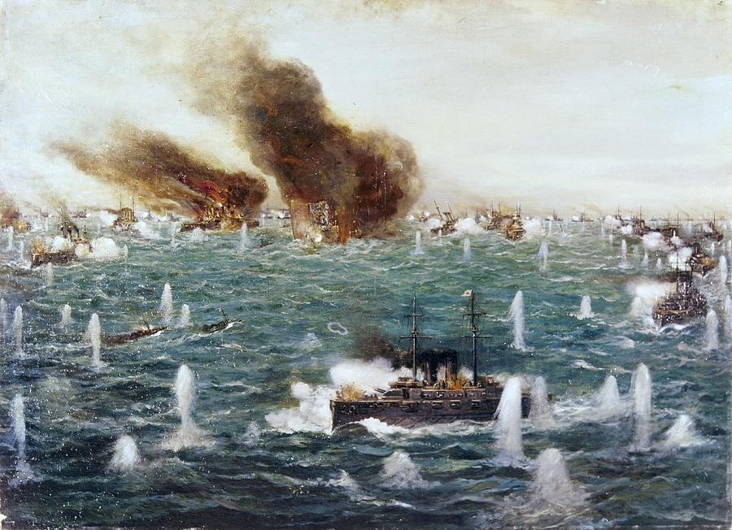
When empires fall, or at least reform From left: the Siege of Sebastopol (1854-55), the Battle of Tsushima (1905), the Battle of Tannenberg (1914), the Red Army withdraws from Afghanistan (1989)

Slide 35
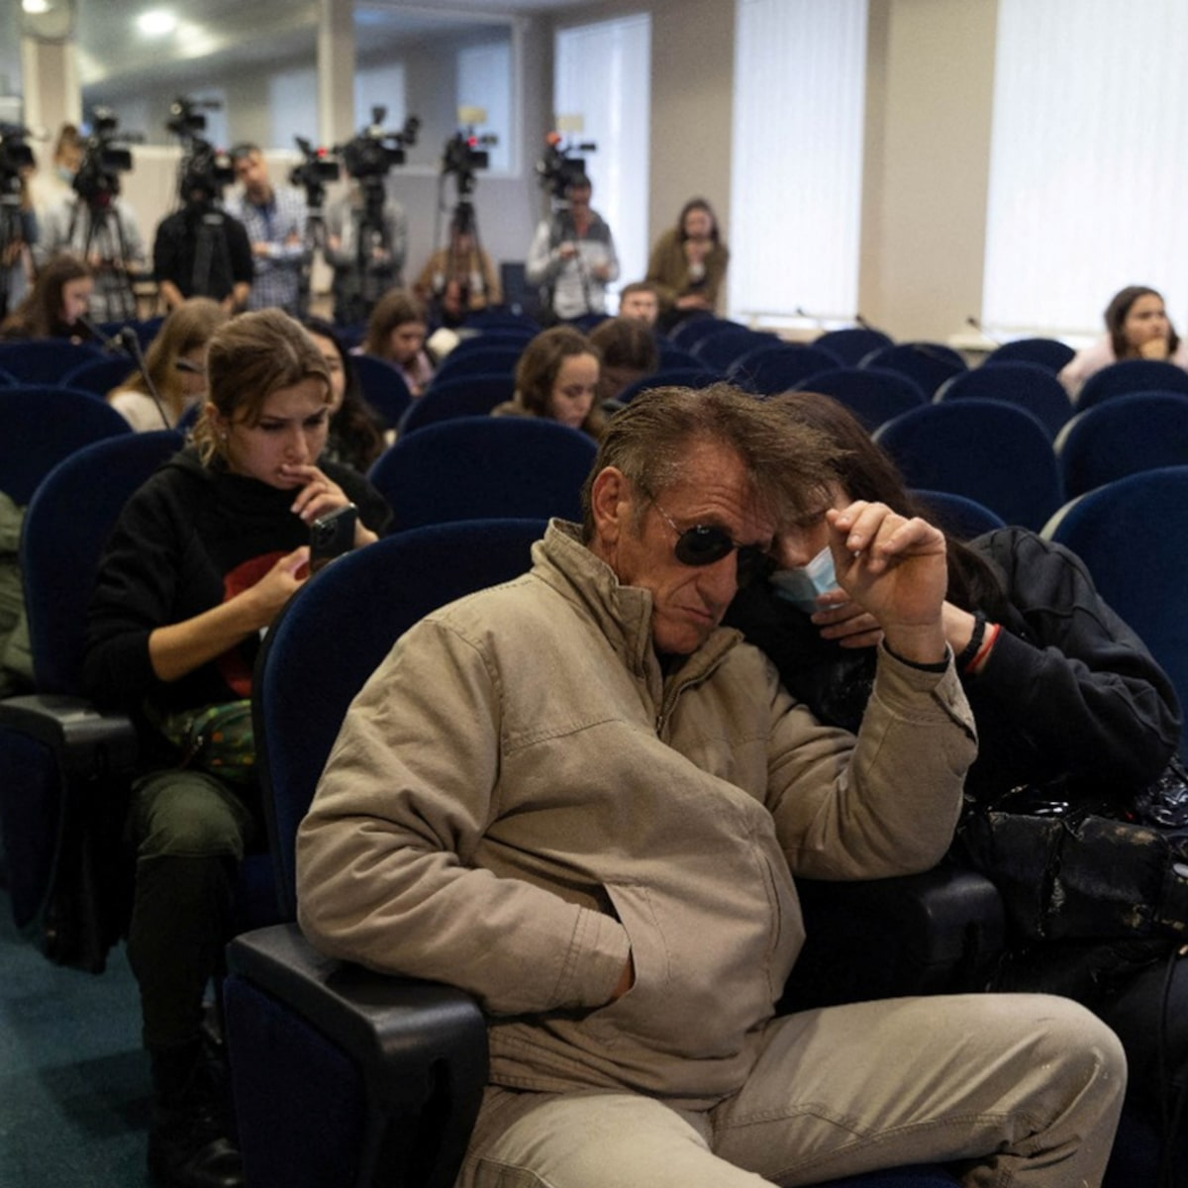
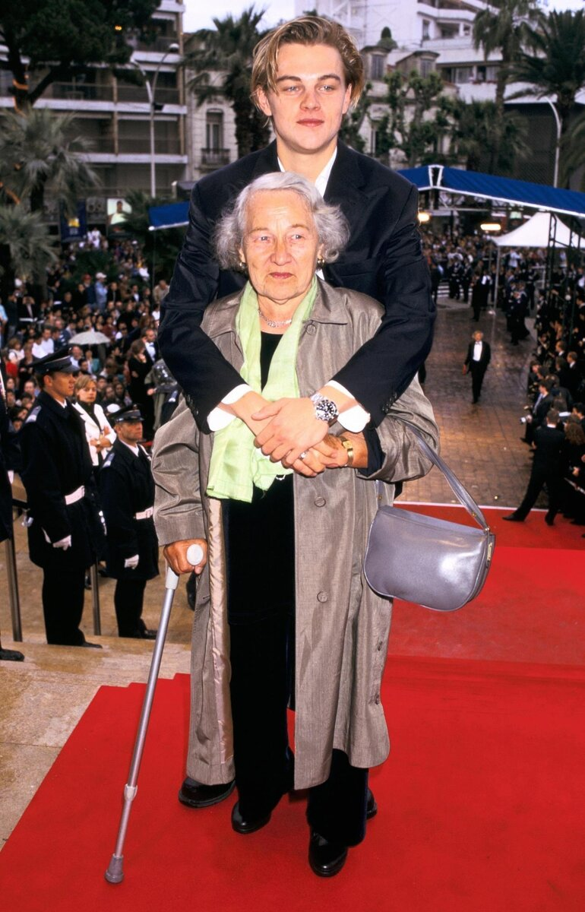
Supporting Ukraine. Ukrainian-born Mila Kunis has donated $3M, Leonardo di Caprio (shown here with his grandmother Elena Smirnova, born in Odessa) has given 10M, while Sean Penn (seen at the Polish-Ukrainian border) is filming a documentary about the war

Slide 36
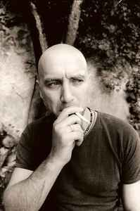
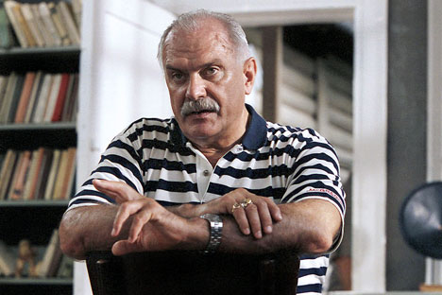
Over on the other side, we have conductor Valery Gerghiev (since fired by the Munich Philharmonic), actor and director Nikita Mikhalkov, and writer Zakhar Prilepin

