Slide 1
OLLI SPRING 2022 TRIUMVIRATE: America, Russia, and China As Global Actors and Rivals
Tuesday, February 22
A Tale of Three Capitalisms
The Russia-Ukraine War

Slide 2
February 20, 2022: closing ceremony of the Beijing Olympics

Slide 3
The Budapest Memorandum was signed on December 5, 1994 by Russia, the United States, and the United Kingdom. France and China signed a separate protocol. In return for giving up their Soviet-era nuclear weapons, Belarus, Kazakhstan, and Ukraine received security assurances relating to their territorial integrity and political independence

Slide 4
The Minsk I and II Agreements were signed in 2014 and 2015, respectively

Slide 5
February 21, 2022: a study in spaces. Meetings of Russia’s Security Council and the US National Security Council

Slide 6
At the Security Council meeting, Putin berated Foreign Intelligence Service chief Sergei Naryshkin

Slide 7
Putin’s February 21 address to the Russian people. Together with his February 10, 2007 speech at the Munich Security conference, this may have been the most important public statement of his career

Slide 8
Main points of Putin’s address (these are actual quotes)
Ukraine is […] an inalienable part of our culture, history, and spiritual space
[…] Modern Ukraine in its entirety was created by Russia or, rather, Bolshevist, communist Russia. […] Lenin […] is its author and architect
Ukrainian nationalists and neo-Nazis [joined] terrorist bands in the North Caucasus and there are ever-louder territorial claims against Russia
With the help of a developed network of NGOs and secret agents, outside forces have cultivated their Ukrainian clients and moved them into positions of power
[…] Ukraine has never had an established tradition of statehood
The so-called pro-Western civilizational choice of Ukraine’s oligarchic government
Statements have been made that Ukraine intends to develop its own nuclear weapons. […] We must respond to this real threat
In recent years NATO troops have in effect become permanently based in Ukraine
[In 1991 we were told that] the unification of Germany would not lead to NATO expansion to the east
[…] I will now tell you something I have never publicly discussed before. In 2000, during the visit to Moscow by President Bill Clinton, who was soon to leave office, I asked him, “Would the United States be willing to accept Russia as a NATO member?” […] his reaction to my question was quite unenthusiastic
the genocide of four million people
We demand that those in Kiev who have usurped and exercised power in Kiev immediately cease military operations. Otherwise all responsibility for a possible continuation of the bloodshed will rest on the conscience of the regime that currently holds power on Ukrainian territory

Slide 9
Lugansk and Donetsk

Slide 10
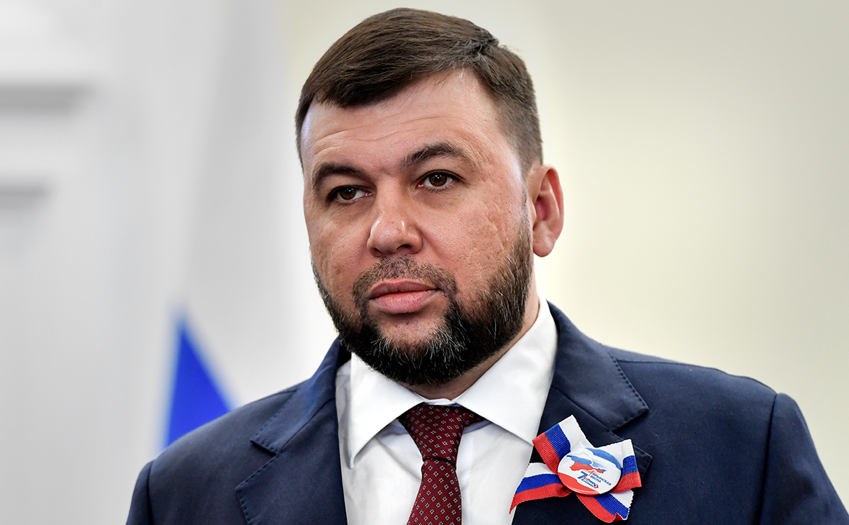
On left, Leonid Pasechnik, head of state of the Lugansk People’s Republic. On right, Denis Pushilin (b. 1982), his counterpart in the Donetsk People’s Republic

Slide 11
Donetsk militia member Aleksandr Mozhaev, better known as Babai the Cossack

Slide 12
Germany’s post-World War I Freikorps

Slide 13
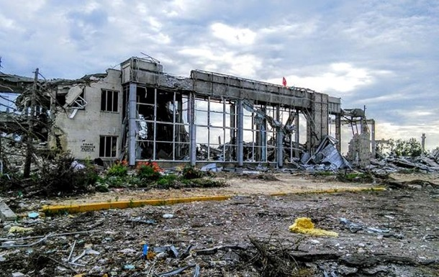
A slum too far?

Slide 14
In response to Russia’s decision to move troops into the two separatist regions, Germany withholds certification of Nord Stream 2 gas pipeline. This 770 mile structure is a remarkable engineering achievement, but a geopolitical headache

Slide 15
It all goes back to the Fukushima nuclear accident of March 11, 2011

Slide 16
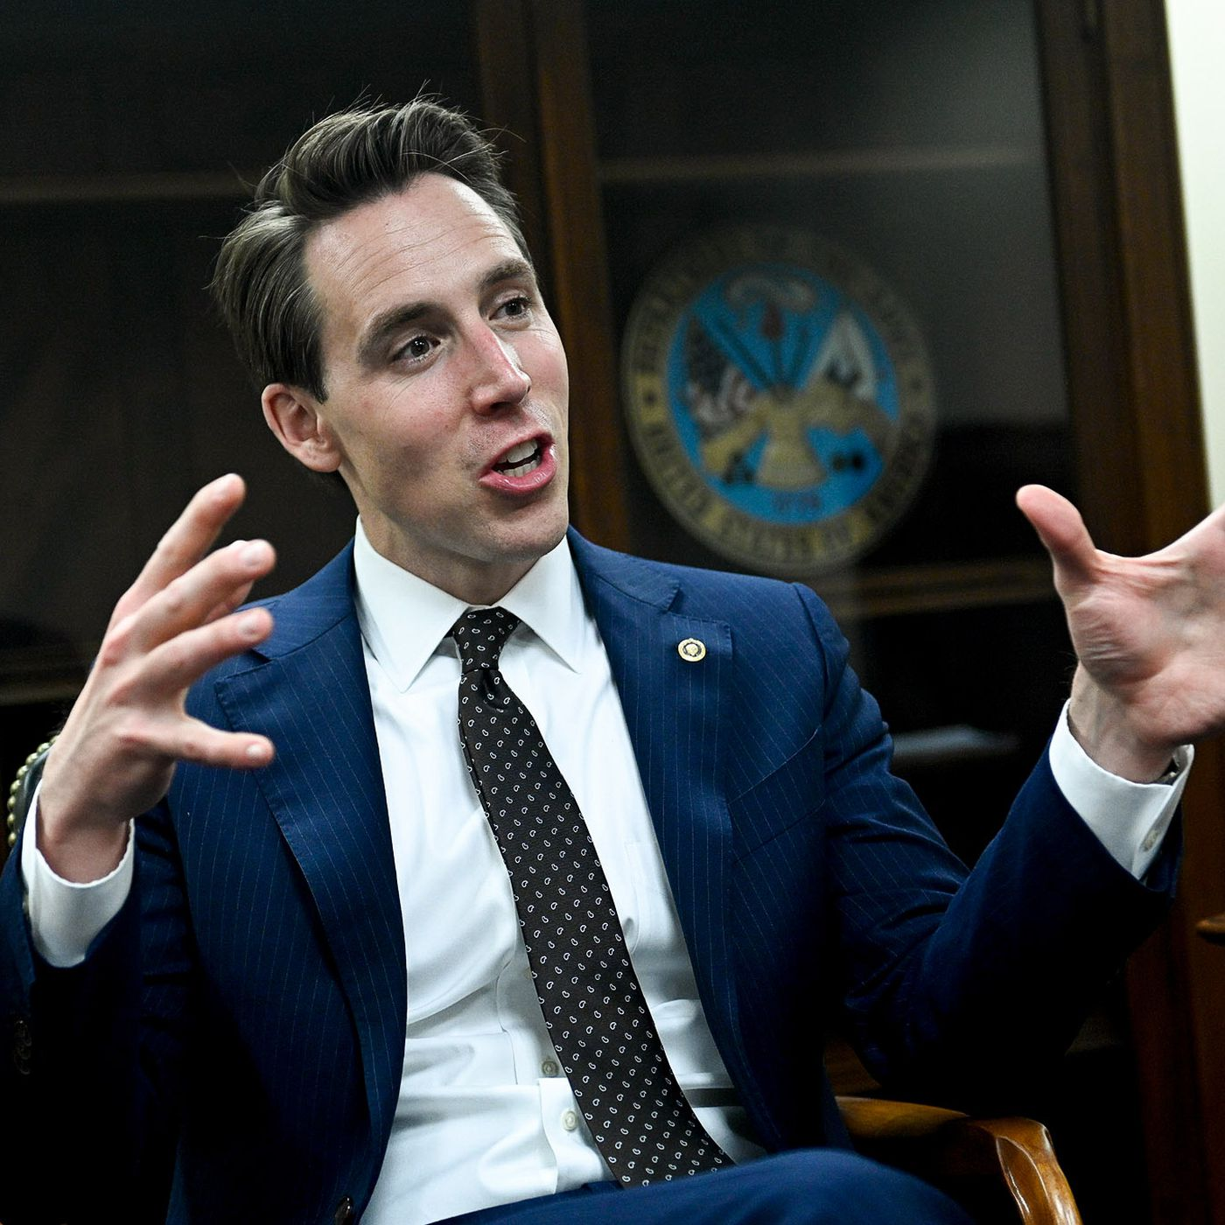
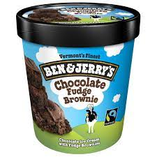
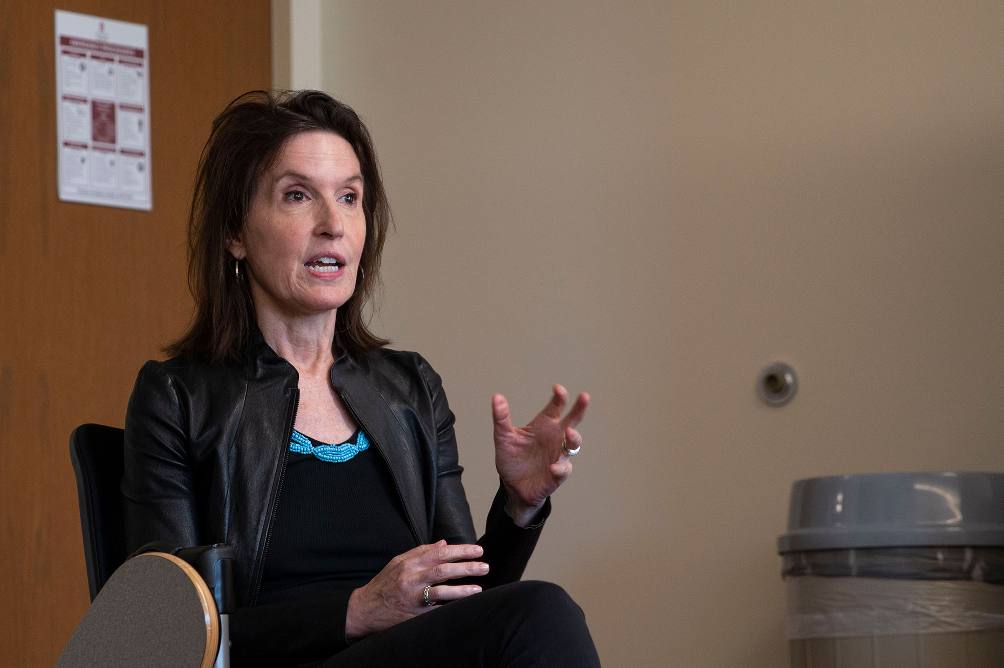
Gesturing against the geopolitical consensus. Left to right (or right to left): Josh Hawley, Rand Paul, Tucker Carlson, Ben & Jerry’s, Katerina vanden Heuvel

Slide 17
Catching the wave of industrial revolutions
First revolution, c. 1760 – c. 1830: steam and coal; iron-making; cotton gins and power looms; first machine tools. Great Britain preeminent
Second revolution, c. 1860 – 1945: steel, rail, electricity, petroleum, internal combustion engine, heavier-than-air flight, telegraph and telephone, chemical industry, production line, rise of national and international corporations. The United States achieves global political and economic dominance
Third revolution, 1945 – present: Computers, nuclear energy, plastics, TV, shift from analogue to digital, the internet, space flight. The United States continues to be preeminent, wins the Cold War, but is challenged by China
Fourth revolution: present – future: cyber-physical systems, with technology embedded in social structures but also human bodies, AI, genetic engineering, the blockchain, quantum computing, colonization of space, the rise of the posthuman. The United States vs China

Slide 18
The numbers speak for themselves. Or do they?

Slide 19
Globalizations mark I, II and III

Slide 20
Supply chains

Slide 21
China
2019 Gross domestic product $14.9T
2020 Estimated per capita GDP $10,511K
2021 fourth quarter growth rate 4.0%
In 2010-2020 share of global GNP adjusted for PPP grew from 13.68% to 18.33%, and is projected to increase to 20.19% by 2026

Slide 22
The Chinese banking sector has its problems

Slide 23
Moscow (a city of 12M people) and its environs are home to 100K HNWIs, or 35% of the entire Russian population of these people. The photo shows the Turandot restaurant, a typical high-end eating establishment (HNWI = high net worth individual, i.e., a person with $1.0M in liquid assets)

Slide 24
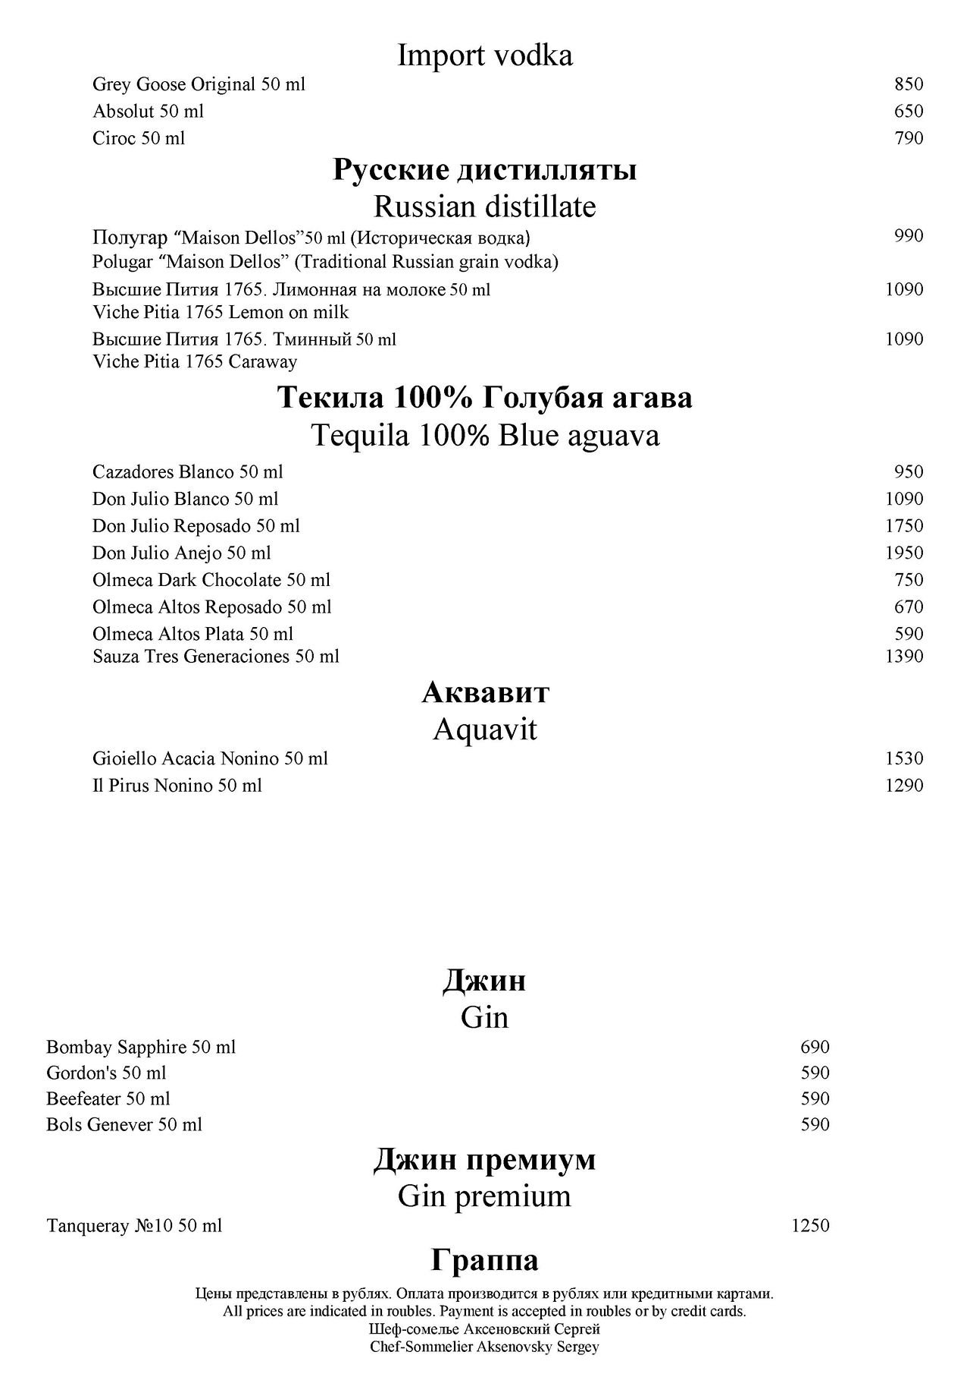
Turandot menu and wine list

Slide 25
On April 1, 2021, the number of pensioners in Russia was 42.6M, out of a total population of 144M

Slide 26
Chelsea Football Club owner Roman Abramovich celebrating his team’s victory in the 2021 Champions League final

Slide 27
Wealth as a more accurate criterion for evaluating a country’s level of prosperity and also, just telling a story of great riches and abject poverty. The information below comes from newworldwealth.com
In many developing countries, a large portion of GDP flows to the government and therefore has little impact on private wealth creation
GDP counts items multiple times
GDP disregards income levels
GDP ignores the efficiency of the local banking sector and the local stock market at retaining wealth in a country.
GDP largely ignores the impact of property and stock market moves. These two factors obviously have a massive impact on wealth.
GDP is static and often fails to indicate upward or downward trends in the economy
Wealth figures, on the other hand, do not have any of these limitations, making them a far better gauge of the financial health of an economy than GDP figures

Slide 28
Shanghai

Slide 29
The industrial revolutions transformed cities into hubs of prosperity. The world’s wealthiest cities according to a newworldwealth.com report dated September 15, 2021
#1 New York: Total wealth $2.9 trillion. America’s financial center. Home to over 370,000 HNWIs, as well as 805 centi-millionaires and 62 billionaires. Site of the two largest stock exchanges in the world (Dow Jones and NASDAQ)
#2 San Francisco Bay area (includes Silicon Valley as well as Palo Alto, Los Altos Hills, and Atherton): Total wealth $2.6 trillion. Projected to overtake New York City at some point before 2030
#5 Beijing: Total wealth $2.0 trillion. Capital city of China and home to the head offices of the country’s largest companies
#6 Shanghai: Total wealth $1.8 trillion. China’s financial capital and site of the Shanghai stock exchange, the 4th largest stock exchange in the world (after Dow Jones, NASDAQ and Tokyo)
#7: Los Angeles (includes Malibu, Laguna Beach, Newport Beach and Beverly Hills): Total wealth $1.3 trillion
#9 Chicago: Total wealth $1.0 trillion. Diversified economy that includes manufacturing, insurance, publishing, and food processing. Home to five financial exchanges
#11 Houston: Total wealth $925B. One of the fastest growing cities in the US. Strong in oil & gas, biotech, engineering, aeronautics

Slide 30
Moscow

Slide 31
The Russian economy in 2020
Gross domestic product at $1.46T (between South Korea and Brazil) = #11 in the world
GDP per capita $10,115.35
Average wealth per capita at $27.4K = #92 in the world
46% of total income accumulated by richest 20%; 6% accumulated by poorest 20%

