Slide 1
OLLI SPRING 2022 TRIUMVIRATE: America, Russia, and China As Global Actors and Rivals
Tuesday, February 15
Lecture 3
Three National Stories and Their Planetary Readership

Slide 2
Writer Viktor Erofeev on Radio Ekho
[…] I believe that having won the Crimea, from its own perspective the [Putin] regime lost Ukraine. And if it goes into Ukraine, it will lose the entire world. Because, strange as it may seem, Putin happens to be the one who taught the Ukrainians their sense of self, and is now busy straightening the West out by making it more realistic, less prone to staying in its zone of comfort. They [the Ukrainians] are beginning to realize where their values lie and are beginning to evolve in that direction. I think they will definitely put up a monument to Putin both in Paris and New York. I don’t know exactly where, the exact location. It’s up to them. But in Kiev the statue they will erect will be on some slope.

Slide 3
…that’s on the one hand. And on the other…
An invasion in the snows of February? In the entire history of Russia, there was only one such successful military operation, when the Mongols embarked on their conquest of Kievan Rus in the winter of 1237-38
Official Russian statements give an indication of a desire to deescalate; the Ukrainian president denies an invasion is imminent; it is the West that is rhetorically and diplomatically upping the ante
Most importantly: Yes, Russia has the military wherewithall to defeat Ukraine and to occupy all of it, or a large portion thereof. But then what?

Slide 4
A difficult neighborhood

Slide 5
Also, remember Transnistria!

Slide 6
On January 31, 2022 General Leonid Ivashov, a prominent Russian nationalist and chairman of the All-Russian Officers’ Assembly, issued a statement condemning Putin’s Ukraine stance and calling on him to resign

Slide 7
“Don’t stand, don’t stand, don’t stand so close to me…”

Slide 8
That figure skating table reappeared for today’s visit to Moscow by German Chancellor Olaf Scholz. At their joint press conference afterward Putin stated he wants the question of Ukraine’s NATO membership resolved now and that Western assurances are not good enough

Slide 9
National texts…

Slide 10
Martin Luther King Jr.’s I Have a Dream speech of August 28, 1963

Slide 11
…and national spaces

Slide 12
“Shining city on a hill” and “Tear down this wall!”

Slide 13
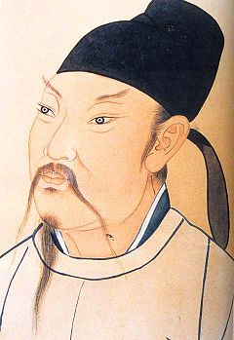
静夜思 (jìng yè sī), or Thoughts on a Quiet Night by Li Bai (701-762), a Tang Dynasty poet
There is moonlight shining before my bed,
I suspect that there is frost on the ground,
Raising my head, I gaze at the moonlight,
Lowering my head, I think of my home village.

Slide 14
Tiananmen Square is China’s national space

Slide 15
Mao Zedong proclaiming the Chinese People’s Republic on October 1, 1949. Despite his strong charisma, Mao was not an effective public speaker

Slide 16
“The June 4 Incident”

Slide 17
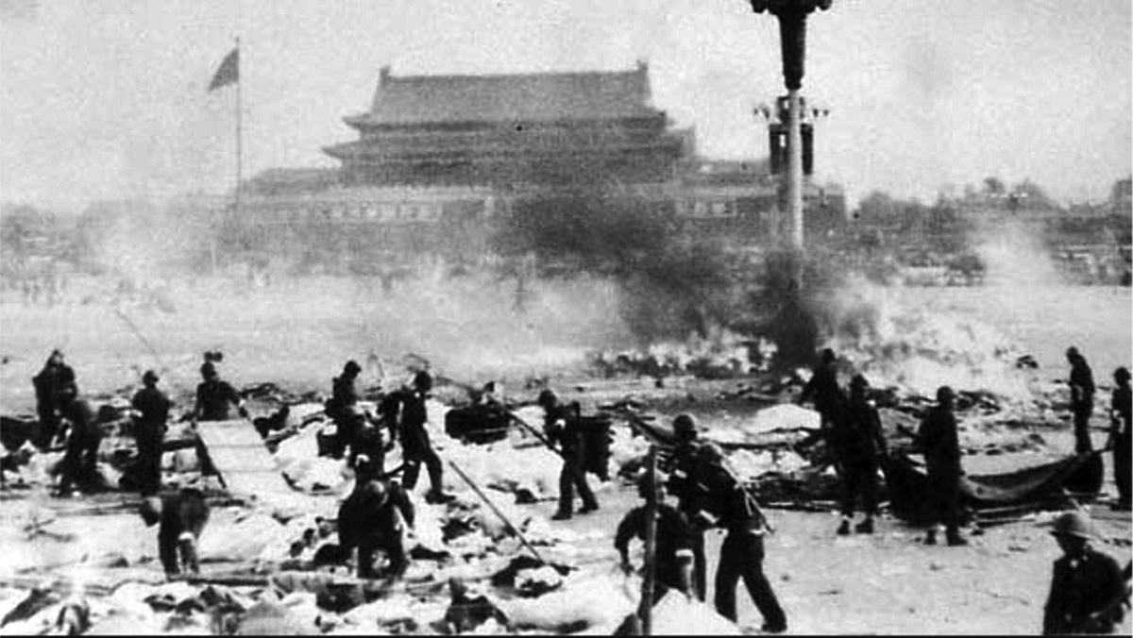
Deng’s world-historical calculus. On left: Richard Hess’s Time magazine cover of the Chinese leader (oil on canvas, National Portrait Gallery); on right: photo showing the violent suppression of the Tiananmen Square protests

Slide 18
The Long March of 1934-36

Slide 19
The Caves of Yan’an in northwestern Shanxi province, where Mao established his headquarters after the Long March. He stayed here until 1947

Slide 20
Bo Xilai with his wife Gu Kailai, or the perils of being a charismatic in post-Mao China

Slide 21
Let 100 flowers bloom (百花齐放), 1956
The use of slogans is linked to the speech patterns in demotic Chinese, where short rhythmic phrases are favored, especially in the propaganda and political spheres
These kinds of phrases are often represented by four characters in Chinese and have been deployed by the country’s leaders for more than 2,000 years.

Slide 22
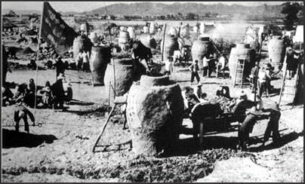
The Great Leap Forward, 1958-62

Slide 23
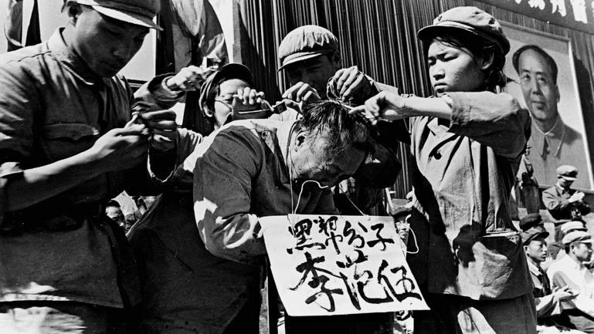
The Cultural Revolution (1966-76)

Slide 24
The Chinese Dream policy, which was announced in 2012, is intended to compete with the American Dream on a variety of levels. “The Chinese Dream” may be the most important slogan of the Xi era

Slide 25
The Road and Belt Initiative (RBI) was launched in 2013

Slide 26
“Only in Russia is poetry respected: it gets people killed.” Osip Mandelshtam (1891-1938)

Slide 27
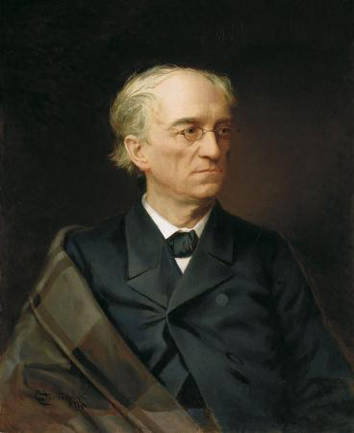
The Slavophile poet and conservative thinker Fyodor Tyutchev (1803-1873) is the author of what is the most famous statement of national identity in the Russian language
You cannot grasp Russia with your mind Or judge her by any common measure, Russia is one of a special kind – You can only believe in her.

Slide 28
Do you believe in permafrost?

Slide 29
“Our land is vast and rich, but there is no order in it”

Slide 30
Red Square and the Kremlin: Russia’s national space

Slide 31
“The greatest geopolitical catastrophe of the twentieth century.” This famous Putin quote about the fall of the Soviet Union dates from April 25, 2005

Slide 32
The Swearing of the Oath of Ratification of the Treaty of Münster by Gerard ter Borch (1648)

Slide 33
Chinese dissident Liu Xiaobo (1955-2017), winner of the 2010 Nobel Peace Prize

Slide 34
Newspaper editor Dmitry Muratov (b. 1961), co-winner of the 2021 Nobel Peace Prize

