Slide 1
OLLI SPRING 2022 TRIUMVIRATE: America, Russia, and China As Global Actors and Rivals
Tuesday, February 8
Lecture Two
1+1+1 = 2 1/2

Slide 2
Xi Jinping and Vladimir Putin meeting in Beijing on February 4, when the Chinese leader voiced support for Russia’s position in the Ukraine crisis. The summit was a rare occurrence for Xi, who since the start of Covid has avoided face-to-face meeting with foreign counterparts. Although peers in terms of age, 69 and 68, the two presidents are at a different point in their respective political trajectories. This is a telling fact, which ought to be borne in mind

Slide 3
Speaking of summit meetings, yesterday (February 7) President Joe Biden met with German chancellor Olaf Scholtz at the White House

Slide 4
…while in the Kremlin, President Putin held talks with President Emmanuel Macron on France. I suspect there was a bit of shouting involved

Slide 5
That table is now a thing

Slide 6
Joe Biden being sworn in as Delaware’s newly elected senator in January 1973. At that time he was the sixth youngest US senator in history

Slide 7
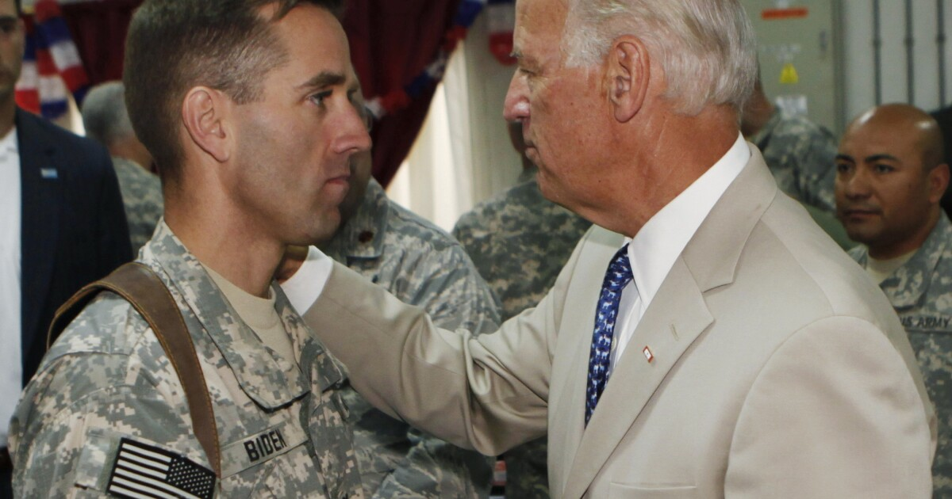
Biden’s life before his elevation to the presidency was bookended by two devastating personal tragedies, the death of his first wife Neilia and daughter Naomi in an automobile accident on December 18, 1972, and the loss of his son Beau to brain cancer on May 30, 2015

Slide 8
In the Senate, the future president supported the cause of human rights behind the Iron Curtain. The photo shows Senator Henry Jackson (D, Washington), Biden (half-hidden behind Jackson), Nobel Prize-winning Russian author Aleksandr Solzhenitsyn, Senator Jesse Helmes (R, South Carolina), Senator Clifford Cas (R, New Jersey)

Slide 9
As chair of the Senate Judiciary Committee (1987-1995), Biden was skeptical of Anita Hill’s charges of sexual harassment against Supreme Court nominee Clarence Thomas

Slide 10
As chair or ranking member of the Senate Foreign Relations Committee (1995-2009), he acquired a reputation as a foreign-policy expert

Slide 11
Before winning the White House, Biden ran for president twice, in 1988 and 2008

Slide 12
In 2008 he was selected by presidential candidate Barak Obama to be his running mate

Slide 13
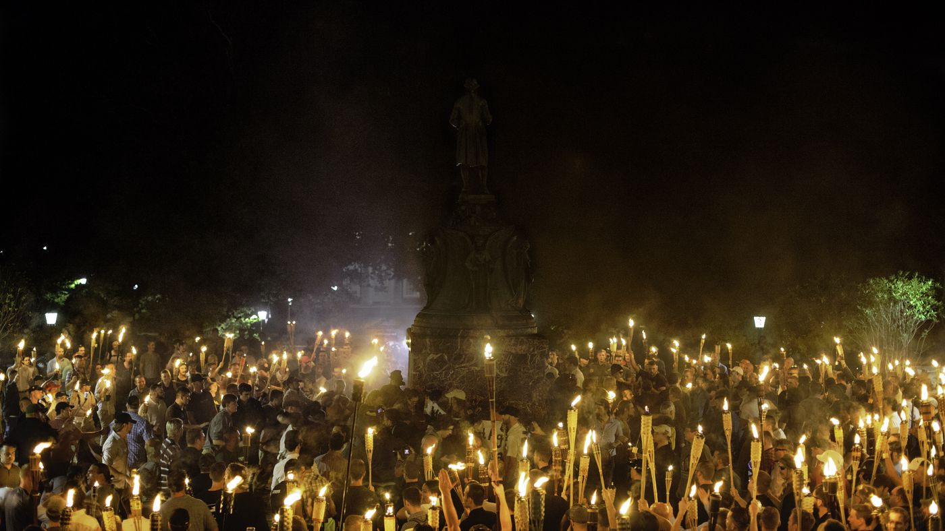
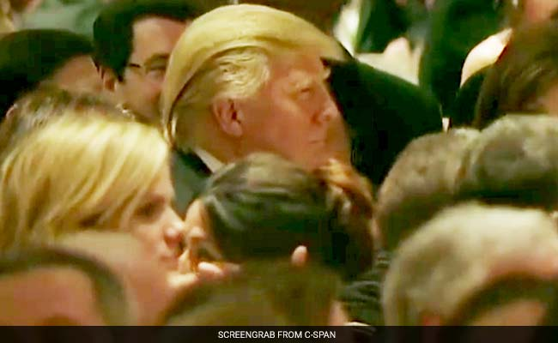
A successful quest for the presidency invariably gives rise to mythologizing interpretations, whether these are generated by the candidates themselves, supporters, or opponents. For Donald Trump, see the White House Correspondents’ Dinner on April 30, 2011; for Joe Biden, see the Unite the Right march and attendant violence at Charlottesville, VA on August 11-12, 2017
https://www.washingtonpost.com/lifestyle/style/i-sat-next-to-donald-trump-at-the-infamous-2011-white-house-correspondents-dinner/2016/04/27/5cf46b74-0bea-11e6-8ab8-9ad050f76d7d_story.html

Slide 14
Pivot to Asia

Slide 15
On November 14, 2012 China witnessed the elevation of Xi Jinping to the position of general secretary. Here we see him at the head of his leadership group for their first public appearance together. Note the identical hair dye, ties, and suits

Slide 16
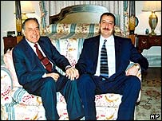
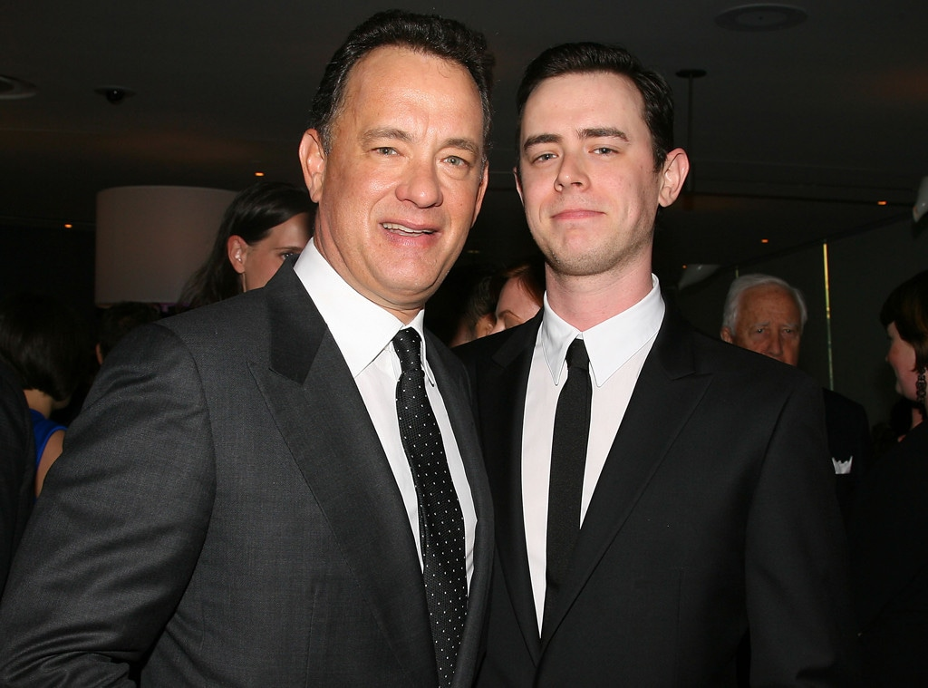
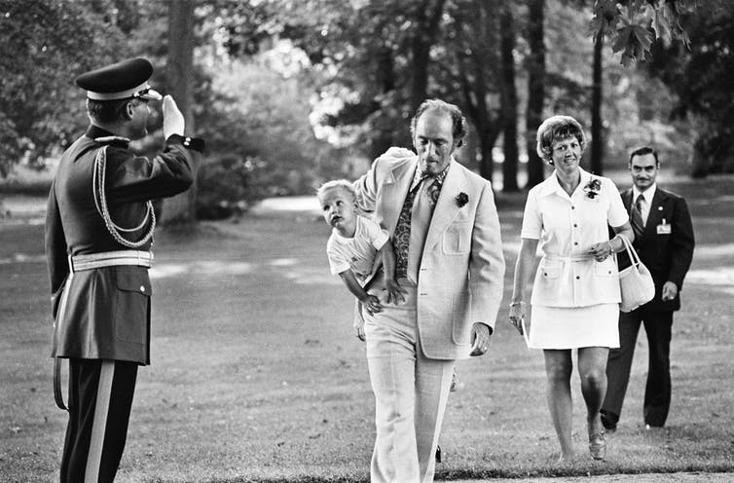
Hereditary elites, or career inheritance at the top. Clockwise from top left: President Heydar Aliev of Azerbaijan with his son, future president Ilham Aliev; George H.W. and George W. Bush; actors Tom and Colin Hanks; supermodel Cindy Crawford with her model daughter Kaia Gerber; prime minister Pierre Trudeau of Canada with prime minister Justin. These patterns of professional inheritance extend to business, the media, and academia

Slide 17
In the United States, one’s parentage can dramatically assist one’s professional prospects. There are two main factors behind the modern phenomenon of career inheritance: 1) careers that are not impacted by economic change are particularly attractive to well-placed families, 2) family connections
If your father was a legislator, you are 354 times more likely to successfully pursue that career. If your father was a doctor, you are 23 times more likely to become one as well. If your father was a lawyer, you’re 17 times more likely to be a lawyer too. The sons and daughters of dentists are 13 times more likely to enter that profession
The sons and daughters of plumbers are 14 times more likely to pursue a job in this field.
The sons and daughters of electricians are nine times more likely to pursue a job in this field.
The sons and daughters of carpenters are five times more likely to pursue a job in this field.

Slide 18
A young Xi Jinping (b. 1953) with his father Xi Zhongxun (1913-2002). Xi senior belonged to the second generation of Chinese communist leadership, which makes his son one of the country’s Red Princelings

Slide 19
The five generations of CCP leadership. Each generation is identified with a distinct period in Chinese history as well as a particular policy orientation. Xi senior was a member of the second generation of leaders, which implemented Deng Xiaoping vision for a transition to a market economy, whereas Xi junior is a member of the fifth, which is guiding China’s quest to become a global superpower

Slide 20
Deng Xiaoping (1904-1997) was one of the most extraordinary world leaders of the twentieth century, up there with Kemal Atatürk and Charles De Gaulle as a successful state-builder who restored his country’s fortunes after the human and social disaster that was Mao’s reign

Slide 21
Xi Zhongxun played a prominent part in the 1947-49 civil war against the Nationalists. After becoming the CCP’s chief propagandist (1952), member of its Central Committee (1956), and vice-premier (1959), he was purged and jailed during the Cultural Revolution. Subsequently he became Party leader in Guangdong Province, which is adjacent to Hong Kong, and was a leading advocate of economic liberalization via the special economic zones policy. A member of the CCP Politburo and Secretariat, where he was identified with the reformist wing, he supported General Secretary Hu Yaobang who in 1987 was forced to resign as a “bourgeois liberal.” Xi retired in 1988

Slide 22
Xi Jinping at age five (on left) with his father and younger brother Xi Yuanping. Jinping and Yanping were Xi senior’s sons from his second marriage, to Qi Xin. Of Xi’s three siblings, Qi Qiaoqia is a businesswoman, Xi An’an (sister) has never been in the news, and Xi Yuanping enjoys a sinecure in the energy sector.

Slide 23
A gilded youth and going places

Slide 24
Peng Liyuan, Xi’s second wife, is a well-known opera-style singer who sits on the Chinese People’s Political Consultative Conference and is also a WHO Goodwill Ambassador

Slide 25
Xi Mingze (b. 1992), the only child of Xi Jinping and Peng Liyuan, earned a BA in psychology from Harvard (2014) before returning to China, where she has kept a low profile

Slide 26
Unlike Mao and Deng, Xi is decidedly uncharismatic, yet is now the subject of a lavish personality cult

Slide 27
Prime minister Li Keqiang (b. 1955) is an economist with limited leeway to formulate policy

Slide 28
Defense minister Wei Fenghe (b. 1954) is a former commander of China’s strategic and tactical missile forces

Slide 29
Foreign minister Wang Yi (b. 1953) is a fluent Japanese and English speaker. He has been an able implementer of President Xi’s foreign policy

Slide 30
Minister of State Security Chen Wenqing (b. 1960) has been in charge of China’s KGB-style civilian security agency since 2016

Slide 31
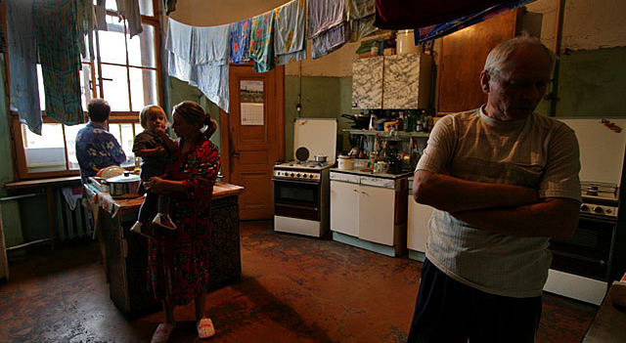
In my typology of world leaders, Vladimir Putin is Dickensian character: from rags to riches in a life that holds high narrative value. This is a photograph of a typical late-Soviet communal apartment, of the kind that Putin grew up in

Slide 32
Charisma is amoral and content-free, as in, “There is nothing either good or bad, but thinking makes it so” (Hamlet). Or, emoting
“Charisma is a certain quality of an individual personality by virtue of which he is set apart from ordinary men and treated as endowed with supernatural, superhuman, or at least specifically exceptional powers or qualities. These are such as are not accessible to the ordinary person, but are regarded as of divine origin or as exemplary, and on the basis of them the individual concerned is treated as a leader.”
Max Weber, The Theory of Social and Economic Organization (Free Press, 1947), 328, 358ff.

Slide 33
Vladimir Putin exemplifies “cold” charisma. Among the three triumvirs that are the subject of this course, he is the only charismatic

Slide 34
There can be no charisma without an audience, whether the leader is a Russian…

Slide 35
…or an American. To understand a charismatic’s policy priorities and methods, look at his audience and its hopes, fears, and expectations

Slide 36
Prime minister Mikhail Mishustin (b. 1966) is often mentioned as Putin’s possible successor

Slide 37
Aleksandr Bortnikov (b. 1951), head of the FSB, or Federal Security Service. He is a leading silovik = “power guy”

Slide 38
Nikolai Patrushev (b. 1951), chair of the Federal Security Council and another powerful silovik

Slide 39
Defense minister Sergei Shoigu (b. 1955) holidaying with Putin in Tuva in September 2021

Slide 40
Foreign minister Sergei Lavrov (b. 1950)

Slide 41
Memento mori = Remember, you will die Apocryphal, but true

Slide 42
Putin is well-informed and well-read, though two decades at the summit of power have inevitably distorted his ability to process advice and information. He is a real maker of memes and would have done well on Twitter. Yet there is also a coarseness about him, which plays well with his target audience. Here we have him joking about poisoned “hobos” (the reference is to the March 4, 2018 attempted assassination of ex-GRU agent Sergei Skripal), commenting on the “give-and-take” among different countries’ intelligence agencies, and saying that spying, like prostitution, is “one of the most important professions in the world”
https://www.youtube.com/watch?v=-7WWImB43kA

Slide 43
After two decades in power, Putin, 69, is the most assertive he has even been on the world stage. The Ukraine crisis has been assiduously furthered and fostered by the Putin administration. The question we should ask is, why the urgency? The image below is from the October 18, 2018 meeting of the Valdai discussion forum at which Putin declared that Ukraine is a “tragedy, not a country” (as I said earlier, he has a way with words)

