Slide 1
OLLI SPRING 2022 TRIUMVIRATE: America, Russia, and China As Global Actors and Rivals
Tuesday, February 1
Lecture One
A Historical Prologue and a Geopolitical Preface

Slide 2
Companion books for our course
Catherine Belton, Putin’s People: How the KGB Took Back Russia and Then Took on the West (New York: Farrar, Straus and Giroux, 2020)
Ray Dalio, Principles for Dealing with the Changing World Order: Why Nations Succeed and Fail (New York: Simon & Schuster, 2021)
Elizabeth C. Economy, The Third Revolution: Xi Jinping and the New Chinese State (New York: Oxford University Press, 2019)
Niall Ferguson, The Politics of Disaster (New York: Penguin, 2021)
Fiona Hill and Clifford G. Gaddy, Mr. Putin: Operative in the Kremlin, 2nd edn. (New York: Brookings Institution Press, 2015)
Paul Kennedy, The Rise and Fall of the Great Powers (New York: Vintage, 2015)
Peter Pomerantsev, Nothing Is True and Everything Is Possible: The Surreal Heart of the New Russia (New York: Public Affairs, 2015)
David Shambaugh, China’s Leaders from Mao to Now (New York: Polity, 2021)
Nassim Taleb, Incerto (comprises Fooled by Randomness, The Black Swan, The Bed of Procrustes, Antifragile, Skin in the Game) (New York: Random House, 2001-19)

Slide 3
In George Orwell’s 1984, three totalitarian powers vie with each other for global supremacy

Slide 4
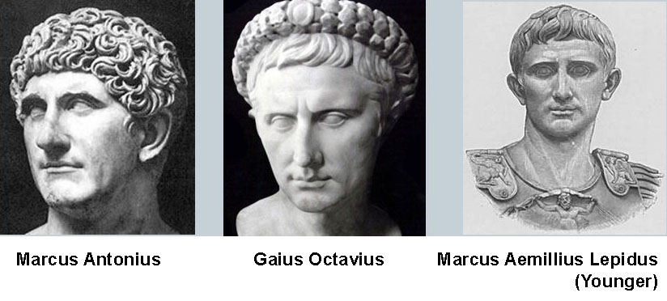
The First (60-53 BCE) and Second (43-32 BCE) Triumvirates of Rome

Slide 5
In the early years of the reign of the child emperor Zhao of Han (94 -74 BCE), three regents, Huo Guang, Jin Midi, and Shangguan Jie, ruled China on his behalf

Slide 6
For the first few years after the fall of Premier Nikita Khrushchev, the Soviet Union was ruled by (left to right) Aleksei Kosygin, Nikolai Podgorny, and Leonid Brezhnev

Slide 7
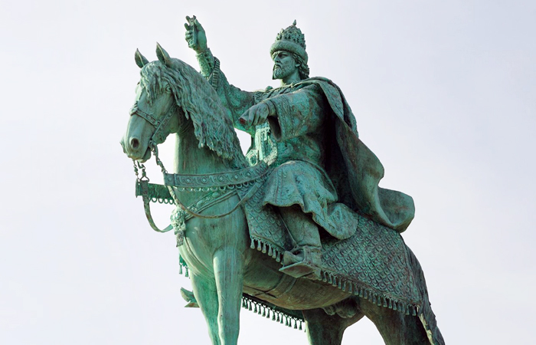
Viktor Vasnetsov, Ivan the Terrible (1897). A monument to the notorious tsar (the first one ever erected) was unveiled in the city of Oryol in 2016. In the year 2022, Ivan the Terrible is very much part of Russia’s national conversation

Slide 8
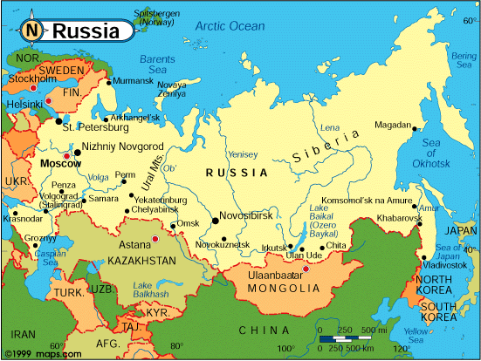
The Tsardom of Muscovy during the reign of Ivan the Terrible and the Russian Federation under Presidents Yeltsin and Putin

Slide 9
There are dozens of armed conflicts taking place in the world today

Slide 10
Some quotes on war as the natural condition of humankind
“No arts; no letters; no society; and which is worst of all, continual fear, and danger of violent death: and the life of man, solitary, poor, nasty, brutish and short” (Thomas Hobbes, Leviathan)
“Making him [the ruler] more despotic at the same time that it augments his kingdom, continuance of this process [of fighting wars] increases his ability to enforce contributions, alike from his original subjects [my emphasis— RT] and from tributaries […]” (Herbert Spencer, The Principles of Sociology)
War is “the original state of things: domination by whoever had the greater might – domination by brute violence or by violence supported by intellect” (Sigmund Freud writing to Albert Einstein)
“I do not know with what weapons World War III will be fought, but World War IV will be fought with sticks and stones” (Albert Einstein, apocryphal)

Slide 11
This photo of US Deputy Secretary of State Wendy Sherman and Russian Deputy Foreign Minister Sergei Rybakov meeting in Geneva on Monday, January 7 has been much used by Russian state media

Slide 12
Surrounded on three sides, Ukraine finds itself in the same strategic position as Poland in August 1939. This, however, does not mean that war is inevitable or even, to quote President Joe Biden, “imminent”

Slide 13
Since the abortive revolution of 2020 President Aleksandr Lukashenko of Belarus has become increasingly dependent on Russia. Putin has been cautious about the pursuit of his geopolitical goals in the ”near” and “far” abroad, often preferring the oblique approach. Russia’s 2014 annexation of the Crimea represented an uncharacteristically decisive move on the part of Putin, who like most politicians prefers to be seen as holding the center ground within the national dispensation of power

Slide 14
Russian troops landing in Kazakhstan on January 6, 2022 as part of a Collective Security Treaty Organization (CSTO) peacekeeping force that arrived in that country at the invitation of President Kassym-Jomart Tokayev, who was facing nation-wide protests against his regime. The peacekeepers have now been withdrawn. The demonstrations in Kazakhstan followed a pattern of other, peaceful or violent, but always unexpected eruptions of popular discontent in Belarus, Armenia, Kyrgyzstan, and Russia itself

Slide 15
Founded in 2015 by Russia and four other former Soviet states, the Eurasian Economic Union (EEU) was conceived as an analogue of the European Union. Together with the CSTO (see previous slide), the EEU belongs to a set of transnational organizations that bring together ex-Soviet states with sometimes very different agendas

Slide 16
The Winter Olympic Games in Beijing will take place on February 4 – February 20. During this period, the Russia-Ukraine conflict is likely to remain frozen

Slide 17
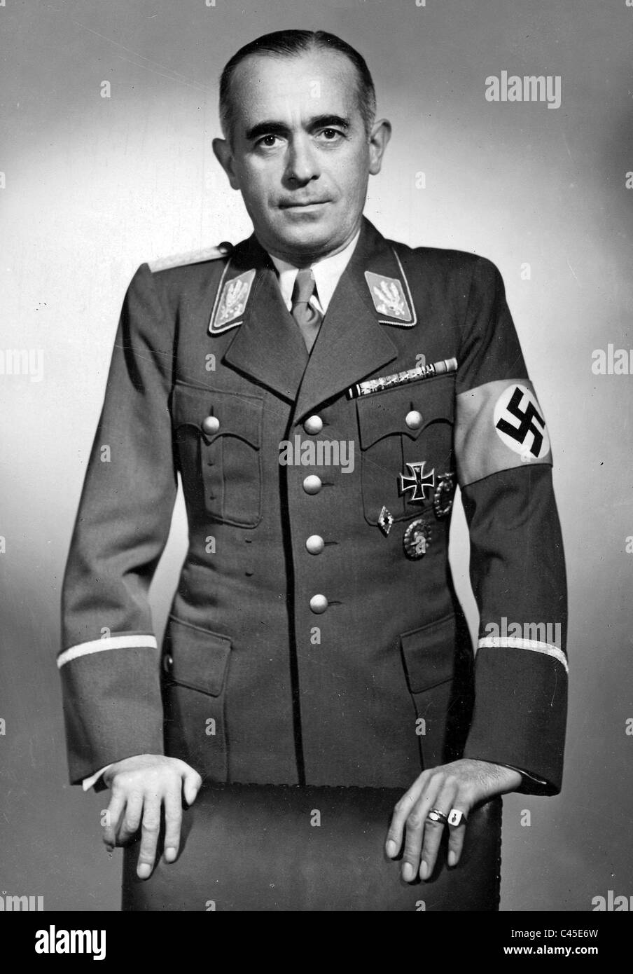
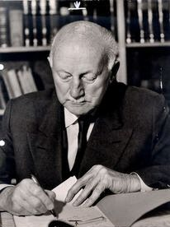
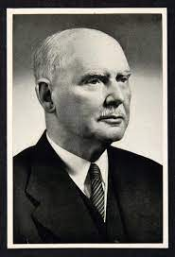
The tradition of the Olympic Games as a propaganda spectacle = exercise in the use of soft power began at the Berlin summer games in 1936. Clockwise from top left: Reichssportführer Hans von Tschammer und Osten (1887-1943), Secretary General of the Organizing Committee of the Berlin games Carl Diem (1882-1962), President of the Organizing Committee of the Berlin Olympics Theodor Lewald (1860-1947), poster for Leni Riefenstahl’s 1938 documentary Olympia

Slide 18
The opening ceremony of the 2008 Beijing Summer Olympics coincided with the start of the Russia-Georgia war

Slide 19
This 1893 portrait of Kaiser Wilhelm II by Ferdinand Keller expresses something of the hubristic overconfidence with which Germany went about trying to win Weltmacht, or world power, in the two decades leading up to World War I

Slide 20
Available from Amazon and other fine book sellers. The design may hark back to the 1950s, but the texts themselves, though coded in party jargon, are highly informative

Slide 21
Below: the defining traits of China’s rise to global (pre)eminence. There are certain parallels here (as well as obvious differences) with Germany’s early twentieth-century quest for Weltmacht
The notion of “comprehensive national power” = a successful foreign policy must include a coordinated balance of political, military, and economic power
A neo-mercantilist calculus of China’s national interest
Consolidation of one-party rule by building up Xi Jinping’s personality cult; restoring, though within limits, the significant myth of Maoist communism; and expanding the communist party’s presence in every walk of life
The policy of “common prosperity,” or a government-led focus on social and economic justice
Technology-enhanced control over the citizens’ public and private lives, though again, within limits, as in China’s social credit system that combines capitalistic and totalitarian elements
Territorial expansion and (a controlled) irredentism
Enhancing China’s armed forces with a view to attaining parity with the United States
The Belt and Road Initiative (think the Berlin-Baghdad Railway)
Emphasis on the development of science and technology

Slide 22
And speaking of hubris — or, rather, not speaking thereof…
命

Slide 23
Alexander Pantsov, Mao: The Real Story (New York: Simon & Schuster, 2013). This revealing biography illustrates the historically central function that the notion and practice of voluntarism plays in Chinese political culture. Mao saw himself, and acted as, a world-historical figure whose will to power trumped even the class struggle. See also the story of Huo Guang, the leading member of the Han-dynasty regency (Slide 5), as recorded in contemporary Chinese sources and celebrated in official and scholarly narratives

Slide 24
Mao Zedong, “Winter Clouds”
Winter clouds snow-laden, cotton fluff flying, None or few of the unfallen flowers. Chill waves sweep through steep skies, Yet earth's gentle breath grows warm. Only heroes can quell tigers and leopards, And wild bears never daunt the brave. Plum blossoms welcome the whirling snow; Small wonder flies freeze and perish.
1962

Slide 25
Nixon in China (1987) by John Adams (b. 1947). This image shows a scene from a February 2020 production by the Scottish Opera, Glasgow. Richard Nixon (Eric Green), Zhou Enlai (Nicholas Lester), Pat Nixon (Julia Sporsén). A heir to Wagner and Mahler (at least, that’s the way I see and hear him), Adams’s operas such as The Death of Klinghoffer (1991) and Doctor Atomic (2005) explore signature, even topical, political events

Slide 26
One of the most famous renversements des alliances in recent history occurred in 1972 when President Richard Nixon visited communist China. The image shows the symbolic gesture that cemented America’s new de facto alliance with the People’s Republic. In his memoirs President Nixon recalls that he “knew that Chou [Zhou] had been deeply insulted by [Eisenhower Secretary of State] Foster Dulles’s refusal to shake hands with him at the Geneva Conference in 1954”

Slide 27
In 1972, the United States stood at the apex of that era’s great power triangle in diplomatic, military, and economic terms

Slide 28
As we shall find out in the next seven weeks, the situation today is very different

