Slide 1
Part One:
Susan Greenfield as neuroscientist, Baroness, and social activist
A Paul Broks conundrum: expertise, creativity -- and mind science fake news?
The Julian Jaynes legacy reconsidered?
Part Two
The Bicameral Mind: finessing The Hard Problem.
The Hard Problem – what the phrase means.
The “bounced Czech” Tom Stoppard.
As a scientific and cultural vortex.
Steven Pinker on Consciousness
The also ubiquitous Deepak Chopra.
The other Bounced Czech: Karel Capek
The Hollywood answer.

Slide 3
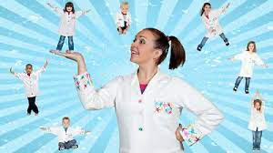
From Paul Broks, The Darker the Night, the Brighter the Stars (2018)
Magical Mush
“You have within your head about a kilo and a half of magical mush. A human brain.” Magical Mush? Oh, Jesus!
“It contains a hundred billion neurons.”
No it doesn’t!
“There are as many neurons in the human brain as stars in our galaxy.”
So what?
“The human brain is the most complex object in the known universe.”
How do you know?
I’m watching a TV documentary about the brain and muttering to myself. It makes me aware that Kate isn’t here because by now, she would have told me to shut up.
Next up is the oft-repeated claim that there are more connections between neurons in the human brain than atoms in the entire universe. Sometimes it’s elementary particles, not atoms. This is a claim that may well be true, though I haven’t seen a mathematical verification. But there are more tunes you can play on a banjo than either of the above. The number of potential tunes is infinite. So what?

Slide 4
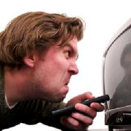
Science is now beginning to shed light on our God-given talents, says the voiceover. Surely, if our talents are God-given there’s no mystery, is there? God gave them. What has science got to do with it. I’m picking narrational nits here, I know. For god’s sake, says Kate, sitting invisibly next to me, give it a rest!

Slide 5
Publisher’s Weekly on The Darker the Night, the Brighter the Stars, 2018
More than a compilation of case studies, Broks’s book is a digressive journey through the subject of human consciousness. He mixes pub banter, philosophy, Greek myths, the “deathbed” music of Estonian composer Arvo Pärt, Paolo Faraldo’s theory of neuronal relativity, Antonio Damasio’s neurobiological search for the self, and many other topics in an attempt to broaden the perspective on neuroscience’s most central question: “how and why physical states of the brain produce mental experiences.” Or, as the author states the question, “How does the insentient, physical stuff of the brain... the 1,200 cubic centimeters of gloop that fills our skulls—how does that stuff create awareness?” Like the box of old family photographs Broks achingly describes, this metascience narrative is well worth sorting through.

Slide 6
[Broks on “ the late Paolo Faraldo, often referred to as the Einstein of neuroscience,” and a colleague named Lewys:]
. . . results were indisputably valid and reliable. Not all human beings are sentient. Roughly speaking, around ten percent are so-called philosophical zombies. We are not
talking here about the shambling undead of those 1950s B-movies and horror comics. Philosophical zombies are an altogether more subtle creation. A philosophical zombie is conceived and born in the usual way, and it grows up and does the same things as the
rest of us. Its brain looks like yours or mine and operates in pretty much the same way. The only difference is that the zombie is insentient. Throughout its entire life it has not the slightest flicker of conscious experience. Zombies laugh and cry just like you and me. They yell and curse when they stub their toe. They say they love you, they say you piss them off. They make orgasm sounds When they're having an orgasm, and sometimes when they're not.
There are straight zombies and gay zombies, liberals and conservatives…

Slide 7
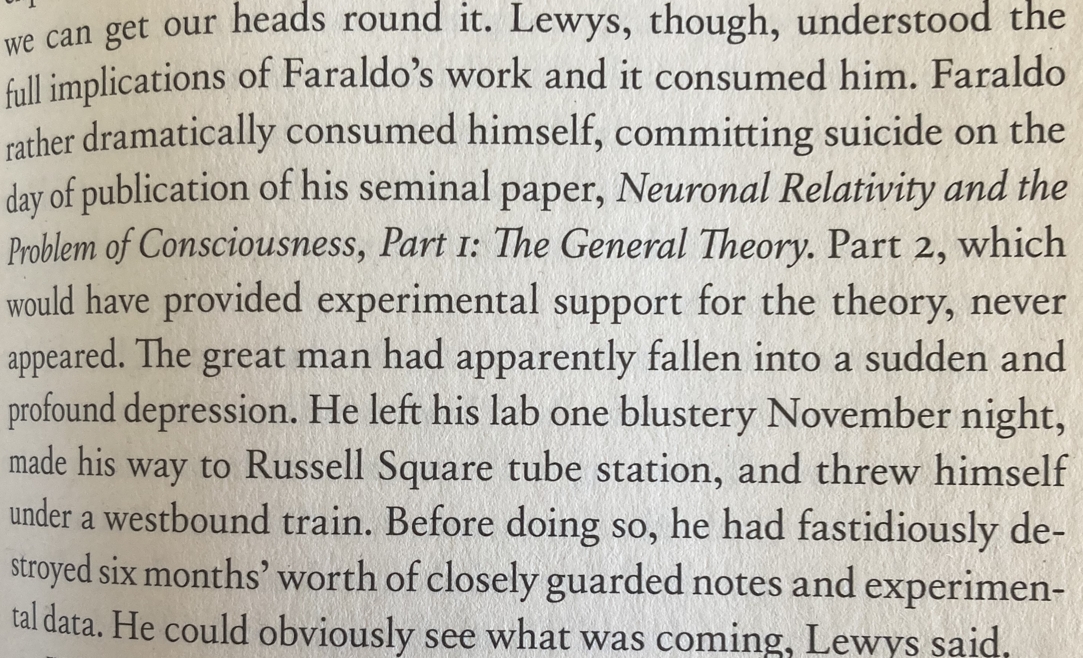

Slide 8
From Broks’s Prologue to The Darker the Night, the Brighter the Stars:
This is not a conventional book and I think you should know what you’re in for. What (I hope) you are about to read is a mix of memoir, neurological case histories, and reflections on life, death, and the mind. I’ve thrown some Greek myths into the pot, and sundry other tales, some true, some not. Fact sits alongside fiction. Science tangles with myth.
… As for the autobiographical stories, I have changed some names, and one or two other inconsequential details, but they are otherwise as true as I could make them. A few minor liberties have been taken with the Greek myths, but, really, that’s what you’re supposed to do. All stories, fact and fiction, hang loosely around two perennial questions: What are we? and How should we live?

Slide 9
The (reliable?) Dr. Broks summarizing Julian Jaynes:
I suppose what I'm suggesting is little more than a variation on the Julian Jaynes theme of psychotic voice-hearing as a vestige of the "bicameral minds" of the Homeric heroes. in his much-disputed (detractors say crackpot) account of the history of consciousness, the American psychologist claimed that it is only recently -- since the second millennium BCE --that human beings have felt themselves to be the authors of their own thoughtsand actions. Prior to that, behavior was directed by hallucinated voices perceived to be of external, supernatural origin (although actually arising from the right hemisphere of the brain). "There is in general no consciousness in the lliad," says Jaynes in support of his thesis. "And in general therefore, no words for consciousness or mental acts." Achilles and Agamemnon were, effectively,
automata -- puppets of the gods.

Slide 14
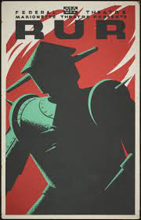
R. U. R. (ROSSUM’S UNIVERSAL ROBOTS)
A Fantastic Melodrama in Three Acts and an Epilogue
By Karel Capek
English version by Paul Selver and Nigel Playfair
(1920)

Slide 15
[Final scene of the play]
Helena. Oh, Primus, don’t bother with the secret of life. What does it matter to you? Come and look quick.
Primus. (Goes to R. of window) What is it?
Helena. See how beautiful the sun is rising. I feel so strange today. It’s as if I was in a dream. I feel an aching in my body, in my heart, all over me. Primus, perhaps I’m going to die.
Primus. Do you not sometimes feel that it would be better to die? You know, perhaps even now we are only sleeping. Last night in my sleep I again spoke to you.
Helena. In your sleep?
Primus. Yes. We spoke a strange new language.
Helena. What about?
Primus. I did not understand it myself, and yet I know I have never said anything more beautiful. And when I touched you I could have died. Even the place was different from any other place in the world.
Helena. I, too, have found a place, Primus. It is very strange. Human beings dwelt there once, but now it is overgrown with weeds. . . . What am I for, Primus?

Slide 16
Alquist. What, you would protect her? Laughter—timidity—protection—I must test you further. Take the girl into the dissecting room.
Primus. Why?
Alquist. I wish to experiment on her.
Primus. Upon—Helena?
Alquist. Of course. Don’t you hear me? Or must I call someone else to take her in?
Primus. If you do, I will kill you. (Steps toward Alquist.)
Alquist. Kill me—kill me, then. What will your future be?
Primus. Sir, take me. I am made on the same day as she is. Take my life, sir. (Step to Alquist.)
Helena. No, no, you shall not.

Slide 17
Alquist. Wait, girl, wait. (To Primus) Do you not wish to live, then?
Primus. Not without her. I will not live without her.
Alquist. Very well, I will use you. Into the dissecting room with you.
Helena. Primus. Primus. (She bursts into tears and moves R. Alquist stops her.)
Alquist. Child, child, you can weep. Tears. What is Primus to you? One Primus more or less in the world—what does it matter?
Helena. I will go myself.
Alquist. Where? Into the dissecting room?
Helena. (Crosses to R.) Yes. In there—to be cut. (Primus stops her from going.) Let me pass, Primus, let me pass.
Primus. You shall not go in there, Helena.
Helena. If you go in there and I do not, I will kill myself.
Primus. (To Alquist) I will not let you. Man, you shall kill neither of us.
Alquist. Why?
Primus. We—we—belong to each other.
Alquist. Go. (Exit Primus and Helena L.) Adam—Eve.

