Slide 1
Amuse bouches
Mass-media dust-ups about DSM 5
--ruining the racket of literature profs?
Steven Pinker et. al on structure in the mind
PIXAR runs with the ball!
AI wonks (in the movies, at least) finesse The Hard Problem
The Great Shwarzenegger, HAL, and a menacing Oscar Issacs!
Messing with the Mind – actual research … and Hollywood:
Christopher Nolan’s new gimmicks -- and old ones?
Fun and games from the past fifteen minutes.

Slide 2
What this country needs is a good five-cent synthesis.

Slide 4
How Long Should It Take to Grieve? Psychiatry Has Come Up With an Answer.
Ellen Barry
New York Times, March 18, 2022
The latest edition of the DSM-5, sometimes known as “psychiatry’s bible,” includes a controversial new diagnosis: prolonged grief disorder.
. . . critics of the idea have argued vigorously against categorizing grief as a mental disorder, saying that the designation risks pathologizing a fundamental aspect of the human experience.
They warn that there will be false positives — grieving people told by doctors that they have mental illnesses when they are actually emerging, slowly but naturally, from their losses. . . .
And they fear grief will be seen as a growth market by drug companies that will try to persuade the public that they need medical treatment to emerge from mourning.

Slide 5
“I completely, utterly disagree that grief is a mental illness,” said Joanne Cacciatore, an associate professor of social work at Arizona State University who has published widely on grief, and who operates the Selah Carefarm, a retreat for bereaved people.
“When someone who is a quote-unquote expert tells us we are disordered and we are feeling very vulnerable and feeling overwhelmed, we no longer trust ourselves and our emotions,” Dr. Cacciatore said. “To me, that is an incredibly dangerous move, and short sighted.”

Slide 6
QUEEN GERTRUDE Good Hamlet, cast thy nighted colour off,
And let thine eye look like a friend on Denmark.
Do not for ever with thy vailed lids
Seek for thy noble father in the dust:
Thou know'st 'tis common; all that lives must die,
Passing through nature to eternity.
HAMLET Ay, madam, it is common.
QUEEN GERTRUDE If it be,
Why seems it so particular with thee?
HAMLET Seems, madam! nay it is; I know not 'seems.’
'Tis not alone my inky cloak, good mother,
Nor customary suits of solemn black,
Nor the dejected 'havior of the visage,
Together with all forms, moods, shapes of grief,
That can denote me truly: these indeed seem,
For they are actions that a man might play:
But I have that within which passeth show;
These but the trappings and the suits of woe.

Slide 7
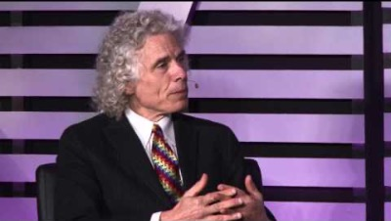

Slide 12
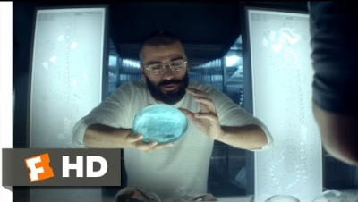

Slide 13
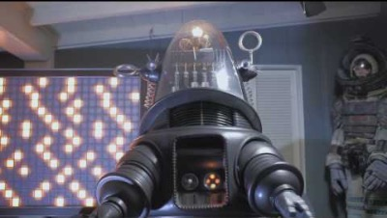

Slide 15
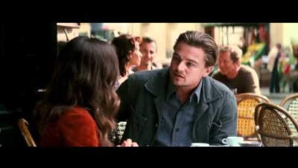

Slide 20
