Slide 1
Now, we should be clear here: social theory always, necessarily, involves a bit of simplification. For instance, almost any human interaction might be said to have a political aspect, an economic aspect, a psychological aspect, and so forth. Social theory is largely a game of make-believe in which we pretend, just for the sake of argument, that there’s just one thing going on: essentially, we reduce everything to a cartoon so as to be able to detect patterns that would be otherwise invisible. As a result, all real progress in social science has been routed in the courage to say things that are, in the final analysis, slightly ridiculous: the work of Karl Marx, Sigmund Freud or Claude Levi-Strauss being only particularly salient cases in point. One must simplify the world to discover something new about it. The problem comes when, long after the discovery has been made, people continue to simplify.
David Graeber and David Wengrow
The Dawn of Everything: A New History of Humanity (2021)
p.21

Slide 2
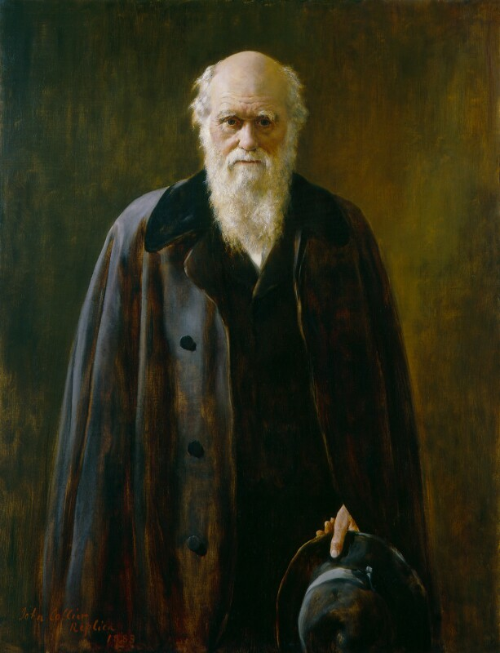
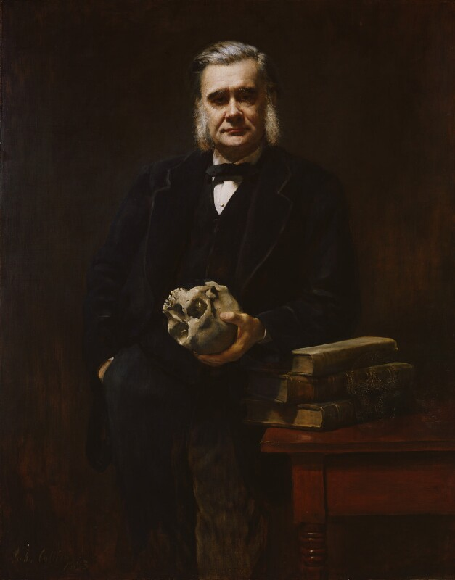
Darwin in 1881
Thomas Henry Huxley in 1885

Slide 3
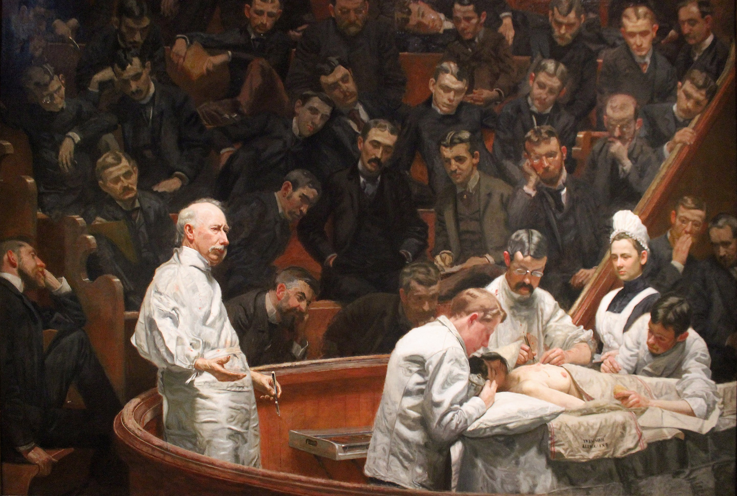
Thomas Eakins
The Agnew
Clinic
1889

Slide 4
Week Three
Gilded Age Mind-science, Quackery, and resistance from American Women and Minority Voices
Part One:
S. Weir Mitchell’s “Rest Cure” and George Miller Beard’s American Nervousness
Charlotte Perkins Gilman, “The Yellow Wallpaper”
Gilded Age patent remedies for ‘nervous’ women
Part Two:
Kate Chopin’s The Awakening
W. E. B. Dubois, from The Souls of Black Folk
Elizabeth Cady Stanton, “The Solitude of Self”

Slide 5
From the opening pages of American Nervousness, summarizing the pedigree and reception of Beard’s study:
https://hdl.handle.net/2027/coo1.ark:/13960/t3qv43r7r?urlappend=%3Bseq=12

Slide 6
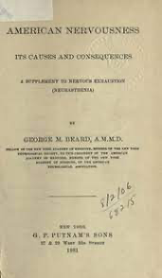
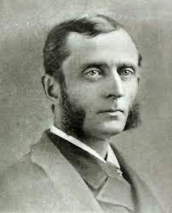
George Beard, American Nervousness: Its Causes and Consequences. A Supplement to Nervous Exhaustion (Neurasthenia) (1881)
[From the Preface]
To those who are beginning the study of this interesting theme, the following epitome of the
philosophy of this work may be of assistance, as a preliminary to a detailed examination.
First. Nervousness is strictly deficiency or lack of nerve-force. This condition, together with all the symptoms of diseases that are evolved from it, has developed mainly within the nineteenth century, and is especially frequent and severe in the Northern and Eastern portions of the United States.
Nervousness, in the sense here used, is to be distinguished rigidly and systematically from simple excess of emotion and from organic disease.
Secondly. The chief and primary cause of this development and very rapid increase of nervousness is modern civilization, which is distinguished from the" ancient by these five characteristics : steam power, the periodical press, the telegraph, the sciences, and the mental activity of women.

Slide 7
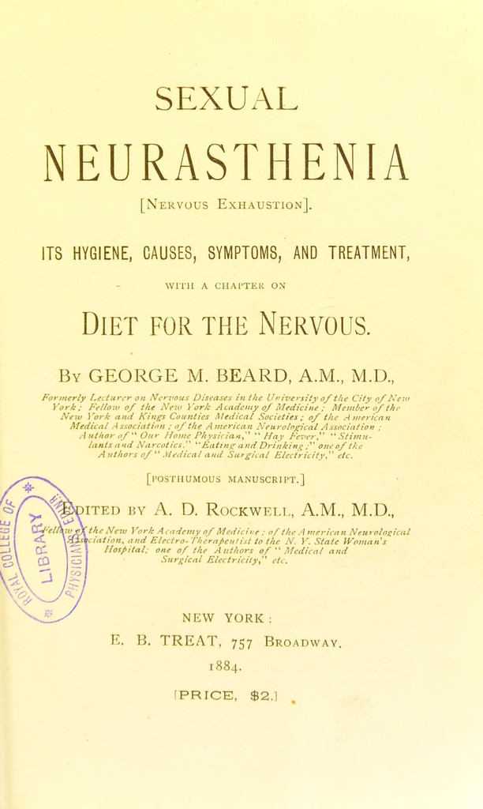
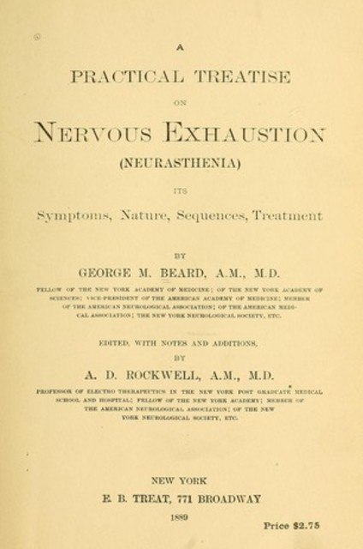
Fourth. The sign and type of functional nervous diseases that are evolved out of this general
nerve sensitiveness is, neurasthenia (nervous exhaustion), which is in close and constant relation with such functional nerve maladies as certain physical forms of hysteria, hay-fever, sick-headache, inebriety, and some phases of insanity; is, indeed, a branch whence at early or later stages of growth these diseases may take their origin.
Fifth. The greater prevalence of nervousness in America is a complex resultant of a number of influences, the chief of which are dryness of the air, extremes of heat and cold, civil and religious liberty, and the great mental activity made necessary and possible in a new and productive country under such climatic conditions.
A new crop of diseases has sprung up in America, of which Great Britain until lately knew nothing, or but little. A class of functional diseases of the nervous system, now beginning to be known everywhere in civilization, seem to have first taken root under an American sky, whence their seed is being distributed.
All this is modern, and originally American; and no age, no country, and no form of civilization … in the days of their glory, possessed such maladies. Of all the facts of modern sociology, this rise and growth of functional nervous disease in the northern part of America is one of the most stupendous, complex, and suggestive; to solve it in all its interlacings . .. and trace them back to their sources and forward to their future developments, is to solve the problem of sociology itself.

Slide 8
Sixth. Among the signs of American nervousness specially worthy of attention are the following: The nervous diathesis; susceptibility to stimulants and narcotics . . . ; increase of the nervous diseases inebriety and neurasthenia (nervous exhaustion), hay-fever, neuralgia, nervous dyspepsia … and allied diseases and symptoms ; early and rapid decay of teeth ; premature baldness; . . . increase of diseases not exclusively nervous, as diabetes, and certain forms of Bright's disease . . . ; unprecedented beauty of American women, frequency of trance and muscle-reading; the strain of dentition, puberty, and change of life ; American oratory, humor, speech, and language; . . . and the greater intensity of animal life on this continent.
. . .
Some of the views herein contained have passed long since through the three stages through which all new truths must pass before they enter into the fellowship of science; the stage of indifference, the stage of denial, the stage of contests of priority ; others are passing out of the second and third of these stages, and others still have not yet passed, or are but be- ginning to pass out of the era of indifference. It is worthy of comment that some of the most iconoclastic of the truths here announced, those which, when first made known, years since, were believed to indicate insanity on the part of the author, and were felt to threaten the stability of the science to which they belong, have already become so interwoven with our medical literature, that their philosophy and their terminology are met with every
day and every hour in reading and in conversation; out of these researches a number of books have been published . . . [and] more, as I learn, are in preparation; in this new and immense field, there is room for an army of workers.

Slide 9
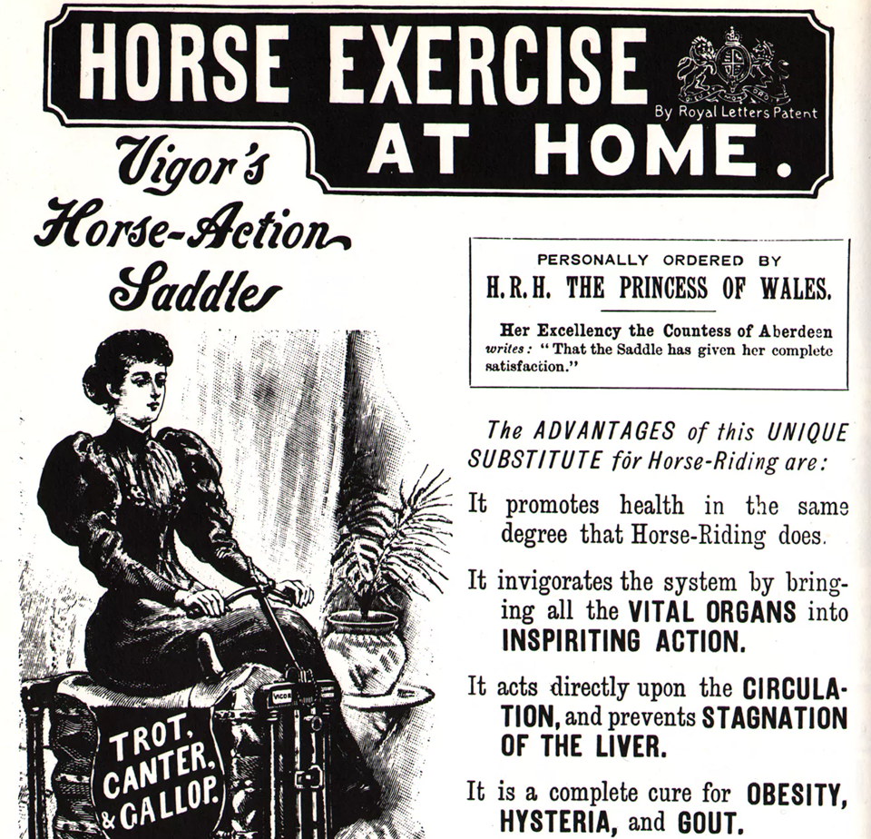
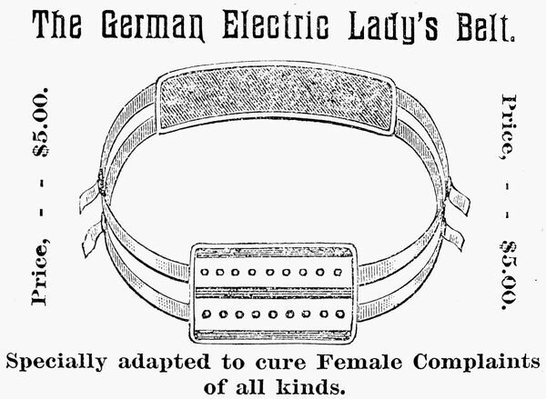
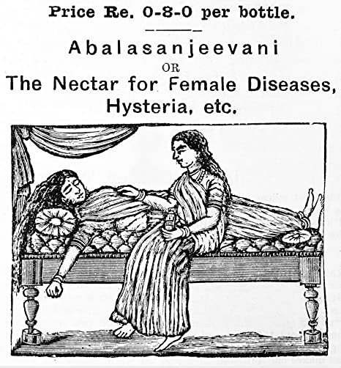
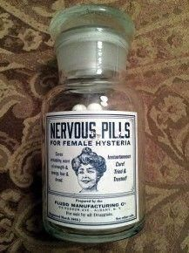
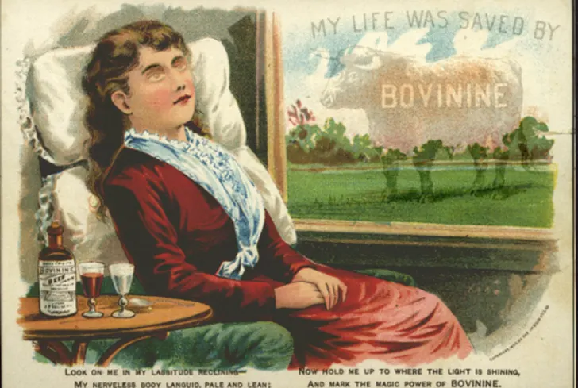
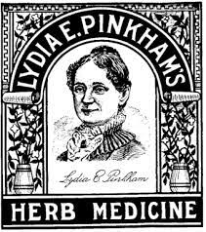

Slide 10
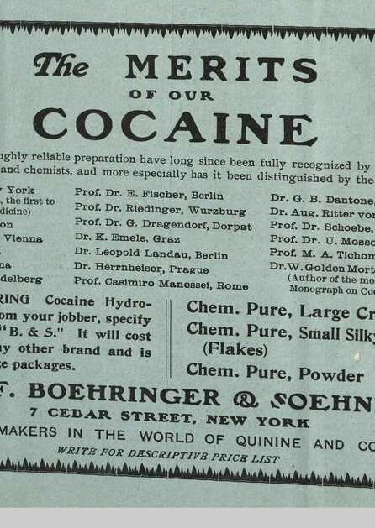

Slide 11
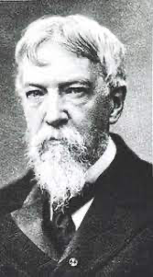
S. Weir Mitchell, from Fat and Blood: An Essay on the Treatment of Certain Forms of Neurasthenia and Hysteria (1877):
Just as it is desirable to change the home of the patient, her diet, her atmosphere, so also is it well, for the mere alterative value of such change, to surround her with strangers and to put aside any nurse with whom she may have grown familiar. As I have sometimes succeeded in treating invalids in their own homes, so have I occasionally been able to carry through cases nursed by a mother, or sister, or friend of exceptional firmness; but to attempt this is to be heavily handicapped, and the position should never be accepted if it be possible to make other arrangements. . ..
The degree of seclusion should be prescribed from the first, and it is far better to find that the original rules may be profitably relaxed than to be obliged to draw the lines more strictly when the patient has at first been indulged. For instance, it is well to forbid the receipt of any letters from home, unless anxious relatives insist that the patient must have home news. In that case the letters should be mere bulletins, should contain nothing, no matter how trifling, that might annoy a too sensitive person, and, most important of all, should come to the nurse and by her be read to the patient.

Slide 12
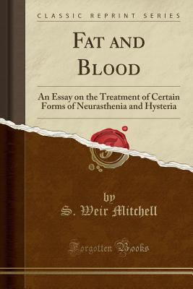
So many nervous people are worried with indecision, with inability to make up their minds to the simplest actions, that to have the responsibility of choice taken away greatly lessens their burdens. It lessens, too, the burdens which may be placed upon them by outside action if they can refuse this or that because they are under orders as to hours.
The following is a skeleton form of such a schedule. The hours, the food, the occupations suggested in each one will vary according to the sex, age, position, desires, intelligence, and opportunities of the patient.
7.30 A.M. Cocoa, coffee, hot milk, beef-extract, or hot water. Bath (temperature stated). Rough rub with towel or flesh-brush: bathing and rubbing may be done by attendant. Lie down a few minutes after finishing.
8.30 A.M. Breakfast in bed. (Detail as to diet. Tonic, aperient, malt extract as ordered.) May read letters, paper, etc., if eyes are good.

Slide 13
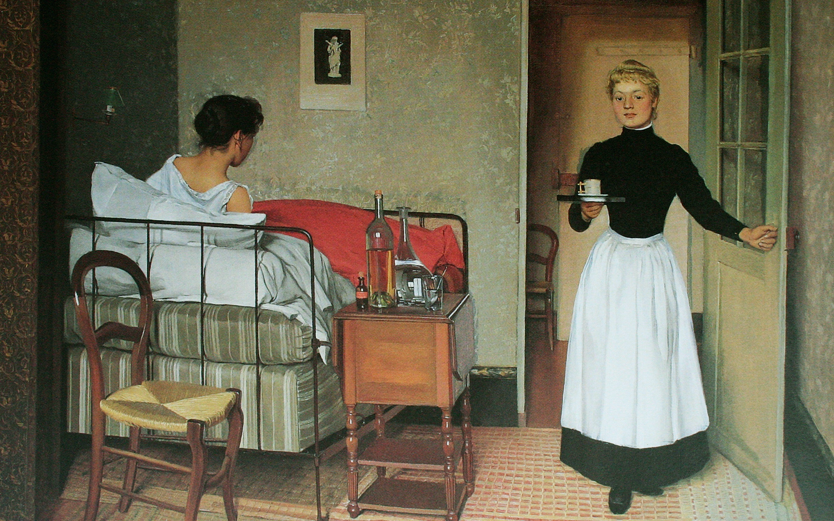
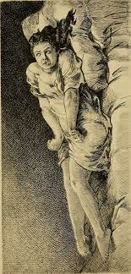
10-11 A.M. Massage, if required, is usually ordered one hour after breakfast; or Swedish movements are given at that time. An hour's rest follows massage. Less rest is needed after the movements. (Milk or broth after massage.)
12 Noon. Rise and dress slowly. If gymnastics or massage are not ordered, may rise earlier. May see visitors, attend to household affairs, or walk out.
1.30 P.M. Luncheon. (Malt, tonic, etc., ordered.) In invalids this should be the chief meal of the day. Rest, lying down, not in bed, for an hour after.
3 P.M. Drive (use street-cars or walk) one to two and a half hours. (Milk or soup on return.)
7 P.M. Supper. (Malt, tonic, etc., ordered; detail of diet.)
Bed at 10 P.M. Hot milk or other food at bedtime.
This schedule is modified for convalescent patients after rest-treatment by orders as to use of the eyes: letter-writing is usually forbidden, walking distinctly directed or forbidden, as the case may require. . . .

Slide 14
In carrying out my general plan of treatment in extreme cases it is my habit to ask the patient to remain in bed from six weeks to two months. At first, and in some cases for four or five weeks, I do not permit the patient to sit up, or to sew or write or read, or to use the hands in any active way except to clean the teeth.
Perhaps a sketch of one of these cases will be better than any list of symptoms. A woman, most often between twenty and thirty years of age, undergoes a season of trial or encounters some prolonged strain. She may have undertaken the hard task of nursing a relative, and have gone through this severe duty with the addition of emotional excitement, swayed by hopes and fears, and forgetful of self . . . . In another set of cases an illness is the cause, and she never rallies entirely, or else some local uterine trouble starts the mischief, and, although this is cured, the doctor wonders that his patient does not get fat and ruddy again.
… the woman grows pale and thin, eats little, or if she eats does not profit by it. Everything wearies her,—to sew, to write, to read, to walk,—and by and by the sofa or the bed is her only comfort. … Then comes the mischievous role of bromides, opium, chloral, and brandy. If the case did not begin with uterine troubles, they soon appear, and are usually treated in vain if the general means employed to build up the bodily health fail, as in many of these cases they do fail. . . . If no rescue comes, the fate of women thus disordered is at last the bed. They acquire tender spines, and furnish the most lamentable examples of all the strange phenomena of hysteria.
…

Slide 15
Charlotte Perkins Gilman, from “The Yellow Wall-Paper” (1899):
John is practical in the extreme. He has no patience with faith, an intense horror of superstition, and he scoffs openly at any talk of things not to be felt and seen and put down in figures.
John is a physician, and perhaps—(I would not say it to a living soul, of course, but this is dead paper and a great relief to my mind)—perhaps that is one reason I do not get well faster.
You see, he does not believe I am sick!
And what can one do?
If a physician of high standing, and one’s own husband, assures friends and relatives that there is really nothing the matter with one but temporary nervous depression—a slight hysterical tendency—what is one to do?
My brother is also a physician, and also of high standing, and he says the same thing.
So I take phosphates or phosphites—whichever it is, and tonics, and journeys, and air, and exercise, and am absolutely forbidden to “work” until I am well again.
Personally, I disagree with their ideas.
Personally, I believe that congenial work, with excitement and change, would do me good.

Slide 16
But what is one to do?
I did write for a while in spite of them; but it does exhaust me a good deal—having to be so sly about it, or else meet with heavy opposition.
I sometimes fancy that in my condition if I had less opposition and more society and stimulus—but John says the very worst thing I can do is to think about my condition, and I confess it always makes me feel bad.
So I will let it alone and talk about the house. . . .
I am glad my case is not serious!
But these nervous troubles are dreadfully depressing.
John does not know how much I really suffer. He knows there is no reason to suffer, and that satisfies him.
Of course it is only nervousness. It does weigh on me so not to do my duty in any way!
I meant to be such a help to John, such a real rest and comfort, and here I am a comparative burden already!

Slide 17
I suppose John never was nervous in his life. He laughs at me so about this wallpaper!
At first he meant to repaper the room, but afterwards he said that I was letting it get the better of me, and that nothing was worse for a nervous patient than to give way to such fancies.
He said that after the wallpaper was changed it would be the heavy bedstead, and then the barred windows, and then that gate at the head of the stairs, and so on.
“You know the place is doing you good,” he said, “and really, dear, I don’t care to renovate the house just for a three months’ rental.”
“Then do let us go downstairs,” I said, “there are such pretty rooms there.”
….
But he is right enough about the beds and windows and things.
It is as airy and comfortable a room as any one need wish, and, of course, I would not be so silly as to make him uncomfortable just for a whim.
I’m really getting quite fond of the big room, all but that horrid paper.

Slide 18
John says if I don’t pick up faster he shall send me to Weir Mitchell in the fall.
But I don’t want to go there at all. I had a friend who was in his hands once, and she says he is just like John and my brother, only more so!
Besides, it is such an undertaking to go so far.
I don’t feel as if it was worthwhile to turn my hand over for anything, and I’m getting dreadfully fretful and querulous.
I cry at nothing, and cry most of the time.
Of course I don’t when John is here, or anybody else, but when I am alone.
And I am alone a good deal just now. John is kept in town very often by serious cases, and Jennie is good and lets me alone when I want her to.
So I walk a little in the garden or down that lovely lane, sit on the porch under the roses, and lie down up here a good deal.
I’m getting really fond of the room in spite of the wallpaper. Perhaps because of the wallpaper.
It dwells in my mind so!

Slide 19
I’m feeling ever so much better! I don’t sleep much at night, for it is so interesting to watch developments; but I sleep a good deal in the daytime.
In the daytime it is tiresome and perplexing.
. . .
It is the strangest yellow, that wallpaper! It makes me think of all the yellow things I ever saw—not beautiful ones like buttercups, but old foul, bad yellow things.
But there is something else about that paper—the smell! I noticed it the moment we came into the room, but with so much air and sun it was not bad. Now we have had a week of fog and rain, and whether the windows are open or not, the smell is here.
It creeps all over the house.
. . .
In this damp weather it is awful. I wake up in the night and find it hanging over me.
It used to disturb me at first. I thought seriously of burning the house—to reach the smell.
But now I am used to it. The only thing I can think of that it is like is the color of the paper! A yellow smell.

Slide 20
I don’t want to go outside. I won’t, even if Jennie asks me to.
For outside you have to creep on the ground, and everything is green instead of yellow.
But here I can creep smoothly on the floor, and my shoulder just fits in that long smooch around the wall, so I cannot lose my way.
Why, there’s John at the door! …
Then he said—very quietly indeed, “Open the door, my darling!”
“I can’t,” said I. “The key is down by the front door under a plantain leaf!”
…
“What is the matter?” he cried. “For God’s sake, what are you doing!”
I kept on creeping just the same, but I looked at him over my shoulder.
“I’ve got out at last,” said I, “in spite of you and Jane! And I’ve pulled off most of the paper, so you can’t put me back!”
Now why should that man have fainted? But he did, and right across my path by the wall, so that I had to creep over him every time!

Slide 21
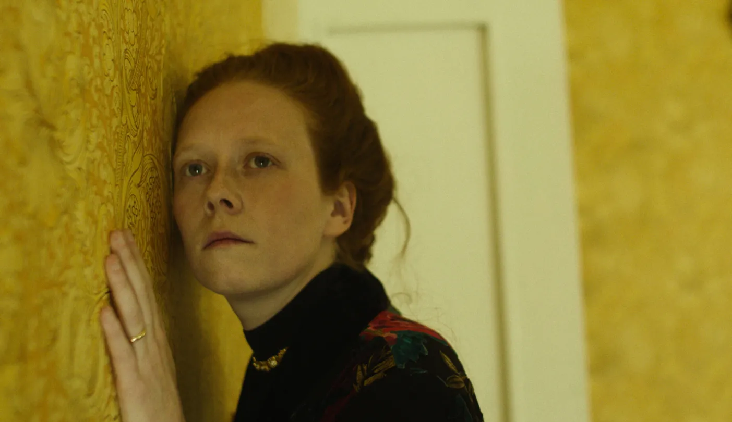

Slide 22
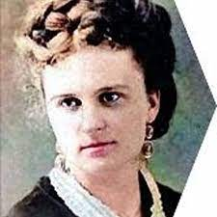
From Kate Chopin, The Awakening, 1899
It was then past midnight. The cottages were all dark. A single faint light gleamed out from the hallway of the house. There was no sound abroad except the hooting of an old owl in the top of a water-oak, and the everlasting voice of the sea, that was not uplifted at that soft hour. It broke like a mournful lullaby upon the night.
The tears came so fast to Mrs. Pontellier’s eyes that the damp sleeve of her peignoir no longer served to dry them. She was holding the back of her chair with one hand; her loose sleeve had slipped almost to the shoulder of her uplifted arm. Turning, she thrust her face, steaming and wet, into the bend of her arm, and she went on crying there, not caring any longer to dry her face, her eyes, her arms. She could not have told why she was crying. Such experiences as the foregoing were not uncommon in her married life. They seemed never before to have weighed much against the abundance of her husband’s kindness and a uniform devotion which had come to be tacit and self-understood.
An indescribable oppression, which seemed to generate in some unfamiliar part of her consciousness, filled her whole being with a vague anguish. It was like a shadow, like a mist passing across her soul’s summer day. It was strange and unfamiliar; it was a mood. She did not sit there inwardly upbraiding her husband, lamenting at Fate, which had directed her footsteps to the path which they had taken. She was just having a good cry all to herself.

Slide 23
“How does she act?” inquired the Doctor.
“Well, it isn’t easy to explain,” said Mr. Pontellier, throwing himself back in his chair. “She lets the housekeeping go to the dickens.”
“Well, well; women are not all alike, my dear Pontellier. We’ve got to consider—”
“I know that; I told you I couldn’t explain. Her whole attitude—toward me and everybody and everything—has changed. . . . She’s making it devilishly uncomfortable for me,” he went on nervously. “She’s got some sort of notion in her head concerning the eternal rights of women; and—you understand—we meet in the morning at the breakfast table.”
The old gentleman lifted his shaggy eyebrows, protruded his thick nether lip, and tapped the arms of his chair with his cushioned fingertips.
“What have you been doing to her, Pontellier?”
“Doing! Parbleu!”
“Has she,” asked the Doctor, with a smile, “has she been associating of late with a circle of pseudo-intellectual women—super-spiritual superior beings? My wife has been telling me about them.”
“That’s the trouble,” broke in Mr. Pontellier, “she hasn’t been associating with anyone. She has abandoned her Tuesdays at home, has thrown over all her acquaintances, and goes tramping about by herself, moping in the street-cars, getting in after dark. I tell you she’s peculiar. I don’t like it; I feel a little worried over it.”

Slide 24
“Send your wife up to the wedding,” exclaimed the Doctor, foreseeing a happy solution. “Let her stay among her own people for a while; it will do her good.”
“That’s what I want her to do. She won’t go to the marriage. She says a wedding is one of the most lamentable spectacles on earth. Nice thing for a woman to say to her husband!” exclaimed Mr. Pontellier, fuming anew at the recollection.
“Pontellier,” said the Doctor, after a moment’s reflection, “let your wife alone for a while. Don’t bother her, and don’t let her bother you. Woman, my dear friend, is a very peculiar and delicate organism—a sensitive and highly organized woman, such as I know Mrs. Pontellier to be, is especially peculiar. It would require an inspired psychologist to deal successfully with them. And when ordinary fellows like you and me attempt to cope with their idiosyncrasies the result is bungling. Most women are moody and whimsical. This is some passing whim of your wife, due to some cause or causes which you and I needn’t try to fathom. But it will pass happily over, especially if you let her alone. Send her around to see me.”

Slide 25
. . .
[Edna and the Doctor]
“The trouble is,” sighed the Doctor, grasping her meaning intuitively, “that youth is given up to illusions. It seems to be a provision of Nature; a decoy to secure mothers for the race. And Nature takes no account of moral consequences, of arbitrary conditions which we create, and which we feel obliged to maintain at any cost.”
“Yes,” she said. “The years that are gone seem like dreams—if one might go on sleeping and dreaming—but to wake up and find—oh! well! perhaps it is better to wake up after all, even to suffer, rather than to remain a dupe to illusions all one’s life.”
“It seems to me, my dear child,” said the Doctor at parting, holding her hand, “you seem to me to be in trouble. I am not going to ask for your confidence. I will only say that if ever you feel moved to give it to me, perhaps I might help you. I know I would understand. And I tell you there are not many who would—not many, my dear.”
“Some way I don’t feel moved to speak of things that trouble me. Don’t think I am ungrateful or that I don’t appreciate your sympathy. There are periods of despondency and suffering which take possession of me. But I don’t want anything but my own way. That is wanting a good deal, of course, when you have to trample upon the lives, the hearts, the prejudices of others—but no matter—still, I shouldn’t want to trample upon the little lives. Oh! I don’t know what I’m saying, Doctor. Good night. Don’t blame me for anything.”

Slide 27
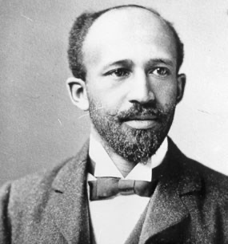
W.E.B. DuBois, from The Souls of Black Folk, (1903):
So dawned the time of Sturm und Drang: storm and stress to-day rocks our little boat on the mad waters of the world-sea; there is within and without the sound of conflict, the burning of body and rending of soul; inspiration strives with doubt, and faith with vain questionings. The bright ideals of the past,—physical freedom, political power, the training of brains and the training of hands,—all these in turn have waxed and waned, until even the last grows dim and overcast. Are they all wrong,—all false? No, not that, but each alone was over-simple and incomplete,—the dreams of a credulous race-childhood, or the fond imaginings of the other world which does not know and does not want to know our power. . . . We the darker ones come even now not altogether empty-handed: there are to-day no truer exponents of the pure human spirit of the Declaration of Independence than the American Negroes; there is no true American music but the wild sweet melodies of the Negro slave; the American fairy tales and folklore are Indian and African; and, all in all, we black men seem the sole oasis of simple faith and reverence in a dusty desert of dollars and smartness. Will America be poorer if she replace her brutal dyspeptic blundering with light-hearted but determined Negro humility? or her coarse and cruel wit with loving jovial good-humor? or her vulgar music with the soul of the Sorrow Songs?

Slide 28
They must perpetually discuss the “Negro Problem,”—must live, move, and have their being in it, and interpret all else in its light or darkness. With this come, too, peculiar problems of their inner life,—of the status of women, the maintenance of Home, the training of children, the accumulation of wealth, and the prevention of crime. All this must mean a time of intense ethical ferment, of religious heart-searching and intellectual unrest. From the double life every American Negro must live, as a Negro and as an American, as swept on by the current of the nineteenth while yet struggling in the eddies of the fifteenth century,—from this must arise a painful self-consciousness, an almost morbid sense of personality and a moral hesitancy which is fatal to self-confidence. The worlds within and without the Veil of Color are changing, and changing rapidly, but not at the same rate, not in the same way; and this must produce a peculiar wrenching of the soul, a peculiar sense of doubt and bewilderment. Such a double life, with double thoughts, double duties, and double social classes, must give rise to double words and double ideals, and tempt the mind to pretence or revolt, to hypocrisy or radicalism.

Slide 29
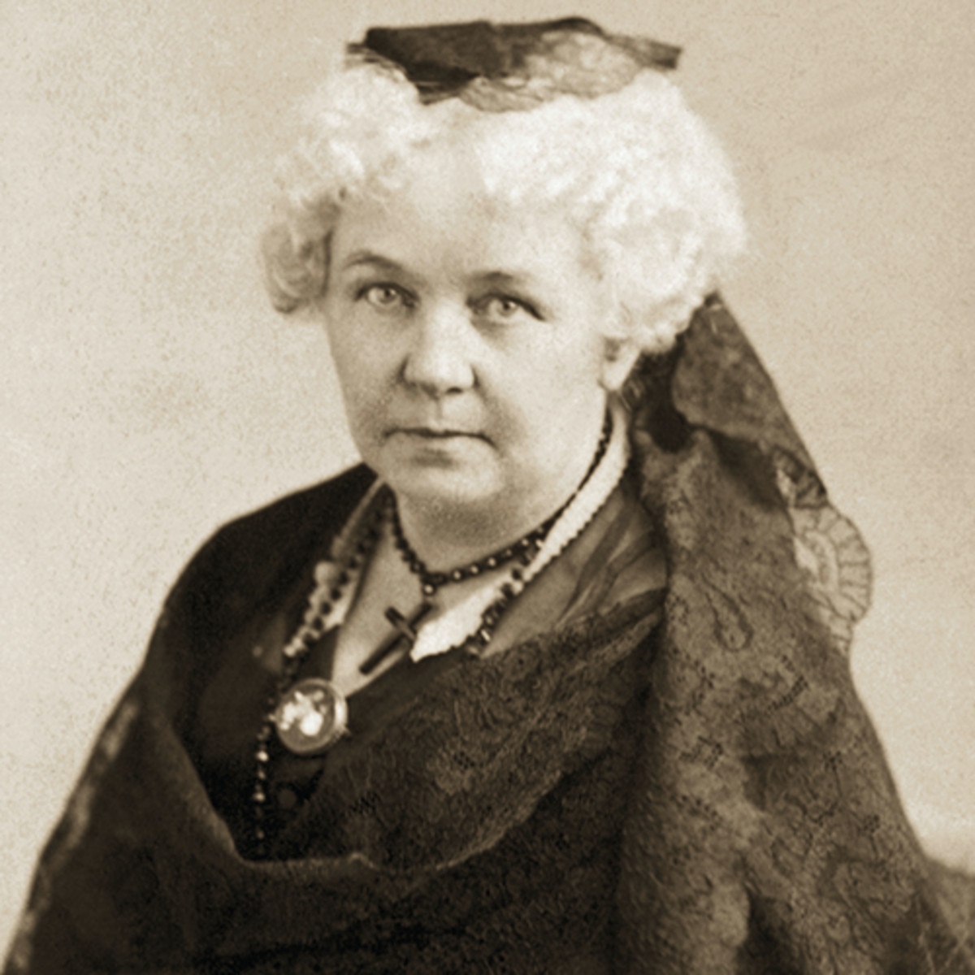
Elizabeth Cady Stanton, from “The Solitude of Self,” speech before the House Judiciary Committee, 1892:
The strongest reason for giving woman all the opportunities for higher education, for the full development of her faculties, forces of mind and body; for giving her the most enlarged freedom of thought and action; a complete emancipation from all forms of bondage, of custom, dependence, superstition; from all the crippling influences of fear — is the solitude and personal responsibility of her own individual life. The strongest reason why we ask for woman a voice in the government under which she lives; in the religion she is asked to believe; equality in social life, where she is the chief factor; a place in the trades and the professions, where she may earn her bread, is because of her birth-right to self-sovereignty; because, as an individual, she must rely on herself.

Slide 30
We come into the world alone, unlike all who have gone before us, we leave it alone, under circumstances peculiar to ourselves. No mortal ever has been, no mortal ever will be like the soul just launched on the sea of life. There can never again be just such a combination of prenatal influences; never again just such environments as make up the infancy, youth and manhood of this one. Nature never repeats herself, and the possibilities of one human soul will never be found in another. No one has ever found two blades of ribbon grass alike, and no one will ever find two human beings alike. Seeing, then, what must be the infinite diversity in human character, we can in a measure appreciate the loss to a nation when any large class of people is uneducated and unrepresented in the government.
…
Alone, we are hunted and hounded through dark courts and alleys, in byways and highways; alone we stand in the judgment seat; alone in the prison cell we lament our crimes and misfortunes; alone we expiate them on the gallows. In hours like these we realize the awful solitude of individual life, its pains, its penalties, its responsibilities; hours in which the youngest and the most helpless are thrown on their own resources for guidance and consolation. Seeing, then, that life must ever be a march and a battle, that each soldier must be equipped for his own protection, it is the height of cruelty to rob the individual of a single natural right.

Slide 31
In that solemn solitude of self, that links us with the immeasurable and the eternal, each soul lives alone forever. A recent writer says: “I remember once, in crossing the Atlantic, to
have gone upon the deck of the ship at midnight, when a dense black cloud enveloped the sky, and the great deep was roaring madly under the lashes of demoniac winds. . . .Again I remembered to have climbed the slopes of the Swiss Alps, up beyond the point where vegetation ceases, and the stunted conifers no longer struggle against the unfeeling blasts. Around me lay a huge confusion of rocks, out of which the gigantic ice peaks shot into the measureless blue of the heavens; and again my only feeling was the awful solitude!”
And yet, there is a solitude which each and every one of us has always carried with him, more inaccessible than the ice-cold mountains, more profound than the midnight sea; the solitude of self. Our inner being which we call ourself, no eye nor touch of man or angel has ever pierced. It is more hidden than the caves of the gnome; the sacred adytum of the oracle; the hidden chamber of Eleusinian mystery, for to it only omniscience is permitted to enter.
Such is individual life. Who, I ask you, can take, dare take on himself the rights, the duties, the responsibilites of another human soul?

