Slide 1
Week Six
Mind-science -- Direct to the Public!
Part One:
Oliver Sacks
Daniel Dennett
Antonio Damasio
Part Two:
The legacy of Julian Jaynes
Paul Broks
Steven Pinker
Susan Greenfield

Slide 2
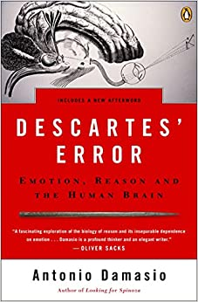
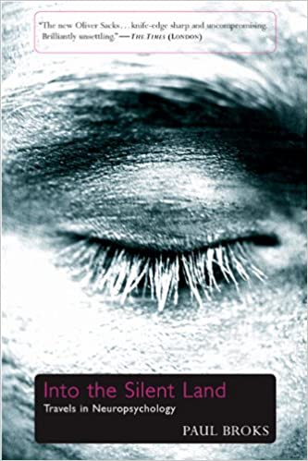
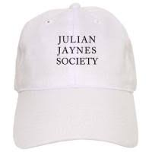
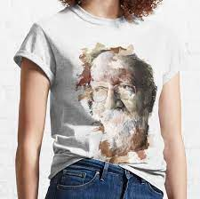
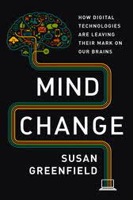
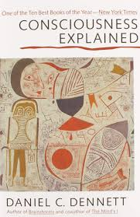
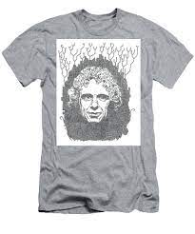
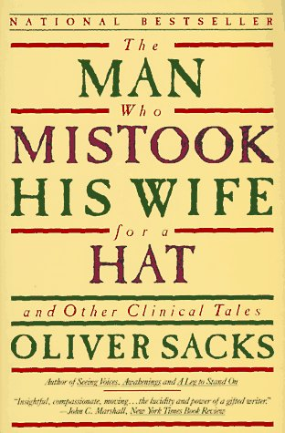
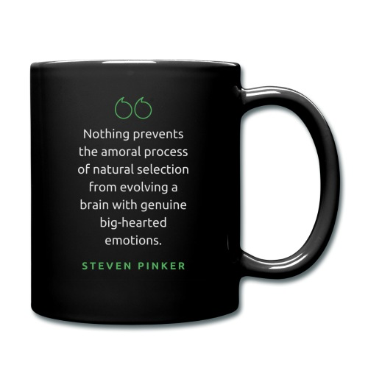
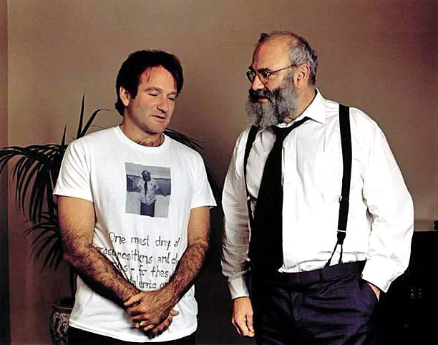

Slide 3
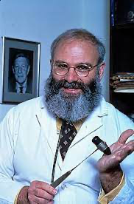
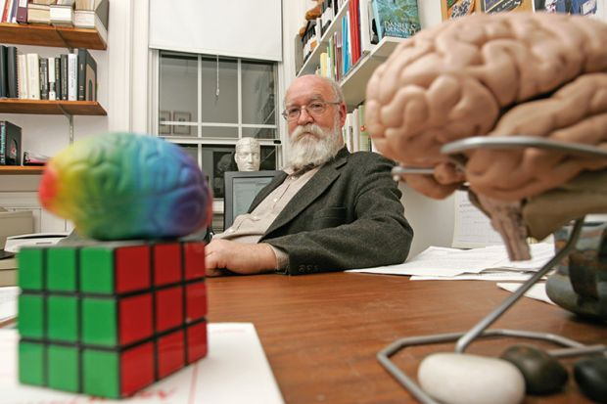
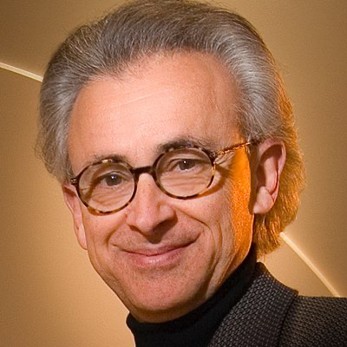
Oliver Sacks (1933-2015)
Daniel Dennett (1942 - )
Antonio Damasio (1944- )

Slide 4
Trailer for Ric Burns’s movie about Oliver Sacks
https://www.youtube.com/watch?v=yfEUtPg2Uzc

Slide 5
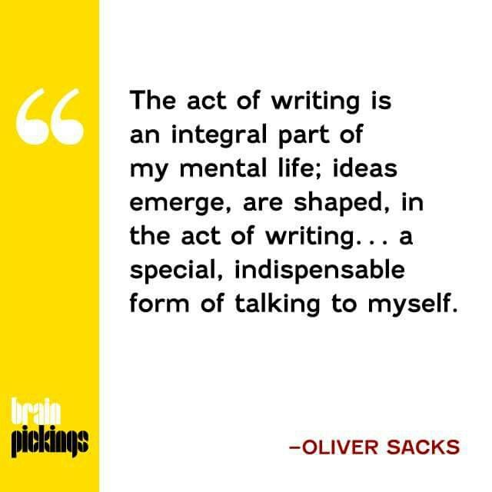
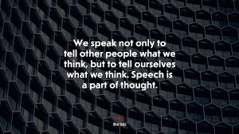
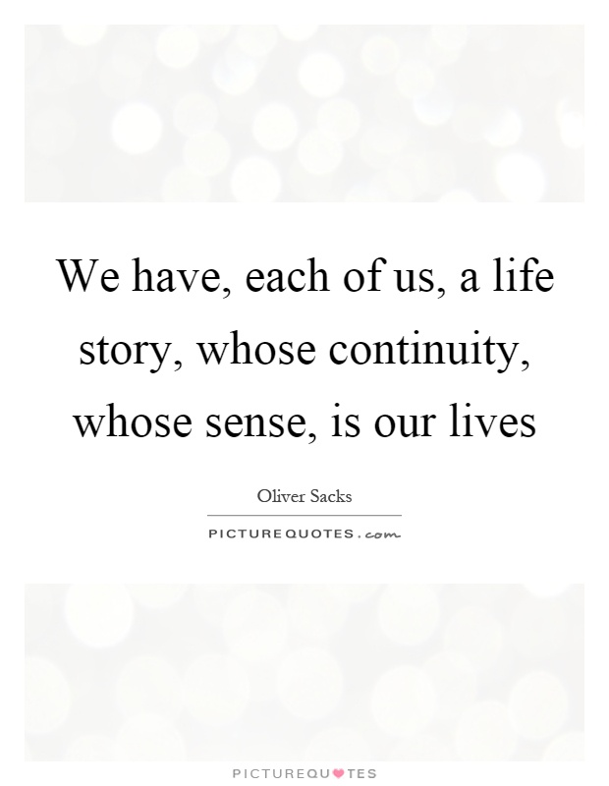
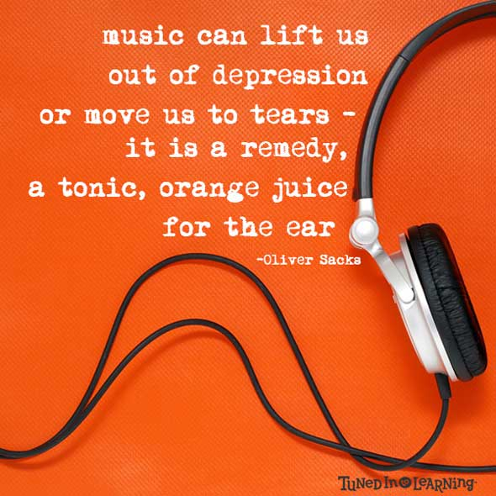
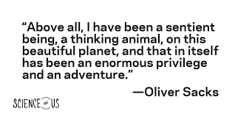

Slide 6
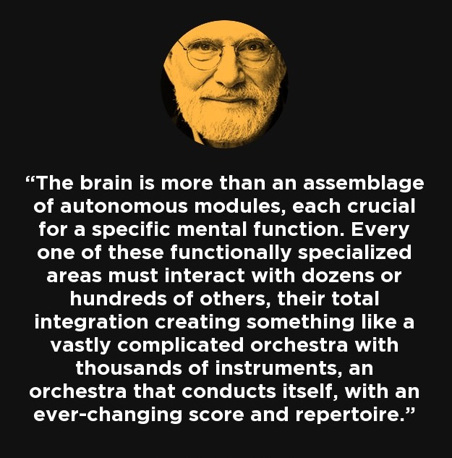

Slide 7
Daniel Dennett talking (in chapel) about consciousness
https://www.youtube.com/watch?v=IL6I0aHQEO8

Slide 9
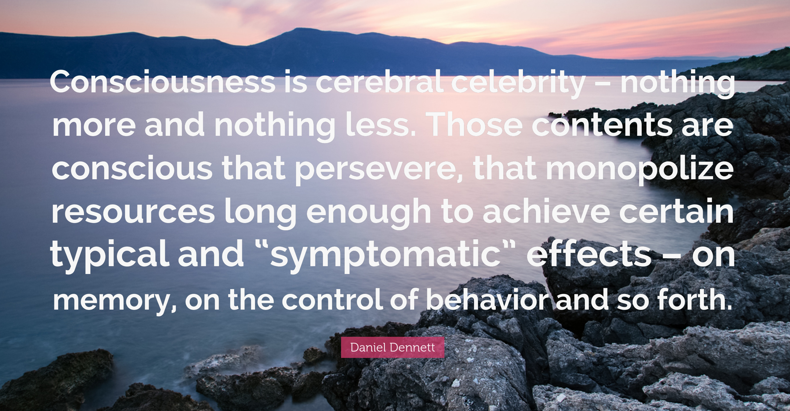
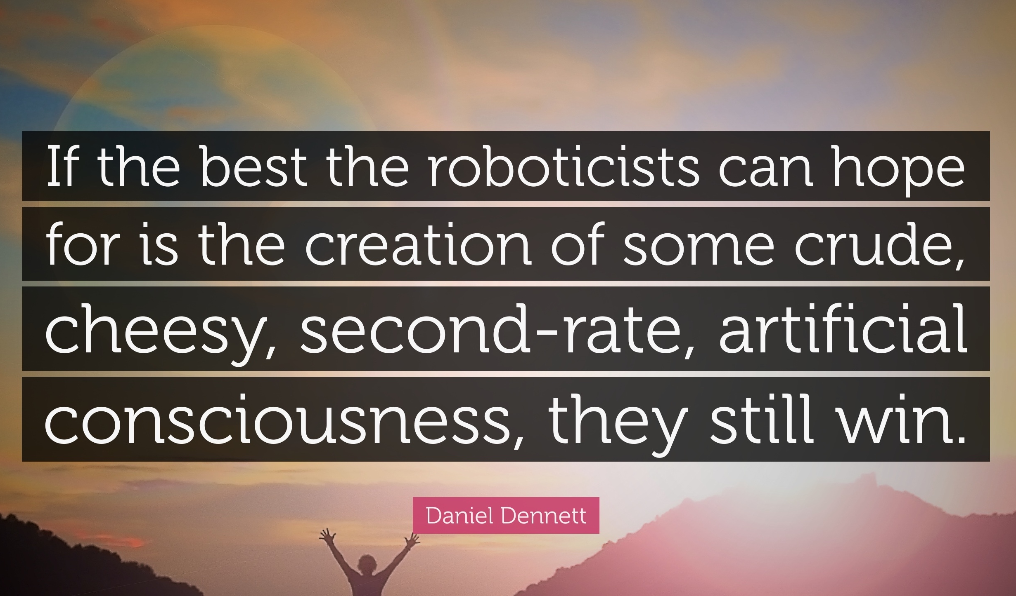

Slide 10
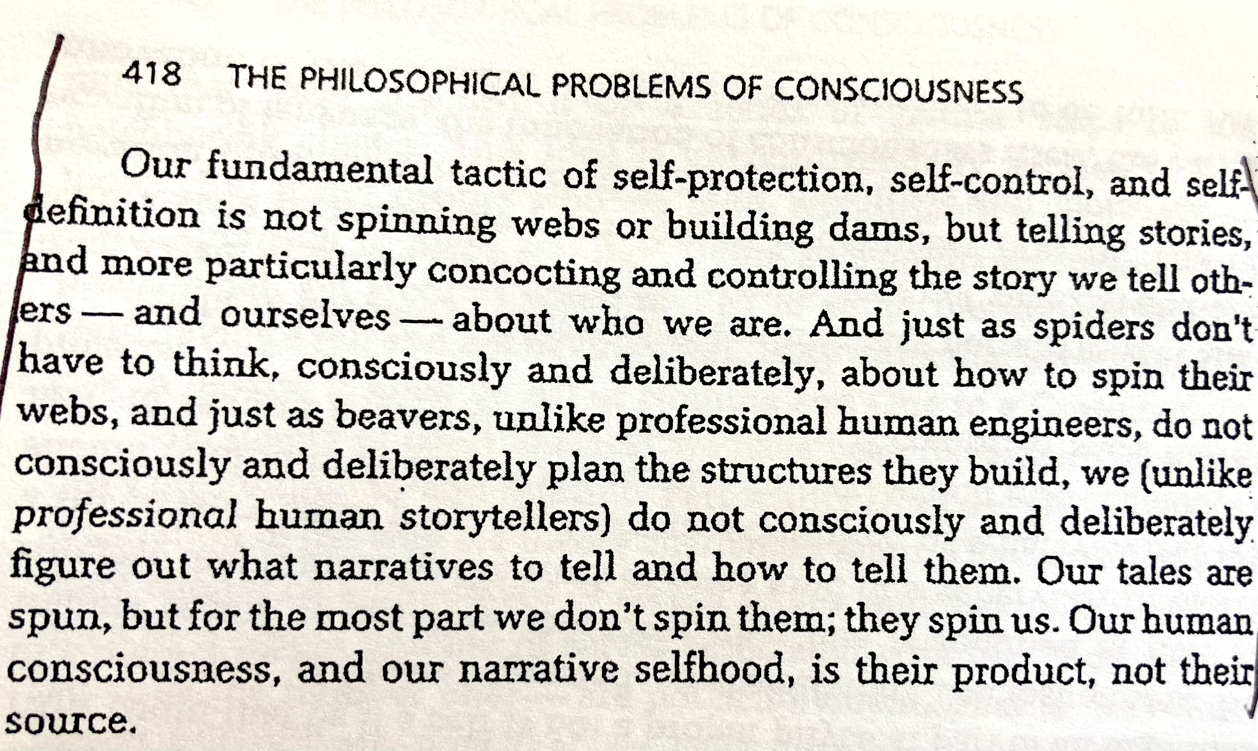

Slide 11
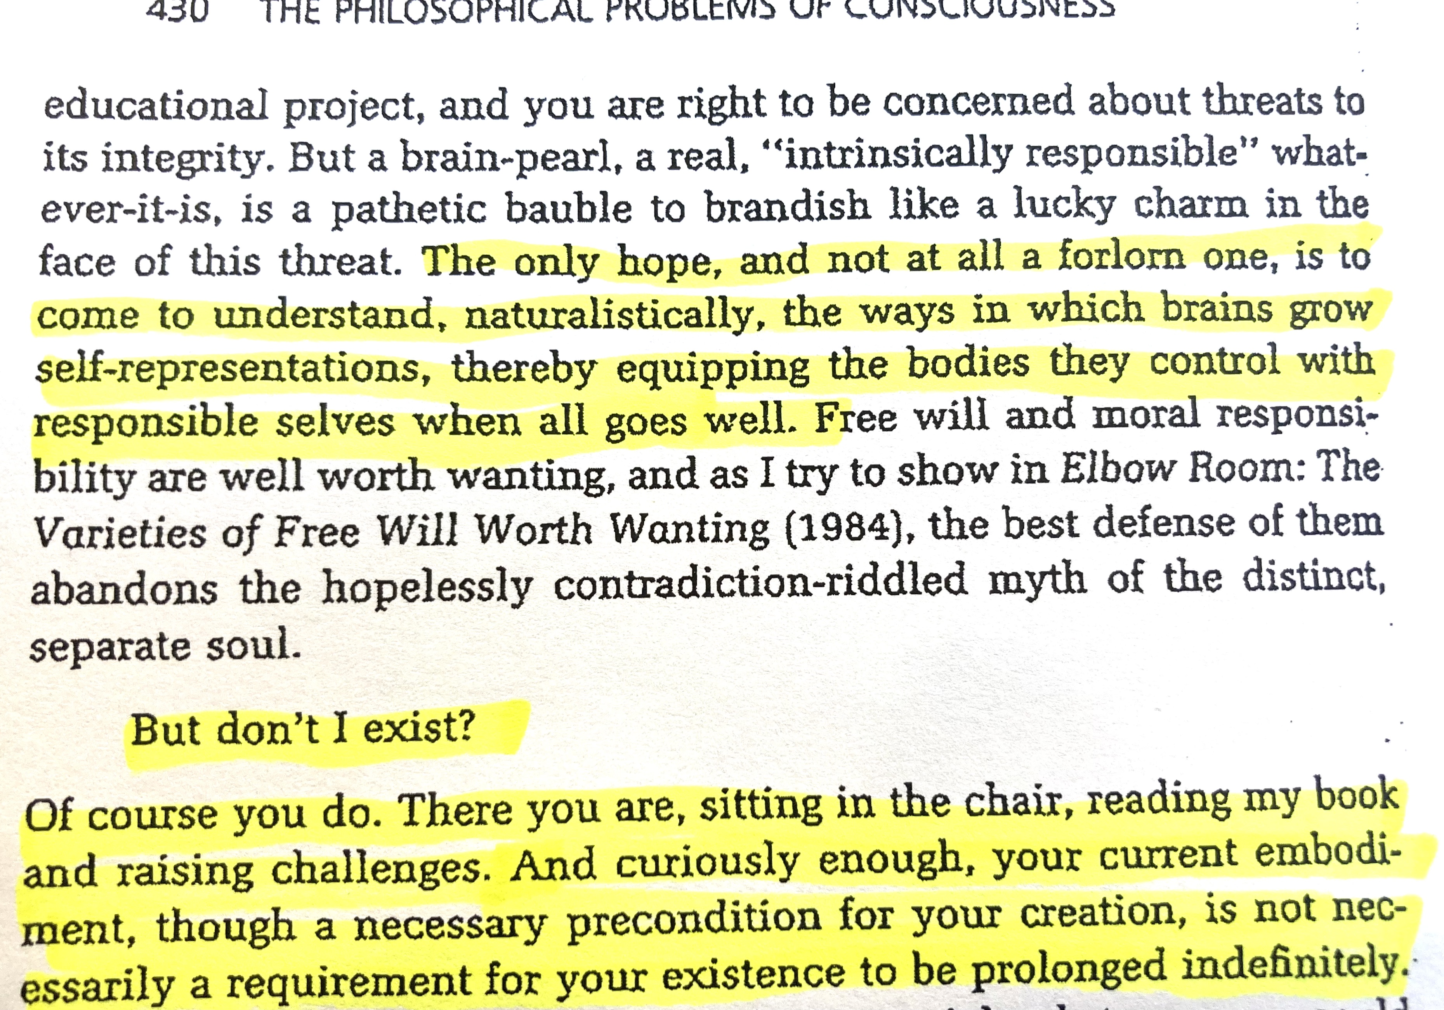

Slide 12
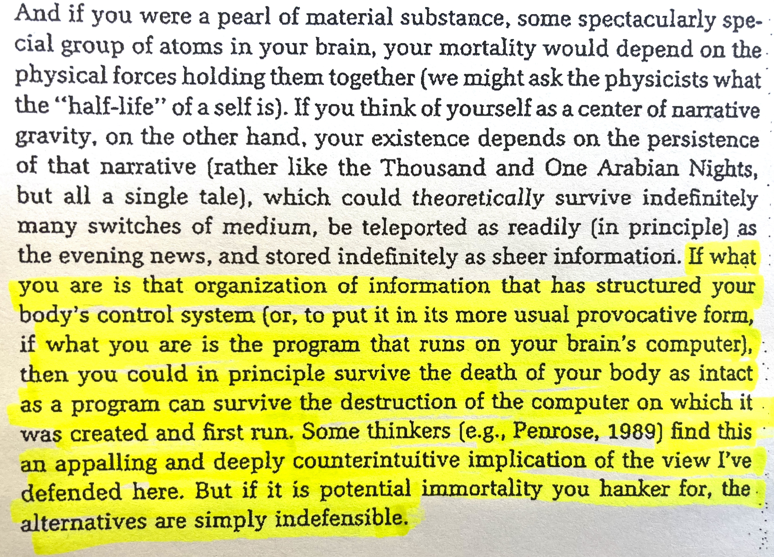

Slide 13
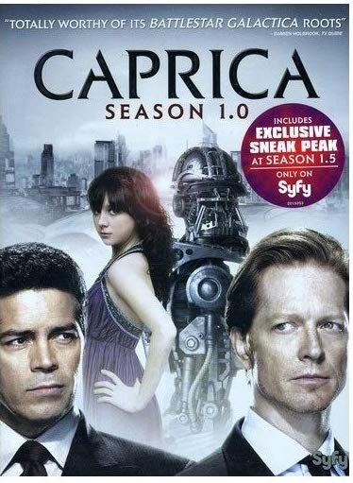

Slide 14
Damasio on Consciousness and Feeling -- Templeton Foundation speech
https://www.youtube.com/watch?v=ilrelFkDYls

Slide 15
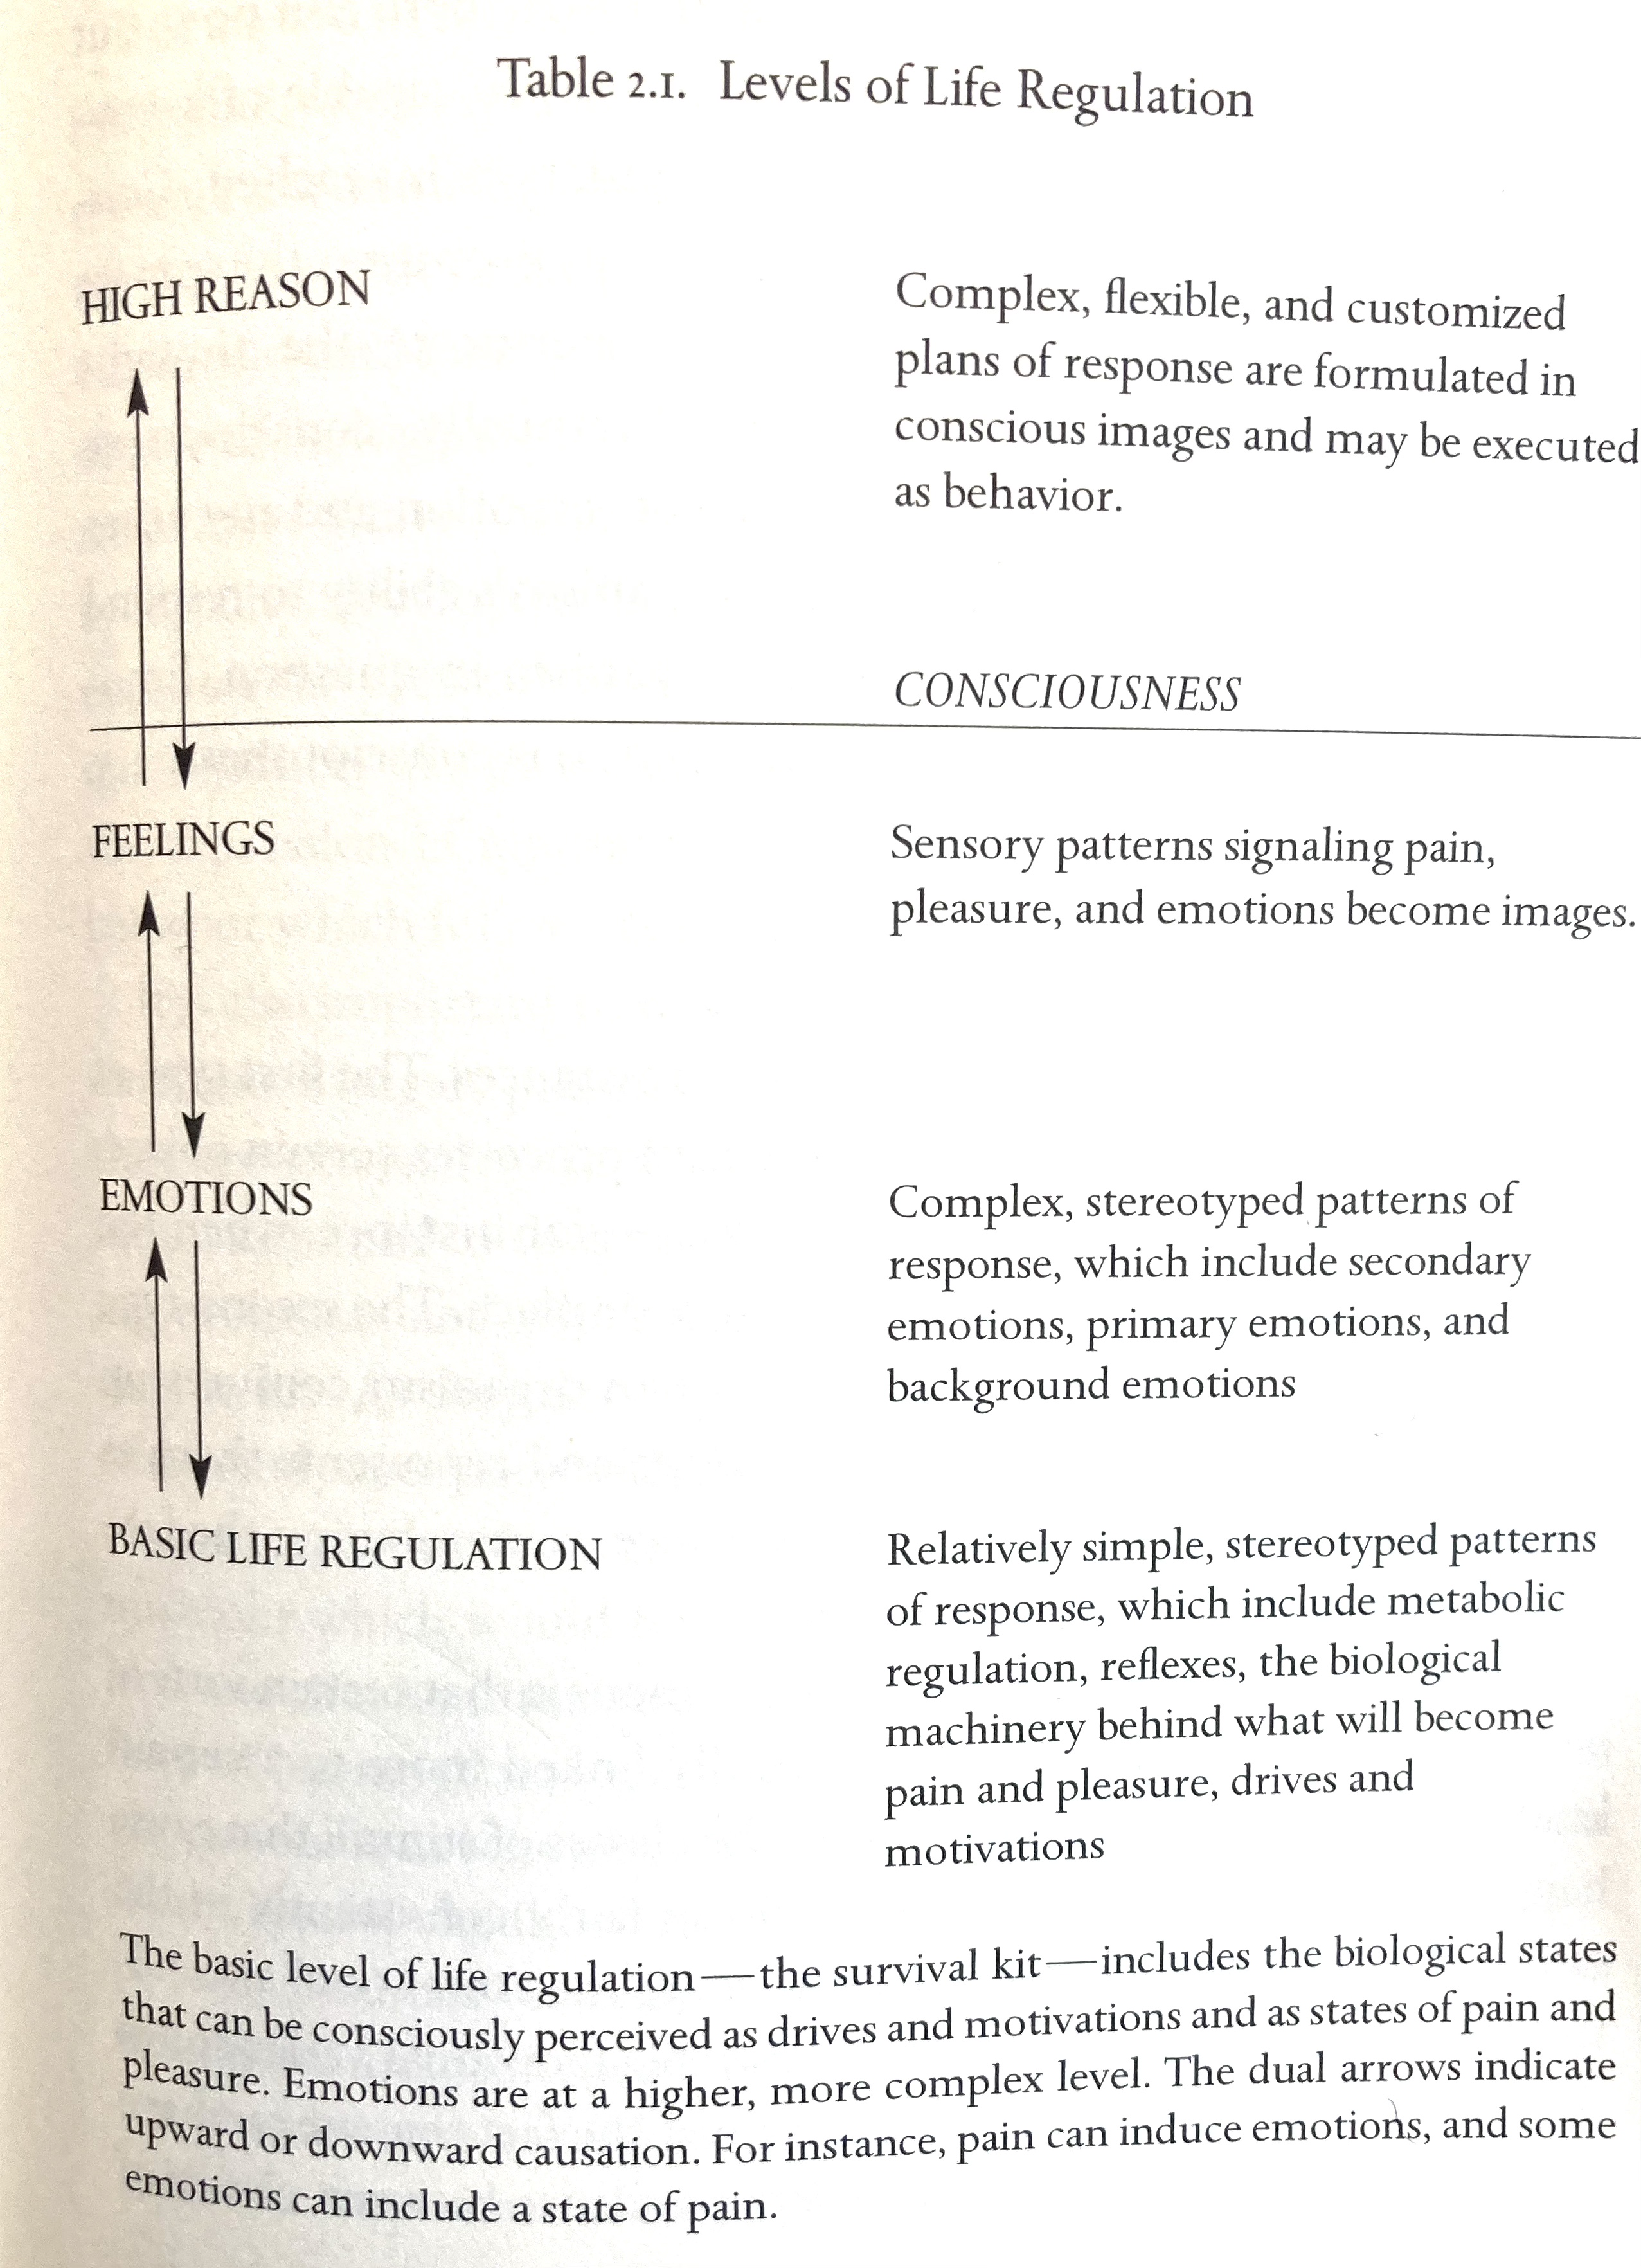
Damasio, from The Feeling of What Happens (1999)

Slide 16
Damasio, from Self Comes to Mind (2010):
Whatever register we operate on, somewhat virtuous or somewhat not, in-the-moment acting is inevitably accompanied by the impression, sometimes false, sometimes not, that we acted there and then, under full conscious control our self plunged headlong into whatever we did. That impression is a feeling, a feeling that arises when our organisms engage in a new perception or initiate a new action, none other than the feeling of knowing that I discussed earlier as part and parcel of the assembled self. . . . In other words, we are not mere “conscious automata” as T. H. Huxley considered us to be, a century ago, unable to control our existence. When the mind is informed of the actions taken by our organism, the feeling associated with the information signifies that the actions were engendered by our self. . . . Without that sort of felt, validated information, we would not be able to assume moral responsibility for the actions taken by our organism.

Slide 17
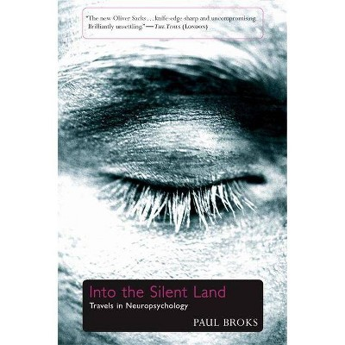
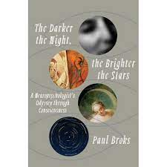
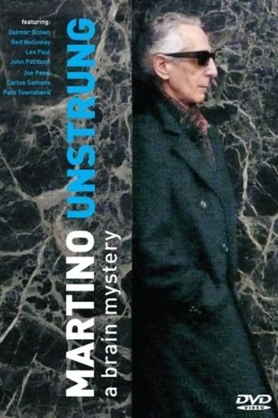
Paul Broks
(c.1955 --)

Slide 18
Paul Broks on the brain – in conversation
https://www.youtube.com/watch?v=rKofOe-3IBo

Slide 19
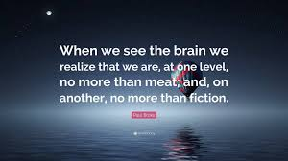

Slide 22
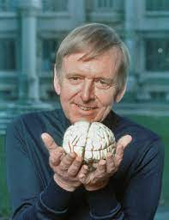
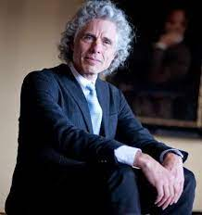
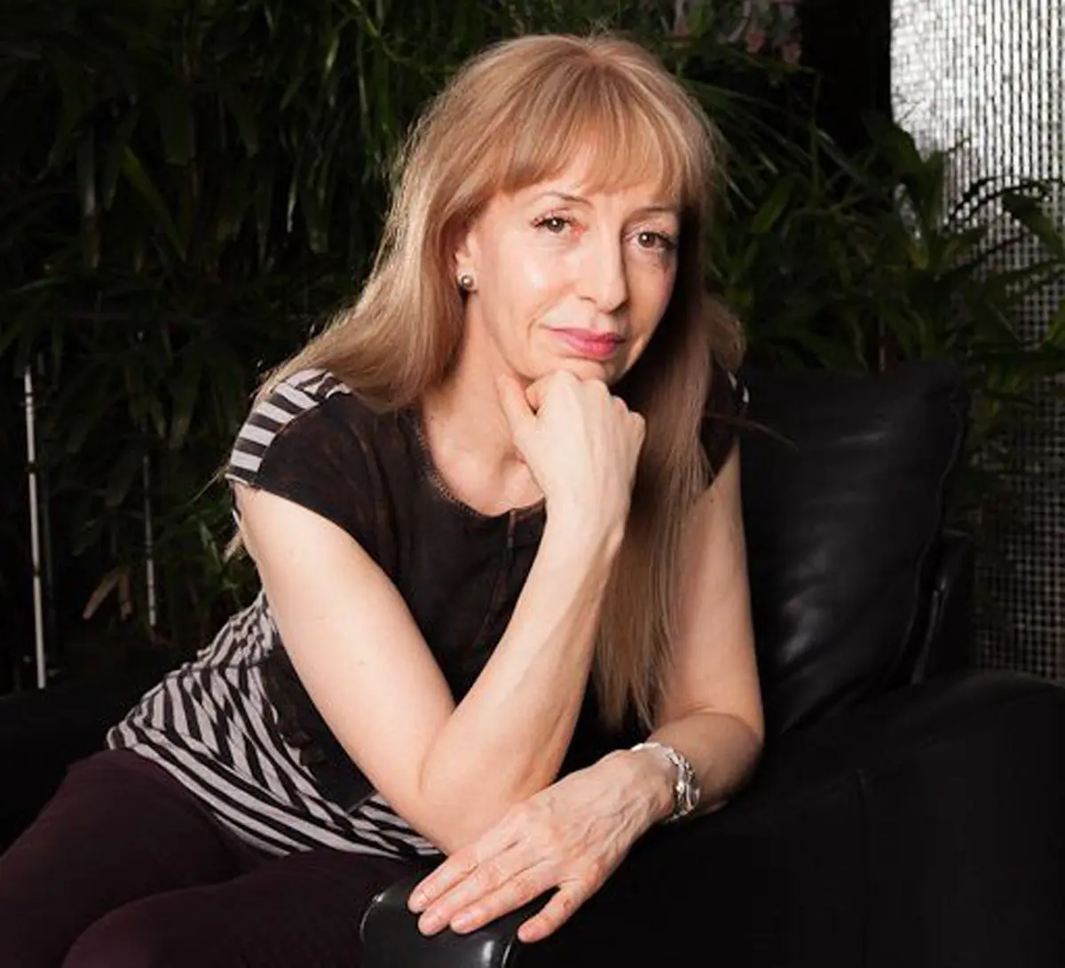
Julian Jaynes, Steven Pinker, Susan Greenfield

Slide 23
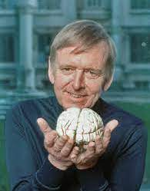
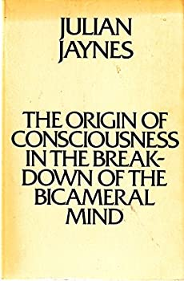
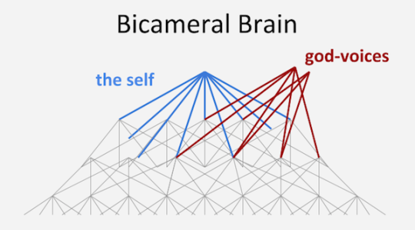
Julian Jaynes
1920-1997
1976

Slide 24
Julian Jaynes, remembered and quoted by his admirers:
https://www.youtube.com/watch?v=ruZoc0F5h_0

Slide 25
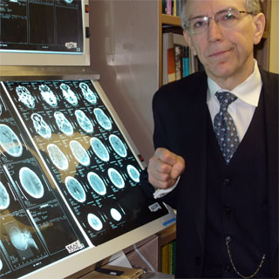
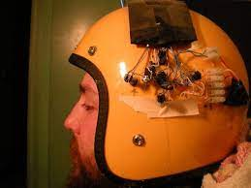
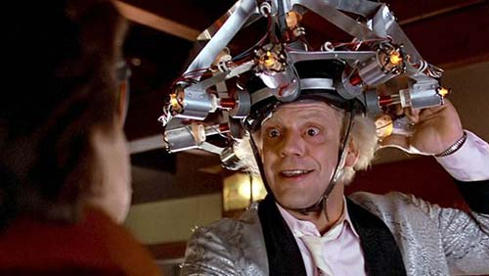
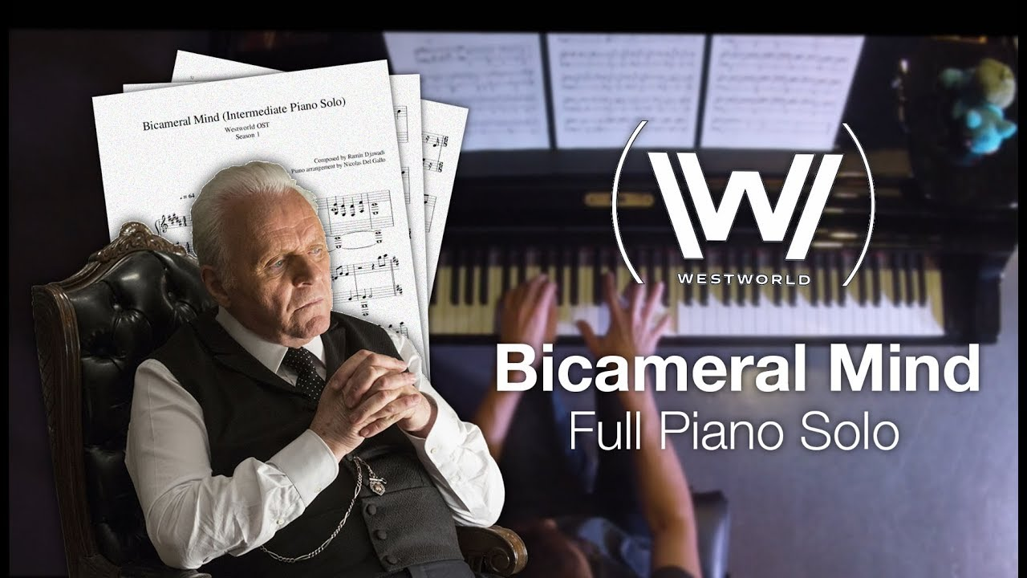
Dr. Michael Persinger
Dr. Persinger’s “God Helmet”
“Dr. Emmett Brown”
“Dr. Robert Ford” – patriarch
Of Westworld

Slide 26
On Julian Jaynes, Westworld, and the Bicameral Mind
https://www.youtube.com/watch?v=Y50nsmUVeVU

Slide 27
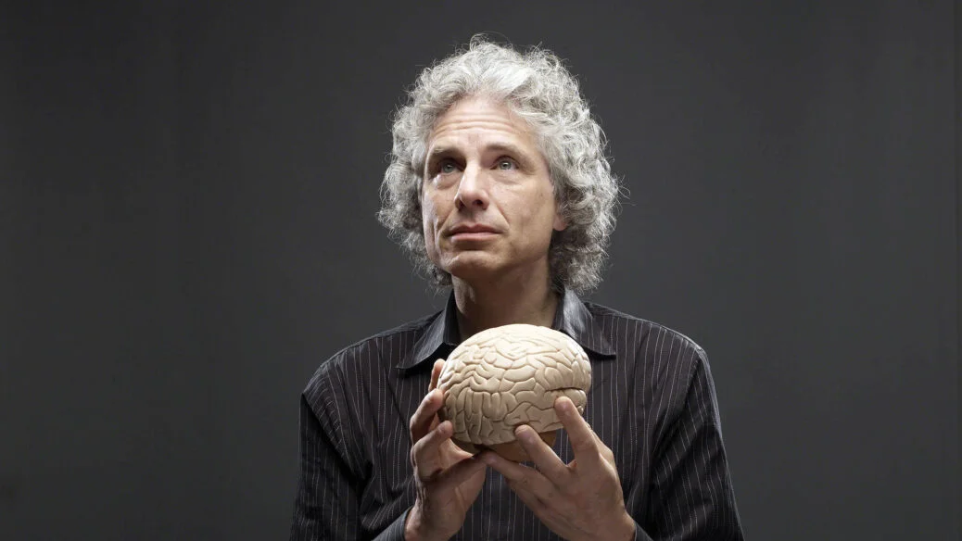
Steven Pinker (1954 --)

Slide 28
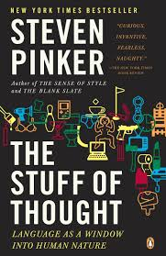
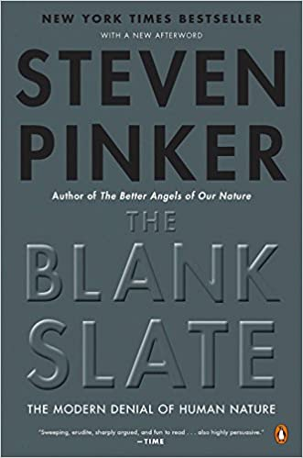
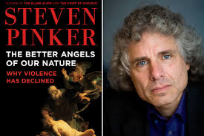

Slide 29
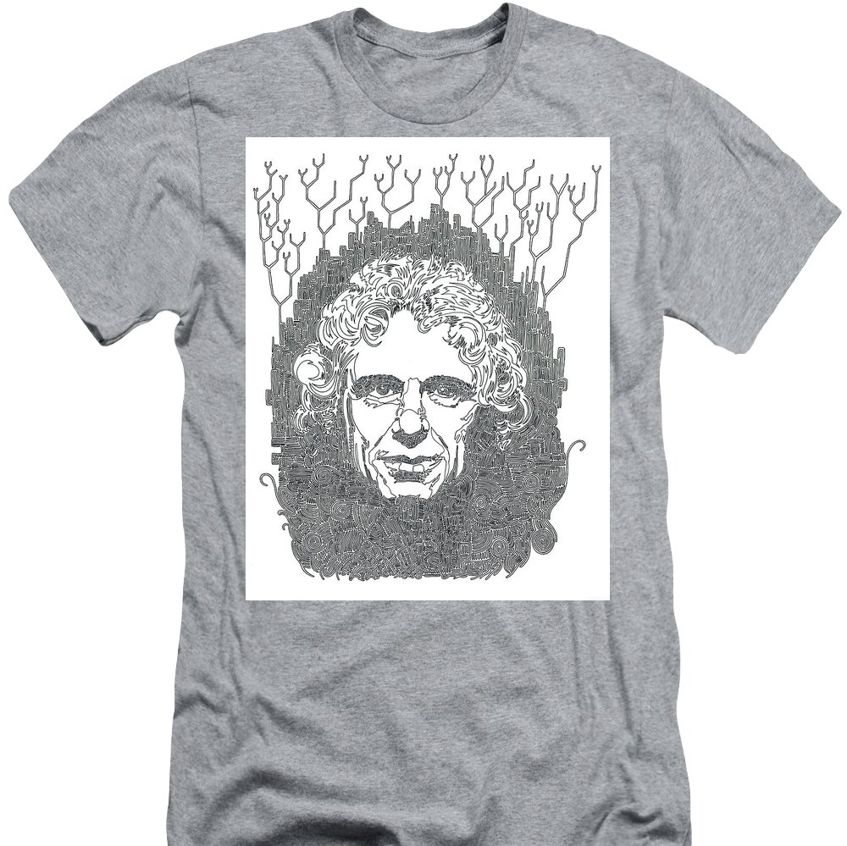
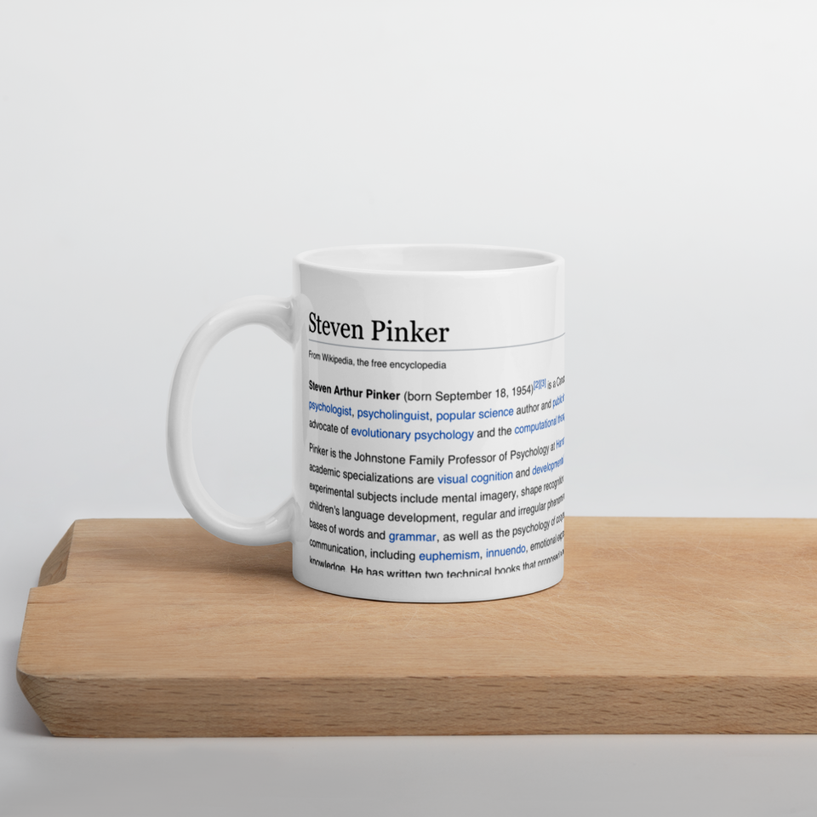

Slide 30
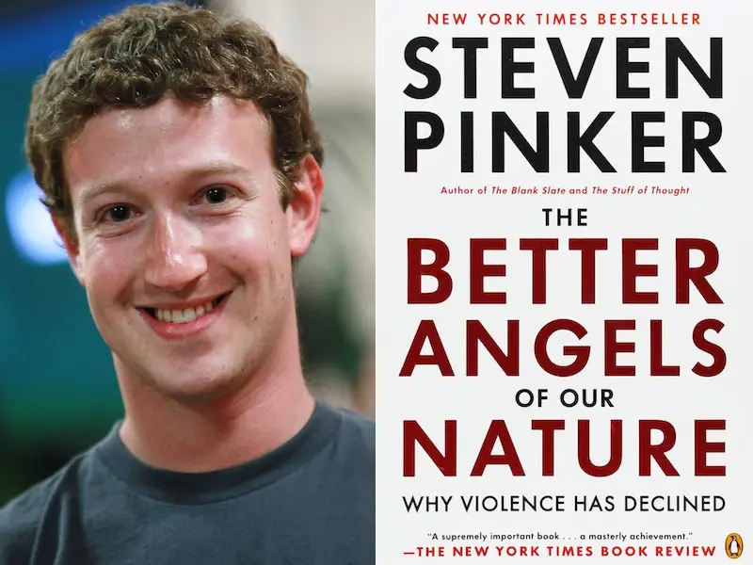
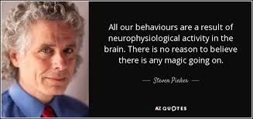
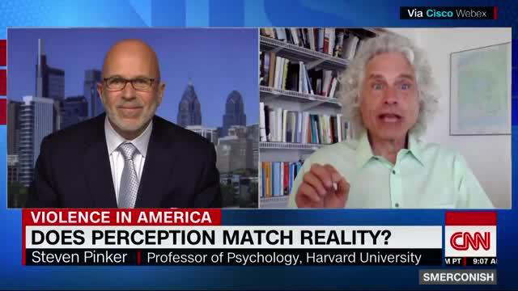

Slide 31
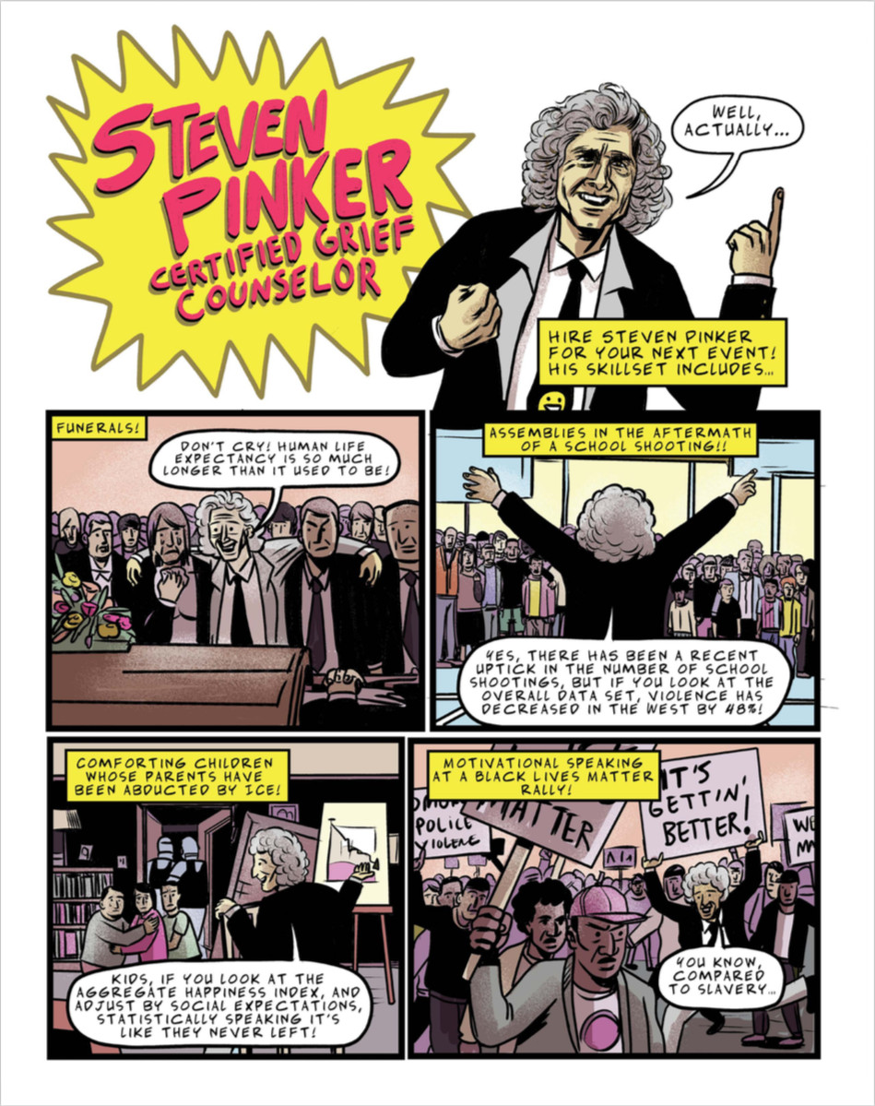

Slide 32
Susan Greenfield, CBE, (1950-)
So impressive is the power of genes that some scientists, such as the geneticist Richard Dawkins or the Psychologist Steven Pinker, argue that the traditional focus on the Self as the most important unit of life is misplaced. The Self is largely unimportant in evolutionary terms, and to Dawkins or Pinker the course of evolution is the subject of primary interest. . . . . In this ‘reductionist’ spirit, one of the Nobel laureates who discovered the structure of DNA, Jim Watson, claimed that ultimately all science was ‘reducable
From biology to biochemistry to chemistry to physics, and hence that everything other than physics was ‘just social work.’ . . . The critical issue is how one component relates to another, how they are organized – be it one brain cell forming a synapse with another, a synapse forming with another into a circuit, many circuits forming brain regions, or brain regions forming into a brain.
As soon as a system, be it a symphony or a curry or a whole human body or a brain, is reduced to its tiniest components, something special is lost.
The Private Life of the Brain (Wiley, 2000), 8-9.

Slide 34
. . . self-disclosure creates a hit of pure pleasure as direct as that derived from food, sex, dancing, or sport. Until now, this natural urge to let it all hang out has been counterbalanced by the rigors and constraints of body language in face-to-face communication, which makes you all too aware of your private self. This awareness of being a private individual can serve the very valuable role of ensuring that we are not manipulated or taken in by the outside. So . . . the opposing desire for privacy will ensure that only trusted individuals access the ‘real,’ vulnerable you.

Slide 35
However, social networking removes these constraints, allowing individuals to disclose more through this medium than ever before. The consequent trading of the age-old birthright of privacy may mean that others will think less of the ‘real’ that is now revealed. But imagine if this mode of constant self-disclosure and feedback became the norm. It might become increasingly difficult to protect the ‘true self’. . . from being reshaped and supplanted by an exaggerated, ideal self that is presented to an audience of hundreds of ‘friends’ and ‘followers.’ So what would happen if such a cyber-airbrushed persona started to elbow out the real you?
Mind Change (Random House, 2015) 110-111

Slide 36
Susan Greenfield, TED Talk on ‘Technology and the Brain
https://www.youtube.com/watch?v=oc7ZYj4CCdM

