Slide 1
[W. H. Auden on the lasting cultural impact of eugenics and literary naturalism]

Slide 2
Week Four
After Darwin: Eugenics, “Degeneration,” and Literary Naturalism
Part One:
Caesare Lombroso, Max Nordau, Francis Galton, Emile Zola,
American Naturalism, first wave: Stephen Crane, Jack London, and Frank Norris -- excerpts from “Maggie, a Girl of the Streets,” The Call of the Wild, and McTeague.
Sherlock Holmes? H G Wells?
Second wave: Upton Sinclair, Ole Rolvaag, Theodore Dreiser: The Jungle, Giants in the Earth, and Sister Carrie.
Part Two:
(briefly) John Steinbeck, Richard Wright, Joyce Carol Oates …
Naturalism and Hollywood casting

Slide 3
Caesare Lombroso, from Criminal Man (first trans. in English 1911)
Thus was explained the origin of the enormous jaws, strong canines, prominent zygomæ, and strongly developed orbital arches which he had so frequently remarked in criminals, for these peculiarities are common to carnivores and savages, who tear and devour raw flesh. Thus also it was easy to understand why the span of the arms in criminals so often exceeds the height, for this is a characteristic of apes, whose fore-limbs are used in walking and climbing. The other anomalies exhibited by criminals—the scanty beard as opposed to the general hairiness of the body, prehensile foot, diminished number of lines in the palm of the hand, cheek-pouches, enormous development of the middle incisors and frequent absence of the lateral ones, flattened nose and angular or sugar-loaf form of the skull, common to criminals and apes; the excessive size of the orbits, which, combined with the hooked nose, so often imparts to criminals the aspect of birds of prey, the projection of the lower part of the face and jaws (prognathism) found in negroes and animals, and supernumerary teeth (amounting in some cases to a double row as in snakes) and cranial bones (epactal bone as in the Peruvian Indians): all these characteristics pointed to one conclusion, the atavistic origin of the criminal, who reproduces physical, psychic, and functional qualities of remote ancestors.

Slide 4
Lombroso on “The Female Offender” (1895)
Nevertheless a comparison of the criminal skull with the skulls of normal women reveals the fact that female criminals approximate more to males, both criminal and normal, than to normal women, especially in the superciliary arches in the seam of the sutures, in the lower jaw-bones, and in peculiarities of the occipital region. They nearly re- semble normal women in their cheek-bones, in the prominence of the crotaphitic line, and in the median occipital fossa. There are also among them a large proportion (9*2 per cent.) of virile crania. The anomalies more frequent in female criminals than in prostitutes are: enormous pterygoid apophisis; cranial depressions ; very heavy lower jaw ; plagiocephalia ; the soldering of the atlas with the occiput ; enormous nasal spine ; deep frontal sinuses ; absence of sutures ; simplicity of sutures ; wormian bones. Fallen women, on the other hand, are distiguished from criminals by the following peculiarities : clinoid apophisis forming a canal ; tumefied parietal prominences ; median occipital fossa of double size ; great occipital irregularity ; narrow or receding forehead ; abnormal nasal bones ; epactal bone ; prognathous jaw and alveolar prognathism ; cranial sclerosis ; a virile type of face ; prominent cheek-bones.

Slide 5
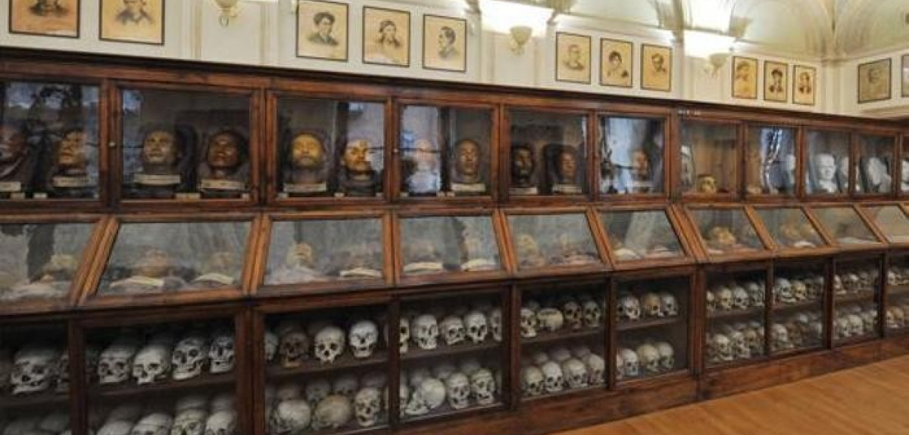
Museum of Criminal Anthropology Turin

Slide 6
Francis Galton, from Hereditary Genius (first edition, 1869):
The average standard of the Lowland Scotch and the English North-country men is decidedly a fraction of a grade superior to that of the ordinary English, because the number of the former who attain to eminence is far greater than the proportionate number of their race would have led us to expect. The same superiority is distinctly shown by a comparison of the well-being of the masses of the population; for the Scotch labourer is much less of a drudge than the Englishman of the Midland counties—he does his work better, and “lives his life” besides. The peasant women of Northumberland work all day in the fields, and are not broken down by the work; on the contrary, they take a pride in their effective labour as girls, and, when married, they attend well to the comfort of their homes. It is perfectly distressing to me to witness the draggled, drudged, mean look of the mass of individuals, especially of the women, that one meets in the streets of London and other purely English towns. The conditions of their life seem too hard for their constitutions, and to be crushing them into degeneracy.
The ablest race of whom history bears record is unquestionably the ancient Greek, partly because their master-pieces in the principal departments of intellectual activity are still unsurpassed, and in many respects unequalled, and partly because the population that gave birth to the creators of those master-pieces was very small. Of the various Greek sub-races, that of Attica was the ablest, and she was no doubt largely indebted to the following cause, for her superiority. Athens opened her arms to immigrants, but not indiscriminately, for her social life was such that none but very able men could take any pleasure in it; on the other hand, she offered attractions such as men of the highest ability and culture could find in no other city.

Slide 7
Pop Quiz!
When the pony-chaise stopped at the door, and my eyes were intent upon the house, I saw a cadaverous face appear at a small window on the ground floor (in a little round tower that formed one side of the house), and quickly disappear. The low arched door then opened, and the face came out. It was quite as cadaverous as it had looked in the window, though in the grain of it there was that tinge of red which is sometimes to be observed in the skins of red-haired people. It belonged
to a red-haired person--a youth of fifteen, as I take it now, but
looking much older--whose hair was cropped as close as the closest stubble; who had hardly any eyebrows, and no eyelashes, and eyes of a red-brown, so unsheltered and unshaded, that I remember wondering how he went to sleep. He was high-shouldered and bony; dressed in decent black, with a white wisp of a neckcloth; buttoned up to the throat; and had a long, lank, skeleton hand, which particularly attracted my attention, as he stood at the pony’s head, rubbing his chin with it, and looking up at us in the chaise.
‘Is Mr. Wickfield at home, Uriah Heep?’ said my aunt.

Slide 8
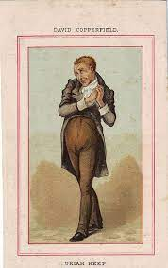

Slide 9
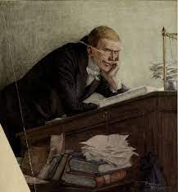

Slide 10
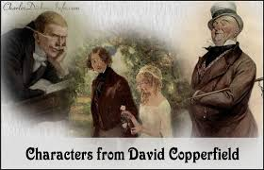

Slide 11
And another Pop Quiz!

Slide 12
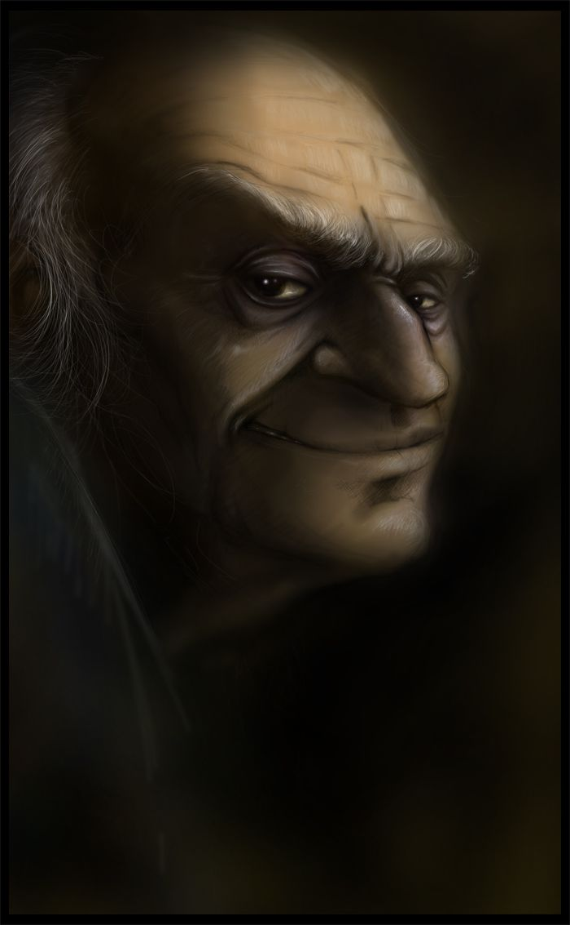
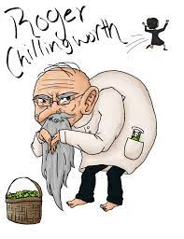

Slide 13
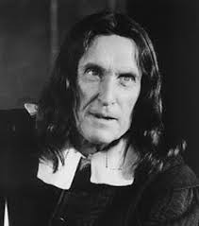
(Normally-blond) Robert Duval looking dark, craggy and scary as Roger Chillingworth

Slide 14
Steven Crane, from “Maggie, A Girl of the Streets” (1893):
Chapter II
Eventually they entered into a dark region where, from a careening building, a dozen gruesome doorways gave up loads of babies to the street and the gutter. A wind of early autumn raised yellow dust from cobbles and swirled it against an hundred windows. Long streamers of garments fluttered from fire-escapes. In all unhandy places there were buckets, brooms, rags and bottles. In the street infants played or fought with other infants or sat stupidly in the way of vehicles. Formidable women, with uncombed hair and disordered dress, gossiped while leaning on railings, or screamed in frantic quarrels. Withered persons, in curious postures of submission to something, sat smoking pipes in obscure corners. A thousand odors of cooking food came forth to the street. The building quivered and creaked from the weight of humanity stamping about in its bowels.
A small ragged girl dragged a red, bawling infant along the crowded ways. He was hanging back, baby-like, bracing his wrinkled, bare legs.
The little girl cried out: "Ah, Tommie, come ahn. Dere's Jimmie and fader. Don't be a-pullin' me back."
She jerked the baby's arm impatiently. He fell on his face, roaring. With a second jerk she pulled him to his feet, and they went on. With the obstinacy of his order, he protested against being dragged in a chosen direction. He made heroic endeavors to keep on his legs, denounce his sister and consume a bit of orange peeling which he chewed between the times of his infantile orations.

Slide 15
As the sullen-eyed man, followed by the blood-covered boy, drew near, the little girl burst into reproachful cries. "Ah, Jimmie, youse bin fightin' agin."
The urchin swelled disdainfully.
"Ah, what deh hell, Mag. See?"
The little girl upbraided him, "Youse allus fightin', Jimmie, an' yeh knows it puts mudder out when yehs come home half dead, an' it's like we'll all get a poundin'."
She began to weep. The babe threw back his head and roared at his prospects.
"Ah, what deh hell!" cried Jimmie. "Shut up er I'll smack yer mout'. See?"
As his sister continued her lamentations, he suddenly swore and struck her. The little girl reeled and, recovering herself, burst into tears and quaveringly cursed him. As she slowly retreated her brother advanced dealing her cuffs. The father heard and turned about.
"Stop that, Jim, d'yeh hear? Leave yer sister alone on the street. It's like I can never beat any sense into yer damned wooden head."
The urchin raised his voice in defiance to his parent and continued his attacks. The babe bawled tremendously, protesting with great violence. During his sister's hasty manoeuvres, he was dragged by the arm.
Finally the procession plunged into one of the gruesome doorways. They crawled up dark stairways and along cold, gloomy halls. At last the father pushed open a door and they entered a lighted room in which a large woman was rampant.

Slide 16
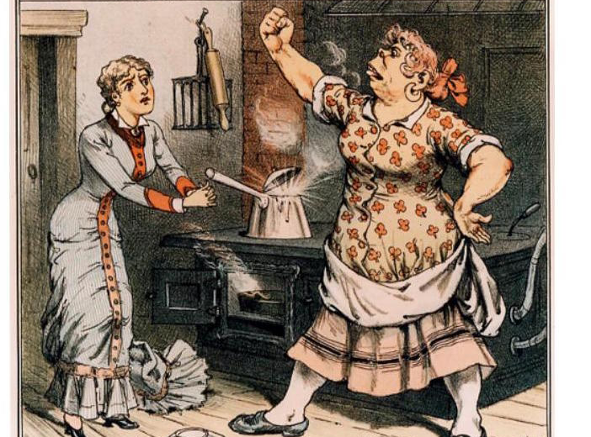
And her Lombroso “Female Offender” mom
Poor Maggie

Slide 17
Frank Norris, the opening of McTeague (1899):
It was Sunday, and, according to his custom on that day, McTeague took his dinner at two in the afternoon at the car conductors' coffee-joint on Polk Street. He had a thick gray soup; heavy, underdone meat, very hot, on a cold plate; two kinds of vegetables; and a sort of suet pudding, full of strong butter and sugar. On his way back to his office, one block above, he stopped at Joe Frenna's saloon and bought a pitcher of steam beer. It was his habit to leave the pitcher there on his way to dinner.
Once in his office, or, as he called it on his signboard, “Dental Parlors,” he took off his coat and shoes, unbuttoned his vest, and, having crammed his little stove full of coke, lay back in his operating chair . . .crop-full, stupid, and warm. By and by, gorged with steam beer, and overcome by the heat of the room, the cheap tobacco, and the effects of his heavy meal, he dropped off to sleep. Late in the afternoon …. He woke slowly, finished the rest of his beer—very flat and stale by this time—and taking down his concertina from the bookcase, where in week days it kept the company of seven volumes of “Allen's Practical Dentist,” played upon it some half-dozen very mournful airs.
McTeague looked forward to these Sunday afternoons as a period of relaxation and enjoyment. He invariably spent them in the same fashion. These were his only pleasures—to eat, to smoke, to sleep, and to play upon his concertina.

Slide 18
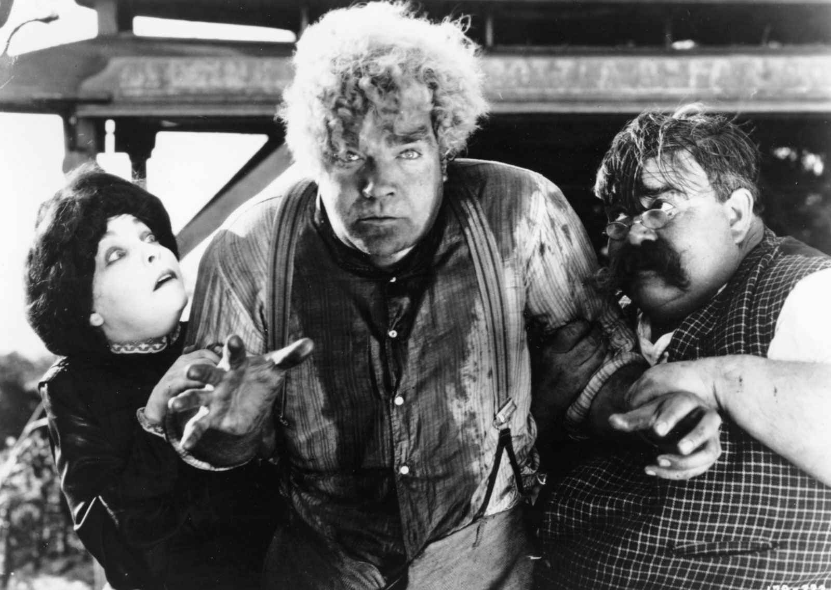
The six lugubrious airs that he knew, always carried him back to the time when he was a car-boy at the Big Dipper Mine in Placer County, ten years before . . . For thirteen days of each fortnight his father was a steady, hard-working shift-boss of the mine. Every other Sunday he became an irresponsible animal, a beast, a brute, crazy with alcohol.
McTeague remembered his mother, too . . . . She was an overworked drudge, fiery and energetic for all that, filled with the one idea of having her son rise in life and enter a profession. The chance had come at last when the father died, corroded with alcohol, collapsing in a few hours. Two or three years later a travelling dentist visited the mine and put up his tent near the bunk-house. He was more or less of a charlatan, but he fired Mrs. McTeague's ambition, and young McTeague went away with him to learn his profession. He had learnt it after a fashion, mostly by watching the charlatan operate. He had read many of the necessary books, but he was too hopelessly stupid to get much benefit from them.
From Erich Von Stroheim’s 8-hour film version
of McTeague -- 1924

Slide 20
Upton Sinclair, from The Jungle (1906):
Jurgis was like a boy, a boy from the country. He was the sort of man the bosses like to get hold of, the sort they make it a grievance they cannot get hold of. When he was told to go to a certain place, he would go there on the run. When he had nothing to do for the moment, he would stand round fidgeting, dancing, with the overflow of energy that was in him. If he were working in a line of men, the line always moved too slowly for him, and you could pick him out by his impatience and restlessness. That was why he had been picked out on one important occasion; for Jurgis had stood outside of Brown and Company’s “Central Time Station” not more than half an hour, the second day of his arrival in Chicago, before he had been beckoned by one of the bosses. Of this he was very proud, and it made him more disposed than ever to laugh at the pessimists. In vain would they all tell him that there were men in that crowd from which he had been chosen who had stood there a month—yes, many months—and not been chosen yet. “Yes,” he would say, “but what sort of men? Broken-down tramps and good-for-nothings, fellows who have spent all their money drinking, and want to get more for it. Do you want me to believe that with these arms”—and he would clench his fists and hold them up in the air, so that you might see the rolling muscles—“that with these arms people will ever let me starve?”

Slide 21
Theodore Dreiser, from Chapter 1 of Sister Carrie (1900):
When a girl leaves her home at eighteen, she does one of two things. Either she falls into saving hands and becomes better, or she rapidly assumes the cosmopolitan standard of virtue and becomes worse. Of an intermediate balance, under the circumstances, there is no possibility. The city has its cunning wiles, no less than the infinitely smaller and more human tempter. There are large forces which allure with all the soulfulness of expression possible in the most cultured human. The gleam of a thousand lights is often as effective as the persuasive light in a wooing and fascinating eye. Half the undoing of the unsophisticated and natural mind is accomplished by forces wholly superhuman. A blare of sound, a roar of life, a vast array of human hives, appeal to the astonished senses in equivocal terms. Without a counsellor at hand to whisper cautious interpretations, what falsehoods may not these things breathe into the unguarded ear! Unrecognised for what they are, their beauty, like music, too often relaxes, then weakens, then perverts the simpler human perceptions.

Slide 22
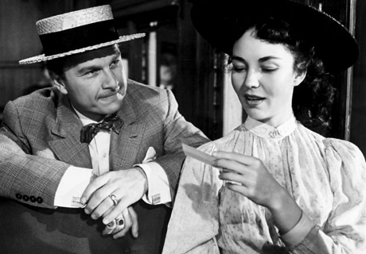
Caroline, or Sister Carrie, as she had been half affectionately termed by the family, was possessed of a mind rudimentary in its power of observation and analysis. Self-interest with her was high, but not strong. It was, nevertheless, her guiding characteristic. Warm with the fancies of youth, pretty with the insipid prettiness of the formative period, possessed of a figure promising eventual shapeliness and an eye alight with certain native intelligence, she was a fair example of the middle American class—two generations removed from the emigrant. Books were beyond her interest—knowledge a sealed book. In the intuitive graces she was still crude. She could scarcely toss her head gracefully. Her hands were almost ineffectual. The feet, though small, were set flatly. And yet she was interested in her charms, quick to understand the keener pleasures of life, ambitious to gain in material things. A half-equipped little knight she was, venturing to reconnoitre the mysterious city and dreaming wild dreams of some vague, far-off supremacy, which should make it prey and subject—the proper penitent, grovelling at a woman’s slipper.
Carrie (Jennifer Jones) and Charlie Drouet, the
salesman who picks her up on a train to Chicago

Slide 23
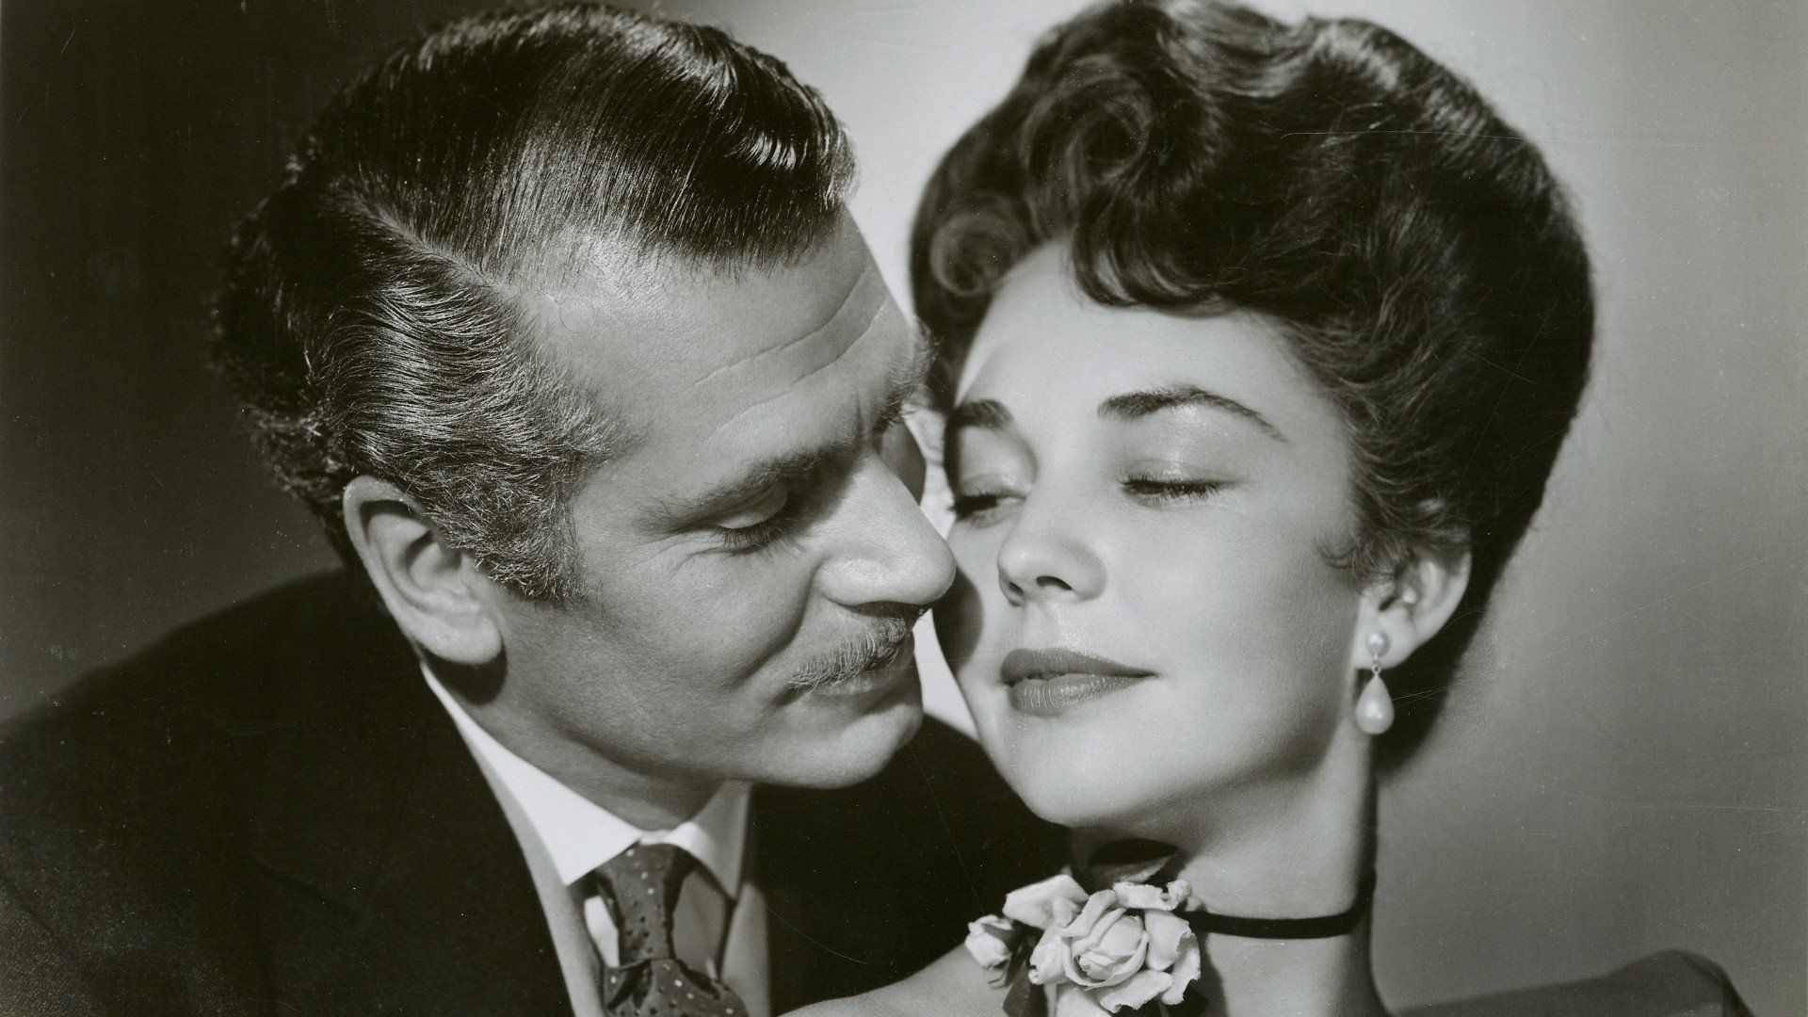
Carrie and
George Hurstwood, her second (and higher-class) conquest.

Slide 24
[Pop quiz!!]
“And now, Dr. James Mortimer—”
“Mister, sir, Mister—a humble M.R.C.S.”
“And a man of precise mind, evidently.”
“A dabbler in science, Mr. Holmes, a picker up of shells on the shores of the great unknown ocean. I presume that it is Mr. Sherlock Holmes whom I am addressing and not—”
“No, this is my friend Dr. Watson.”
“Glad to meet you, sir. I have heard your name mentioned in connection with that of your friend. You interest me very much, Mr. Holmes. I had hardly expected so dolichocephalic a skull or such well-marked supra-orbital development. Would you have any objection to my running my finger along your parietal fissure? A cast of your skull, sir, until the original is available, would be an ornament to any anthropological museum. It is not my intention to be fulsome, but I confess that I covet your skull.”
Sherlock Holmes waved our strange visitor into a chair. “You are an enthusiast in your line of thought, I perceive, sir, as I am in mine,” said he. “I observe from your forefinger that you make your own cigarettes. Have no hesitation in lighting one.”
The man drew out paper and tobacco and twirled the one up in the other with surprising dexterity. He had long, quivering fingers as agile and restless as the antennæ of an insect.
Holmes was silent, but his little darting glances showed me the interest which he took in our curious companion. “I presume, sir,” said he at last, “that it was not merely for the purpose of examining my skull that you have done me the honour to call here last night and again today?”

Slide 25
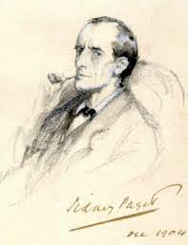
Early illustration of Sherlock Holmes

Slide 26
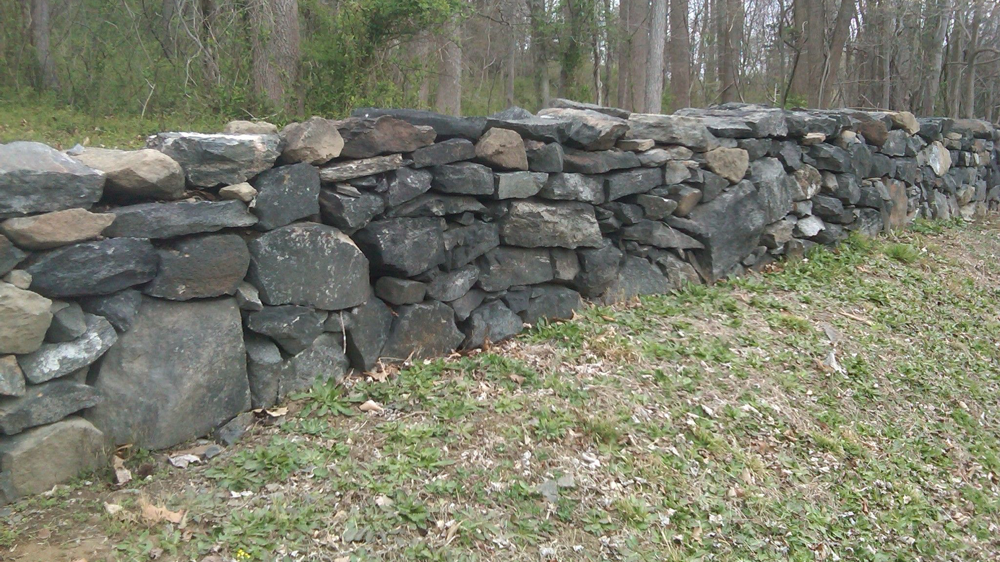
ROBERT FROST, “MENDING WALL” (1914)

Slide 27
Something there is that doesn't love a wall,
That sends the frozen-ground-swell under it, And spills the upper boulders in the sun; And makes gaps even two can pass abreast. The work of hunters is another thing: I have come after them and made repair Where they have left not one stone on a stone, But they would have the rabbit out of hiding, To please the yelping dogs. The gaps I mean, No one has seen them made or heard them made, But at spring mending-time we find them there. I let my neighbor know beyond the hill; And on a day we meet to walk the line And set the wall between us once again. We keep the wall between us as we go.
…
There where it is we do not need the wall: He is all pine and I am apple orchard. My apple trees will never get across And eat the cones under his pines, I tell him. He only says, ‘Good fences make good neighbors.’

Slide 28
Spring is the mischief in me, and I wonder If I could put a notion in his head: ‘Why do they make good neighbors? Isn't it Where there are cows? But here there are no cows. Before I built a wall I'd ask to know What I was walling in or walling out, And to whom I was like to give offense. Something there is that doesn't love a wall, That wants it down.’ I could say ‘Elves’ to him, But it's not elves exactly, and I'd rather He said it for himself. I see him there Bringing a stone grasped firmly by the top In each hand, like an old-stone savage armed. He moves in darkness as it seems to me,
Not of woods only and the shade of trees. He will not go behind his father's saying, And he likes having thought of it so well He says again, ‘Good fences make good neighbors.’

Slide 29
“Out, Out –” (1916)
The buzz saw snarled and rattled in the yard And made dust and dropped stove-length sticks of wood, Sweet-scented stuff when the breeze drew across it. And from there those that lifted eyes could count
Five mountain ranges one behind the other Under the sunset far into Vermont. And the saw snarled and rattled, snarled and rattled, As it ran light, or had to bear a load. And nothing happened: day was all but done. Call it a day, I wish they might have said To please the boy by giving him the half hour That a boy counts so much when saved from work. His sister stood beside him in her apron To tell them ‘Supper.’ At the word, the saw, As if to prove saws knew what supper meant, Leaped out at the boy’s hand, or seemed to leap— He must have given the hand.

Slide 30
However it was, Neither refused the meeting. But the hand! The boy’s first outcry was a rueful laugh, As he swung toward them holding up the hand Half in appeal, but half as if to keep The life from spilling. Then the boy saw all— Since he was old enough to know, big boy Doing a man’s work, though a child at heart— He saw all spoiled. ‘Don’t let him cut my hand off— The doctor, when he comes. Don’t let him, sister!’ So. But the hand was gone already. The doctor put him in the dark of ether. He lay and puffed his lips out with his breath. And then—the watcher at his pulse took fright. No one believed. They listened at his heart. Little—less—nothing!—and that ended it. No more to build on there. And they, since they Were not the one dead, turned to their affairs.

Slide 31
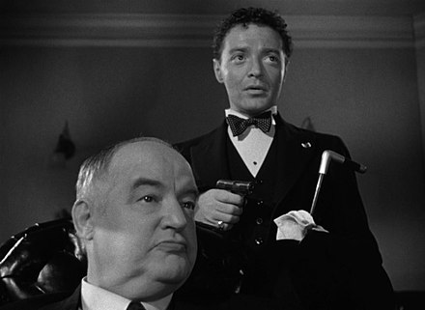
Sidney Greenstreet and Peter Lorre in The Maltese Falcon, 1941

Slide 32
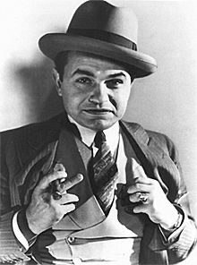
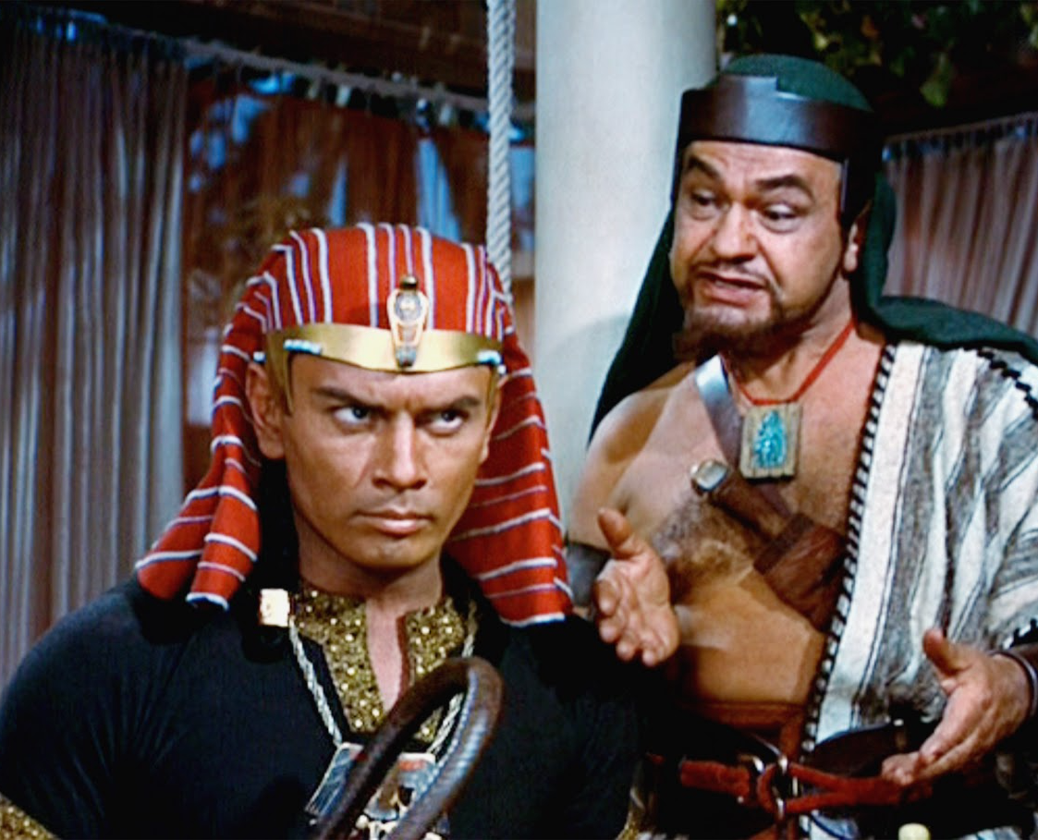
Edward G. Robinson, as different sorts of bad guys

Slide 33
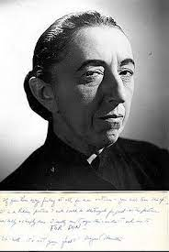
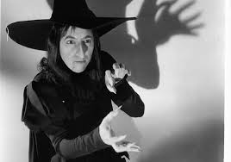
Margaret Hamilton in the role that defined her career

Slide 34
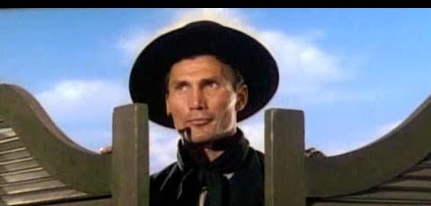
Jack Palance in Shane, 1953

Slide 35
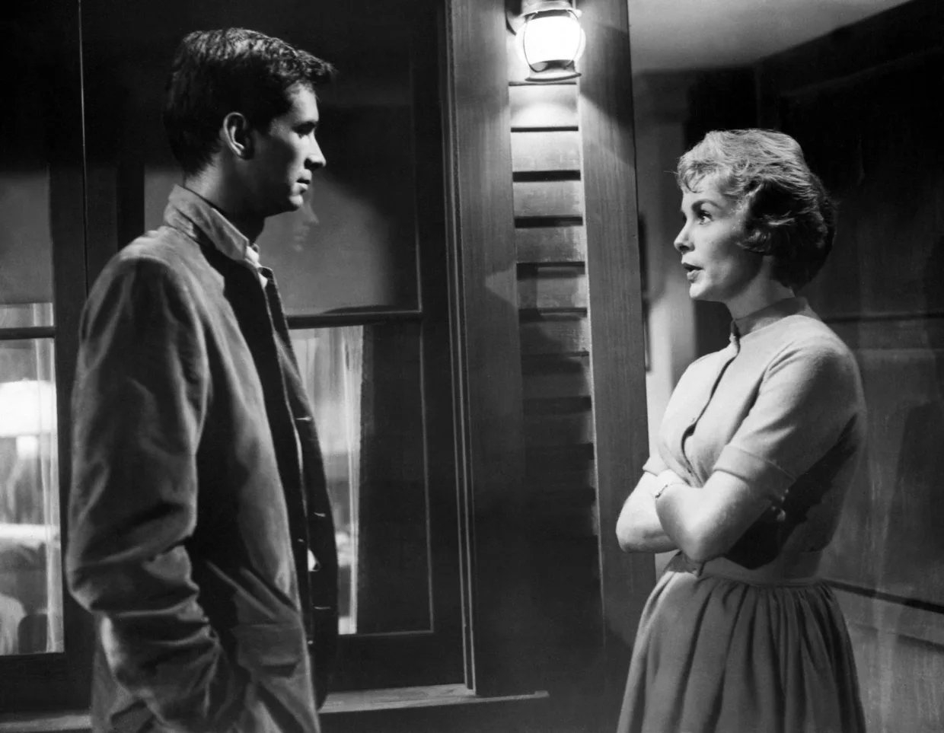
Anthony Perkins as
Alfred Hitchcock’s bad-guy surprise.
Psycho, 1960

Slide 36
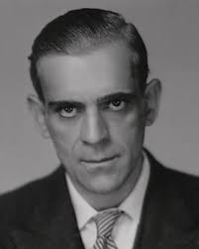
If Boris Karloff
ran the Bates Motel …?

Slide 37
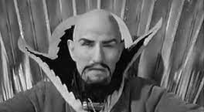
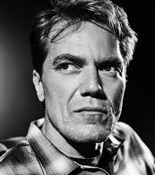
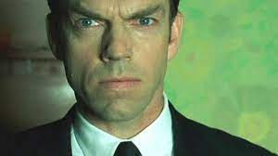
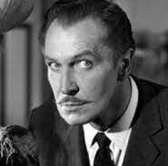
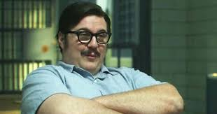
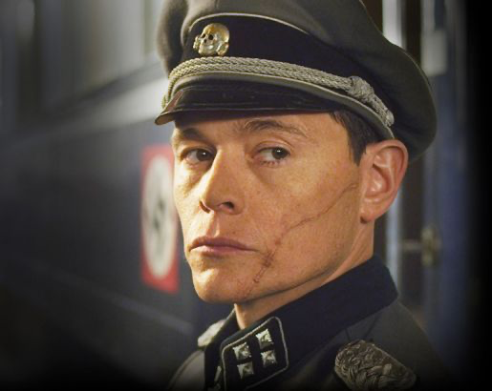
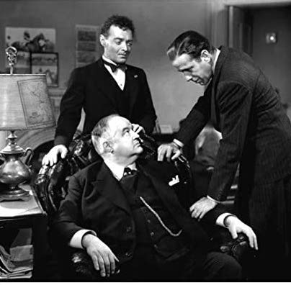
Hollywood bad guy faces
Then and now

