Slide 1
Mayim Balik’s pitch for Neurvira:
https://www.ispot.tv/ad/O6KI/neuriva-actual-neuroscientist-featuring-mayim-bialik

Slide 2
Trailer for a new brain-hacking series, Severance, from Apple TV:
https://www.youtube.com/watch?v=xEQP4VVuyrY

Slide 3
Week two
Part one:
William James (1842-1910) and the birth of modern psychology.
From William James: “The Stream of Consciousness,” “Imagination,” and “The Self” (From Psychology, The Briefer Course, 1892).
Part two:
William’s younger brother Henry James; experiments in Psychological Realism.
Henry James, Excerpts from “The Turn of the Screw” (1898), “The Beast in the Jungle,” (1903), and “The Jolly Corner” (1908).
Robert Louis Stevenson, from “The Strange Case of Dr. Jekyll and Mr. Hyde” (1886)
Stream of Consciousness as a Literary trope: excerpts from early and final chapters of James Joyce’s Ulysses (1922) and Virginia Woolf’s Mrs. Dalloway (1925).

Slide 4
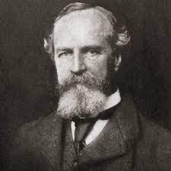
William James (1842-1910) : “The Stream of Consciousness,” from Psychology: the Briefer Course (1892).
Consciousness is in constant change. I do not mean by this to say that no one state of mind has any duration— even if true, that would be hard to establish. What I wish to lay stress on is this, that no state once gone can recur and be identical with what it was before. Now we are seeing, now hearing; now reasoning, now willing; now recollecting, now expecting; now loving, now hating; and in a hundred other ways we know our minds to be alternately engaged. …
It is, the reader will see, the reinstatement of the vague and inarticulate to its proper place in our mental life which I am so anxious to press on the attention. Mr. Galton and Prof. Huxley have… made one step in advance in exploding the ridiculous theory of Hume and Berkeley that we can have no images but of perfectly definite things. Another is made if we overthrow the equally ridiculous notion that, whilst simple objective qualities are revealed to our knowledge in 'states of consciousness,' relations are not. But these reforms are not half sweeping and radical enough.

Slide 5
[William James on the stream of consciousness]
What must be admitted is that the definite images of traditional psychology form but the very smallest part of our minds as they actually live. The traditional psychology talks like one who should say a river consists of nothing but pailsful, spoonsful, quartpotsful, barrelsful, and other moulded forms of water. Even were the pails and the pots all actually standing in the stream, still between them the free water would continue to flow. It is just this free water of consciousness that psychologists resolutely over-look. Every definite image in the mind is steeped and dyed in the free water that flows round it. With it goes the sense of its relations, near and remote, the dying echo of whence it came to us, the dawning sense of whither it is to lead.

Slide 6
CHAPTER XII
THE SELF
The Me and the I. Whatever I may be thinking of, I am always at the same time more or less aware of myself, of my personal existence. At the same time it is I who am aware; so that the total self of me, being as it were duplex, partly known and partly knower, partly object and partly subject, must have two aspects discriminated in it, of which for shortness we may call one the Me and the other the I. I call these discriminated aspects,' and not separate things, because the identity of I with me, even in the very act of their discrimination, is perhaps the most ineradicable dictum of common-sense, and must not be
undermined by our terminology here at the outset, what-
ever we may come to think of its validity at our inquiry’s end.
I shall therefore treat successively of A) the self as
known, or the me, the empirical ego' as it is sometimes
called; and of B) the self as knower, or the I, the 'pure
Ego’ of certain authors.

Slide 7
The Soul as a Combining Medium. The spiritualists in philosophy have been prompt to see that things which are known together are known by one something, but that something, they say, is no mere passing thought, but a simple and permanent spiritual being on which many ideas combine their effects. It makes no difference in this connection whether this being be called Soul, Ego, or Spirit, in either case its chief function is that of a combining medium.
This is a different vehicle of knowledge from that in which we just said that the mystery of knowing things together might be most simply lodged. Which is the real knower, this permanent being, or our passing state? If we had other grounds, not yet considered, for admitting the Soul into our psychology, then getting there on those grounds, she might turn out to be the knower too. But if there be no other grounds for admitting the Soul, we had better cling to our passing 'states'
as the exclusive agents of knowledge; for we have to assume their existence anyhow in psychology, and the knowing of many things together is just as well accounted for
when we call it one of their functions as when we call it a reaction of the Soul. Explained it is not by either conception, and has to figure in psychology as a datum that is ultimate.

Slide 8
[On feelings, emotions, and thought:]
I now proceed to urge the vital point of my whole theory, which is this: If we fancy some strong emotion, and then try to abstract from our consciousness of it all the feelings of its bodily symptoms, we find we have nothing left behind, no 'mind-stuff' out of which the emotion can be constituted, and that a cold and neutral state of intellectual perception is all that remains. . . . What kind of an emotion of fear would be left if the feeling neither of quickened heart-beats nor of shallow breathing, neither of trembling lips nor of weakened limbs, neither of goose-flesh nor of visceral stirrings, were present, it is quite impossible for me to think. Can one fancy the state of rage and picture no ebullition in the chest, no flushing of the face, no dilatation of the nostrils, no clenching of the teeth, no impulse to vigorous action, but instead limp muscles, calm breathing, and a placid face?
. ..
… I say that for us emotion dissociated from all bodily feeling is inconceivable. The more closely I scrutinize my states, the more persuaded I become that whatever 'coarse' affections and passions I have are in very truth constituted by, and made up of, those bodily changes which we ordinarily call their expression or consequence;
and the more it seems to me that, if I were to become corporeally anaesthetic, I should be excluded from the life of the affections ... and drag out an existence of merely cognitive or intellectual form.

Slide 9
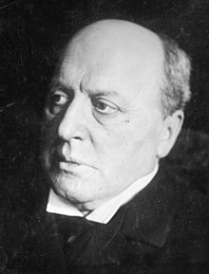
Henry James (1843-1916)
Opening of “The Jolly Corner” (1908)
“Everyone asks me what I 'think’ of everything," said Spencer Brydon; “ and I make answer as I can-begging or dodging the question, putting them off with any nonsense. It wouldn't matter to any of them really,” he went on,“ for, even were it possible to meet in that stand-and-deliver way so silly a demand on so big a subject, my thoughts' would still be almost altogether about something that concerns only myself.” He was talking to Miss Staverton, with whom for a couple of months now he had availed himself of every possible occasion to talk; this dis-position and this resource, this comfort and support, as the situation in fact presented itself, having promptly enough taken the first place in the considerable array of rather
unattenuated surprises attending his so strangely belated return to America. Every-
thing was somehow a surprise; and that might be natural when one had so long and so consistently neglected everything, taken pains to give surprises so much margin for play.

Slide 10
[Climax of “The Jolly Corner”]
He had given them more than thirty years, thirty-three, to be exact; and they now seemed to him to have organised their performance quite on the scale of that licence. He had been twenty-three on leaving New York -- he was fifty-six today ; unless indeed he were to reckon as he had sometimes, since his repatriation, found himself feeling; in which case he would have lived longer than is often allotted to man. It would have taken a century, he repeatedly said to himself . . . it would have taken a longer absence and a more averted mind than those even of which he had been guilty, to pile up the differences, the newnesses, the queernesses, above all the bignesses, for the better or the worse, that at present assaulted his vision wherever he looked. Wasn't the proof in the splendid covering hands, strong and completely spread ?—so spread and so intentional that, in spite of a special verity that surpassed every other, the fact that one of these hands had lost two fingers, which were reduced to stumps, as if accidentally shot away, the face was effectually guarded and saved.

Slide 11
Rigid and conscious, spectral yet human, a man of his own substance and stature waited there to measure himself with his power-to dismay. . . . So Brydon, before him, took him in; with every fact of him now, in the higher light, hard and acute—his planted stillness, his vivid truth, his grizzled bent head and white masking hands, his queer actuality of evening-dress, of dangling double eye-glass, of gleaming silk lappet and white linen, of pearl button and gold watch-guard and polished shoe. . . . The revulsion, for our friend, had become, before he knew it, immense—this drop, in the act of apprehension, to the sense of his adversary's inscrutable manæuvre. That meaning at least, while he gaped, it offered him ; for he could but gape at his other self in this other anguish, gape as a proof that he, standing there for the achieved, the enjoyed, the triumphant life, couldn't be faced in his triumph.

Slide 12
“Saved,” though, would it be ? -- Brydon breathed his wonder till the very impunity of his attitude and the very insistence of his eyes produced, as he felt, a sudden stir which showed the next instant as a deeper portent, while the head raised itself, the betrayal of a braver purpose. The hands, as he looked, began to move, to open; then, as if deciding in a flash, dropped from the face and left it uncovered and presented. Horror, with the sight, had leaped into Brydon's throat, gasping there in a sound he couldn't utter; for the bared identity was too hideous as his, and his glare was the passion of his protest. The face, that face, Spencer Brydon's ? -- he searched it still, but looking away from it in dismay and denial, falling straight from his height of sublimity. It was unknown, inconceivable, awful . . .

Slide 13
[Closing pages of “The Turn of the Screw,” 1898]
---
“I know everything.”
He gave me at this the longest and strangest look. “Everything?”
“Everything. Therefore did you—?” But I couldn’t say it again.
Miles could, very simply. “No. I didn’t steal.”
. . .
“What then did you do?”
He looked in vague pain all round the top of the room and drew his breath, two or three times over, as if with difficulty. He might have been standing at the bottom of the sea and raising his eyes to some faint green twilight. “Well—I said things.”
“Only that?”
“They thought it was enough!”
“To turn you out for?”
Never, truly, had a person “turned out” shown so little to explain it as this little person! He appeared to weigh my question, but in a manner quite detached and almost helpless. “Well, I suppose I oughtn’t.”
“But to whom did you say them?”
He evidently tried to remember, but it dropped—he had lost it. “I don’t know!”

Slide 14
He almost smiled at me in the desolation of his surrender, which was indeed practically, by this time, so complete that I ought to have left it there. But I was infatuated—I was blind with victory, though even then the very effect that was to have brought him so much nearer was already that of added separation. “Was it to everyone?” I asked.
“No; it was only to—” But he gave a sick little headshake. “I don’t remember their names.”
“Were they then so many?”
“No—only a few. Those I liked.”
Those he liked? I seemed to float not into clearness, but into a darker obscure, and within a minute there had come to me out of my very pity the appalling alarm of his being perhaps innocent. It was for the instant confounding and bottomless, for if he were innocent, what then on earth was I?

Slide 15
“What were these things?”
My sternness was all for his judge, his executioner; yet it made him avert himself again, and that movement made me, with a single bound and an irrepressible cry, spring straight upon him. For there again, against the glass, as if to blight his confession and stay his answer, was the hideous author of our woe—the white face of damnation. I felt a sick swim at the drop of my victory and all the return of my battle, so that the wildness of my veritable leap only served as a great betrayal. I saw him, from the midst of my act, meet it with a divination, and on the perception that even now he only guessed, and that the window was still to his own eyes free, I let the impulse flame up to convert the climax of his dismay into the very proof of his liberation. “No more, no more, no more!” I shrieked, as I tried to press him against me, to my visitant.
“Is she here?” Miles panted as he caught with his sealed eyes the direction of my words. Then as his strange “she” staggered me and, with a gasp, I echoed it, “Miss Jessel, Miss Jessel!” he with a sudden fury gave me back.
I seized, stupefied, his supposition—some sequel to what we had done to Flora, but this made me only want to show him that it was better still than that. “It’s not Miss Jessel! But it’s at the window—straight before us. It’s there—the coward horror, there for the last time!”

Slide 16
At this, after a second in which his head made the movement of a baffled dog’s on a scent and then gave a frantic little shake for air and light, he was at me in a white rage, bewildered, glaring vainly over the place and missing wholly, though it now, to my sense, filled the room like the taste of poison, the wide, overwhelming presence. “It’s he?”
I was so determined to have all my proof that I flashed into ice to challenge him. “Whom do you mean by ‘he’?”
“Peter Quint—you devil!” His face gave again, round the room, its convulsed supplication. “Where?”
They are in my ears still, his supreme surrender of the name and his tribute to my devotion. “What does he matter now, my own?—what will he ever matter? I have you,” I launched at the beast, “but he has lost you forever!” Then, for the demonstration of my work, “There, there!” I said to Miles.
But he had already jerked straight round, stared, glared again, and seen but the quiet day. With the stroke of the loss I was so proud of he uttered the cry of a creature hurled over an abyss, and the grasp with which I recovered him might have been that of catching him in his fall. I caught him, yes, I held him—it may be imagined with what a passion; but at the end of a minute I began to feel what it truly was that I held. We were alone with the quiet day, and his little heart, dispossessed, had stopped.

Slide 17
[Pop quiz!]
With every day, and from both sides of my intelligence, the moral and the intellectual, I thus drew steadily nearer to that truth, by whose partial discovery I have been doomed to such a dreadful shipwreck: that man is not truly one, but truly two. I say two, because the state of my own knowledge does not pass beyond that point. Others will follow, others will outstrip me on the same lines; and I hazard the guess that man will be ultimately known for a mere polity of multifarious, incongruous and independent denizens.
. . . I had learned to dwell with pleasure, as a beloved daydream, on the thought of the separation of these elements. If each, I told myself, could be housed in separate identities, life would be relieved of all that was unbearable; the unjust might go his way, delivered from the aspirations and remorse of his more upright twin; and the just could walk steadfastly and securely on his upward path, doing the good things in which he found his pleasure, and no longer exposed to disgrace and penitence by the hands of this extraneous evil. It was the curse of mankind that these incongruous faggots were thus bound together—that in the agonised womb of consciousness, these polar twins should be continuously struggling. How, then were they dissociated?

Slide 18
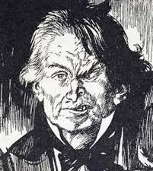
For two good reasons, I will not enter deeply into this scientific branch of my confession. First, because I have been made to learn that the doom and burthen of our life is bound for ever on man’s shoulders, and when the attempt is made to cast it off, it but returns upon us with more unfamiliar and more awful pressure. Second, because, as my narrative will make, alas! too evident, my discoveries were incomplete. Enough then, that I not only recognised my natural body from the mere aura and effulgence of certain of the powers that made up my spirit, but managed to compound a drug by which these powers should be dethroned from their supremacy, and a second form and countenance substituted, none the less natural to me because they were the expression, and bore the stamp of lower elements in my soul.

Slide 19
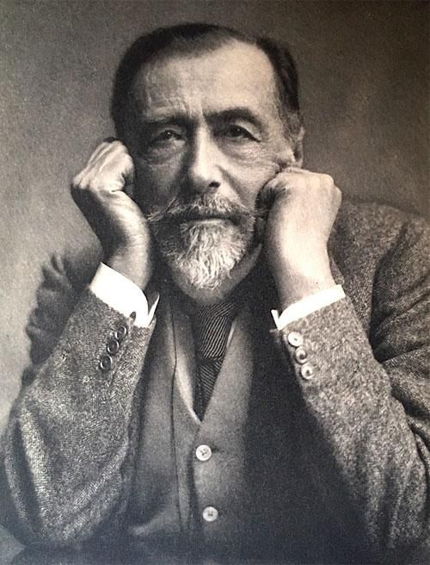
Joseph Conrad, from “Heart of Darkness,” 1899:
What was in there? I could see a little ivory coming out from there, and I had heard Mr. Kurtz was in there. I had heard enough about it, too—God knows! Yet somehow it didn’t bring any image with it—no more than if I had been told an angel or a fiend was in there. I believed it in the same way one of you might believe there are inhabitants in the planet Mars. I knew once a Scotch sailmaker who was certain, dead sure, there were people in Mars. If you asked him for some idea how they looked and behaved, he would get shy and mutter something about ‘walking on all-fours.’ If you as much as smiled, he would—though a man of sixty—offer to fight you. I would not have gone so far as to fight for Kurtz, but I went for him near enough to a lie. You know I hate, detest, and can’t bear a lie, not because I am straighter than the rest of us, but simply because it appalls me. There is a taint of death, a flavour of mortality in lies—which is exactly what I hate and detest in the world—what I want to forget. It makes me miserable and sick, like biting something rotten would do. Temperament, I suppose.

Slide 20
Well, I went near enough to it by letting the young fool there believe anything he liked to imagine as to my influence in Europe. I became in an instant as much of a pretence as the rest of the bewitched pilgrims. This simply because I had a notion it somehow would be of help to that Kurtz whom at the time I did not see—you understand. He was just a word for me. I did not see the man in the name any more than you do. Do you see him? Do you see the story? Do you see anything? It seems to me I am trying to tell you a dream—making a vain attempt, because no relation of a dream can convey the dream-sensation, that commingling of absurdity, surprise, and bewilderment in a tremor of struggling revolt, that notion of being captured by the incredible which is of the very essence of dreams....”
He was silent for a while.
“... No, it is impossible; it is impossible to convey the life-sensation of any given epoch of one’s existence—that which makes its truth, its meaning—its subtle and penetrating essence. It is impossible. We live, as we dream—alone....”
He paused again as if reflecting, then added:
“Of course in this you fellows see more than I could then. You see me, whom you know....”
It had become so pitch dark that we listeners could hardly see one another.

Slide 21
[From ‘Heart of Darkness,’ 1899]
It was very curious to see the contrast of expressions of the white men and of the black fellows of our crew, who were as much strangers to that part of the river as we, though their homes were only eight hundred miles away. The whites, of course greatly discomposed, had besides a curious look of being painfully shocked by such an outrageous row. . . . Their headman, a young, broad-chested black, severely draped in dark-blue fringed cloths, with fierce nostrils and his hair all done up artfully in oily ringlets, stood near me. ‘Aha!’ I said, just for good fellowship’s sake. ‘Catch ’im,’ he snapped, with a bloodshot widening of his eyes and a flash of sharp teeth—‘catch ’im. Give ’im to us.’ ‘To you, eh?’ I asked; ‘what would you do with them?’ ‘Eat ‘im!’ he said curtly, and, leaning his elbow on the rail, looked out into the fog in a dignified and profoundly pensive attitude. I would no doubt have been properly horrified, had it not occurred to me that he and his chaps must be very hungry: that they must have been growing increasingly hungry for at least this month past. . . . Certainly they had brought with them some rotten hippo-meat, which couldn’t have lasted very long, anyway, even if the pilgrims hadn’t, in the midst of a shocking hullabaloo, thrown a considerable quantity of it overboard. It looked like a high-handed proceeding; but it was really a case of legitimate self-defence. You can’t breathe dead hippo waking, sleeping, and eating, and at the same time keep your precarious grip on existence.

Slide 22
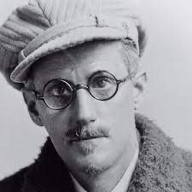
James Joyce, Ulysses, 1922:

Slide 23
Ulysses: from Molly Bloom’s monologue:

Slide 24
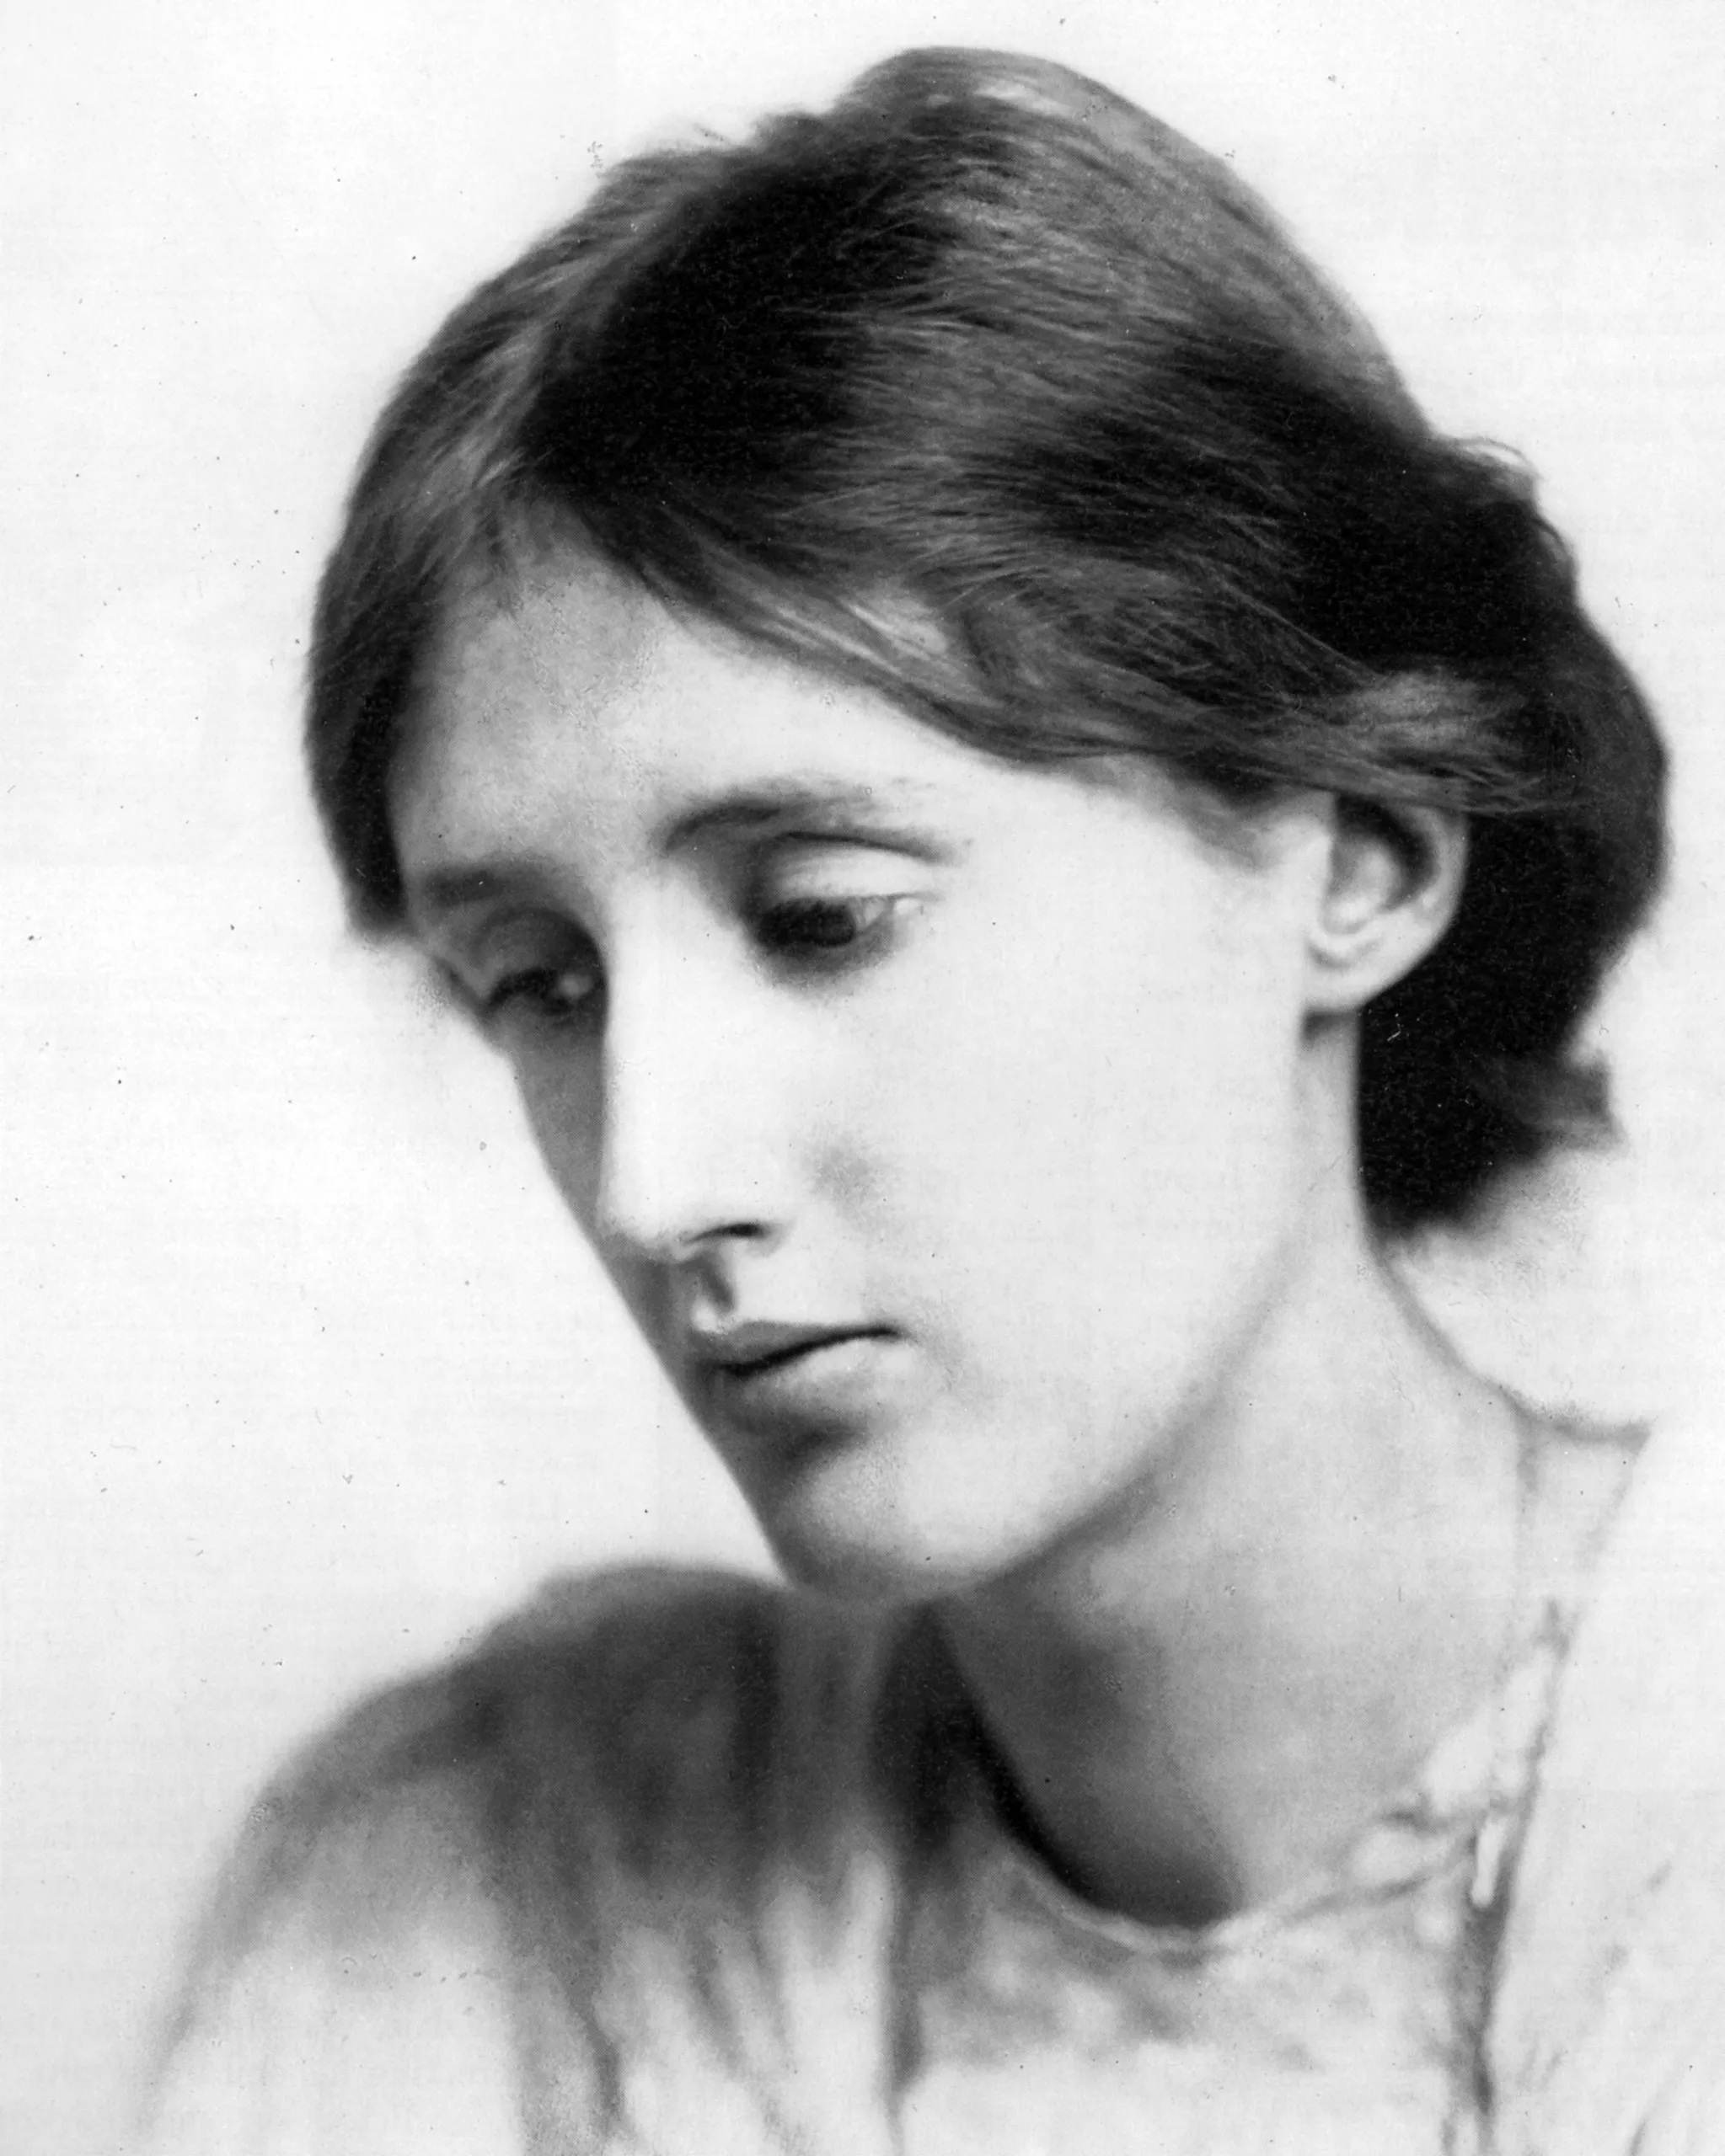
Virginia Woolf, opening pages of Mrs. Dalloway (1925)
---
Mrs. Dalloway said she would buy the flowers herself.
For Lucy had her work cut out for her. The doors would be taken off their hinges; Rumpelmayer's men were coming. And then, thought Clarissa Dalloway, what a morning--fresh as if issued to children on a beach.
What a lark! What a plunge! For so it had always seemed to her, when, with a little squeak of the hinges, which she could hear now, she had burst open the French windows and plunged at Bourton into the open air. How fresh, how calm, stiller than this of course, the air was in the early morning; like the flap of a wave; the kiss of a wave; chill and sharp and yet (for a girl of eighteen as she then was) solemn, feeling as she did, standing there at the open window, that something awful was about to happen; looking at the flowers, at the trees with the smoke winding off them and the rooks rising, falling; standing and looking until Peter Walsh said, "Musing among the vegetables?"--was that it?--"I prefer men to cauliflowers"--was that it?

Slide 25
For having lived in Westminster--how many years now? over twenty,--one feels even in the midst of the traffic, or waking at night, Clarissa was positive, a particular hush, or solemnity; an indescribable pause; a suspense (but that might be her heart, affected, they said, by influenza) before Big Ben strikes. There! Out it boomed. First a warning, musical; then the hour, irrevocable. The leaden circles dissolved in the air. Such fools we are, she thought, crossing Victoria Street. For Heaven only knows why one loves it so, how one sees it so, making it up, building it round one, tumbling it, creating it every moment afresh; but the veriest frumps, the most dejected of miseries sitting on doorsteps (drink their downfall) do the same; can't be dealt with, she felt positive, by Acts of Parliament for that very reason: they love life. In people's eyes, in the swing, tramp, and trudge; in the bellow and the uproar; the carriages, motor cars, omnibuses, vans, sandwich men shuffling and swinging; brass bands; barrel organs; in the triumph and the jingle and the strange high singing of some aeroplane overhead was what she loved; life; London; this moment of June.

