Slide 1
WEEK ONE
Part one: Hors d’oeuvres and keywords.
Part two: Influential ideas about consciousness and the mind, c.1800-1870
WEEK TWO:
Part one: William James (1842-1910) and the birth of modern psychology.
Part two: William’s younger brother Henry and experiments in Psychological Realism.
WEEK THREE:
Gilded Age Mind-science; Quackery; Resistance from American Women; Minority Perspectives.

Slide 2
WEEK FOUR:
After Darwin: Eugenics, “Degeneration,” and Literary Naturalism.
WEEK FIVE
The Long Shadow of Sigmund Freud.
WEEK SIX
Mind-science Goes Direct to the Public
Part One: Oliver Sacks, Daniel Dennett, and Antonio Damasio
Part Two: Julian Jaynes; Paul Broks; Steven Pinker.

Slide 3
WEEK SEVEN
Consciousness and the Mind in Contemporary Fiction and Drama:
WEEK EIGHT
Hollywood Riffs on the Brain -- and a Freewheeling Wrap-up

Slide 5
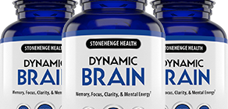
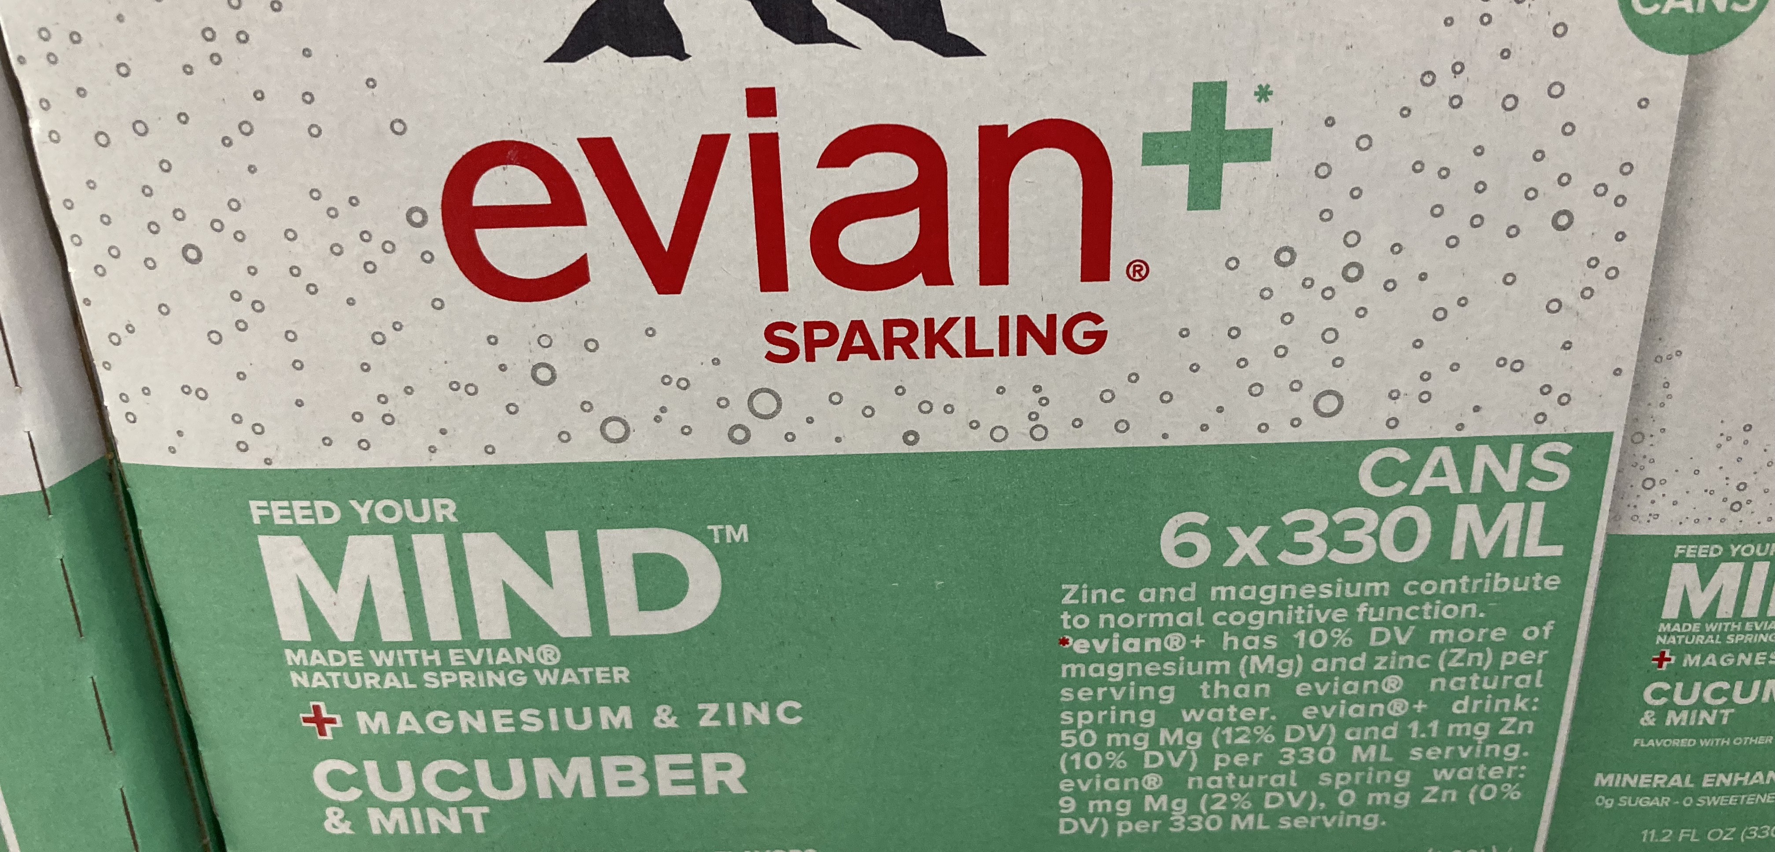



Slide 6

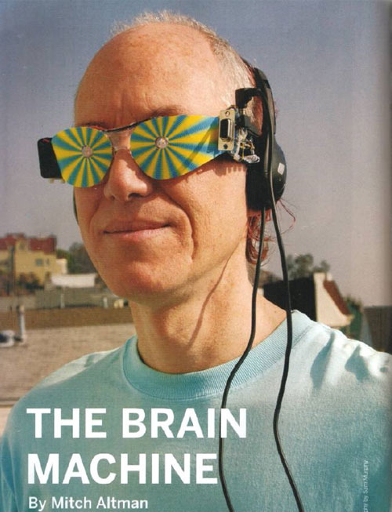



Slide 7
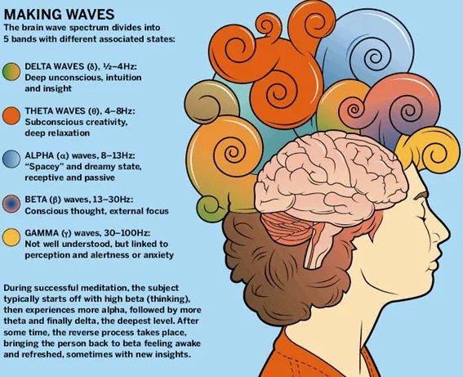

Slide 8
Mayim Balik for Neuvira:
https://www.ispot.tv/ad/O6KI/neuriva-actual-neuroscientist-featuring-mayim-bialik

Slide 9
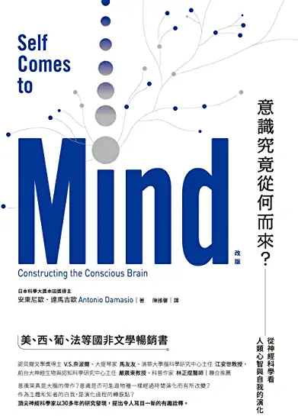
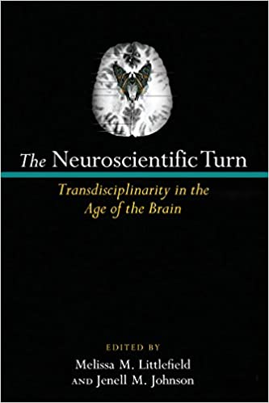
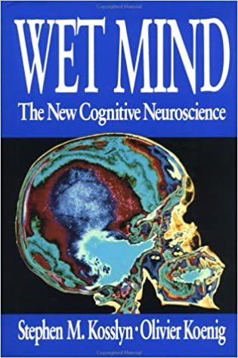
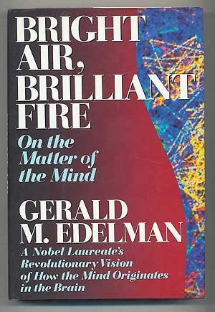
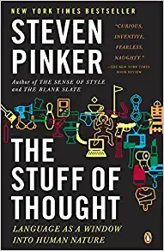
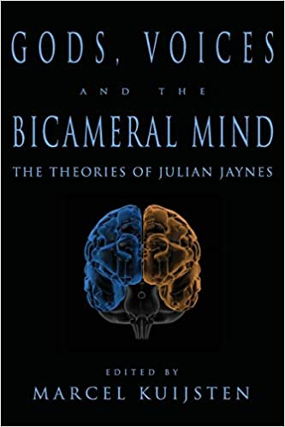
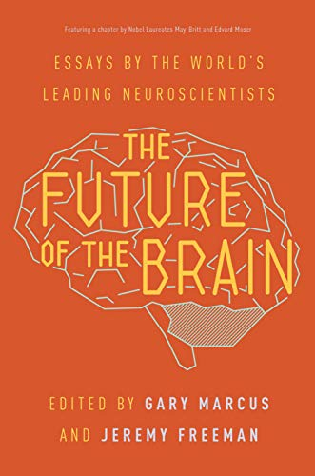
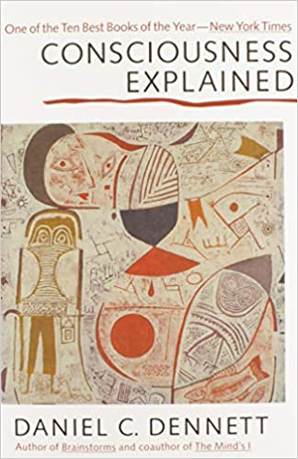

Slide 10


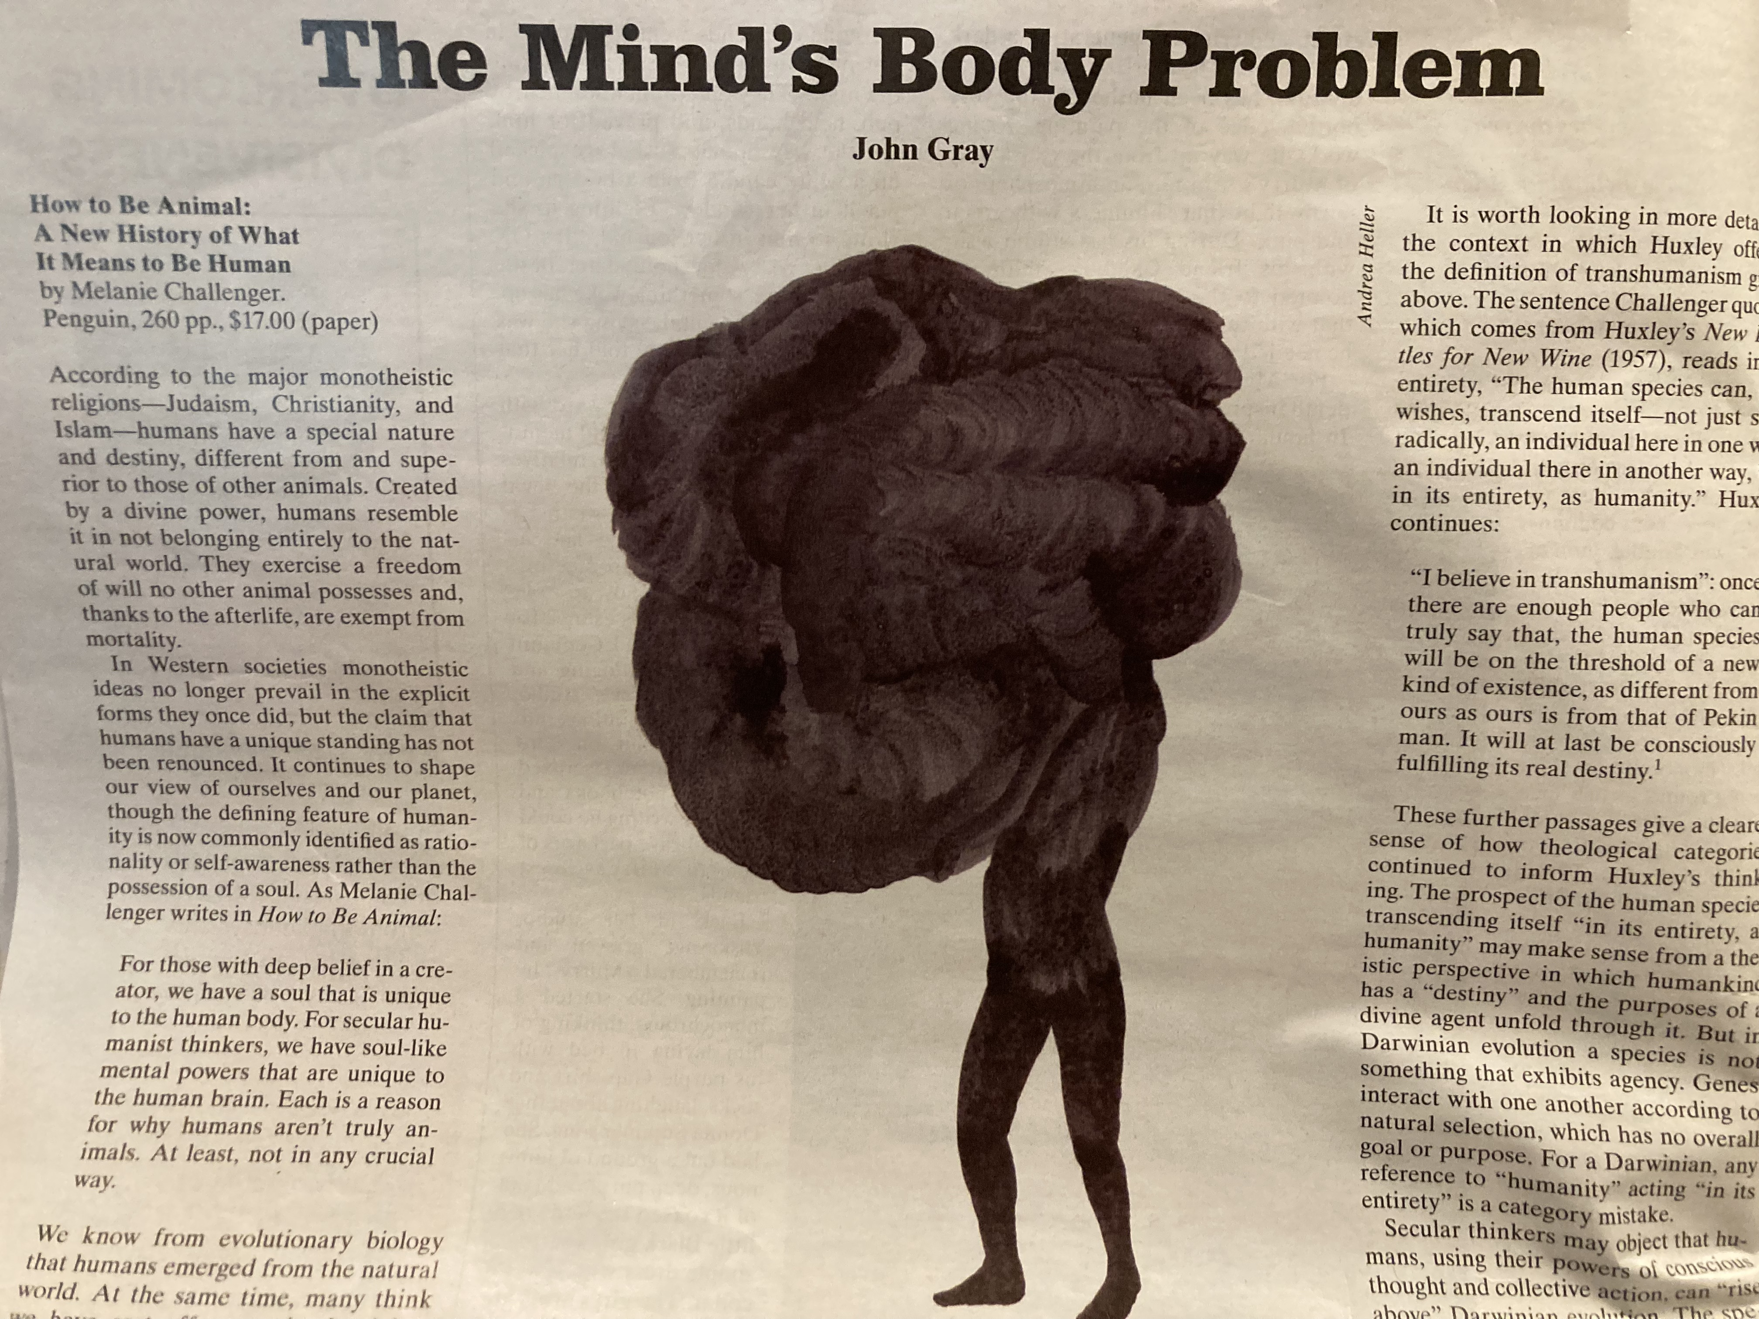




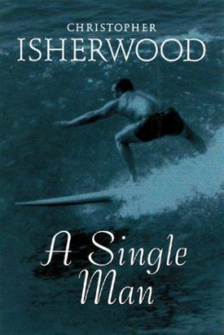
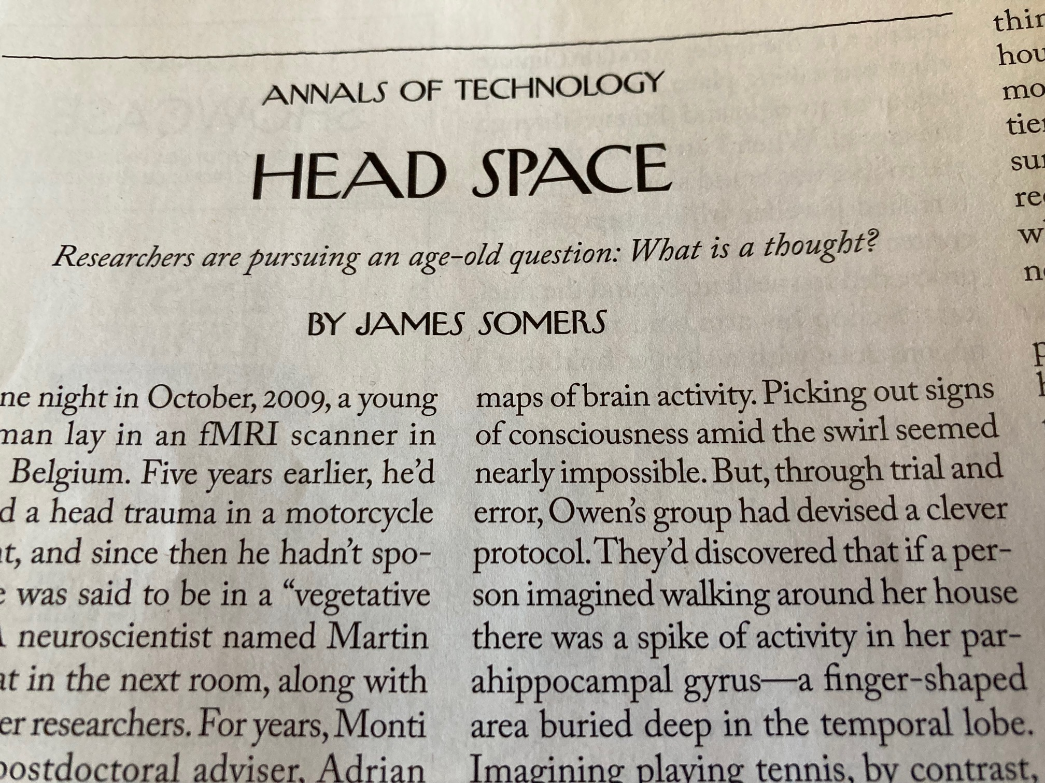

Slide 11


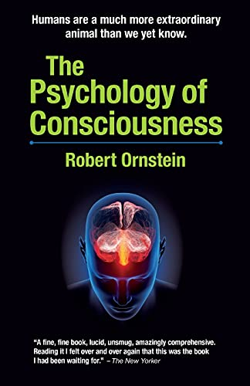





Slide 12



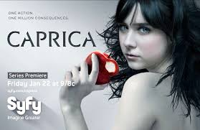






Slide 19
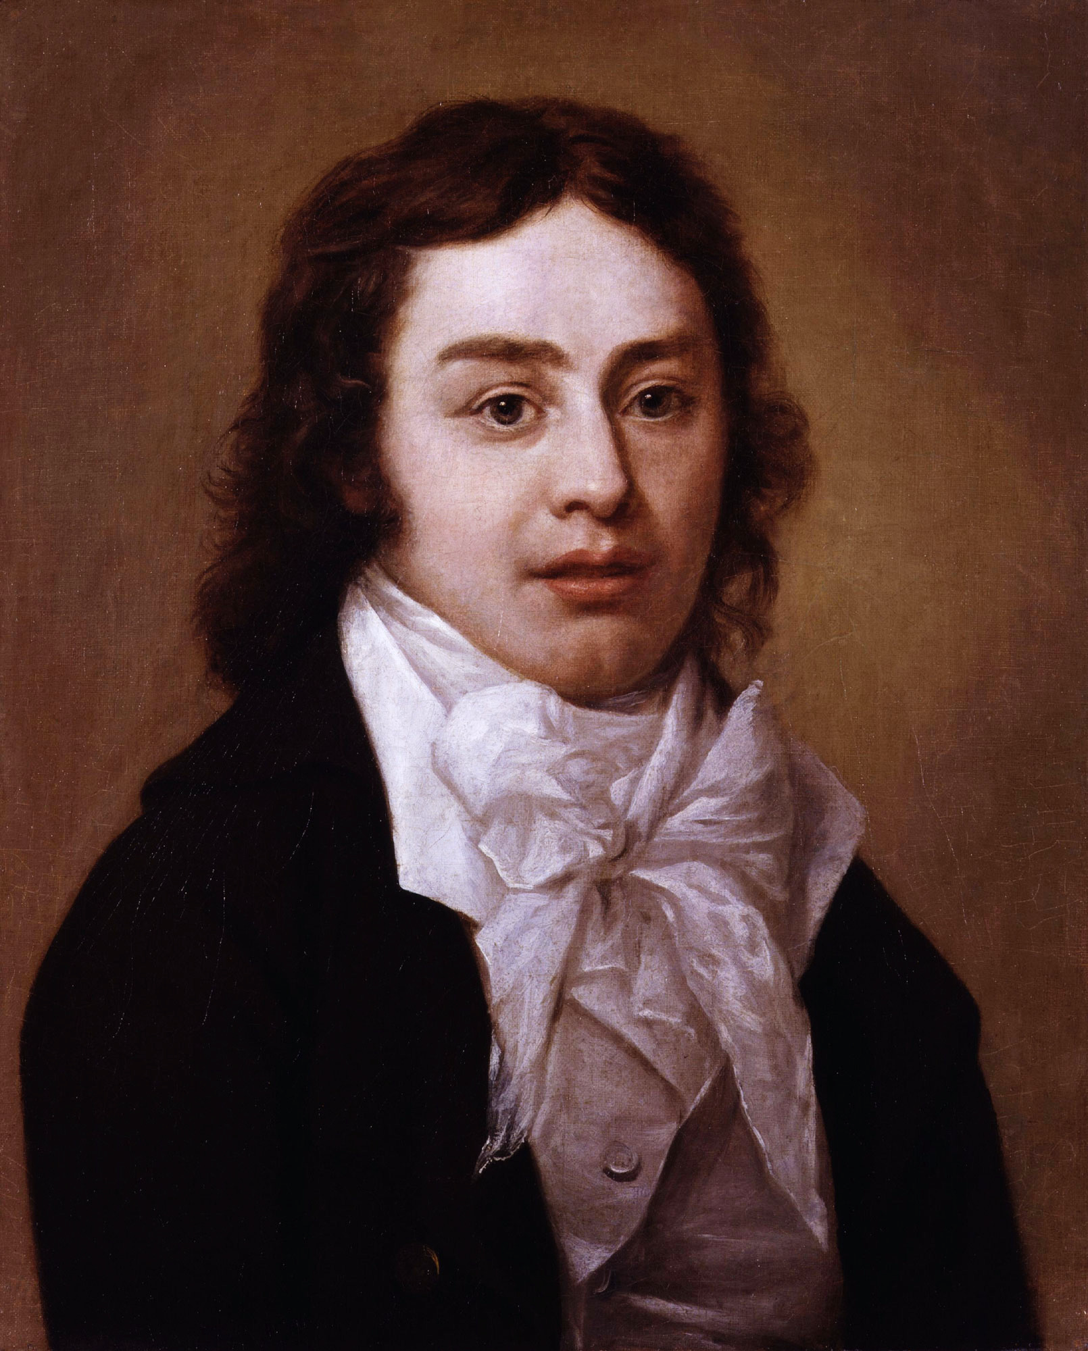

Slide 20
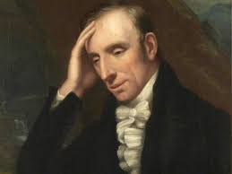
The waves beside them danced, but they
Out-did the sparkling waves in glee:—
A Poet could not but be gay
In such a jocund company:
I gazed—and gazed—but little thought
What wealth the shew to me had brought:
For oft when on my couch I lie
In vacant or in pensive mood,
They flash upon that inward eye
Which is the bliss of solitude,
And then my heart with pleasure fills,
And dances with the Daffodils.

Slide 21
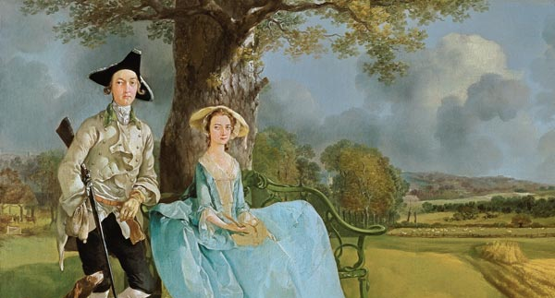

Slide 22
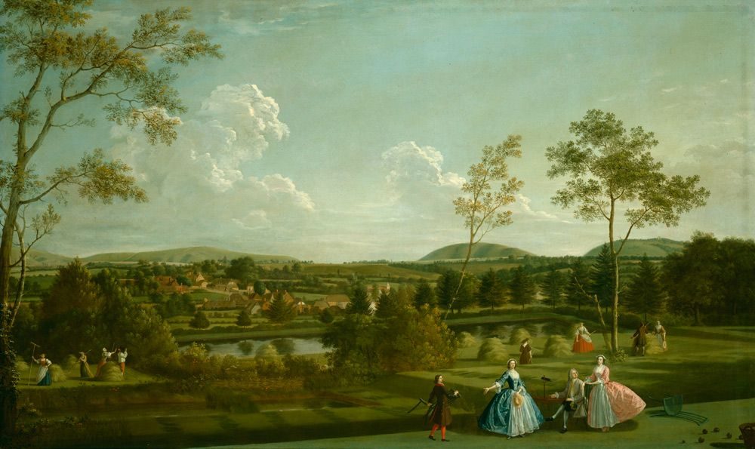

Slide 23
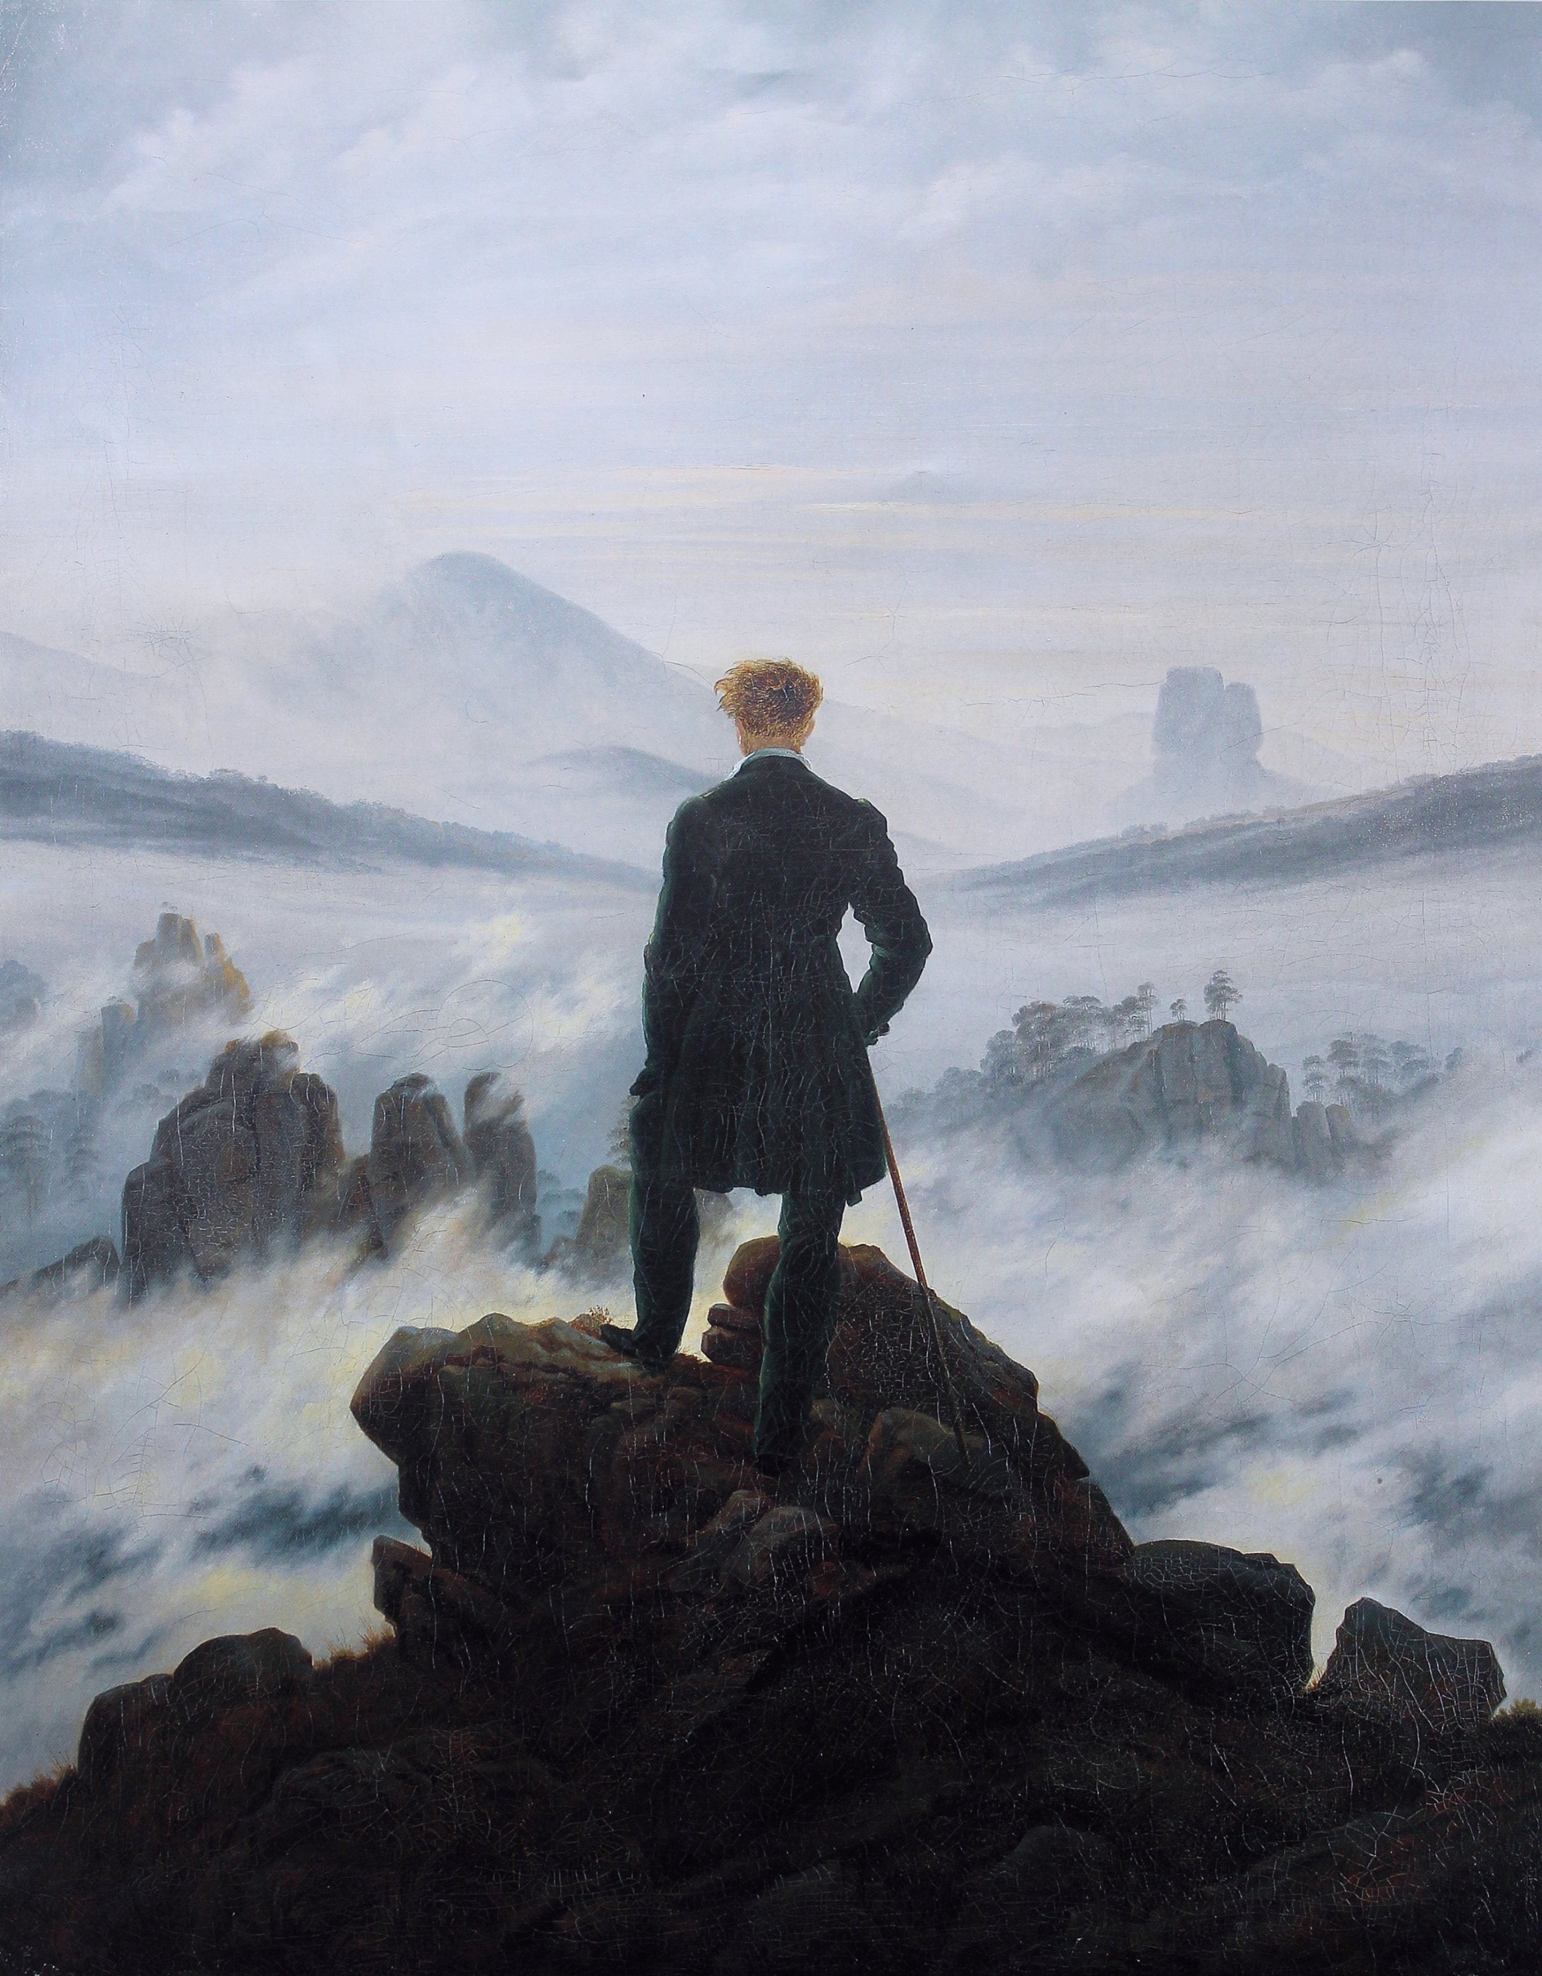

Slide 24
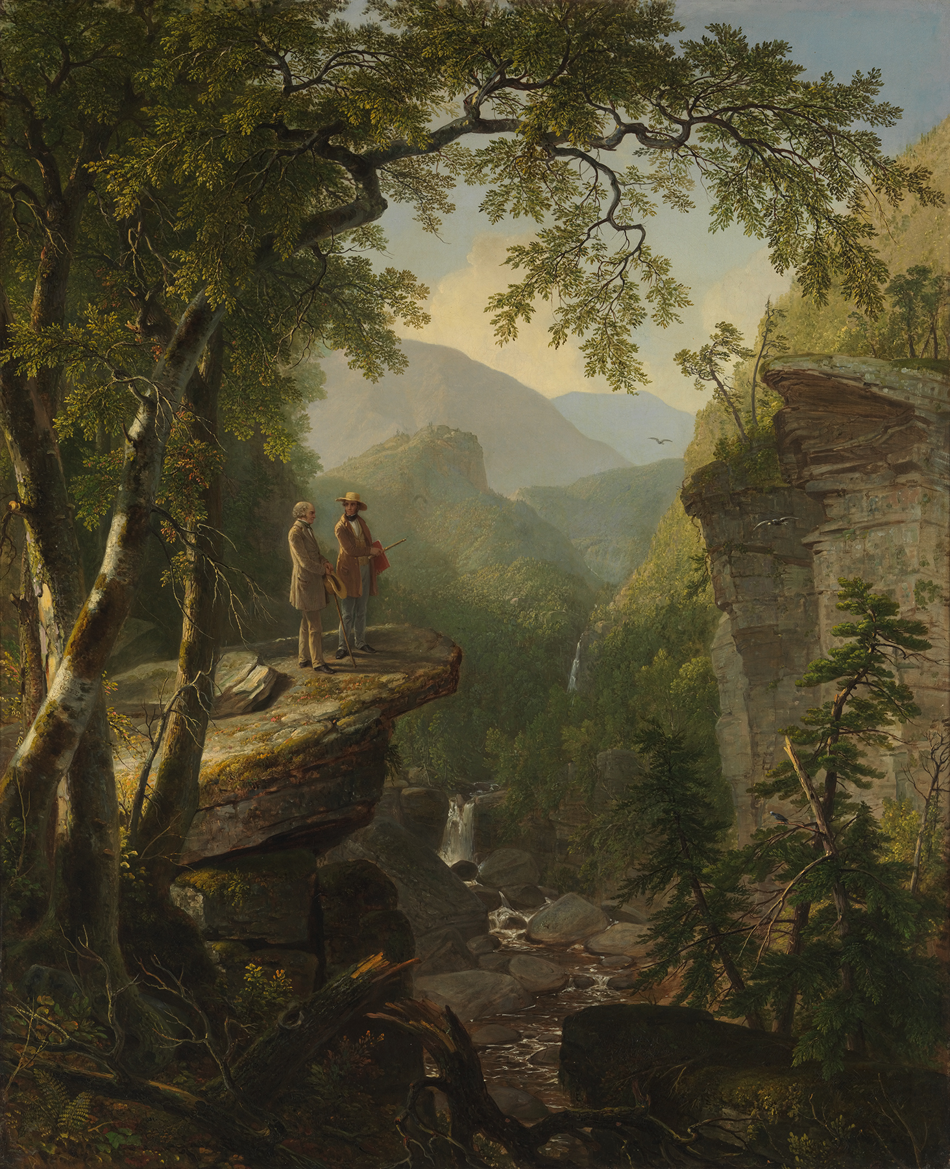

Slide 25
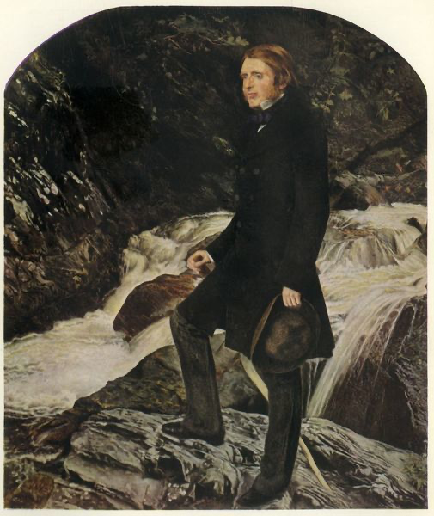

Slide 26
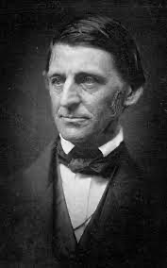
Ralph Waldo Emerson, “Nature” 1837
Nature is a setting that fits equally well a comic or a mourning piece. In good health, the air is a cordial of incredible virtue. Crossing a bare common, in snow puddles, at twilight, under a clouded sky, without having in my thoughts any occurrence of special good fortune, I have enjoyed a perfect exhilaration. I am glad to the brink of fear. In the woods too, a man casts off his years, as the snake his slough, and at what period soever of life, is always a child. In the woods, is perpetual youth. Within these plantations of God, a decorum and sanctity reign, a perennial festival is dressed, and the guest sees not how he should tire of them in a thousand years. In the woods, we return to reason and faith. There I feel that nothing can befall me in life,— no disgrace, no calamity, (leaving me my eyes,) which nature cannot repair. Standing on the bare ground,— my head bathed by the blithe air, and uplifted into infinite space,—all mean egotism vanishes. I become a transparent eye-ball; I am nothing; I see all; the currents of the Universal Being circulate through me; I am part or particle of God.

Slide 27
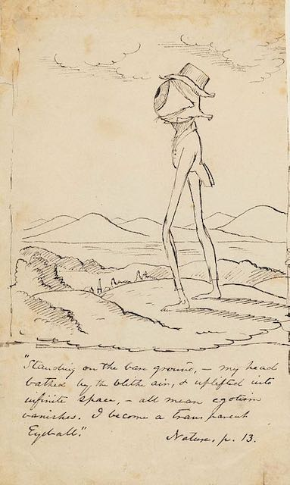


Slide 28


