Slide 1
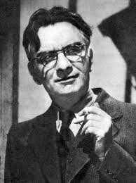
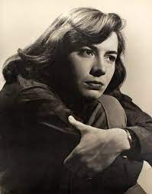
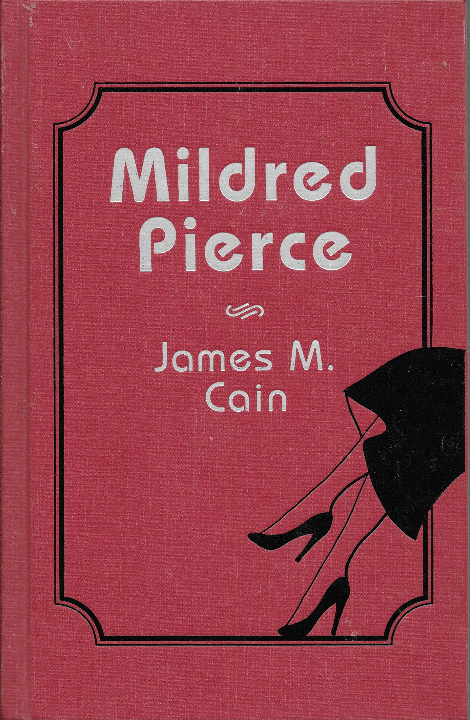
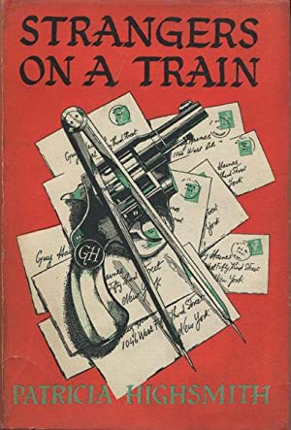
James M. Cain
1892-1977
Patricia Highsmith
1921-1995

Slide 2
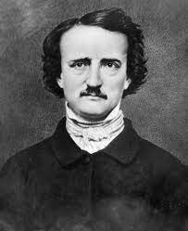
While Voltaire and others had written early detective stories, Poe's first detective story, now considered the first written in the English language, was “The Murders in the Rue Morgue” which he published in 1841. In this story, he created his detective character, C. Auguste Dupin, who later appeared in "The Purloined Letter” and “The Mystery of Marie Rogêt,” Poe's take on the real murder of Mary Cecilia Rogers who was found floating down the Hudson River in Hoboken, New Jersey. Though fictionalizing real events was a common practice when the story was written in 1842, it was the first time a murder was written into a detective story. With the Dupin stories, Poe created an enduring formula for the genre that has only endured and thrived, as fiction, drama, television, and film.
1809-1849
20th-century writers of all genres, including James Cain and Patricia Highsmith, acknowledged their profound debt to Poe’s storytelling strategies of terror and the macabre.
Cain and Highsmith were both especially indebted to Poe’s character of the seemingly hapless and/or solitary detective in his stories.

Slide 3
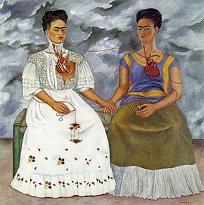
“But love and hate, [Guy] thought now, good and evil, lived side by side in the human heart, and not merely in differing proportions in one man and the next, but all good and all evil. One had merely to look for a little of either to find it all, one had merely to scratch the surface. All things had opposites close by, every decision a reason against it, every animal an animal that destroys it, the male the female, the positive the negative. The splitting of the atom was the only true destruction, the breaking of the universal law of oneness. Nothing could be without its opposite that was bound up with it. Could space exist in a building without objects that stopped it? Could energy exist without matter, or matter without energy? Matter and energy, the inert and the active, once considered opposites, were now known to be one” (chapter twenty-eight, 180).
The Two Fridas
Frida Kahlo, 1939
Museo de Arte Moderno, Mexico City

Slide 4
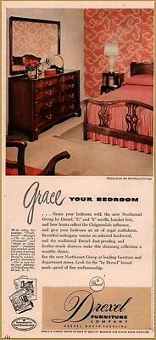
“’Don’t forget to thank Mother for the furniture, will you?’ [Anne] whispered to him. ‘Mother gave it to us, you know.’ The cherry bedroom set, of course. He remembered her telling him that morning at breakfast, remembered his bandaged hand, and Anne in the black dress she had worn to Helen’s party. But when he should have said something about the furniture, he didn’t, and then it seemed too late. They must know something is the matter, he felt. Everyone in the world must know. He was only somehow being reprieved, being saved for some weight to fall upon him and annihilate him” (chapter twenty-nine, 184).
1949 Drexel Furniture Advertisement
Courtesy Pinterest

Slide 5
“There was a moment after dusk, on the terrace with Anne, when he imagined he might not have known her any better than he had the first evening he visited her, when he suddenly felt a tremendous, joyous longing to make her love him. Then he remembered the house in Alton awaiting them after the wedding Sunday, and all the happiness he had known already with Anne rushed back to him. He wanted to protect her, to achieve some impossible goal, which would please her. It seemed the most positive, the happiest ambition he had ever known. There was a way out, then, if he could feel like this. It was only a part of himself he had to cope with, not his whole self, not Bruno, or his work. He had merely to crush the other part of himself, and live in the self he was now” (chapter thirty, 189).
Manhassat, NY Mid-Century Home
Courtesy Patch.com

Slide 6
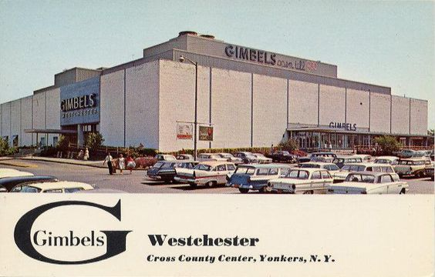
”He spent the morning dawdling over a job that he had been on for several days. Take your time, they told him. All he had to do was give the client what he wanted and sign his name to it. Now, this job was a department store for an opulent little community in Westchester, and the client wanted something like an old mansion, in keeping with the town, only sort of modern, too, see? And he had asked especially for Guy Daniel Haines. By adjusting his brain to the level of the trick, the cartoon, Guy could have tossed it off, but the fact it was really going to be a department store kept intruding certain functional demands. He erased and sharpened pencils all morning, and figured it would take him four or five more days, well into next week, until he got anything down as even a rough idea to show the client. ‘Charley Bruno’s coming tonight, too,’ Anne called that evening from the kitchen” (chapter thirty-two, 197).
Courtesy mallsofamerica.com

Slide 7
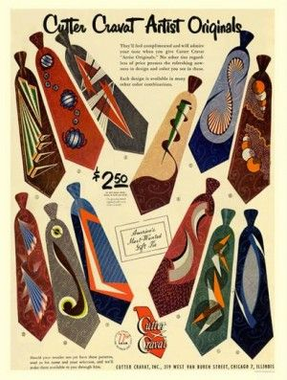
“Bruno ordered the cocktails and the lunch. He ordered broiled liver for himself, because of his new diet, he said, and eggs Benedict for Guy, because he knew Guy liked them. Guy was inspecting the table nearest them. He felt a puzzled suspicion of the four smartly dressed, fortyish women, all of whom were smiling with their eyes almost closed, all of whom lifted cocktail glasses. Beyond them, a well-fed, European-looking man hurled a smile across the table at his invisible companion. Waiters scurried zealously. Could it all be a show created and enacted by madmen, he and Bruno the main characters, and the maddest of all? For every movement he saw, every word he heard, seemed wrapped in the heroic gloom of predestination. ‘Like ’em?’ Bruno was saying. ‘I got ’em at Clyde’s this morning. Best selection in town. For summer anyway’ . . .
Why was he sitting here with Bruno, eating at the same table with him? He wanted to fight Bruno and he wanted to weep. But all at once he felt his curses dissolve in a flood of pity. Bruno did not know how to love, and that was all he needed. Bruno was too lost, too blind to love or to inspire love. It seemed all at once tragic” (chapter thirty-three, 205, 207).
Courtesy Getty Images

Slide 8
Guy looked at Bruno, and Bruno lowered his eyes. Bruno was waiting, as if for him to tell him how to fall in love. ‘Do you know the greatest wisdom in the world, Bruno?’ ‘I know a lot of wisdoms,’ Bruno smirked. ‘Which one do you mean?’ ‘That everything has its opposite close beside it.’ ‘Opposites attract?’ ‘That’s too simple. I mean—you give me ties. But it also occurred to me you might have the police waiting for me here.’
‘F’ Christ’s sake, Guy, you’re my friend!’ Bruno said quickly, suddenly frantic. ‘I like you!’ I like you, I don’t hate you, Guy thought. But Bruno wouldn’t say that, because he did hate him. Just as he would never say to Bruno, I like you, but instead, I hate you, because he did like him. Guy set his jaw, and rubbed his fingers back and forth across his forehead. He could foresee a balance of positive and negative will that would paralyze every action before he began it. Such as that, for instance, that kept him sitting here. He jumped up, and the new drinks splashed on the cloth (chapter thirty-three, 208).
Courtesy ancient-symbols.com

Slide 9
“As a boy . . . he had known that he would not merely dream, as he had somehow known, too . . . that he would create famous buildings, that his name would take its proper place in architecture, and finally—it had always seemed to him the crowning achievement—that he would build a bridge. It would be a white bridge with a span like an angel’s wing, he had thought as a boy, like the curving white bridge of Robert Maillart in his architecture books . . .
The murder that had seemed an outrageous departure, a sin against himself, he believed now might have been a part of his destiny, too. It was impossible to think otherwise. And if it were so, he would be given a way to make his atonement, and given the strength to make it. And if death by law overtook him first, he would be given the strength to meet that also, and strength besides sufficient for Anne to meet it. In a strange way, he felt humbler than the smallest minnow of the sea, and stronger than the greatest mountain on earth” (chapter thirty-five, 211).
Salginatobel Bridge is a reinforced concrete arch bridge designed by Swiss civil engineer Robert Maillart. It was constructed across an alpine ravine in the grisonian Prättigau, belonging to the municipality of Schiers, in Switzerland between 1929 and 1930.

Slide 10
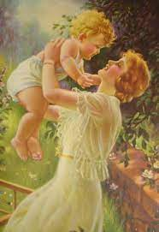
“’Promise me?’ She watched his eyelids flutter shut again, and heard him sigh. The tragedy was not this morning, she thought, but years ago when he had taken his first drink by himself. The tragedy was not even the first drink, because the first drink was not the first resort but the last. There’d had to be first the failure of everything else—of her and Sam, of his friends, of his hope, of his interests, really. And hard as she tried, she could never discover why or where it might have begun, because Charley had always been given everything, and both she and Sam had done their best to encourage him in everything and anything he had ever shown interest in. If she could only discover the place in the past where it might have begun— She got up, needing a drink herself” (chapter thirty-eight, 225).
Courtesy Alamy

Slide 11
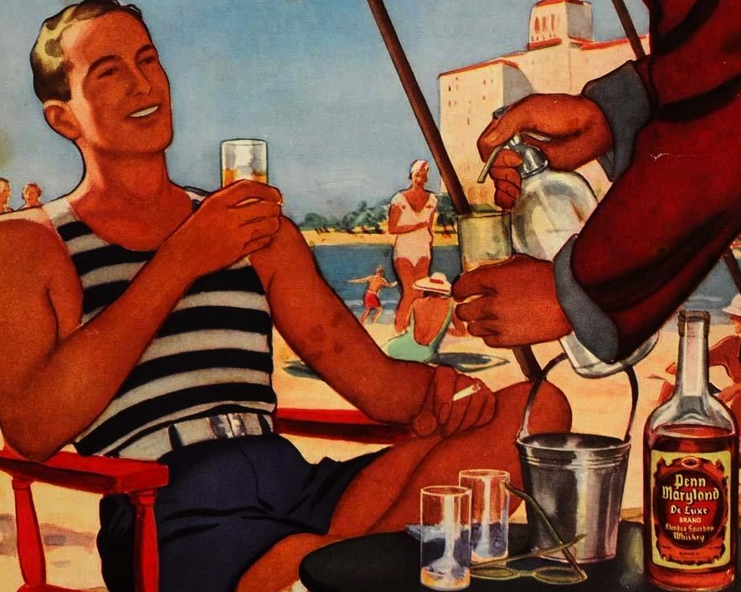
“Bruno opened his eyes tentatively. He felt deliciously heavy with sleep. He saw himself halfway across the room, as if he watched himself on a screen. He was in his red-brown suit. It was the island in Metcalf. He saw his younger, slimmer body arc toward Miriam and fling her to the earth, those few short moments separate from time before and time after. He felt he had made special movements, thought special brilliant thoughts in those moments, and that such an interval would never come again. Like Guy had talked about himself, the other day on the boat, when he built the Palmyra. Bruno was glad those special moments for both of them had come so near the same time. Sometimes he thought he could die without regrets, because what else could he ever do that would measure up to the night in Metcalf?” (chapter thirty-eight, 225).
Courtesy Vintage Ad Archive

Slide 12
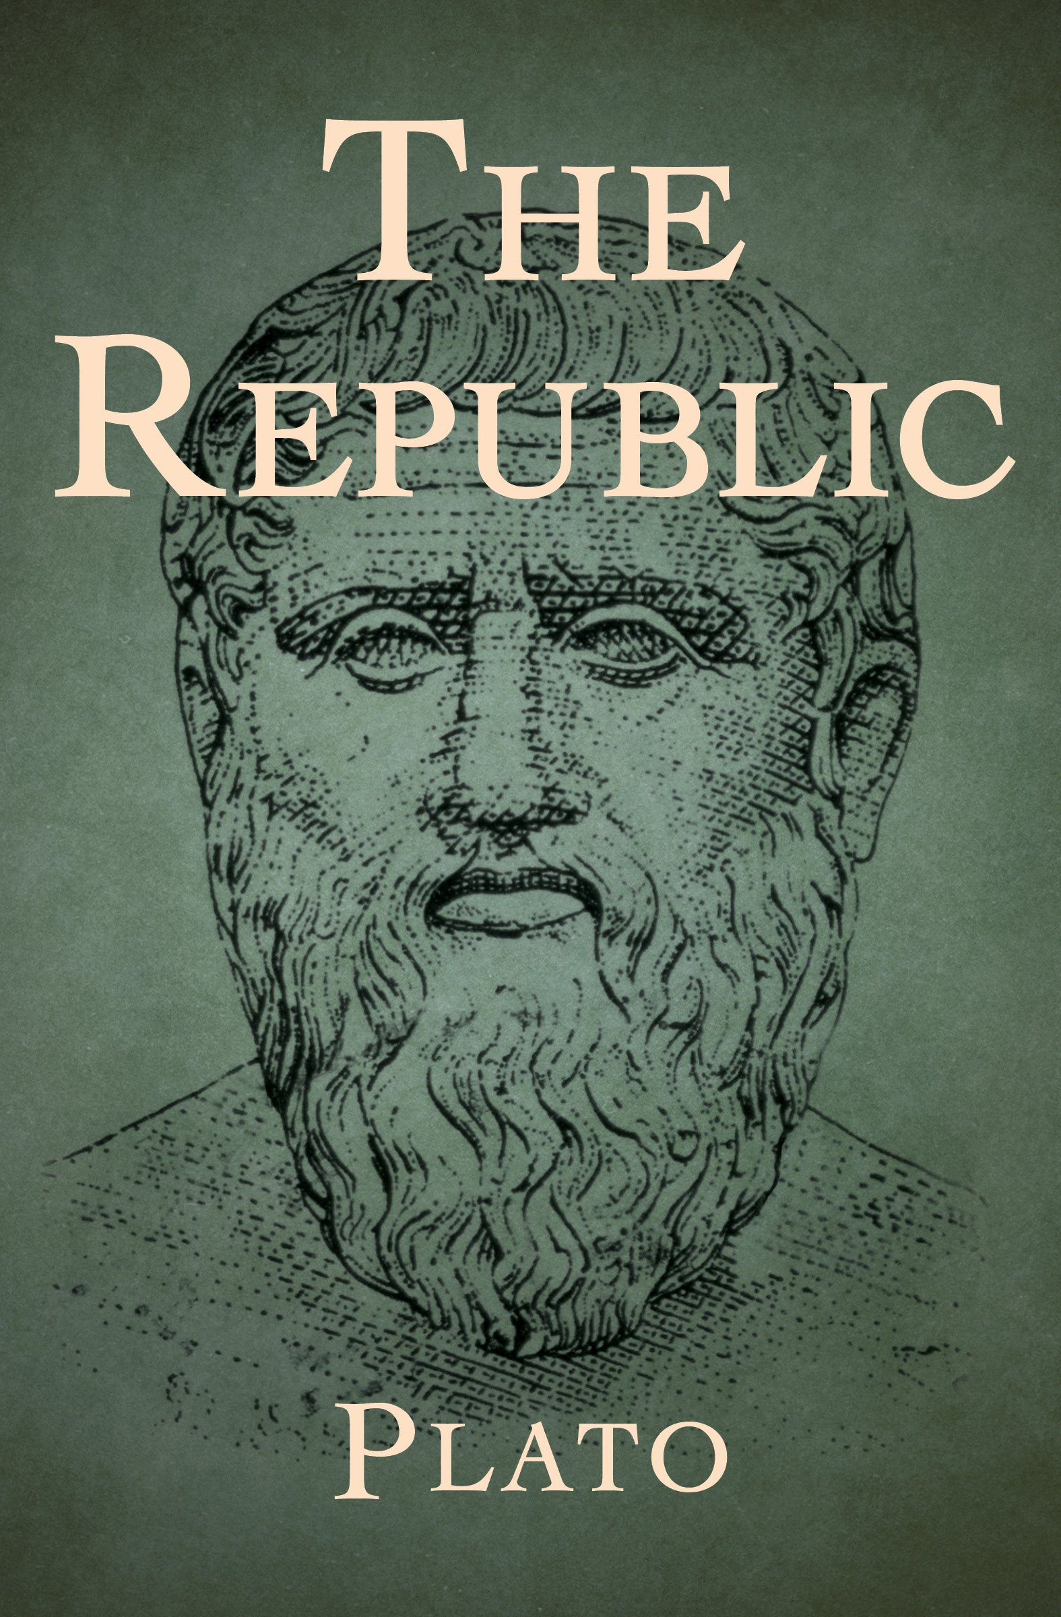
[Guy] “tried to slow his breathing, tried to slow his pace. He looked up at the small disc of the winter sun. His black brows with the gray hair, with the white scar, his brows that were growing shaggier lately, Anne said, broke the glare into particles and protected him. If one looks directly into the sun for fifteen seconds, one can burn through the cornea, he remembered from somewhere. Anne protected him, too. His work protected him. The new suit, the stupid new suit. He felt suddenly inadequate and dull-witted, helpless. Death had insinuated itself into his brain. It enwrapped him. He had breathed its air so long, perhaps, he had grown quite used to it. Well, then, he was not afraid. He squared his shoulders superfluously” (chapter forty, 231).
In the Republic (375 BC) we encounter Socrates developing a position on justice and its relation to eudaimonia (happiness). He provides a long and complicated, but unified argument, in defense of the just life and its necessary connection to the happy life.
The dialogue explores two central questions. The first question is “what is justice?” Socrates addresses this question both in terms of political communities and in terms of the individual person or soul. He does this to address the second and driving question of the dialogue: “is the just person happier than the unjust person?” or “what is the relation of justice to happiness?” (Encyclopedia of Philosophy).

Slide 13
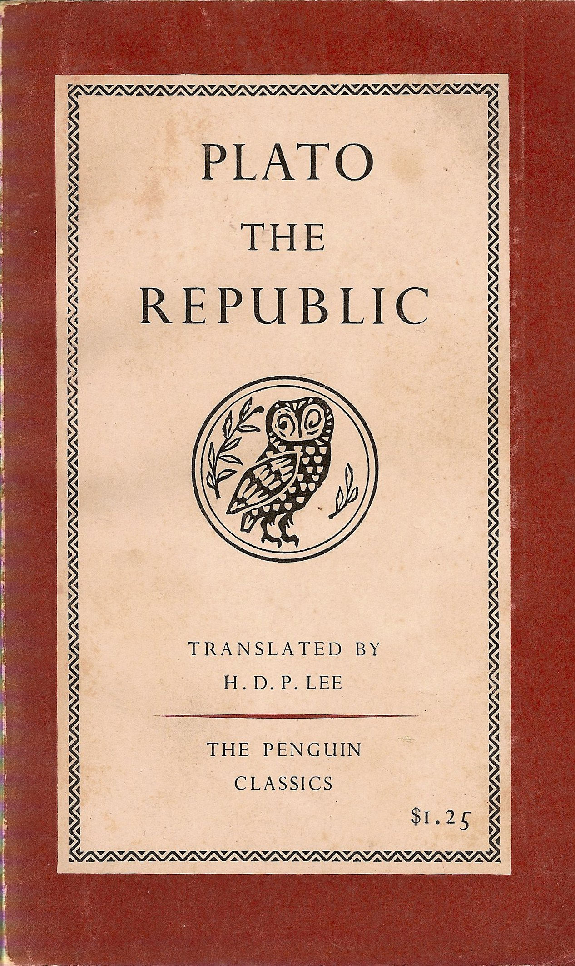
”In [Guy’s] mind, the side of the scale that bore his guilt was hopelessly weighted, beyond the scale’s measure, yet into the other side he continually threw the equally hopeless featherweight of self-defense. He had committed the crime in self-defense, he reasoned. But he vacillated in completely believing this. If he believed in the full complement of evil in himself, he had to believe also in a natural compulsion to express it. He found himself wondering, therefore, from time to time, if he might have enjoyed his crime in some way, derived some primal satisfaction from it—how else could one really explain in mankind the continued toleration of wars, the perennial enthusiasm for wars when they came, if not for some primal pleasure in killing?—and because the capacity to wonder came so often, he accepted it as true that he had” (chapter forty-two, 242).

Slide 14
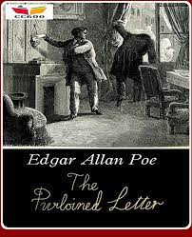
“ [Gerard]: ‘Oh, I’ve solved a few cases in the last fifteen years.’ ‘A man like Guy Haines?’ Howland laughed again. ‘Against a fellow like Charles? Mind you, I don’t say Guy Haines did it of his own free will. He was made to do it for Charles’ unsolicited favor of freeing him of his wife. Charles hates women,’ he remarked in a parenthesis. ‘That was Charles’ plan. Exchange. No clues, you see. No motives. Oh, I can just hear him! But even Charles is human. He was too interested in Guy Haines to leave him alone afterward. And Guy Haines was too frightened to do anything about it. Yes—’ Gerard jerked his head for emphasis, and his jowls shook—’Haines was coerced’” (chapter forty-three, 245).
The Purloined Letter belongs to a group of detective stories that Poe called tales of ratiocination, or reasoning, as opposed to typical sleuth work such as gathering evidence and interviewing witnesses. The reader's sense of excited participation is grounded not in the facts of the case but in the duel of wits that occurs between formidable antagonists—usually the criminal and the detective, who is not a conventional police detective. See: Double Indemnity, James M. Cain.

Slide 15
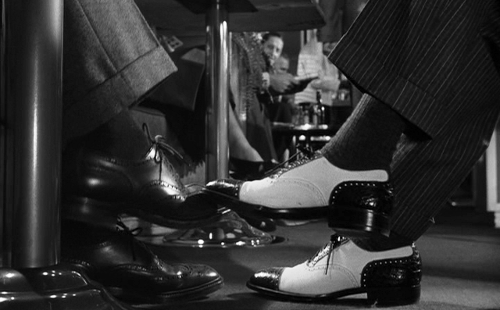
“[Bruno] ‘People, feelings, everything! Double! Two people in each person. There’s also a person exactly the opposite of you, like the unseen part of you, somewhere in the world, and he waits in ambush.’ It thrilled him to say Guy’s words, though he hadn’t liked hearing them, he remembered, because Guy had said the two people were mortal enemies, too, and Guy had meant him and himself. Anne brought her head up slowly from the sofa back. It sounded so like Guy, yet he had never said it to her” (chapter forty-four,251).
The shoes of Guy Haines (Farley Granger) and Charles Bruno (Robert Walker) in an opening shot from Hitchcock’s Strangers on a Train (1951).

Slide 16
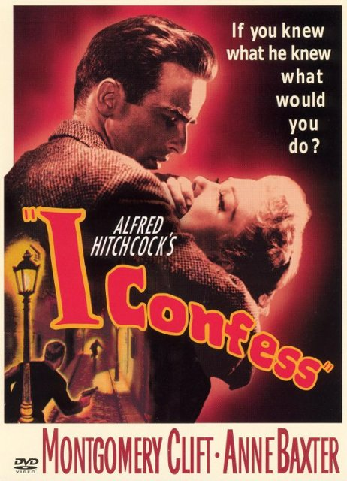
“Slowly, [Guy] stood up. An idea was taking form in his mind even as he tried to weigh his memories of the long, dark face and tall, slouching figure that was Owen Markman. He would go and see Markman and talk with him, tell him everything. If he owed it to anyone, he owed it to Markman. Let Markman kill him if he would, call the police in, anything. But he would have told him, honestly, and face to face. Suddenly it was an urgent necessity. Of course. It was the only step and the next step. After that, after his personal debt, he would shoulder whatever the law put upon him. He would be ready then. He could catch a train today, after the questions they were supposed to answer about Bruno” (chapter forty-six, 266).
1953

Slide 17
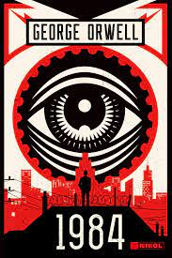
“Guy couldn’t find the telephone. There was a wire by the bed table, though. He traced the wire under the bed. The telephone was off the hook, on the floor, and he knew immediately it hadn’t fallen, because both parts were dragged up near the foot of the bed, the hand piece eerily focused on the armchair where Owen had been sitting. Guy pulled the telephone slowly toward him . . . He was holding the telephone in a position for speaking, and now he brought it closer to his ear. He heard the intelligent silence of a live wire. ‘Hello?’ he said. ‘Hello, Mr. Haines.’ The voice was rich, courteous, and just the least brusque” (chapter forty-seven, 280).
‘We are the dead,’ [Winston] said.
‘We are the dead,’ echoed Julia dutifully.
‘You are the dead,’ said an iron voice behind them.
They sprang apart. Winston’s entrails seemed to have turned into ice. He could see the white all round the irises of Julia’s eyes. Her face had turned a milky yellow. The smear of rouge that was still on each cheekbone stood out sharply, almost as though unconnected with the skin beneath.
‘You are the dead,’ repeated the iron voice.
‘It was behind the picture,’ breathed Julia.
‘It was behind the picture,’ said the voice. ‘Remain exactly where you are. Make no movement until you are ordered.’
From George Orwell, 1984 (1949)

Slide 18
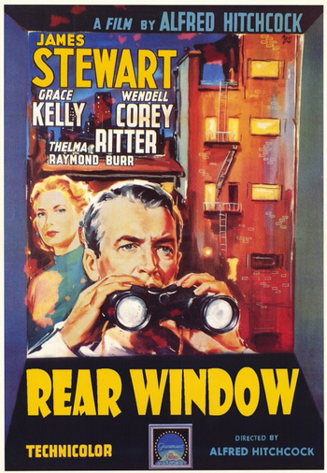
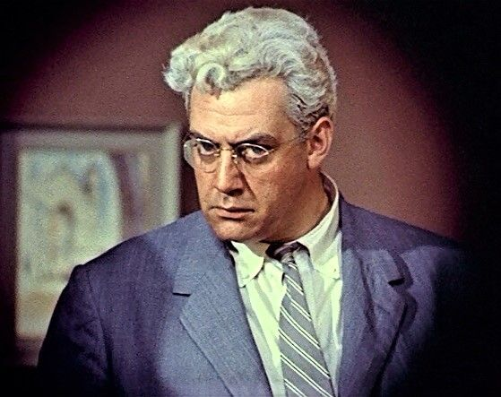
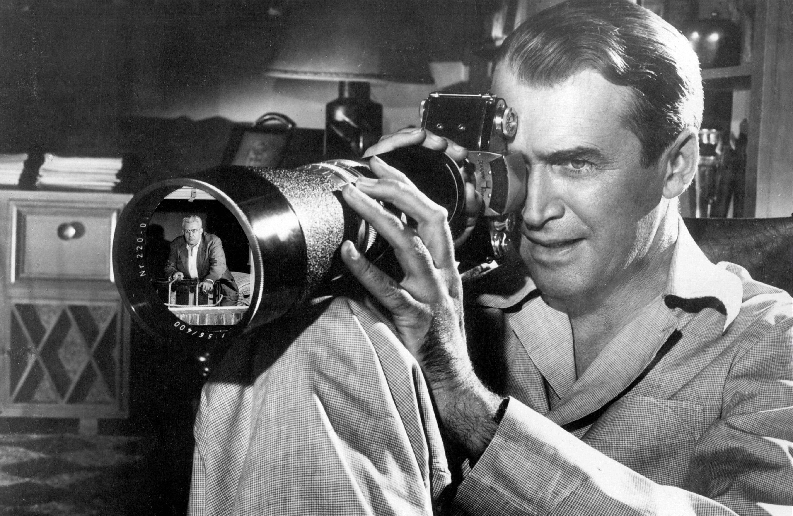
Lars Thornwald (Raymond Burr)
Sees Jeff Jeffries (James Stewart) watching him through his Rear Window.

Slide 19
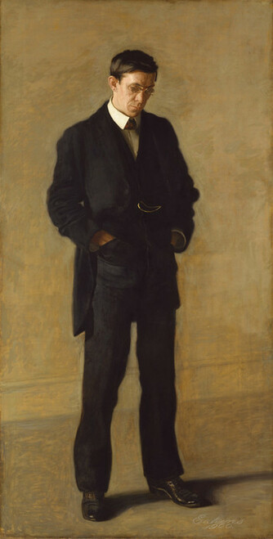
“’Eh?’ Gerard said. Guy tried to speak, and said something entirely different from what he had intended. ‘Take me.’” (chapter forty-seven, 281).
The Thinker: Portrait of Louis N. Kenton
Thomas Eakins, 1900
Metropolitan Museum of Art, NYC

