Slide 1
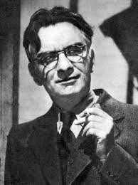
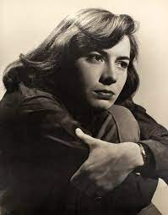
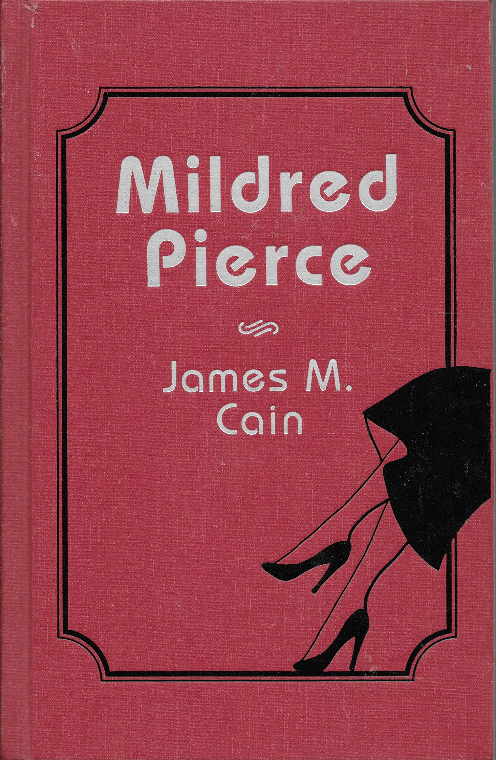
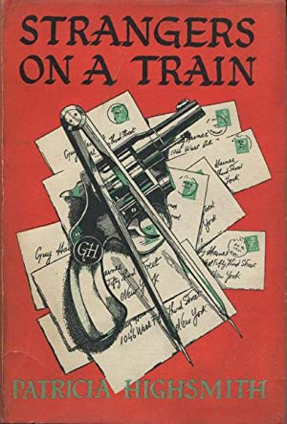
James M. Cain
1892-1977
Patricia Highsmith
1921-1995

Slide 2
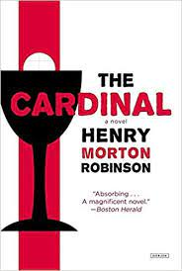
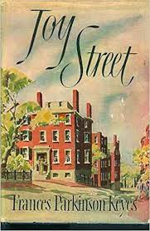
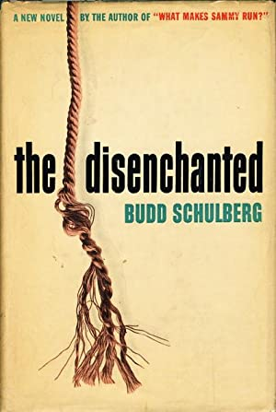
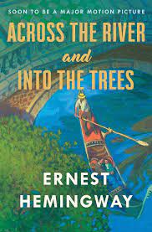
Best Sellers in the USA, 1950
The Cardinal by Henry Morton Robinson Joy Street by Frances Parkinson Keyes Across the River and into the Trees by Ernest Hemingway The Wall by John Hersey Star Money by Kathleen Winsor The Parasites by Daphne du Maurier Floodtide by Frank Yerby Jubilee Trail by Gwen Bristow The Adventurer by Mika Waltari The Disenchanted by Budd Schulberg

Slide 3
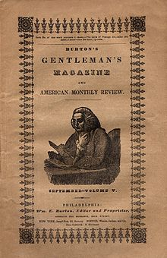
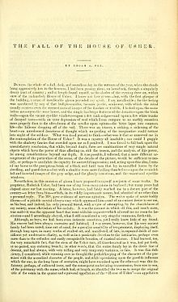
1839

Slide 4
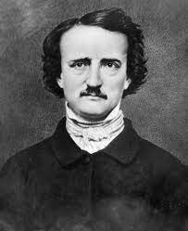
A Dream Within a Dream
Take this kiss upon the brow! And, in parting from you now, Thus much let me avow — You are not wrong, who deem That my days have been a dream; Yet if hope has flown away In a night, or in a day, In a vision, or in none, Is it therefore the less gone? All that we see or seem Is but a dream within a dream.
I stand amid the roar Of a surf-tormented shore, And I hold within my hand Grains of the golden sand — How few! yet how they creep Through my fingers to the deep, While I weep — while I weep! O God! Can I not grasp Them with a tighter clasp? O God! can I not save One from the pitiless wave? Is all that we see or seem But a dream within a dream?
Edgar Allan Poe, 1849
The Fall of the House of Usher
“DURING the whole of a dull, dark, and soundless day in the autumn of the year, when the clouds hung oppressively low in the heavens, I had been passing alone, on horseback, through a singularly dreary tract of country, and at length found myself, as the shades of the evening drew on, within view of the melancholy House of Usher. I know not how it was—but, with the first glimpse of the building, a sense of insufferable gloom pervaded my spirit. I say insufferable; for the feeling was unrelieved by any of that half-pleasurable, because poetic, sentiment, with which the mind usually receives even the sternest natural images of the desolate or terrible. I looked upon the scene before me—upon the mere house, and the simple landscape features of the domain—upon the bleak walls—upon the vacant eye-like windows—upon a few rank sedges—and upon a few white trunks of decayed trees—with an utter depression of soul which I can compare to no earthly sensation more properly than to the after-dream of the reveller upon opium—the bitter lapse into every-day life—the hideous dropping off of the veil. ”
Edgar Allan Poe
1809-1849

Slide 5
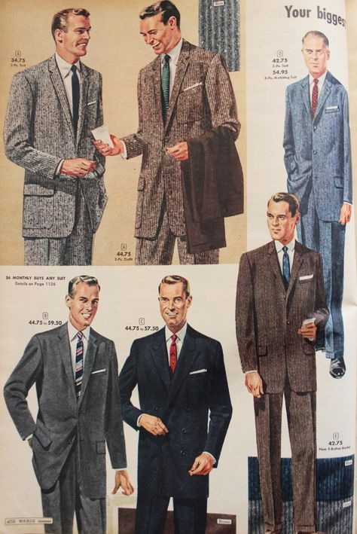
“A slow ache fell through [Guy] to his feet. He could not bear to be alone in his room. He went out to a bar, and almost before he knew what he was doing, had two ryes and then a third. In the mirror behind the bar, he saw himself glance at his sunburnt face, and it struck him that his eyes looked dishonest and furtive. Bruno had done it. It came thundering down with a weight that left no possibility of doubt any longer, like a cataclysm that only a madman’s unreason could have kept suspended all this while. He glanced about in the little bar as if he expected the walls to topple down on him. Bruno had done it. There was no mistaking Bruno’s personal pride in his, Guy’s, freedom now. Or the P.S. Or possibly even the trip to Haiti. But what did Bruno mean? Guy scowled at the face in the mirror and dropped his eyes, looked down at his hands, the front of his tweed jacket, his flannel trousers, and it flashed through his mind he had put these clothes on this morning as a certain person and that he would take them off tonight as another person, the person he would be from now on. He knew now. This was an instant—He could not say just what was happening, but he felt his entire life would be different, must be different, from now on” (chapter sixteen, 101-102).
Men’s flannel and tweed, 1950s
Courtesy jimmystailor.com

Slide 6
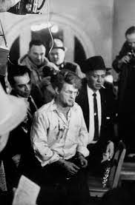
[Bruno] “was not like the dopes in the newspapers who killed “to see what it felt like,” and never had a bloody thing to report except sometimes a sick-making, ‘It wasn’t as good as I expected.’ If he were interviewed, he would say, ‘It was terrific! There’s nothing in the world like it!’ (‘Would you ever do it again, Mr. Bruno?’) ‘Well, I might,’ reflectively, with caution, as an arctic explorer when asked if he will winter up north again next year might reply uncommittingly to a reporter. (‘Can you tell us a little bit about your sensations?’) He would tip the microphone toward him, look up, and muse, while the world awaited his first word. How had it felt? Well, there’s only it, see, and nothing to compare it with” (chapter seventeen, 106) .
Charles Starkweather, murderer of 12 people in Nebraska, answering questions from the press after being apprehended in 1958. Courtesy Alamy

Slide 7
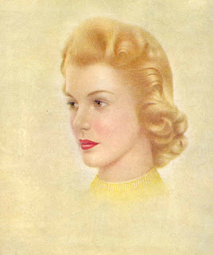
“Bruno jerked his head this way and that to avoid the cool washcloth. He hated them both and he hated Guy! He had killed for him, dodged police for him, kept quiet when he asked him to, fallen in the stinking water for him, and Guy didn’t even want to see him! Guy spent his time with a girl! Guy wasn’t scared or unhappy, just didn’t have time for him! Three times he had seen her around Guy’s house in New York! If he had her here, he would kill her just like he had killed Miriam! . . .
Guy would get married again and never have time for him. See what sympathy he’d get now when this girl played him for a sucker! He’d been seeing her in Mexico, not just visiting friends. No wonder he’d wanted Miriam out of the way! And he hadn’t even mentioned Anne Faulkner on the train! Guy had used him. Maybe Guy would kill his father whether he liked it or not. Anybody can do a murder. Guy hadn’t believed it, Bruno remembered” (chapter nineteen, 119).
Breck Girl, 1957
Courtesy goldcountrygirls.com

Slide 8
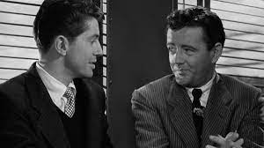
“’You know,’ Bruno said quietly. ‘What we talked about on the train. The exchange of victims. You’re going to kill my father.’ Guy made a sound of contempt. He had known it before Bruno said it, had suspected it since Miriam’s death. He stared into Bruno’s fixed, still wistful eyes, fascinated by their cool insanity . . . .
Ignore him, Guy thought, ignore him! ‘You don’t frighten me in the least. It’d be the easiest thing in the world to prove you insane.’ ‘I’m no more insane than you are!’” (chapter twenty, 122-123).
Guy (Farley Granger) and Bruno (Robert Walker) on a train.
Strangers on a Train, 1951.
Courtesy filmthreat.com

Slide 9
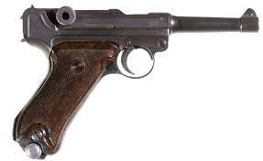
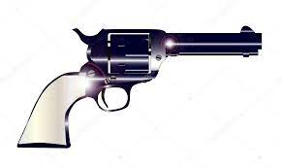
“Some impulse made Guy take his own little revolver from the back of his top drawer, made him heft his own beautiful pearl-handled gun over his bed where the Luger lay. He smiled at his action, then brought the Texas gun up closer to his eyes and studied it. He had seen it in a glutted pawnshop window on lower Main Street in Metcalf when he was about fifteen, and had bought it with money from his paper route, not because it was a gun but because it was beautiful. Its compactness, the economy of its short barrel had delighted him. The more he had learned of mechanical design, the more pleased he had been with his gun. He had kept it in various top drawers for fifteen years. He opened the chamber and removed the bullets, three of them, and turned the cylinder around with six pulls of the trigger, admiring the deep pitched clicks of its perfect machinery. Then he slipped the bullets back, put the gun into its lavender-colored flannel bag, and replaced it in his drawer” (chapter twenty-one, 125).
Modern Stoeger Luger Semi-Automatic Pistol
Courtesy iCollector.com
Pearl-handled pistol, 1940s
Courtesy Alamy

Slide 10
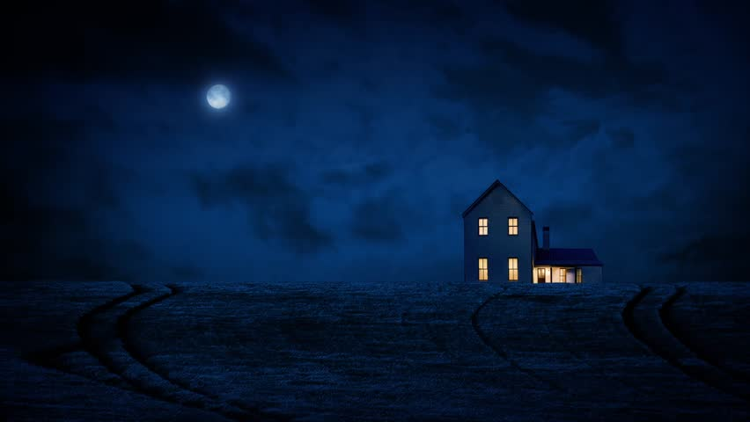
“’What is it, Guy?’ [Anne] knew there was something, he thought. She always knew. ‘Nothing.’ He followed her as she turned and walked toward the house. The night had blackened the earth, made the snowy ground hardly distinguishable from woods and sky. And Guy felt it again—the sense of hostility in the clump of woods east of the house. Before him, the kitchen door spilled a warm yellow light some way onto the lawn. Guy turned again, letting his eyes rest on the blackness where the woods began. The feeling he had when he gazed there was discomforting and relieving at once, like biting on an ailing tooth (chapter twenty-one, 128).
House In Country At Night With Moon
Courtesy Shutterstock.com

Slide 11
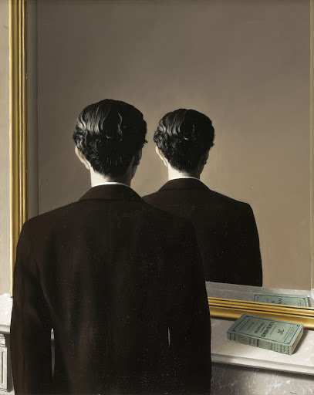
[Guy] “lighted a cigarette, then noticed he already had one. Hunched over the shiny black table, he smoked them both. His arms and hands with the cigarettes seemed mirrored. What was he doing here at 1:15 in the afternoon, growing swimmy on his third martini, making himself incapable of work, assuming he had any? Guy Haines who loved Anne, who had built the Palmyra? He hadn’t even the courage to throw his martini glass into the corner. Quicksand. Suppose he sank completely. Suppose he did kill for Bruno. It would be so simple, as Bruno said, when the house was empty except for his father and the butler, and Guy knew the house more exactly than his home in Metcalf. He could leave clues against Bruno, too, leave the Luger in the room. This thought became a single point of concreteness. His fists closed reflexively against Bruno, then the impotence of his clenched hands before him on the table shamed him. He must not let his mind go there again. That was exactly what Bruno wanted his mind to do” (chapter twenty-two, 139-140).
Not to Be Reproduced
Rene Magritte, 1937
Museum Boijmans Van Beuningen,
Rotterdam, Netherlands

Slide 12
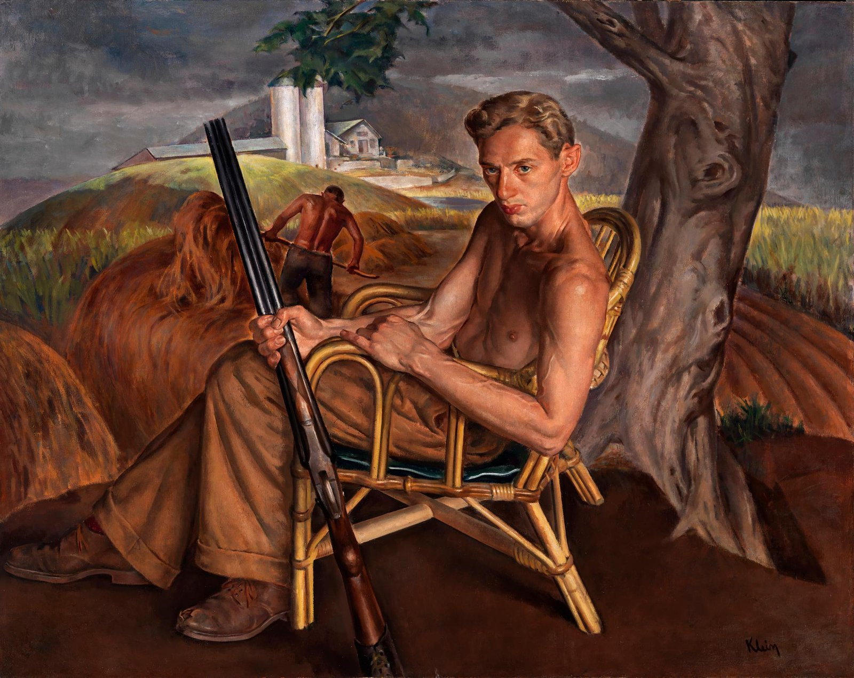
“Guy examined him from his small brown shoes to his stringy oiled hair, as if from his physical appearance he could discover what had caused his change of feeling, or even what the feeling was. It was familiarity and something more, something brotherly. Bruno clicked the gun shut and turned to him. His face was heavier than the last time Guy had seen it, flushed and more alive than he remembered ever having seen it. His gray eyes looked bigger with his tears and rather golden. He looked at Guy as if he tried to find words, or as if he pled with Guy to find them. Then he moistened the thin parted lips, shook his head, and reached an arm out toward the lamp. The light went out” (chapter twenty-three, 146).
American Farm Hand
Sandor Klein, 1937
National Gallery of Art, Washington D.C.

Slide 13
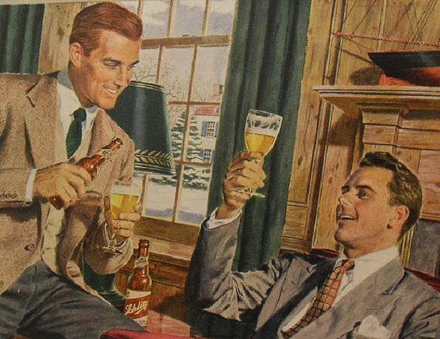
“There was a moment on the train, when a man bumped [Guy’s] shoulder, when his nerves seemed to go quivering up and up to a pitch at which he thought something must happen, and a flurry of words rushed to his mind, almost to his tongue: It’s not really a gun in my pocket. I’ve never thought of it as a gun. I didn’t buy it because it was a gun. And immediately he felt easier, because he knew he was going to kill with it. He was like Bruno. Hadn’t he sensed it time and time again, and like a coward never admitted it? Hadn’t he known Bruno was like himself? Or why had he liked Bruno? He loved Bruno. Bruno had prepared every inch of the way for him, and everything would go well because everything always went well for Bruno. The world was geared for people like Bruno” (chapter twenty-three, 148).
Schlitz Beer Advertisement, 1940s
Courtesy flickr.com

Slide 14
“Then daylight made a sudden thrust at the night, and cracked the whole horizon on [Guy’s] left. A silver line ran around the top of a hill, and the hill became mauve and green and tan, as if it were opening its eyes. A little yellow house stood under a tree on the hill. On his right, a dark field had become high grass of green and tan, gently moving like a sea. As he looked, a bird flew out of the grass with a cry and wrote a fast, jagged, exuberant message with its sharp-pointed wings across the sky. Guy stopped and watched it until it disappeared” (chapter twenty-three, 157).
Adirondack Mountains Sunrise
Courtesy Maplogs.com

Slide 15
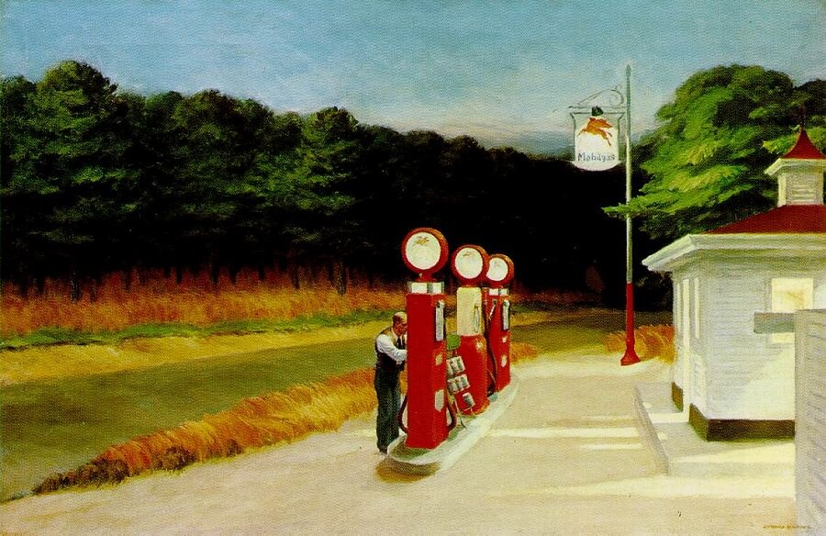
“Except for [Guy’s] scratched hands, he might have believed it one of his dreams that he had done it. Because he had not wanted to do it, he thought. It had not been his will. It had been Bruno’s will, working through him. He wanted to curse Bruno, curse him aloud, but he simply had not the energy now. The curious thing was that he felt no guilt, and it seemed to him now that the fact Bruno’s will had motivated him was the explanation. But what was this thing, guilt, that he had felt more after Miriam’s death than now? Now he was merely tired, and unconcerned about anything. Or was this how anyone would feel after killing? He tried to sleep, and his mind retraced the moments on the Long Island bus, the two workmen who had stared at him, his pretense of sleep with the newspaper over his face. He had felt more shame with the workmen. . . .” (chapter twenty-four, 158).
Gas
Edward Hopper, 1940
Museum of Modern Art, NYC

Slide 16
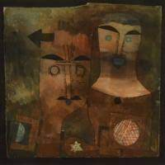
” Guy! Bruno smiled going down in the elevator. Not once had Guy crossed his mind in Gerard’s office! Not one flicker even when Gerard had hammered at him about where he went Thursday night! Guy! Guy and himself! Who else was like them? Who else was their equal? He longed for Guy to be with him now. He would clasp Guy’s hand, and to hell with the rest of the world! Their feats were unparalleled! Like a sweep across the sky! Like two streaks of red fire that came and disappeared so fast, everybody stood wondering if they really had seen them” (chapter 25, 167).
A Couple of Gods
Paul Klee, 1924
Scharf-Gerstenberg Collection
Berlin, Germany

Slide 17
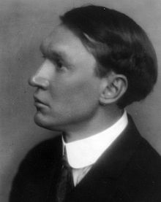
The Leaden-Eyed
Let not young souls be smothered out before They do quaint deeds and fully flaunt their pride. It is the world's one crime its babes grow dull, Its poor are ox-like, limp and leaden-eyed. Not that they starve; but starve so dreamlessly, Not that they sow, but that they seldom reap, Not that they serve, but have no gods to serve, Not that they die, but that they die like sheep.
Vachel Lindsay, 1914
”He and Guy were not leaden-eyed. He and Guy would not die like sheep now. He and Guy would reap. He would give Guy money, too, if he would take it” (chapter twenty-five, 168).
Vachel Lindsay (1879-1931)
Born in Springfield, Illinois

Slide 18
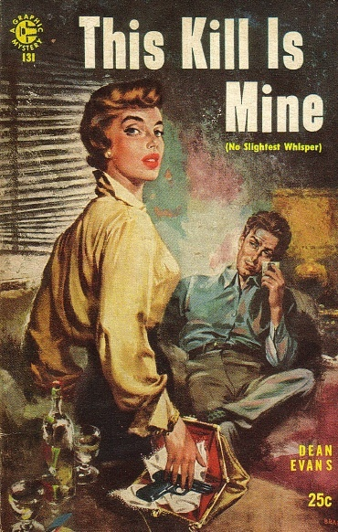
“If Bruno dared to contact him again, he would kill him, too. Guy was sure that he could. Bruno would know it, too. Bruno had always been able to read him. The silence from Bruno now brought more relief than the silence from the police. In fact, he was not anxious at all lest the police find him, had never been. The anxiety had always been within himself, a battle of himself against himself, so torturous he might have welcomed the law’s intervention. Society’s law was lax compared to the law of conscience. He might go to the law and confess, but confession seemed a minor point, a mere gesture, even an easy way out, an avoidance of truth. If the law executed him, it would be a mere gesture” (chapter twenty-eight, 178).
This Kill is Mine
Book Cover, 1956
Courtesy Crimereads.com

Slide 19
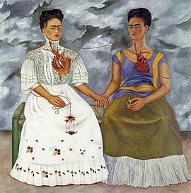
“But love and hate, [Guy] thought now, good and evil, lived side by side in the human heart, and not merely in differing proportions in one man and the next, but all good and all evil. One had merely to look for a little of either to find it all, one had merely to scratch the surface. All things had opposites close by, every decision a reason against it, every animal an animal that destroys it, the male the female, the positive the negative. The splitting of the atom was the only true destruction, the breaking of the universal law of oneness. Nothing could be without its opposite that was bound up with it. Could space exist in a building without objects that stopped it? Could energy exist without matter, or matter without energy? Matter and energy, the inert and the active, once considered opposites, were now known to be one” (chapter twenty-eight, 180).
The Two Fridas
Frida Kahlo, 1939
Museo de Arte Moderno, Mexico City

Slide 20
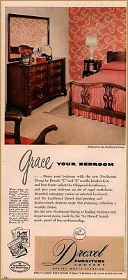
“’Don’t forget to thank Mother for the furniture, will you?’ [Anne] whispered to him. ‘Mother gave it to us, you know.’ The cherry bedroom set, of course. He remembered her telling him that morning at breakfast, remembered his bandaged hand, and Anne in the black dress she had worn to Helen’s party. But when he should have said something about the furniture, he didn’t, and then it seemed too late. They must know something is the matter, he felt. Everyone in the world must know. He was only somehow being reprieved, being saved for some weight to fall upon him and annihilate him” (chapter twenty-nine, 184).
1949 Drexel Furniture Advertisement
Courtesy Pinterest

