Slide 1
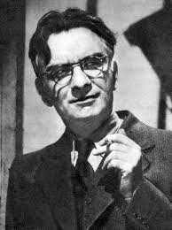
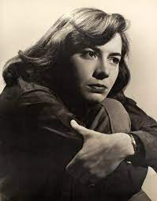
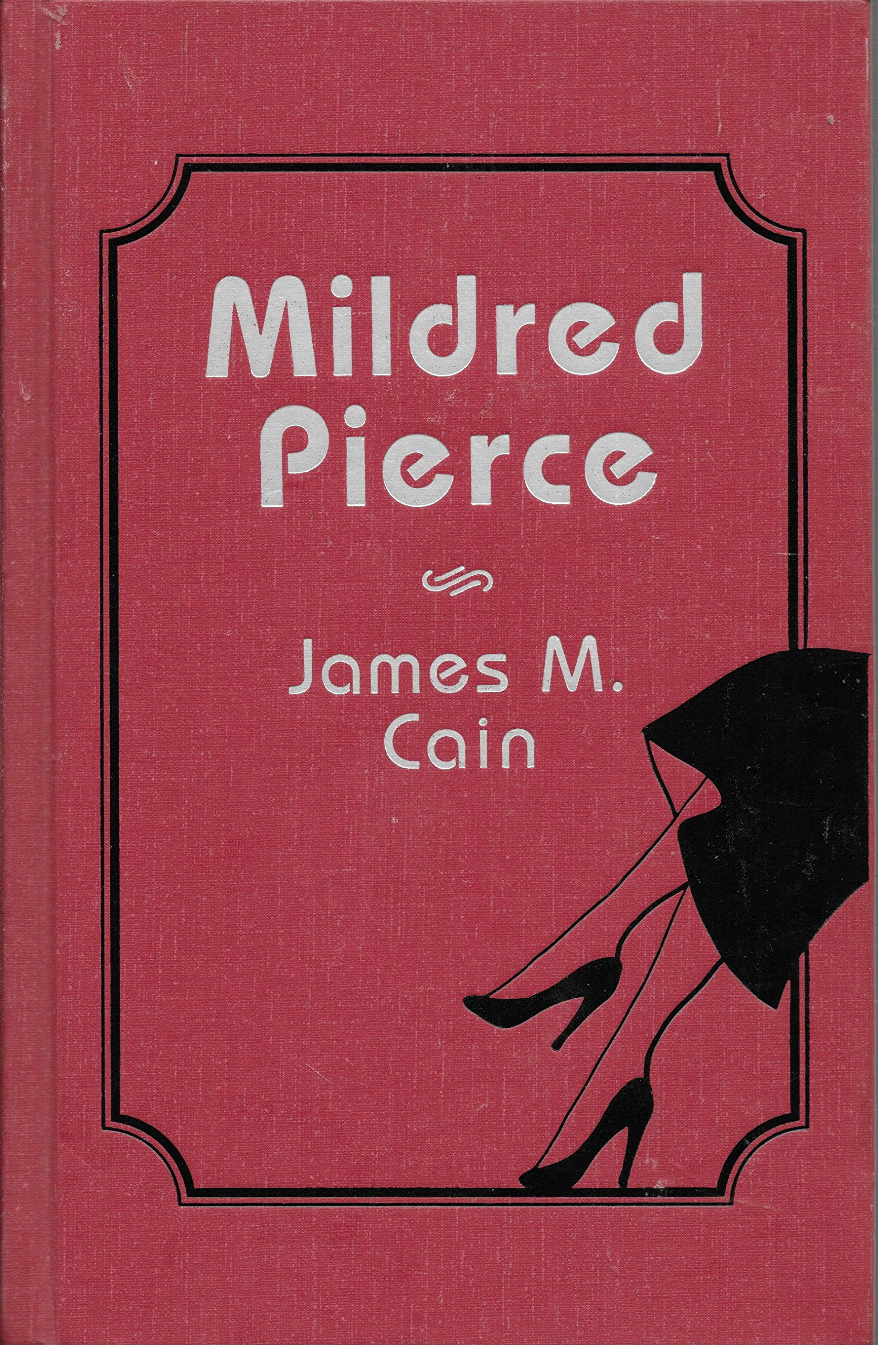
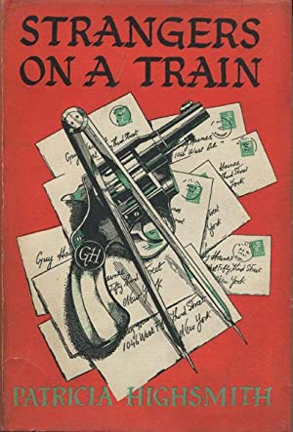
James M. Cain
1892-1977
Patricia Highsmith
1921-1995

Slide 2
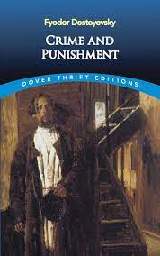
“The battleline between good and evil runs through the heart of every man.” Aleksandr Solzhenitsyn
“We sometimes encounter people, even perfect strangers, who begin to interest us at first sight, somehow suddenly, all at once, before a word has been spoken.” Fyodor Dostoyevsky
“I have never met any really wicked person before. I feel rather frightened. I am so afraid he will look just like every one else.”
Oscar Wilde, The Importance of Being Earnest
Crime and Punishment follows the mental anguish and moral dilemmas of Rodion Raskolnikov, an impoverished ex-student in Saint Petersburg who plans to kill an unscrupulous pawnbroker, an old woman who stores money and valuable objects in her flat. He theorises that with the money he could liberate himself from poverty and go on to perform great deeds, and seeks to convince himself that certain crimes are justifiable if they are committed in order to remove obstacles to the higher goals of 'extraordinary' men. Once the deed is done, however, he finds himself racked with confusion, paranoia, and disgust. His theoretical justifications lose all their power as he struggles with guilt and horror and confronts both the internal and external consequences of his deed.
Crime and Punishment was one of Patricia Highsmith’s favorite novels.

Slide 3
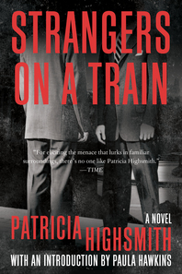
Strangers on a Train
2021 edition with an Introduction by Paula Hawkins
Back Cover:
"An incredible study of psychological torture and how fine the membrane is between normality and the underlying darkness." — Tana French
"Strangers on a Train is a moral-vertigo thriller: Crime and Punishment for a post-atomic age." — Tom Nolan, The Los Angeles Times
"Strangers on a Train is filled with paranoia and anxiety, and through its twists and turns, we, like poor Guy Haines, are also drawn into psychopath Bruno's web." — Sarah Pinborough, author of Behind Her Eyes
"A moody and disturbing excavation of guilty paranoia…Strangers on a Train was her debut novel, but [Highsmith's] sense of anxious foreboding was already fully formed." — Leonard Cassuto, Wall Street Journal
"Unfathomably great." — Errol Morris
"One is held by an evil kind of suspense…a rarely perceptive study in criminal psychology." — New York Herald Tribune
W.W. Norton & Co.
2021

Slide 4
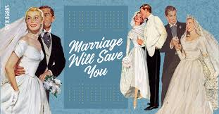
”He was standing beside Anne, and Bruno was here with them, not an event, not a moment, but a condition, something that had always been and always would be. Bruno, himself, Anne. And the moving on the tracks. And the lifetime of moving on the tracks until death do us part, for that was the punishment. What more punishment was he looking for?” (Chapter thirty-one, 193).
Courtesy sheoligans. com

Slide 5
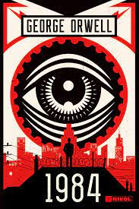
“Guy couldn’t find the telephone. There was a wire by the bed table, though. He traced the wire under the bed. The telephone was off the hook, on the floor, and he knew immediately it hadn’t fallen, because both parts were dragged up near the foot of the bed, the hand piece eerily focused on the armchair where Owen had been sitting. Guy pulled the telephone slowly toward him . . . He was holding the telephone in a position for speaking, and now he brought it closer to his ear. He heard the intelligent silence of a live wire. ‘Hello?’ he said. ‘Hello, Mr. Haines.’ The voice was rich, courteous, and just the least brusque” (chapter forty-seven, 280).
‘We are the dead,’ [Winston] said.
‘We are the dead,’ echoed Julia dutifully.
‘You are the dead,’ said an iron voice behind them.
They sprang apart. Winston’s entrails seemed to have turned into ice. He could see the white all round the irises of Julia’s eyes. Her face had turned a milky yellow. The smear of rouge that was still on each cheekbone stood out sharply, almost as though unconnected with the skin beneath.
‘You are the dead,’ repeated the iron voice.
‘It was behind the picture,’ breathed Julia.
‘It was behind the picture,’ said the voice. ‘Remain exactly where you are. Make no movement until you are ordered.’
From George Orwell, 1984 (1949)

Slide 6
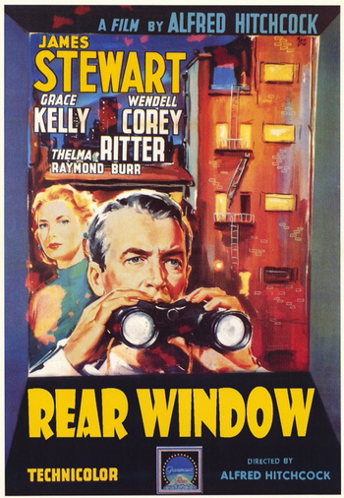
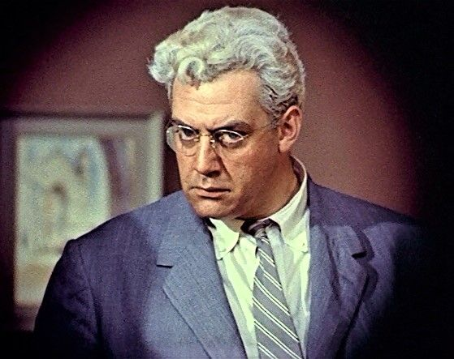
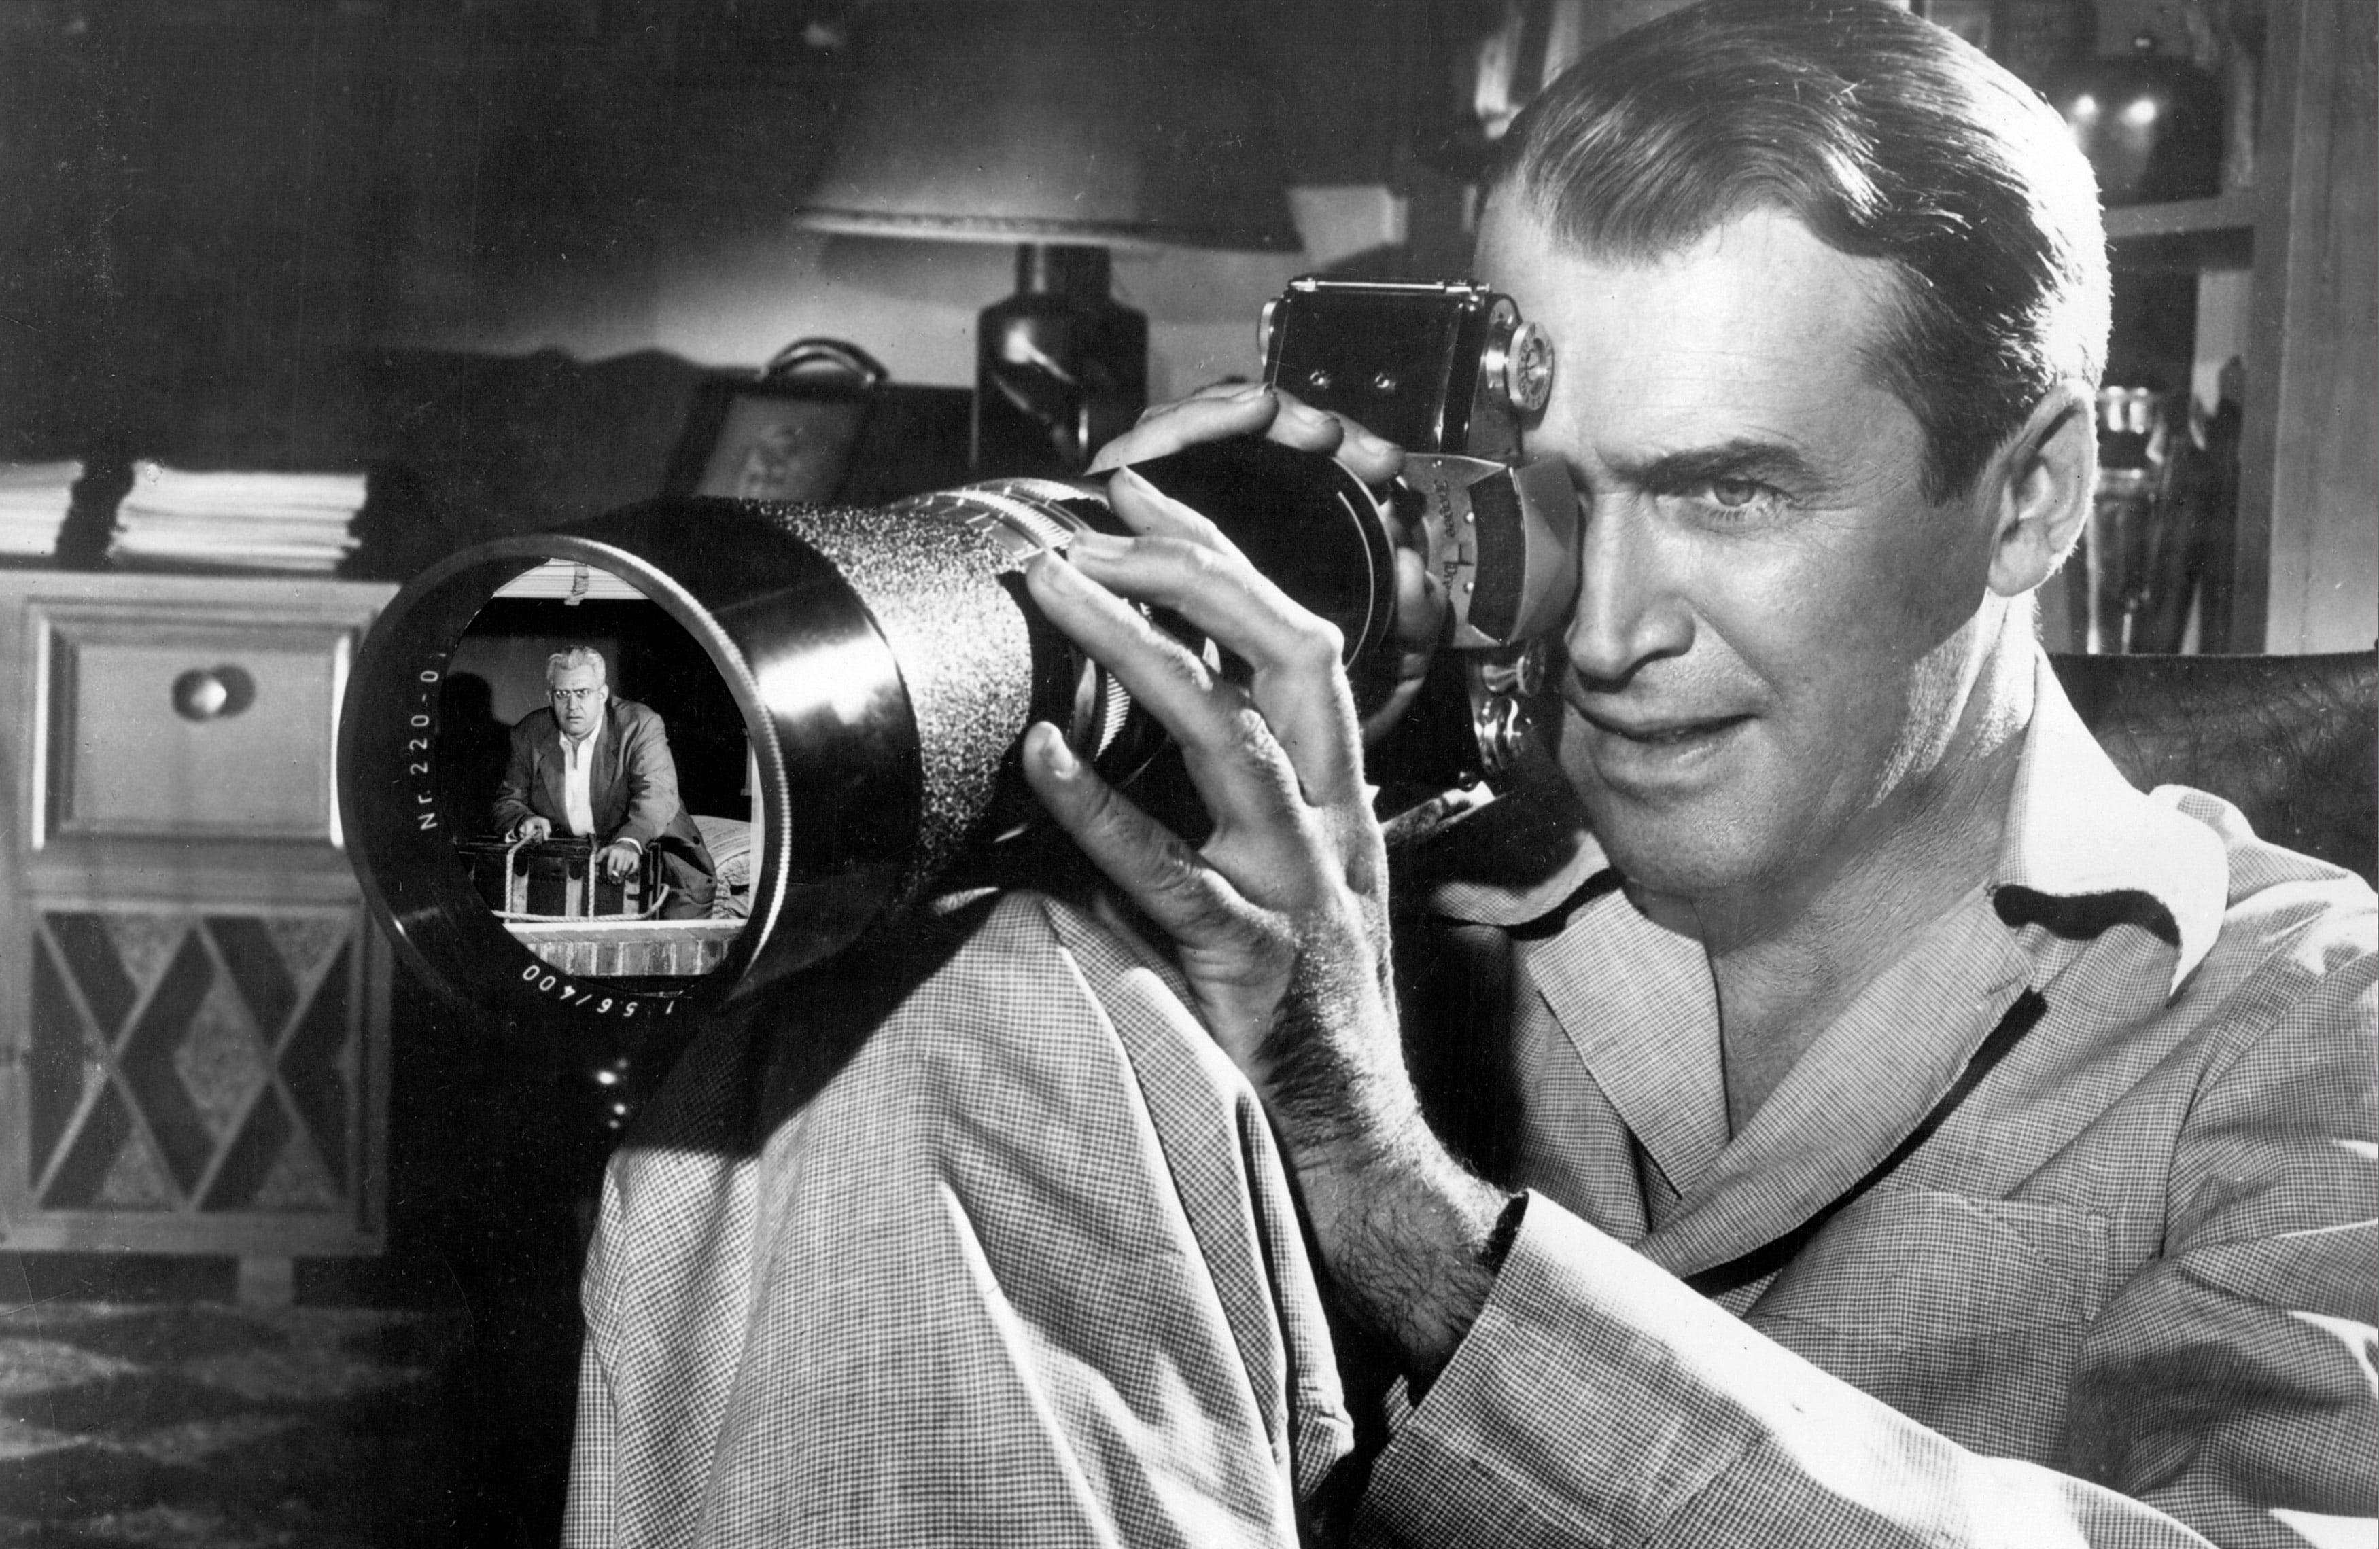
Lars Thornwald (Raymond Burr)
Sees Jeff Jeffries (James Stewart) watching him through his Rear Window.

Slide 7
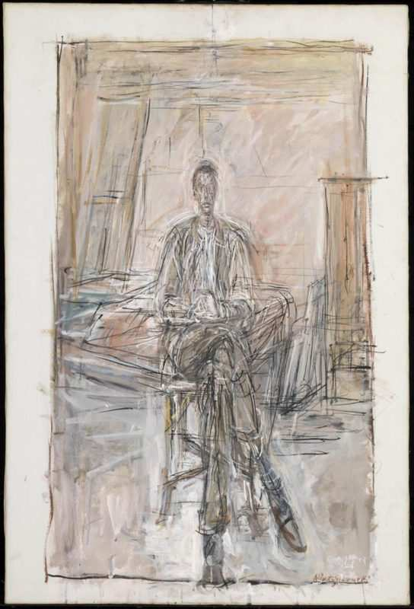
“’Eh?’ Gerard said. Guy tried to speak, and said something entirely different from what he had intended. ‘Take me.’” (chapter forty-seven, 281).
Seated Man
Alberto Giacometti, 1949
Tate Gallery, London

Slide 8
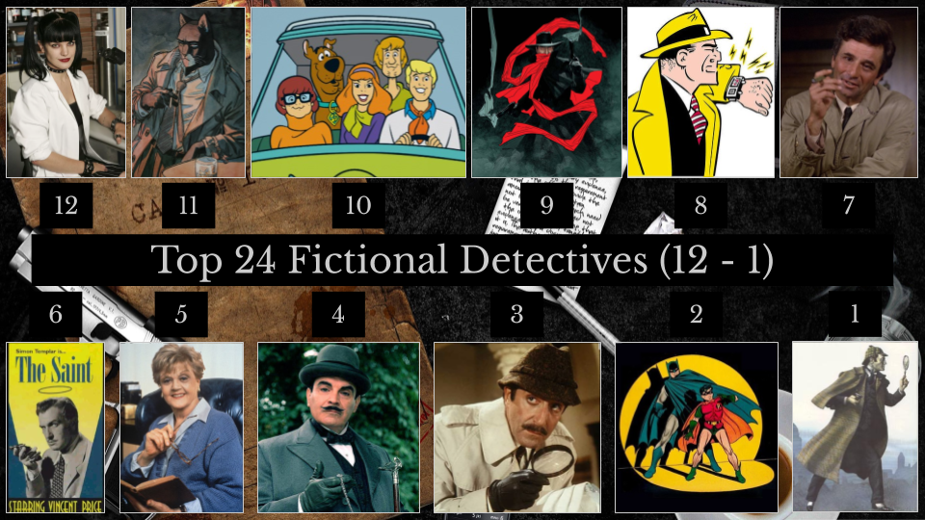
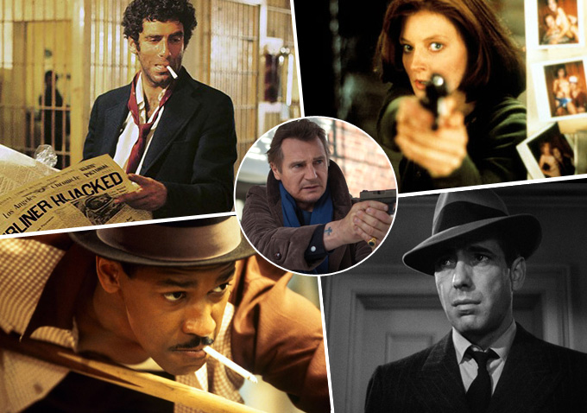
Private detective Gerard realigns the pieces of the two murders for us, and as he does, we get to hear the story again. Like all good fictional detectives, he goes back and forth in time, in place, and in memory, and allows us to do the same, retelling the story of Bruno and Guy together.
Part of our delight with fictional detective stories is precisely this pattern: we get to imagine the story at least twice, revising and reimagining as we go.

Slide 9
meets
1. Emotional disfunction/violence among family members
2. Pregnancy narratives
3. Suggestions of incest/pedophilia
4. Flawed characters with profound talents
5. Silenced mother figures
6. Social class distinctions and resentments
7. Bad assumptions made by characters
8. Bad assumptions made by readers
9. Alcohol

Slide 10
Chinatown
Directed by Roman Polanski, 1974
Starring Jack Nicholson, Faye Dunaway, John Huston

