Slide 1
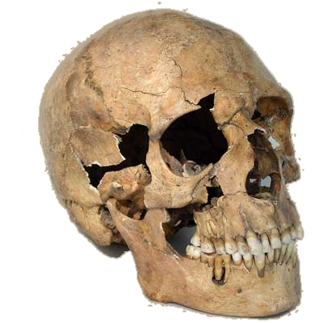
All roads lead to peace, eventually.
--Leo Tolstoy

Slide 2
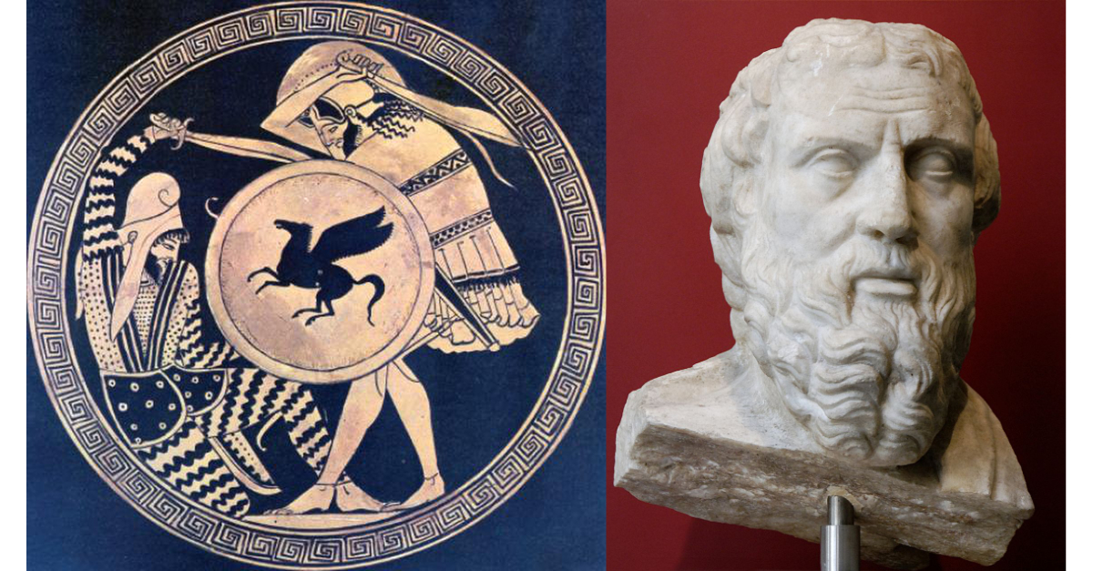
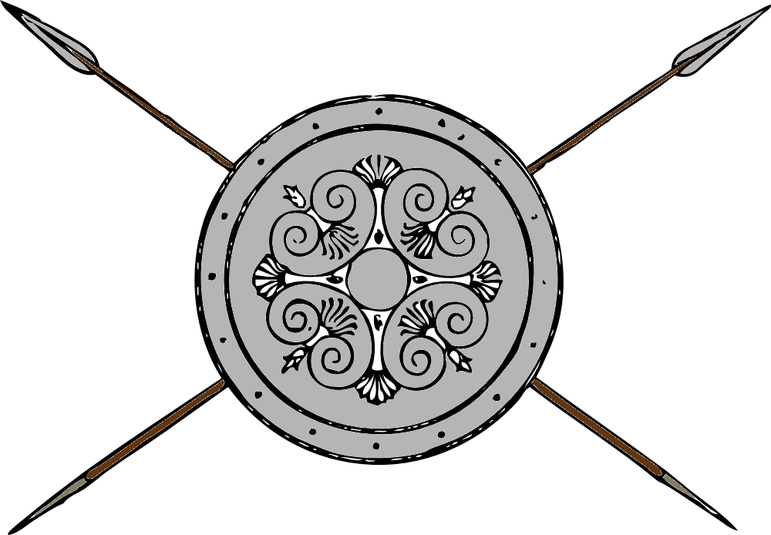
Greece and Persia The war that Created History
OLLI Spring 2022
Week 8: Alexander the Accursed
Destruction of an Empire

Slide 3
Course Overview
Week 1: The Story, and its sources
Week 2: The Greeks—Who they were and why we should care
Week 3: The Persians—Who were they, and should we care?
Week 4: When the Mede Came—From Cyrus to Darius
Week 5: The Great Invasion—The Stunning Greek Victory
Week 6: The Victors Fall Out—The Peloponnesian Wars
Week 7: The King’s “Peace”—Fifty Years of War
Week 8: Alexander the Accursed—Destruction of an Empire

Slide 4
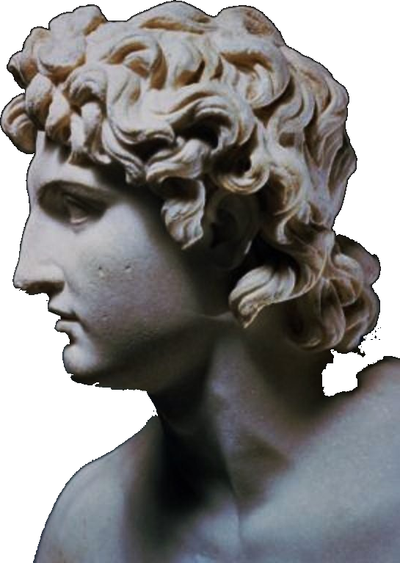
Alexander the Accursed
Sources
Two Kings: Alexander II and Darius III “Codomannus”
The Campaign for Asia Minor (334)
The Campaign for the Levant (333-332)
Defeat of Persia (331-330)
Alexander’s Final Years (329-323)
Legacy

Slide 5
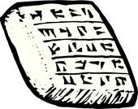
Part I: Sources
Curtius, The History of Alexander (Quintus Curtius Rufus)
1st Century CE
Roman soldier and statesman, wrote only surviving book-length history of Alexander in Latin
Arrian, The Campaigns of Alexander (Lucius Flavius Arrianus, Anabasis Alexandrou)
2nd Century CE
Roman of Greek ancestry, took the pen name Xenophon.
Plutarch, Parallel Lives (Lucius Mestrius Plutarchus)
2nd Century CE
Roman of Greek ancestry writing in Greek for both Greeks and Romans
Series of short biographies of Greek, Roman, and sometimes Persian great men, with moral lessons embedded. Used Ctesius as his sole source for the biography of Artaxerxes II (grrr…)
Plutarch scholar R. H. Barrow, “Plutarch is fanatically biased in favor of the Greek cities; they can do no wrong.”

Slide 6
I: Sources (continued)
Who were Their Sources?
Callisthenes of Olynthus ➔
Aristotle’s nephew, official historian of the expedition, whose job was literally to right glowing accounts of Alexander’s triumphs.
His Official History remained unfinished (because Alexander executed him in 328 BCE)
Cleitarchus
Not part of campaign. Relied on Callisthenes, Onesicritus, Nearchus.
Much less forgiving of Alexander’s vices. (Historians used to say too unforgiving, but not so much these days.)
Curtius and Diodorus relied primarily on Cleitarchus.
Ptolemy Soter➔
Macedonian general. Kept a daily journal of the campaign, later became king of Egypt, wrote history of the campaign late in life (after Cleitarchus).
When sources conflicted, Arrian relied on him because “only he became a king, and kings are less likely to lie.”

Slide 7
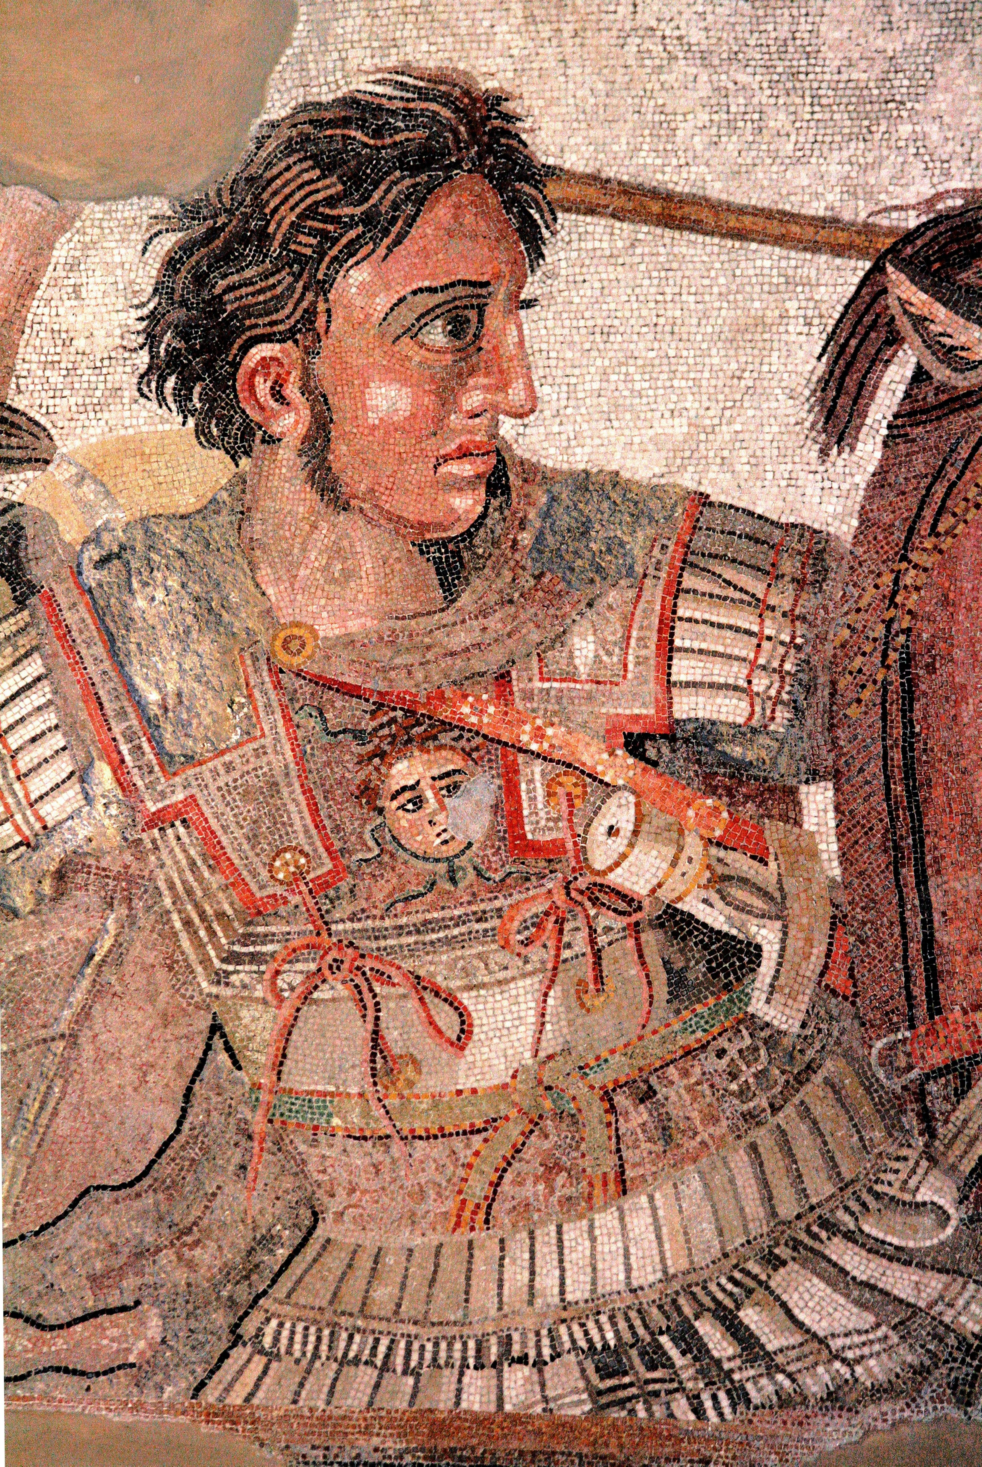
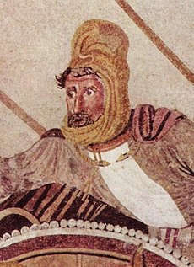
Part II: Two Kings (in the same year)— Alexander II and Darius III
Alexander II came to the Macedonian throne in 336 BCE upon the assassination of his predecessor and father, Philip II.
Darius III “Codomannus” also came to the Perian throne in 336 BCE upon the assassination of his predecessor, Artaxerxes IV “Arshu” (Greek: Arses)

Slide 8
II: Alexander and Olympias
Alexander born 356 BCE, 20 years old in 336.
Born of two extraordinary parents: Philip of Macedon and Olympias of Epirus, but in a time and place where extraordinary women were considered monstrous.
Philip married Olympias out of passion, but later apparently became frightened of her. He divorced her toward the end of his life and remarried.
Alexander and Olympias maintained a close relationship throughout their lives.
[Angelina Jolie as Olympias in Alexander (2004)]

Slide 9
II: Alexander and Aristotle
Alexander lived in his father’s shadow, but chafed in it rather than withered.
In adolescence, Aristotle became his tutor, and instilled in him a deep belief in the superiority of Greeks over foreigners, the superiority of certain extraordinary men over all others, and that Alexander was such an extraordinary “superman.”
Aristotle gave him a copy of the Illiad which Alexander carried with him the rest of his life. Alexander saw himself as a reborn Achilles, who lived only for glory.

Slide 10
II: Alexander and Philip
As he grew into manhood he showed considerable talent. Philip made him regent when Philip was on campaign and later took him as his second in command,
Alexander led the decisive charge at Chaeronea which broke the allied Greek line.
Overstepped his role after Chaeronea, which led Philip to suspect Alexander and Olympias of plotting to replace him.
Philip and Alexander were estranged when Philip killed.

Slide 11
II: Alexander
When Alexander came to the throne he immediately had to fight a number of revolts in his own kingdom and in Greece.
His speed of decision and action shattered most resistance within a few months.
Thebes revolted and Alexander destroyed the city, selling the citizenry into slavery. ➔
Alexander’s strategy of rule: turn anger against an “other”
For Macedonians, “others“ were snobbish Greeks.
For Greeks “ohers” were foreign Persians

Slide 12
II: Alexander--The Logic of Invading Persia
The Official Logic
The invasion is punishment and repayment for Xerxes’ invasion of Greece and destruction of the Athenian temples.
(Even though everyone alive during Xerxes’ invasion was now long dead.)
(And even though Greece had long ago made peace with Persia and put that behind them)
(And even though Xerxes’ burning of the Athenian temples had been in retaliation to the Athenian burning of the temples in Sardis, thus evening the score)
(Remember, for the Greeks, you were never “even”)

Slide 13
II: Alexander--The Logic of Invading Persia
The Actual Logic
We Greeks have to stop killing each other
But we cannot seem to give up killing altogether . . .
So let’s go kill the Persians and take all their money!

Slide 14
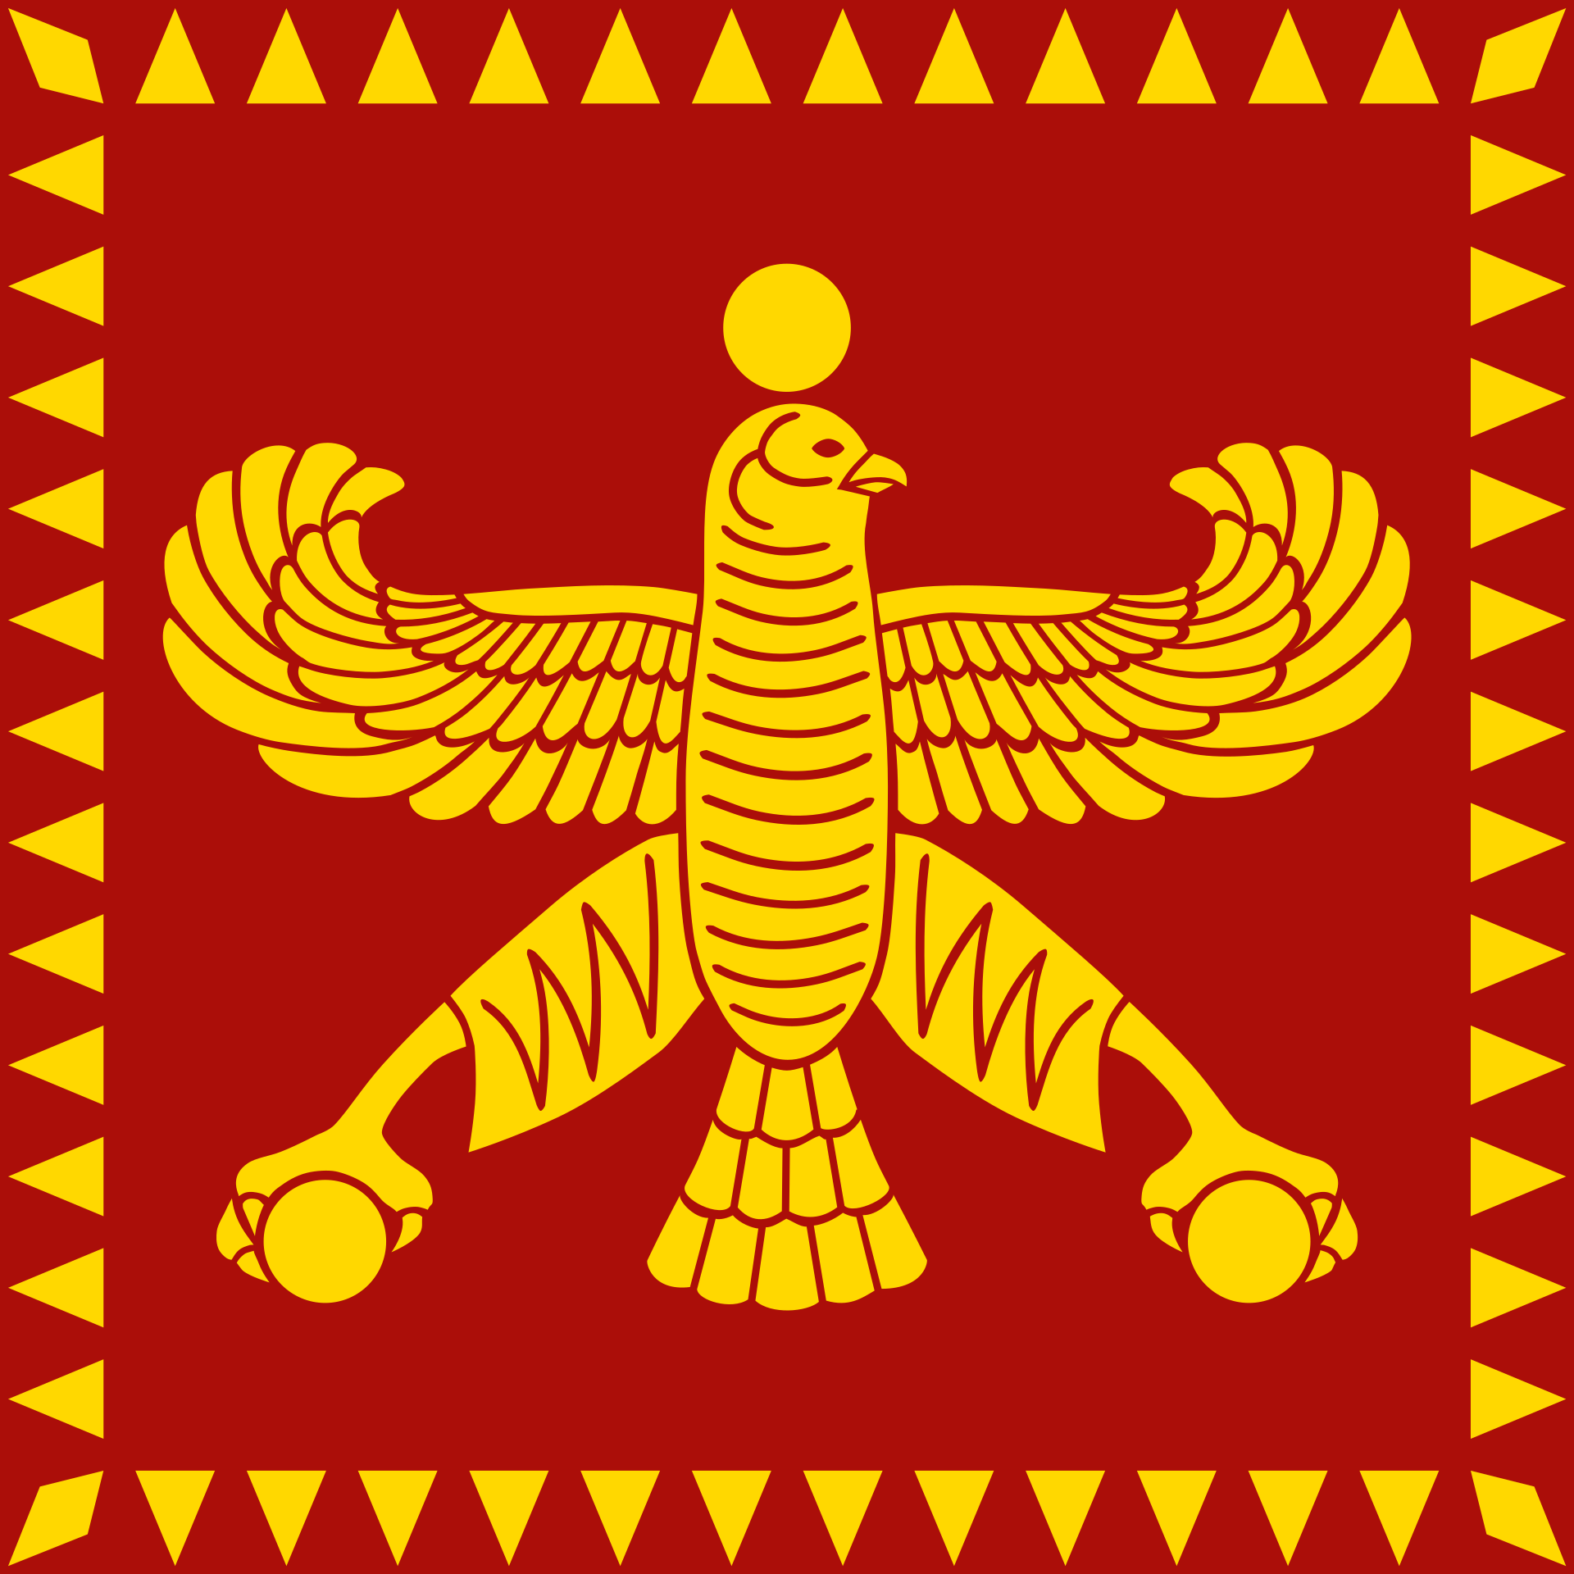
II: Darius III Codomannus (before he was king)
380 Artashata born, 44 years old in 336
Grandson of King Darius II
340 Engaged in single combat against champion of the Cadusiian rebels, killed him and ended the rebellion. Made satrap (governor) of Armenia.
Also as reward possibly given the surname Codomannus (great in war) and the royal princess Stateira as wife (2nd wife) and made satrap of Armenia.
Described as handsome and unusually tall. Also even-tempered and just.

Slide 15
II: Darius III Codomannus
338 Artaxerxes III died, succeeded by Artaxerxes IV “Arses.” Artashata named as his Astandes (head of the royal messenger service).
336 Artaxerxes IV died (probably assassinated), succeeded by Artashata “Codomannus” who took the throne name Darius (III), and then probably killed the assassin of Artaxerxes IV.
Darius immediately led an army and successfully suppressed (yet another) Egyptian rebellion.
Sent troops under Memnon of Rhodes to defeat the Macedonian advanced force in Asia Minor.

Slide 16
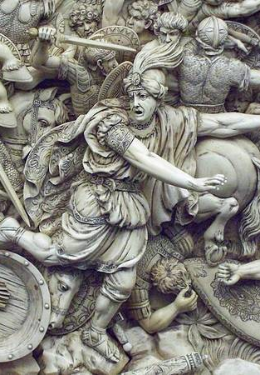
II: Darius III--What The Greeks Said
Unqualified--He had no military experience and was a common messenger
He had been head of the messenger service and satrap of Armenia.
Weak and cowardly--He always ran away.
But he was called Codomannus?
Illegitimate Ruler-He was not of royal blood, was chosen by Bagoas the Eunich because he would be easy to manipulate .
He was an Achaemenid descended directly from Darius II.
Inbred--His father and mother were brother and sister and he and his wife Stateira were also brother and sister.
His mother was probably a daughter or granddaughter of Artaxerxes II, not a daughter of Darius II
His wife Stateira was possibly not his sister, but a daughter or granddaughter of Artaxerxes III.

Slide 17
II: Darius III—Why the Smear Campaign?
Alexander was copying Cyrus The Great’s Strategy
The enemy is a coward and poor warrior.
The enemy did not legally deserve to rule.
The enemy is not qualified or capable of ruling well.
The enemy is a loser, and so not favored by the gods.
So make me your king.
Alexander would continue to follow Cyrus’s playbook throughout his campaign against Darius.

Slide 18
II: Some Supporting Characters
Artabazus and his children
Satrap or northeast Asia Minor. Revolted against Artaxerxes III,defeated, and spent a decade in exile in Macedonia. Knew Philip, Alexander, most of the Macedonian nobles and generals.
Later pardoned by Artaxerxes III and returned to Persia.
Cousin of Artashata (who became Darius III) and was heavily relied upon.
Artabazus: Commander of the Greek mercenaries And Darius’s closest advior.
His daughter Barsine: wife of Memnon of Rhodes, commander in the West.
His son Pharnabazus: Second in command in the west (commander following death of Memnon)
His son Kophon: Quartermaster and army treasurer for Darius

Slide 19
II: Some Supporting Characters
Barsine, oldest daughter of Artabazus
Had spent a decade in exile with her family in the court of Philip of Macedon. Well educated and fluent in Greek. Knew the Macedonian royal family well.
Had been married to Mentor of Rhodes, the general who was personally persuaded to come back to the royal service by Artaxerxes III. Made commander in the west, but he died of a fever shortly afterwards.
Barsine then married his brother Memnon of Rhodes.
Memnon of Rhodes
Ethnic Greek soldier from Rhodes who grew up a Persian subject.
Brother-in-law to Artabazus and fought in his rebellion. Spent a decade in exile in Macedon. Pardoned, and given duties in the west, but Artaxerxes III never fully trusted him.
Artabazus was a relative of Darius III, so Memnon was now trusted with command of the king’s mercenaries in the west, and later supreme commander there.

Slide 20
Greece and Persia The War that Created History
Question Break

Slide 21
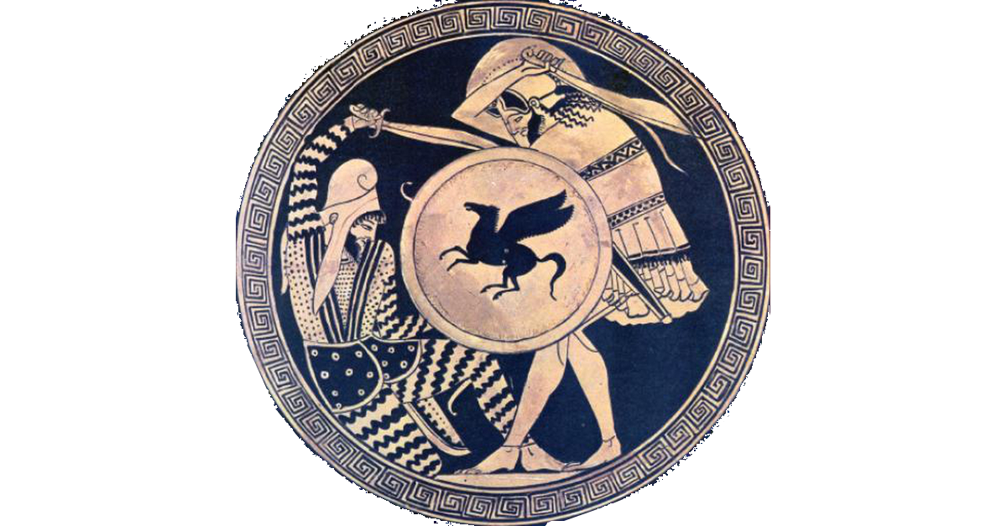
Part III: The Campaign for Asia Minor (334 BCE)
Alexander’s Army of Invasion
Cavalry (5,000)
1,700 Macedonian hetairoi (companions) heavy cavalry
1,700 Thessalian heavy cavalry
1,600 light cavalry (Macedonian, Greek, Thracian, etc.)
Infantry (35-45,000*)
3,000 Macedonian hypaspists (elite guard infantry)
12-14,000* Macedonian petetairoi (phalanx pikemen)
7-8,000* Allied Greek hoplites (spear, armor, and shield)
11-18,000* Thracian and Greek mercenary peltasts (well-equipped light infantry—sword, javelins, and small shield)
2,000 very light infantry (archers, slingers, etc.)
*The difference of 10,000 in the numbers depends on Philip’s Advanced Guard

Slide 22
III: Asia Minor—The Persian Defenders
Persian Army (25-30,000)
15,000 cavalry
6-8,000 mercenary hoplites
1-2,000 mercenary peltasts
3-5,000 local levy infantry
Memnon of Rhodes’s proposal
Scorched Earth—burn everything and withdraw. Alexander is short of money and provisions. Starve him.
Arsites’ counter
Do what we are called to do: stand our ground at the Granicus River, defend our people, kill the invader. If Alexander dies, the threat is over.

Slide 23
III: Asia Minor—The Battle (334 BCE)
May, 334 BCE, Alexander’s army reached the Granicus River and deployed.
A questions arose about the month and whether it was legal to begin a war then.
Alexander charged across the river at the head of the Companion Cavalry to capture the ford.
The Persian cavalry counter-attacked the bridgehead.

Slide 24
III: Asia Minor—The Battle
All of the senior Persian commanders concentrated at the ford and tried to kill Alexander in single combat.
Most of them were killed in the effort. Alexander was wounded and stunned by a blow that split his helmet open, but he survived.
With the loss of their leaders, the Persian cavalry broke and retreated. Most of the Persian infantry were killed or captured.

Slide 25
III: Asia Minor--Aftermath
Large number of Persian commanders and nobles were killed including one or two sons-in-law of Darius III and the brother of Queen Stateira.
Arsites committed suicide after the disastrous loss.
Memnon sent his wife Barsine to Darius for protection (or perhaps hostage for his loyalty). Darius appointed him commander of the west, with Pharnabazus, son of Artabazus, as his second in command.

Slide 26
III: Asia Minor--Aftermath
Memnon began his strategy of delaying actions.
Alexander delayed by stubborn resistance in coastal cities. Forced to conduct costly and time-consuming sieges, then the defending troops were taken away by ship before the cities fell.
Took a year to take even the most critical cities in Asia Minor.

Slide 27
III: Asia Minor
Persia still had naval superiority. Memnon began an amphibious naval campaign in the Aegean aimed at taking the key island cities and cutting Alexander’s communications with Macedonia.
Memnon soon fell sick during a siege and died, but Pharnabazus (son of Artabazus) took command and continued the campaign even more energetically.
Darius recalled most of the best mercenaries to join the new army he was assembling to defeat Alexander. This weakened the Aegean campaign, but did not stop it.

Slide 28
Part IV: The Campaign for the Levant (333-332 BCE)
Darius’s First Army
No consensus on size. Ancient estimates range from 250,000-600,000. Modern estimates about 100,000. Given how quickly the Persian Army marched in the campaign, it was probably less than that.
Cavalry (11-13,000)
3,000 Persian cavalry
8-10,000 other
Infantry (60-93,000)
8,000 mercenary hoplites
20-30,000 Persians (Guard and Kardakes)
12-15,000 light infantry
20-40,000 levies (not engaged)

Slide 29
IV: The Levant—Darius’s Strategy
Darius knew Alexander expected him to defend a chokepoint leading south, like the Syrian Gates.
Instead, once he knew Alexander was racing south to get to the Syrian Gates ahead of him, Darius marched wide to the northeast, then doubled back toward the coast.
Darius took up a strong position south of Issus, between the mountains and the sea, on high ground behind the Pinarus River.
He had cut Alexander off from Macedon.

Slide 30
IV: The Levant--Battle of Issus (333 BCE)
Darius held a strong position on rising ground behind a river.
Alexander attacked. Infantry stalled at the river bank under heavy missile fire.
Alexander threw his cavalry in on his right, drove back the Persian troops there, then enveloped the center.
In a confused melee he nearly killed Darius, but the Persian king escaped.
Persian Army nearly destroyed.

Slide 31
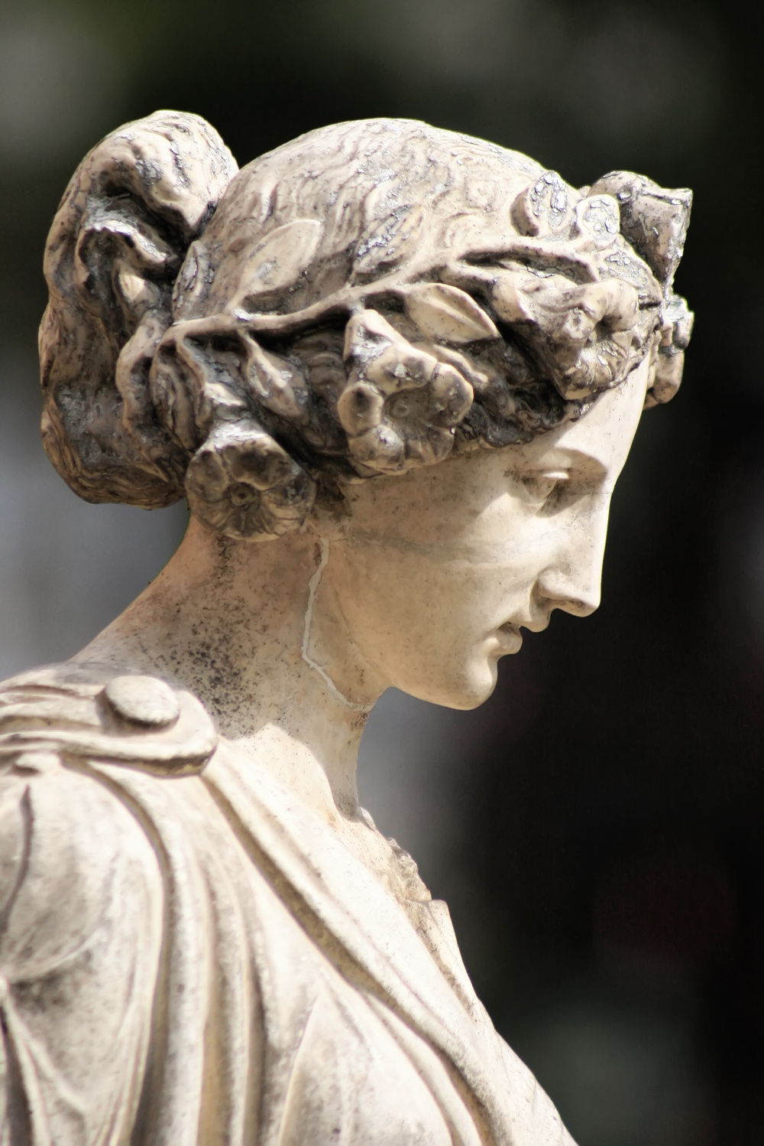
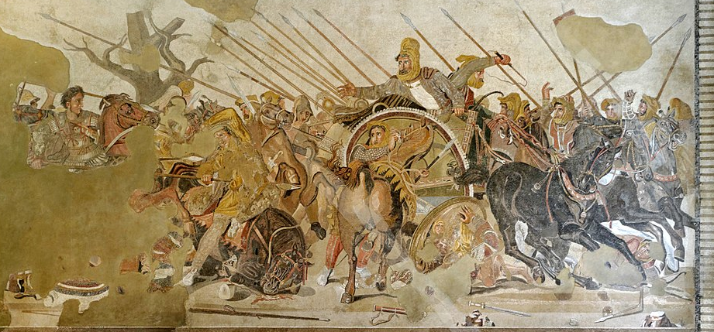
IV: The Levant—Issus Mosaic
Original

Slide 32
IV: The Levant—Issus Mosaic
Reconstruction

Slide 33
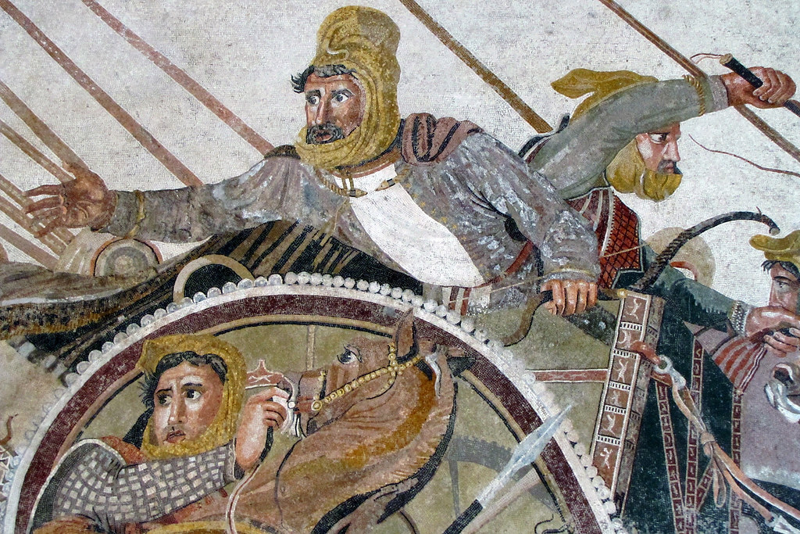
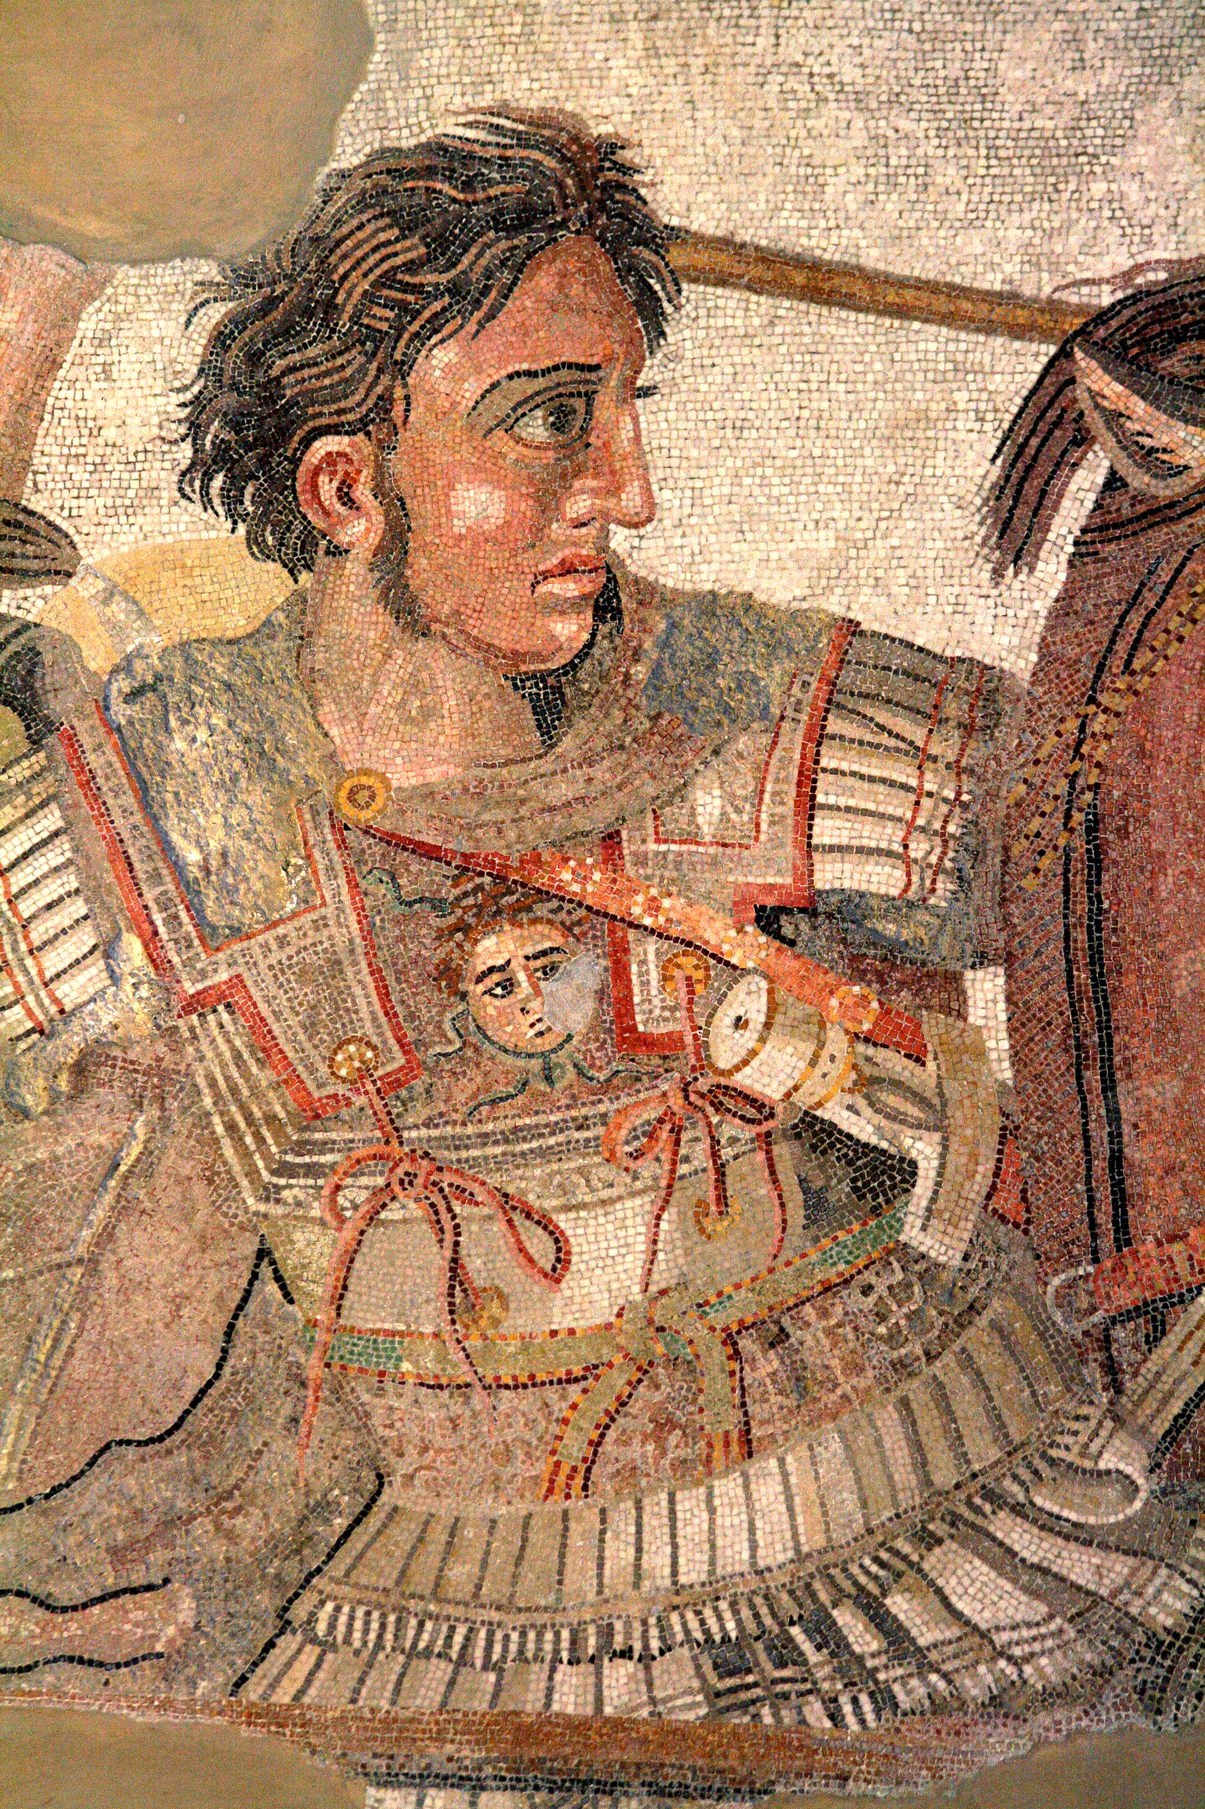
IV: The Levant—Issus Mosaic
Alexander and Darius III

Slide 34
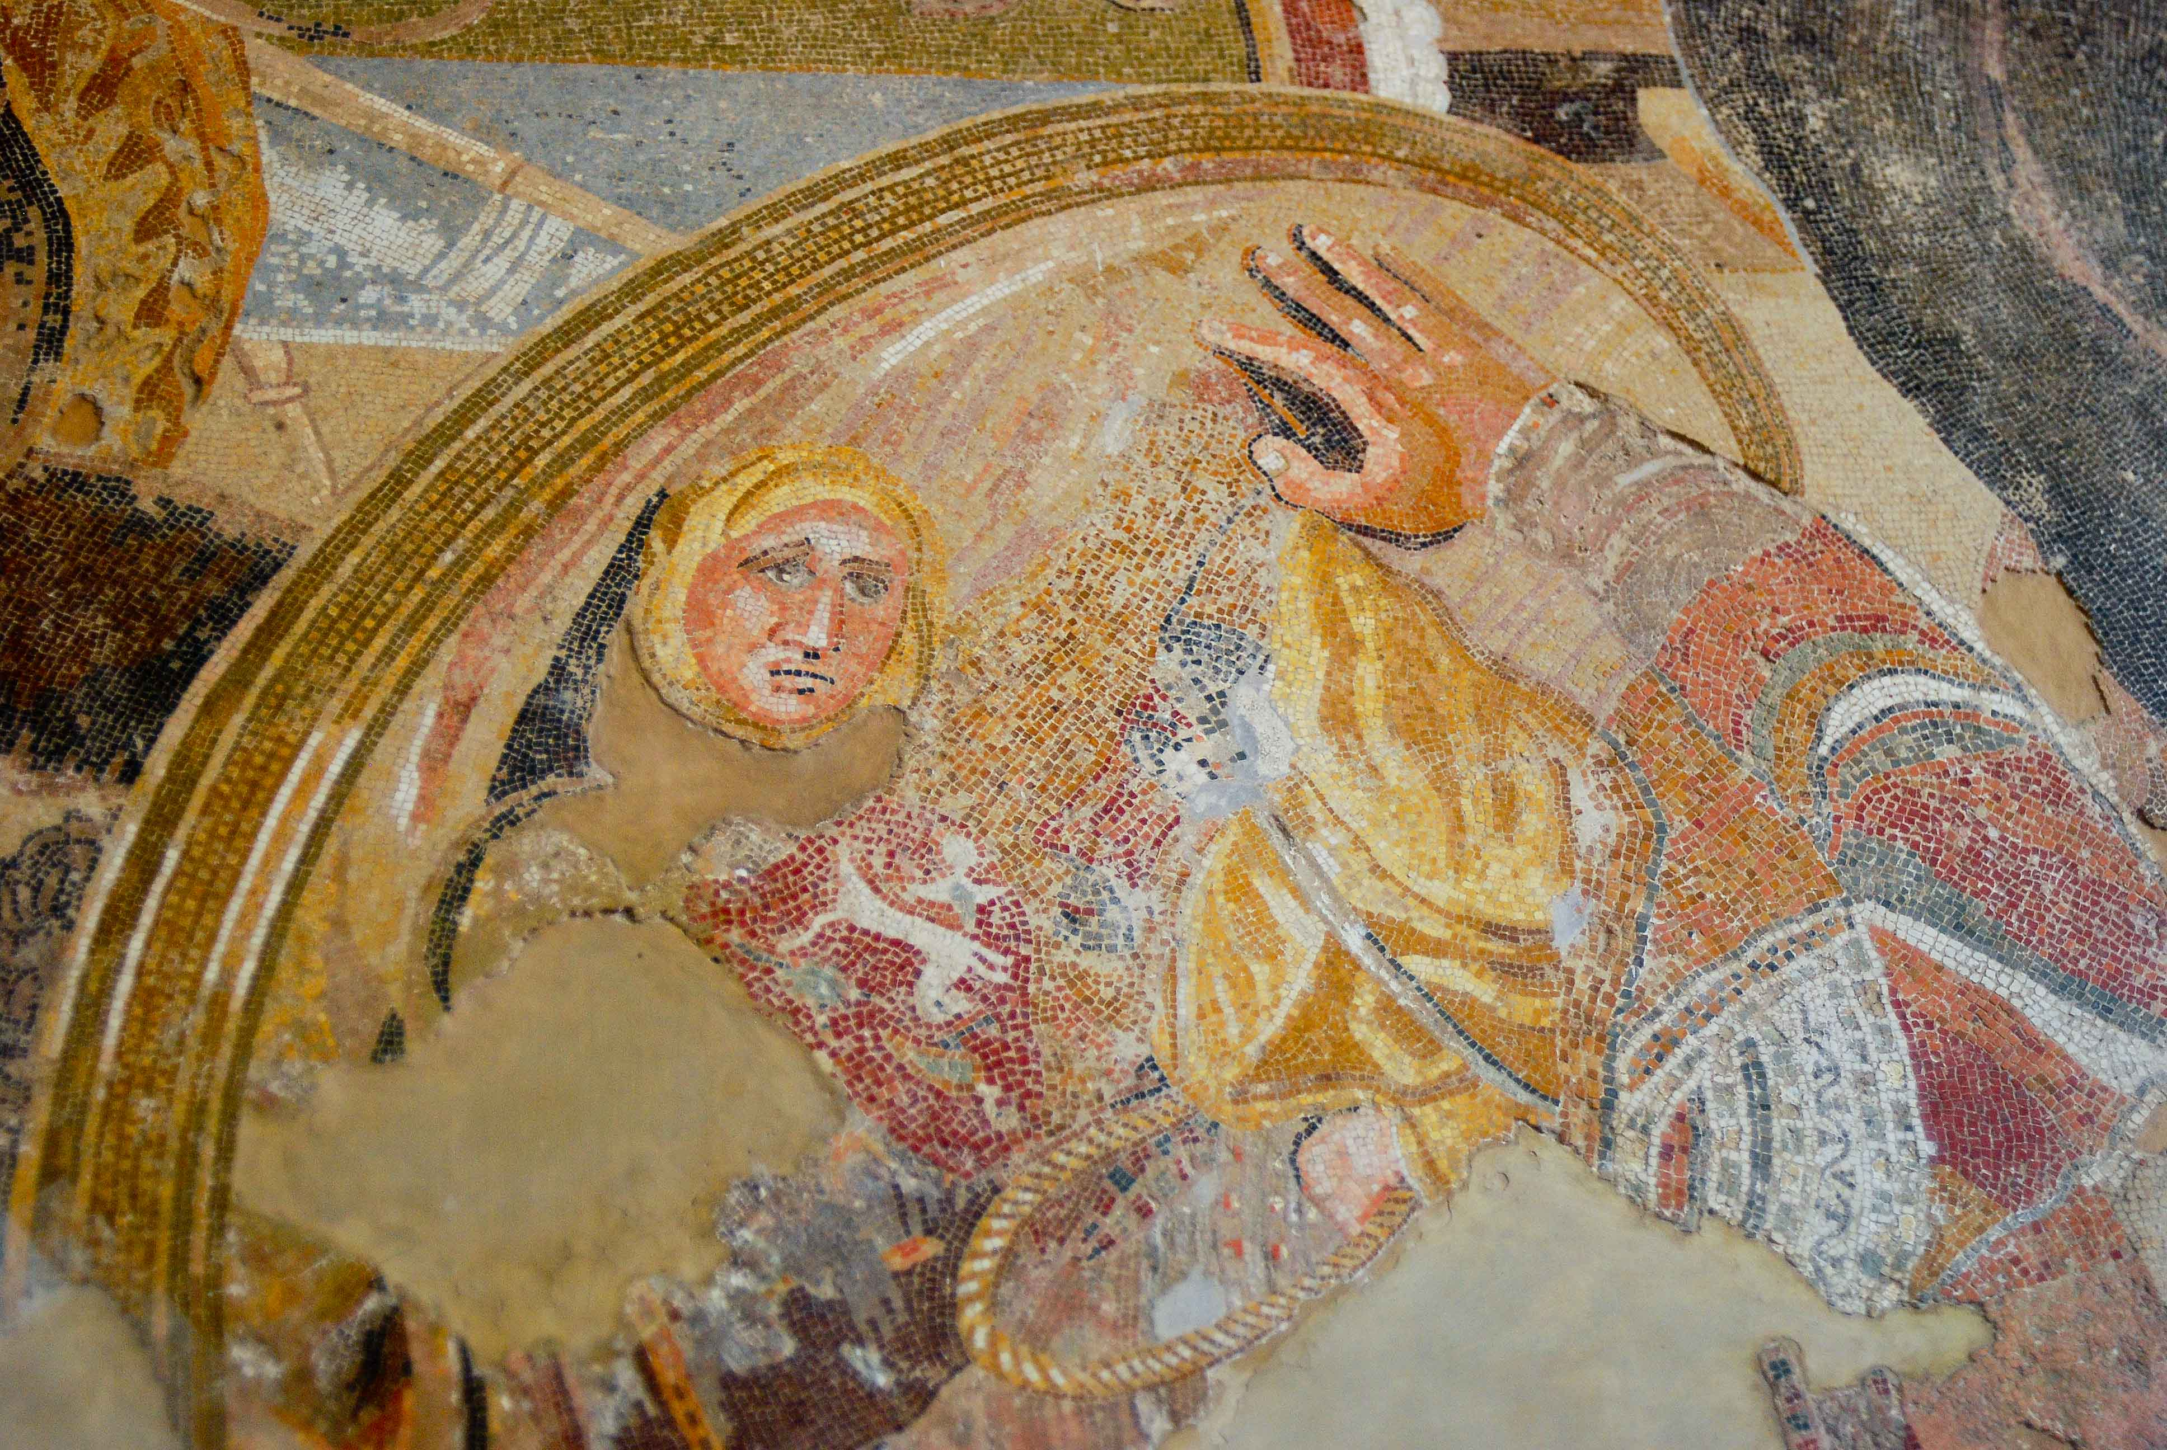
IV: The Levant—Issus Mosaic

Slide 35
IV: The Levant—Aftermath of the Defeat
333: Capture of the Royal Family after the battle.
Including Little Ochus.
332: Conquest of the Phoenician Coast (siege of Tyre)
332: Aegean naval campaign comes apart (capture and escape of Pharnabazus )
332-1: Capture of Egypt by Alexander
331: Alexander marches on Babylon

Slide 36
Greece and Persia The War that Created History
Question Break

Slide 37
Part V: The Defeat of Persia—331-330 BCE
Darius supposedly conducted a series of correspondences with Alexander trying to negotiate a peace and the return of his family
Many modern scholars, and a number of ancient historians, consider these to be Macedonian forgeries, to further the propaganda claim that Darius was a weak leader.
If he was conducting this correspondence, it may have been to gain time for his others plans.
Darius sent money to his remaining generals in Asia Minor who conducted a vigorous, but ultimately unsuccessful, campaign to cut Alexander’s communications with Macedonia.
Meanwhile he was gathering a new army around Babylon and preparing to defend the heartland of the kingdom.

Slide 38
V: Defeat of Persia—Darius’s Army
Darius’s Second Army
Cavalry (35,000) and 200 scythed chariots
Eastern Iranian Cavalry: 11,000
Central and Northern Iranian Cavalry: 17,000
Parthian and Saka Allied cavalry: 7,000
Good infantry (11,000)
4,00 Persians
4,000 Greek mercenaries
3,000 Mardians, Indians, and Carians
Undetermined numbers of levy infantry (never engaged in the battle)
Estimates range from 20,000 (possible) to over one million (absurd).

Slide 39
V: Defeat of Persia--Death of Queen Stateira
Died September 331 BCE
Greek/Macedonian sources are confused in their relation of the timing and cause of death.
Those who say she died in childbirth do not mention when she died.
Those who mention when she died attribute it to fatigue or do not give a cause of death.
Iranian oral tradition: Alexander raped her, she became pregnant, and she died of a hemorrhage after trying to abort the fetus.
News reached Darius shortly before the climactic Battle of Gaugamela. Reportedly shattered by grief.

Slide 40
V: Defeat of Persia—Gaugamela 331 BCE
October 1, 331 BCE
The two armies met. Both deployed infantry in the center and cavalry on the wings.
The Persian right wing defeated the left wing of the Macedonian Army,
At the same time, Alexander began moving his right flank further out to the right. The Persian left conformed to his movement and opened a gap between it and the center.
Alexander attacked into the gap, tried to turn the flank of Darius’s guard and kill him. After a hard fight, Persian center broke.
The two Persian wings then withdrew as well.
The Greeks say Darius was the first to flee.

Slide 41
V: Defeat of Persia—Did Darius Flee?
“The Persian king received their attack and fighting from a chariot hurled javelins against his opponents, and many supported him. As the kings approached one another, Alexander flung a javelin at Dareius and missed him, but struck the driver standing beside him and knocked him to the ground. A shout went up at this from the Persians around Dareius, and those at a greater distance thought that the king had fallen. They were the first to take flight, and they were followed by those next to them, and steadily, little by little, the solid ranks of Dareius’s guard disintegrated.”
--Diodorus of Sicily, Library of History, 17, 60. 2-4
Curtius tells essentially the same version of the story.

Slide 42
V: Defeat of Persia—Did Darius Flee?
“Darius, when he saw his army repulsed, wished himself to die, but was compelled by his officers to flee. Some advising the bridge over the Cyndus should be broken down, in order to stop the advance of the enemy, he said that ‘he would not provide for his safety in such way as to expose so many thousands of his followers to the foe; and that the road which was open to himself, ought also to be open to others.’”
Justin, Epitome of the Philippic Histories of Gnaeus Pompeius Trogus, 9, 14.

Slide 43
V: Defeat of Persia—Mesopotamia 331 BCE
November-December: Alexander advanced without resistance and captured Babylon and Susa.
Darius’s throne at Susa was too tall for Alexander. (They brought a table for him to rest his feet on.)
Susa’s Treasury
40-50,000 talents silver and gold (mostly silver)(1,250 tons, or $720 million at current price of silver)
9,000 talents minted gold Darics (225 tons, or $18.8 billion at current price of gold, but about $1.5 billion at the value ratio then)
Represented 10 years of Persian state revenues.

Slide 44
V: Defeat of Persia—The Persian Gate
Ariobarzan
Satrap (governor) of Persis (the province). Commanded the ethnic Persian regular troops at Gaugamela.
Hurried back to Persepolis after Gaugamela and organized the defense of the capital.
Youtab
Ariobarzan’s sister. Female warrior who fought as part of her brother’s army.
Not mentioned in any Greek source. Known only from Iranian oral tradition.

Slide 45
V: Defeat of Persia— Battle of the Persian Gate (330 BCE)
Alexander sent mercenaries, allies, and baggage train along the southern road. He took the Macedonian royal troops on a forced march along the more direct route.
Ariobarzan had somehow managed to gather a force of 25,000 infantry and 700 cavalry. (Only 700-2,000 total, according to some modern estimates.)
Fortified the narrowest part of the pass, called The Persian Gate, and ambushed Alexander’s column.

Slide 46
V: Defeat of Persia—The Persian Gate
The First Battle (early January, 330 BCE)
Ariobarzan’s picked troops held the narrows against repeated assaults while the bulk of the Persian troops lined the cliffs to either side of the pass and,
“. . . began rolling massive rocks down the mountain slopes . . . crushing not only individuals but entire companies. Stones shot from slings, and arrows were also showered on them from every direction. . . their being caught and slaughtered like animals in a pit. . . . Alexander suffered agonies, as much of shame as despondency. . . Till that day he had been unbeaten.”
-Curtius, Book 5, 3.18-22
Arguably Alexander’s only clear battlefield defeat.
Possibly his single most costly battle in terms of Macedonian casualties. None of the ancient sources even offer an estimate of how many men he lost, which means the number was very large. Modern estimates are 6-9,000 Macedonian casualties.

Slide 47
V: Defeat of Persia—The Persian Gates
The Second Battle (20 January300 BCE)
Almost a month later Alexander found way around pass, attacked Persians from behind at night. Persians defeated.
“Accompanied by a force of some forty cavalry and 5,000 infantry Ariobarzanes broke through the center of the Macedonian line, causing great loss of Macedonian and Persian blood, as he hurried to occupy . . . Persepolis.” –Curtius, Book 5, 4.31
Ariobarzan was locked out of Persepolis by garrison commander (who had defected to Alexander). Surrounded and killed along with his sister Youtab and the last of his troops.

Slide 48
V: Defeat of Persia--Persepolis
Alexander captured Persepolis without any further fighting.
The Persian Treasury in Persepolis
Silver: 120,000 talents (3,000 tons) = $1.7 billion in today’s value.
Gold: 8,000 talents (200 tons) = $1.4 billion at the ancient ratio of value.
Represented 14 ½ years of Persian state revenues.
Required enormous numbers of pack animals (including 3,000 Asiatic camels) to move it to Susa, and later Ecbatana.

Slide 49
V: Defeat of Persia--Persepolis
“Where are the boyars?”
–Napoleon, in Moscow, 1812
Alexander expected the Persian people to accept him as king and send peace delegations. No delegations showed up and resistance in the surrounding countryside remained stiff.
After four months of partying in Darius’s palace, but no sign of widespread Persian acceptance, Alexander took his frustration out on the inhabitants of the city which had surrendered without a fight and had not attacked the garrison.
He allowed his army to pillage the palace and the surrounding city.

Slide 50
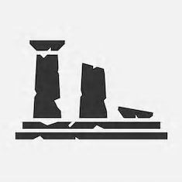
V: Defeat of Persia-- The Looting of Persepolis
“(The Macedonians) hacked to pieces with axes vases that were precious works of art. Nothing was left intact, nothing removed in one piece. Statues were dismembered and individuals dragged away the limbs they had broken off.”
Quintus Curtius Rufus, The History of Alexander, Book 5, 6.5-6
The photograph shown of the statue of Penelope Waiting for Odysseus, one of the finest examples of the Greek Severe school, is of a copy made before the original was sent to Persepolis by the Greeks as an offering of peace.

Slide 51
V: Defeat of Persia-- The Looting of Persepolis
Of the original, only the torso and one arm have been found in the ruins of Persepolis, and in different halls. The head and remaining arm have never been located.

Slide 52
V: Defeat of Persia-- The Looting of Persepolis
“But cruelty as well as avarice ran amok in the captured city: soldiers laden with gold and silver butchered their captives, now of no worth, and cut down people they came across at random.”
Quintus Curtius Rufus, The History of Alexander, Book 5, 6.5-6

Slide 53
V: Defeat of Persia– Alexander Burns Persepolis
Alexander burned the palace complex himself.

Slide 54
V: Defeat of Persia—Death of Darius 330 BCE
Darius’s own generals turned on him and murdered him (July, 330 BCE)
Greeks spread the story his dying wish was that Alexander succeed him.
A month later (August 14, 330 BCE) Alexander executed the brilliant Babylonian astronomer Kidinnu.
A large number of his notes and papers were sent back to Greece to aid in making a better calendar, without much success.
Later that year he had Parmenion, his father’s senior general, assassinated.
Last of the “Old Guard.”
What happened to Little Ochus?

Slide 55
Greece and Persia The War that Created History
Question Break

Slide 56
Part VI: Alexander’s Final Years (329-323)
Subduing the East—Five Years of Hell
329 BCE: Afghanistan
Alexander capturesd and killed Bessus in the northeast. Artabazus made satrap of Bactria.
Fought a costly battle at the Jaxtartes River, drove back the Saka
Revolts started in Bactria and the northeast.
328 BCE: Afghanistan
More revolts in the northeast.
Artabazus stepped down as satrap of Bactria, Cleitus killed at his retirement party➔
327 BCE: Afghanistan!
More revolts! Callisthenes executed
Alexander married Roxanne, tried to establish ties to local nobility
Autumn, declared victory and marched away to India
326 BCE: Indian Campaign
Battle of Hydaspes River
325 BCE: Long, costly march back to Persia

Slide 57
VI: Final Years
Important Developments During This Period
Alexander showing signs of mental deterioration
Frequent heavy drinking bouts
Increased paranoia and killing of suspected enemies
Elevation of Greeks to positions of increased authority and respect embitters the Macedonians
For Macedonians, Greeks are the “Other”
Elevation of Persians to positions of authority and respect embitters the Greeks
For Greeks, Persians are the “Other”
Persians are willing to go along with the program, but nobody else is.
Who is the “Other” now?

Slide 58
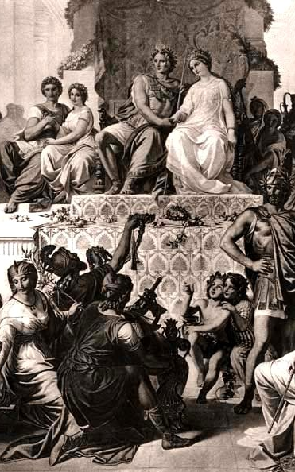
VI: Final Years--Death
324: Alexander and the army return to Susa
May, mass marriage of Persian noble women to Greek and Macedonian officers
Alexander and his BFF Hephaestion marry the two surviving daughters of Darius III ➔
October, Hephaestion dies of a fever
323: June, Alexander dies of a fever
On his deathbed he is asked who his empire should go to.
He says, “To the strongest.” (Or so the generals all claimed later.)
After capturing Persian treasure worth at least $6 billion dollars, equal to over thirty years of Persian state revenue, he had run through all of it and died in debt.

Slide 59
VI: Excursus—Who Done It?
Wide suspicion of Alexander having been poisoned. (Symptoms match extended low-dose strychnine poisoning.)
None of the Successors seemed willing to press the matter for fear it would lead to one of their allies. But maybe it wasn’t any of the Successors at all.
Alexander and Hephaestion both . . .
died of a “fever” with similar symptoms,
not long after marrying the two daughters of Darius III,
who just might have had a motive.

Slide 60
VI: Excursus—Who Done It?
But no self-respecting Greek would ever suspect a woman could lay low the greatest conqueror in history.

Slide 61
VI: Final Years--Epilogue
322-275 BCE: Wars of the Diadochi (Successors)
Alexander’s empire splintered into three large kingdoms (Macedon, Egypt, Asia/Seleucia) and several minor states, all ruled by an ethnic Macedonian noble class.
The Classical Era ended and was replaced by the Hellenistic Era.

Slide 62
Part VII: Enduring Legacies
Was anything left of Achaemenid Persia?
Zoroastrian influence on Judeo-Christian values remains an unquantifiable, but significant, contribution to western culture.
But most of Persian culture seems to have been swept aside, replaced by the new Hellenistic culture which supplanted Classical Greece.
Or was it?

Slide 63
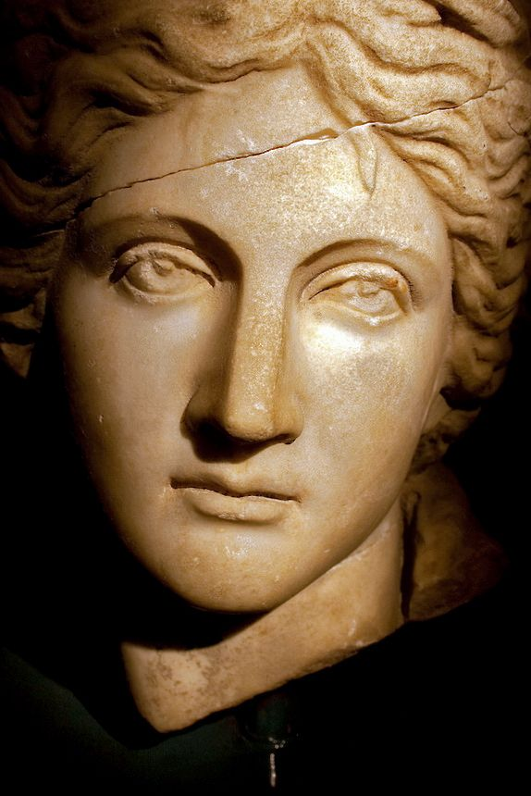
VII: Enduring Legacies--Women
The status of women in Hellenistic Greece changed in interesting (and familiar) ways.
Women gained access to education, and became more cultured.
Wider variety of occupations available.
No longer needed permission (or escort) to leave the home and travel.
Could enter contracts, including marriage contracts covering their rights in the event of adultery, and the right to divorce.
Equal pay for equal work, however, would take another 2,000 years.
(And counting)
But there’s more . . .

Slide 64
VII: Enduring Legacies--Hellenism
What was Hellenism? How did it differ from the Classical Era?
Spirit of lively secular interest in science and mathematics.
“Melting pot” cities with enormous diversity of cultures and religious traditions.
Increasing upward economic and social mobility, regardless of ethnic origin.
Increasing understanding of responsibility of rulers to their subjects.
Increasing interest in ethical/spiritual-based religions and philosophies.

Slide 65
VII: Enduring Legacies
In broad outline, those are the defining characteristics and principles of
the Achaemenid Persian Empire.
The historians of the Hellenistic age are right to celebrate the values of Hellenistic society, which later spread west into the Roman empire.
Their mistake is in thinking the Greeks brought those values to the east.
In fact, the Greeks found them there, and then spread them west.

Slide 66
VII: Enduring Legacies
The Greeks set out to conquer the Persian Empire.
Fortunately for us, it sort of conquered them.

Slide 67
Greece and Persia The War that Created History
Question Break

Slide 68
Greece and Persia The war that Created History
Thank You All
For a Wonderful Teaching Experience!

