Slide 1
But war’s a game which,
Were their subjects wise,
Kings would not play at.
Nations would do well
T’extort their truncheons from the puny hands
Of heroes, whose infirm and baby minds
Are gratified with mischief, and who spoil,
Because men suffer it, their toy the world.
--William Cowper, The Task, 1785

Slide 2
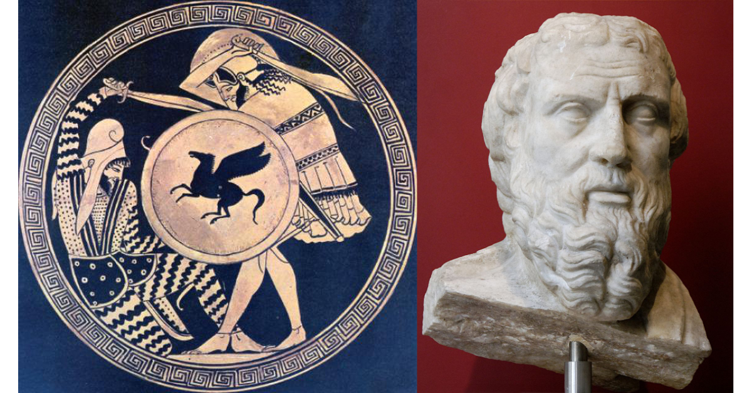
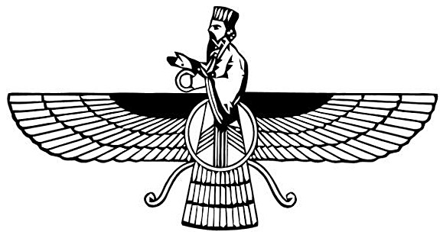
Greece and Persia The war that Created History
OLLI Spring 2022
Week 7: The King’s “Peace”
or
Fifty Years of War

Slide 3
Course Overview
Week 1: The Story, and its sources
Week 2: The Greeks—Who they were and why we should care
Week 3: The Persians—Who were they, and should we care?
Week 4: When The Mede Came—From Cyrus to Darius
Week 5: The Great Invasion—The Stunning Greek Victory
Week 6: The Victors Fall Out—The Peloponnesian Wars
Week 7: The King’s “Peace”—Fifty Years of War
Week 8: Alexander the Demon—Destruction of an Empire

Slide 4
Fifty Years of War (403-336)
(Actually, over sixty years)
Sources
The Decline of Sparta (403-386)
Theban Ascendancy (371-362)
Meanwhile . . .
Rise of Macedon (359-356)
The Collapse of Classical Greece (356-336)

Slide 5
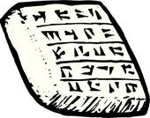
Part I: Sources
Xenophon
Athenian aristocratic soldier, philosopher, and historian.
Studied under Socrates (who later saved Xenophon’s life at the Battle of Delium).
Served as mercenary in Asia and was one of the commanders of “The Ten Thousand.”
Exiled from Athens for pro-Spartan sympathies, he spent the later half of his life in Sparta and then other parts of southern Greece.
His sons returned to Athens and performed notable military service.

Slide 6
Part I: Sources
Xenophon’s Major Historical Works
Hellenika. A history of Greece in the style of Thucydides, picking up where his Hostory of the Peloponnesian War left off (411 BCE) and ending in 362 BCE, not long before Xenophon’s death in 354.
Anabasis. (The March Upcountry) Account of the revolt of Cyrus the Younger and the escape of “The Ten Thousand” from deep in Persia.
Agesilaus. The life of the Spartan king Agesilaus II, including his campaign against Persia.

Slide 7
Part I: Sources
Justin’s Epitome of the Philippic Histories of Gnaeus Pompeius Trogus
Trogus was a Roman historian whose history concentrated on the rise of Macedon and the fate of its successor states. His history is lost but we have Justin’s lengthy and detailed summary of it.
Most of books V through X cover the events of this lecture.

Slide 8
Part I: Sources
Some Other Usual Suspects
Diodorus of Sicily (Very Useful)
Ctesias of Cnidus (Not So Much)

Slide 9
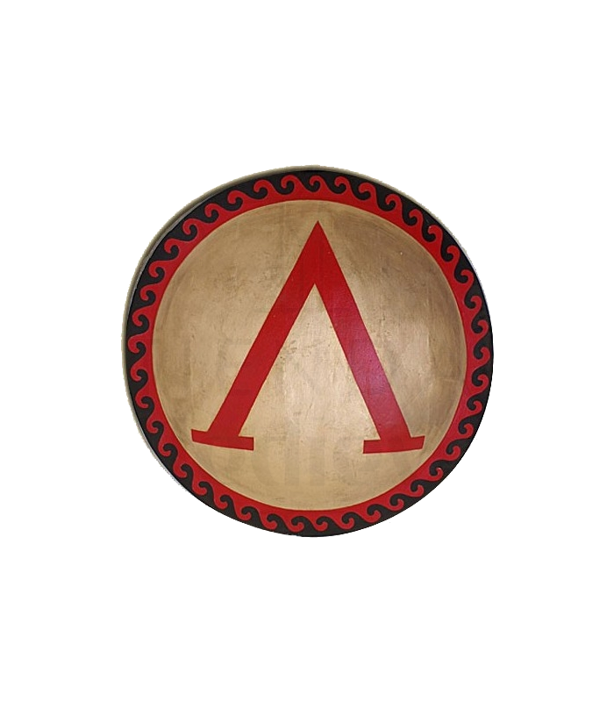
Part II: The Decline of Sparta (403-386)
405: Darius II “Ochus” died, succeeded by Artaxerxes II “The Mindful”
403: Athens overthrows the Thirty Tyrants
401: Revolt of Cyrus the Younger
400: Support Egyptian campaign against Phoenicia
396: Sparta turned on its erstwhile ally Persia (Hubris)
395: Corinthian War, “The King’s Ten Thousand Archers” (Nemesis)
386: “The King’s Peace”

Slide 10
Part II: The Decline of Sparta (403-386)
Setting the Stage: The Spartan-Persian Alliance
412: Spartan alliance with Darius II
Negotiated and managed by king’s son Cyrus
405: Darius II died, succeeded by eldest son Arsaces--Artaxerxes II “The Mindful”
Queen mother preferred her younger son Cyrus
403: Athens overthrew the Thirty Tyrants
Reestablished democratic government

Slide 11
II. Decline of Sparta – King Agesilaus II
398: Agesilaus, son of Archidaemus II (Spartan king at start of the Peloponessian War). Attended agoge because not expected to succeed his older brother (King Agis II), but Agis’s son declared illegitimate (product of an adulterous affair*), and so in 398 BCE Agesilaus became king in his forties.
(*And we know who the scoundrel was, don’t we?)
Somewhat lame (one leg shorter), slight of stature, and not a good public speaker. But smart and brave.
Probably as good an organizer and battlefield leader as Sparta ever produced. Excellent at logistics, but not as good at strategy or diplomacy.

Slide 12
II. Decline of Sparta – Cyrus the Younger
Cyrus in Asia Minor (412 BCE)
Younger son of Darius II. Main advocate for alliance with Sparta, and as satrap (governor) of much of Asia Minor disbursed the money to Spartan generals. Had good relations with senior Spartan officers.
Cyrus and the Succession (404 BCE)
His mother favored him to replace his father. His older brother was first born, but Cyrus was the first born after Darius became king, and either were acceptable credentials. Darius went with the older son.
The Revolt of Cyrus (401 BCE)
Cyrus hired about 12,000 Greek mercenaries (with a Spartan general) and then marched on the heart of the Persian empire to overthrow his brother, Artaxerxes II.

Slide 13
II. Decline of Sparta – Revolt of Cyrus
The Greek Mercenaries
10,000 hoplites and about 2,000 peltasts (light troops)
Battle of Cunaxa (401 BCE)
Marched almost to Babylon, met the royal army at Cunaxa
Battle going well for Cyrus until he led a cavalry charge and was killed.
Cyrus’s Persian troops immediately surrendered.
What to do about his Greek mercenaries?

Slide 14
II. Decline of Sparta – The Ten Thousand
Negotiations
Persians took all the Greek generals prisoner (and later executed them)
Greeks elected new generals (including Xenophon)
Anabasis (the March Upcountry) (401-399)
Harassed by Persian troops most of the way, the “Ten Thousand” fought their way north through Armenia and then along the Black Sea coast until they reached friendly territory. Took about a year.

Slide 15
II. Decline of Sparta – The Ten Thousand
Results
The Greek world was convinced Persia was weak. How else could the “Ten Thousand” have just marched out?
There were now 10,000 very experienced mercenaries in northwest Asia Minor looking for work.

Slide 16
II. Decline of Sparta – The Turn on Persia
Hubris
Sparta assisted the Egyptians against Persia (400 BCE)
Sparta invaded Persia’s Asian possessions (396-395 BCE)
Newly crowned king, Agesilaus II took command.
Invasion force was 8,000 men: 2,000 freed helots, 6,000 perioikoi and allies, only 30 Spartiates. (They were getting stingy with them.)
Spartans at first hampered by lack of cavalry and light infantry.
Once Agesilaus raised supporting troops, especially cavalry, Sparta generally had the better of the battles fought. Persians conducted delaying actions, cautious retreats. Traded space for time. (But waiting for what to happen?)

Slide 17
II. Decline of Sparta – Corinthian War
Nemesis: The Corinthian War (395-387)
395: Alliance of Thebes, Athens, Corinth and Argos (backed by Persia) declared war on Sparta
Agesilaus recalled from Asia. Had to fight his way back through hostile territory
Agesilaus won several remarkable battlefield victories, but eventually both sides were worn down and fought to a stalemate.
Agesilaus later said he was driven out of Asia by “The King’s Ten Thousand archers.”

Slide 18
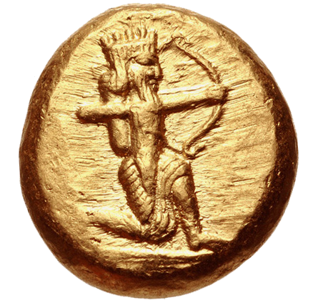
II. Decline of Sparta – Ten Thousand Archers

Slide 19
II. Decline of Sparta – Ten Thousand Archers
Persian gold daric.
Daric was the wage of a common laborer for over a year, or a trained mercenary for a month.
Too large a denomination to be used in most commercial transactions.
Instead used to pay mercenaries and bribe governments and their officials.
Every coin featured an image of the Persian king holding a bow.

Slide 20
II. Decline of Sparta – Stalemate
War dragged on for eight years with battles lost and won by each side but no clear resolution.
The generations of old grudges, old injuries, and old scores to settle made it impossible for the Greeks to make peace.
Spartans finally came to Artaxerxes II, king of Persia, and asked him to broker and enforce a peace.

Slide 21
II. Decline of Sparta – The King’s Peace
Peace of Antalcidas, “The King’s Peace” (387 BCE)
“ King Artaxerxes thinks it just that the cities in Asia should belong to him, as well as Clazomenae and Cyprus among the islands, and that the other Greek cities, both small and great, should be left independent, except Lemnos, Imbros, and Scyros; and these should belong, as of old, to the Athenians. But whichever of the two parties does not accept this peace, upon them I will make war, in company with those who desire this arrangement, both by land and by sea, with ships and with money.”
— Hellenika Book 5,Chapter 1

Slide 22
II. Decline of Sparta – Athens Rising (again)
386-371: Continuous, simmering warfare
377: Athens established Second Athenian League
Many more safeguards on rights of members
Stated purpose was “to make the Spartans leave the Greeks to enjoy peace in freedom and autonomy.”
376: Naval battle of Naxos
Athens defeated Sparta
70 small Aegean Greek city-states revolted from Spartan control and joined Athenian League.

Slide 23
Greece and Persia The War that Created History
Question Break

Slide 24
Part III: Theban Ascendancy (371-362)
385: Young Epaminondas saved life of Pelopidas in battle. Led to friendship and political alliance. ➔
382: Sparta took over Thebes, drove out the anti-Spartans. Epaminondas allowed to stay because his poverty made him appear unimportant to the Spartans.
378: Joint coup by Epaminondas and Pelopidas liberated Thebes from Spartan occupying force.
378-370: Thebes unified Boeotia as democratic federation. Epaminondas and Pelopidas major political leaders.
371: Spartan army invaded Boeotia.

Slide 25
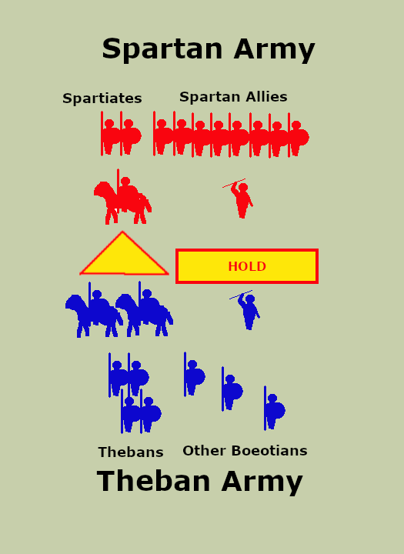
III: Theban Ascendancy – Leuctra 371 BCE
An outnumbered Theban army broke the Spartan myth of invincibility in open battle
Sparta
10,000 hoplites (2000 Spartiates)
1,100 light infantry
1,000 cavalry
Thebes
6-7,000 hoplites
1,000 light infantry
1,500 cavalry
Epaminondas stacked his left side deep to hit the Spartans head-on. Led with his cavalry. Ordered the rest of the line to hold back.

Slide 26
III: Theban Ascendancy – Leuctra 371 BCE
Theban cavalry routed Spartan cavalry back into Spartan infantry lines. Disordered Spartan ranks.
Theban deep column crashed into the Spartans, led by the Theban Sacred Band.
Spartans broke, and when they did, their allies fled as well without ever being engaged.
Decisive Victory
1,000 Spartiates killed, including their king Cleombratus, plus 1-3,000 allies killed in pursuit
300 Thebans killed

Slide 27
III: Theban Ascendancy – Mantinea 362 BCE
For nine years Thebes was the dominant military and political power in Greece.
Battle of Mantinea
One of the largest hoplite battles in history
Sparta
20,000 hoplites (1500 Spartiates)
1,000 light infantry
2,000 cavalry
Thebes
26,000 hoplites
4,000 light infantry
3,000 cavalry

Slide 28
III: Theban Ascendancy – Mantinea 362 BCE
Epaminondas again stacked his left side deep to hit the Spartans head-on.
Ordered the rest of the line to hold back.
Cavalry and light troops covered the flanks.
Another overwhelming victory, but Epaminondas was killed at the end of the battle.
The army marched home and Thebes never again tried to dominate Greek affairs.

Slide 29
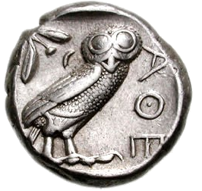
Part IV: Meanwhile . . . In Greek Society
Birth of Modern Individualism
Not an expression of celebration, but disillusionment and despair
Gained at the expense of the polis
Increasing conspicuous concentration of wealth breeds increased preoccupation with amassing wealth
Longer and more frequent wars take the middle class away from their farms and trades for longer stretches, and only benefit the already wealthy
“So what’s in this for me?”
Reluctance to serve, increased reliance on mercenaries.
Corruption of orators (“the media”) and officials of the polis. Everyone’s for sale.
Collapse of respect for religious institutions, with nothing to take their place.
People did not abandon the polis; the polis abandoned them. The growing tendency toward individual self-serving greed merely reflected the same attitude by the polis itself.

Slide 30
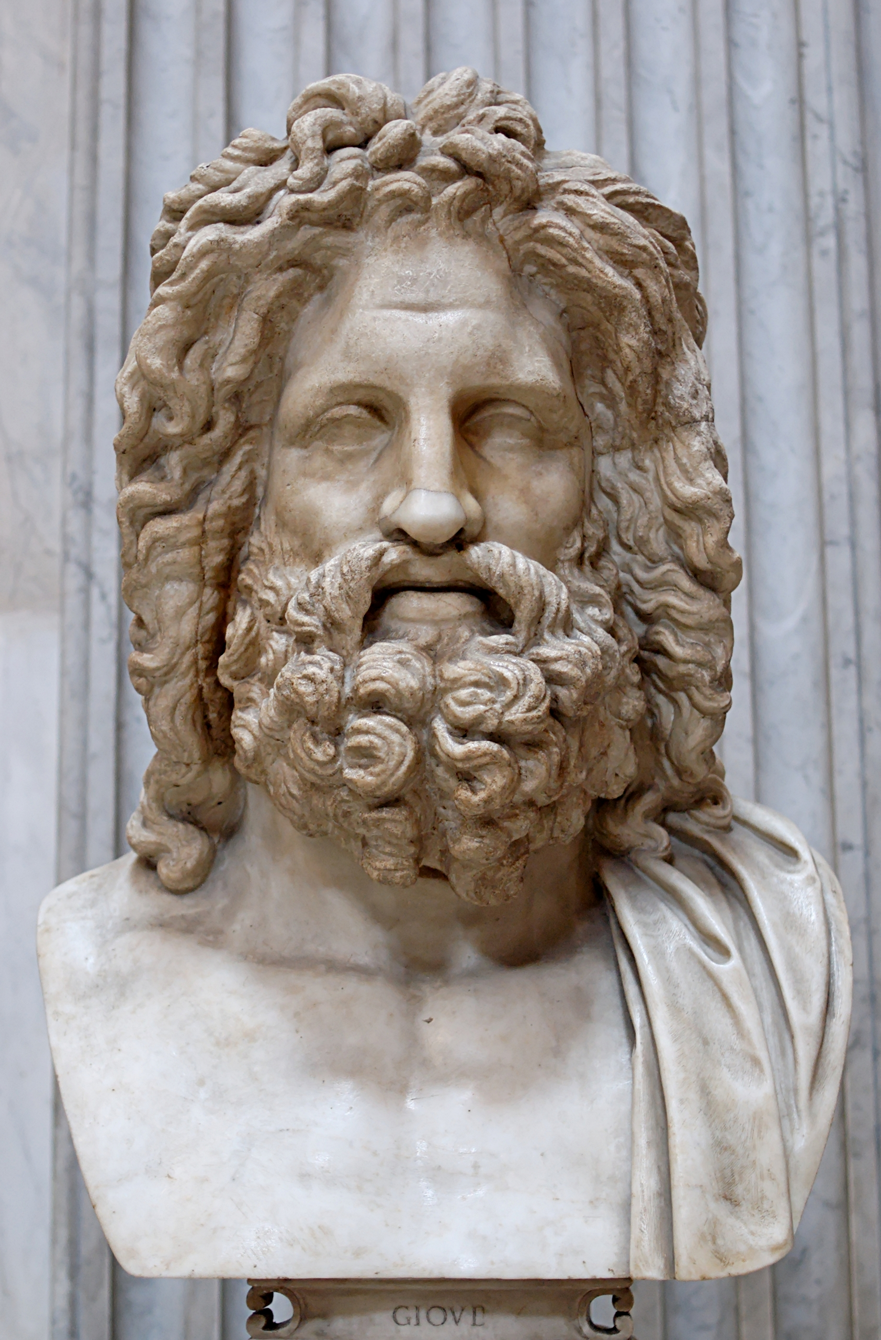
IV Meanwhile . . . Greek Religion
Near-total disintegration of religion as an anchor of society
Degenerating into a means of settling scores and dealing with political opponents

Slide 31
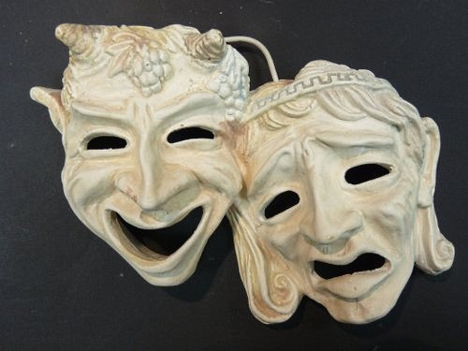
IV Meanwhile . . . Drama
Many plays from the previous decade or two foreshadowed the dramatic social changes coming. Challenged the assumptions of Greek society, questioned the justice of its institutions.
Medea (Euripides, 431 BCE) Shows a non-Greek woman, Medea, driven to horrific violence by her unjust treatment at the hands of her Greek husband, Jason, all of which Jason justifies simply by the fact she is a barbarian.
Plutus (Aristophanes, 388 BCE) A father journeys to Delphi to ask the oracle how he can turn his son into a villainous character, and so insure his success in Athens.

Slide 32
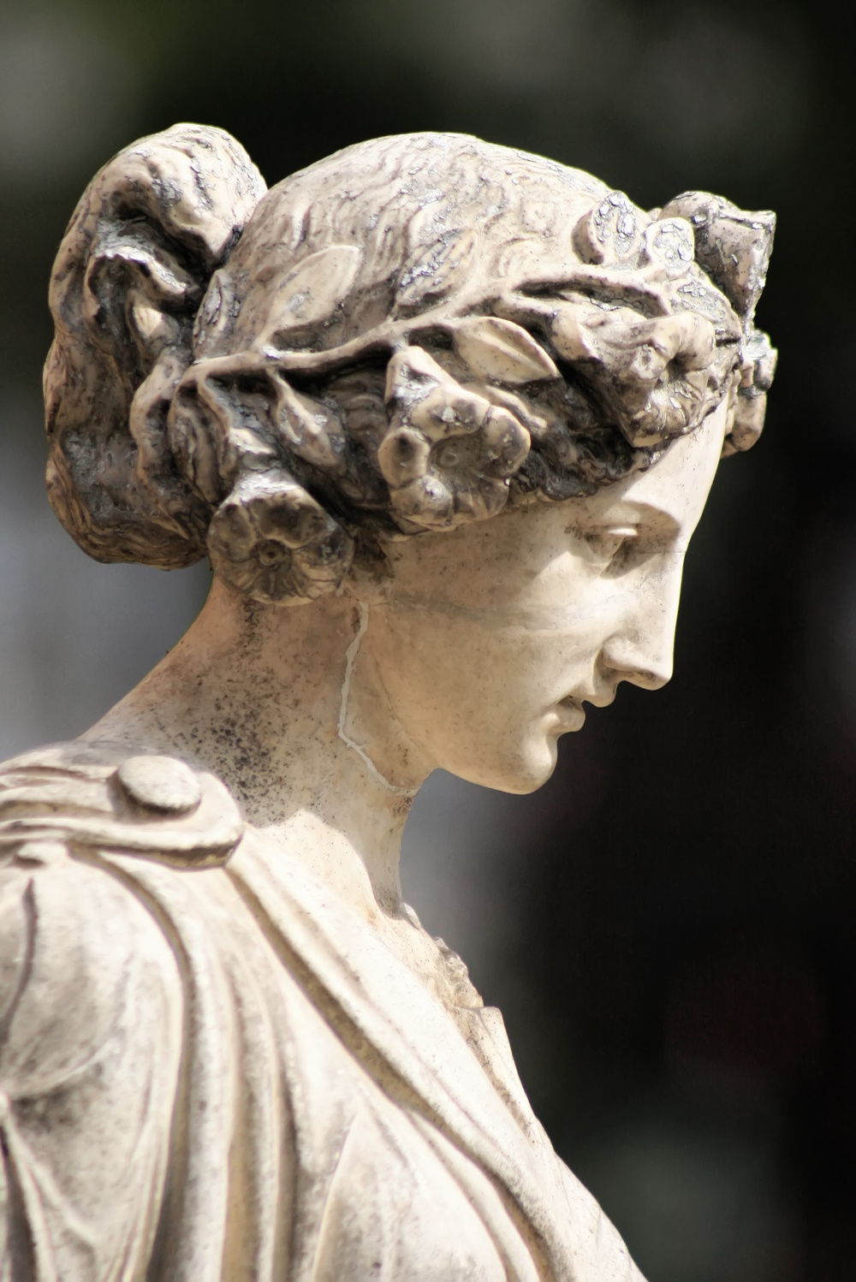
IV Meanwhile . . . Art
Many full-body statues previously had been of naked men, heavily muscled, with a clearly homoerotic theme. Statues of women were usually heavily draped. (right)
In this later period, however, Greek artists began showing an increased interest in accurate portrayal of the naked female form.
Praxiteles’ statue of Aphrodite of Cnidus is a well-known example. (far right)
Zeuxis of Heraclea, in researching his painting of Helen of Troy, studied local women and used features from many of them.
This increased interest in accurate depiction of the female form probably came from a reviving interest in women themselves.

Slide 33
IV Meanwhile . . . Art
At the same time, much interest turned to busts in addition to full-body statues, and the busts, featuring detailed character studies, mostly concentrated on men. So in that sense men continued to be the dominant subject of art.
The emotions portrayed are more complex than in previous periods, and often suggest deep internal conflicts, mirroring the traumatic self-examination Greek society was undergoing.

Slide 34
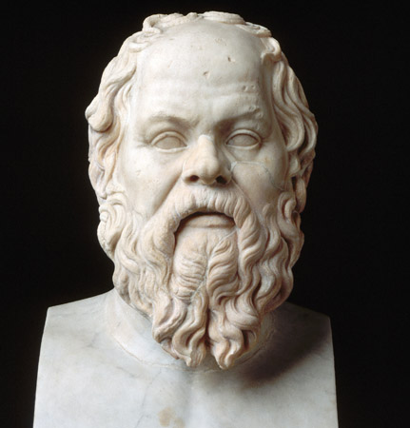
IV Meanwhile . . . Philosophy —Death of Socrates (399 BCE)
Four years after overthrow of the Thirty Tyrants. Democratic government badly shaken by the bloody purges. Socrates executed as an enemy of democracy by an embattled government.
Socrates convicted of “Corrupting the minds of the youth of Athens” and “Impiety,” sentenced to death by poison.
Socrates offered no defense, was “arrogant and defiant” at the trial.
Seemed to welcome death as a final political statement against the democratic government of Athens.
Claimed his role was as a “gadfly to the state,” and criticized the notion that “might made right.”
But never criticized any act by any of the three oligarchic governments he lived under, including their purges.
Consistently expressed his admiration for Spartan oligarchy.
Students of his had been among “The Thirty Tyrants.”

Slide 35
IV Meanwhile . . . Philosophy —The Original Academy
Founded by Plato in Athens, in about 387 BCE. Evolved from regular conversations held on Plato’s property with acquaintances.
No fees charged, but membership controlled by Plato. (Only two women known to have attended.) No fixed curriculum. Some lectures, mostly discussion.
Begins to regularize and institutionalize the understanding of what a philosopher is.
Occasionally described as a school for future politicians, but practical politics not part of the known subjects. More likely a school for philosophers, many of whom went on to become politicians.
Aristotle studied there for twenty years (367-347) before leaving, later starting his own school, the Lyceum.
All western philosophy often described as having flowered from one of two branches of the Academy: Plato or Aristotle.

Slide 36
IV Meanwhile . . . The Academy on Women
Xenophon: In the ideal society, women are confined to the home and subordinate to their husbands.
Plato: In theory, women might serve as Guardians (the highest class in his Republic) if sufficiently accomplished. In practice such women would be very rare.
Aristotle: Women are irremediably inferior to men.

Slide 37
IV Meanwhile . . . The Academy on Government
Plato: “The rulers of the state are the only persons who ought to have the privilege of lying.”
Aristotle: "The citizens must not lead the life of mechanics or tradesmen, for such a life is ignoble, and inimical to virtue. Neither must they be farmers, since leisure is necessary both for the development of virtue and the performance of political duties.“
Aristotle: “Democracy is a government in the hands of men of low birth, no property, and vulgar employments.”

Slide 38
IV Meanwhile . . . The Academy on Xenophobia
“Cosmopolitan commerce was one of the major factors eroding the old particularism and xenophobia of the polis. Both Plato and Aristotle realized this, although with their idealized view of the polis they were highly critical of the trend.”
–Frank J. Frost, Greek Society (1997)
Aristotle: “Be a leader to the Greeks and a despot to the barbarians. Look after the former as after friends and relatives, and deal with the latter as with beasts or plants."
"When Hitler exterminated the European Jews, he based his actions, precisely, on the belief that certain categories of mankind could be dismissed as sub-human—that is, like Aristotle, he equated them with beasts or plants."
-Peter Green, Alexander of Macedon (1991)

Slide 39
IV Meanwhile . . . Philosophy —The Cynics
Antisthenes (445-365 BCE)
Student of Socrates and founder of Cynicism
Cynicism as practiced by Antisthenes and his followers:
Live in virtue, in harmony with nature.
Train yourself to reject all conventional desires for wealth, power, sex, and fame.
Lead a simple life free from all possessions.
Later revival (and modern understanding of the word cynicism) distorted disdain for wealth and social conventions into a simple contempt for all people’s motives. That was not what Greek Cynicism was about.

Slide 40
IV Meanwhile . . . Philosophy —The Cynics
Diogenes (412-323 BCE)
Embraced a life of poverty and virtue. Rejected all social conventions.
Contemptuous of Plato--too abstract. Thought Antisthenes was the true heir of Socrates.
Taught his philosophy to Crates, who taught Zeno of Citium, who refined it into Stoicism.
Greek Cynicism quickly died out, but Stoicism became one of the most enduring philosophies to emerge from Greek thought.

Slide 41
Greece and Persia The War that Created History
Still to come
V. The Rise of Macedon (359-357)
VI. The Collapse of Classical Greece (356-336)
Question Break

Slide 42
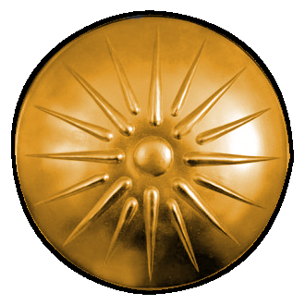
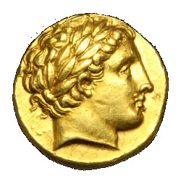
Part V: Rise of Macedon (359-357)
368-365: Philip of Macedon hostage in Thrace
359 Philip becomes regent, then king
358: Death of Artaxerxes II, succeeded by Artaxerxes III “Ochus”
357: Big years for Philip. Takes Amphipolis: gold and silver mines
Begins minting gold coins, Macedonian gold staters, his likeness on the front.
What’s on the back?

Slide 43
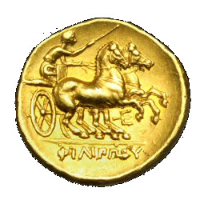
Part V: Rise of Macedon (359-357)
philos (loving) + hippos (horse)
Philip (Philippos) = “horse lover”

Slide 44
Part V: Military Revolution
Philip’s Military Revolution
Gold and silver from Amphipolis enabled creation of permanent standing army
National troops became permanent soldiers
Regular pay enabled purchase of slaves to work their lands
Major upgrade of equipment and drill of troops

Slide 45
Part V: Macedonian Cavalry
Unlike most of Greece, Macedon is good horse country.
Cavalry increased from a small royal guard to a large force of armored spear-armed shock cavalry: the Hetairoi (Companions)
Best mercenaries recruited from throughout Greece
Granted land to tie them to the future of Macedonian state

Slide 46
Part V: Macedonian Allied Cavalry
Supplemented by excellent Thessalonian cavalry once Thessaly became part of royal domain (352 BCE)
Thessalian horses the best cavalry mounts in the Greek world.
Heavily cross-bred with Persian Nisean horses, so larger and stronger than other Greek horses
Known as “Oxheads” because the Niseans had broader, heavier heads than most other breeds.

Slide 47
Part V: Macedonian Cavalry
Persian statue of a horse head—may be closer to the appearance of a Nisean’s head.

Slide 48
Part V: Macedonian Infantry
Infantry converted from light “peltasts” to heavily armored infantry
Hoplite spears replaced with sarissas (very long pikes, 14-18 feet)
Called pezhetairoi (foot companions)
Phalanx becomes a deadly, bristling hedge of pikes.

Slide 49
Part V: Macedonian Guard Infantry
Elite guard infantry unit of 3,000 men called the Shield Bearers (hypaspists)
Probably equipped as hoplites, with long spears, but not full-length sarissas, to make them more maneuverable on the battlefield.
Generally held the most dangerous position on the right of the battle line.

Slide 50
Part V: Growth of Macedon
Growth of Macedon
Amphipolis, Potidea, Pynda (356)
Thessaly (352 BCE)
Thrace and Molossia (343-342)
League of Corinth (338-337)

Slide 51
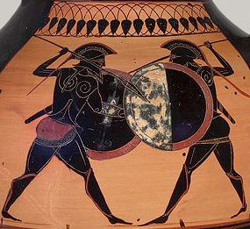
Part VI: The Collapse of Classical Greece (356-336 BCE)
The Social War (357-355 BCE)
357: (Twenty years after formation of Second Athenian League) Four member states of the Athenian League (Chios, Cos, Rhodes, Byzantium) overthrew their democratic governments and seceded. Athens launched a campaign to force their return.
In the confusion, Philip of Macedon captured Amphipolis, and its rich gold and silver mines. Ensured financial future of Macedon.
Athenians made little progress, lost several major naval battles.
Starved for money, the Athenian army in the Aegean helped (for pay) the Persian satrap Artabazus rebel against the King.

Slide 52
Part VI: The Collapse of Classical Greece (356-336 BCE)
The Social War (357-355 BCE)
356: The new Persian King Artaxerxes III (came to the throne in 358 BCE), requested Athens stop helping the rebels and withdraw completely from the Asian mainland.
355: Athens agreeed to Persian request and withdrew from Asia Minor. Also concluded peace with rebels. Abandoned war policy and any attempt to dominate Greek affairs as a solo power.
Took the treasure surplus amassed to finance the war and dedicated it to funding public entertainments.
Rebel satrap (Artabazus) fled to the court of Philip of Macedon.

Slide 53
Part VI: Third Sacred War (356-346)
Delphic Amphictyonic League
Religious organization of several city-states to administer the shrine of the Oracle of Apollo at Delphi.
Council had religious authority and a power to levy fines against religious offenders.
357: Council imposed enormous fines on Phocis (the state where the shrine was located) and Sparta. Thebes was main instigator, vote was on political lines.
Phocis and Sparta refused to pay. Subsequent war involved much of Greece and eventually Macedon.

Slide 54
Part VI: Third Sacred War (356-346)
Sparta gave Phocis 15 talents of silver to hire 1,000 mercenaries. (A talent was about 52 pounds of silver, $14,676)
After over a hundred years of nearly continuous war, Greece was full of trained, experienced soldiers willing to fight for money.
Phocis used the mercenaries to immediately seize the shrine at Delphi, fortified it, and used the stored treasure to hire more.
Much fighting back and forth, but Phocis maintained a substantial army in the field for ten years using up the treasury.
For comparison, annual revenue of the Athenian Empire at the start of the Peloponnesian War was 600 talents.
Total treasury expended by Phocis: about 10,000 talents (260 tons!)
Phocis finally defeated by Macedonian Army of Philip.
The war left everyone materially and morally bankrupt. Every pretense of reverence for the political, legal, and religious traditions of Greece had been sacrificed to political expediency or monetary greed.

Slide 55
Part VI: Philip’s Final Campaigns (342-338)
Quick Review
The Aegean Sea
The Athenian Grain Trade

Slide 56
Part VI: Philip’s Final Campaigns (342-338)
340-339: The Thracian Coast
Perinthus and Bizantium attacked and besieged.
Persia sent mercenaries to help coastal cities.
Philip seized Athenian grain ships to feed army.
Athens joined Persia in fighting Philip.
Philip checked, but marched south on Athens

Slide 57
Part VI: Philip’s Final Campaigns (342-338)
338: The Chaeronea Campaign
Athenian ambassadors convinced Thebes to join Athens in resisting Macedon
Athenian orator Demosthenes major voice in favor of resisting Macedon. Why?

Slide 58
Part VI: Demosthenes (and everyone else)

Slide 59
Part VI: Battle of Chaeronea (338 BCE)
Battle of Chaeronea 338 BCE
Macedonian Army (32,000)
18,000 pezhetairoi (pike infantry)
3,000 hypaspists *guard infantry)
5,000 allied infantry (Thssalian, Phocian)
4,000 merenary light infantry
1,000 hetaerae (heavy cavalry)
1,000 Thessalian cavalry
Greek Allied Army (30,000)
12,000 Boeotian (Theban) Hoplites
6-8,000 Athenian hoplites
10-12,000 other Allied hoplites (center)
Decisive Macedonian Victory
Greek army broken and scattered
2-3,000 dead, 5-10,000 prisoners

Slide 60
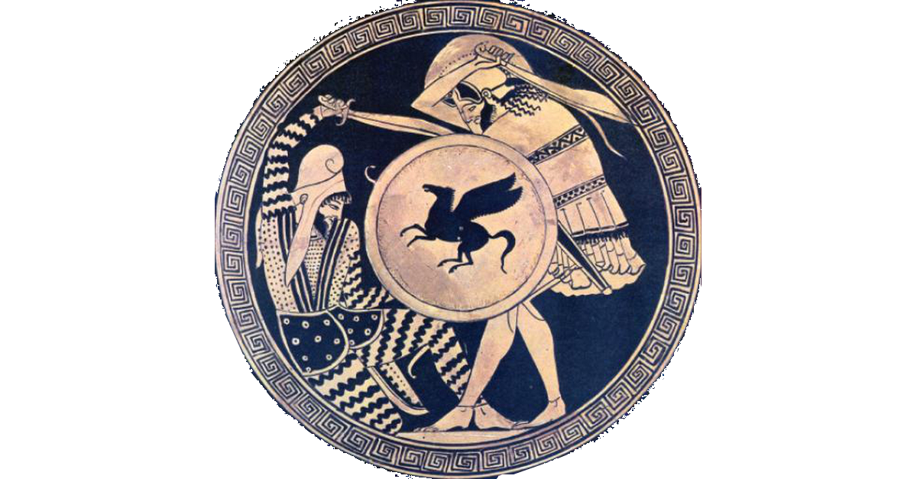
Part VI: Aftermath (338-336 BCE)
338/337: League of Corinth (capitulation of Greece)
Formed for the sole purpose of launching a united invasion of Persia
Included all of Greece except Sparta and Crete (which remained neutral)
Philip elected hegemon (commander)
336: 10,000-man advanced guard sent to Asia Minor to secure Hellespont
Philip hosts lavish feasts and games to celebrate the marriage of his daughter.
To show how popular he is, he eschews all security. (Hubris!)
Assassinated by a former lover. (Nemesis!)
Assassin killed trying to escape, and before he could talk.

Slide 61
Greece and Persia The War that Created History
Question Break

Slide 62
Next Week: (Week 8) Alexander the Demon
Alexander’s invasion and destruction of the Achaemenid Persian Empire

