Slide 1
Hubris
Excessive pride or self-confidence
Nemesis
The inescapable agent of
someone’s or something’s downfall

Slide 2
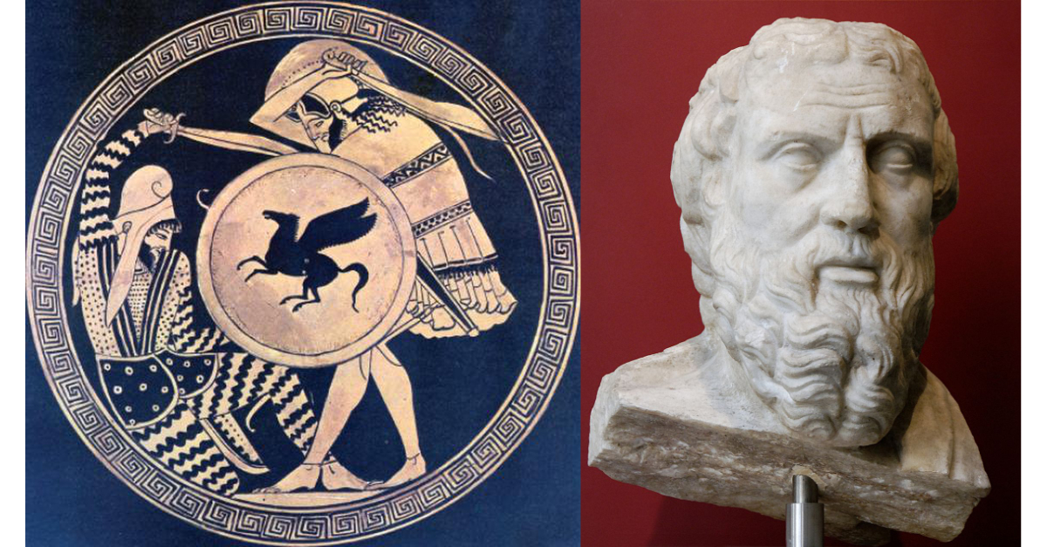
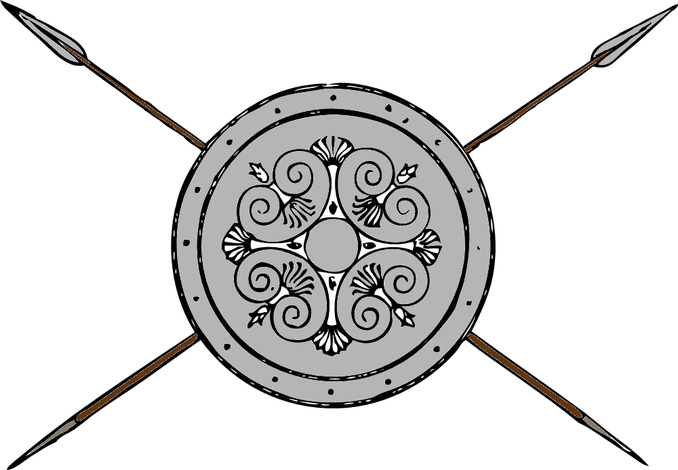
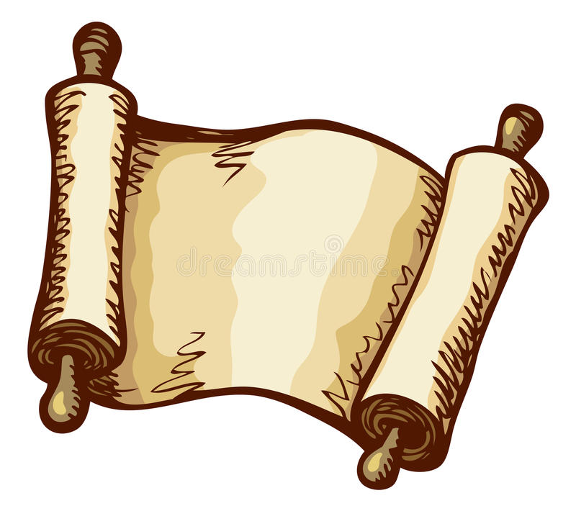
Greece and Persia The war that Created History
OLLI Spring 2022
Week 6: The Victors Fall Out
or . . .
Hubris and Nemesis

Slide 3
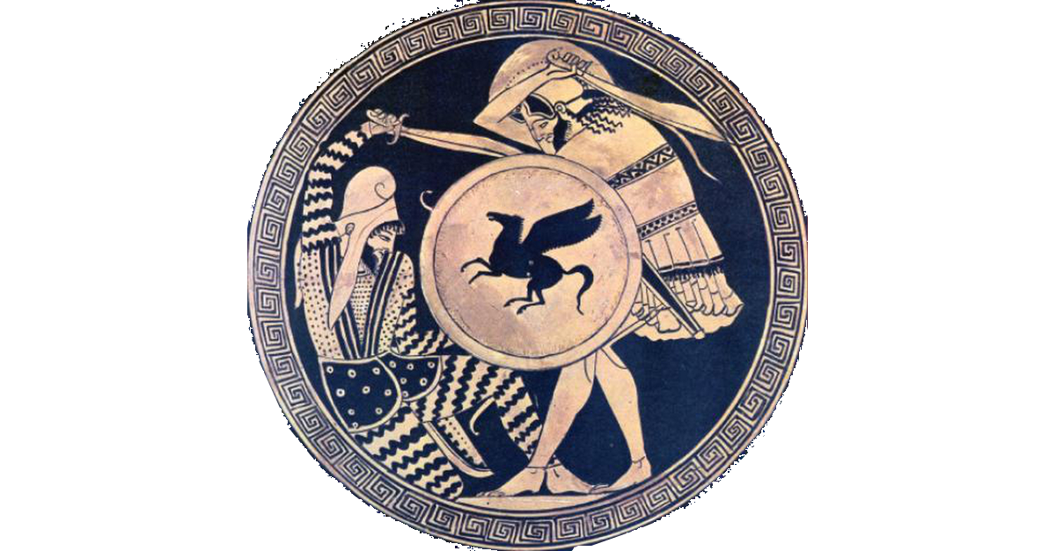
Course Overview
Week 1: The Story, and its sources
Week 2: The Greeks—Who they were and why we should care
Week 3: The Persians—Who were they, and should we care?
Week 4: When the Mede Came—From Cyrus to Darius
Week 5: The Great Invasion—The Stunning Greek Victory
Week 6: The Victors Fall Out—The Peloponnesian Wars
Week 7: The King’s “Peace”—Fifty Years of War
Week 8: Alexander the Demon—Destruction of an Empire

Slide 4
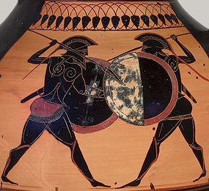
The Victors Fall Out
Historical Sources
Meet the Spartans
Pentecontaetia, Golden Age of Greece: Fifty Years of Peace (480-431 BCE)
Archidaemion War (431-421 BCE) (Peloponnesian War Part 1)
Athenian expedition to Syracuse (in Sicily) (415-13 BCE)
“The Second War” (413-404 BCE) (Peloponnesian War Part 2)
Excursus: The Strange Career of Alcibiades
Meanwhile . . . Changes in Philosophy, Drama, Religion

Slide 5
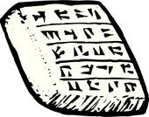
Historical Sources--Thucydides
Athenian aristocrat, statesman, general, and historian
Relieved of his command after the Athenian defeat at Amphipolis (424 BCE), which led to the end of the Archidaemion War
Later wrote History of The Peloponnesian War, perhaps in part to explain his role in it. But there is no obvious self-justification and in general historians give him high marks for objectivity.
Our single most detailed and reliable source on this period, although it limits its coverage to the Greek war.

Slide 6
Historical Sources—Diodorus of Sicily
Lived about 400 years after the events covered here.
His Library of History was a 40-volume history of the Greek and Western Asian world from the times of Egypt and Assyria forward. It was compiled from, and is a summary of, a variety of other sources, most of which have not survived.
About 20 volumes of Diodorus survive, including Books 11, 12, and 13 which cover this period.
It covers a broader canvass than does Thucydides (but also spends a great deal of ink on the history of Sicily).
Historians often discounted Diodorus as he challenged many aspects of the “accepted” story, but some are now reevaluating him more favorably.

Slide 7
Historical Sources—Ctesias of Cnindus
Was a Greek physician at the court of Artaxerxes II from about 414 to 397 BCE. Because he is our only source on Persian court life at this time, his work gets more attention than it deserves.
Attacked Herodotus for inaccuracies. In every instance where Ctesias disagrees with Herodotus, and which can be independently verified, Herodotus is right and Ctesias is wrong.
Widely regarded by historians in the ancient world. (Plutarch based his life of Artaxerxes II entirely on Ctesias’s account.) Today he’s more often viewed as a pathological liar.
After returning to his home in Caria, wrote Persica and Indica.
Ctestias: In India there are trees made out of metal, a fountain of liquid gold, and people with only one leg, but their foot is large enough to use as an umbrella. ➔
Claimed he had access to Persian “historical archives”. There is no evidence such archives existed.
Ctesias: The Persian king has a sword which, when thrust into the ground, repells rain, hailstones, and clouds. With my own eyes I saw Artaxerxes demonstrate it. Twice.

Slide 8
Historical Sources—Murashu Archive
Financial records of Murashu banking family
300 whole and 400 partial tablets
Covers legal issues, loans, rents, transactions, business trips, and employee contracts.
Lease land and water from its owners
Farm the land to produce crops
Or sublet the leased lands to tenants, who would work the land with livestock, seeds, and equipment provided by the firm.
Converted the produce from the land into cash (silver) which was lent on the basis of collateral to other businesses

Slide 9
Historical Sources—Ezra-Nehemiah
Originally the two books of Ezra, but later Protestant translations called the second book Nehemiah
Covers Nehemiah’s mission to rebuild the walls of Jerusalem and reestablish adherence to the Law, and Ezra’s part of the same general mission. Probably in period 445-433 BCE
Mission ordered and financed by Artaxerxes I (whom Nehemiah served as cupbearer)
Mostly covers events in Judah

Slide 10
Historical Sources—Elephantine Archive
Elephantine Fortress in Egypt
175 documents over the course of 1,000 years, many from the Achaemenid period. Mostly papyrus but some on leather.
Gives insight into military garrisons and what’s going on in Egypt at this time.

Slide 11
Historical Sources—Which Artaxerxes?
Monumental inscriptions, including inscriptions on privately-purchased statues and shrines, often allow dating of mentioned people and events. But . . .
Artaxerxes I was the first Achamaenid king to give up his name and take a throne name, but all those after him did so, and several went with “Artaxerxes”.
The numbering system (Artaxerxes I, Artaxerxes II, etc.) is a modern invention. To their contemporaries, they were all simply “Artaxerxes.”
Since both Artaxerxes I and II reined a long time, and in close proximity, it’s difficult to precisely date an inscription from “the seventh year of the reign of Artaxerxes.”
..

Slide 12
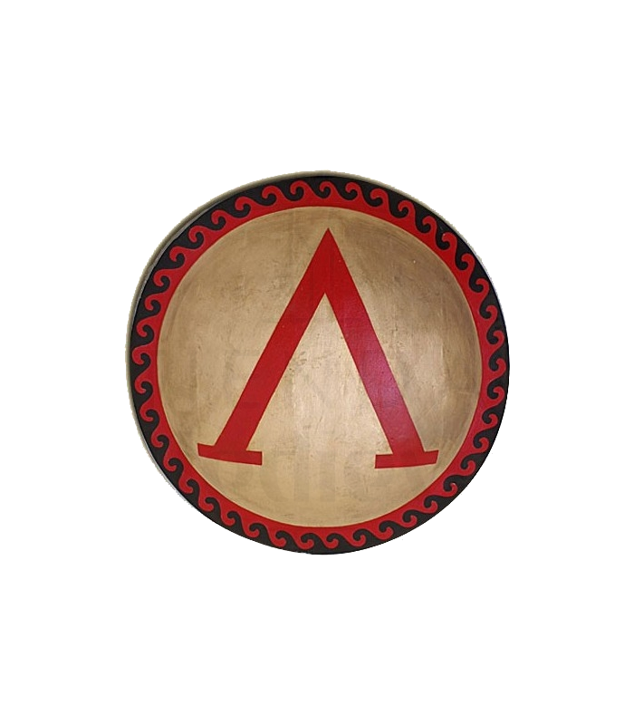
Meet the Spartans
Sparta the capital of Laconia
Spartans often called Lacadaemonians
Rigid, militaristic and hierarchical society
Spartiatae (“Spartan peers”): Trained as warriors from youth, prohibited from following trades, lived communally with the other “peers”. Owned land but slaves farmed it.
Perioikoi (“dwellers about”): Free, owned land, farmed, provided merchants and craftsmen. Communities self-governed but no role in State policy or laws.
Helots (slaves): Original pre-Dorian Invasion inhabitants. Slaves with no legal rights.

Slide 13
Meet the Spartans
At their peak, the best soldiers in Greece.
Never very numerous, however.
(very rough estimates for the Classical Era)
6,000 Spartiatae, plus 15-20,000 dependents
This number steadily declined over time. 5,000 at Plataea.
10-15,000 adult male Perioikoi, plus 25-50,000 dependents
Hoplites not as capable as the Spartiates, but still pretty good.
40,000 adult male Helots, plus 100-150,000 dependents
(During large mobilizations, Spartiatae each took seven Helots with them, mostly to get them out of the country while the army was away.)
The army in the field almost always consisted of a mix of Spartiatae and Perioikoi. (50/50 at Plataea)
Sparta relied on bluff and diplomacy as much as possible.
Tried to avoid fighting repeated wars against the same state, so as not to “teach them the Spartan way of war.”

Slide 14
Meet the Spartans
Government in the hands of the Spartiates
Two hereditary kings led the army in wartime
Five Ephors, elected annually, senior magisrates and ran government on day-to-day basis.
Gerousai consisted of 28 elders (over sixty) and the two kings. Introduced legislation to the Assembly.
Ekklesia (Assembly) of all male Spartiates at least 30 years old. Accepted or rejected proposed laws, decided on peace and war, elected 5 ephors, decided questions of royal succession.
Despite democratic-seeming institutions, Sparta was an oligarchy, with the government entirely in the hands of about 2% of the population (the male Spartiates).

Slide 15
Meet the Spartans
Spartan Women
Only women in Greece educated at state expense. All of them were literate and numerate. Also participated in sports.
Plato commented favorably on their ability to discuss philosophy
Marriage not allowed until girls were in their late teens or early twenties
Unlike other Greek cities, where marriage was common for early teens
Avoided health complications from early adolescent pregnancies, resulted in a much longer life span.
Spartiatae women controlled most estates and could inherit property directly. By the end of the Classical era, an estimated 35% of all Spartan land was owned exclusively by women.
Queen Gorgo was asked, “Why is it that only Spartan women can rule their men?”

Slide 16
Meet the Spartans
She answered,
“Because only Spartan women give birth to men.”
(Lena Heady as Queen Gorgo in “300”)

Slide 17
Meet the Spartans
The Core Problem: Fewer and Fewer Spartans
War casualties and late marriage meant Spartiatae sometimes died without a male heir
Increased commercialism undermined farm income, reduced some of the Spartiates class to poverty
If could not pay mess dues, removed from citizen roles, became legal equivalent of perioikoi
No legal way to create new Spartiatae
Late in the period, emergencies forced the State to free some Helots to fight as warriors and elevate some free non-citizens to citizenship
Proposals for structural changes to the society to permanently increase the citizen rolls usually resulted in execution
By the end of the Classical Period, Sparta was reduced to a second-rate power. The number of Spartiatae had dropped to about 2,500 and the Spartan Army had lost its reputation for invincibility.
But that came later.

Slide 18
Meet the Spartans . . . And Their Friends
The Peloponnesian League
The formal name for “The Spartans and their Allies”
After several Spartan wars with Argos, most cities in the Peloponnesus (except Argos and Achaea) joined the Spartan alliance.
No formal or permanent institutions of the League. Network of bilateral alliances which required states to send troops to assist the Spartans wage war.
..

Slide 19
And the Athenian Alliance—Delian League
Formed 478 BCE in the wake of the defeat of Xerxes’ invasion army.
Considered a means of further punishing the Persians by the members, but formally was against “all enemies.”
Members contributed ships or tribute. First Greek alliance to assess cash tribute.
Local self-rule but Athenian war leadership, supported by cash tribute: clearly inspired by Darius’s organization of Persian Empire.
By the start of the Peloponnesian Wars, the League was commonly called “The Athenian Empire.”
In modern terms, Athens was “mirror imaging” its principal opponent.
..

Slide 20
Greece and Persia The War that Created History
Questions?

Slide 21
Pentecontaetia (480-431 BCE)
Timeline (Part 1)
479: Began rebuilding Athens
478: Formation of Delian League
469: Battle of the Eurymedon
468: Revolt of Naxos from Delian League
465: Xerxes assassinated, succeeded by Artaxerxes I
465: Revolt of Thasos from Delian League
Earthquake and helot rebellion occupies Sparta
461: Athenian assistance refused by Sparta
Rise of Pericles in Athens
460: Athens aids Egyptian revolt (disaster, lost 250 ships, 50,000 men)
459: Beginning of First Peloponnesian War (lasts until 445 BCE)
458: Athens constructs “Long Walls”
458-456: Fighting between Athens and Sparta in Boeotia
450: Battle of Cypriote Salamis
449: Peace of Callias ends Persian War

Slide 22
The Age of Pericles (461-429 BCE)
Eloquent orator and successful Athenian politician.
Aristocratic credentials but championed the popular party.
Use the revenues of the Delian League to enrich Athens and its citizens. Oversaw massive rebuilding effort which included the Parthenon and most of the new Acropolis.
Made Athens the Greek epicenter of the arts and learning.
Transitioned Delian League to Athenian Empire, and unashamedly called on the Athenian people to act as an imperial power. Might makes right.
Was simultaneously the architect of the Athenian Golden Age and the embodiment of Athenian Hubris.

Slide 23
Athens’ Long Walls
Linked Athens city to ports of Piraeus and Phaleron
Enabled Athens to withstand a land siege, so long as it controlled the seas.
Clearly intended to enable Athens to fight a war against Sparta, and Sparta understood that immediately.

Slide 24
Pentecontaetia (480-431 BCE)
Timeline (Continued)
446: Spartan invasion of Attica,
445: Athens and Sparta agree to “Thirty Year Truce”
(Nehemiah begins mission to Jerusalem)
441: Revolt in Samos
432: Revolt in Potidaea, backed by Spartans, Corinthians, Macedonians. Athens besieges city (eventually victorious in 430)
432: Megarian Decree--Athens passed law refusing to allow Megara to use Athenian markets and harbors. Megarians demand repeal of decree. Sparta backs Megara. Athens refuses
431: War with Peloponnesian League headed by Sparta (Archidamian War)
430: (approximately) Torah compiled by Ezra in Jersualem

Slide 25
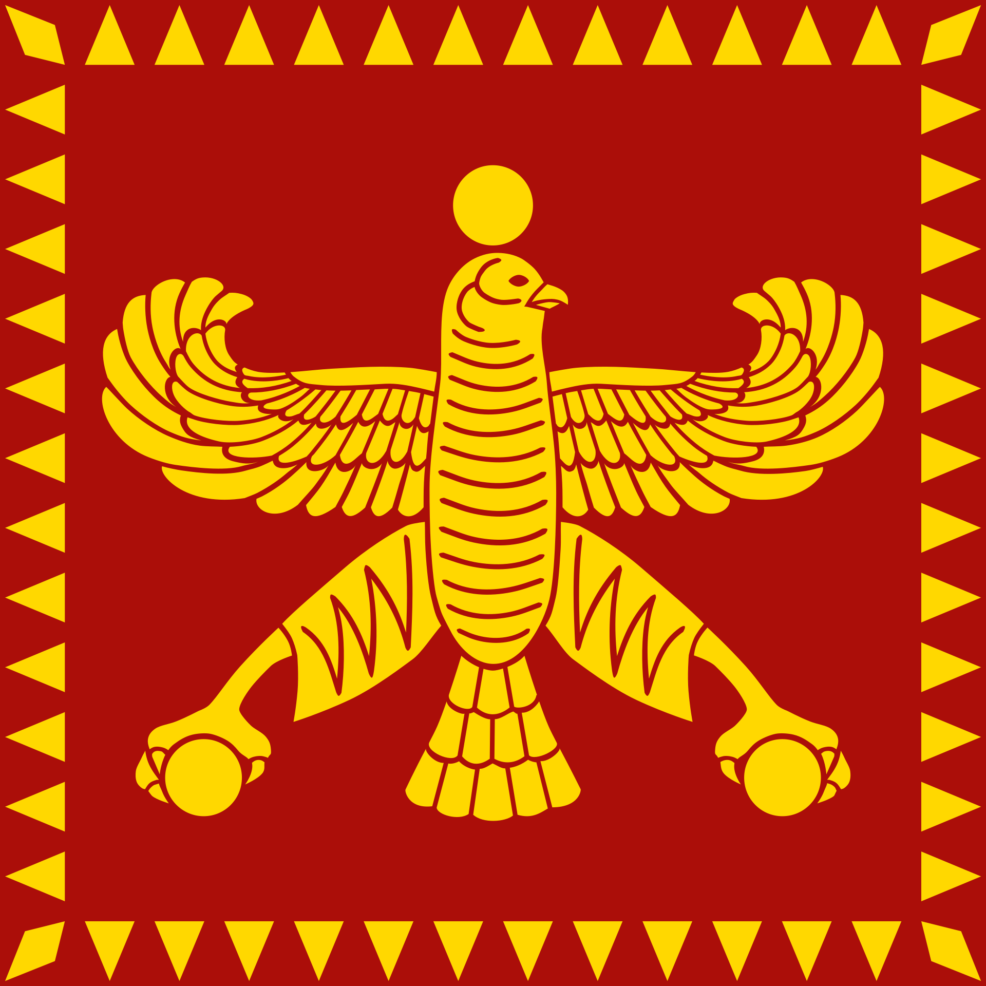
Meanwhile in Persia (480-431 BCE)
465: Xerxes assassinated, succeeded by Artaxerxes I
460-454: Egyptian revolt in Nile Delta, ends with defeat of Athenian expedition, execution of rebel leader.
Begins a forty-year period of peace, calm, and prosperity in Persia.
458: Ezra (a scribe versed in the Law of Moses) begins mission to Jerusalem
Sent to rebuild temple and conduct lavish sacrifices
Appoint magistrates and administer justice. Laws of Moses placed under protection of the king.
May begin compiling Torah at about this time
445: Nehemiah begins mission to Jerusalem
Rebuild city walls and temple walls, secure the city defenses, insure public order
430: Nehemiah returns to Jerusalem to strengthen political and social order, regularize tribute payments
Torah compiled by Ezra in Jerusalem about the same time

Slide 26
The Archidamion War (431-421 BCE)
Named for Spartan King Archidamus II
Spartan reaction to Athens’ attempt to break the economies of Megara and Corinth, Sparta’s two larges allies.

Slide 27
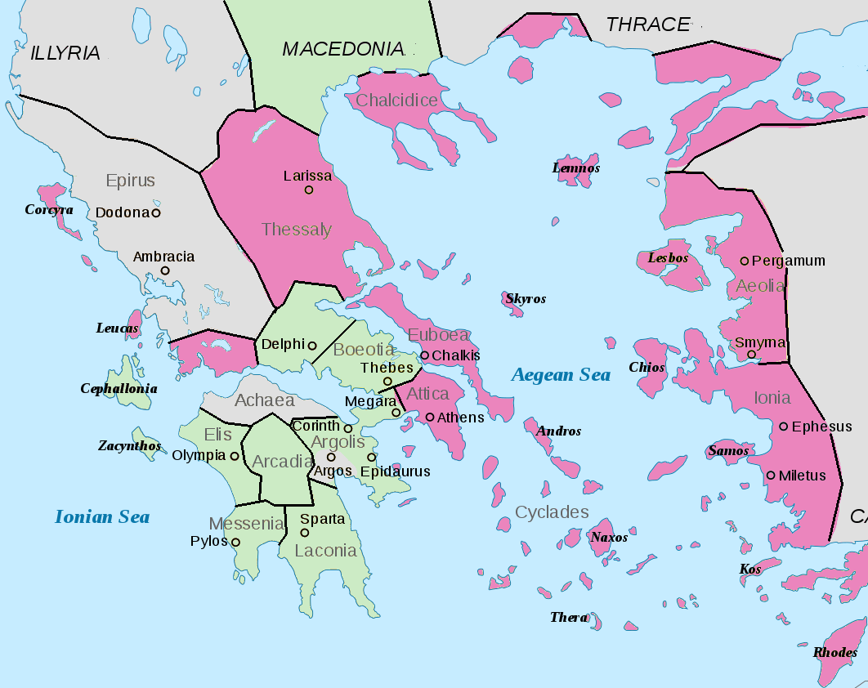
The Archidamion War (431-421 BCE)
The Alliances at the Start of War
Delian League: Pink
Peloponnesian League: Green
Neutral: Gray

Slide 28
The Archidamion War (431-421 BCE)
Sparta had no fleet but relied on that of Corinth. If Corinthian power broken, Sparta defenseless against seaborne attack.
Sparta asked Athens to repeal the Megaran Decree.
Hubris: Athens answered that to do so would be to give Sparta the power to dictate to Athens.
Translation: “You’re not the boss of me!”
Sparta and its allies declared war. (431)
Nemesis: Spartan army invaded and immediately overran most of Attica. The Athenian rural population displaced into the walled city of Athens. Overcrowding soon led to disease, and then the plague.

Slide 29
The Athenian Plague (430-429 BCE))
Athenian Plague (430-429)
Came by sea simultaneously throughout the Aegean, but not as virulently as in Athens
Documented symptoms fit a number of diseases, but no one disease has all of them
Current thinking leans toward a near-simultaneous outbreak of three diseases: typhoid, typhus, and some form of viral hemorrhagic fever.

Slide 30
The Athenian Plague (430-429 BCE)
Physical toll of the Plague
30,000 male citizens (soldiers and sailors died), including Pericles
About 1/3 of total population of Attica died, at least 100,000

Slide 31
The Athenian Plague (430-429 BCE)
Psychological Impact of the Plague
“The catastrophe was so overwhelming that men, not knowing what would happen next to them, became indifferent to every rule of religion or law.”— Thucydides,
Religious doubt (transactional nature)
Why were the pious and the impious swept away with the same scythe?
Contempt for the law
Already under a death sentence, so what can the law do?
Abandonment of responsibility
Disease was highly contagious, especially by physical contact. Sick abandoned without care, dead thrown into mass graves without funerals.

Slide 32
The Archidamion War (431-421 BCE)
Somehow, Athens endured through the plague and continued to fight the war.
Only the resources of the Delian League allow them to survive.
Terribly weakened by the plague, Athens could not directly oppose the Peloponnesian League’s armies.
Instead, in 429 BCE began a policy of aggressive raids along Spartan frontiers, mostly using the fleet to land raiding parties on the coasts and offshore islands.

Slide 33
The Archidamion War (431-421 BCE)
Battle of Sphacteria 425 BCE
Athenians trapped a unit of 400 Spartan hoplites on the island of Sphacteria
Outnumbered Spartans cornered on island and harassed by light missile troops. Survivors surrendered
292 prisoners, of which 120 were Spartiates
Turned the war’s tide in Athens’ favor. Athens promised to execute prisoners if Sparta again invaded Attica.
Sparta did not invade that year. First time since the start of the war Athenian farmers could tend their land.

Slide 34
The Archidamion War (431-421 BCE)
One year later (424 BCE) Spartans captured Amphipolis in Thrace, source of much Athenian silver, essential to prosecuting war.
Athenians tried to recapture it in 422 BCE, failed.
Peace of Nicias (421 BCE). Athenians traded Spartan prisoners for return of Amphipolis. Both sides agree to a “Fifty Year Peace.”
Terms of peace favorable to Athens, but violated immediately when Amphipolis not returned. Both sides now treated this period as a short truce, not a true peace.
By 418 Athens and Sparta were again briefly at war in Peloponnesus over Mantinea.

Slide 35
Meanwhile in Persia (431-421 BCE)
431-424: Calm
424 Artaxerxes I died, brief period of civil war (about six months in 424-3)
423 Darius II “Ochus” secured throne
Given name was Ochus, but took Darius as a throne name
Illegitimate son of Artaxerxes (i.e. son by concubine, not wife)
Brief revolt in Asia Minor, quickly put down by the new king.
Other than that, fairly peaceful decade

Slide 36
Greece and Persia The War that Created History
Still to come
Athenian expedition to Syracuse (in Sicily) (415-13 BCE)
“The Second War” (413-404 BCE) (Peloponnesian War Part 2)
Excursus: The Strange Career of Alcibiades
Meanwhile . . . Changes in Philosophy, Drama, Religion
Question Break

Slide 37
The Sicilian Expedition (415-13 BCE)
Why Syracuse?
The most populous, prosperous, and powerful Greek polis outside of Greece, and friendly to Sparta.
Segesta, an Athenian ally requested help in resisting Syracusan aggression (and offered to pay for the war).
Hubris: But an important additional reason was that Syracuse was rich. Athens had grown used to taking by force whatever they desired.

Slide 38
The Sicilian Expedition (415-13 BCE)
Expedition Strength
5,100 hoplites (2,200 Athenian)
1,300 light troops
26,000 sailors (apprx.)
134 triremes (100 Athenian)
130 supply ships and transports

Slide 39
The Sicilian Expedition (415-13 BCE)
Leaders of the Athenian Expedition
Alcibiades
Young rising aristocrat, advocate of war with Sparta.
Advocated careful strategy in Sicily of first gathering allies, then attacking Syracuse.
Nicias
Opposed Sicilian expedition. Elected general against his wishes, perhaps as a moderating influence.
Advocated very limited expedition to settle Segesta’s immediate problems, then return home.
Lamachus
Experienced and courageous general, but poor and not from the aristocracy. Limited his influence.
Advocated immediate all-out attack on Syracuse before they had time to prepare their defenses. Broke the three-way standoff by supporting Alcibiades’ strategy.

Slide 40
The Expedition to Syracuse (415 BCE)
Alcibiades recalled while en route to Sicily to stand trial for sacrilege. Lamachus left in overall command, but committed to Alcibiades’ strategy.
Athenians failed to find other allies in Italy or Sicily, and Segesta could not pay for the war after all.
After some initial maneuvering around Catania, the Athenians re-boarded their ships and sailed directly into Syracuse harbor.
Athenians won battle fought outside wall of Syracuse, but bulk of Syracuse army retreated into the walled city. Athenians returned to Catania to spend the winter.
Wrote home for reinforcements and cash.

Slide 41
The Expedition to Syracuse (414 BCE)
Over the winter, both sides tried to gain more allies. Mostly unsuccessful, but Sparta promised to send Syracuse help.
In the Spring reinforcements of cavalry and cash arrived from Athens. Athenians returned to Syracuse in the spring 414 BCE, landed in harbor, and began siege works around Syracuse. Syracuse built counter walls and in confused fighting Lamachus died. Nicias then in sole command.
Spartan general Gylippus arrived with about 3,000 fresh troops, drove Athenians back, and completed counter wall.
Nicias, never enthusiastic and now ill as well, advocated abandoning the expedition and withdrawing.

Slide 42
The Expedition to Syracuse (413 BCE)
Hubris: Withdrawal was unacceptable, because it would mean loss of prestige.
Instead, the next year Athens sent reinforcements under the general Demosthenes.
Reinforcements
5,000 hoplites
3,000 light troops
73 triremes (15,000 sailors)
Immediate Athenian attack resulted in Athenian defeat and heavy losses.
Overcrowding in Athenian camp (located in marshy lowlands) soon caused outbreak of disease.
So . . . time to go home, right? Right!

Slide 43
The Expedition to Syracuse (413 BCE)
But as the Athenians prepared to withdraw, Syracusan fleet attacked and destroyed Athenian fleet.

Slide 44
The Expedition to Syracuse (413 BCE)
Athenians tried to withdraw overland but ambushed in narrow defiles. Retreat turned into a rout, most were cut down.
Only about 7,000 survivors were taken prisoner. Nicias and Demosthenes were both killed after they surrendered.

Slide 45
The Expedition to Syracuse (413 BCE)
NEMESIS
The prisoners were sent to work in the quarries, and many of them died there.
The playwrite Euripides was very popular in Syracuse, so any Athenians who could recite passages of his plays from memory were spared.
The final cost to the Delian League: over 50,000 men (at least half of them Athenians). Coming on top of losses from the plague, Athens never fully recovered.
Two years later the total number of Athenian male citizens of zeugitai (hoplite) class or higher was only 5,000.
And now Sparta resumed all-out war.
"This was the greatest Hellenic victory of any in this war, or, in my opinion, in Hellenic history; at once most glorious to the victors, and most calamitous to the conquered"
-Thucydides

Slide 46
Greece and Persia The War that Created History
Questions?

Slide 47
The “Second” War (413-404 BCE)
“The Second War,” Decelean War, or the Ionian War (or Everything Goes to Hell)
413 BCE: Sparta invaded Attica, captured Decelean (an Attic town) and fortified it. Enabled them to blockade Athens year-round.
Also in 413, Chios (Ionian Greek island member of the Delian League) revolted from Athens. When Sparta reinforced them, the revolt spread to Miletus on the Asian mainland, the largest city in Ionian Greece.
412 BCE: Sparta negotiated treaty with Darius II of Persia. Persia would pay for the Spartan fleet in return for a free hand in Asia Minor.
Also in 412, City of Cnidus in Caria defected from Athens directly to Persia.

Slide 48
The “Second” War (413-404 BCE)—The Coup
Enormous losses, strategic reverses, and crushing financial problems produce widespread dissatisfaction with Athenian government.
Secret groups of anti-democratic aristocrats and followers formed secret clubs called hetairai (companions)
411 BCE: Coup in Athens replaced democracy with oligarchy. Placed power in the hands of “The 400,” representing the richest of the aristocracy.
Hetairai came at night, murdered the leaders of the popular party and anyone who spoke against The 400. Populace cowed into acceptance.

Slide 49
The “Second” War (413-404 BCE)—The Coup
Response to the Coup
Cities along Hellespont revolted, threatening grain supply from the Black Sea.
Spartans landed an army on Euboea, where Athens had moved its herds of cattle.
Athenian Navy (at Samos in Asia) proclaimed itself “the demos.” Said they had not revolted from the government, the government revolted from them. Elected pro-democracy Thrasybulus their admiral. ➔
Original oligarchy collapsed, replaced by “moderate” oligarchy, “The 5000” (meaning every citizen of hoplite status or higher).
Within a year democracy back in power, but Athenian confidence in the durability of democracy badly shaken.

Slide 50
The “Second” War (413-404 BCE)
Hubris: 410 BCE Athens won a major naval battle at Cyzicus (in the Hellespont), destroying the Spartan fleet (which was actually a Corinthian and Syracusan fleet). Sparta offered peace. Athens refused. (“Why quit while we’re ahead?”)
More Hubris: 406 BCE Athens won another major naval battle. Sparta again offered peace. Athens again refused. (“We’ve really got them on the ropes now!”) Sparta began building a new fleet with Persian gold.
405 BCE Athenian Fleet destroyed by Spartan fleet. Spartans began close siege of Athens.
Nemesis: 404 BCE: Athens capitulated, ended Peloponnesian War. Athenian democracy overturned and replaced with the 30 Tyrants, hand-picked by Sparta. They began a rein of terror which in a short period of time killed 5% of Athens’ population.

Slide 51
A Final Comment on Hubris
“Success should always call for showing greater Kindness, Generosity, and Justice; only people lost in the darkness treat it as an occasion for greater greed.”
--Cyrus the Great

Slide 52
Excursus: The Strange Career of Alcibiades
Wealthy, handsome, intelligent, charming, and eloquent aristocrat. Student and lover of Socrates (who once saved his life in battle). Leading advocate of Syracuse expedition.
When charged with sacrilege, fled to Sparta (Athens’ bitter enemy) and gave them military advice in return for sanctuary.
Left Sparta after seducing and impregnating the Spartan queen (while her husband was away) but helped Spartans reinforce the anti-Athenian rebels on Samos.

Slide 53
Excursus: The Strange Career of Alcibiades
Defected to Persia, then offered Athens an alliance with Persia if they would pardon him and get rid of democracy. (No deal.)
Later pardoned and elected admiral, played a heroic part in the Athenian naval victory at Cyzicus, returned to a hero’s welcome in Athens, and elected supreme land and sea commander.
Defeated in next campaign, stripped of offices and again fled to Persia.
Murdered in Persia, either by satrap trying to keep him from contacting the king, or by angry male relatives of a local woman he seduced. (Take your pick.)
So . . . misunderstood charismatic genius, or narcissistic sociopath?

Slide 54
Meanwhile in Persia (421-404 BCE)
411 revolt in Egypt by Amyrtaeus. Contained in western Nile Delta and peaceful settlement negotiated.
408 Darius II decided to ally with Sparta and continue the war with Athens. Sent son Cyrus to Asia Minor as satrap and ambassador
405 Darius II died, succeeded by Artaxerxes II “The Mindful” (Mnemon in Greek, Abiataka in Persian)
404 renewed revolt in Egypt by Amyrtaeus gained Egyptian independence for the next 60 years
Last period of Egyptian self-rule until modern times

Slide 55
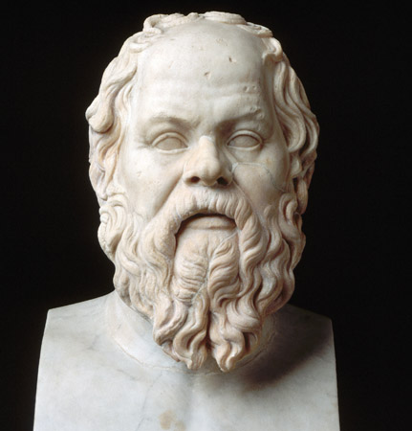
Meanwhile, in Philosophy . . .
Socrates: The first great western philosopher whose wisdom still reaches us across the millennia. Arguably the first of the “moral” philosophers, concerned not at all with the natural world, but only the inner, ethical world of man.
Philosophy becoming recognizable as philosophy in the modern sense: examination of personal and societal values—how to live a good life.
Greeks universally considered Socrates an ugly man. (They wouldn’t have thought much of Santa Claus.)

Slide 56
Meanwhile, in Philosophy . . .
Of humble origin (son of a stone mason and a midwife), but also anti-democratic, and spent much of his time currying favor from aristocrats (such as Alcibiades). Was never harmed or threatened in any of the oligarchist purges.
Saved Alcibiades’ life, Battle of Potidaea.➔
Since he wrote nothing, we know his thoughts only from those who wrote about him, principally Plato. But as Plato was obsessed with the notion of “ideal types,” it’s likely he idealized Socrates, remaking him as the perfect philosopher.
Xenophon, another of his students, paints him as earthier and much more likeable.

Slide 57
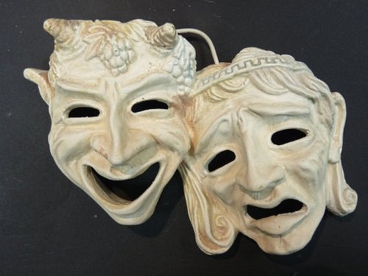
Drama
Sophocles added third actor to tragedy and employed changeable painted scenery.
Plays in this period became darker in theme and began asking more troubling questions.
Oedipus the King (Sophocles) dealt (in part) with a Theban plague and its effect on Oedipus, echoing the effects of the Athenian plague.
While plays by Sophocles and Euripides in this period made frequent references to disease and poison, the word loimos (plague) disappeared entirely from the vocabulary of tragedies, as if the word itself had become “inauspicious.”

Slide 58
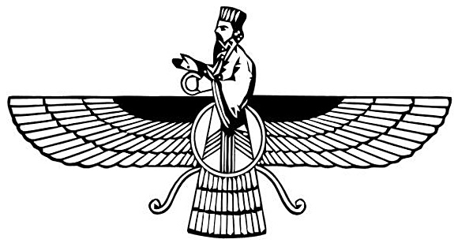
Religion
Stark contrast between Zoroastrianism (spiritualism) and the religion of Greece (materialism) becoming clearer.
Growing emphasis in Zoroastrianism of the primacy, and possible exclusivity, of Ahura Mazda as creator god.
Purpose of life is to live authentically; live the Truth and reject the Lie.
People have Free Will and choose their own life path
Body is mortal, soul immortal. The ultimate reward for virtue (and punishment for evil) comes in life everlasting.
Transactional materialistic “covenant” of Greek religion severely shaken by the Athenian Plague and growing evidence that piety or impiety in this world did not seem to have a noticeable effect on material outcomes.
Growing sense that if people want their lives to be better, they have to make them better themselves, not rely on the gods.

Slide 59
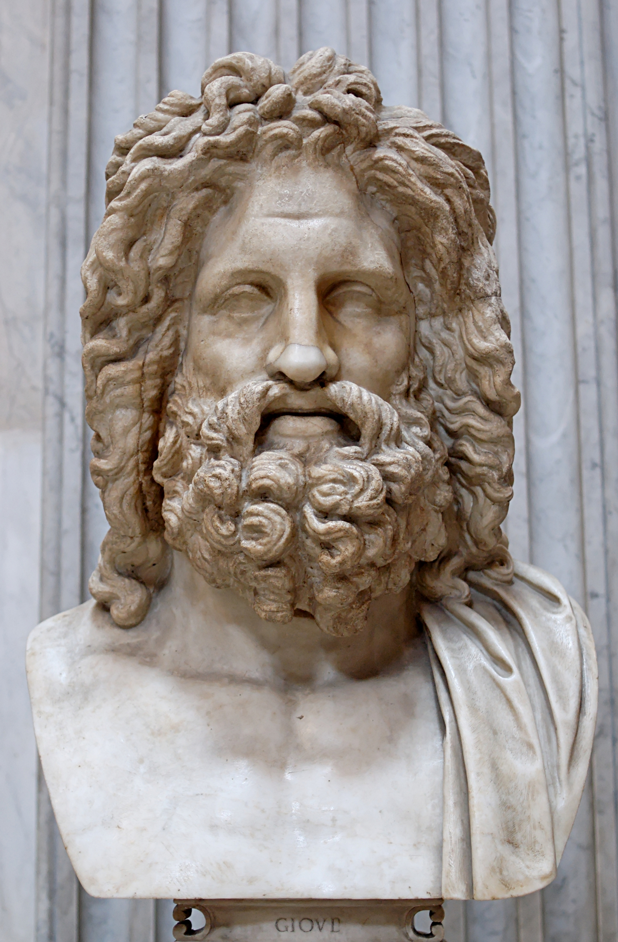
Religion
Increasing consideration in Greek philosophy of the notion that there may only be one god, and that the road to a happy life might be the road of virtue instead of material gain.
Origin of Virtue Ethics. (see philosophy above, but beginning to touch on religion as well.)

Slide 60
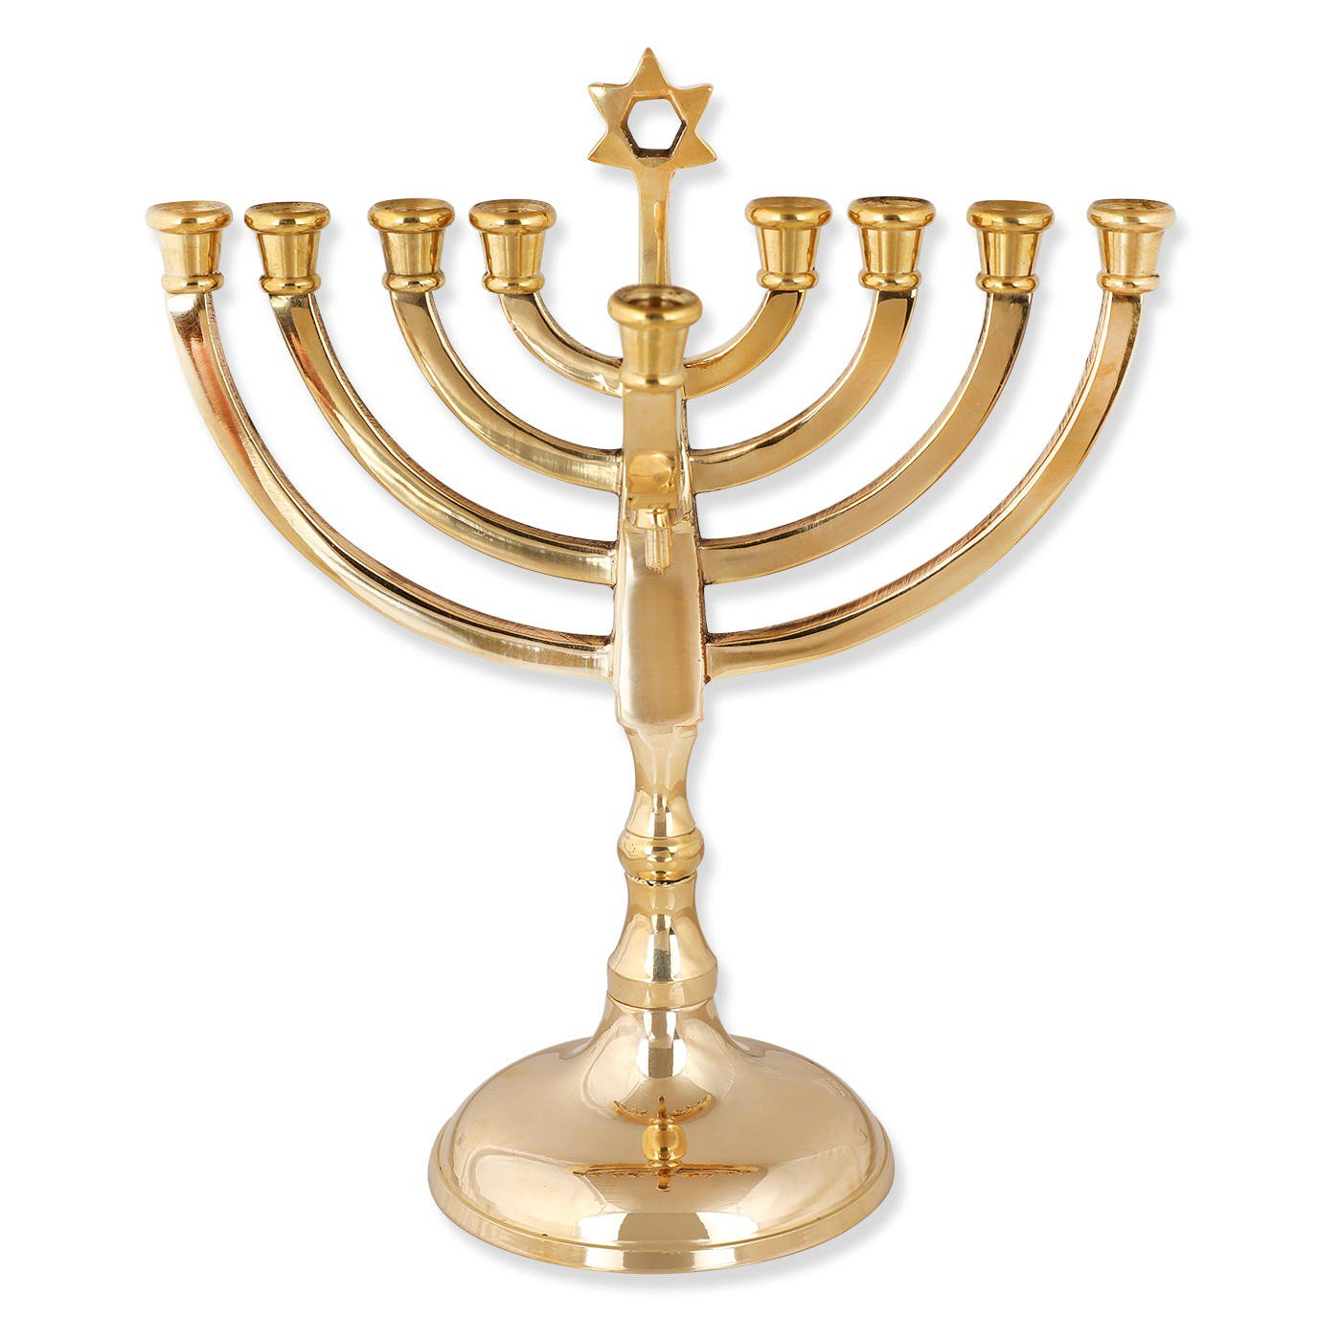
Religion
Torah most likely compiled in the period following the reestablishment of the Temple, traditionally by Ezra between 445 and 430 BCE. (Scholarly consensus is between 450 and 350 BCE)
Compilation and editing influenced by Zoroastrianism.
“Most scholars, Jewish as well as non-Jewish, are of the opinion that Judaism was strongly influenced by Zoroastrianism in views relating to angelology and demonology, and probably also in the doctrine of the resurrection, as well as in eschatological ideas in general, and also that the monotheistic conception of Yhwh may have been quickened and strengthened by being opposed to the dualism or quasi-monotheism of the Persians."
--Kaufmann Kohler & A. V. W. Jackson, The Jewish Encyclopedia, 1904

Slide 61
Greece and Persia The War that Created History
Questions?

Slide 62
Next Week: (Week 7) The King’s “Peace”
Greece Consumed by Endless War
The death throes of Classical Greece
The rise of Macedon

