Slide 1
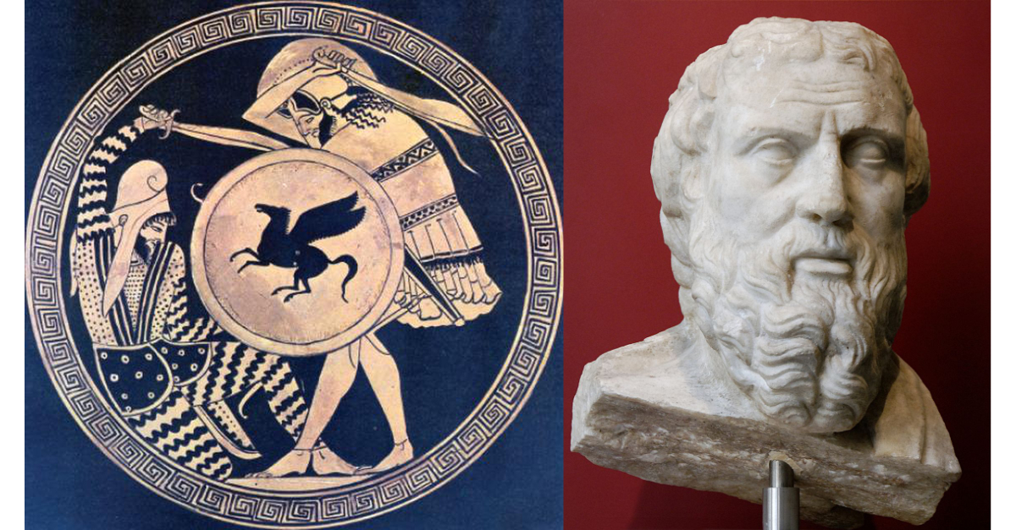
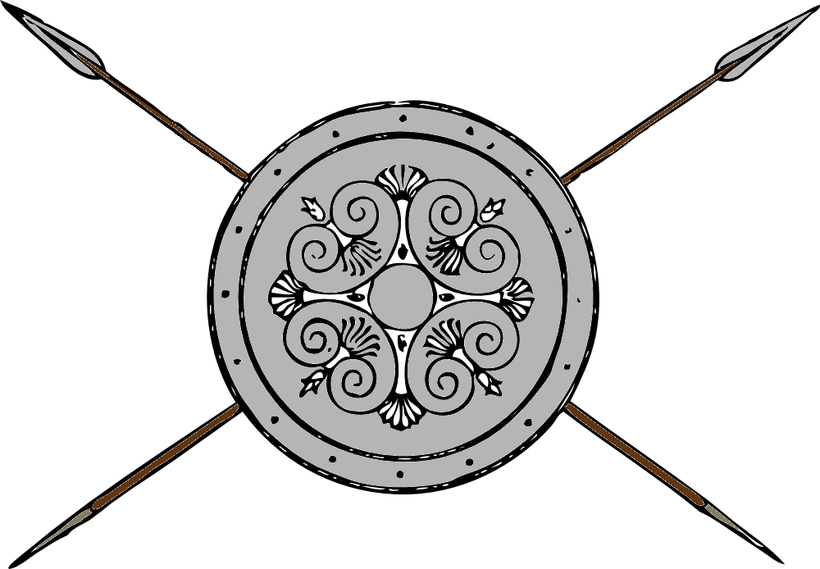
Greece and Persia The war that Created History
OLLI Fall 2022
Week 5: The Great Invasion

Slide 2
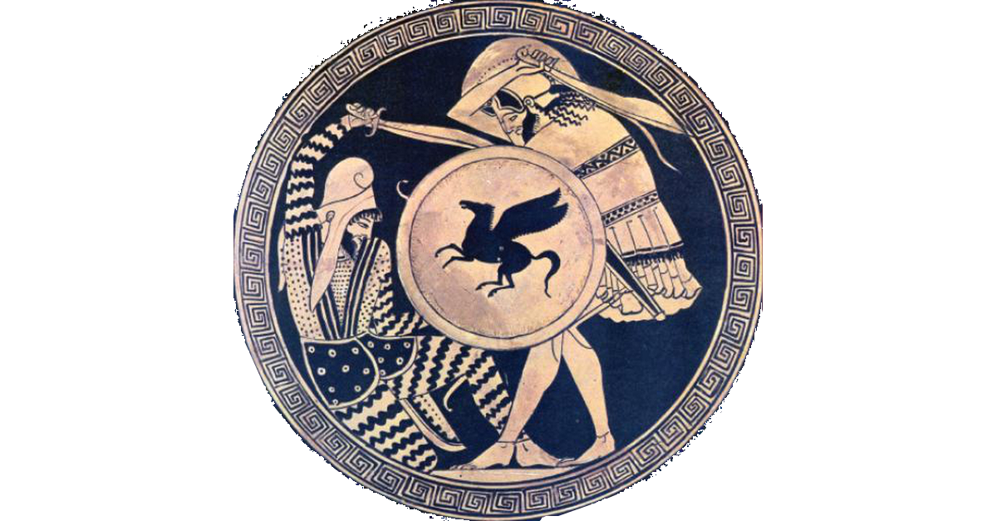
Course Overview
Week 1: The Story, and its sources
Week 2: The Greeks—Who they were and why we should care
Week 3: The Persians—Who were they, and should we care?
Week 4: When The Mede Came—From Cyrus to Darius
Week 5: The Great Invasion—The Stunning Greek Victory
Week 6: The Victors Fall Out—The Peloponnesian Wars
Week 7: The King’s “Peace”—An Ancient Cold War
Week 8: Alexander the Demon—Conquest of the Empire

Slide 3
But First, Some Pronunciation Questions
“Why do you pronounce it Da-RYE-us instead of DARE-ee-us?”
This is closer to the original Persian name--Dārayava(h)uš (pronounced Da-RYE-uh-va-hoosh) which means “holding all that is good.”)
The Persian version of Xerxes is Xšayaṛša (pronounced Khash-a-yar-shah). which means “regal” or “king.”
The Persian version of Great King (King of Kings) is Xšāyaθiya Xšāyaθiyānām. We’ll stick with king or shah.
“Why did you pronounce Cappadocia Kappadokia?”
Oh . . . don’t get me started.

Slide 4
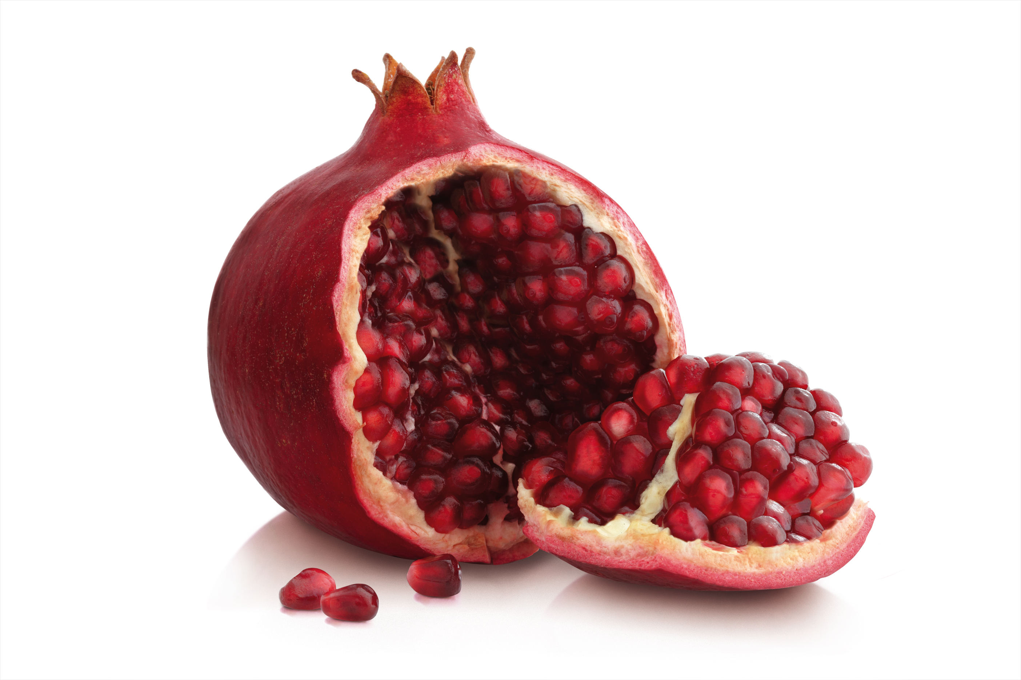
And Some Notes on Apples and Pomegranates
Apple
Greek: milo, melon (tree fruit in general)
Modern Persian: sab
Symbolism of Apple
Ancient Israel: Knowledge, temptation
Greece: immortality (Garden of Hesperides)
Pomegranate
Greek: ródi
Modern Persian: anar
Symbolism of the Pomegranite
Egypt, Persia, ancient Israel: Fertility, Abundance (by extension immortality)
Greece: Death (Myth of Persephone, seven pomegranate seeds)

Slide 5
And a picture of earthworks in a siege
A sloping earthen ramp (or siege terrace) build up to the wall enables the besiegers to push wooden towers up the wall.
Archers can fire down on the wall defenders and then ramps from the towers let attackers move quickly onto the wall.
Long sheds allow attackers to move under cover up to the towers.

Slide 6
And on Persian Gardening
Persian formal gardens were lush, beautiful preserves for the trees, flowers, and plants found in a region.
Their word for enclosed garden (pairi-daeza) is the origin of our word paradise.
Every Persian satrapy had at least one paradise. Some larger ones also served as game preserves.

Slide 7
Persian Gardening
The Persian Gardens of Cyrus at Pasargardae
mathematically based geometric designs.
sophisticated irrigation system featuring 900 meters of stone water-channels and open ditches which channeled water into small basins every 15 meters in the garden.

Slide 8
Persian Gardening
Persian enclosed gardens with integrated water features inspired formal gardens around the world, including those at the palace at Versailles.

Slide 9
The Great Invasion, and its Aftermath
Athens and Persia after Marathon
Xerxes’s Army—How Big Was It Really?
Xerxes’s Invasion (480-479 BCE)
Delian League Wars (478-449 BCE)
Peace of Callias ends Persian War (449 BCE)

Slide 10
Athens—What Came Next?
489: Miltiades (Athenian commander at Marathon) wounded leading unsuccessful expedition, accused of treason and condemned to death. Sentence converted to stiff fine, but died of wounds.
Renewed struggles between zeugites (hoplite class) and popular party for dominance.
483: Rich vein of silver discovered in Athenian mines.
Rising politician named Themistocles argues for using the money to build a fleet of 200 ships.
Aristides (a leading zeugite) argues against it. Ostracism of 482 becomes a referendum on the fleet. Aristides loses.
Fleet of 100 ships built first, then soon an additional 100 added.
Athens’ “wooden walls”

Slide 11
Persia—What Came Next?
Darius’s new policy—not enough to punish Athens (and Sparta), have to subdue Greece, one way or another
486: Egyptian revolt distracts Darius. Dies while preparing to march on Egypt.
Xerxes becomes king, puts down Egyptian revolt.
Returns to preparation to subdue Greece
Win over as many Greek states as possible as allied/client states using diplomacy.
Militarily defeat those who would not offer earth and water.

Slide 12
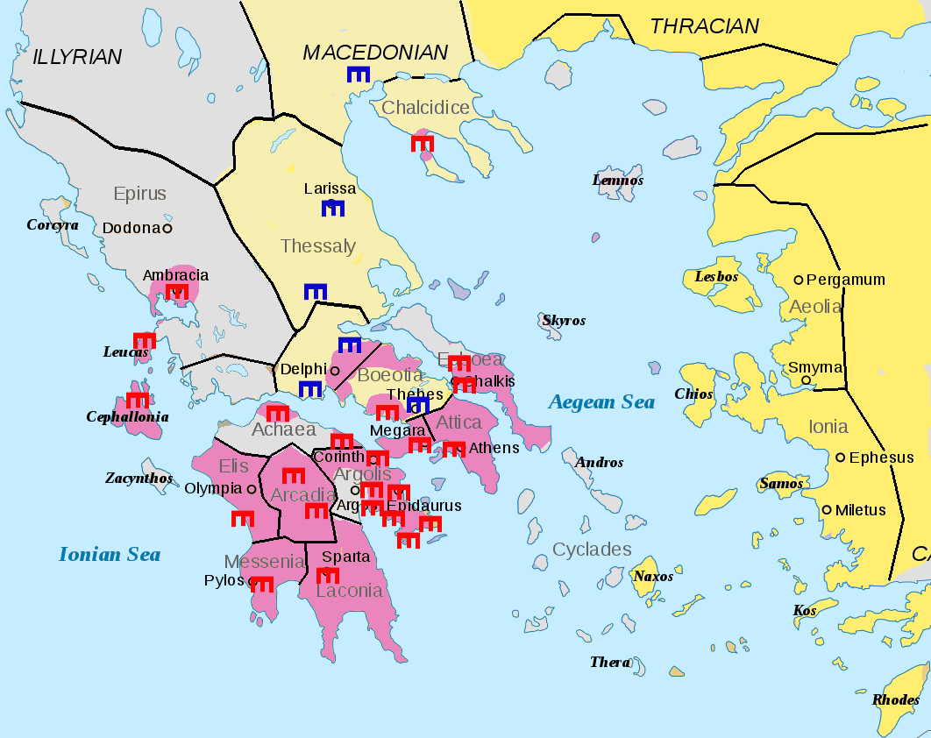
Xerxes-Diplomatic Preparations
Demand Earth and Water from all the Greek city-states (except Athens and Sparta)
Athens and Sparta had killed the last Persian ambassadors sent to them.
Most Central and Northern Greek cities submit (but not all right away)
Dark Yellow: Persian-controlled lands
Light Yellow: “Medizing” Greeks (those who gave earth and water to the king)
Purple/Pink: Anti-Persian Greek States
Gray: Neutral
Icons show cities which sent troops to fight (Red with Allies, Blue with Persia)

Slide 13
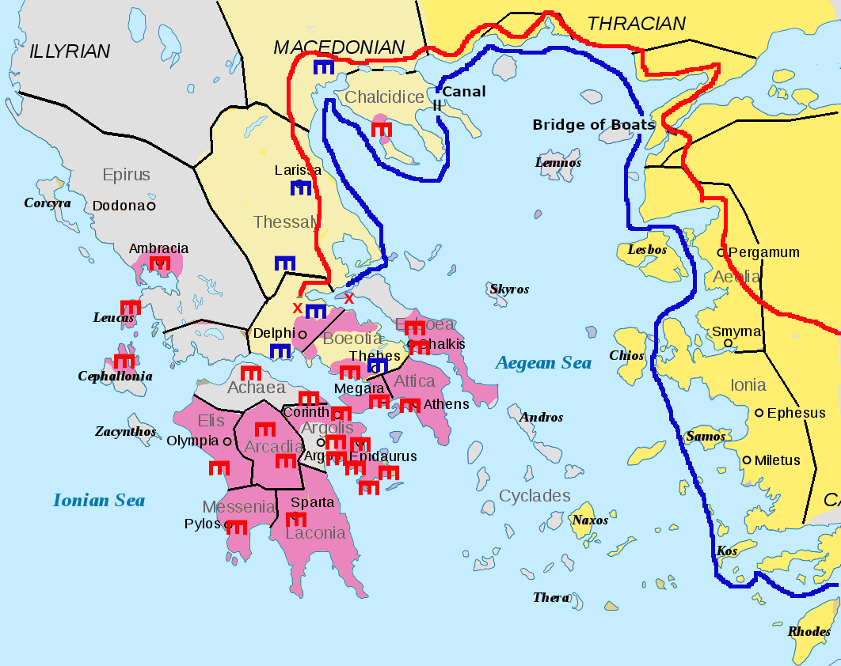
Xerxes-Preparations
Logistics
Gather boats to bridge the Hellespont
Collect fleet, including supply ships
Dig canal to bypass Cape Athos
length two km, width 30 meters, three meters deep.
Red shows land route (army)
Blue show sea route (navy)
“X” indicates progress halted (temporarily) by battles
Thermopylae (land)
Artemisium (sea)

Slide 14
Xerxes Army of Invasion—How Big Really?
The Persian Host as Enumerated by Herodotus
Persians
1,700,000 infantry
80,000 cavalry
20,000 camelry
517,610 sailor and marines
2,317,610 male noncombatants
TOTAL: 4,635,220 Persian males
Medizing Greeks and Thracians
300,000 soldiers
24,000 sailors and marines
324,000 male noncombatants
TOTAL: 648,000 Greeks and Thracians
Grand Total: 5,283,220

Slide 15
Some Problems with Herodotus’s Numbers
Column Length
Hans Delbrück calculated that the march column would be 2,000 miles long. When the lead troops reached Thermopylae, the tail of the column would just be leaving Susa in Mesopotamia, and would take another four months to get to Greece.
Even eliminating all Greek and Thracian troops, and the naval forces, and assuming a slightly wider column, the column would still be 1,000 miles long and would have taken two months to cross the bridge of boats

Slide 16
Some Problems with Herodotus’s Numbers
Logistics
Throughout history, supplying armies in the field has been the most demanding technical challenge of waging war.
On average, each soldier needs 2 pounds of food a day and each working horse or other draft animal needs about 10-20 pounds of food, part grain and part bulk fodder. (If they’re working hard, grass isn’t enough.)
Including one pack animal for every ten men, an Army of 5 million men would require 20,000 tons of food each day.
No one managed to put together an army larger than about 60-100,000 soldiers in one place and feed it before the invention of railroads and internal combustion engines.

Slide 17
Some Problems with Herodotus’s Numbers
Demographics
The peak front-line strength of the Red Army in World War 2 was 6.9 million men and women, drawn from a population of 190 million people.
An army of invasion of 4.6 million Persians, drawn from a population of only 14 million people is impossible.
A population of 14 million people in the Persian Empire meant:
7 million males
4-5 million healthy males of military age.
Did they all come along?

Slide 18
Some Problems with Herodotus’s Numbers
Even the Greeks Didn’t Believe It
Ctesias of Cnidu: not more than 800,000 Persian infantry
Isocrates, Athenian orator: 700,000 Persian fighting men total
Thucydides, historian and Athenian general, reports (and apparently agrees with) speech of Hermocrates who claimed Xerxes invasion failed because the Persian army was not larger than that of the united Greeks.
Most modern historians agree with that assessment.

Slide 19
Size of the Navy
Herodotus says 1,200 Persian warships and 3,000 supply ships (total of 4,200 vessels).
Almost certainly a literary device, as 1,200 is the same number of ships the Iliad says the Greeks used to invade Troy.
By comparison, 5,000 total ships were assembled for the Normandy invasion in June of 1944, which was the largest naval armada in modern history.
Few fleets at sea exceded 100-200 ships until the 20th century. (Spanish Armada had 130 ships.)
Modern estimates: a total of 400-600 warships maximum.

Slide 20
Modern Estimates of Xerxes’ Army
Total Numbers: 80,000
The Allied Greeks had about 80,000 men (including light troops) at the climactic Battle of Plataea. Since Thucydides claims the Persian army was no larger than this, 80,000 is a good upward number for the army of invasion.
Asian forces in the invasion (not including Medizing Greeks)
40-50,000 infantry
8-10,000 cavalry
Joined by 20-30,000 Medizing Greeks and Thracians

Slide 21
Invasion--The First Year (480 BCE)
Importance of Thermopylae
The inland mountains make it impossible to bypass with a large army.
Combined Greek Fleet at Artemisium
Keeps Persian navy from by-passing Thermopylae by sea
Spartans having another religious festival
Main army cannot march, but King Leonidas takes his personal bodyguard of 300 picked warriors north to hold Thermopylae.
Joined by 7,000 other hoplites: 4,000 Peloponnesians, 3,000 others (including 400 Thebans)
Note: Thebans still on the fence.

Slide 22
Invasion--The First Year (480 BCE)
Battles of Thermopylae
Greeks held for seven days (three days of battle) until outflanked through the mountains. Most escape, rearguard (including King Leonidas) wiped out.
Battle of Artemisium
Greek fleet holds off part of Persian fleet but retreats when news of the fall of Thermopylae arrives
Thebes sends earth and water to the king, joins the ranks of Medizing Greeks.
Athenian population evacuated to island of Salamis. Persian army marches south and burns Athens.

Slide 23
What were Naval Battles Like?
Triremes (large warships) had 170 rowers, only about 15 marines, so relied on ramming the enemy with a bronze-tipped beak.
Tight formations were very important. Presented only the bow to the enemy—least vulnerable place. But most battles ended in confusion.
Probably not as stately and orderly as this painting suggests.

Slide 24
What were Naval Battles Like?
Probably more like this . . .

Slide 25
Invasion--The First Year (480 BCE)
Sea Battle of Salamis
A few weeks after Thermopylae, the Persian fleet attacks the Greeks.
370 Greek triremes (large warships)
About 450 Persian triremes
Assume 600 initially
About 50 lost at Artimesium
About 200 lost in two storms
About 100 reinforcements from the Medizing Greek islands
Persian ship ranks became confused in the narrow channel
Greeks maintained solid formation. Athenians turned Persian right.
Crushing Greek victory. Persians lost about half their fleet. Greeks lost 40 ships.

Slide 26
Invasion--The First Year (480 BCE)
Result of Salamis: Persia lost command of the sea
Can no longer supply army by sea
Can no longer guarantee security of the bridge of boats at the Hellespont
News of the defeat may encourage rebellion in the other parts of the empire
Xerxes leaves, turns over command to Mardonius
Takes part of the army as an escort
Leaves the best troops with Mardonius to continue the campaign.

Slide 27
Invasion--The Second Year (479 BCE)
Persian forces left under Mardonius in 479 after Xerxes withdrew
After part of the army departed with Xerxes, Mardonius remained with the rest. He constructed a camp near Plataea 2,000 yards square. Based on other known camps and the number of men held, this would hold an army of up to 60-70,000, fewer if a significant number were cavalry.
Modern estimates of his force average 32,000 Asian infantry and 4,000 Asian cavalry, plus 12,000 Medizing Greek infantry and 1,000 Medizing Greek cavalry.
Total: 44,000 infantry, 5,000 cavalry

Slide 28
Invasion--The Second Year (479 BCE)
Stalemate
Mardonius winters in Thessaly, supplied by Medizing Greeks
Dissention in Allied Greek Ranks
Peloponnesians refuse to commit to a land campaign in the north
In response, Athens refuses to commit fleet to joint action
Mardonius negotiates with Athens, offers:
Peace
Self-government
Territorial expansion
Athens refuses
Mardonius marches south.
Burns Athens a second time. Allied Greeks march north.
Armies meet at Plataea in Boeotia.

Slide 29
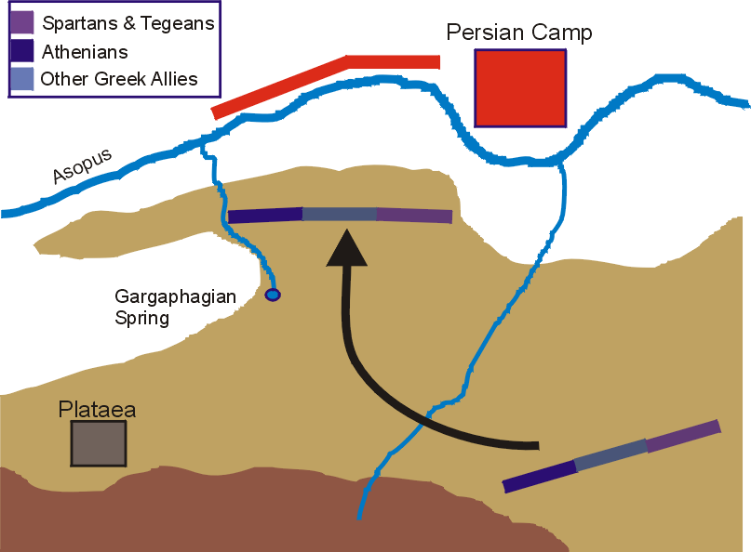
Invasion—Battle of Plataea (479 BCE)
Mardonius camped in open ground north of the Asopus River, where his cavalry would be at an advantage.
The Greeks camped on high ground south of the river. After some initial skirmishes, the Greeks advanced to a ridge overlooking the river.

Slide 30
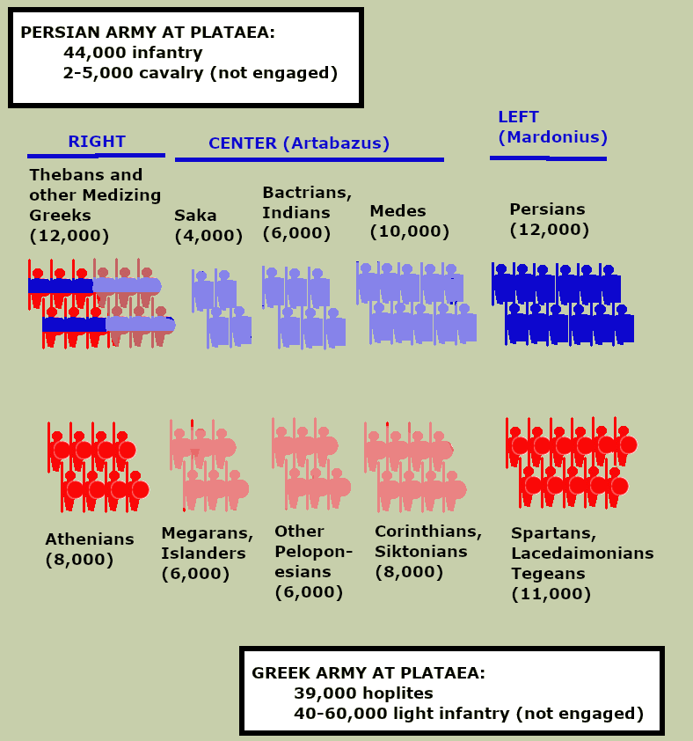
Invasion—Battle of Plataea (479 BCE)
The armies were numerically similar, and both sides deployed their best troops on the flanks.
Each figure represents 1,000 soldiers.
Persians in blue.
Medizing Greeks blue and red.
Greek Allies in red.
Lighter colors indicate less capable troops, although all the Persian troops present were experienced and reliable.

Slide 31
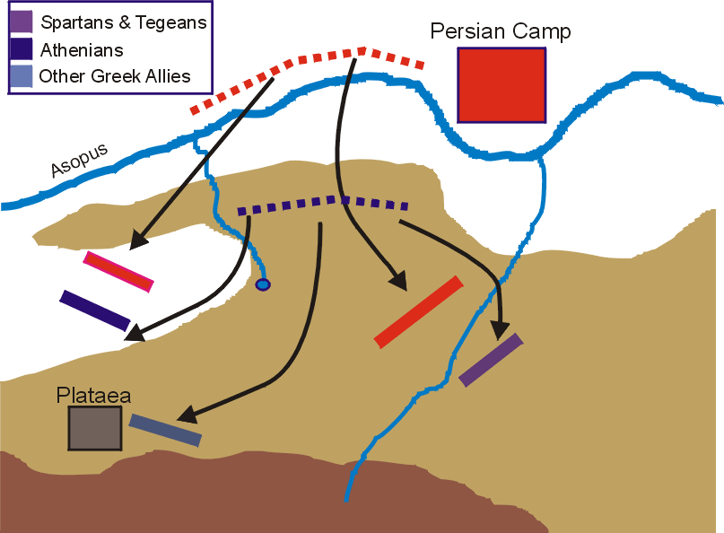
Invasion—Battle of Plataea (479 BCE)
After eight days of facing each other, Persian cavalry raids on the Greek rear cut their supply line.
The Greeks attempted a withdrawal to Plataea under cover of night, but became confused and badly scattered.
Seeing the Greek army in diasarray the next morning, Mardonius ordered an all-out attack.

Slide 32
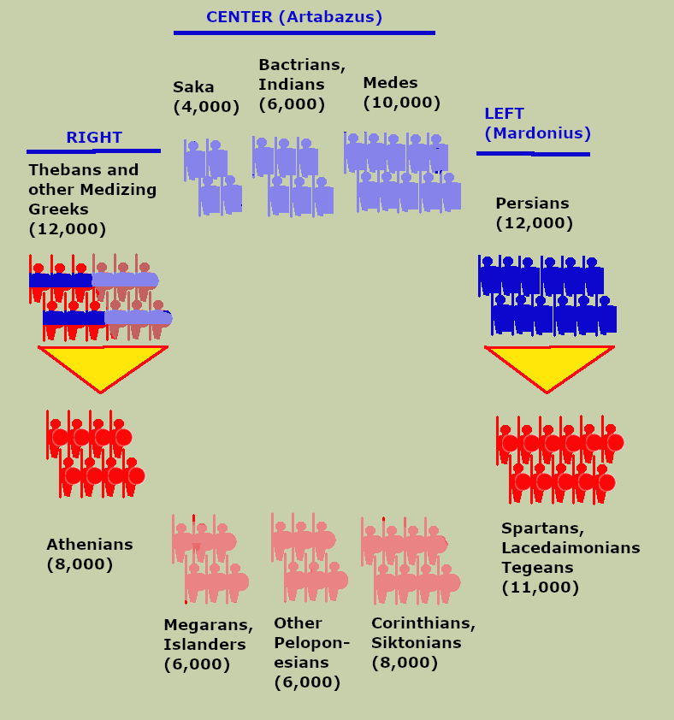
Invasion—Battle of Plataea (479 BCE)
At first only the two wings of the Persian Army advanced, and contacted the two separated wings of the Greeks.
The Persian Guard advanced on the Spartans and the Medizing Greeks (led by the Thebans) advanced on the Athenians.
The centers remained unengaged.

Slide 33
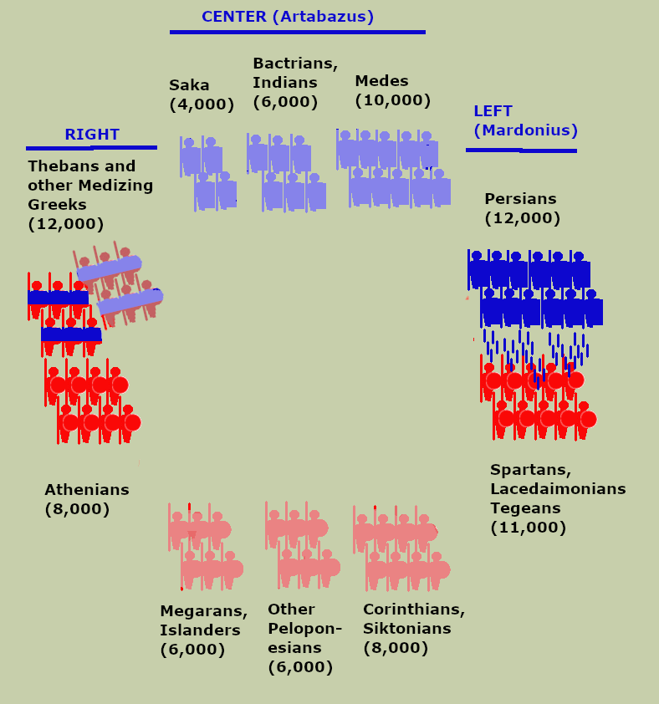
Invasion—Battle of Plataea (479 BCE)
The Athenians and Medizing Greeks came to close quarters. According to Herodotus some of the Medizing Greeks “behaved as cowards,” but the Thebans stood their ground and held off the Athenians.
On the other flank the Persians halted in bow range and began showering the Spartans with arrows. The Spartan commander Pausanias was about to order the charge when the priests present with the army conducted the sacrifice and found the omens bad.
Pausanias asked for a second opinion (ordered another sacrifice).

Slide 34
Invasion—Battle of Plataea (479 BCE)
“. . . but the omens continued to be unfavorable for them. And during all this time, many of them fell to their deaths and many more by far were wounded. . . .(A)s Pausanius concluded his prayer, the Lacedaemonians’ sacrifices yielded favorable omens. Now that this had finally happened, the Lacedaemonians also advanced agains the Persians, who threw down their bows as they confronted them.”
--Herodotus, Histories, IX.9.61-2

Slide 35
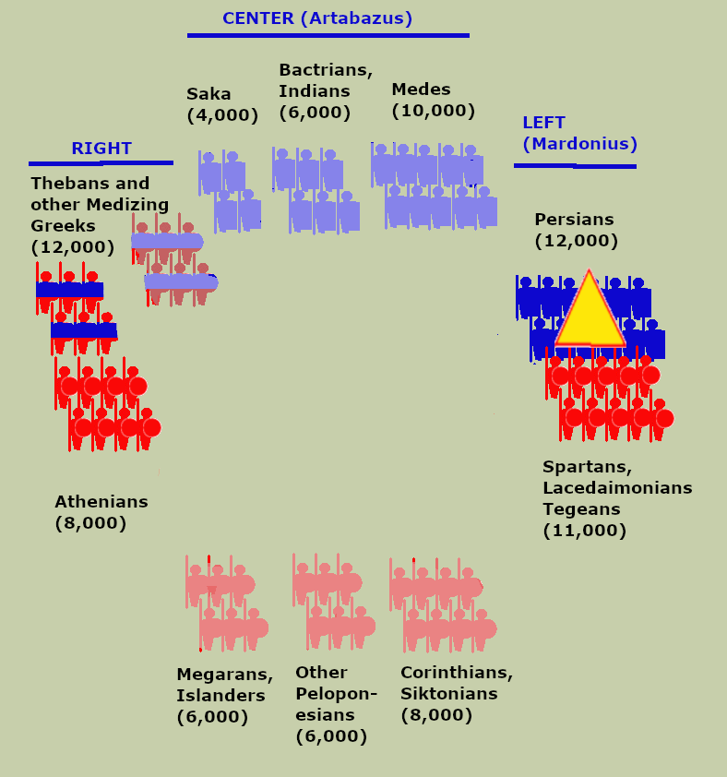
Invasion—Battle of Plataea (479 BCE)
The Spartans Advance
Spartans are more heavily armored than Persian Guard, but Persians stand their ground
Fight continues for some time until Mardonius, at the center of the fighting is killed. Persians then give way and retreat.
The Thebans hold the Athenians until they see the Persian Guard break. Then they retreat in good order.
When the Allied Greeks (Megarans and Islanders) join the pursuit aginst the Theban hoplites, the Theban cavalry attack them and cause heavy casualtiues
Artabazus arrives with the Persian center, sees the Guard broken, and immediately retreats.
Remnants of Persian Guard take refuge in the Persian camp, but are overrun and killed.

Slide 36
Invasion—Battle of Plataea (479 BCE)
Losses
Greek Allies: 159 according to Herodotus (very unlikely). 1,360 hoplites according to Plutarch. Including light troops and casualties suffered in the earlier skirmishes, Greek casualties may have numbered over 10,000, according to Diodorus and Ephorus.
Persians: 9,000 Persian guards (out of 12,000 present), plus about 1,500 Medizing Greeks. Including earlier skirmishes and casualties suffered during the retreat, probably 15-20,000.

Slide 37
Results of the Persian Defeat at Plataea
Remnants of the Persian army retreat to Asia.
Persia never again attempts an invasion of Greece.
Sea Battle of Mycale (479)
Remnant of Persian fleet shattered.
Persian naval power broken (temporarily)
3rd (or 2nd) Ionian Revolt (479)
Affects mostly the islands. Mainland Ionian cities remain under Persian control.
Athenian and Spartan Senior Commanders Disgraced
478: Pausanias, the Spartan regent and general, accused of taking Persian bribes. Dies of starvation in temple sanctuary while avoiding arrest.
472: Themistocles, the Athenian archon and admiral, accused of same crime, flees into exile. Later receives sanctuary from Persian king. Dies in Persia 459.
Sparta loses interest in pursuing the war. Athens assumes leadership.

Slide 38
The Delian League 478-449 BCE)
Formation of the League (478 BCE)
Initially consists of Athens and most of the Island city-states, especially those which recently gained independence from Persia
Voluntary alliance under Athenian leadership. (Supposedly)
Battle of the Eurymedon (469 BCE)
Crushes Persian attempt at naval counteroffensive
End major hostilities between Persia and Greek Allies (at least temporarily)
First Delian League revolt: Naxos (468)
Since the war appears to be over, Naxos withdraws from the Delian League.
Turns out, it’s not exactly voluntary after all.
Athens defeats Naxos, forces them to tear down walls, loses its fleet, and lose its vote in the League (but still a tribute-paying member)
Xerxes assassinated, succeeded by Artaxerxes I (465 BCE)
Second Delian League revolt: Thasos (465-463)
Thasos sees Athens as undermining their mineral rights in silver mine.
Withdraws and defects to Persia, but beaten by Athens after two-year siege.
Suffers the same punishment as Naxos.

Slide 39
The Delian League 478-449 BCE)
Revolt in Egypt (460-457)
Egyptian revolt against Persia, Athens decides to back rebels
Renewed rationale for maintaining Delian League
Large expeditionary force nearly destroyed by Persians
Modern esitmates of Delian League losses: 250 ships, 50,000 men
Extension of League to mainland Ionia
Exact timing unknown, but probably on-going throughout 450s

Slide 40
End of Hostilities
Battle of Cypriot Salamis (450)
Athenians defeat Persian force trying to reestablish control over Cyprus.
Peace of Callias (449)
Not certain a formal treaty every actually existed. (May have been Athenian propaganda to enhance their reputation.)
Definite “meeting of the minds” between Persia and Athens ended hostilities and accepted status quo in Asia Minor. (That is, accepted the status of Ionaian Greek coastal and island cities as part of the Athenian sphere of influence.)
Effectively ended the Greco-Persian War.

Slide 41
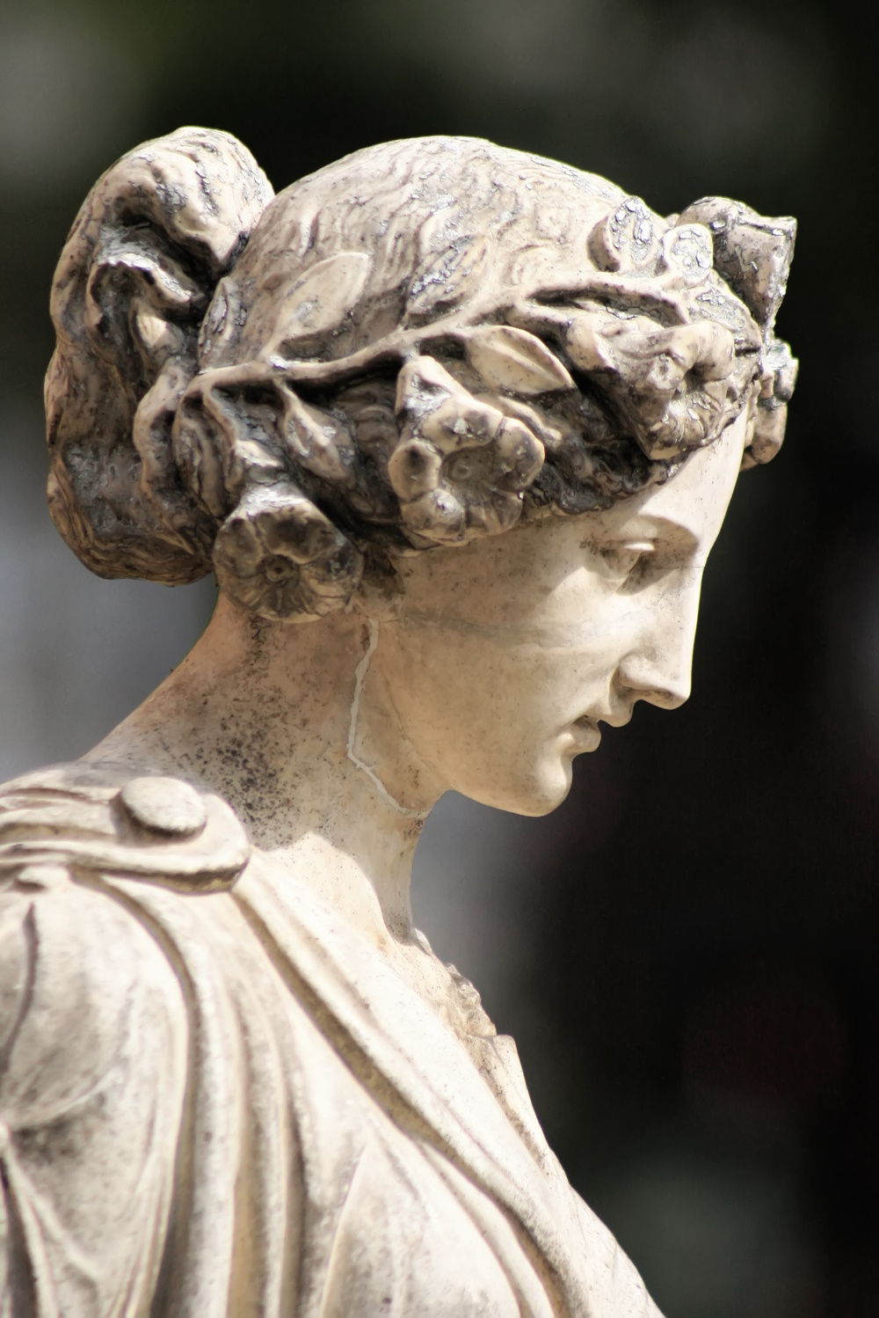
Meanwhile in Art . . .
Statue of Penelope
Moved from Ionia to the Persian royal palace at Persepolis around 450 BCE.
Since there was no fighting in Ionia at that time, this was probably a peace offering from the Delian League to the king.
Art history can sometimes assist political history.

Slide 42
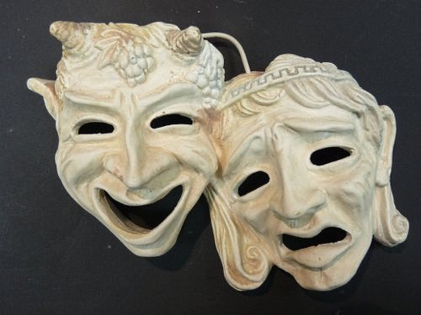
And Drama
Aeschylus’s “The Persians”
First performed in 472 BCE (seven years after the battle of Plataea)
Oldest surviving play by Aeschylus
Aeschylus added a second actor to Greek tragedies, allowing dialog between characters
Art Intersects Politics
Aeschylus fought as a hoplite at the battle of Marthon (where his brother was killed), and as a marine at Salamis
“The Persians” was financed by a rising young Athenian aristocrat—Pericles
The play was once considered sympathetic to the Persians, but it’s hard to understand why. It’s now viewed as a clearly self-congratulatory gloat.

Slide 43
And Architecture
The Parthenon
Since Athens was burned twice during the war, a major post-war effort made to rebuild it on a much grander scale.
The Parthenon was the crowning glory of the project, an enormous (by Greek standards) temple to Athena crowning the Acropolis (the central fortified hill in Athens).

Slide 44
Architecture
The Parthenon
Now hailed as the finest example of Greek architecture.
There are no straight lines in the façade, only gentle curves.
Some believe this was to relieve the monotony of enless right angles.
Other believe it was to defeat the natural optical illusion caused by lines intersecting parallel lines, which makes them seem to curve.
At one time it was thought the proportions of the façade equaled the Golden Ratio, but they do not.

Slide 45
Architecture
The Frieze of the Parthenon
In order to communicate grandeur, the Parthenon is surrounded by a sculpted frieze.
Unlike most Greek sculpture, this frieze is processional and stylistically repetitive, clearly modelled on the Persian royal friezes at Susa and Persepolis.

Slide 46
Architecture
The Odeon
Among the booty captured at the Battle fo Plataea was Xerxes’ royal tent, an enormous square, peaked-roof affair with 90 wooden pillars holding it up.
It was used for a while to cover part of the “backstage” part of the theater
When the Odeon was built near the acropolis in Athens, it was a near-exact copy of Xerxes’ tent, but in wood and stone, with a square floorplan, peaked roof, and supported by ninety pillars.

Slide 47
Architecture
Persepolis
Begun by Darius the Great, Xerxes finished the main buildings before his death.
Enormous royal city on an artificial raised stone terrace, with temples, palaces, and built-in plumbing and sewers.
Ceremonial capital used as treasury and for select holidays and special occasions.
Work continued to enlarge it until the end of the empire.

Slide 48
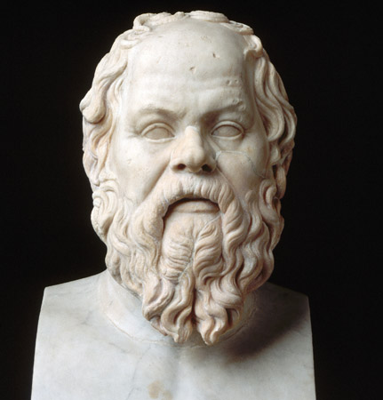
And Philosophy
The Sophists
Not treated well by history, probably worse than they deserve. Sophists represented a departure from the notion that:
Fate was fixed by the gods, and could only be influence by appeal to the gods
To . . .
People can improve their fate by improving themselves.
Sophists were self-help gurus for the very wealthy.
At a time when democracy was the legal government of Athens, those who spoke well before the assembly held much power.
Aristocrats, if they wanted to remain the political and economic elite of Athens, had to know how to give a compelling, persuasive speech.

Slide 49
Next Week: (Week 6) The Victors Fall Out
The Peloponnesian War
Athens and Sparta duel for control of the Greek World
Persia looks on in bewilderment.

