Slide 1
In winter, as you lie on a soft couch by the fire,
Full of good food, munching on nuts and drinking sweet wine,
Then you must ask questions such as these:
“Where do you come from? Tell me, what is your age?
How old were you when the Mede came?”
– Xenophanes of Colophon

Slide 2
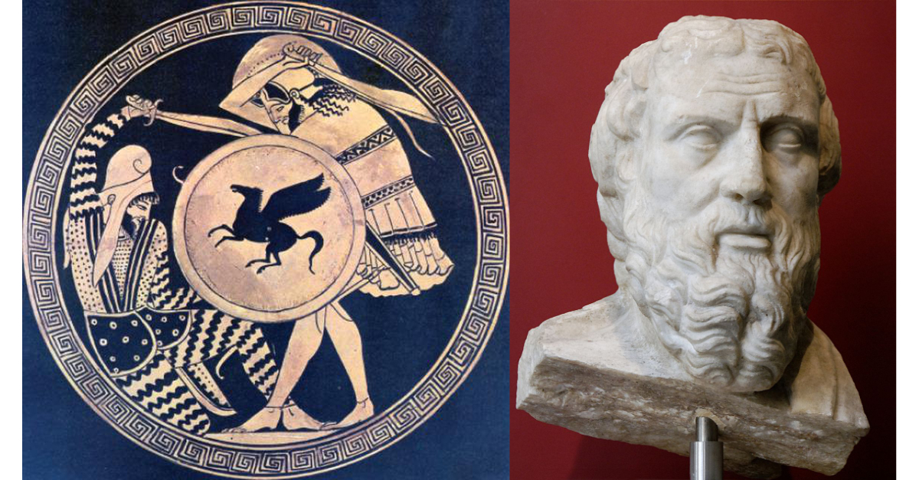
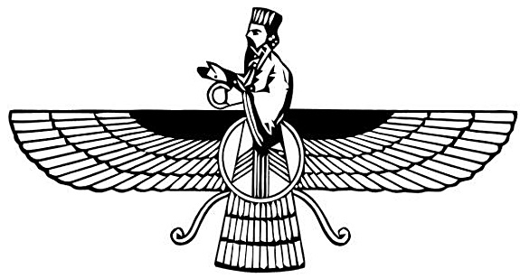
Greece and Persia The war that Created History
OLLI Fall 2019
Week 4: When the Mede Came

Slide 3
Course Overview
Week 1: The Story, and its sources
Week 2: The Greeks—Who they were and why we should care
Week 3: The Persians—Who were they, and should we care?
Week 4: When the Mede Came—From Cyrus to Darius
Week 5: The Great Invasion—The Stunning Greek Victory
Week 6: The Victors Fall Out—The Peloponnesian Wars
Week 7: The King’s Peace—Fifty Years of War
Week 8: Alexander the Accursed—Destruction of an Empire

Slide 4
Historical Overview—The Rise of Persia
Cyrus the Great and the Rise of Persia (550-530 BCE)
Cambyses, the conquest of Egypt (530-522)
The Crisis of 522
Darius the Great: Consolidation, Reorganization, Expansion (521-500)
Ionian Revolt (499-494)
Persian punitive expedition, Battle of Marathon (490)

Slide 5
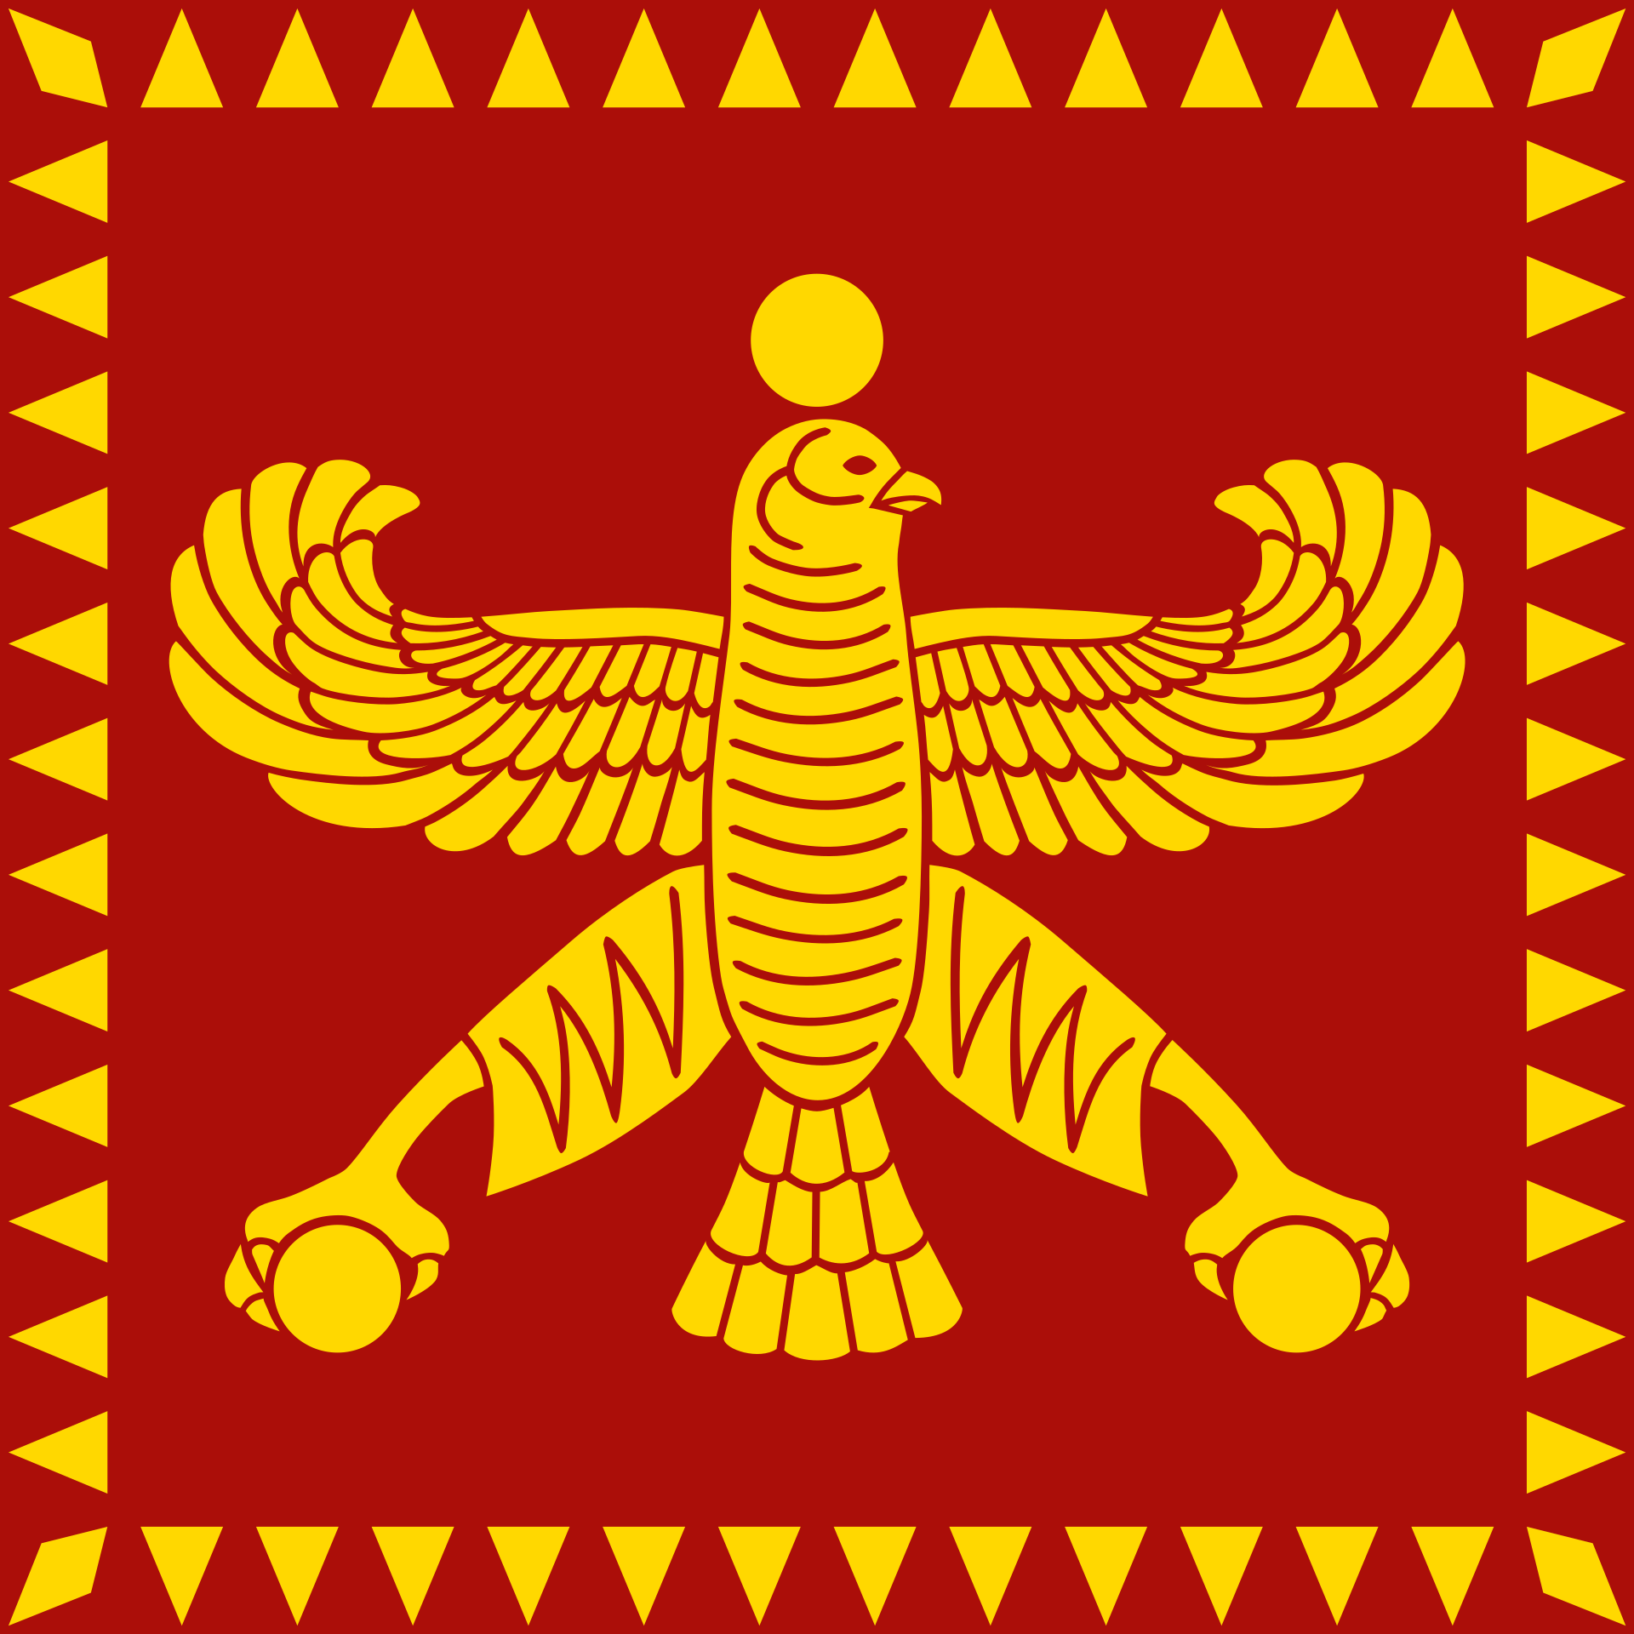
Cyrus the Great—The Persian Revolt (553-550)
Astyages, king of the Medes
Probably elected by tribal leaders.
35 years on the throne—began behaving like a real king.
Harpagus the Mede
The bloodless victory
The just peace--Cyrus takes his first step toward empire

Slide 6
Cyrus—The Lydian War (550-546)
Croesus (who really was as rich as Croesus)
Coinage invented to pay mercenaries
Family ties—brother-in-law to Astyages
Consulting the Oracle at Delphi
Inconclusive battle
Unexpected winter campaign
Croesus’s fate

Slide 7
Croesus’s Fate
Sentenced to burn to death by Cyrus. According to Herodotus, Cyrus changed his mind at the last minute and pardoned him. He then lived the rest of his life in luxury as Cyrus’s close friend and most trusted advisor.
Or maybe not . . .

Slide 8
“We have nothing to fear from them.”
The Ionian Greeks (vassals of Lydia)—Cyrus offer same deal as under Croesus
When the Spartan embassy warned Cyrus not to deal harshly with the Ionian Greeks, he first asked his advisors who the Spartans were.
Then he said the Persians had nothing to fear from people who set aside a part of their city where they gather together to cheat each other.
What was he talking about?

Slide 9
Market versus Bazaar
The Greeks use a marketplace economy. Individuals with goods to sell set up stalls in the center of town and sold directly to their neighbors, bargaining with them over price.

Slide 10
Market versus Bazaar
The Persians use a bazaar economy. (Our word bazaar comes from the old Persian word bāzār.) A bazaar was an enclosed district of the city with permanent shops for merchants who bought from suppliers and sold to consumers.
This class of middlemen, often foreigners, kept the majority of Persians from having to haggle with each other—which was important given the value the Persians placed on honesty.

Slide 11
Cyrus—Iranian Highlands (546-540)
Settling with the Lydians and Ionian Greeks
Not all of the Eastern Iranian highlands had been brought into the new kingdom. Cyrus set out to do so.

Slide 12
Cyrus—The First Ionian Revolt (545-542)
What was this really about?
Pactys & treasure?
“When the Mede Came”
Mazara, then Harpagus the Mede
Systematically reduced Ionian cities using earthworks (not previously seen by the Greeks)
Hand-picked tyrants rule Greek cities after this

Slide 13
Cyrus—Babylonia and Phoenicia (540-539)
Nabonidus
Ten-year retirement
Favored moon goddess over Marduk
Nabonidus’s fate

Slide 14
Cyrus—Final Campaigns and Death (530-529)
Final campaigns against Chorasmia (530) and the Saka Massagetae (529)—Queen Tomrys

Slide 15
Cyrus—Final Campaign and Death (530-529)

Slide 16
Cyrus—Final Campaign and Death (530-529)

Slide 17
What Queen Tomrys Really Looked Like
Scythian, Sāka, and Sarmatian grave mounds include the bodies of warrior women, some of them clearly nobles based on their possessions.
Greek legends of Amazon warriors are almost certainly based on them.
It’s possible from these finds to reconstruct their equipment and appearance in battle.
At least so far, no chainmail bikinis have been found.

Slide 18
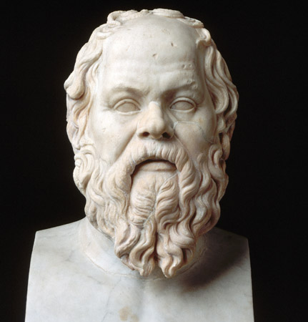
Meanwhile in Ionian Greece . . . Philosophy!
Western philosophy dated from the prediction by Thales of Miletus of a solar eclipse in 585 BCE
Miletus became center of radical new inquiries into the nature of reality, “The Milesian Revolution.”
Rejection of the “Theologists,” believed in natural causation rather than will of the gods
“Rain is the manifestation of Zeus’s stormy mood.” (Hesiod)
“Rain is condensed air.” (Anaximenes)

Slide 19
And in Athens . . .
Peisistratos ruled Athens as popular tyrant (561-527)
Ousted twice by aristocratic parties, but solid from 546 to his death in 527
Although an aristocrat himself, he consistently championed the cause of the popular party
The entire reign of Cyrus the Great took place during Peisistratos’s tenure
First competition for best tragedy held (534)
Red Figure pottery replacing Black Figure.

Slide 20
Greece and Persia The War that Created History
Question Break
Coming Up: Darius the Great

Slide 21
Back to Persia--Enter Cambyses (529-522)
Transition of royal authority to oldest son, Cambyses II
Cyrus’s younger son, Bardiya, became governor of eastern territories, including Bactria

Slide 22
Cambyses—Phoenicia and Egypt (526-523)
War with Egypt following death of the pharaoh
Catastrophically failed invasions of Nubia and Libya

Slide 23
Cambyses—Death and Civil War (522)
Died while returning to Susa . . . but how?
Possible execution of Bardiya (his brother)
Revolt of Bardiya (or the false Bardiya)
Before or after death of Cambyses?
Smerdis?
Gaumata, a Median magus? A radical Zoroastrian religious reformer? A double for the real Bardiya?
Or is it all baloney?
Seven nobles (leading the royal army in Egypt) assassinated Bardiya/Gaumata/Smerdis and seized the government

Slide 24
Government—The Great Debate
Otones (Democracy): “I propose that we abandon monarchy and raise the majority to a ruling position, for in the many is the whole.”
Megabyzos (Oligarchy): “How could someone who has not been educated be knowledgeable about anything? . . . (Let us) pick out the best men to make up an intimate company and endow it with power and authority.”
Darius (Monarchy): “Were did our freedom come from, who gave it to us? Did it come from the people, from an oligarchy, or from a monarchy?”

Slide 25
Darius—Weathering the Storm (522)
Nine revolts (at least two of them involving someone claiming to be Bardiya), most of them at the same time.
Extent of revolts in Iranian territory suggest resistance to Darius as legitimate king.
Behistum inscription commemorates Darius’s successful campaign.

Slide 26
Darius—Second Egyptian Campaign (521-520)
Quelled remaining unrest in Egypt, then incorporated Libya and the Greek colony polis of Kyrene (near modern Benghazi)
Established permanent garrisons in fortresses, mostly non-Egyptian.
Elephantine garrison mostly Jewish military settlers.

Slide 27
Darius—Eastern Campaign (516-515)
Impetus of the campaign uncertain (but the Indus valley was fabulously rich land and included several gold mines).
Campaign incorporates the western Indus valley in the empire.
Probably also when the southern Sāka were incorporated.

Slide 28
Darius—Babylonian Revolt (515-514)
Another revolt in Babylon, probably started while Darius was still campaigning in India.
During the revolt, Scythians/Sāka invaded from the north, more an extended plundering expedition than an attempt to conquer. Still very destructive.

Slide 29
Darius—Scythian Punitive Campaign (513)
Scythians avoided open battle by steady retreat
Darius severely damaged the Scythian farm lands and crippled several of their allied states
Hardships of the retreat over-played in Greek accounts
End result: Scythians never again launched a major invasion or raid into Persia

Slide 30
Darius—Peace and Consolidation (512-500)
Reorganized finances—regularized tribute
Reorganized provincial administration. Divided military, judicial, and financial functions among different officials
Linked roads into the King’s Highway network, expanded and regularized the courier service
Reorganized the armed forces

Slide 31
Darius—Peace and Consolidation (512-500)
Rebuilt temples and other public buildings damaged in the recent revolts and raids
Rotated the working capital between Susa and Ecbatana
Began building a new ceremonial capital at Persepolis

Slide 32
Darius—Peace and Consolidation (512-500)
Also began work on a canal linking the Red Sea with the Nile River (but not completed)

Slide 33
Meanwhile in Athens . . .
Death of Peisistratos tyrant of Athens (527)
His son Hippias (not so popular) takes over (527-510)
During the short reign of Cambyses and Darius’s expansionist period.
Hippias ousted (510-509)
Flees to Persia, welcomed at court
Athens adopts democratic government (509-508)
Athens sends ambassadors to Persia (507)
Ambassadors offer Earth and Water—what does that mean?

Slide 34
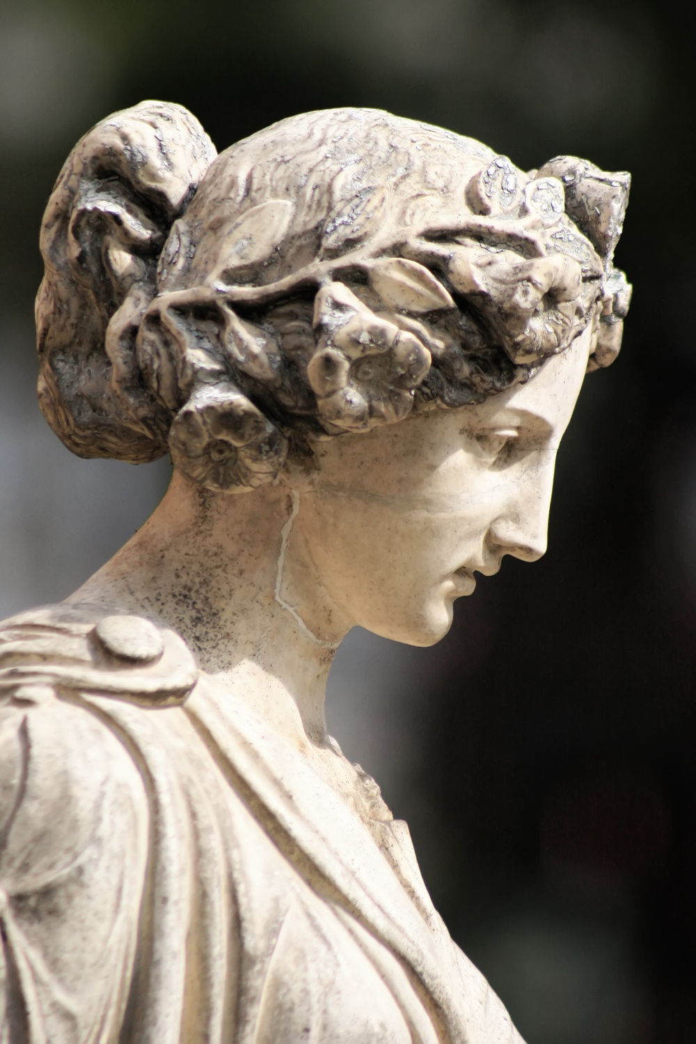
And in the World of Art . . .
With the huge temple and palace construction projects of Darius, Persian monumental/palatial art takes on its unique characteristics, and remains virtually unchanged for the next two hundred years
In Greek art, archaic sculpture giving way to the Severe School.
More realistic depictions of human form and clothing
More varied poses
More naturalistic expression in face.
Statue of Penelope waiting for return of Odysseus (right).
Excellent example of the Severe Style, originally from Ionia, but so admired that many copies made and widely distributed.

Slide 35
And in Philosophy . . .
Heraclitus of Ephesus: (535-475)
Defined the mind as the theoretical capacity to understand the world.
Skirted conflict with religious orthodoxy by suggesting Zeus chose to rule the world through logos (laws, or rules)
Greek philosopher? Or Persian?
A Persian subject his entire life: under Cyrus, then Cambyses, then Darius.
One day he received an interesting letter.

Slide 36
Philosophy-Darius’s letter
King Darius, son of Hystaspes,
to Heraclitus the wise man of Ephesus,
greeting.

Slide 37
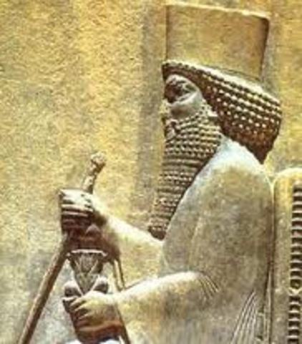
Philosophy-Darius’s letter
“King Darius, son of Hystaspes, to Heraclitus the wise man of Ephesus, greeting.
“You are the author of a treatise On Nature (which) is hard to interpret. In certain parts, if it be interpreted word for word, it seems to contain power of speculation on the whole universe and all that goes on within it, which depends upon motion most divine; but for the most part judgment is suspended, so that even those who are the most conversant with literature are at a loss to know what is the right interpretation of your work.

Slide 38
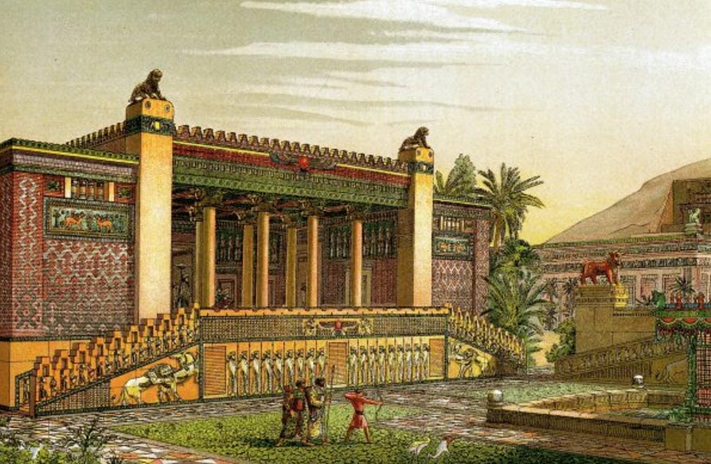
Philosophy—Darius’s letter continued
“Accordingly King Darius, son of Hystaspes, wishes to enjoy your instruction and Greek culture. Come then with all speed to see me at my palace. For the Greeks as a rule are not prone to mark their wise men; nay, they neglect their excellent precepts which make for good hearing and learning. But at my court there is secured for you every privilege and daily conversation of a good and worthy kind, and a life in keeping with your counsels.”

Slide 39
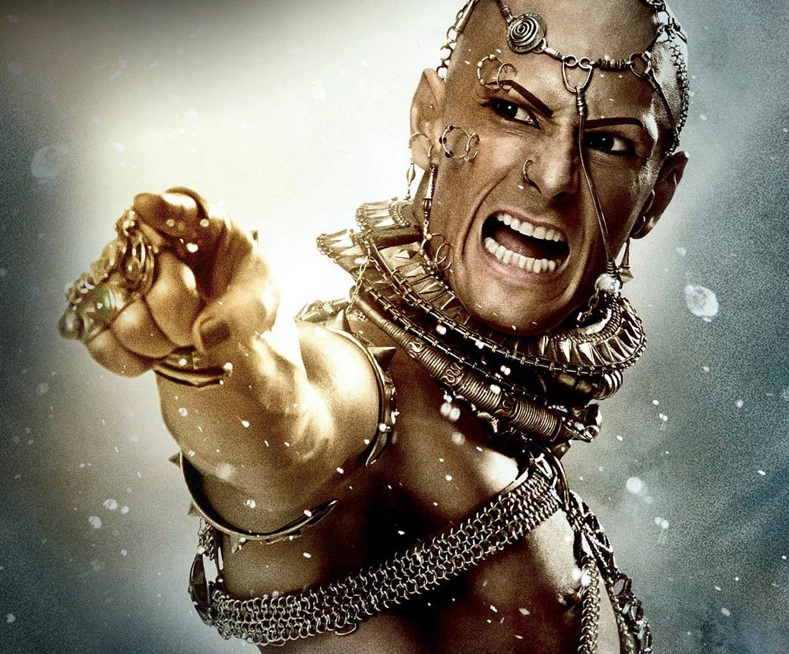
Philosophy—Darius’s letter continued
HE REFUSED MY SUMMONS?
BRING THE INSOLENT SWINE TO ME SO I MAY LISTEN TO HIS SCREAMS OF AGONY AS HE IS TORTURED TO DEATH!!!!!
(In fact, Darius may not have responded at all to Heraclitus’s refusal.)

Slide 40
Greece and Persia The War that Created History
Question Break
Still to Come
The Persian Way of War
War comes between the Greeks and Persians

Slide 41
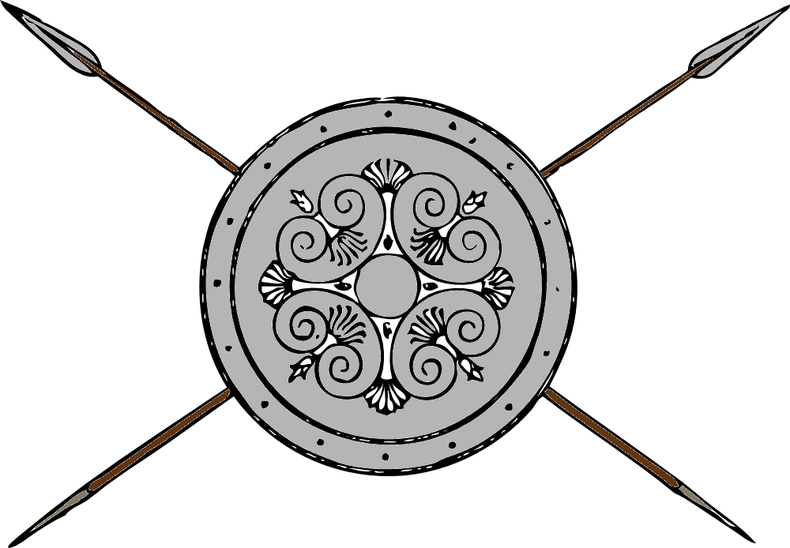
Persian Way of War
Cyrus’s Army
Consisted mainly of the core of Persian and Median veteran troops.
A few additional national contingents added over time, but mostly as garrisons.
Strong Median cavalry, but Cyrus worked hard to build up the Persian national cavalry force.
“Ride the Horse”

Slide 42
Persian Way of War
Darius’s Army
Reorganized and regularized
Mostly Iranian standing army
Other nations provided garrisons and would raise troops in emergencies
Babylonian practice of Bow Land, Horse Land, and Spear Land expanded to create (mostly Iranian) military colonies in frontier areas.

Slide 43
Persian Way of War
Who Were the Iranians?
Persians
Medes
Hyrkanians
Sagartians
Aerians (the local province)
Sogdians
Bactrians
Arachosians
Elamites/Susans (Honorary)
Scythians (Saka)

Slide 44
Persian Way of War
Four Components of the Army
Standing Royal Army (all Iranian)
10,000 Guard infantry and 2,000 Guard Cavalry
20,000-30,000 Kardakes
Permanent Garrisons
Paid mercenaries, foreign or just from different regions
Satrapal Troops
Bodyguard cavalry regiment, 500-1000
Mercenary garrisons from satrapy
Local levies as needed
Levée en Masse (seldom used)
General levy of a region, gathered at marshalling center.

Slide 45
Persian Way of War
Iranian Troops Dominated the Army
The closer (physically and culturally) a people were to Persia, the lower their tribute amount but the higher the requirement for troops to the standing army. Less based on ethnicity than on perceived kinship bonds. (eg. Sussians)
Each Iranian national province may have provided one regiment of foot guards along with large numbers of young men to the Kardakes (standing regular army).
Non-Iranian provinces were still liable to a general call-up in times of emergency or major war, but generally contributed little to the standing army in peacetime.

Slide 46
Persian Way of War
Decimal Organization
Ten men formed a squad (dathabam)
Ten squads (100 men) formed a company (satabam)
Ten companies (1,000 men) formed a regiment (hazarabam)
Ten regiments (10,000 men) formed a corps (baivarabam)
In Practice . . .
Muster rolls of garrison troops show squads (nominally ten men) with from six to eight, sometimes fewer. (This is routine in almost all peacetime armies.)
Only the Guard regiments were routinely kept at full strength, probably in part because of their ceremonial duties.
Corps (baivarabam) were seldom if ever ten regiments, and were probably simply a group of units under a senior officer.

Slide 47
Persian Way of War—The Guard Infantry
10,000 guard infantry, in ten regiments.
These were almost certainly not called Immortals. Their title was probably Anûšiya, which means Companions. The Persian word for immortal was Anauša, which may explain Herodotus’s confusion.
One regiment, called the Amrtaka (spearmen) was selected from best and most loyal of all the guardsmen. Another was called the Huvaka (“equals” but usually translated as “kinsmen”).

Slide 48
Persian Way of War—The Guard Cavalry
2,000 guard cavalry in two regiments
Again, one was made up of “kinsmen” and one was selected from the best of the regular cavalry.
Mounted on strong Nisaean horses, by the later half of the empire they wore extensive armor.
In addition to their helmet and body armor, they sometimes wore a set of armored “chaps” which protected their legs and the flanks of the horse, as well as an armored apron (pectoral) covering the horse’s breast and a bronze plate (champron) protecting the horse’s face.
In the first half of the kingdom’s history, much less horse armor was worn, possibly because the horses were not quite as large as later, or possibly due to later improvements in load-distributing saddles.

Slide 49
Persian Way of War--Infantry
Iranian Sparabara
Iranians (Medes, Persians, Hyrkanians, etc.) were the most numerous infantry in the Persian Army.
Regiments of 1,000 men formed up ten ranks deep.
Only the front rank had a large shield (called a spara) and a spear. They made a breastwork of these to cover the rest of the regiment, which was armed with bows.

Slide 50
Persian Way of War--Infantry
Takabara
Troops from Anatolia and Thrace mostly fought with spears or javelins and a smaller, lighter shield called a taka.
The Greeks called a shield like this a pelte, and so their similarly armed troops were called peltasts.
These troops could fight in line of battle but they were better as open-order skirmishers, particularly in difficult ground.

Slide 51
Persian Way of War--Infantry
Spearmen
Troops from the Greek cities in the empire, and mercenaries from abroad, fought in hoplite equipment.
Many other regions (such a Caria, Assyria, Egypt) also fielded heavy spearmen similar to hoplites.

Slide 52
Persian Way of War--Infantry
Light infantry
Most parts of the empire contributed lightly-armed missile troops (slingers, archers, and javelin men).
The best of the archers were very good, but most of the rest were simply men who could not afford better equipment, and had little real experience with war.

Slide 53
Persian Way of War--Cavalry
Iranian cavalry
This was always the backbone of the army.
Armed with two or three very sturdy throwing spears, one of which was retained for thrusting.
Tactics were to disorder the enemy ranks with thrown spears, then charge home.
The Scythian sigaris (battle axe) was often used for close-in melee.
A mail breastplate was often worn under the loose-fitting tunic. No shield was carried.
Some units, particularly guard units, later added more armor, including horse armor, but the bulk of the cavalry remained armed and equipped as shown here.

Slide 54
Persian Way of War--Cavalry
Sāka horse archers
Persian cavalry carried bows, but mostly for hunting. They were not accomplished horse archers.
The Sāka fielded the best horse archers in the region, possibly in the world at this time.
They were seldom the subjects of Persia but were often allies or hired as mercenaries.

Slide 55
Persian Way of War--Chariots
Scythed chariots
Chariots were considered obsolete by this time but one variety was still used.
Scythed chariots had blades mounted in various places but most noticeably on the wheel hub.
Horses and crew were armored to enable them to get close to the enemy.
They were seldom used, and worked even less often.

Slide 56
Greece and Persia The War that Created History
Question Break
Coming Up: The Second Ionian Revolt

Slide 57
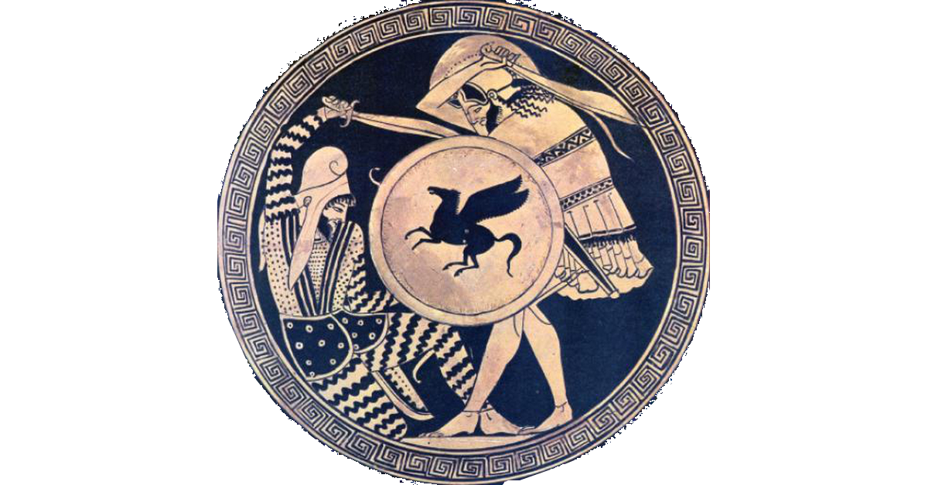
Darius--Second Ionian Revolt (499-493 BCE)
Cause of the revolt (499)
Herodotus
Aristagoras, tyrant of Miletus: joint campaign against Nexos
Athenian and Euboean assistance (498)
Siege and burning of Sardis by Greeks (498)

Slide 58
Darius--Second Ionian Revolt (499-494 BCE)
Siege of Sardis
Lower town taken, but Persian garrison hold out in Acropolis
Fire consumes much of the lower town, including many temples
Greeks later claim the fire started by accident.
Why this enraged the Persians
Act of sacrilege against local religions
Athens violated it pledge of Earth and Water to Darius.

Slide 59
Darius--Second Ionian Revolt (499-494 BCE)
Persian counterattack thwarted by Carians joining revolt (497)
Major Persian army routed by a Carian ambush
Several years spent regrouping and mustering reinforcements
Systematic campaign overcomes the revolting cities (494-493)

Slide 60
Darius—First Expedition (491 BCE)
Mardonius pacifies Ionian Greece
Reorganized territory, split between several different satrapies
Replaced tyrants with democracies
Organization of Thrace as a satrapy
Thrace to serve as base for move south
Macedon become client kingdom
Plans overland march through Greece to punish Athens and Eritrea (in Euboea)
Advance along coast to allow supply by the navy

Slide 61
Greek Democracy in 491 BCE
WAS DEMOCRACY IN DANGER?
Every Greek democratic city-state on the Aegean in 491 BCE, except Athens, was in Persian territory and had been established at the order of the Persian king.

Slide 62
Darius—First Expedition (491 BCE)
Supply fleet sunk by storm as rounding Cape Athos. Punitive expedition called off (temporarily).

Slide 63
Darius—Second Expedition (490 BCE)
Attack by sea across Aegean (secure Samos and Nexos on the way)
Destruction of Eritrea in Euboea
Landing of Persian main force at Marathon
Spartans cannot march due to religious festival
Athens marches alone to meet the Persians

Slide 64
Marathon—Balance of Forces
Athens
9,000 citizen hoplites
Joined by 600 Plateans
Greeks deploy on a steep hill, making it hard for the Persian cavalry to attack, but the hill covers the road to Athens.
Persia
c. 20-25,000 infantry
c. 1-5,000 cavalry
Persians deploy covering their beached ships and face the Athenians for five days.

Slide 65
Marathon—Course of the Battle (1)
Persians begin loading cavalry onto ships to make naval end run around the Greeks.
Athenians advance as the Persian cavalry is being loaded onto the ships.
Persia deploys an infantry rearguard force (which still outnumbers the Greeks) to cover the loading of the army.
Athenians charge at the run to spend less time under archery fire.

Slide 66
Marathon—Course of the Battle (2)
Athenian center gives ground but the Greeks break the wings of the Persian line and envelope the center.
Many Persians killed, but many retreat to the ships and load successfully.

Slide 67
Aftermath
Athenian Army force marched to Athens and arrived shortly before the Persian fleet. With the Athenian army in place the Persians could not land, and so sailed back to Asia Minor
From the Greek perspective, a great victory had been won against the previously invincible Persians.
From the Persian perspective, a punitive force had suffered a reverse after achieving half of its objectives.
In distant Susa, King Darius began thinking a simple punitive expedition might not be the solution to the growing Greek problem. . .

Slide 68
Next Week: (Week 5) The Great Invasion
Xerxes sends the hosts of Asia against Greece

Slide 69
Greece and Persia The War that Created History
Question Break
Coming Up: The Second Ionian Revolt

