Slide 1
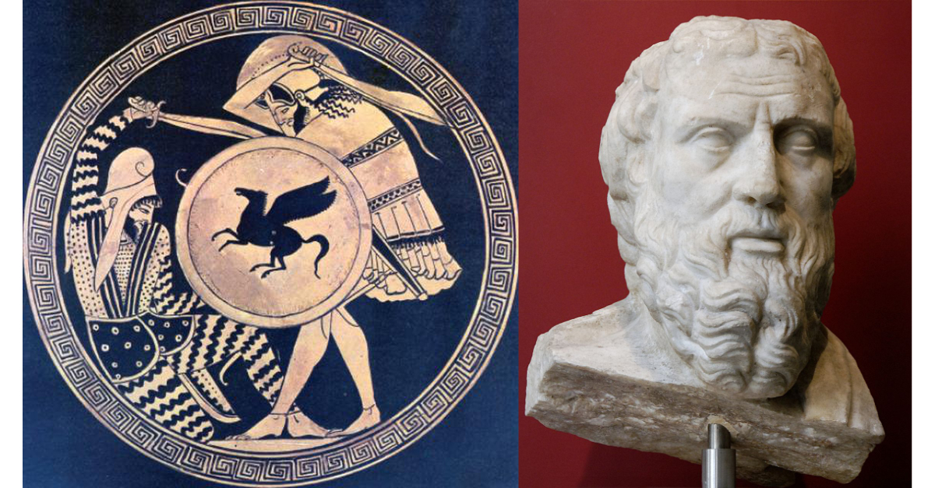
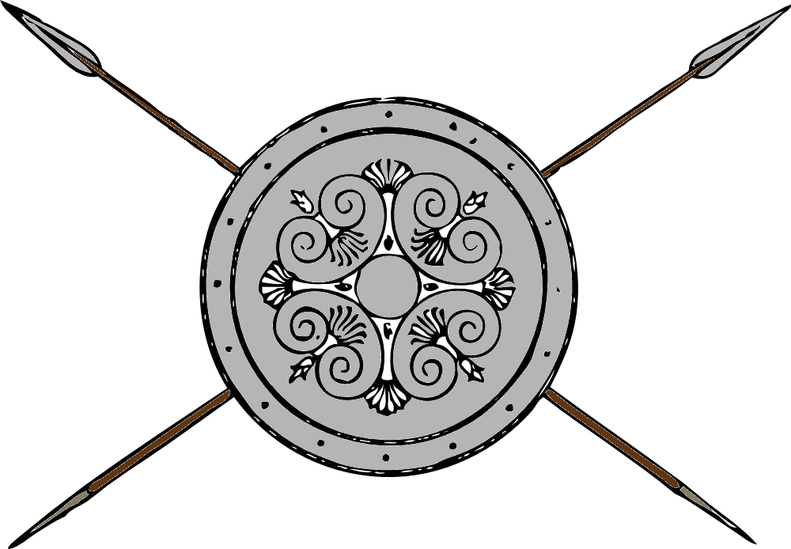
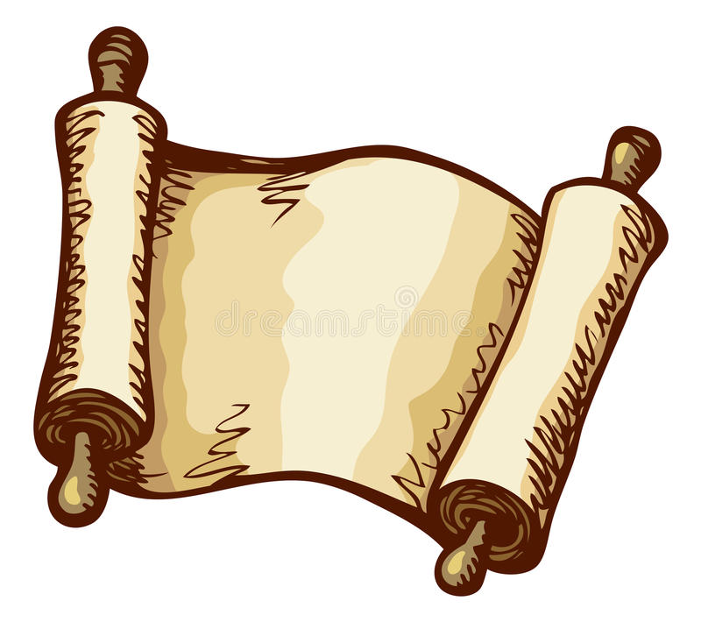
Greece and Persia The war that Created History
OLLI Fall 2019
Week 3: The Persians—Who were they?

Slide 2
Course Overview
Week 1: The Story, and its sources
Week 2: The Greeks—Who they were and why we should care
Week 3: The Persians—Who were they, and should we care?
Week 4: When the Mede Came—From Cyrus to Darius
Week 5: The Great Invasion—The Stunning Greek Victory
Week 6: The Victors Fall Out—The Peloponnesian Wars
Week 7: The King’s Peace—Fifty Years of War
Week 8: Alexander the Accursed—Destruction of an Empire

Slide 3
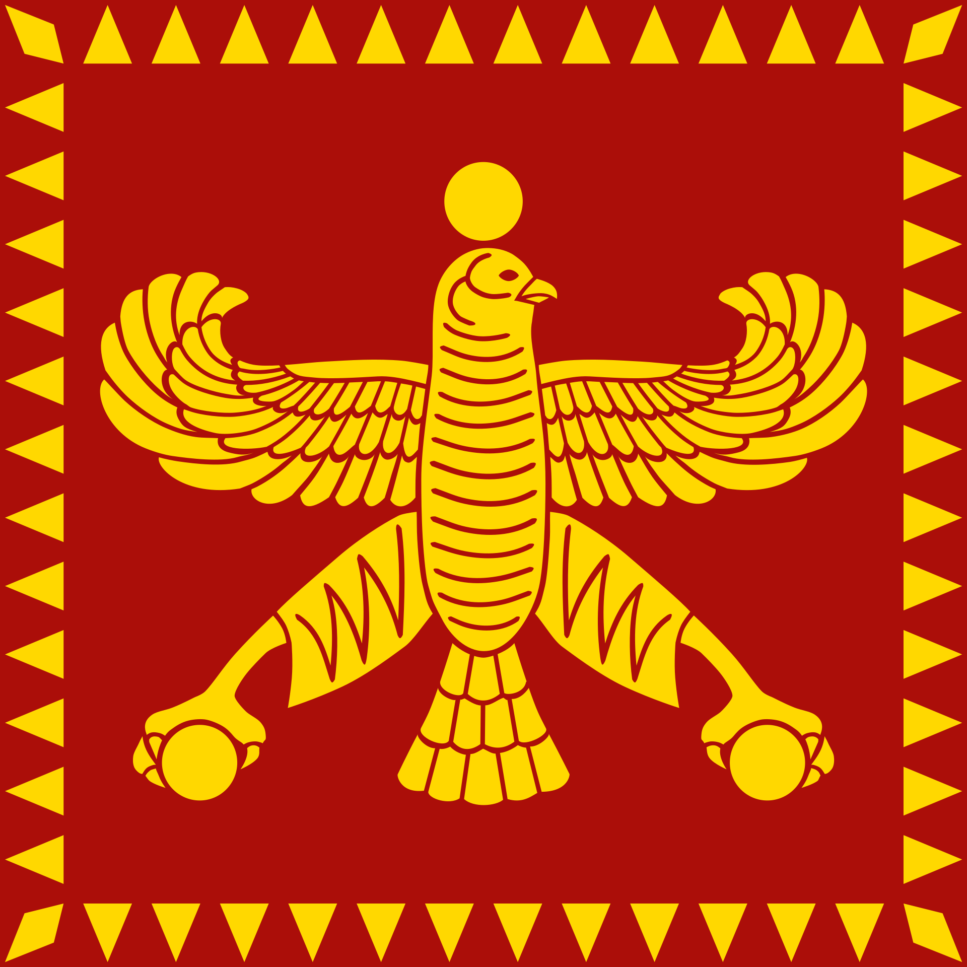
Week 3: The Persians
From Nomad to Empire
Government
Society
Religion and Values
Philosophy and Science
Art

Slide 4
1. Nomad to Empire
1st wave (pre-historic) Indo-European migration, up to the beginning of the Bronze Age.

Slide 5
Nomad to Empire
2nd wave Indo-European migration, during the Heroic, or Mycenaean Age of Greece.
Arrival of Iranians/Aryans in the Caspian-Aral Sea area.

Slide 6
Nomad to Empire
3rd wave Indo-European Iranian/Aryan migration, during the Bronze Dark Age.
By this time a recognizable Iranian culture and language had emerged.
Iranians were nomadic and pastoral, but by end of period had settled into clearly defined areas and practiced agriculture.
Brought the Nisaean breed of horses with them, the first breed in this region large enough to carry an armed rider in war.
Median cavalry revolutionized warfare and eventually spelled the end of the war chariot.

Slide 7
Nomad to Empire
In 606 BCE, the Assyrian Empire fell and the Median Empire took much of northern Assyria.
Persia was a province in the Median Empire.
The other major powers were the Chaldean (Babylonian), the Lydian, and Egyptian empires.

Slide 8
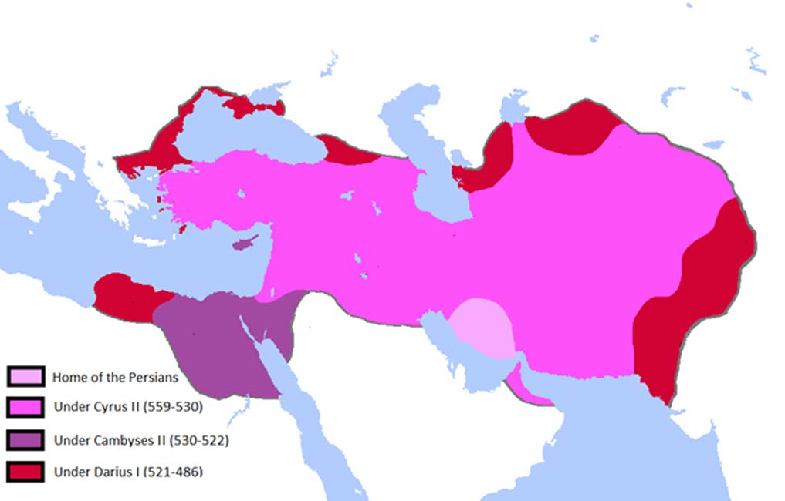
Nomad to Empire
The vast bulk of the empire was conquered by Cyrus in the first 25 years.
In about 70 years, the Empire grew to its greatest extent.
The Persian Empire was built in the lifetime of one man. Darius, who finished the expansion of the empire, had fought as a soldier under Cyrus as a young man.

Slide 9
Greece and Persia The War that Created History
Question Break
Coming Up: Government

Slide 10
2. Government -- People of the Empire
Population in 500 BCE
Persians, Medes, and the Iranian East: 6 million
Babylonia, Assyria, Phoenicia: 3 million
Egypt: 2-3 million
Asia Minor: 3-4 million
TOTAL: 14-15 million

Slide 11
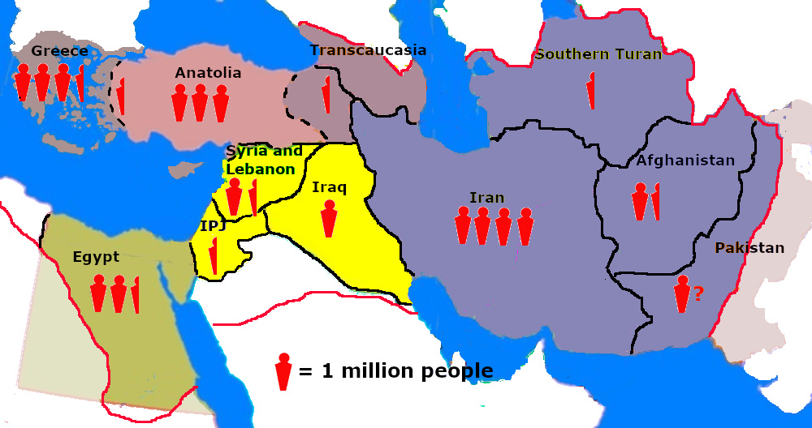
Government -- People of the Empire
Population
and
Languages
About 500 BCE
Yellow: Semitic
Green: Demotic
Shades of Gray: Indo-European

Slide 12
Government
Absolute monarchy, but based (in theory) on consent of governed and virtue of ruler
absolutism felt most directly by the noble class
Loyalty to ruling family required, but based on existing local institutions
Regions (former kingdoms) enjoyed internal self government and freedom of religion
Conquered people accepted as equal subjects, not objects of exploitation

Slide 13
Government
Principles of ruler’s fitness to rule
Good Protector (mighty in battle)
Virtuous Ruler (truthful and honorable, god-favored)
Generous Friend (reward loyalty and good acts)
Outlined the King’s Duty to his subjects.
Reinforced by coronation ceremony
New king and queen appeared in clothes of herders
Ate simple first meal, the sort herders ate in the field
Figs, wine preserved with terabinth juice, sour milk.
Symbolic of king’s bond to the common people

Slide 14
Government—Citizen Assemblies
“(Cyrus) considered the shrewdest way to persuade the Persians to revolt (from the Medes) . . . . He first wrote down on a scroll everything that he wanted to say to them. Then after convening an assembly of the Persians, he read from the scroll.”
--Herodotus, Histories
Local government involved varying degrees of democracy
Citizen Assemblies were ubiquitous throughout the region. In Mesopotamia based on Temple Districts. In Iranian areas based on tribal assemblies.
Civil Rights (the right to participate in local government) was based on land ownership in temple districts (in Mesopotamia). Citizens of temple districts formed Assemblies, passed local laws, elected judges and officials.
In most of the Near East, Assyrian and Babylonian kings had steadily limited the authority of assemblies to local concerns, but they still retained influence.

Slide 15
Government—Administration
Established standards of weight, measure, currency, language, etc.
Babylonian weights and measures
Mints set up in major regional centers
Aramaic (not Persian) became official language
Centralized Defense
Standing army paid for by the crown, but provinces provided first line of local defense.
Centralized treasury
Regions had taxes (tribute) levels set, and adjusted periodically.
Financed extensive “public works” programs: canals, aqueducts, temples, palaces, roads
Fiscally conservative: never spent more than brought in.
Royal roads and postal service tied the empire together.

Slide 16
Government—The King’s Roads
Herodotus described the road from Sardis to Susa as “the King’s Road,” but there was an extensive network of royal highways.
Caravanserais (staging posts) every 10-20 miles, with fresh horses and royal dispatch riders. Couriers rode day and night, regardless of season or weather.
From Susa to Sardis took three months for a caravan or army, but only about ten days for a royal message.
“Neither snow nor rain nor heat nor gloom of night stays these couriers from the swift completion of their appointed rounds.”
-Herodotus, Histories, 8:98

Slide 17
Government: Proto-Federalism
Regional semi-autonomy
Customs and institutions unchanged by Persians
Governors were a combination of local hereditary rulers and Persian transplants (depending on how cooperative the local population was)
Freedom of religion guaranteed
There was no official state region
Cyrus returned captured god statues take by Babylonians, Darius rebuilt temples
Royal inscriptions honored local gods in addition to Persian gods
Persian rule rested lightly on the common people, more heavily in the nobility

Slide 18
Government
The “Social Contract” between
Ruler and Subject
“You shall dwell in the same houses and work the same farms; you shall lie with the same wives and have control of your children just as now. But you shall not have to fight either us or anyone else.”
--Cyrus the Great to the Assyrians

Slide 19
Greece and Persia The War that Created History
Question Break
Coming Up: People and Society

Slide 20
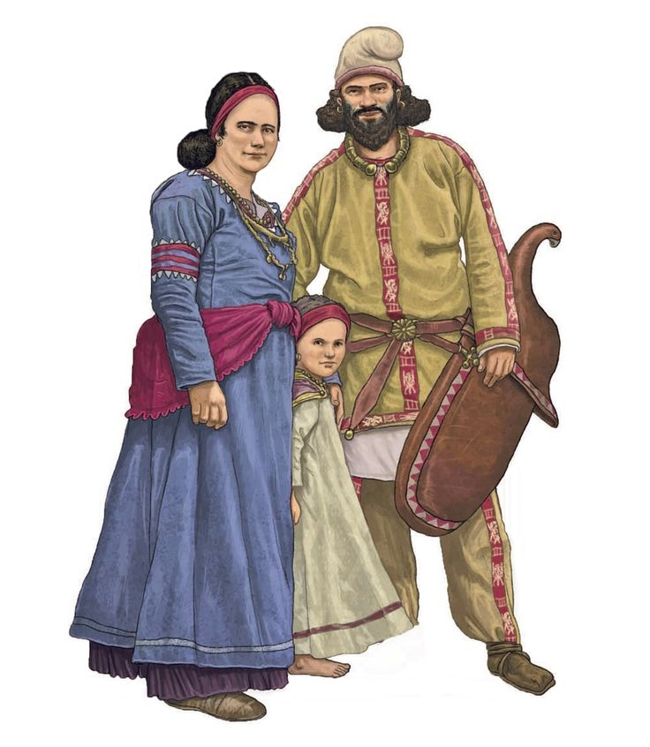
3. Society
Society showed relics of nomadic vertical organization
A Family lived in the “house” of the eldest male. Darius “son of Vishtapa”
A Clan lived in a settlement. Darius of the Achaemenid clan.
A Tribe lived in a territory. Darius was of the Pasargadai Tribe.
A Province or Country was inhabited by numerous tribes under a single ruler. Darius was king of Parsa (country of the Persians).
A People or Nation lived in a land or region. Darius was from Arya (Aerea to the Greeks), (land of the Aryans, or Iranians)
The patriarchal Clan was the most important element in Persian society. Both the family and Tribe were less important signs of self-identification.
Note that the ruling dynasty of the Persian empire identified the royal lineage through the Achaemenid Clan, not a single family.

Slide 21
Society
Old nomadic Vertical divisions of society (family, clan, etc.) gradually giving way to more settled (and stratified) Horizontal divisions:
Aristocracy
Land-owners (farmers and merchants)
The landless free
Slaves

Slide 22
People and Society--Slaves
Who were slaves?
Generally prisoners of war, often from suppressed rebellions.
Selling of self or children into slavery had generally been outlawed by this time
Mostly slaves were household servants or unskilled manual laborers
Not extensively used in the productive economy

Slide 23
People and Society--Slaves
Economic Inefficiency
Productivity of slave labor was so much lower that large-scale land owners (mostly temples and the crown) found it more profitable to use share cropping than to directly farm the land with slaves
Similar economies in skilled artisanal labor
Less demand = lower numbers
On a number of documented occasions, prisoners were resettled and released rather than sold, because there was insufficient demand for slaves.
Slaves probably made up from 10-20% of the population in the central part of the Achaemenid Empire. (Greece was 30-40%)

Slide 24
People and Society--Women
Persian nobles visiting northern Greece, at the evening meal: “Where are your women?”
Greek women did not dine with the men; Persian women did.
But the Greeks insist Persians sequestered their women in harems, guarded by eunuchs, and never allowed anyone else to see them.
What’s going on?

Slide 25
People and Society--Women
The Story of Esther
Persian king marries a princess and after the wedding, while the guests are all eating at the banquet, goes to her and says, “Come, join me and our guests and let them see my new bride.”
She freaks out. She’s married now--nobody should see her but her husband. How dare he insult her this way?
He freaks out, has never heard of anything so stupid, decides to get a new wife who doesn’t mind being seen in public with him. Enter Esther, stage right.

Slide 26
People and Society--Women
The Central Problem with The Story of Esther
It defies logic that the Persian king does not know the marriage customs of his own culture.

Slide 27
People and Society--Women
Story of Esther was written after the fall of the empire.
Most of the characters mentioned in the story appear in various Persian documents and records, but all at different times during the empire’s history.
The story of Esther is probably a composite story, based on several genuine incidents from different times, combined to form a meaningful narrative.
The marriage anecdote almost certainly took place very early in the history of the kingdom, and the king’s bride was not Persian.
The opening is the story of the clash of cultures between the Persians and the Mesopotamians, in the different ways they treated women.

Slide 28
People and Society--Women
Why is this important?
The Greeks repeatedly insist the Persians prevented their women from interacting with society.
The Greeks mostly interacted with the societies between Greece and Persia, and those societies did indeed sequester women.
The Greeks probably observed the behavior of subject societies and assumed that reflected Persian practice.
In fact, it simply represented Persian reluctance to interfere with local customs.

Slide 29
People and Society--Women
Persia was not a woman’s paradise. Persia was a patriarchal society in which unmarried women were essentially the property of their fathers, and they had no say in who they married.
Once married, however, they had much more autonomy than did women in either Greek or Mesopotamian societies.
Own land, divorce their husbands and remain independent, enter into contracts, run businesses, and file law suits.
Equal pay for equal (skilled) work
They could not testify in court, however.
Some of the Persian provinces were ruled by women, and when called upon they led their armies or fleets into battle, such as Queen Artemisia of Caria (shown commanding her naval squadron at the Battle of Salamis).

Slide 30
Greece and Persia The War that Created History
Question Break
Coming Up: Values & Religion;
Philosophy and Science ; Art

Slide 31
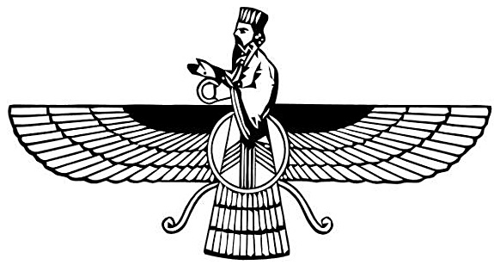
4. Values and Religion
Achaemenid/Iranian Values—Cyrus’s Instructions
Ride the Horse (Duty)
Shoot the Bow (Courage)
Speak the Truth (Virtue)
The two worst sins, in the Achaemenid view
Tell a lie
Go into debt (because debt encourages lying)
The most common beginning of a Persian male name: Arta (Truth)

Slide 32
Values and Religions
Achaemenid/Iranian Royal Religions
No official religion of the empire, but the religion practiced by the current monarch received special attention
Zoroastrian Magi may have been particularly important
Universal freedom of religion (but organized religion seen as a necessary element of social cohesion)
Persian monarchs respected all religions of their subjects, and where their duties required them to practice the religion, they did so.
Egypt
Babylon
Judea

Slide 33
Values and Religions: Zoroastrianism
Actual name at this time: Mazdayasna (Worship of Mazda)
Ahura (Lord) Mazda (Wisdom)
Symbol of Ahura Mazda, a major symbol of Zoroastrianism, also semi-official symbol of Achaemenid Persia.

Slide 34
Values and Religions: Zoroastrianism
Monotheistic or Polytheistic?
Polytheistic in transition to monotheism
Monotheistic theological vision transplanted onto polytheistic framework
Evolving Pantheon
Mithra and Anahita are originally lesser gods
They become manifestations of Ahura Mazda’s being
Sometimes likened to the Christian trinity.
But Anahita and Mithra continue to be worshipped by some adherents throughout this period

Slide 35
Values and Religions: Zoroastrianism
Important Principles
Dualism: Good (Truth) vs Evil (The Lie)
Ahura Mazda is opposed by Angra Mainyu (Evil Spirit)
God, the embodiment of Truth, is omnipresent in nature
Free Will: People choose good or evil
The moral life requires Good Thought, Good Speech, Good Acts
Body is mortal, soul immortal.
Virtuous life rewarded in afterlife, Evil life punished
Pray for enlightenment, not good fortune

Slide 36
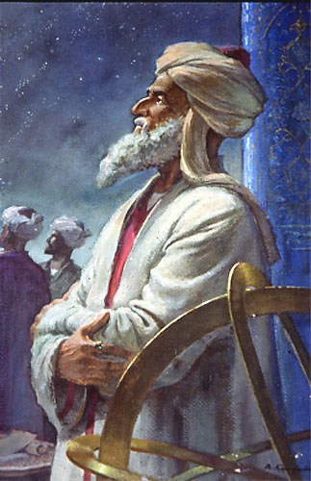
5. Philosophy and Science
The natural world has Laws, and experiences Conflict.
What the Greeks would later call Logos and Dike.
The natural world is God’s creation; to understand it better can never be blasphemous, only worshipful
Mathematics and Astronomy very advanced
Kidinnu, probably responsible for System B method of calculating the speed of the moon in its orbit.
His calulation (29.53059414 days) is within one third of a second of being correct. His caluculation of the length of a year was as close as anyone came before computers.
Engineering (particularly irrigation) also very advanced

Slide 37
Science--Qanats (irrigation aqueducts)
Underground irrigation channels which brought water from highlands to arid lowlands dating from about 1000 BCE.
Financed by early tax incentive system (land irrigated exempt from taxes for three generations)

Slide 38
Science--Early Central Air Conditioning
House built along the trace of a Qanat could use the cool, deep water flow to cool the house in summer, using a wind tower for forced air circulation.

Slide 39
Greece and Persia The War that Created History
Question Break
Coming Up: Persian Art

Slide 40
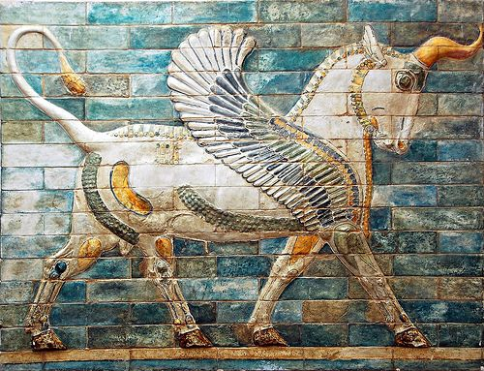
6.Art: Scythian influences

Slide 41
Art: More Scythian

Slide 42
Art: Assyrian influences (The Hunt)

Slide 43
Art: Assyrian (War)

Slide 44
Art: Assyrian (More War) (They liked war)

Slide 45
Art: Assyrian (Kings and Gods)
Note the vanquished enemy trampled under the king’s foot.

Slide 46
Art: Egyptian influences (Gods and Rulers)

Slide 47
Art: Egyptian (Hunt and Farming)

Slide 48
Art: Egyptian (Battle)

Slide 49
Art: Egyptian (More Battle)
Note the defeated enemy trampled underfoot.

Slide 50
Art: Achaemenid Art
Achaemenid official (monumental and architectural) art tended to be derivative, processional and dull.

Slide 51
Achaemenid Art (More Processions)
These appeared on monuments but mostly on the walls of palaces, particularly in the entrances to audience halls.

Slide 52
Achaemenid Art (Processions)
Processional parties are usually shown in groups of six men in the costume of one people of the empire, led by a guide in Persian or Mede dress (alternating).
The guide holds the first man by the hand.
In this (above) a Mede leads a party of Babylonians and (below) a Persian leads a party of Phoenicians.

Slide 53
Achaemenid Art (Processions)
The procession leads to the Great King, where his chamberlain introduces each party to him. The Chamberlain begins the introduction by throwing the king a kiss of respect.
Collectively these carvings give a detailed catalogue of the people of the empire, their unique dress, and the products they brought as tribute—the things they were most famous for.

Slide 54
Achaemenid Art (Processions)
Even warriors and wild animals are orderly.

Slide 55
Acaemenid Art
Nice, but boring.
What about the good stuff? The pictures of mighty battles, violent hunts, and subject people being crushed under the king’s chariot?

Slide 57
Achaemenid Art
There are some depictions of a man hunting or a warrior doing battle, but only on personal seals.
Achaemenid official inscriptions and architectural art contain:
No depictions of battles, or any human doing violence to another
No depictions of hunts
No depictions of subject people being abused, imprisoned, or humiliated
It was also non-narrative. It does not tell what happened, but simply shows what is.

Slide 58
The One Exception: Behistum
The Behistum inscription was made to commemorate the triumph of Darius the Great over nine “kings” (rebellious pretenders to the throne) in a single year.
The prisoners on the inscription are not “subject peoples” but rather the nine specific rebel leaders.
The extensive inscriptions tell the story of how each of those nine rebelled and how they were defeated—the only significant historical narratives in Achaemenid monumental inscriptions.

Slide 59
Achaemenid Official Art as Aspiration
Official art is almost by definition propaganda. It does not represent a society as it was.
But it does show how a society wished to be thought of. It shows the society it aspires to be.
Assyrian, Egyptian, and much of Greek art demands of us that we view those people as mighty warriors to be feared.
Achaemenid official inscriptions never speak of lands conquered, but rather of things built, and they depict an orderly, peaceful and prosperous life shared by people of many different nationalities.

Slide 60
Achaemenid Official Art as Aspiration
“The stone columns which were here wrought, a village named Abiradu, in Elam - from there were brought. The stone-cutters who wrought the stone, those were Yaunâ (Greeks) and Lydians. “The goldsmiths who wrought the gold, those were Medes and Egyptians. The men who wrought the wood, those were Lydians and Egyptians. The men who wrought the baked brick, those were Babylonians. The men who adorned the walls, those were Medes and Egyptians.”
--Darius’s inscription describing the palace at Susa.

Slide 61
Achaemenid Art: Personal Items

Slide 62
Greece and Persia The War that Created History
Question Break

Slide 63
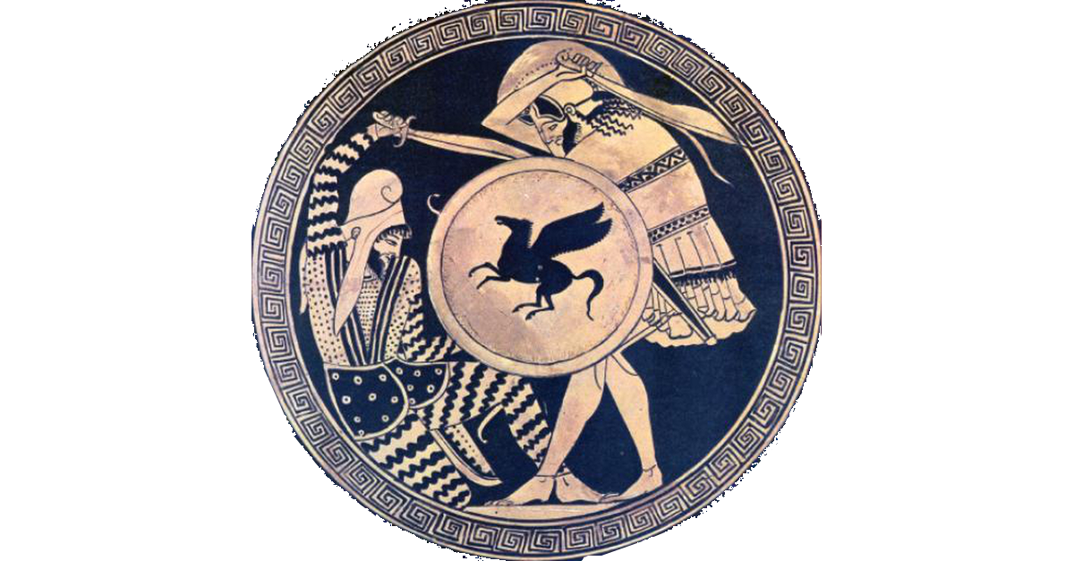
Next Week: (Week 4) “When The Mede Came”
Athens from Tyranny to Democracy
Persia from Backwater Province to Empire in 75 years
The first clash

