Slide 1
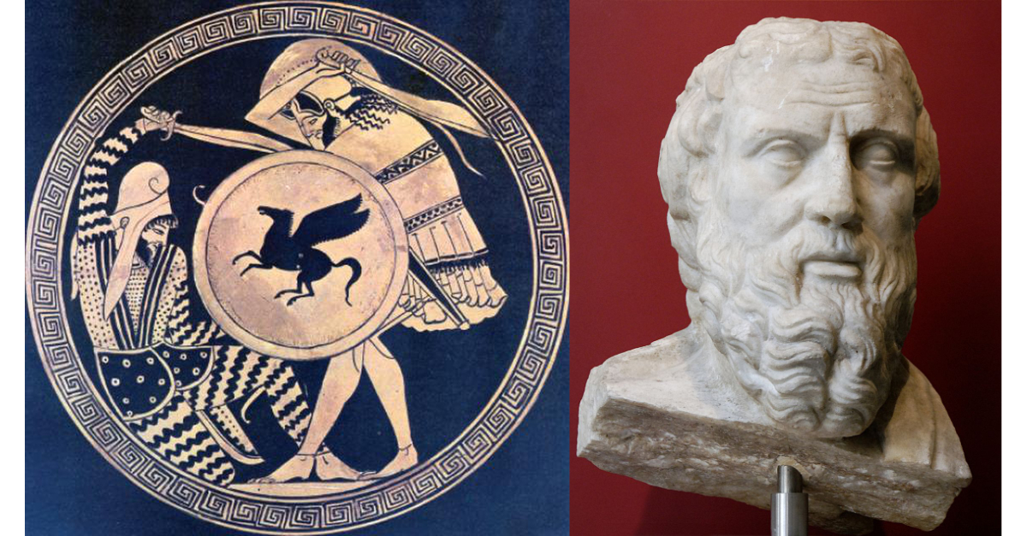
Greece and Persia The war that Created History
OLLI Fall 2019
Week 2: The Greeks—Who were they?

Slide 2
Course Overview
Week 1: The Story, and its sources
Week 2: The Greeks—Who they were and why we should care
Week 3: The Persians—Who were they, and should we care?
Week 4: When the Mede Came—From Cyrus to Darius
Week 5: The Great Invasion—The Stunning Greek Victory
Week 6: The Victors Fall Out—The Peloponnesian Wars
Week 7: The King’s Peace—Fifty Years of War
Week 8: Alexander the Accursed—Destruction of an Empire

Slide 3
Week 2: The Greeks
History (From Archaic Greece to Classical Greece)
Society
Government
Religion
Philosophy
Science
Literature and Drama
Art
War

Slide 4
Putting the Greeks in Context
“The Story” is that the Greeks single-handedly created Western Civilization from nothing, and so their defeat would have meant the loss of everything: democracy, philosophy, science, art.
The message of this course is not that the Greeks did not achieve much which deserves our admiration. It is that they did not do so in a vacuum, nor were they the only ones who did so.
With respect to the Greeks, the greatest problem with “The Story” is its claim of uniqueness.

Slide 5
Archaic Greece Becomes Classical Greece
Greece as we know it arose from the chaos and violence of Bronze Dark Age. It arose by strength of arms.
As one historian noted, during the Dark Age, “The Greeks always landed on their feet, or on someone else’s.”
Their core self image revolved around heroic incidents of The Illiad, Homer’s epic poem about the siege of Troy. They were, in their own minds, a people forged in war.
Greeks had one word which meant both “manly” and “warlike,” because to them, the two were synonymous.
By about 1100 BCE, population pressures in Greece led to the establishment of colonies in nearby lands.

Slide 6
Colonization: First Wave (1100 – 800 BCE)
The Central Greeks colonized the northern coast of Asia Minor (Aeolia)
The Eastern Greeks colonized the central coast (Ionia), (and later the coasts of Macedonia and Thrace).
The Western Greeks colonized the southern (Dorian) coast.
These were not uninhabited areas. The colonies were established by killing, enslaving, or driving off the people who already lived there.

Slide 7
Colonization: Second Wave (800-500 BCE)
A total of 500 separate colonies were established throughout the Mediterranean basin.
Colonies became the outposts of trade.
Greek wine, olive oil, and finished goods flowed out
Grain and raw materials flowed in.
By 500 BCE the colonies contained 40% of the total Greek population.
Most densely settled colonial areas were eastern Sicily and southern Italy.

Slide 8
Estimated Greek Population 400 BCE
Mainland Greece: 3 million
Western colonies (Sicily, southern Italy, etc.): 1 million
Asian colonies (Ionia): ½ million
Others (North Africa, Cyprus, Black Sea): ½ million
Total: 5 million Greeks

Slide 9
QUESTIONS?

Slide 10
Greek Society—Basic Organization
The basic sovereign political unit in the Greek world was the city-state—Polis in Greek-- which consisted of a single major city and all of the lands controlled by it.
Athens was a Polis including the entire territory known as Attica.
It had a population of between 150,000 and 200,000, but probably no more than 30,000 to 40,000 lived in the city of Athens itself.
This still made Athens one of the largest cities of the ancient world.

Slide 11
Greek Society—Who’s Who?
Citizens (All Male) (30-40,000 in Attica)
Aristocrats: Inherited land and wealth
Mercantile Middle Class
Appeared late in the period
Propertied Working Class
Mostly small farmers and craftsmen
Poor day laborers
Non-Citizens (120-160,000 in Attica)
Metics (non-citizen artisans and merchants—substantial legal rights)
Male Slaves (a few legal rights)
Women and children (no legal rights)

Slide 12
Greek Society--Education
Male children of the wealthy began school at the age of seven and continued to the age of fourteen, leaning to read and write, simple arithmetic, music, and recitation of poetry.
Poorer children learned trades as apprentices or followed the family trade.
Girls learned spinning and weaving at home, or occasionally were apprenticed as musicians. Rarely literate.
Very wealthy males, after finishing school, studied under a travelling scholar (sophist).

Slide 13
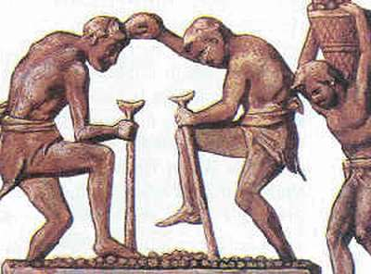
Greek Society: Slaves
Considered essential to allowing the wealthy class the leisure necessary to pursue education and politics
Slaves used extensively in the home, farming, mining, and artisanal work.
Athens had more slaves than it had citizens (over 40,000). This grew in the period of the Athenian Empire.
Athens has been described as “the first slave-based economy.”
Probably more true of Sparta.

Slide 14
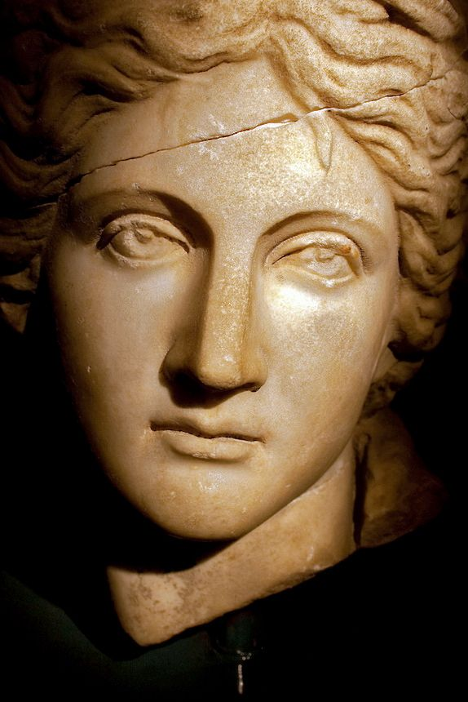
Greek Society: Women
Female “citizens” in Athens, and most Greek city-states, had the status of minors.
They could not own or inherit property, enter into business, be party to a contract, or testify in court.
If widowed or divorced, they reverted to the custody of their father or oldest surviving male relative.
They slept and ate in their own quarters, often on a separate floor from the men of the house. They were almost never present at banquets.
They could not leave the house without permission.

Slide 15
Greek Society: Women
Exception 1—Sparta
Alone among the Greek states, Sparta provided universal education to both boys and girls at state expense
Boys and girls played together and girls participated in their own athletic games
The focus of male lives on warfare in Sparta meant women had a more important hand in running the economy (but not government)

Slide 16
Greek Society: Women
Exception 2—Sappho
One of the great lyric poets of Archaic Greece. Prolific (over 10,000 lines written), widely read, and admired throughout antiquity.
Known as “The Poetess” and “The Tenth Muse.”
Lived from about 630-570 BCE
Also known as a symbol of love and desire between women.
The English words “sapphic” and “lesbian” are derived from her name and the name of her home island (Lesbos).

Slide 17
Greek Society: Women
Exception 3—Aspasia
Metic (foreign immigrant) to Athens, from the Ionian city Miletus.
May have been a hetaira (professional “escort”). Attended banquets (which were usually all-male except for the hetairai). Her wit, intelligence, and breadth of knowledge made her a favorite of Socrates.
Greek statesman Pericles divorced his wife and lived with Aspasia for the rest of his life.
Aspasia is rumored to have written Pericles’ most famous speech, the Funeral Oration.

Slide 18
Greek Society: Male Sexuality
Lack of religious sexual taboos
Zeus as role model
Absolute dominance of males in society
Deliberate segregation of sexes throughout much of life meant a lack of female objects of adolescent lust and romanticism (other than prostitutes)
Pairings often were between an older man and a younger man (or boy).
Sometimes between young men of similar age. References in romantic Greek writing to “first boyfriend.”

Slide 19
Greek Society: Male Sexuality
Expected to marry and have children, but allowed to continue having love affairs with other (usually younger) men and prostitutes (but not married women).
Socrates and Alcibiades
What was considered improper and/or degrading?
Adultery (with a married woman)
Shaving the body and face to appear adolescent, and so taking the role of the younger (submissive) male.
Homosexual adult life-long pair bonding.

Slide 20
Greek Society: Male Sexuality
A famous exception: Thebes
Thebes was known for accepting mature homosexual pair-bonding (and was ridiculed by Athenian philosophers for that reason)
Epaminondas (Theban General)
Arguably the greates Greek general of the Classical era.
Never married. Lived with male lovers his entire life.
When he and his lover Caphisodorus both fell at the Battle of Mantinea (362 BCE), they were buried together, a practice usually reserved for husband and wife.
Theban Sacred Band
Elite spearhead unit of Theban army.
Consisted of 150 pairs of male lovers.

Slide 21
Greek Society: Male Sexuality
Greek glorification of pederasty remains one of the most challenging aspects of Greek society. Until the early Twentieth Century, the west attempted to deal with it by covering it up.
The Greek phrase in Plato’s Symposium which is usually translated as “true love” was orthos paederastein (“the right sort of pederasty”).
“. . . Boy-love, pederasty, or sodomy, which in most of the published moral codes of the world counts as a heinous offense against nature, was for Plato’s model company the one true way to spirituality . . .” –Joseph Campbell, The Masks of God: Occidental Mythology (1964)
Of all the ancient societies we know of, only Greece and Rome shared this characteristic, which by our standards (and those of most other civilizations throughout history) was pathological.

Slide 22
Greek Society: Sexuality
Prostitutes
Prostitution was widely practiced in most of Greece, regulated, and in many cases prices were fixed by the state.
Generally limited to metics (foreigners from a different Greek polis) and barbarian slaves.
Prostitutes were mostly women but included some young men. The clientele was entirely male.

Slide 23
Greek Society: Sexuality
Types of Prostitutes
Pornoi were lowest level, usually slaves owned by their pimps who charged money for sexual favors.
Hetairai were educated, often trained in music, and provided higher-class companionship.
Temple Prostitutes were slaves dedicated to temples of Aphrodite, and a portion of their fees went to the temple.

Slide 24
Society: Notable Characteristics
Patriarchal
Only adult males were citizens
Senior male in household had absolute legal authority
Stratified economically and socially
Religious, but (paradoxically) amoral
Strong sense of loyalty to the Polis (but very little to other Greeks)
Tradition-minded (and grudge-carrying)
Xenophobic coupled with strong sense of cultural superiority
Aggressive and militarily capable. A society made by war.

Slide 25
Greece and Persia The War that Created History
QUESTIONS?

Slide 26
Government
Politics—the business of the Polis—always came down to one thing: concentration and distribution of wealth.
Cycle of governments was Monarchy > Oligarchy > Tyranny > Democracy > Oligarchy > Tyranny > etc.
Disillusioned with monarchy, but not aristocracy (oligarchy)
Athens, and other democracies, for most of their existence, voted on which aristocrats to lead them.
Tyrannies were extra-legal dictators, but generally had the support of the common people (at least for the first generation).

Slide 27
Government
Democracy vs Oligarchy: What’s the Dif?
Citizen Assemblies common throughout the region, regardless of government type. Issue was how much actual power they had and (most importantly) who got to vote in them.
Oligarchy: The franchise (right to vote in the Assembly) was limited to property holders, sometimes with a fixed value of property required for the franchise (and so limiting it to the upper-class).
Democracy: All free-born (male) citizens, regardless of property, were entitled to vote in the Assembly.
Roman Republic (509 BCE) came shortly before Athenian democracy (508-7 BCE).
Was it a democracy or an oligarchy? (A good question to ask in a different class.)

Slide 28
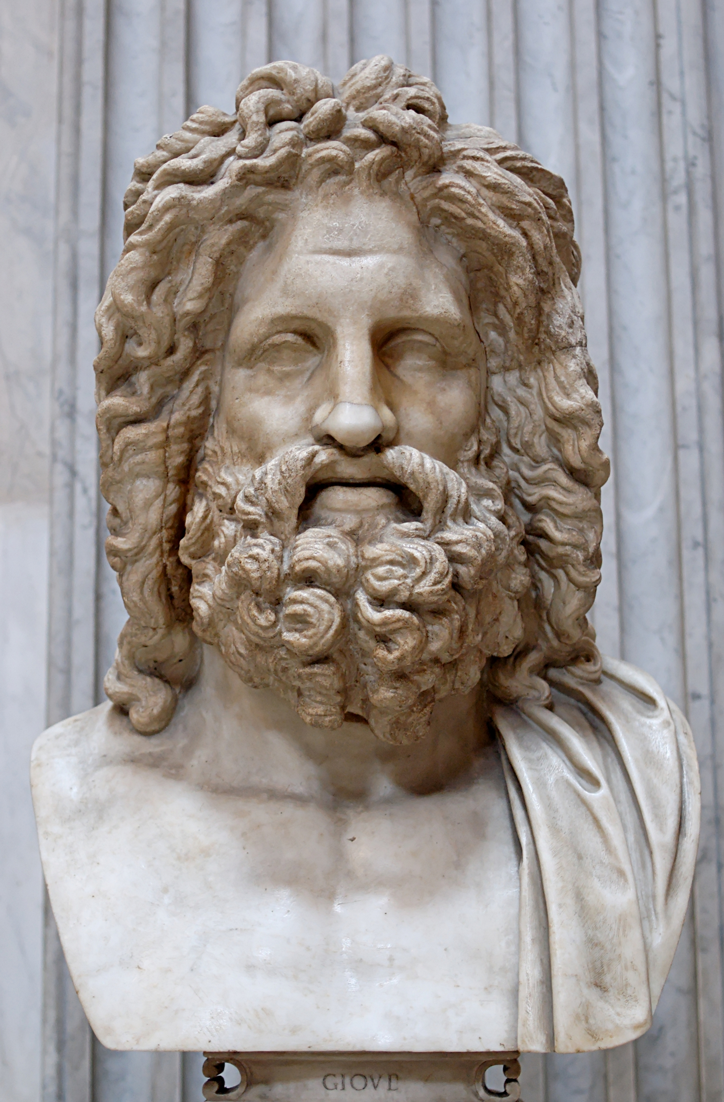
Religion: The Olympian Gods
One of the essential defining features of “Greekness.” Pious practice rigidly enforced by law.
Polytheistic, materialistic, transactional religion
Sacrifice to the gods and they will do something to help you in this world.
The gods are no better (moral) than ordinary men, only more powerful
No moral direction from religion
No requirement to believe, no call to faith
Only call to follow rituals precisely and avoid angering the gods (usually by boastful displays of arrogance)
Hubris and Nemesis
The closest to a moral warning.

Slide 29
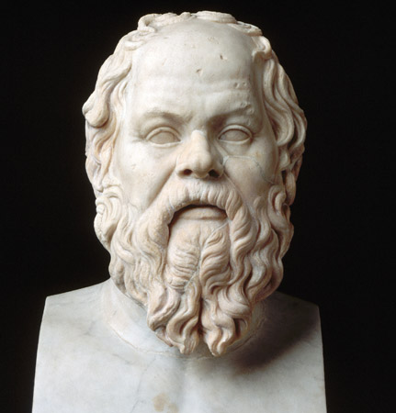
Philosophy
Lack of moral guidance from religion created a need for some independent guidance concerning the good life.
Start date: 585 BCE, solar eclipse prediction by Thales of Miletus.
Early philosophy more concerned with understanding the natural world.
What is it? How does it work?
Efforts to escape “received knowledge” led to rejection of the senses (and so discounting of observation)
Most philosophers were teachers to the sons of the aristocracy, and were contemptuous of democracy.

Slide 30
Science and Mathematics
Hampered by religious dogma
The world is the way it is because gods chose to make it so.
The fiery chariot of Helios circles the world once a day. (And if you disagree, you are guilty of impiety.)
Hampered by philosophy
Philosophical attempts to escape “received knowledge” produced high degree of logic, but unsupported by facts.
“Unreliability of the senses” led to discounting the value of observation of phenomena
Believed superiority of Mind over Senses led to over-abundance of theory
Hampered by a lack of interest in Mathematics
Pythagoras “discovered” most early principles of geometry and mathematics after studying for several years in Egypt and (possibly) Babylon. He then made it a religion.

Slide 31
Science and Mathematics
Egypt was far ahead of the Greeks in Geometry
We have only fragmentary records of very early (3000 to 300 BCE) Egyptian geometry, but we know they knew how to calculate the areas and volumes of various shapes.
Much of Pythagoras’s knowledge of geometry came from Egypt. He made the point of learning to speak Egyptian so he could study there.

Slide 32
Science and Mathematics
Babylonian algebra was very advanced, superior to anything the Greeks worked with.
There are stories that Pythagoras studied under the Babylonian Magi, but no conclusive proof of it. He should have.
“If the early Greeks were cognizant of Babylonian algebra, they made no attempt to develop or even to use it, and thereby they stand convicted of the supreme stupidity in the history of mathematics. ...The ancient Babylonians had a rare capacity for numerical calculation; the majority of Greeks were either mystical or obtuse in their first approach to number.”
--Eric Temple Bell, The Development of Mathematics (1940)

Slide 33
Greece and Persia The War that Created History
Still to come
Literature and Drama
Art
War
Question Break

Slide 34
Literature and Drama
Epic mythic poems of Homer
Critical in defining national character
Narrative Prose History
Herodotus and those who followed
Philosophical and Practical Essays
Plato, Xenophon, Aristotle
Drama, based on similar mythic themes
Initially fairly direct religious lessons
Later more critical and psychological in content

Slide 35
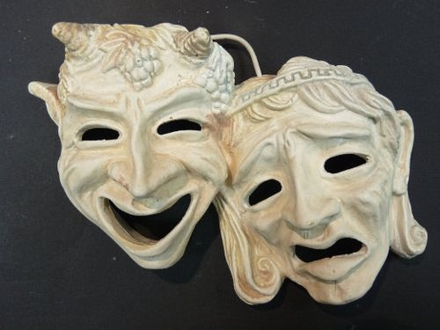
Drama
Evolved from traditions of oral storytelling and religious ritual
First tragedies performed in Athens about 532 BCE by Thespis.
Originally consisted of one actor and a chorus. Later more actors added.
Actors and chorus wore masks to emphasize character.
Three types of plays: Tragedy, Comedy, and Satyr (broad, bawdy tragicomedy)

Slide 36
Drama
Of the hundreds of plays written and performed during the Classical Era, fewer than fifty survive, and only from five authors.
7 by Aeschylus (out of 70-90)
11 by Aristophanes (out of 40)
18-19 by Euripides (out of 92)
1 by Menander (out of 108)
7 by Sophocles (out of 120+)

Slide 37
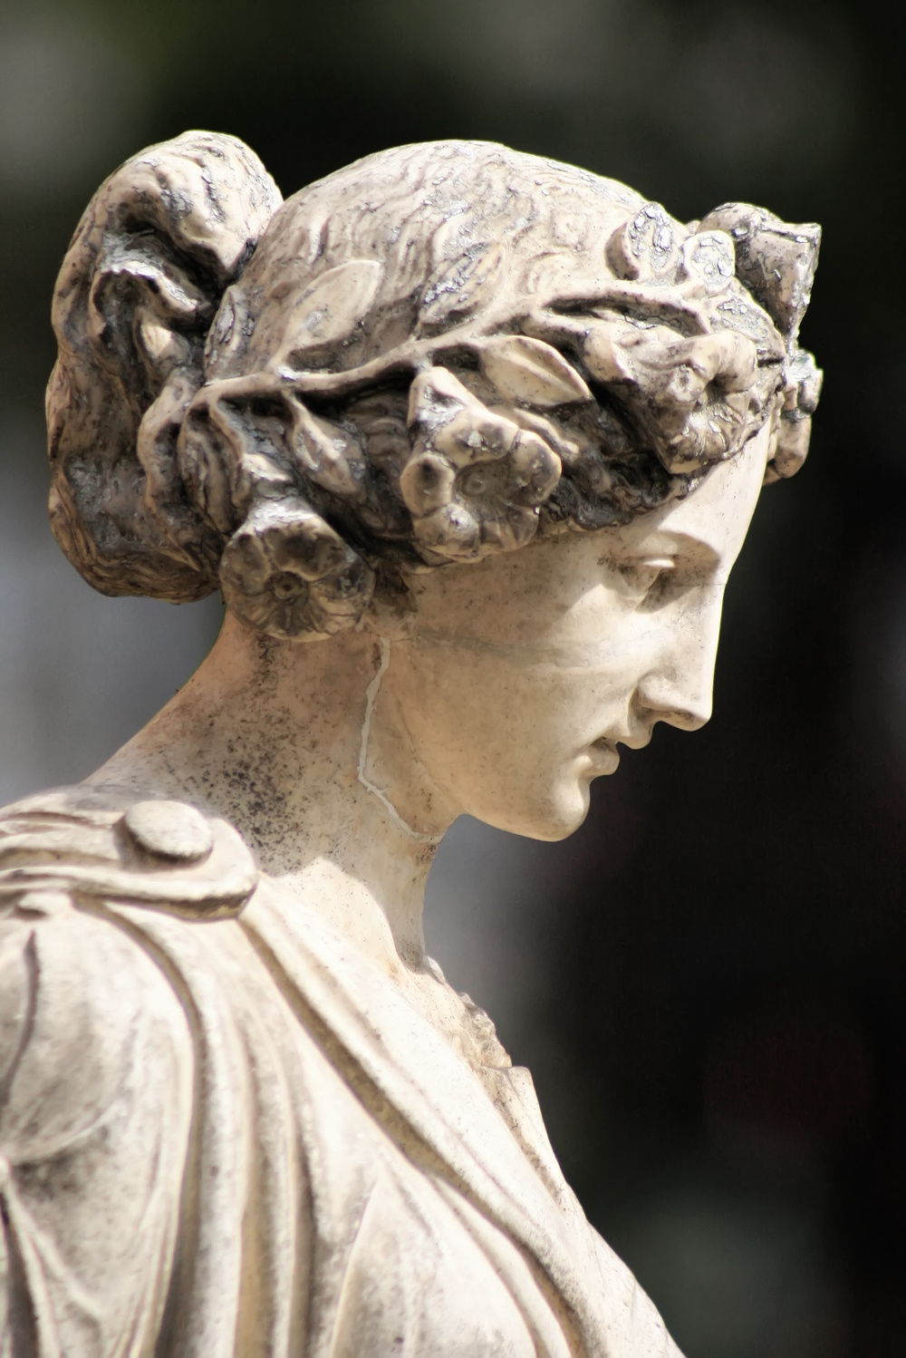
Art
Portrait art, especially sculpture, appeared at a very early time, originally inspired by Egyptian statues.
Individuals nearly identical, with identical neutral expressions, almost a half-smile (even when dying)

Slide 38
Art
Late in the classical period, evolved into more individualistic faces with personality and a variety of expressions.

Slide 39
Art
Painted pottery major export of Greece. Found throughout the Mediterranean basin.
In the Archaic Period, Black Figure Pottery, made mostly in Corinth and Athens, was the most common.
Subjects included the Gods, everyday life, worship, and war.

Slide 40
Art
Starting in about 520 BCE, Red Figure Pottery, invented in Athens, became the dominant form.
The Greek self-image was in large part defined by war, and so depictions of combat are common. They provide us with much of what we know about period weapons and fighting techniques.

Slide 41
Greece and Persia The War that Created History
Still to come
The Greeks at War
Question Break

Slide 42
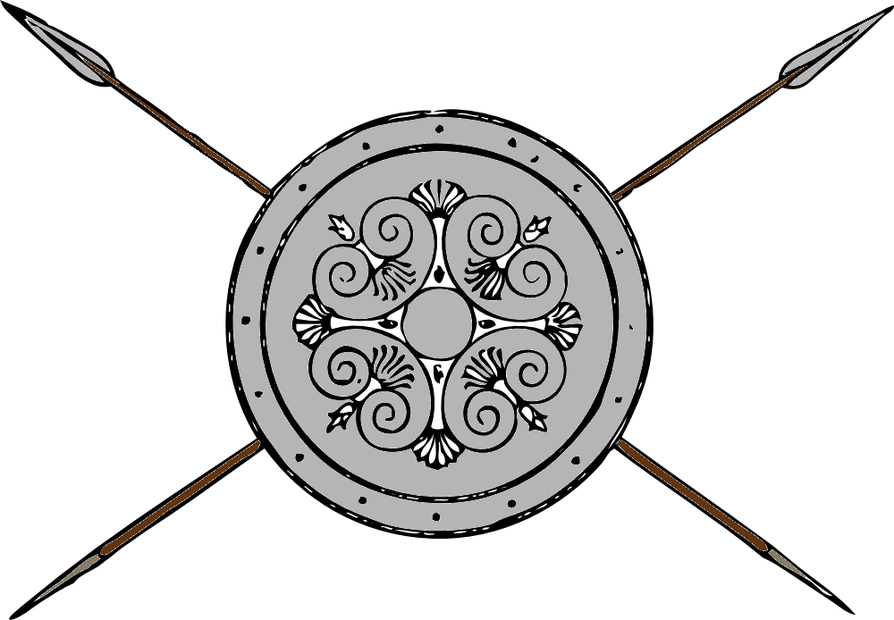
The Greeks at War
Most Greek wars were directed against their neighboring Greeks.
Wars were usually fought in the summer, once crops were planted and farm work force not needed until harvest.
Scarcity of good farmland meant armies had to protect what they had, and that meant fighting in the open on mostly level ground.

Slide 43
The Greeks at War--Cavalry
Greece (especially southern Greece) was not good horse country, so Greek armies had few cavalrymen.
The upper class, who could afford horses, provided what little there was.
The northern areas (Thessaly, Macedon) had more and better horses, and so more and better cavalry.

Slide 44
The Greeks at War—Heavy Infantry
The middle class provided citizen Hoplites (heavy spearmen).
Armed with a long spear, large circular shield, helmet, and body armor
Greek hoplites were the finest heavy infantry of the Classical Period—until the appearance of the Macedonian pikeman.
Ability to afford hoplite equipment defined the Greek middle class.
Hoplite equipment may have evolved in Caria (Asia Minor) but was embraced and perfected by the Greeks.

Slide 45
The Greeks at War—The Hoplite Phalanx
The hoplites fought in a dense formation, called a Phalanx.
Usually eight or ten men deep, presenting a solid front bristling with spears.
Each man’s shield partly covered the man to his left.

Slide 46
The Greeks at War—Light Troops
The poorer classes provided lightly-armed troops (Psiloi), usually armed only with slings or javelins.

Slide 47
The Greeks at War—Navies (and Politics)
The basic warship of the Classical Period was the trireme (trieres in Greek), literally a “three-rower,” so called because it had three banks of oars on each side.
Each ship usually carried 10-20 marines.
The bow, tipped with a bronze ram, was its main weapon.
Each trireme required 170 rowers (the bulk of the crew).
At its peak strength the Athenian navy had 300 triremes, which required the employment of 51,000 rowers.
The rowers were from the poorer classes and Metics (resident foreigners), not galley slaves.
In addition to providing income to the poor, this increased their importance to the defense of the state (and hence their political power).
As a result, expansion of the navy was often backed by the popular party, and opposed by the aristocracy (and the hoplite class).

Slide 48
Two Views on War’s Likely Outcome
“We make war that we may live in peace.” -Aristotle
“All who draw the sword will die by the sword.”
-Matthew 26:52

Slide 49
War and the End of Classical Greece
Greeks defined themselves in terms of war.
They made war to “live in peace,” but never did so. Not even Aristotle could see a way beyond it.
They achieved only endless war, which eventually consumed them.

Slide 50
A Couple More Suggested Readings
Robert Garland, ANCIENT GREECE: Everyday Life in the Birthplace of Western Civilization. New York: Sterling Publishing, 2008.
Frank J. Frost, GREEK SOCIETY(Fifth Edition). Boston: Houghton Mifflin, 1997.

Slide 51
Greece and Persia The War that Created History
Question Break

Slide 52
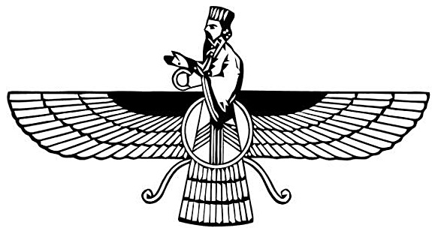
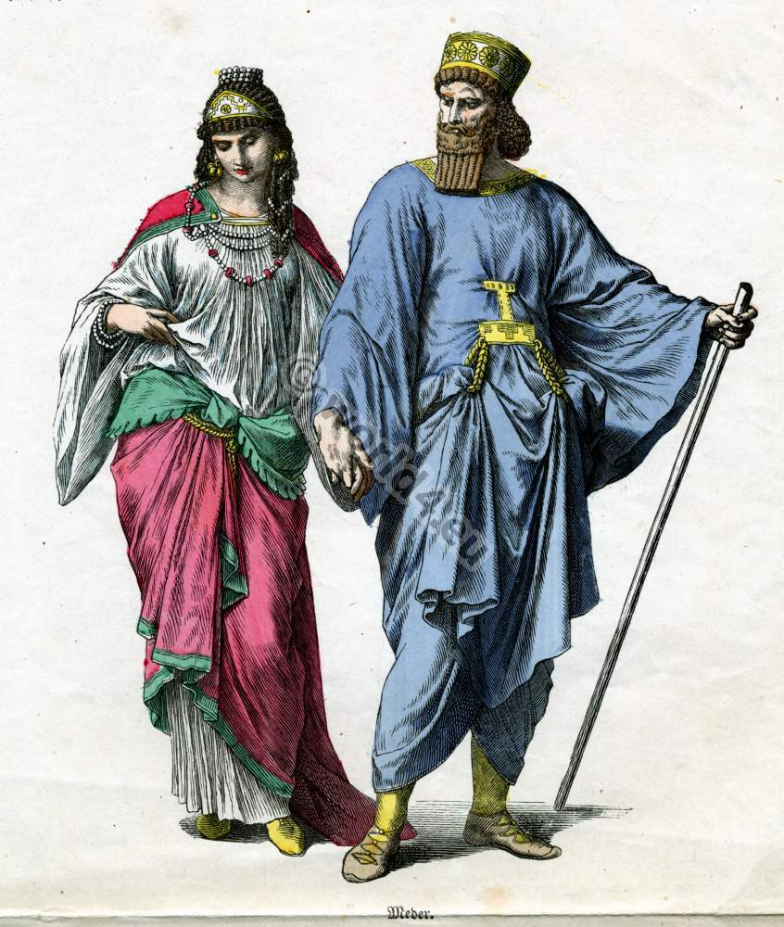
Next Week: (Week 3) Meet the Persians!
Who were they, and should we care?
(Well, of course!)

