Slide 1
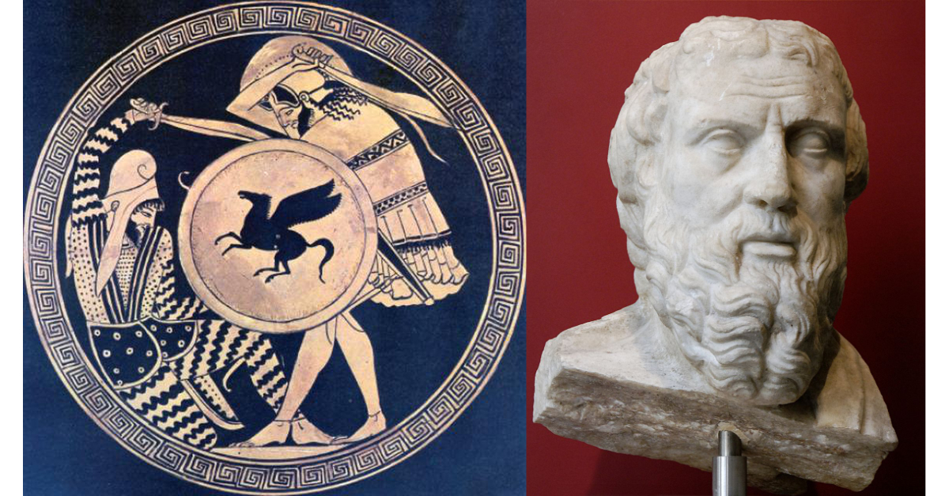
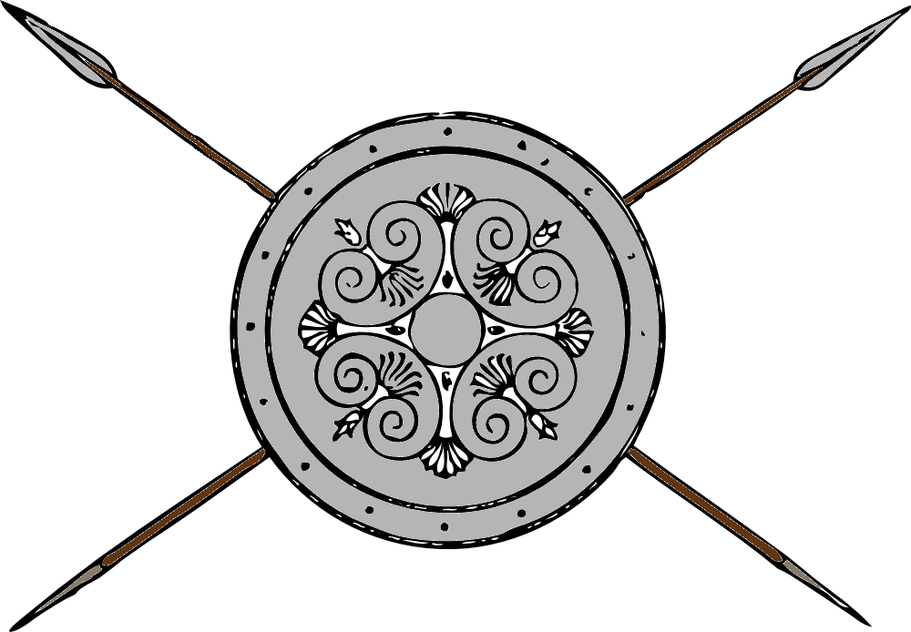
Greece and Persia The war that Created History
OLLI Winter 2022
Week 1: The Story

Slide 2
Greece and Persia The war that Created History
What is History?

Slide 3
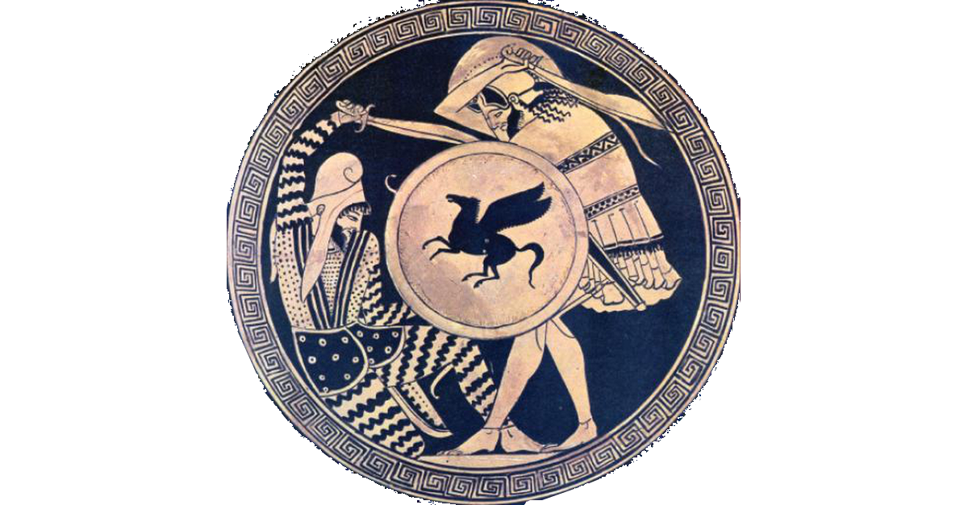
Course Overview
What do you know about the Greek-Persian Wars?

Slide 4
Course Overview
Probably This:
Greece was the birthplace of western civilization, philosophy, and democracy.
Invaded by the Persians, and hopelessly outnumbered, the Greeks fought a heroic defense, pushed back the forces of oriental absolutism, and saved western civilization.
Later, Alexander the Great invaded and conquered the decadent Persian empire and spread Hellenistic civilization throughout the east.

Slide 5
Course Overview
This view has been reinforced and driven
by popular culture.
From the film 300
Left, Spartan King Leonidas
Right, Persian King Xerxes.
(Guess who’s the bad guy.)

Slide 6
Course Overview
The Course in a Nutshell
The victors write the history, but what they write isn’t always true.
Most of what you have been told about Achaemenid Persia and its people is wrong.
What follows is not new, revisionist theories. It is the result of decades of work by legions of scholars, and is now widely accepted in the historical community.
Why it is not part of the popular understanding of the event is an interesting question.

Slide 7
Course Outline
Week 1: The Story, and its sources
Week 2: The Greeks—Who they were and why we should care
Week 3: The Persians—Who were they, and should we care?
Week 4: When the Mede Came—From Cyrus to Darius
Week 5: The Great Invasion—The Stunning Greek Victory
Week 6: The Victors Fall Out—The Peloponnesian Wars
Week 7: The King’s Peace—Fifty Years of War
Week 8: Alexander the Accursed—Destruction of an Empire

Slide 8
Week 1: The Story
Historical Background
Herodotus, father of history
The Greek and Roman successors of Herodotus
The story they told
The other sources
What the other sources say
Why you’ve probably never heard that story

Slide 9
1. Historical Background-- Timeline (overview)
1600 BCE: Heroic (Mycenaean) Period
1100 BCE: Bronze Age Collapse (Dark Age)
650 BCE: Archaic Period
480 BCE: Classical Period 499-323 BCE Persian Wars
323 BCE: Hellenistic Period
31 BCE: Ascendancy of Rome

Slide 10
1. Historical Background-- Timeline (continued)
1600-1100 BCE: Heroic (Mycenaean) Period
1570: Rise of New Kingdom Egypt
1200: Trojan War
1100-650 BCE: The Bronze Dark Age
1069: Collapse of New Kingdom Egypt
800: earliest Greek writing
776: First Olympic Games
725-700: Homer composes Illiad and Odyssey
675: Nomadic Persians settle in Iranian Plateau

Slide 11
1. Historical Background-- Timeline (continued)
650-480 BCE: Archaic Period
612: Collapse of Assyrian Empire. Rise of Medes
594: Solon’s reforms in Athens
553-530: Cyrus the Great conquers Medes, Babylonia, Asia Minor and other lands to form the Achaemenid Persian Empire.
522: Darius The Great becomes king, consolidates and reorganizes empire
510: Athenians drive tyrant Hippias into exile.
509: Rome overthrows king, establishes republic
508-7: Athens adopts democratic constitution
START OF THE PERSIAN WARS
499-493: Ionian cities, with Athenian aid, revolt from Persia, but fail
490: Persians send punitive force against Athens, defeated at Marathon
482: Athens builds a fleet

Slide 12
1. Historical Background-- Timeline (continued)
480-323 BCE: Classical Period
480: Persia invades Greece. Battles of Thermopylae and Salamis
479: Defeat of Persians at Plataea and Mykale temporarily ends war
447-449: Wars of the Delian League (later Athenian Empire) against Persia
430: Herodotus publishes Histories (Inquiries)
431-404: Peloponnesian Wars (ends in defeat of Athens by Sparta)
396-5: Sparta invades Persian Asia Minor, but withdraws
395-387: Corinthian War between Sparta and coalition of Greek states
387: King’s Peace (dictated by Artaxerxes II) ends Corinthian War
371-362: Theban Hegemony breaks Sparta’s power
338: Philip of Macedon defeats Athens and Thebes at Chaeronea
334-330: Alexander invades and conquers Persia.
323: Alexander dies, his empire disintegrates into warring states.

Slide 13
1. Historical Background-- Timeline (continued)
323-31 BCE: Hellenistic Period
323: Greece becomes province of Macedon, Athenian democracy ends.
272: Greeks in Southern Italy conquered by Rome
218-201: Rome defeats Carthage in 2nd Punic War (Hannibal’s War)
211: Rome sacks Syracuse, conquers Sicily
146: Greece (as part of Macedonia) becomes Roman province.
31: Octavian defeats Mark Anthony at Actium. Rome becomes master of the Mediterranean basin.
27: Roman Republic replaced by Roman Empire

Slide 14
1. Historical Background-- Geography
Persian Empire
490 BCE

Slide 15
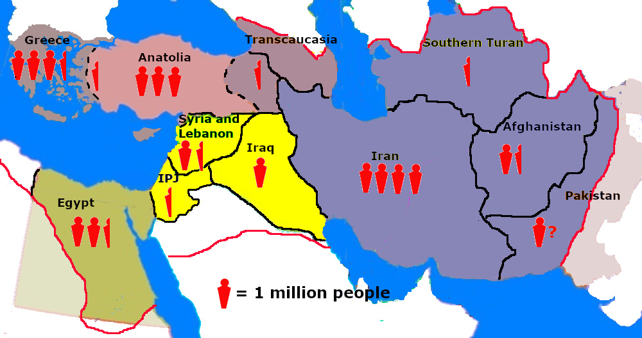
1. Historical Background-- Geography
Population
and
Languages
About 500 BCE
Yellow: Semitic
Green: Demotic
Shades of Gray: Indo-European

Slide 16
2. Herodotus, The Father of History
Previous historians and chroniclers mostly provided a list of events and when they took place
Herodotus set out to tell a multi-generational story with a clear conclusion proving a point (the superiority of the Greeks over the Persians).
Collected as much evidence as he could. The book was called “Inquiries,” which in Greek is Historias.

Slide 17
2. Herodotus, The Father of History
Herodotus’s two important contributions to History:
Switching focus from a chronical of events and elite biographies to an examination of cause and effect over long periods of time.
Replaced emphasis on isolated events with multi-generational stories
Anticipated the Longue Durée view of history
A commitment to a systematic search for information leading to an understanding of the truth
He did not always discover the truth, but he always tried to do so.

Slide 18
3. Greek Contemporary Successors
Thucydides: The Peloponnesian War
Began where Herodotus’s Histories left off. (435-410 BCE)
Ctesias of Cnidus, Persica
Sometime physician to the Persian king Artaxerxes II, his accuracy is no longer trusted. Now viewed as mostly court legends and gossip.
Xenophon: The Anabasis (The March Upcountry)
Recounts Cyrus the Younger’s revolt against Shah Artaxerxes II and the later actions of the “Ten Thousand” (Greek mercenaries) fighting their way beck from the heart of Persia. (401 BCE)
Xenophon: Hellenica
History of the Greek world beginning from where Thucydides left off. (410-362 BCE)

Slide 19
3. Later Greek and Roman Successors
Diodorus Siculus: The Library of History
Drawing on a wide variety of now-lost sources, Diodorus is the most detailed surviving ancient account covering this entire period.
Arrian: The Campaigns of Alexander
Draws mostly on the official chronicle of the campaign kept by Ptolemy Soter, now lost.
Quintus Curtius Rufus: The History of Alexander
Based on the now-lost accounts of three contemporaries of Alexander. A non-flattering psychological portrait of Alexander.
Plutarch: Lives of the Noble Greeks and Romans
Particularly of Alexander, Agesileos, and Artaxerxes II
Justin: Epitome of the Philippic Histories
Extracted from Gnaeus Pompeius Trogus, now lost

Slide 20
4. The Story They Told
The Persian monarchy was an absolutist tyranny bent on enslaving the known world.

Slide 21
4. The Story They Told (continued)
Even though hopelessly outnumbered, the Greeks refused to give up their freedom and submit.
The Spartans threw the Persian ambassadors down a well.

Slide 22
4. The Story They Told (continued)
Through a combination of brilliant strategy and incredible heroism, the Greeks broke the advancing wave of Persian conquest and saved the rest of the western world.

Slide 23
4. The Story They Told (continued)
Following their defeat, the Persians lapsed into luxury, decadence, and weakness.
The common people were crushed by taxation, government was poisoned with intrigue, and their only reliable troops became Greek mercenaries.

Slide 24
4. The Story They Told (continued)
When a coalition of Greek states led by Alexander invaded Persia, they faced enormous armies poorly led by a cowardly king, and they swept the rotten façade of the empire away.

Slide 25
Greece and Persia The War that Created History
Question Break

Slide 26
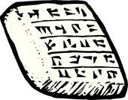
5. The Other Sources
Babylonian and Egyptian chronicles and temple records
The Hebrew Bible
Legal and banking records
Persian monumental inscriptions
Iranian and Zoroastrian oral traditions
The Persepolis archives

Slide 27
Other Sources: Chronicles and Temple Records
Greeks claim Cambyses II, the son of Cyrus the Great, slaughtered the sacred Apis Bull in Egypt, an act of religious desecration and persecution.
Egyptian chronicles show the opposite—that the Apis Bull passed away naturally and that Cambyses mourned and honored its passing.
Greeks claim Artaxerxes III was assassinated by a scheming eunuch named Bagoas.
The surviving Babylonian chronicles have him passing away of natural causes.

Slide 28
Other Sources: The Hebrew Bible
Several books, written during and shortly after the fall of the empire, present a view of Achaemenid Persia contradictory to the Greek portrayal.
Example: Book of Esther (More on this in Week 3)

Slide 29
Other Sources: Banking records
The Greeks claim over-taxation by the Persian monarchy toward the end of the kingdom sucked money from the economy, bankrupted small farmers, driving them from the land, and destroyed the land-owning “yeoman” class.
The records of banks in Babylonia show no evidence of a shortage of currency, increased foreclosures, or greater concentration of land in the hands of the wealthy.

Slide 30
Other Sources: Legal records
The Greeks claim Persian women were sequestered from society in “harems” and not allowed to show themselves in public.
Persian and Babylonia legal documents show many examples of women owning property, engaging in commerce, managing businesses, travelling to tend to their business affairs, and hosting large banquets on their own.
Divorce records show court-mandated payments of alimony and child support to women by their former husbands, over and above return of their dowry.

Slide 31
Other Sources: Inscriptions and Oral Traditions
We’ll talk about those in Week 3.

Slide 32
Other Sources The Persepolis Archives (The Big One!)
In 1933, Ernst Herzfeld of the Oriental Institute (University of Chicago) discovered a cache of over 30,000 clay tablets and fragments of tablets in the ruins of Persepolis, the ceremonial capital of Achaemenid Persia.
Most were in the area known as The Fortification, with a smaller number found in The Treasury.

Slide 33
Other Sources The Persepolis Archives (continued)
Sun-baked clay tablets recording financial transactions, mostly payment by the treasury to cover salary to officials, government travel, and payments for large numbers of construction projects.
Sample:
“2 BAR of figs, supplied by Sutena, was taken to Persepolis for the royal stores. Bakabada and Nababa received it. 21st year.”

Slide 34
Other Sources The Persepolis Archives (continued)
Would never have survived two thousand years except for Alexander’s destruction of Persepolis by fire.
The heat of the fire hardened the tablets further.
The collapse of building material on the archives sealed them against the elements until archaeologists discovered them
Since then they have been slowly catalogued, photographed, and translated at the Oriental Institute in Chicago.

Slide 35
Other Sources The Persepolis Archives (continued)
The routine nature of the records meant translation and publication was not a high priority. Their importance was only realized when a sufficient number were translated so that clear patterns could be detected.
In 1969 Richard Hallock of the Oriental Institute published Persepolis Fortification Tablets, with translations of over 2,000 intact (or mostly so) tablets. The revelations began a renaissance of Achaemenid studies from the 1970s to the present.
Now they have changed our thinking about the Achaemenid Persian Empire.

Slide 36
6. The Story They Told
The Achaemenid Persian empire was a peaceful, prosperous, and stable political union for the two hundred and twenty years of its existence.
After the first surge of military campaigns established the outer boundaries, Achaemenid Persia ceased being an expansionist power.
There is little or no evidence of economic, political, military, or moral “decadence” in the Achaemenid Persian empire.
In their approach to religion, science, acceptance of different cultures, and the role of women in society, the Achaemenid Persians were much closer to modern western civilization than were the Greeks.

Slide 37
7. Why You’ve Never Heard This Before
The Persepolis archives have been available less than ninety years, and significant portions of them have only been catalogued and translated for the last fifty years.
Greek and Latin literature has been available and studied for centuries. Those stories took root in our imaginations.
It’s easier to read Greek or Latin than decipher Cuneiform tablets.
It’s more interesting to read exciting prose narratives than sift through records of financial and legal transactions.
The original story has become embedded in our self-image, to the point of becoming a political/cultural cause. Some now have an ideological interest in maintaining the original popular narrative.

Slide 38
Next Week: (Week 2) Meet the Greeks!
Who they were and why we should care.

