Slide 1
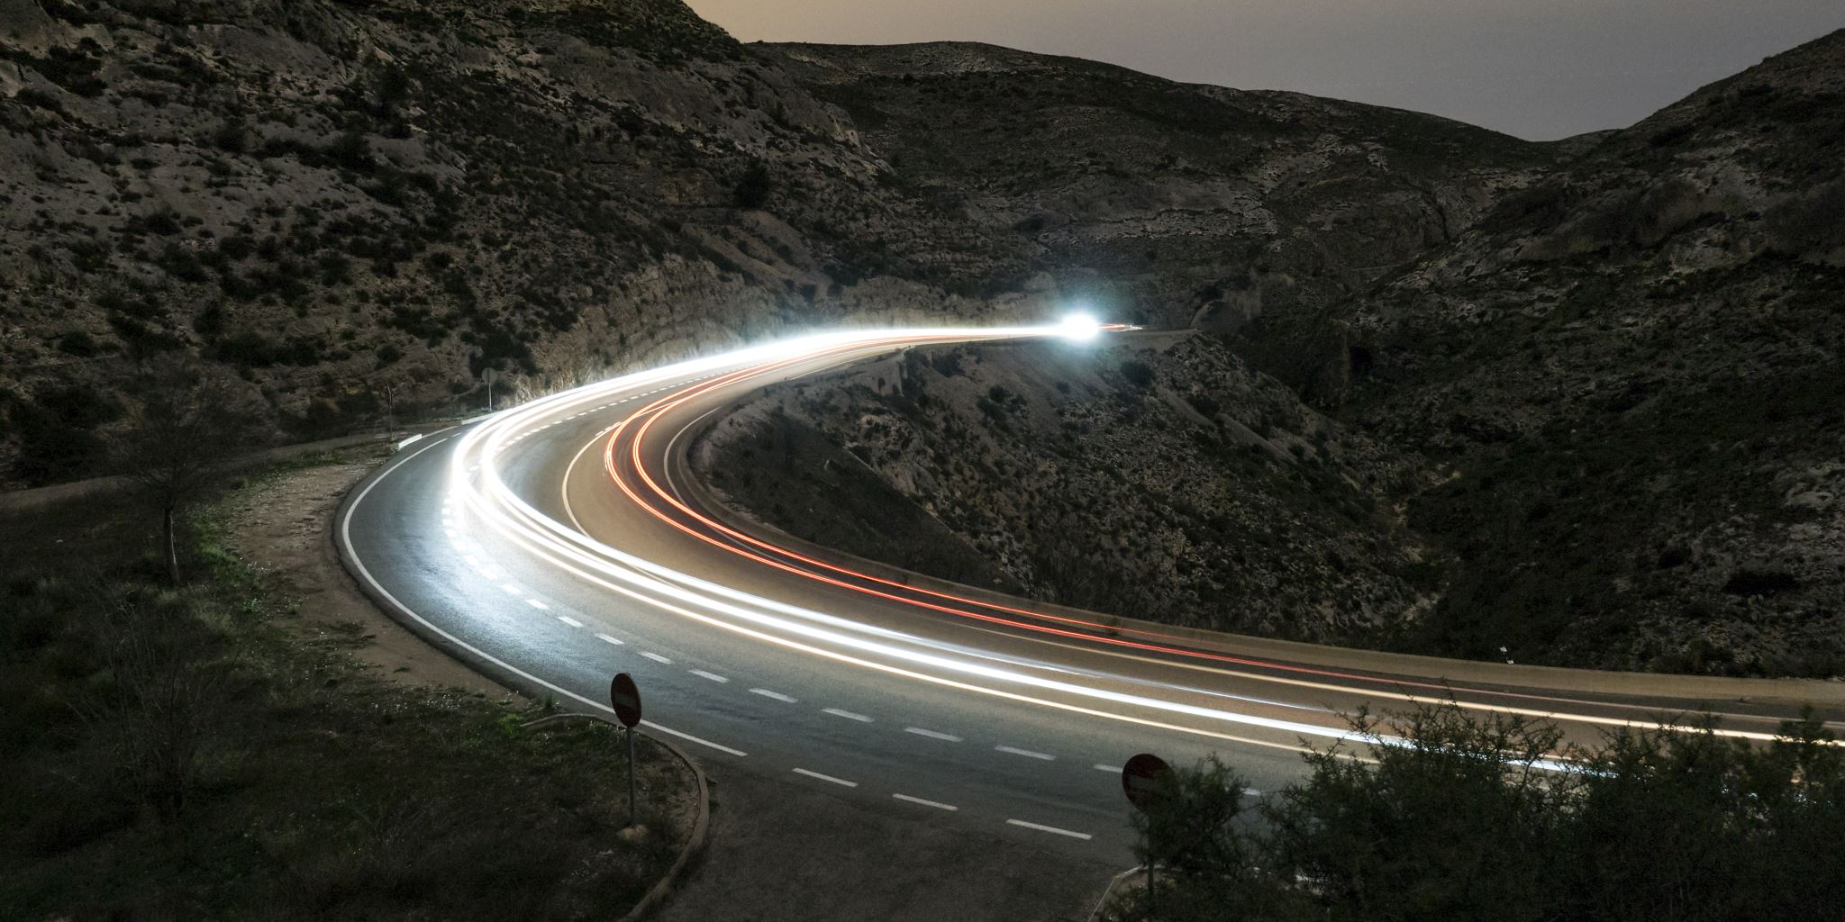
The Road Movie
Generic iconography and narrative conventions and themes

Slide 2
Generic Iconography
Man + machine (what kind of man? what kind of machine?)
The open road / the Frontier / the city
Distances and borders
East/west versus north/south
Landscapes/lifestyles (nature/culture)
Traveling camera shots
Musical soundtrack

Slide 3
Narrative conventions
Normal status quo
Who is going? (post-1969 two men; earlier, man/woman)
Reasons for going on the road
Preparations for travel
Pit stops → plot events
Resistance to closure?

Slide 4
Road Movie Thematics
Adventure versus domesticity
Freedom versus responsibility
The Journey versus the Destination
Quest road movies versus outlaw road movies
Ending of the journey
Does going on the road help?
Personal growth/change

Slide 5
The Essential Canadian Genre
Regional disparity: the ROC and the Maritimes versus the major cities
The place of work in a man’s life
English versus French Canada
Alcohol consumption and class
Adventure versus safety
Economic migrancy
Relation to ideal masculinity

