Slide 1
Canada at a Glance

Slide 2
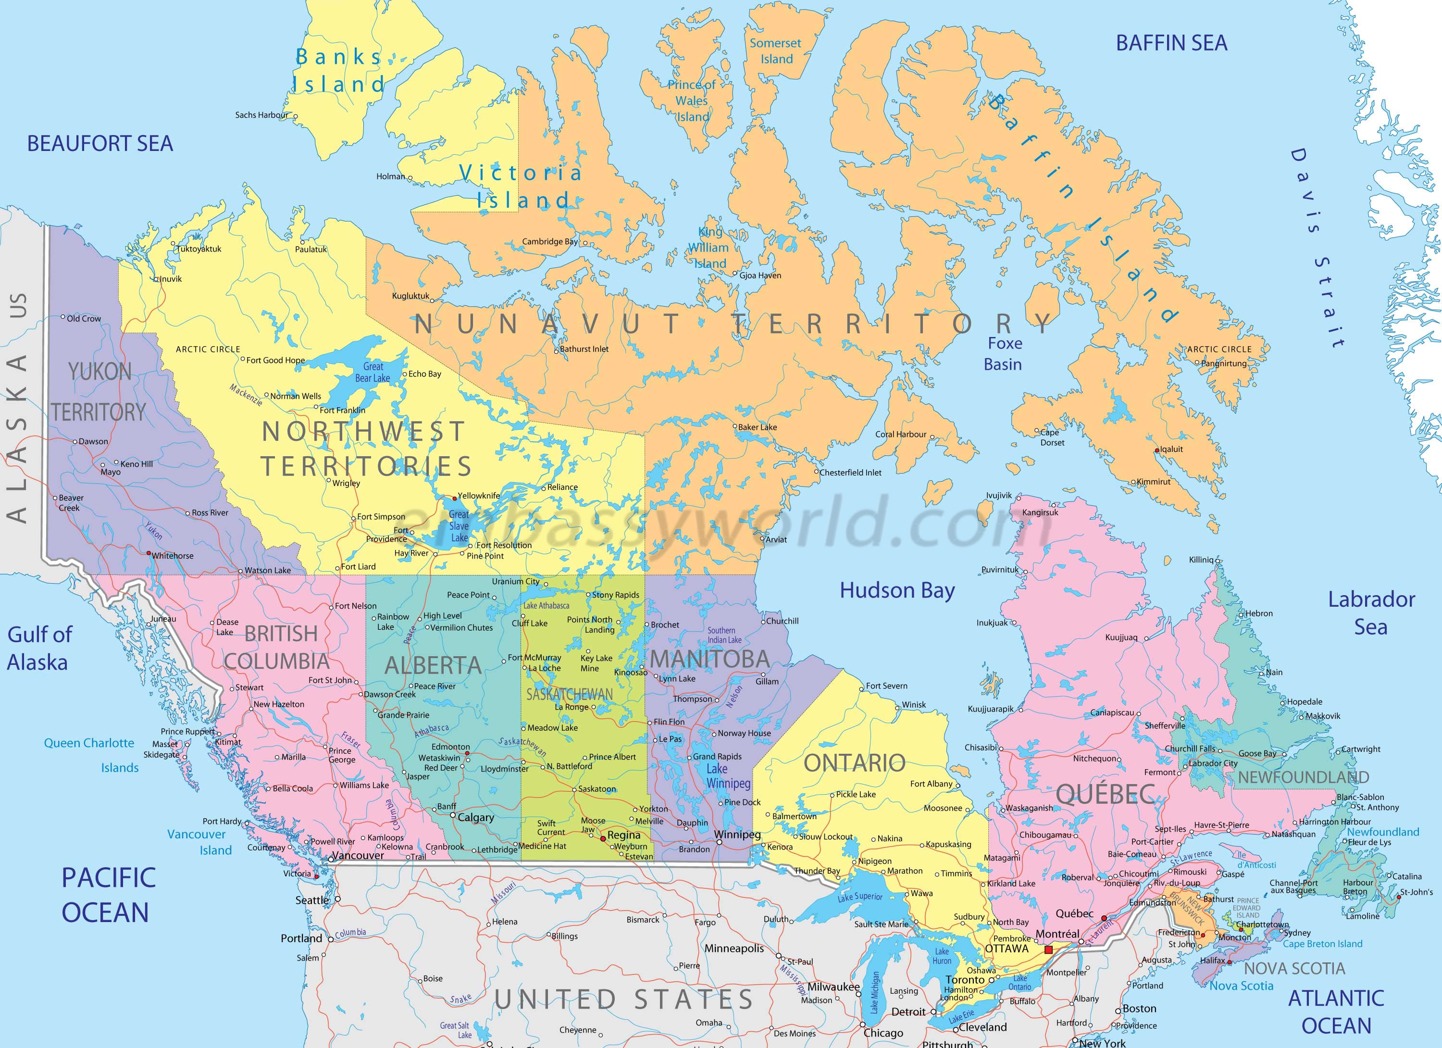
Canada

Slide 3
Some Facts
Canada is the second-largest country in the world, after Russia. Canada has 6 time zones.
2020 population estimate: 38.1 million (US 2020 population estimate: 329.5 million)
ethnic breakdown: 18% British; 16% “visible minority”; 14% Scottish, 14% French; 13% Irish; 10% German; 5% Chinese; 4.6 Italian; 4.4% Aboriginals; 4% East Indian. Aboriginals include First Nations, Métis, and Inuit.

Slide 4
Key Events in
Canadian History
British-French tensions from the beginning
1625 French Jesuits arrive to convert Native peoples
17th Century: French and English kings support economic exploitation of Canada
Canada made a British colony after 1756
American Loyalists emigrate to Canada during the Revolution; Canadian English language becomes more American and less British

Slide 5
Key Events in
Canadian History
1867 Confederation formed (Ontario, Quebec, New Brunswick, and Nova Scotia)
1873 The Mounties are formed, becoming the symbol of Canada and part of Canadian mythology
1879: first organized hockey game with a flat puck; 1893 Lord Stanley’s Cup donated
1896: Gold discovered in the Klondike, Yukon Territory

Slide 6
Key events
1918: Women get the vote (1920 in US)
1931: Canadian independence
1950: Inuits get the vote
1960 Natives living on reserves get the vote
1960: the “Quiet Revolution” begins in Quebec
1969: Canada becomes officially bilingual
1976: death penalty abolished

Slide 7
Key events
1980: Quebec voters reject separation; again in 1995
1989: dollar bill replaced by the dollar coin, called a “loonie”
1996: first celebration of National Aboriginal Day
1999: creation of Nunavut as Inuit state (“our land”)
2002: Canadian Multiculturalism Day proclaimed
2008: Official apology for reserve school system

