Slide 1
OLLI FALL 2022 Wisdom in Statecraft, Or, Why History Always, Yet Never, Repeats Itself
Tuesday, November 1
Lecture Eight
Historical Cycles and Agitprop Noises

Slide 2
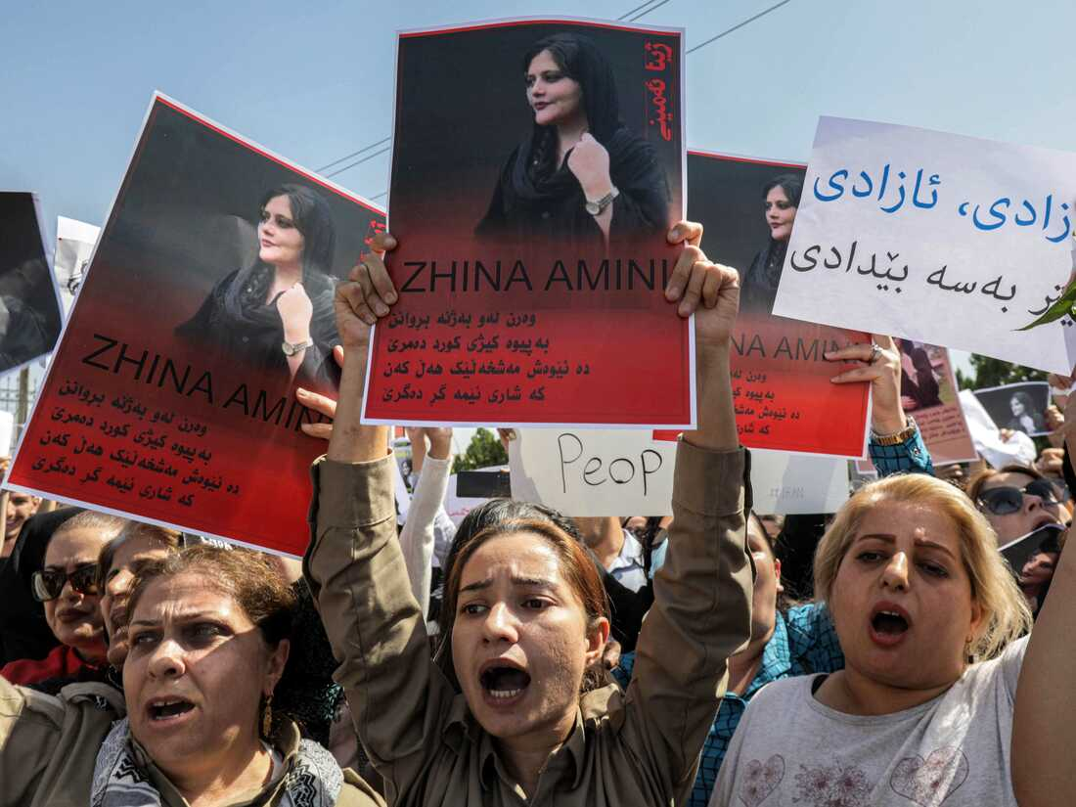
“History […] is surely rhyming on the streets of Teheran,” comments Ray Takeyh, one of our best scholars of the Middle East, borrowing Theodor Reik’s piece of poetic historiosophy (see Lecture One, Slide 3). The Iranian Revolution of 1978-79 and the current rebellion against the Islamic Republic stem from the challenges of modernization as well as the never-ending burden of Iran’s regional power ambitions

Slide 3
The How? of history
Historians strive to establish causality, agency, and consequence. Many are accomplished storytellers. For modern, narrating historians, the aesthetic model to which they subscribe is a Realist one.
Yet there is always the temptation and, frankly, the need to go beyond history’s rhymes and rhythms to the documented, quantifiable, and algorithmic

Slide 4
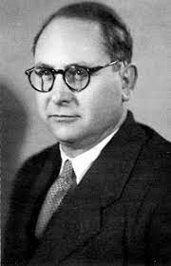
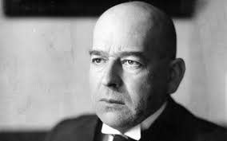
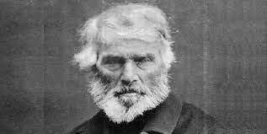
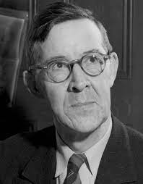
Cyclical theories of history. Left to right: Giambattista Vico (1688-1744), Thomas Carlyle (1795-1881), Oswald Spengler (1880-1936), Pitirim Sorokin (1889-1968), Alexandre Deulofeu (1903-1978)

Slide 5
The ultimate in the quantification of the past? Deulofeu, who invented the Mathematics of History, followed Spengler in the belief that civilizations and empires have finite lifespans that are akin to those of biological beings. Inspired (or depressed) by this vision, he placed a temporal value on the longevity of each

Slide 6
A seminal, if controversial, study of the historical process at what may have been its most sinister inflection point. Taylor focuses on the role of continuity, improvisation, and chance. His analysis of Mussolini as a political personality is a standout aspect of this book

Slide 7
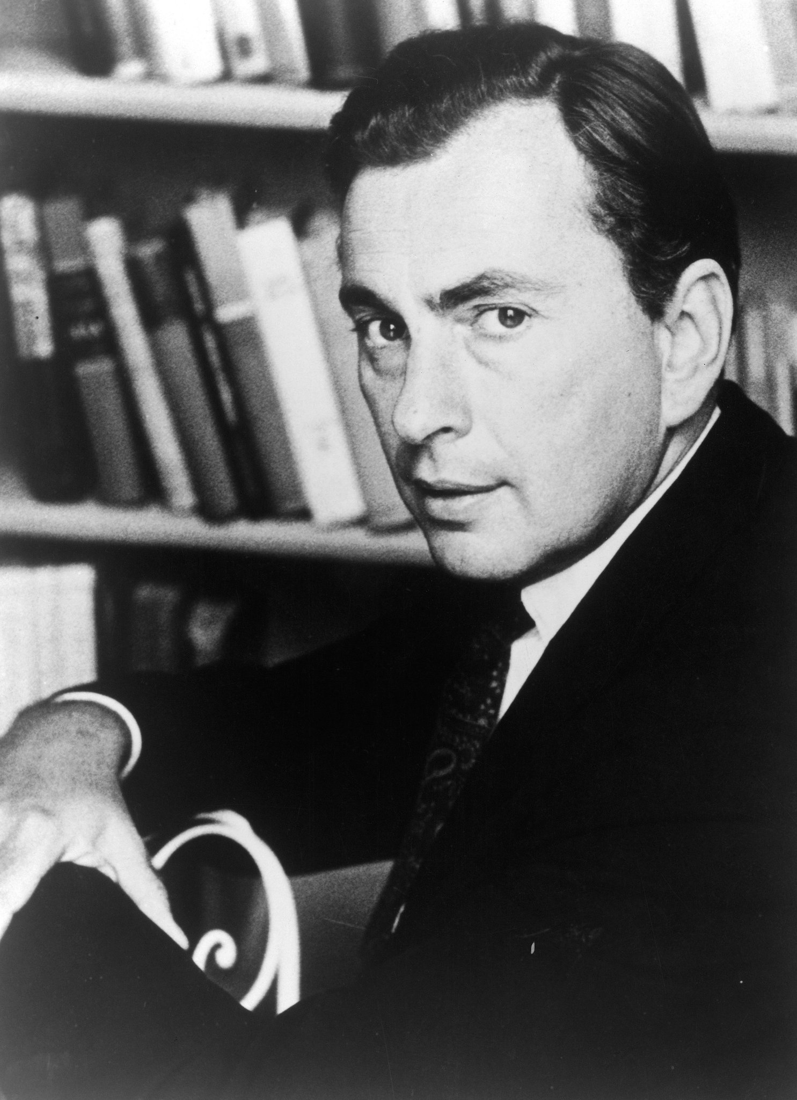
Politics is… “the art of competitive storytelling” (Joe Klein) or “showbusiness for ugly people” (Gore Vidal)
VS
Klein
Vidal

Slide 8
Cross-border migration is a global challenge. Often, it is the outcome of a colonial or communist past. Immigration opponents use this phenomenon to claim that a democratic deficit exists in contemporary Western society

Slide 9
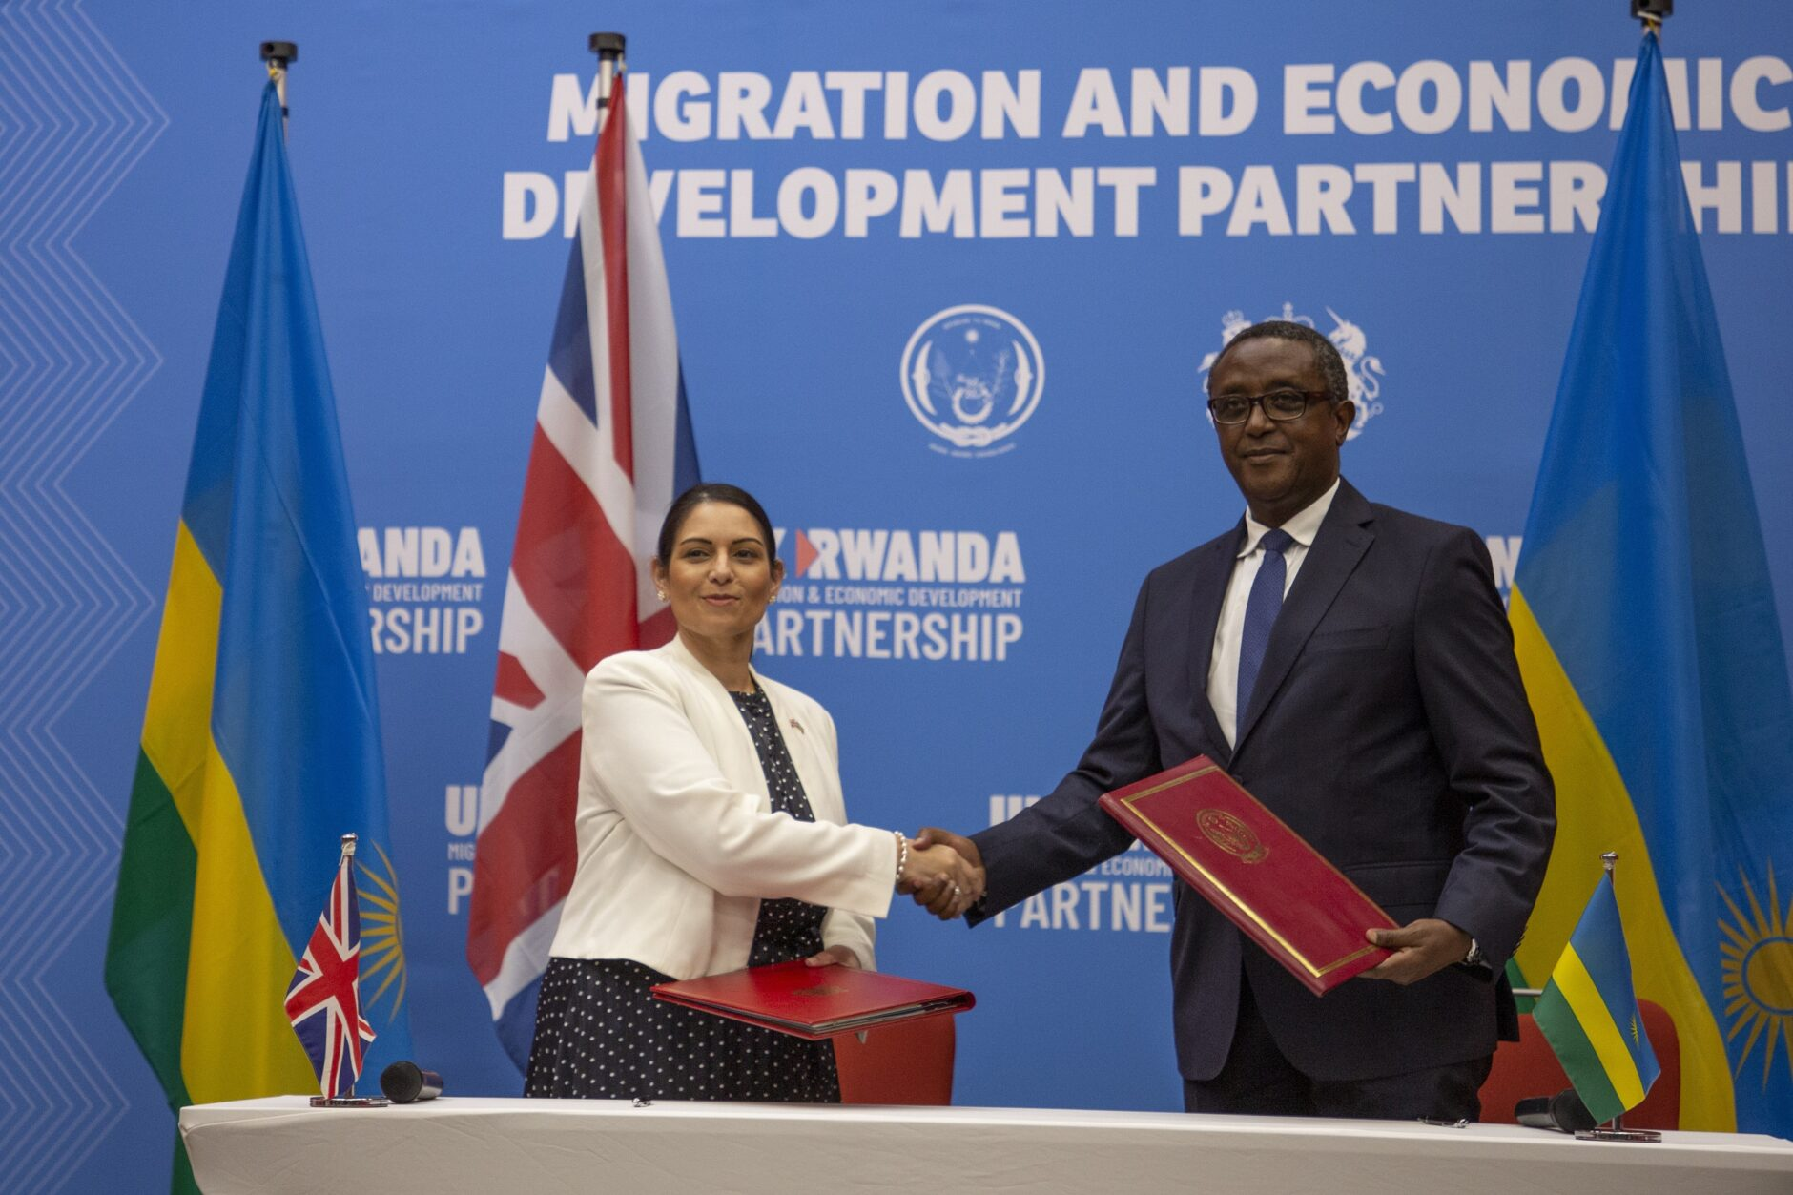
In 2021 Boris Johnson’s government reached an agreement with Rwanda, Africa’s most densely populated country, to “offshore” asylum seekers there. The scheme is being challenged in the the British courts. No indication yet whether Rishi Sunak’s administration will continue the policy

Slide 10
A kingdom summed up

Slide 11
Rwanda 2022: the Prussia of Africa?

Slide 12
Branding a nation. Le Pays des Milles Collines = Land of a Thousand Hills

Slide 13
Radio Télévision Libre des Milles Collines

Slide 14
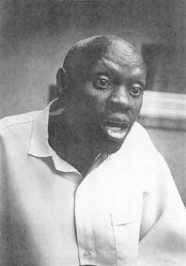
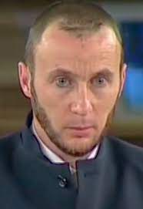
RTLMC personalities that incited the Rwanda genocide: (left to right) Kantano Habimana (died ca. 2000), Valérie Bemeriki (incarcerated in Rwanda), Noël Hitimana (died in a Rwandan prison), Georges Ruggiu (sentenced to 12 years by the International Criminal Tribunal for Rwanda, now free)

Slide 15
President Paul Kagame of Rwanda and his daughter Ange Kagame visiting the White House in 2014

Slide 16
Yoweri Museveni, President of Uganda since 1986, one-time “African Bismarck” and Kagame’s original patron and occasional ally

Slide 17
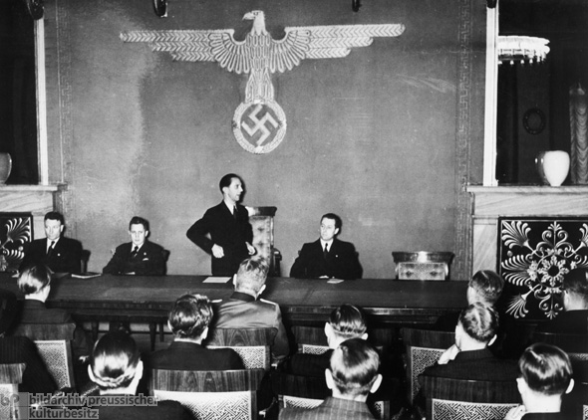
Hans Fritzsche (1900-1953), the Third Reich’s most popular radio broadcaster, was a close associate of propaganda minister Joseph Goebbels

Slide 18
No stab-in-the-back mythology this time
The aftermath of Operation Gomorrah,
the Allied bombing of Hamburg in July
1943

Slide 19
Anton Krasovsky, (former) director of the Russian-language service of RT, interviewed by Russian SF writer Sergei Lukyanenko (author of the Night Watch urban fantasy novels) on October 20 of this year
Krasovsky: Those children should have been
drowned, drowned I say… As soon as one of
them says the Muscovites are occupiers, you
just throw it into a raging river.
Lukyanenko: For such a purpose, we Russians have traditionally used whipping rods, they work better than any river.
Krasovsky: Over there they call every hut a spruce cabin. So cram them into one of those cabins and strike a match!

Slide 20
Margarita Simonyan (b. 1980) has been in charge of RT since 2005. Fired Krasovsky after his kill-the-kids interview but is now willing to take him back. Under Western sanctions
There are no ugly people, there are just
poor people

Slide 21
Russian TV personality Vladimir Solovyov with President Putin. Solovyov has been sanctioned by the West
The death of a nation begins with the
degeneracy of its women

Slide 22
Russian TV personality Yaakov Kedmi. He is a former director of Nativ (1992-1999), an Israeli government body that facilitates the repatriation of Jews from Eastern Europe and Russia
To judge communism by its repressive actions is akin to judging Christianity by the Inquisition
The American army does not know how to fight an enemy that is just as strong, when they [the Americans] can’t be sure of total victory because they don’t enjoy numerical and technological superiority. And they will never have that kind of superiority over Russia

Slide 23
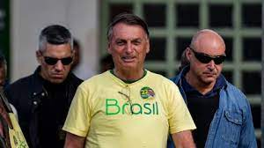
A “censorship of noise”

Slide 24
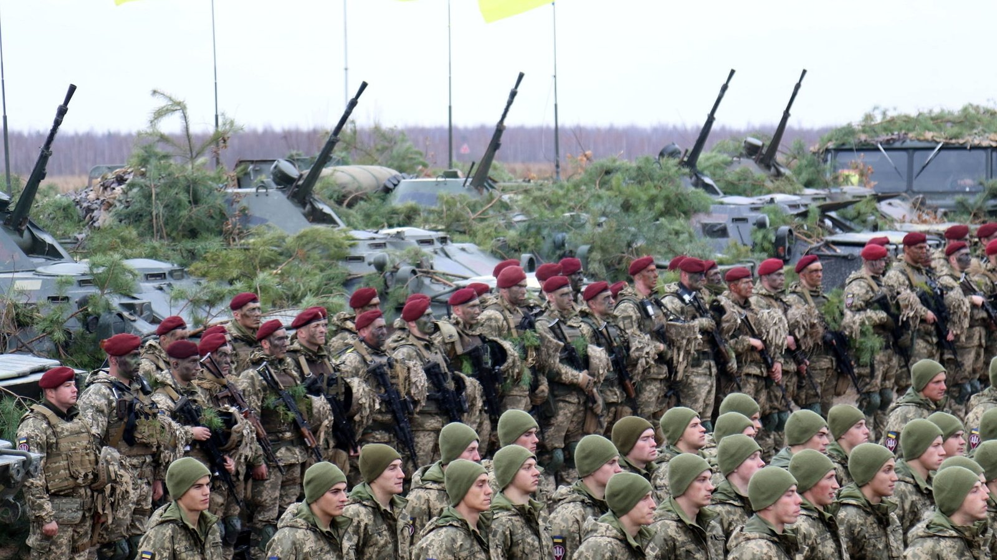
Fighting over the legacy of empire: The Winter War of 1939-1940 and the Russo-Ukrainian War of 2022-

Slide 25
History’s two greatest conspiracists

Slide 26
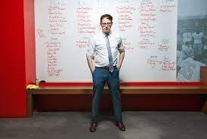
“There’s a bias toward believing in explanations that involve secrecy or things happening that are hidden.” Psephologist Nate Silver, quoted in David A. Graham, “Can You Still Trust Nate Silver?”, The Atlantic, March 2020, p. 24.
Silver’s FiveThirtyEight website: https://fivethirtyeight.com/

