Slide 1
OLLI FALL 2022 Wisdom in Statecraft, Or, Why History Always, Yet Never, Repeats Itself
Tuesday, October 25
Lecture Seven
National Projects of Renewal and Refoundation

Slide 2
A Message to All Course Attendees
I am very sorry we did not have class on Tuesday, October 25. The fault was entirely mine. For some reason I found myself in a state of abstraction and decided we would be meeting at 3.30 pm rather than at the correct time of 1.30!
I hope that all those members of the class who came to OLLI to listen to me, as well as those of you who tuned in online, were not too inconvenienced.
I very much look forward to our final meeting next week, but meanwhile, here is the PowerPoint presentation for Lecture Seven. In addition, I have created an audio recording to go with the presentation.

Slide 3
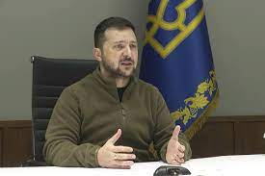
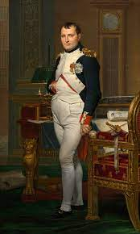
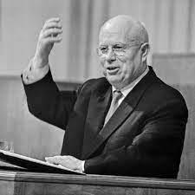
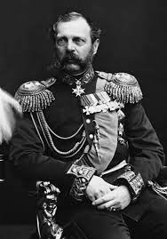
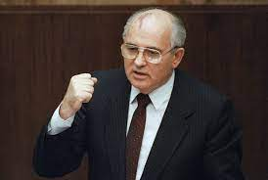
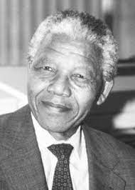
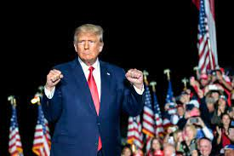
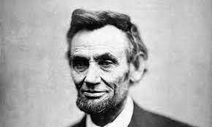
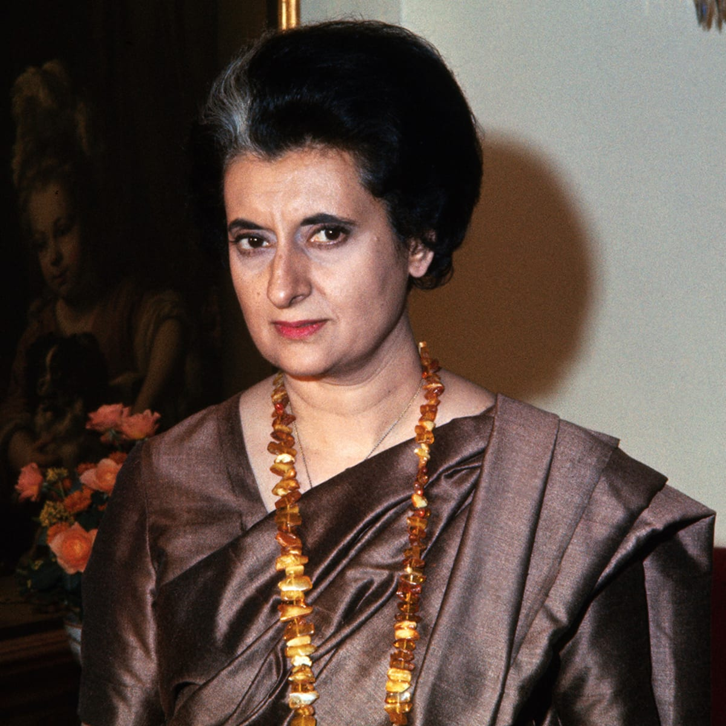
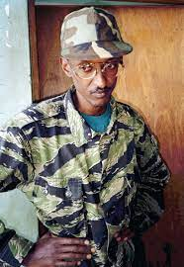
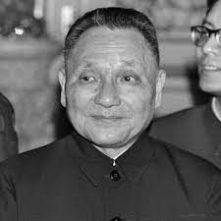
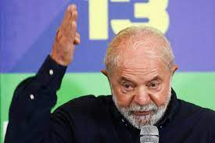
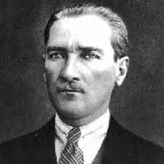
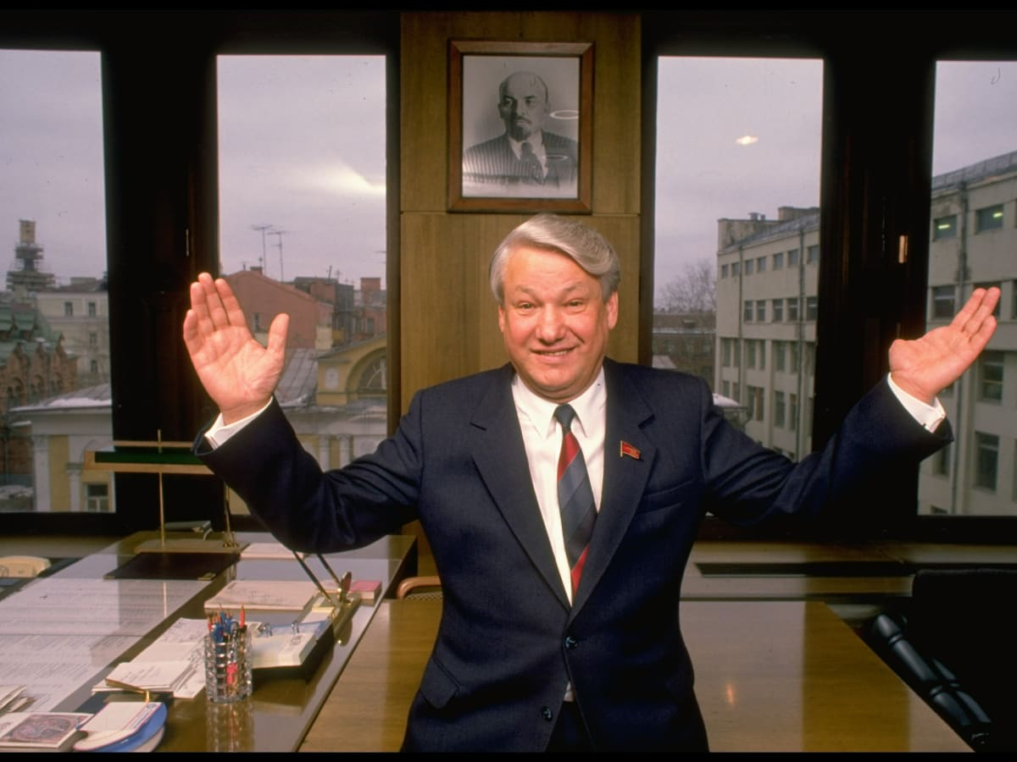
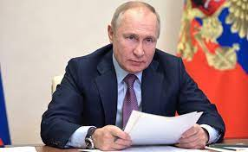
National renewal vs. national refoundation. It’s a question of institutions (reform or transform?), and failure is always an option
VS

Slide 4
The Great Rejuvenation

Slide 5
The ex-president vanishes. On October 22, former paramount leader Hu Jintao was apparently ejected from the 20th party congress. President Xi’s national rejuvenation project rolled on

Slide 6
China’s new heptarchy, presented at the closing of the 2Oth party congress. Li Qiang, party chief of Shanghai, will be named the new prime minister; Zhao Leji, former head of the Central Commission of Discipline Inspection, is expected to head the National People’s Congress, and Wang Huning, a former professor, continues as the party’s chief ideologue

Slide 7
Volodymyr Zelensky was elected on the promise of national reform, not revolution. He must now contend with the need to refound the Ukrainian state

Slide 8
Semi-outsider Peter Obi is leading in Nigeria’s presidential race. His is a promise of national renewal and, perhaps, refounding

Slide 9
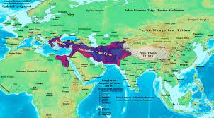
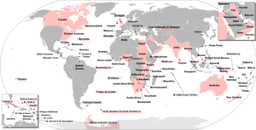
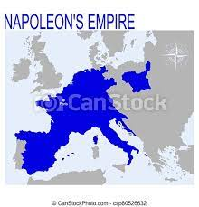
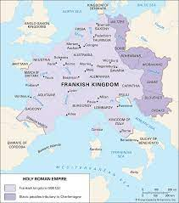
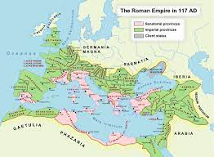
Some empires endured for centuries, others lasted for a few years. Yet longevity is not the criterion by which one ought to judge their impact. Rather, it is their success or failure in creating an enduring single space — linguistic, legal, or political. And on an ethical level, their contribution to the sum of human misery

Slide 10
The Russian Empire, a one-time tri-continental polity that underwent a violent ideological transformation into the bi-continental Soviet Union, and thence into the bi-continental Russian Federation

Slide 11
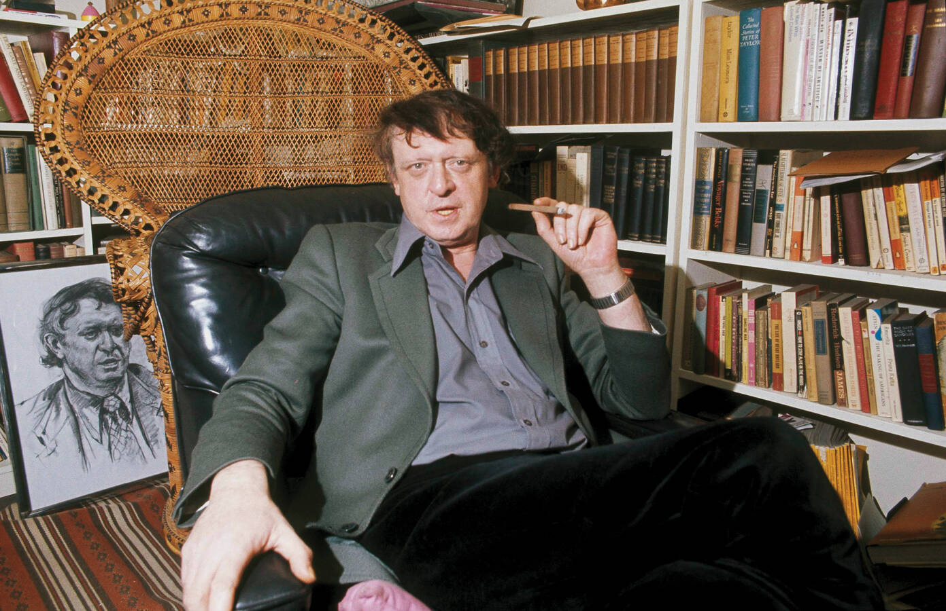
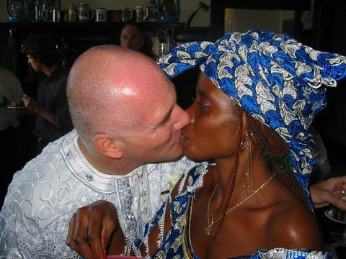
To paraphrase L.P. Hartley, sometimes the past truly is a foreign country
Colonialism. The enforced spread of the rule of reason. But who is going to spread it among the colonizers?
Anthony Burgess
Silence about borders has become Africa’s pathology, born in the era of strongman leaders that followed decolonialization.
G. Pascal Zachary

Slide 12
Africa’s colonial legacy found its (topo)graphic expression in the lines on the map that were arbitrarily drawn by the imperial powers. Note the number of geometrically straight borders

Slide 13
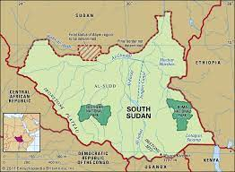
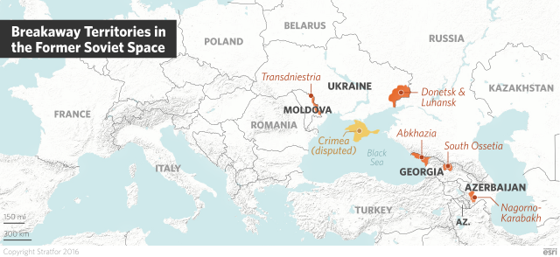
Newly created and de facto states in Eurasia and Africa

Slide 14
Post-communist Ukraine and Russia received their geographical shape via the same lethal lines
The communists — [Yugoslavia] had Tito, we had Lenin
and Stalin — charted out arbitrary, ethnically nonsensical
and historically unjustifiable internal administrative
borders, and for years moved inhabitants from one region
to the next. Aleksandr Solzhenitsyn, Interview to Forbes
magazine, 1994

Slide 15
1961. During a visit to newly independent Ghana, Queen Elizabeth II made a point of dancing with the first of Africa’s Big Men, President Kwame Nkrumah, an icon of the anticolonial struggle. Yet neither socialism nor Pan-Africanism, which Nkrumah passionately promoted, were able to transcend the continent’s divisions

Slide 16
Robert Mugabe vs. Nelson Mandela. The former was a national liberation figure who upon winning power in Zimbabwe became an utterly retrograde leader, a corrupt tribalist who visited great suffering upon his country. He ruled for almost four decades. The latter, a supremely charismatic politician, understood that the reversal of historical injustices must be achieved through a nation-building and institution-building project that unites and transcends, rather than divides and despoils; and that such a project may never cease, but must forever go forward. Political stasis, Mandela believed, will lead to social entropy
Patriarchalism is the most important type of traditional authority. We are talking about the power of male figures — fathers, elders, patrons — over the family, the clan, the tribe. This type of authority can have the whiff of magic. Traditional authority with an occult twist may extend over an entire society, even one with a modern economy and modern weapons.

Slide 17
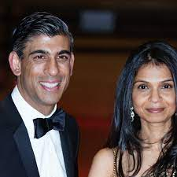
Boris Johnson’s charisma was enough for five premiers in 10 years. Is this history repeating itself, the first time as drama, and the next four times as a game of musical chairs?
Rishi Sunak, Britain’s newly appointed prime minister,
with his wife,
billionaire’s daughter
Akshata Murty

Slide 18
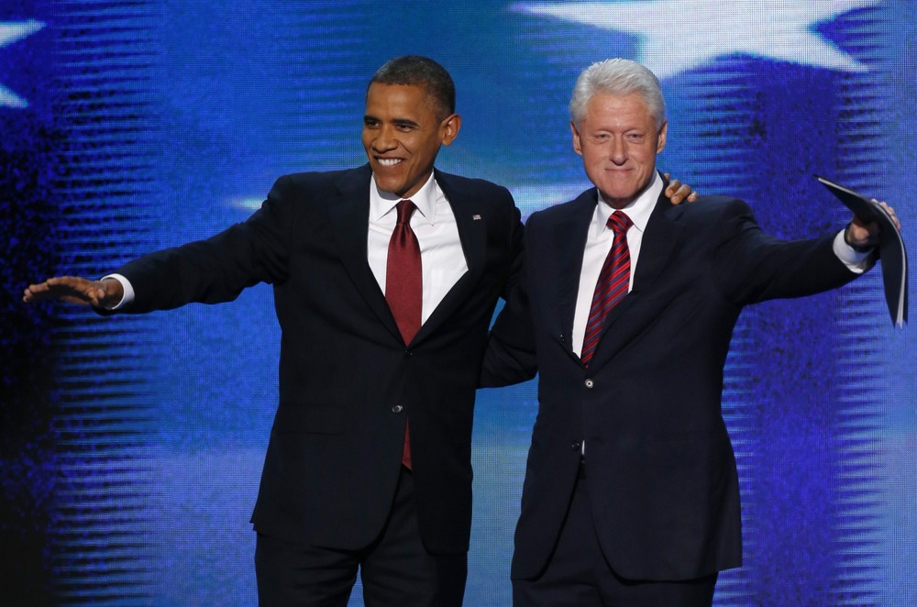
Political leaders of the managerial or apparatchik type. Some, however, also happen to be charismatic and even inspirational figures

Slide 19
…yet the ubiquitousness of these manager types explains in some considerable measure the rise of anti-establishment charismatic, populist disruptors

