Slide 1
OLLI FALL 2022 Wisdom in Statecraft, Or, Why History Always, Yet Never, Repeats Itself
Tuesday, October 18
Lecture Six
National Liberation vs. National Stagnation

Slide 2
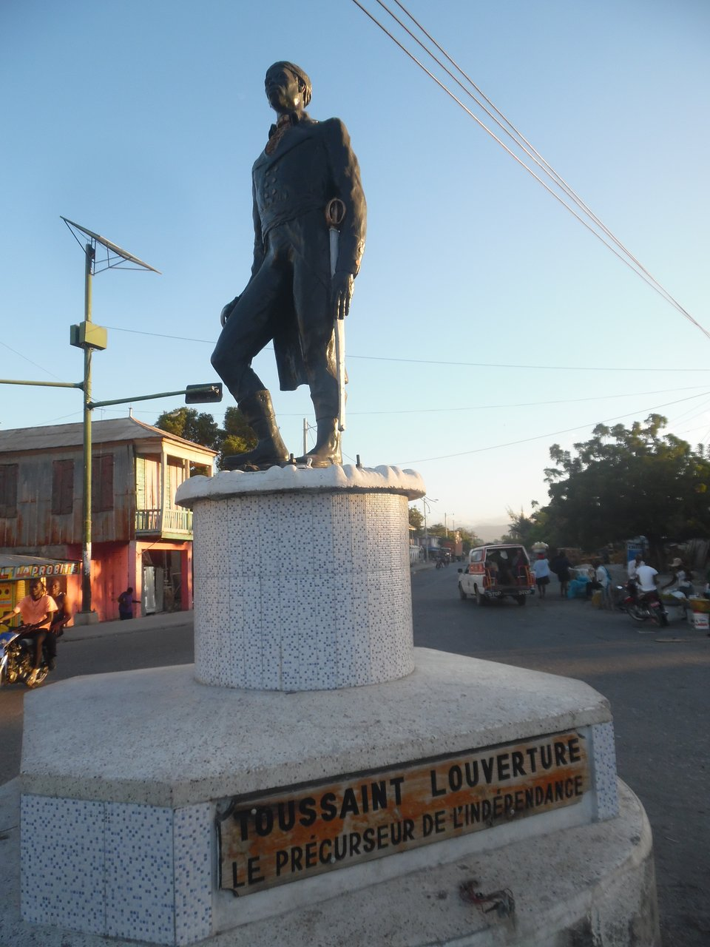
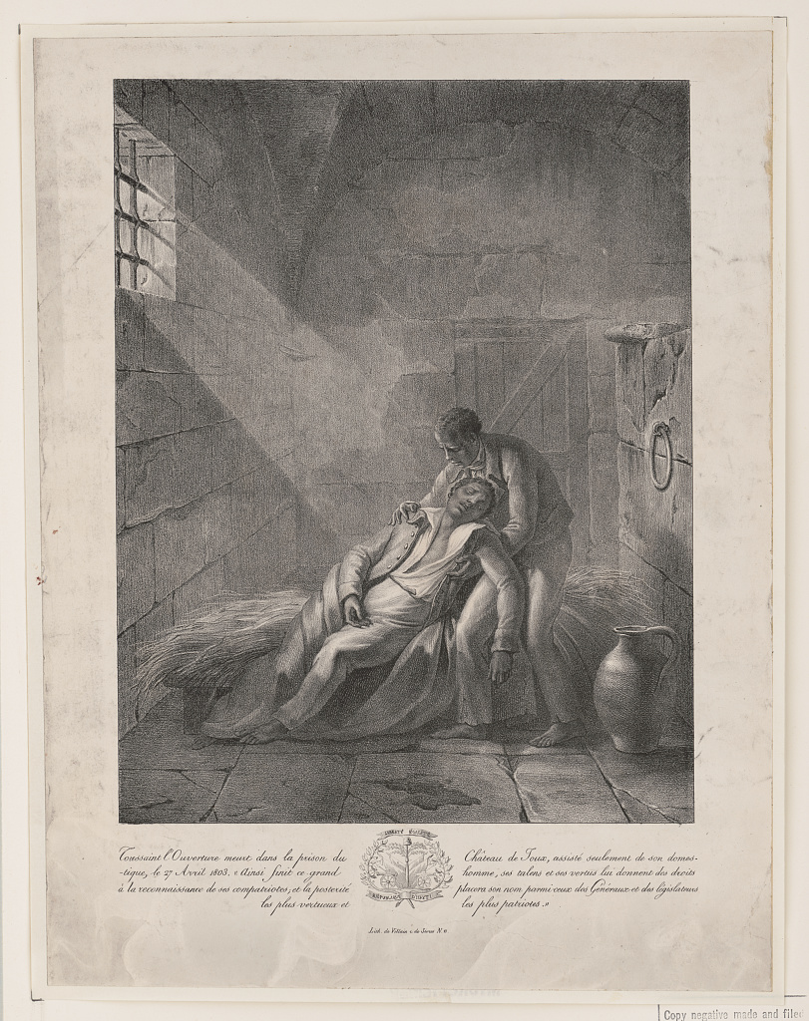
Toussaint Louverture (1743-1803), known as The Father of Haiti and the Black Spartacus, was the leader of an anti-slave rebellion in the French colony of Saint-Domingue

Slide 3
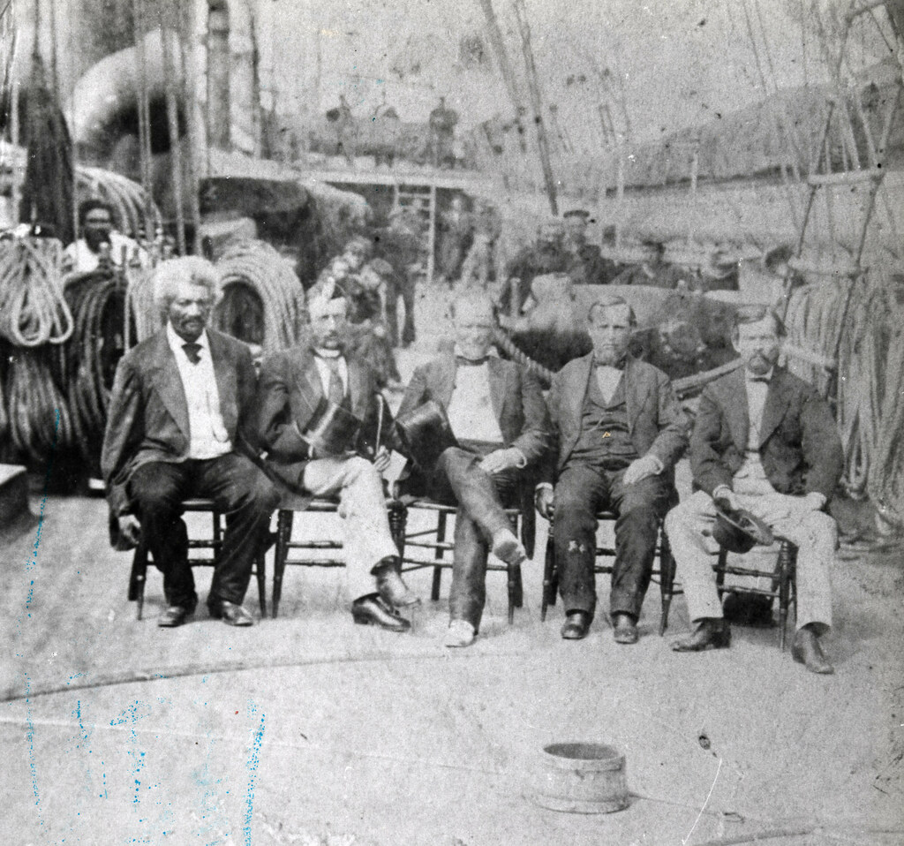
Frederick Douglass (1817/18? – 1895) On left, one of the many formal portraits of the famous abolitionist leader. On right, a photograph taken on board the USS Tennessee in Key West, FL in 1871. In 1889-91 during the presidency of Benjamin Harrison, Douglass would serve as US ambassador to Haiti

Slide 4
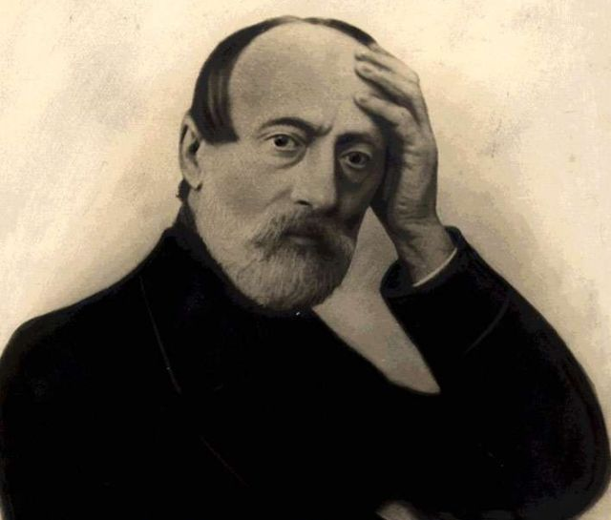
Like Douglass, Giuseppe Garibaldi (1807-1882; on left), understood the power of the photographic portrait. Giuseppe Mazzini (1805-1872) inspired the tradition of popular democracy and national liberation that proved to be so influential in the twentieth century

Slide 5
Two national liberation narratives. On left, Yasser Arafat (1929-2004), PLO Chairman and first president of the Palestinian National Authority; on right, Kurdish female fighters in Iraq during the campaign to defeat ISIS in 2017

Slide 6
Ukraine’s official national narrative, formerly contested and problematic…

Slide 7
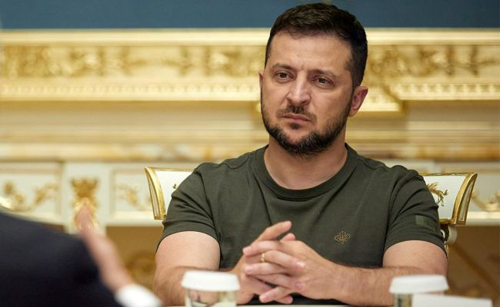
…has dramatically changed as a result of the Russian invasion. Left to right: President Volodymyr Zelensky, border guards from Snake Island taken prisoner by the Russians, cancer surgeon Oksana Leontyeva

Slide 8
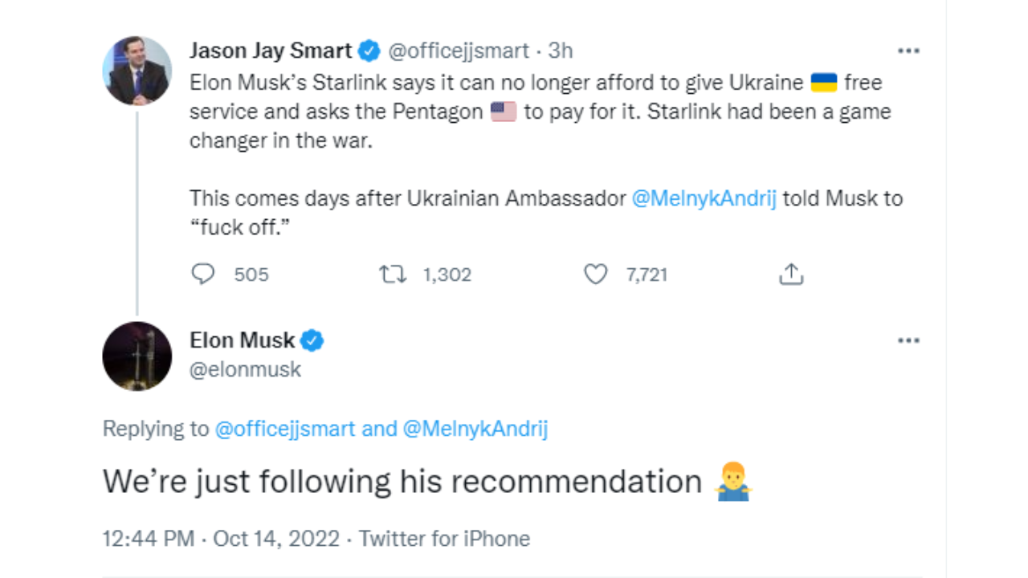
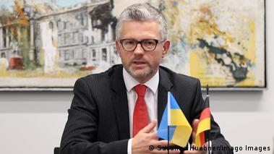
"An ambassador is an honest gentleman sent to lie abroad for the good of his country.” Sir Henry Wotton (1568-1639)
Ex-ambassador Andrij Melnik, who does not like to lie

Slide 9
The name of China’s armed forces, the People’s Liberation Army, is a nod to the CCP’s Marxist cum Maoist mythology. As has been the case with every communist regime, the CCP aesthetic suffers from a stylistic deficiency, even though inside the country party propaganda continues to function as a powerful tool of control

Slide 10
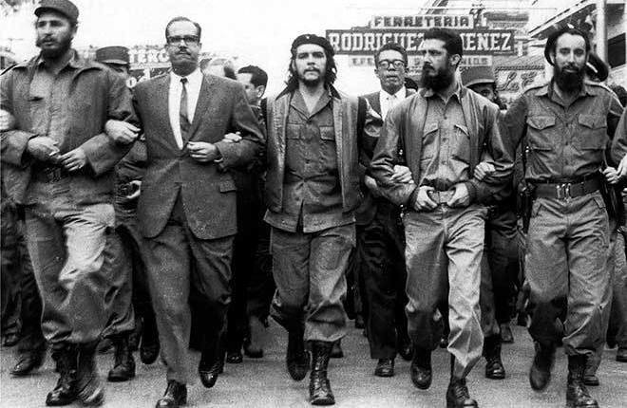
“Fascism is the aestheticization of politics.” Fascists strive to turn the world into a beautiful place inhabited by beautiful people
“The logical outcome of fascism is
an aestheticizing of political life.”
Walter Benjamin

Slide 11
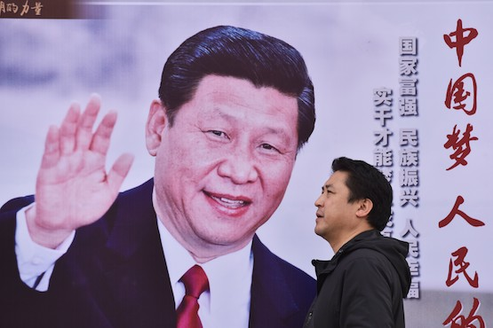
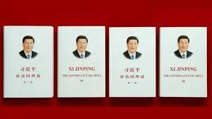
Though not a charismatic politician, President Xi Jinping, 69 is the subject of a personality cult, while “Xi Jinping Thought on Socialism with Chinese Characteristics for a New Era” has been incorporated into the national high school curriculum. Rumors are afoot that at the 20th Chinese Communist Party congress Xi will be elevated to the position of Chairman, which has remained vacant since the death of Mao Zedong

Slide 12
China’s broader leadership group, with President Xi at the center, during the 19th party congress in 2017. They may not be aesthetic, but they are effective

Slide 13
The photo shows members of the Politburo Standing Committee (PSC) assembled for a reception at the Great Hall of the People to celebrate China’s National Day in 2021. Set to retire: prime minister Li Keqiang, 67 (on Xi’s right).

Slide 14
Major developments since the 19th Congress
Term limits for paramount leader abolished (2018)
China is the seat of the Covid-19 pandemic (2019)
Hong Kong’s political autonomy crushed (2021)
Assertion of party control over private business
Social Credit system expanded
The property sector experiences a severe crisis and economic growth declines
Worsening relations with the West
The Russia-Ukraine war impacts China’s global interests

Slide 15
The Social Credit system is associated with President Xi and his administration
Josh Chin and Liza Lin,
Surveillance State (New
York: St. Martin’s Press,
2022)

Slide 16
Xi Jinping arrives at the opening of the 20th party congress on October 16. In his opening speech, he warned of “dangerous storms” ahead, was unapologetic about the Covid lockdowns and the suppression of political dissent in Hong Kong, but appeared to soft-pedal the possibility of uniting Taiwan to China by force. China’s leadership for the next five years will be publicly revealed on the last day of the congress (October 23), when the new PSC lineup walks out on stage

Slide 17
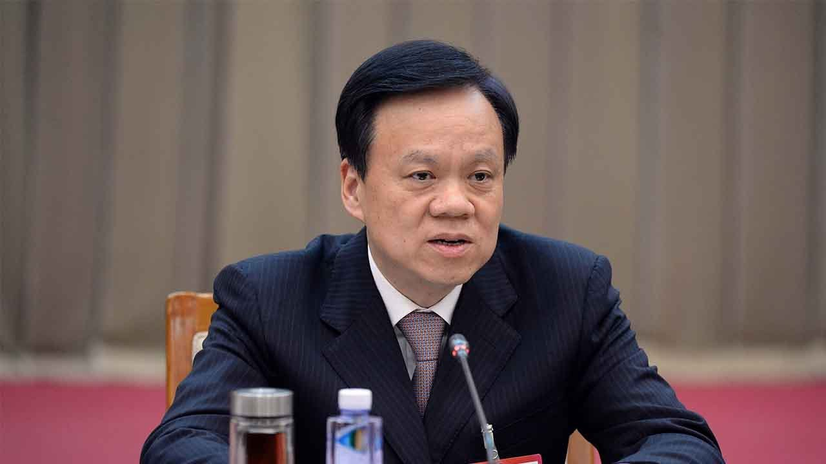
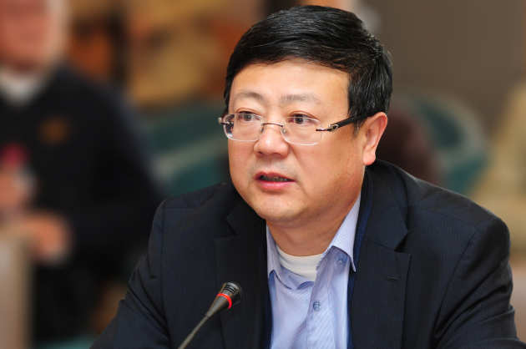
Sixth Generation leadership figures (left to right): Li Qiang (Shanghai party chief), 63; Chen Miner (Chongqing party chief), 62; Ding Xuexiang (Director, General Office, CCP), 60; and Chen Jining (Mayor, Beijing), 58 (holds a PhD in Engineering from Imperial College, London). The first three are Xi protégés

Slide 18
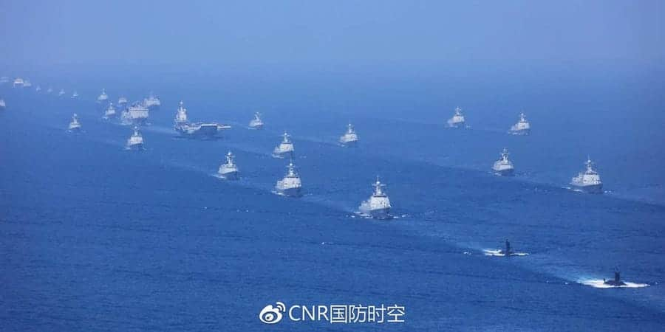
Hubris, or just a bump in the Road and Belt Initiative?

Slide 19
On October 17 in Manchester, England staff from the Chinese consulate dragged an anti-communist demonstrator into the consular grounds and beat him up before he was rescued by police. One of the alleged attackers had earlier torn down an anti-CCP poster that mocked President Xi

Slide 20
One-man rule inevitably damages political institutions and instils a pernicious kind of groupthink. In 2014 the current сhairman of the State Duma, Vyacheslav Volodin, then Putin’s deputy chief of staff, offered an insight: “If Putin lives, Russia lives, if Putin dies, then Russia dies”

