Slide 1
OLLI FALL 2022 Wisdom in Statecraft, Or, Why History Always, Yet Never, Repeats Itself
Tuesday, October 4
Lecture 4
The Promise and Peril of Alliance Reversal

Slide 2
Ivan Krastev lecture tonight!

Slide 3
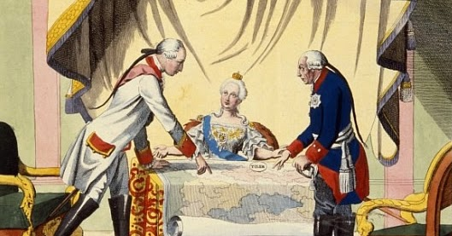
The Diplomatic Revolution of 1756, which led to the Seven Years War, was a classic case of a renversement des alliances, or alliance reversal. History shows that as a rule, such diplomatic shifts result in armed conflict

Slide 4
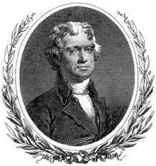
Donald Trump’s transactional foreign policy, first enunciated in his inaugural address — “It is the right on all nations to put their own interests first” — was not without precedent. See the Doctrine of Unstable Alliances formulated by George Washington and confirmed by Thomas Jefferson
Europe has a set of primary interests, which to us have none, or a very remote relation. […] It is our true policy to steer clear of permanent alliances with any portion of the foreign world […]. George Washington, Farewell Speech (1796)
Peace, commerce, and honest friendship with
all nations — entangling alliances with none […]
Thomas Jefferson, First Inaugural Address (1801)

Slide 5
An alliance that stunned the world, albeit briefly

Slide 6
June 25, 1807. History’s first summit meeting in the modern sense

Slide 7
Unstable alliances = reversible alliances. The Great Rapprochement between the United States and Great Britain, which occurred in 1895-1915

Slide 8
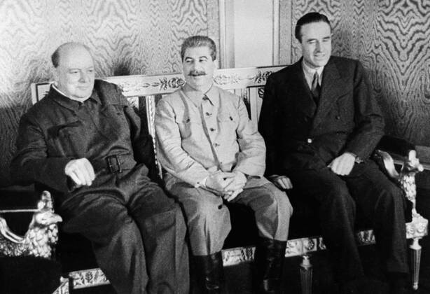
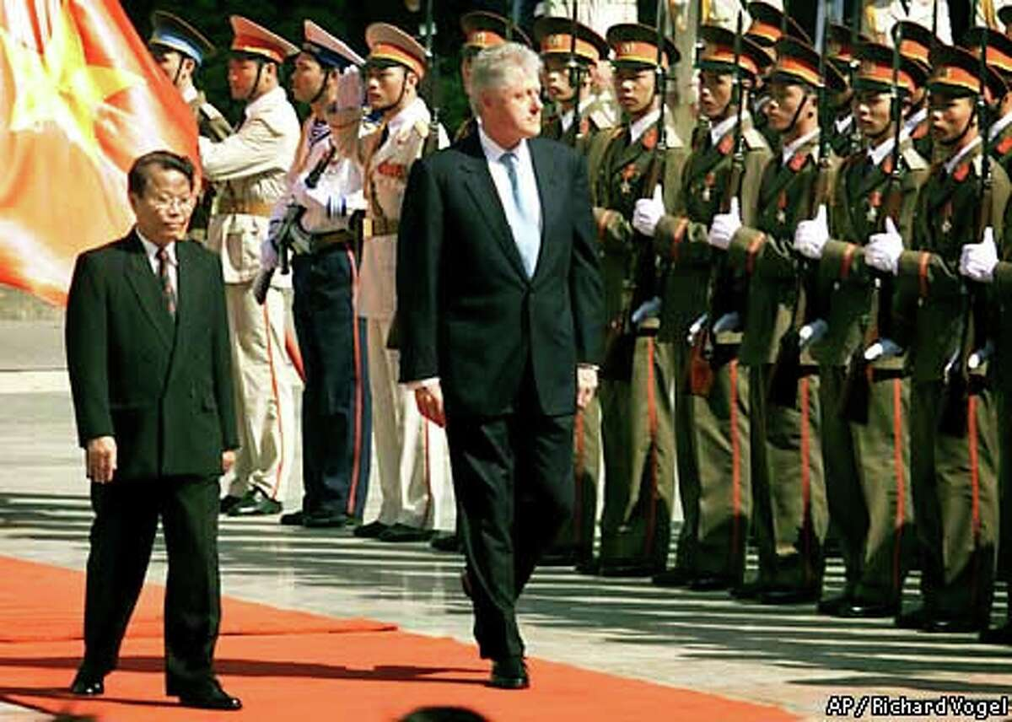
From left to right: Churchill and W. Averell Harriman visiting Stalin in Moscow (1942), Nixon arrives in Beijing (1972), Clinton inspects honor guard in Hanoi (2000)

Slide 9
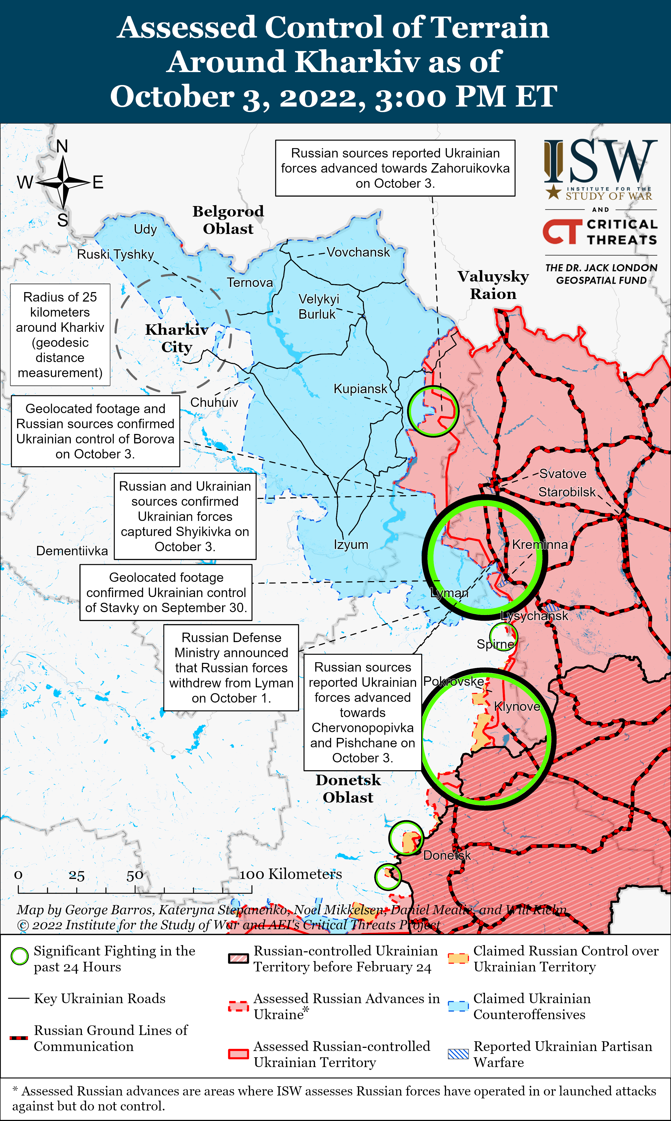
Ukrainian armed forces are advancing on two fronts

Slide 10
A billboard reading “Citizens, you are free!” in the city of Kupiansk, liberated last month

Slide 11
Citizen X was a 1995 HBO movie

Slide 12
Public figures are defined by their words; but also by the model, or target, audience those words are scripting
Col. Viktor Burakov (Stephen Rea): “You think that a man is what he says.”
Gen. Mikhail Fetisov (Donald Sutherland): “He is, if he talks for a living.”
Citizen X (1995)

Slide 13
Vladimir Putin giving his September 30, 2022 (“Annexation”) speech. But who exactly was he addressing?

Slide 14
Selected passages from Putin’s September 30 address
The overthrow of the Yanukovich government in 2014 was a “neo-Nazi coup.”
In 1991 members of the former party elites, without consulting ordinary citizens, decided to destroy the Soviet Union […]. [This was] a national catastrophe.
[…] The residents of Lugansk and Donetsk, Kherson and Zaporozhye are Russian citizens, now and forever.
We call on the Kiev regime to immediately cease fire […] and return to the negotiating table.
After the collapse of the Soviet Union the West decided that the entire world […] would have to obey its diktat for all time. […] The West constantly sought, and still seeks […] to destroy Russia […].
[…] “The collective West” considers our intellectual and philosophical tradition a direct threat, which is why they cast aspersions on our philosophers.
[The Western elites’] hegemony is a vivid manifestation of totalitarianism, despotism, and apartheid.
The United States is the world’s only country to have twice used nuclear weapons […]. I should add that by doing this, they created a precedent.
[…] during the Second World War the United States and the British turned into rubble, with no military justification, Dresden, Hamburg, Cologne and many other German cities. […] They did this for one reason only, the same reason that explains the atomic bombing of Japan: to intimidate our country and the entire world.
[The West is guity of] developing biological weapons and conducting experiments on live human beings, including in Ukraine […].
Even today they are de facto occupying Germany, Japan, the Republic of Korea as well as other countries […].
[…] Do we really want to have in our country, instead of moms and dads, a “parent #1,” ”parent #2,” and ”parent #3” (and let me tell you, over there they have gone completely crazy!)
The dictatorship of the Western [represents] the complete negation of the dignity of man, the destruction of religious faith and traditional values, the suppression of liberty [and] a “religion in reverse,” that is, blatant Satanism.

Slide 15
The audience’s joy was palpable

Slide 16
Not a good look

Slide 17
After the speech — a party!

Slide 18
Putin’s annexation calculus has as much to do with his domestic situation as the course of the war in Ukraine

Slide 19
October 4, 2022. President Vladimir Zelensky signs a decree refusing any negotiations with President Putin, but keeps open the possibility of talks with his successor, whoever he or she may be

Slide 20
Vladimir Lenin’s conditions for a revolutionary upheaval (as opposed to a coup)
The elites can no longer rule in the old way
The masses can no longer live in the old way
A major crisis occurs, which creates resentment and rage among the people
The presence of a revolutionary party with a plan of action

Slide 21
Possible diplomatic rearrangements? Iran is an ideological enemy of the United States as well as revisionist, regional power

Slide 22
Turkey is a military ally of the United States. Like Iran, however, it too is a revisionist, regional power

Slide 23
North Korea’s Kim dynasty opposes the United States not for ideological, but regime-survival reasons. Sometimes referred to as a hermit kingdom, it is a totalitarian regime unto itself

Slide 24
A post-Soviet region of declining Russian influence, which is of growing interest to China and the United States. In recent years, these five countries’ geopolitical orientations and alliances have been undergoing a shift

Slide 25
Russia after Putin: Where will it go and what can it achieve?

Slide 26
And finally, China, where the upcoming 20th Chinese Communist Party Congress is expected to endorse President Xi Jinping as the country’s paramount leader for a third five-year term
The congress will take place against a
backdrop of the most serious economic, social,
and geopolitical challenges China has faced
in 30 years

