Slide 1
OLLI FALL 2022 Wisdom in Statecraft, Or, Why History Always, Yet Never, Repeats Itself
Tuesday, September 27
Geostrategic Snares, Conceits, and Decoys

Slide 2
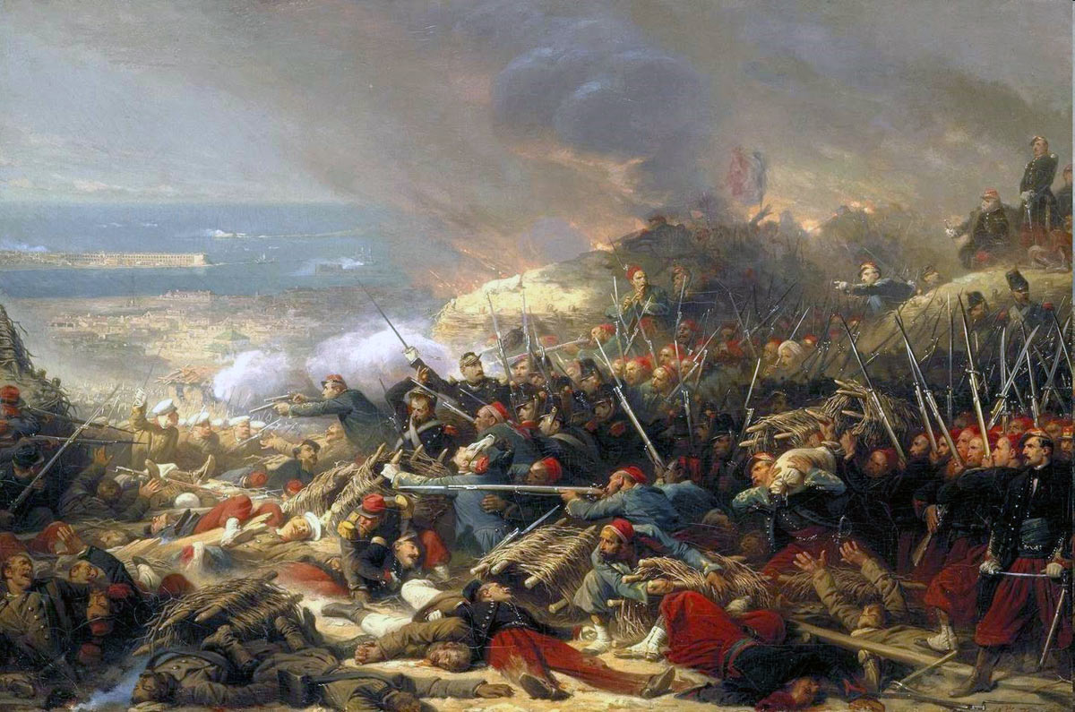
Coasting on a military reputation. French military successes such as the invasion of Spain (1823), intervention in Belgium (1830-32), and participation in the Crimean War (1854-55) and the Second War of Italian Independence (1859) were followed by the failed Second Military Intervention in Mexico (1861-67) and the utterly disastrous Franco-Prussian War (1870-71). The images below show the siege of Sebastopol (1854-55), the Battle of Solferino (1859), and the surrender of Napoleon III at Sedan (1870)

Slide 3
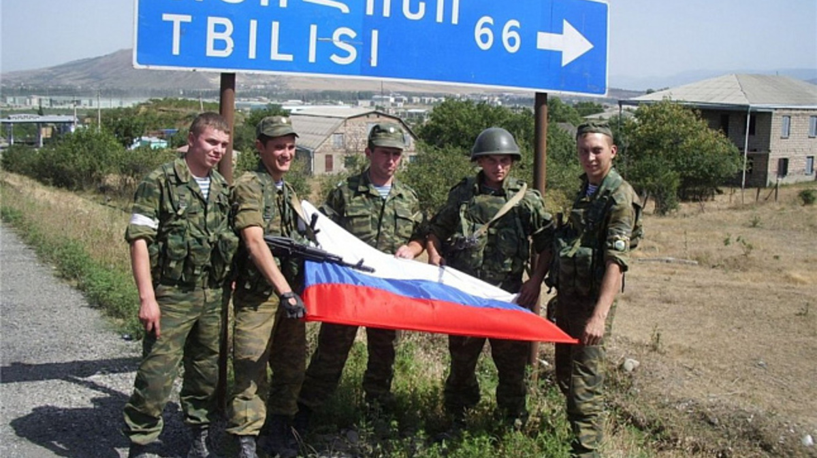
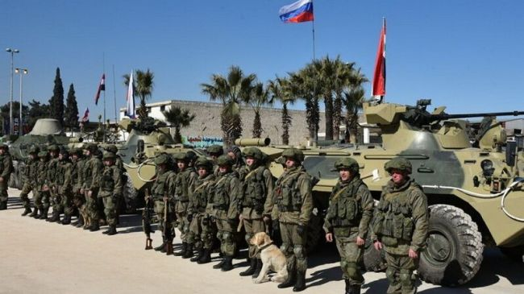
The Second Chechen War (1999-09), the Russia-Georgia war (2008), and Russia’s intervention in Syria (2015-)

Slide 4
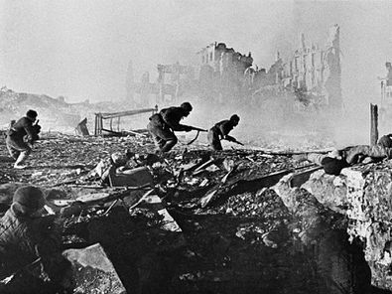
Verdun and Stalingrad: two iconic battles that singed the nation’s sense of self

Slide 5
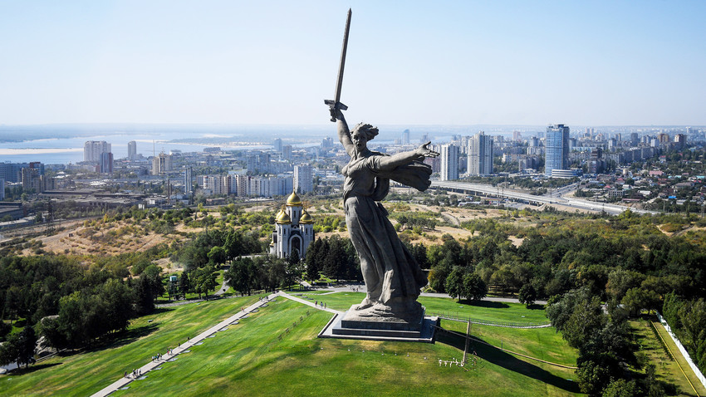
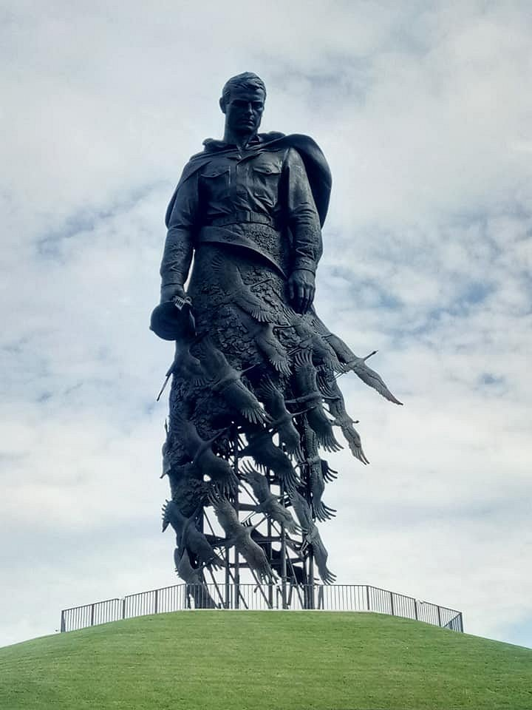
French and Russian commemorations of war in stone and bronze

Slide 6
Charles De Gaulle, who reinvented France. Twice

Slide 7
The Russia-Ukraine War: an update

Slide 8
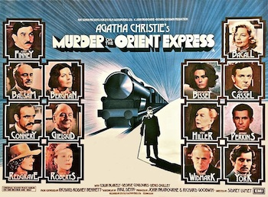
What can Murder on the Orient Express teach us about geopolitics in 2022?

Slide 9
The parallels are prominent!

Slide 10
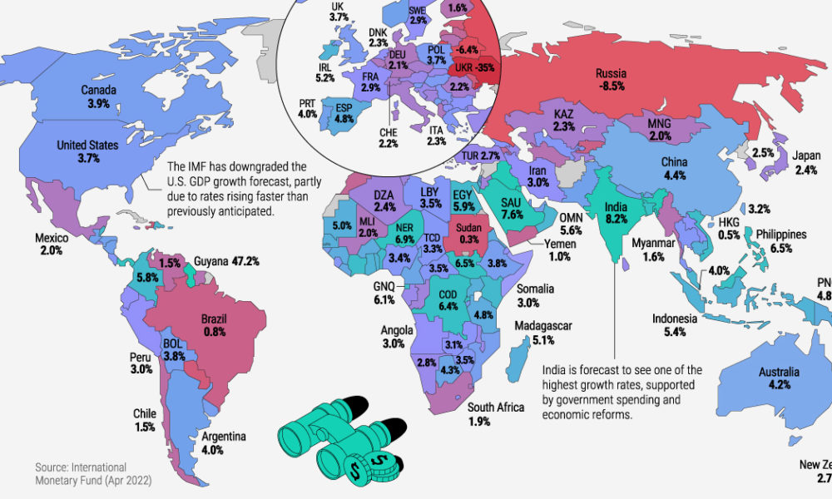
Putin’s geostrategic calculus hinges on a recognition of Russia’s relative and absolute decline vis-à-vis China

Slide 11
Below: the defining traits of China’s rise to global (pre)eminence. There are certain parallels here (as well as obvious differences) with Germany’s early twentieth-century quest for Weltmacht
A neo-mercantilist calculus of China’s national interest + an old-fashioned belief in imperial reach. I.e., territorial expansion + an aggressively expressed irredentism
Strengthening one-party rule; enhancing Xi Jinping’s personality cult; restoring the significant myth of Maoist communism; expanding the communist party’s presence in every walk of life
The policy of “common prosperity,” or a government-led focus on social and economic justice
Technology-enhanced control over the citizens’ public and private lives via the Social Credit system which combines capitalistic and totalitarian elements
Territorial expansion and (a controlled) irredentism
Growing China’s armed forces
The Belt and Road Initiative
State-sponsored development of science and technology

Slide 12
The populist temptation is still running strong around the world. Matteo Salvini, Silvio Berlusconi, and Giorgia Miloni: victors in the Italian general election
[…] These people […] have undoubtedly done a great deal of mischief, especially in confusing public opinion about the nature of the puppet regimes in Eastern Europe; but one ought not hurriedly to assume that they all hold the same opinions. Probably some of them are actuated by nothing worse than stupidity. (George Orwell writing in 1947)

Slide 13
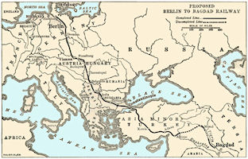
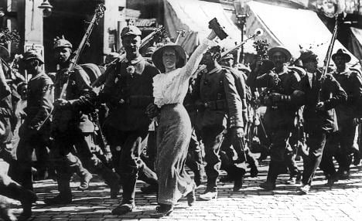
Established vs. revisionist powers: The German Empire ca. 1914

Slide 14
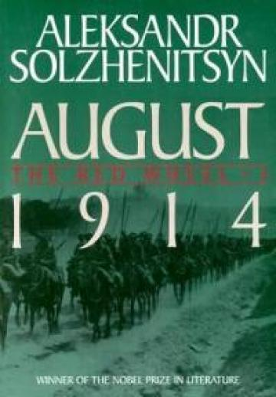
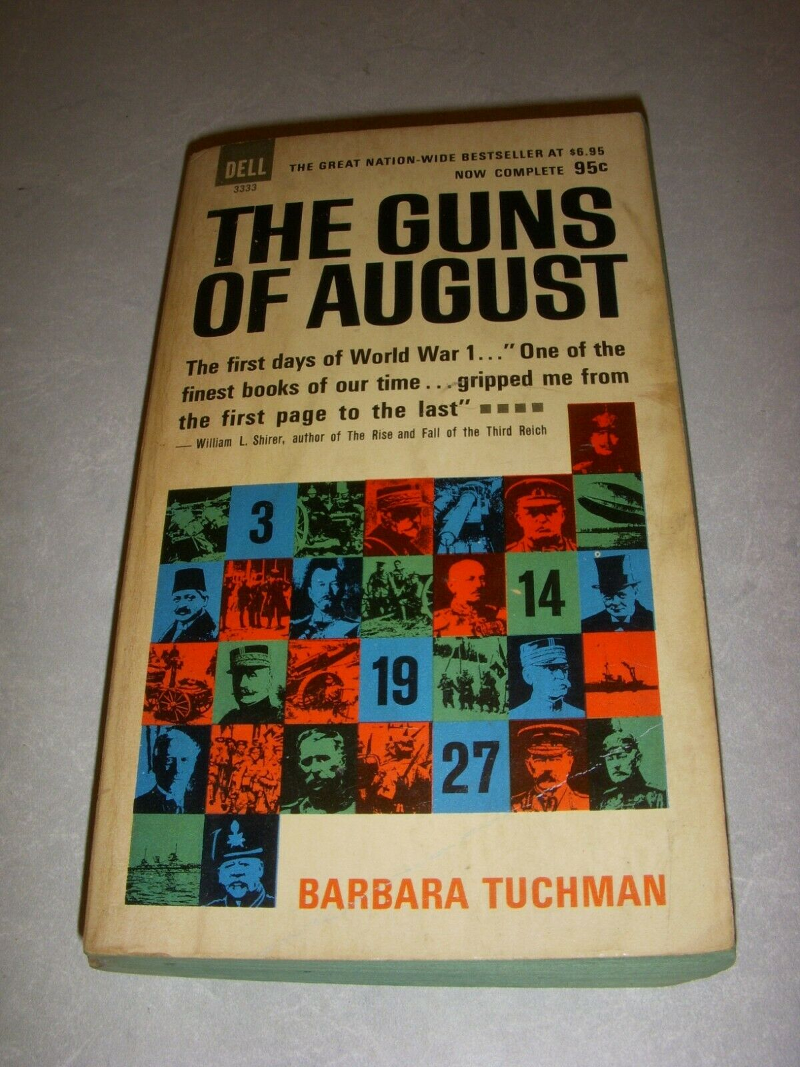
Four important interpretations

Slide 15
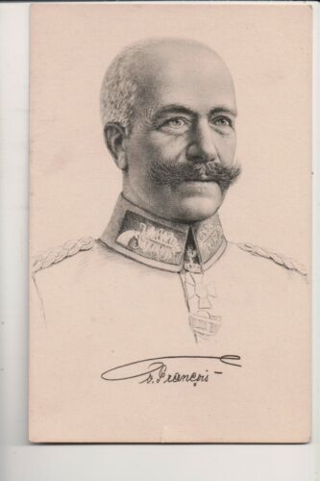
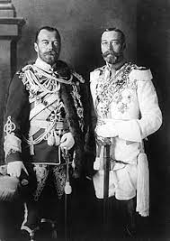
A reminder of the centrality of political and military actors in the historical process — or, at least, in our interpretations thereof
We might look for consolation to Tolstoy’s belief that armies are not led by generals, ships are not steered by captains, states and parties are not run by presidents and politicians — but the twentieth century has shown us only too often they are.
Aleksandr Solzhenitsyn, August 1914

Slide 16
Charisma is…
a certain quality of an individual personality, by virtue of which he is set apart from ordinary men and treated as endowed with supernatural, superhuman, or at least specifically exceptional powers or qualities. These are such as are not accessible to the ordinary person, but are regarded as of divine origin or as exemplary, and on the basis of them the individual concerned is treated as a leader. [. . .] How the quality in question would be ultimately judged from an ethical, aesthetic, or other such point of view is naturally indifferent for the purpose of definition.
Max Weber

Slide 17
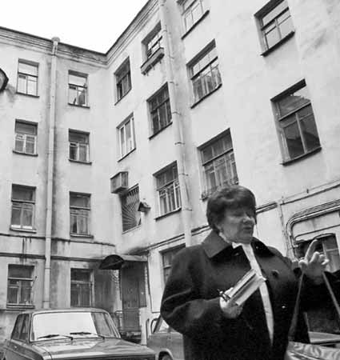
“A courtyard like a well”

Slide 18
Some charismatics emerge out of “nowhere”…
Over and over again one hears a tale describing a hero’s miraculous but humble birth, his early proof of superhuman strength, his rapid rise to prominence or power, his triumphant struggle with the forces of evil, his fallibility to the sin of pride (hybris), and his fall through betrayal or “heroic” sacrifice that ends in his death.
Joseph L. Henderson

Slide 19
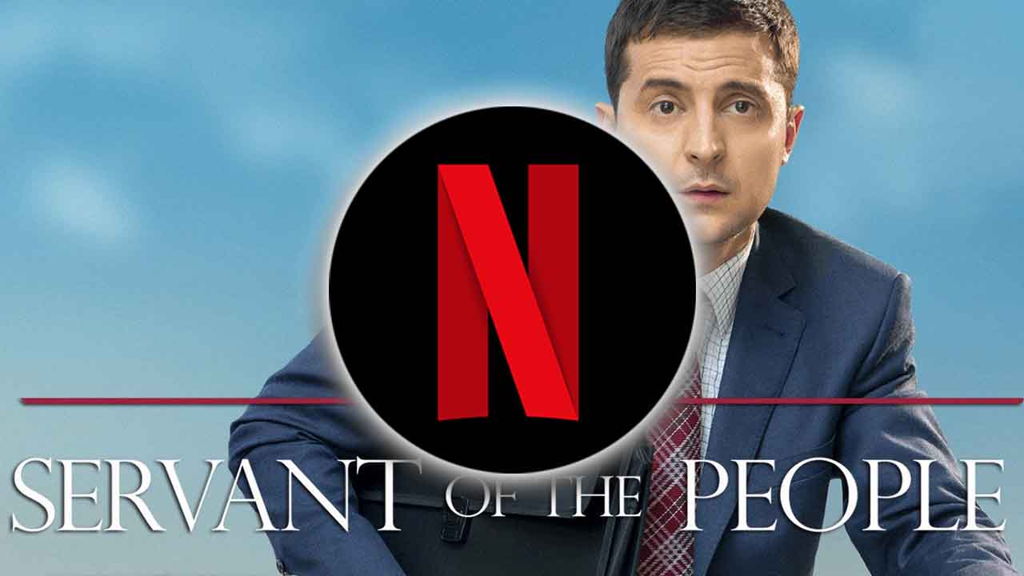
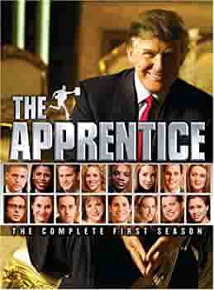
…and some come from inside our own living rooms

Slide 20
The battle of the ifs in a (barely) diplomatic dialogue
“If the territorial integrity of our country is threatened, we will certainly use all the means at our disposal to protect Russia and our people. This is not a bluff.”
President Vladimir Putin, September 21, 2002
“If Russia crosses this line, there will be catastrophic consequences for Russia. The United States will respond decisively.”
National Security Advisor Jake Sullivan, September 25, 2002

Slide 21
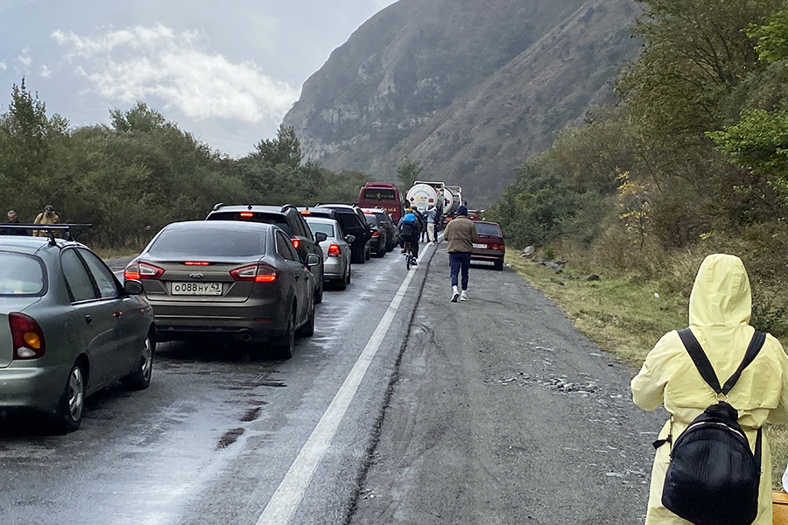
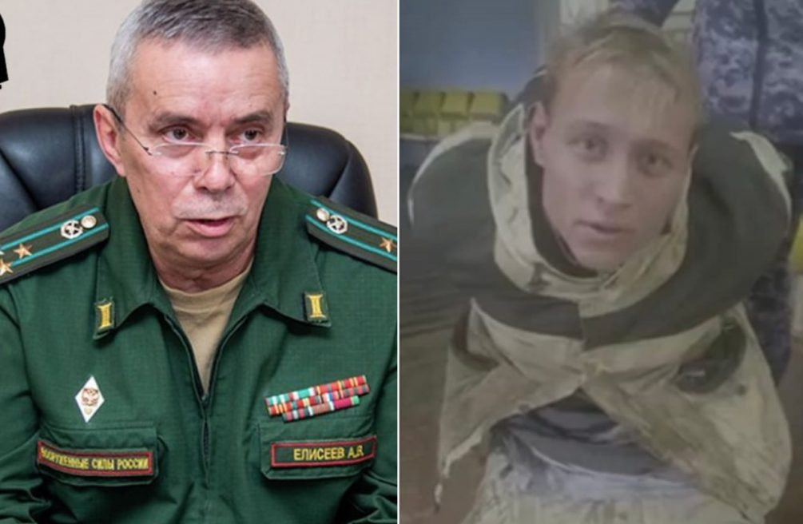
Demonstrations in Dagestan, enlistment officer shot in Irkutsk, line of Russian-registered cars at the border with Georgia

