Slide 1
OLLI FALL 2022 Wisdom in Statecraft, Or, Why History Always, Yet Never, Repeats Itself
Tuesday, September 20
Lecture Two
History Reform School

Slide 2
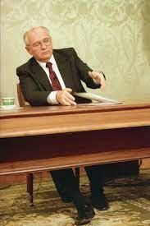
Gorbachev’s entropic legacy: states-in-being + states-not-yet-ready

Slide 3
Armenian and Azerbaijani officials to fly to New York for US-sponsored peace talks

Slide 4
The Tajikistan-Kyrgyzstan conflict: another sign of Russia’s waning influence across the former Soviet space

Slide 5
The second most famous fist bump in history?

Slide 6
(The most famous one was featured on the cover of The New Yorker during the 2008 presidential campaign)

Slide 7
The Ottoman Empire in 1918

Slide 8
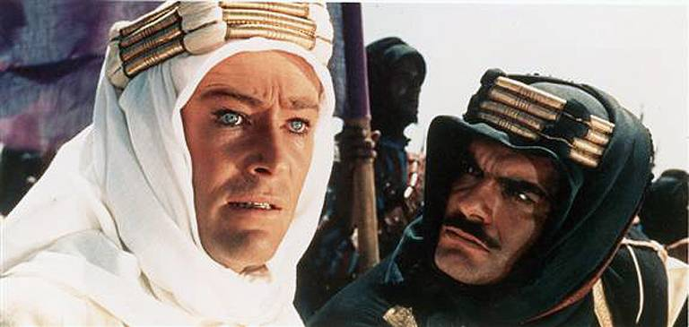
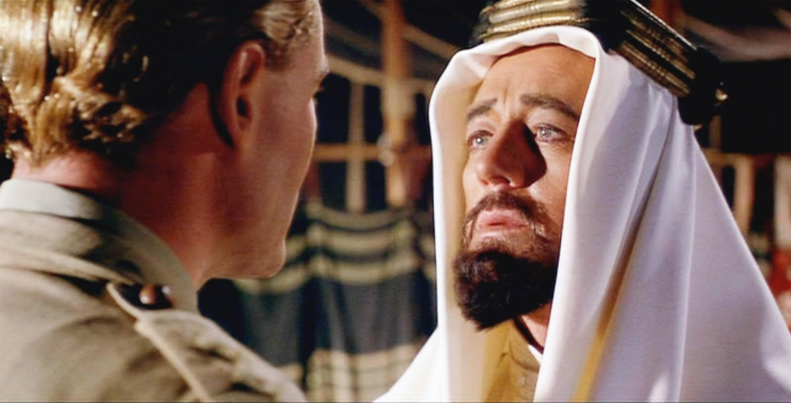
Lawrence of Arabia: The man (1888-1935) and the movie (1962)

Slide 9
Who is MBS, AKA Crown Prince Mohammed bin Salman (b. August 31, 1985) of Saudi Arabia?

Slide 10
Check out the biographical feature on MBS in The Economist, July 30-August 12, 2022 issue

Slide 11
Louise Hersent-Maudit, Louis XV visiting Peter the Great, May 10, 1717 (c. 1840). The founder of the Russian Empire and the greatest Westernizing reformer in the country’s history, Peter (1672-1725; reigned 1682-1725; ruled 1696-1725) put it on the map geopolitically and, in due time, culturally

Slide 12
The regent Princess Sophia with Tsars Ivan V (her brother) and Peter I (half-brother) when they were children

Slide 13
Carving “a window to Europe”: the founding of St. Petersburg in 1703

Slide 14
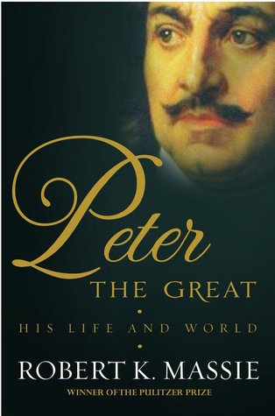
In seeking to reform Russia, Peter sought state-based efficiency, but his extreme Westernism had psychological roots

Slide 15
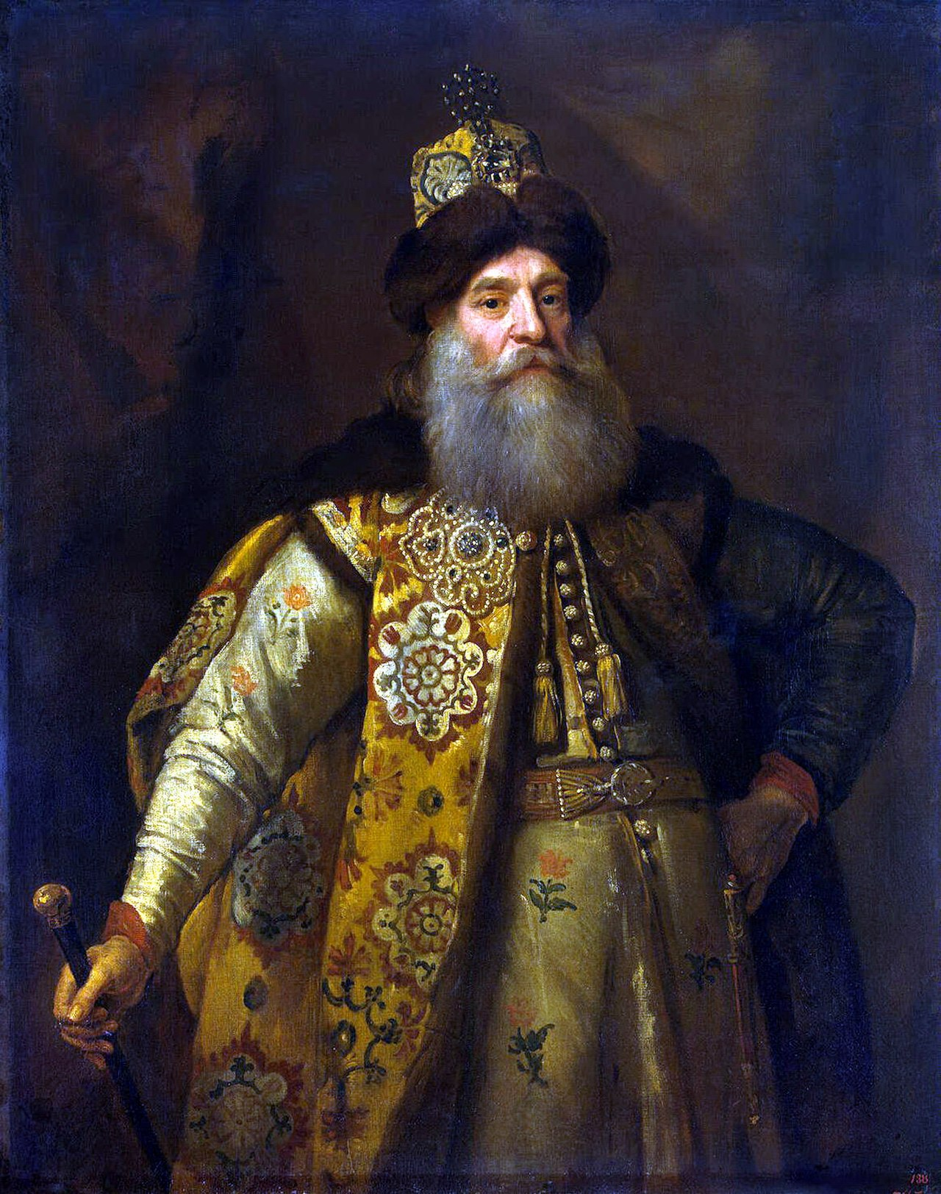
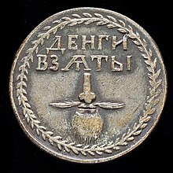
Peter’s anti-beard campaign

Slide 16
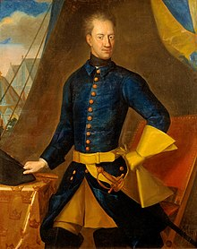
Peter’s victory over Charles XII of Sweden at Poltava (1709) was a world-historical event that marked Russia’s elevation to the rank of a great power

Slide 17
Nikolai Ge, Peter I Interrogating Tsarevich Aleksei Petrovich at Peterhof (1871)

Slide 18
Petr Shamshin, Peter the Great Rescuing the Drowning on Lakhta Bay (1844)

Slide 19
Lakhta Bay is now the site of a 87-story skyscraper. Peter would have approved!

Slide 20
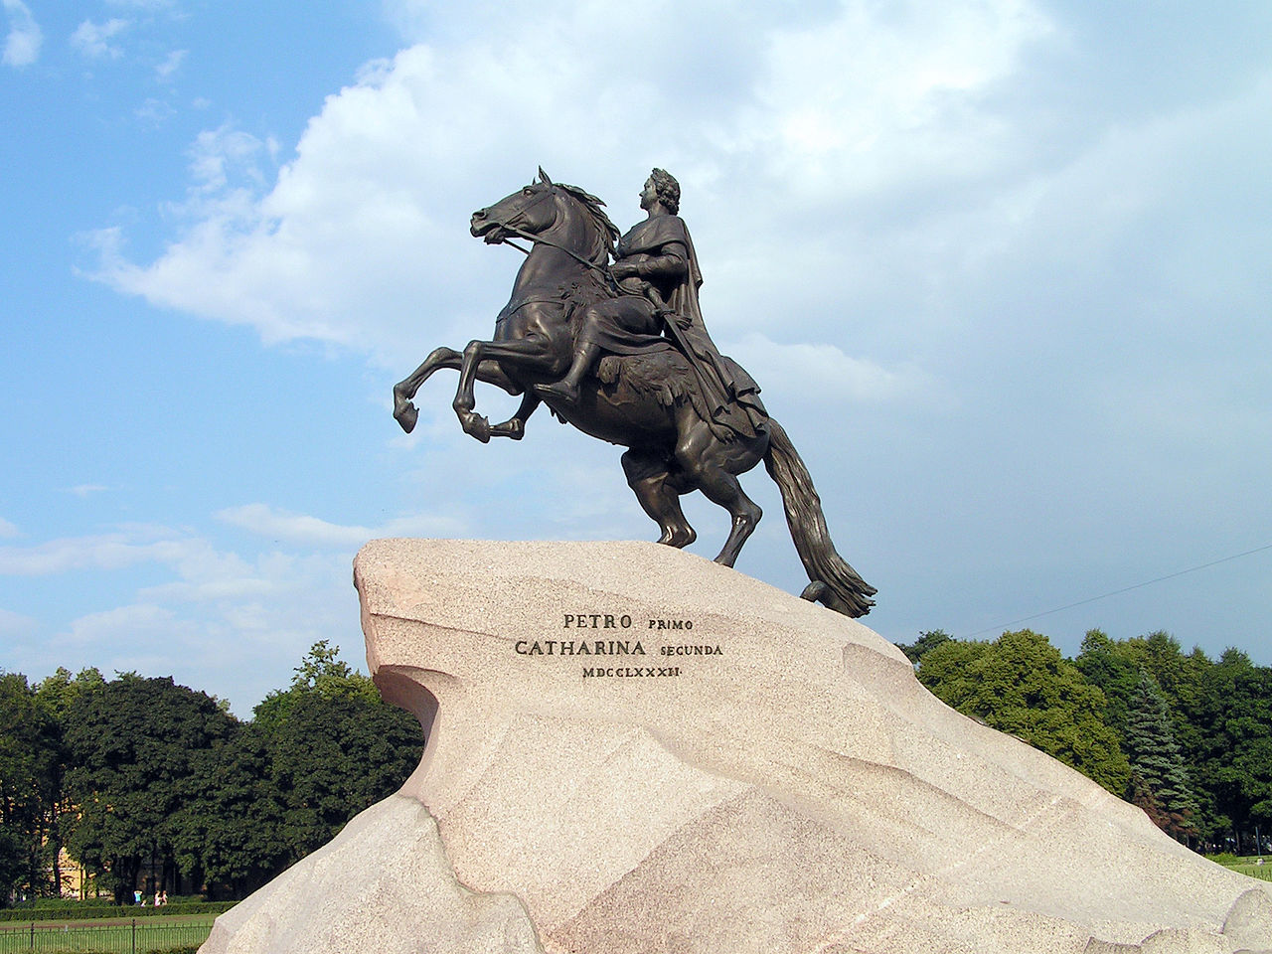
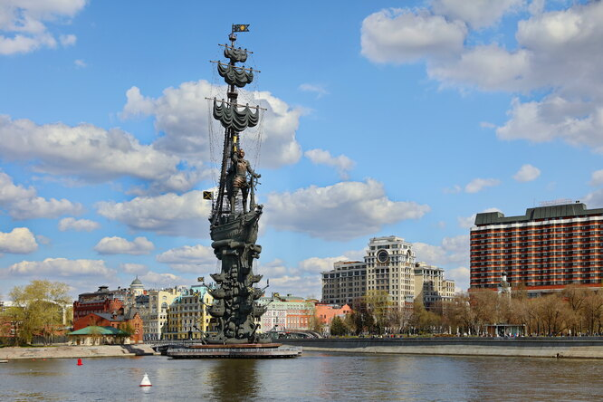
Three monuments to Peter the Great, by Étienne de Falconet (1782), Mikhail Shemyakin (1991), and Zurab Tsereteli (1997). Together, they tell a story about Peter, three hundred years of Russian history, and good and bad art.

Slide 21
Kemal Atatürk (1881-1938)

Slide 22
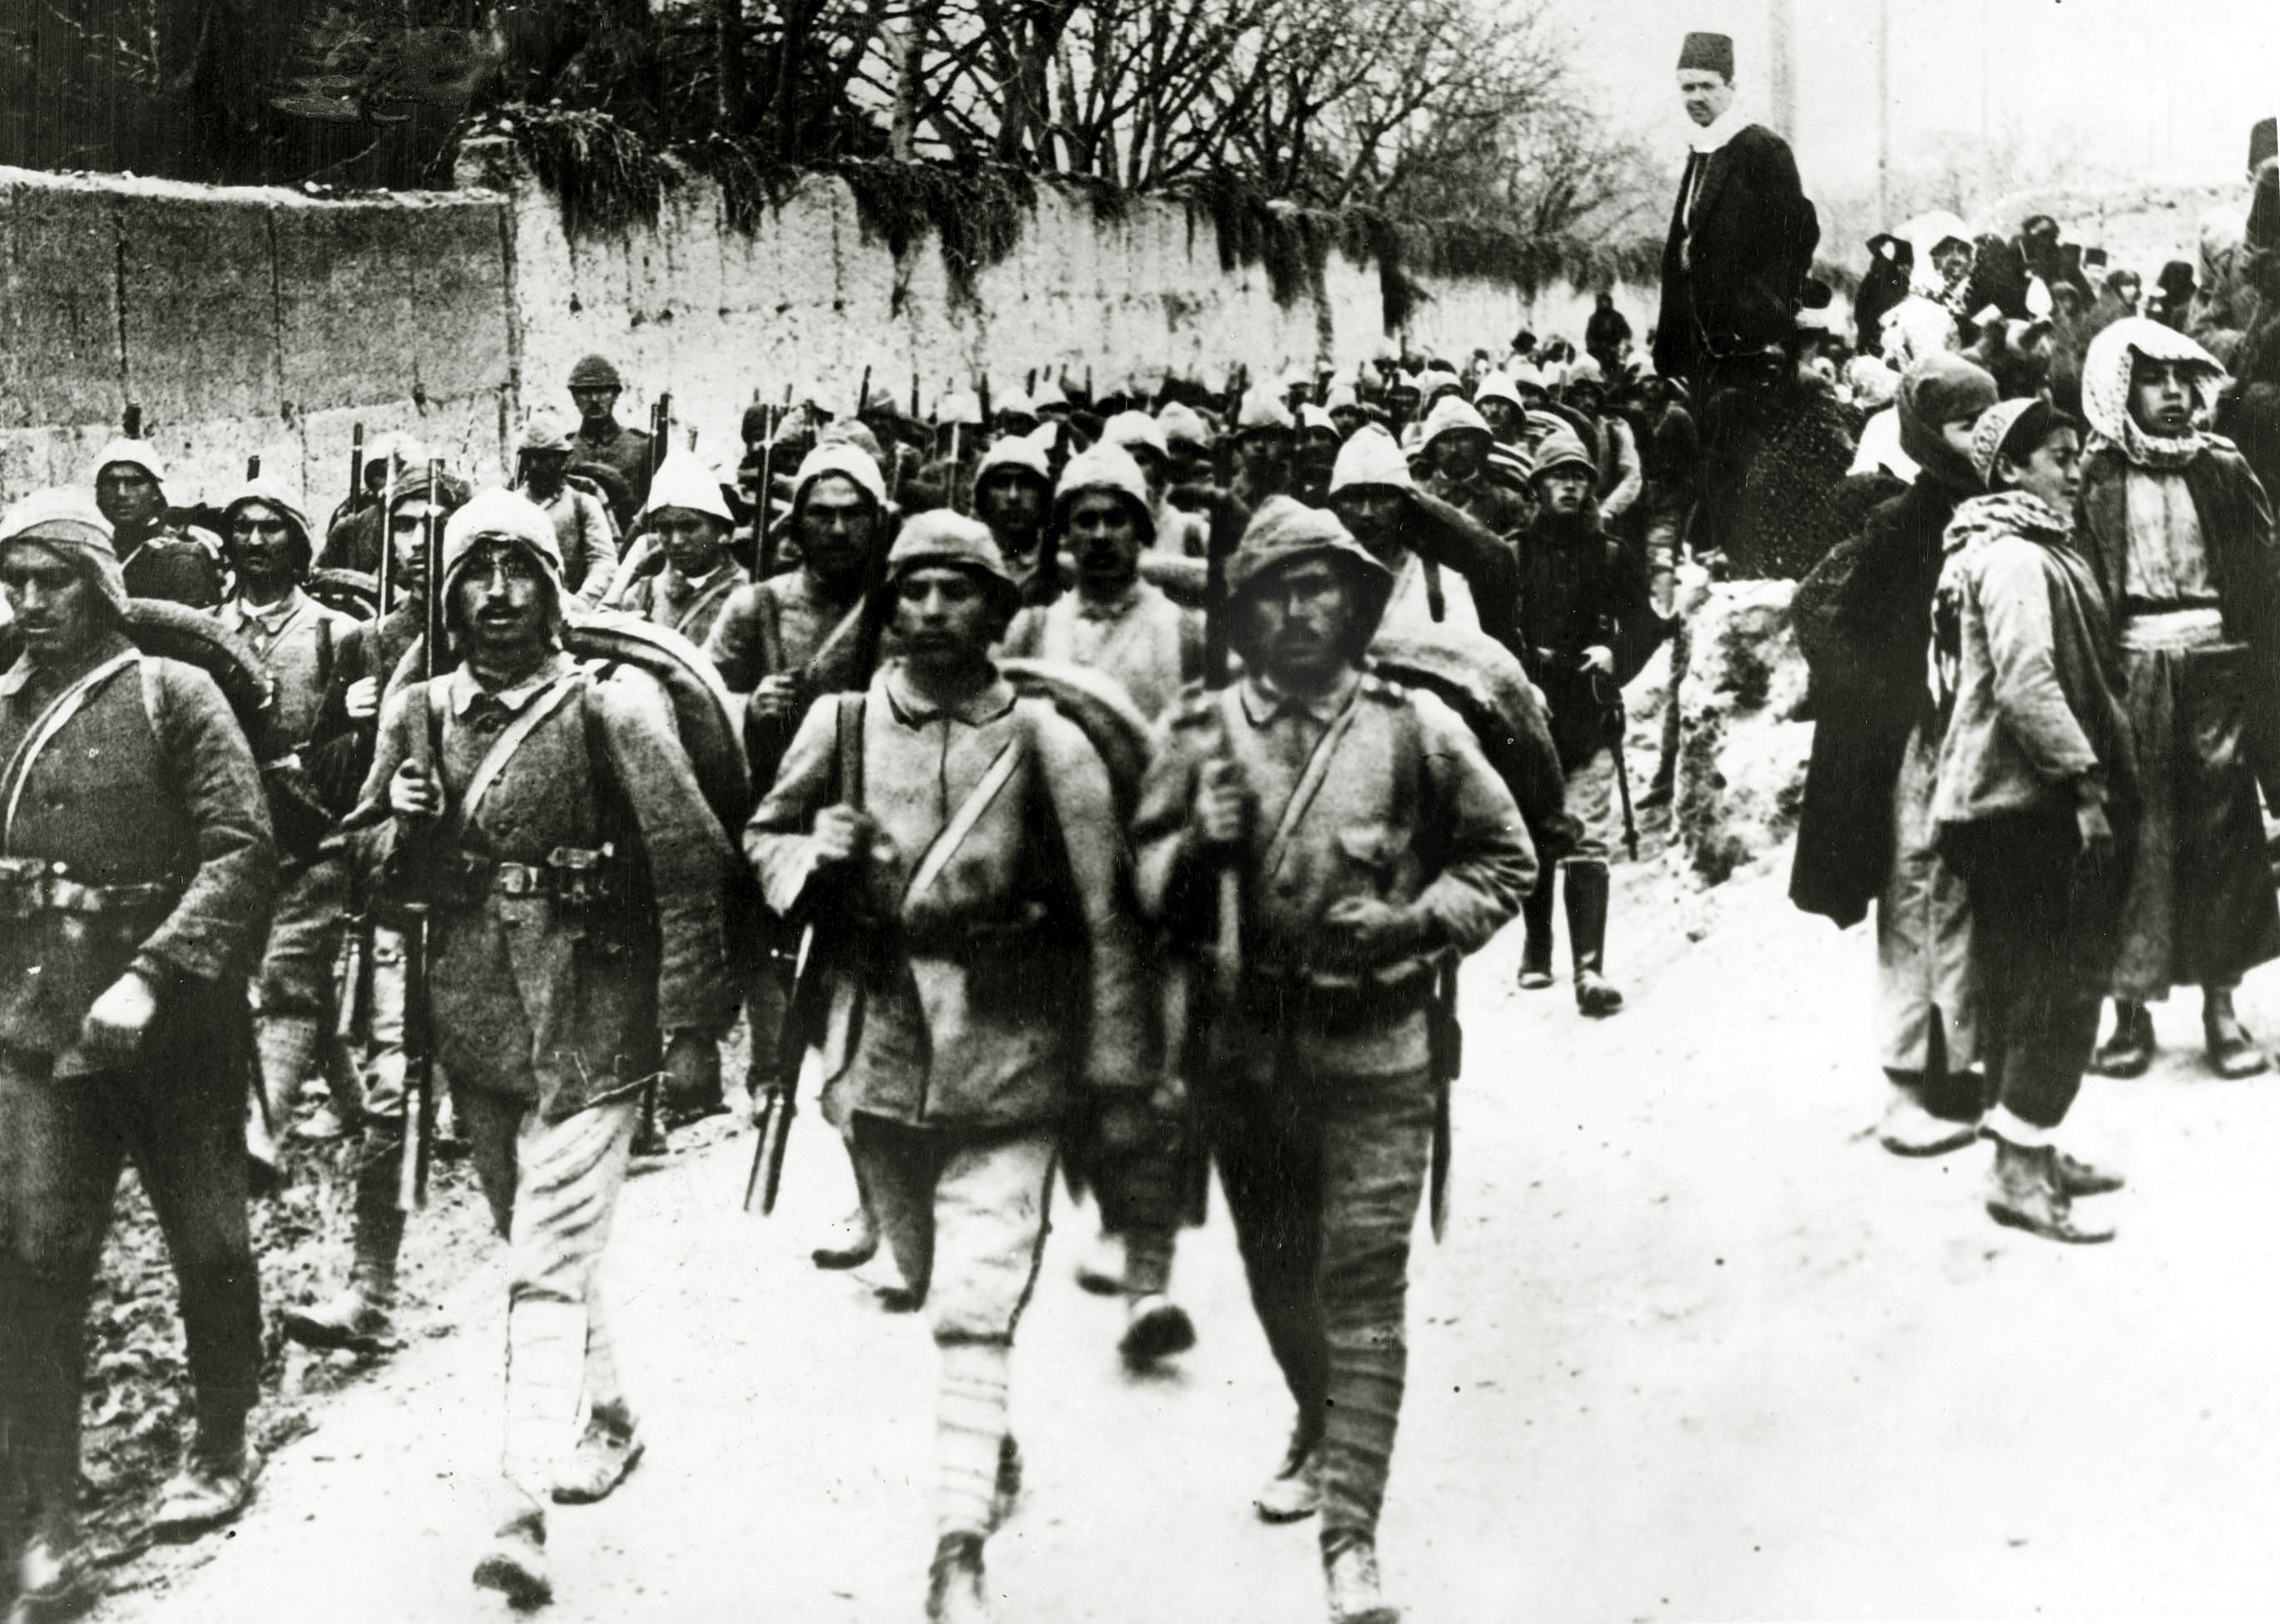
The Gallipoli campaign (1915-16) and the Greco-Turkish War (1919-23)

Slide 23
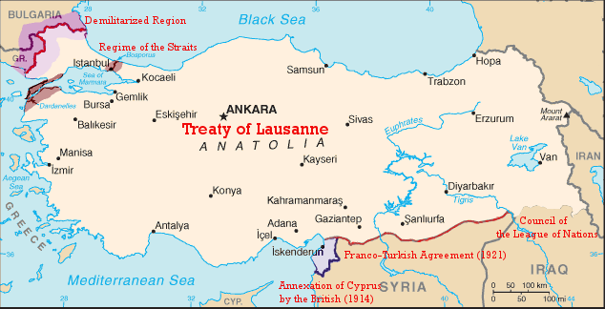
The Treaty of Sèvres (1920) was superseded by the Treaty of Lausanne (1923)

Slide 24
Atatürk’s reforms

Slide 25
Ankara: Atatürk’s new capital but an ancient city

Slide 26
The Atatürk Mausoleum in Ankara The proof of a state reformer’s success comes only after his death

Slide 27
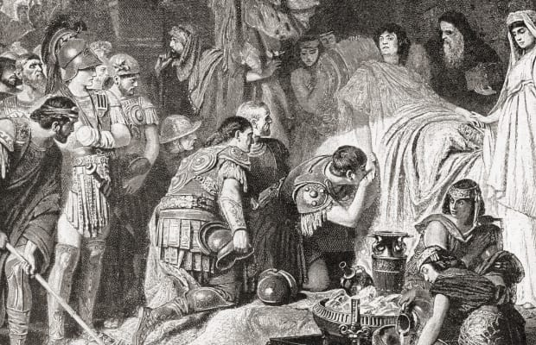
Two deaths, two mysteries: June 11, 323 BCE and February 8, 1725

Slide 28
Recep Erdogan: Nationalist or Islamist, Populist or Strongman?

Slide 29
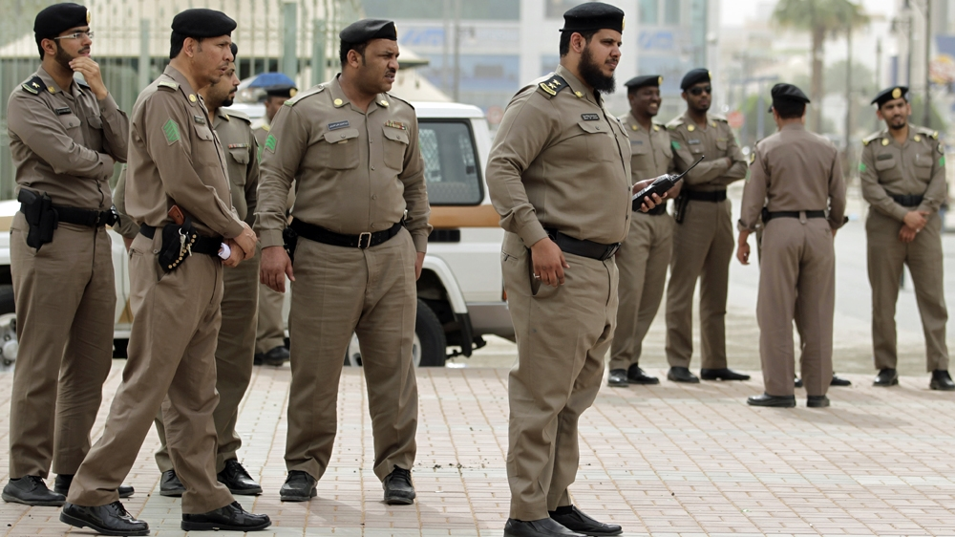
MBS’s secularizing reforms are popular with his subjects. “Subjects” being the operative word. No Kuwaiti-style experiments with democracy here!

Slide 30
November 2017. Bringing the elites to heel at the Riyadh Ritz-Carlton
“There is a cultural readiness in Saudi
Arabia to treat everyone equally. If
these princes are found guilty then
their place will be in jail and rightly
so.” Political science professor
Abdulkhaleq Abdulla of the UAE

Slide 31
The war in Yemen

Slide 32
Imam Adel Al-Kabani acts as card dealer on live TV (April 2, 2018)

Slide 33
Peter’s All-Joking, All-Drunken Synod of Fools and Jesters was founded in 1692

Slide 34
The murder of Washington Post journalist Jamal Khashoggi on October 2, 2018

Slide 35
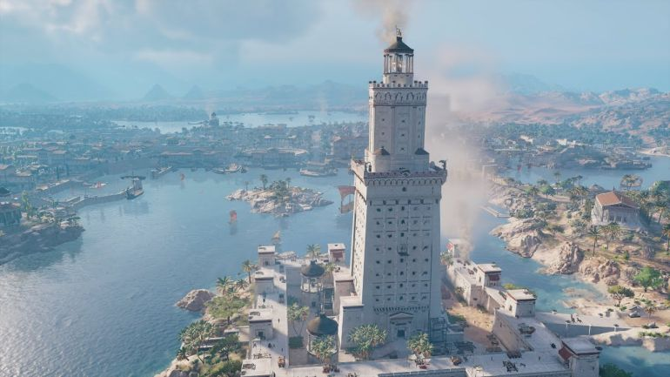
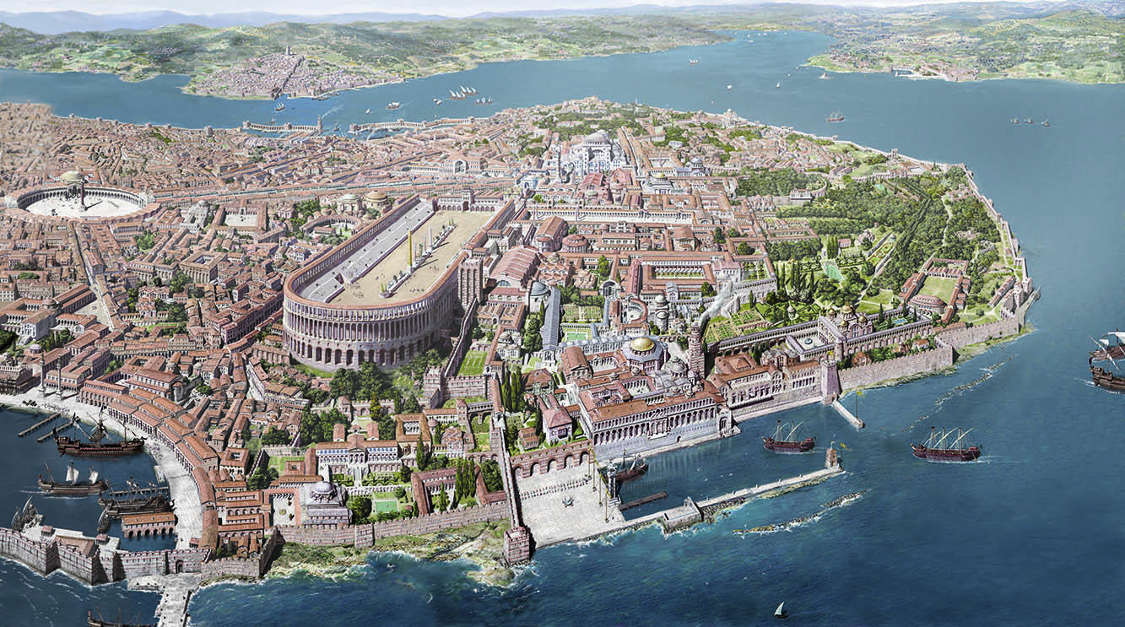
Alexandria, Constantinople, St. Petersburg…

Slide 36
…and Neom = neos + mustaqbal: a (half-)foreign name, just like St. Petersburg, Russia check out https://www.neom.com/en-us

