Slide 1
Jus in Bello
Session 3

Slide 2
Jus in Bello Components
Civilians v. Combatants
POWs vs. Enemy Combatants
Occupation
Limits on Weaponry

Slide 3
Civilians vs. Combatants
Combatants – legitimate targets
Civilians – not legitimate targets, but collateral damage possible
Who is a combatant?

Slide 4
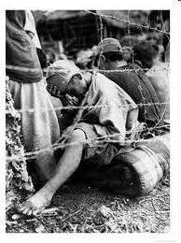
POWs vs. “Enemy Combatants”
Prisoners of War vs. “Enemy Combatants”
POW: members of armed forces, militias, volunteers, and resistance groups:
a. under command
b. uniform or distinctive sign
c. carrying arms openly
d. conducting lawful operations
If status is in doubt, competent tribunal decides

Slide 5
Law of Occupation
Conquest is Illegal
Treatment of Occupied Territories
NO MASS DEPORTATIONS OR TRANSFERS
MUST PROVIDE SECURITY AND ORDER
CANNOT TRANSFER SOVEREIGNTY (CAN’T ANNEX TERRITORY TO YOUR OWN)

Slide 6
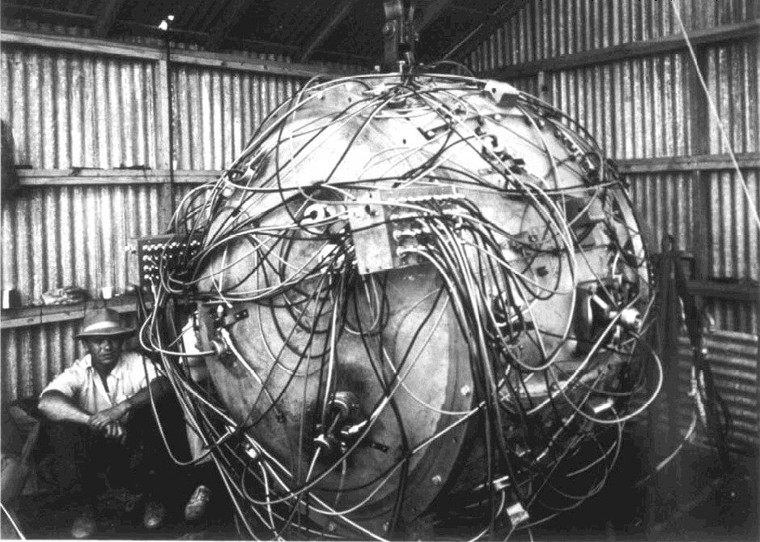
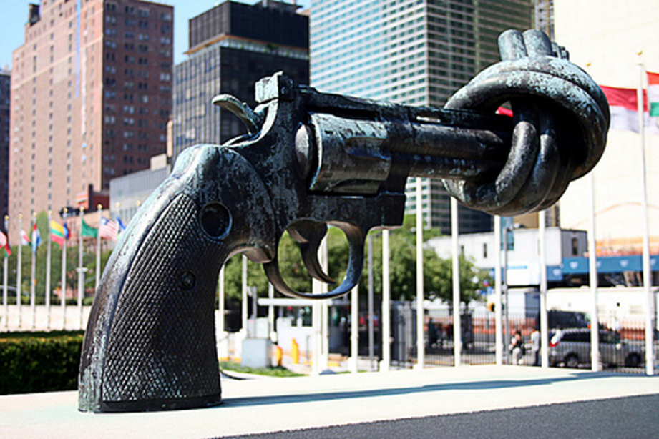
Arms Control Treaties

Slide 7
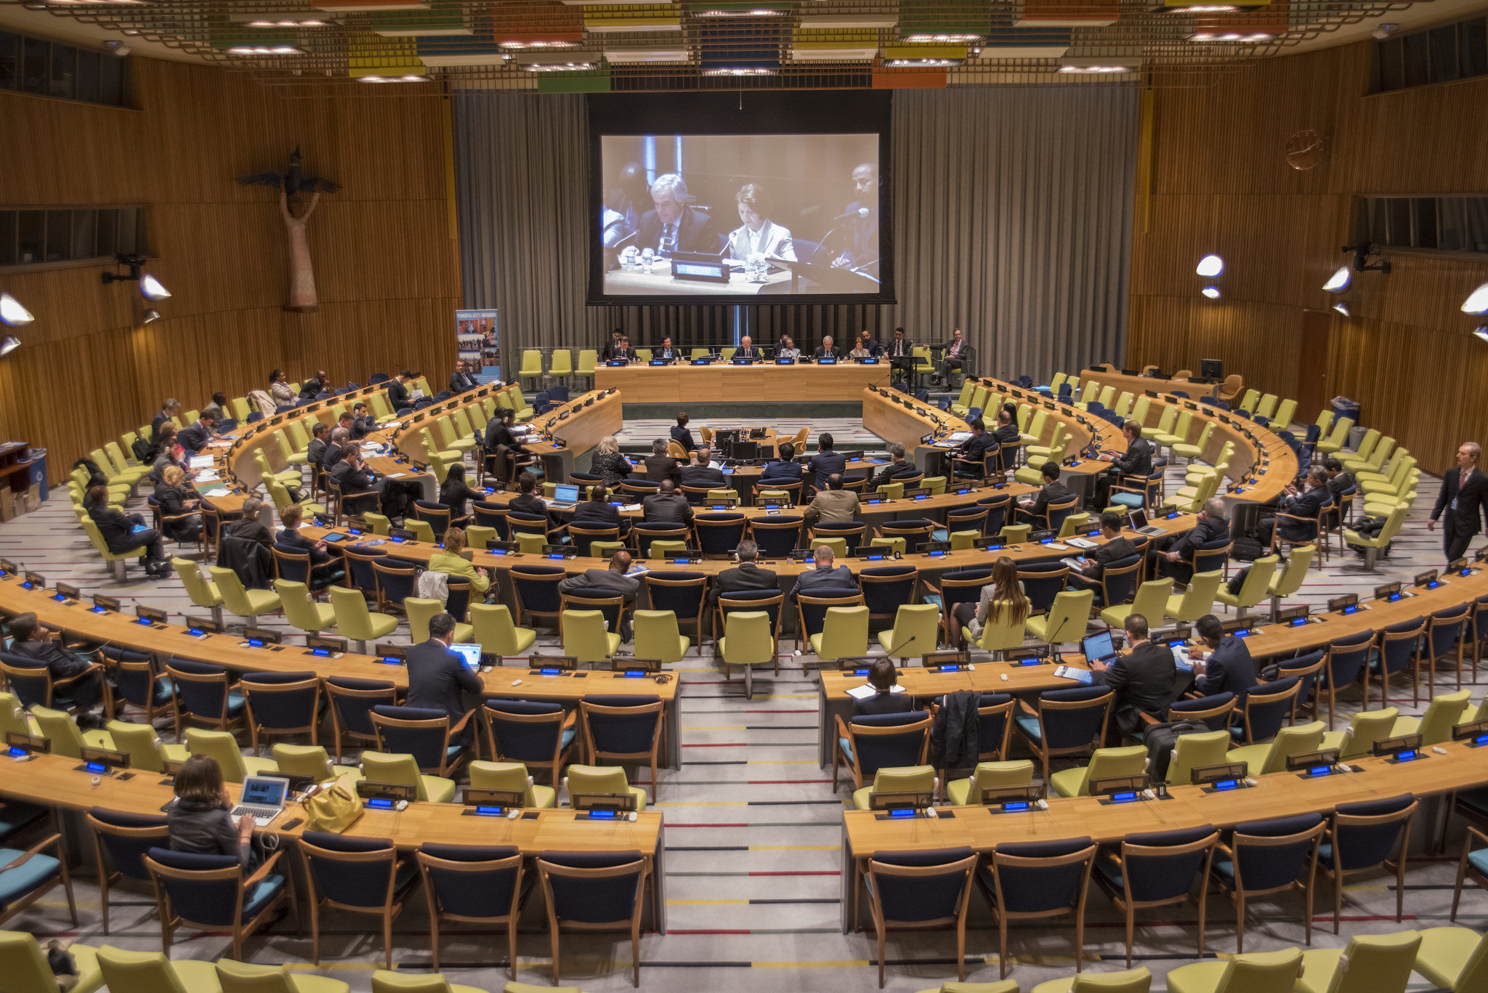
Arms Control Treaties
Arms Trade Treaty
Chemical Weapons Treaty
Nuclear Nonproliferation Treaty

Slide 8
Arms Trade Treaty
Open for Signature: June 3rd, 2013
Entered into Force: December 24th, 2014
State parties (entry into force): 103
Signatories: 130
Major Non-ratifications: U.S., Russia, China. (Latter two unsigned)

Slide 9
Arms Trade Treaty
Aims to Restrict International Trade of:
Battle Tanks
Armored combat vehicles
Large-caliber artillery systems
Combat aircraft
Attack helicopters
Warships
Enforcement:
Article 14: “Each State Party shall take appropriate measures to enforce national laws and regulations that implement the provisions of this Treaty”

Slide 10
Chemical Weapons Convention
Open for Signature: September 3rd, 1992
Entered into Force: April 29th, 1997
State parties: 193
Major Ratifications: U.S. Russia, China
Non-ratifications: North Korea, Israel, Egypt,
South Sudan

Slide 11
Chemical Weapons Convention
General Obligations: Each State Party to this Convention undertakes never under any circumstances:
To develop, produce, otherwise acquire, stockpile or retain chemical weapons, or transfer, directly or indirectly, chemical weapons to anyone;
To use chemical weapons;
To engage in any military preparations to use chemical weapons;
To assist, encourage or induce, in any way, anyone to engage in any activity prohibited to a State Party under this Convention.
What are considered chemical weapons?
Munitions and devices specifically designed to cause death or other harm through the toxic properties of those toxic chemicals

Slide 12
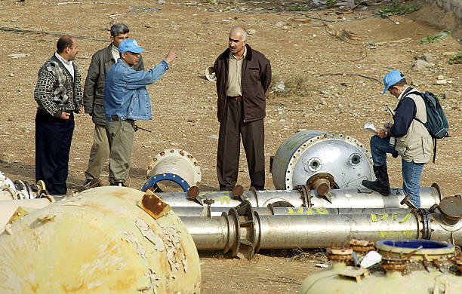
Chemical Weapons Convention
Monitoring: OPCW – Organization for the Prohibition of Chemical Weapons

Slide 13
Treaty on the Non-Proliferation of Nuclear Weapons
Open for Signature: July 1st, 1968
Entered into Force: March 5th, 1970
State parties: 191
Major Ratifications: All Permanent Members of UN Security Council
Non-ratifications: India, Pakistan, Israel, North Korea
Countries in possession of nukes: China, France, Russia, United Kingdom, United States, India, Pakistan, Israel, North Korea
Countries that have possessed nukes before: South Africa, Ukraine, Belarus, Kazakhstan

Slide 14
Treaty on the Non-Proliferation of Nuclear Weapons
“Believing that the proliferation of nuclear weapons would seriously enhance the danger of nuclear war…”
Three pillars of NPT
Nonproliferation
The peaceful use of nuclear energy
Disarmament
Monitoring: International Atomic
Energy Agency (IAEA)

