Slide 1
INTERNATIONAL LAWS OF WAR
Instructor: Paul F. Diehl
OLLI – FALL 2022

Slide 2
DOMESTIC VS. INTERNATIONAL LAW
LEGISLATIVE ORIGINS OF THE LAW
ENFORCEMENT
ROLE OF CONSENT
CENTRALITY OF COURTS

Slide 3
Almost all nations observe almost all principles of international law and almost all of their obligations almost all the time”
Louis Henkin

Slide 4
Reasons for Compliance
Self-Interest
Reciprocity
Reputation (“Diffuse Reciprocity”)
Domestic Incorporation

Slide 5
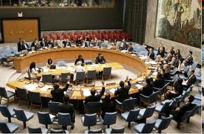
HIERARCHY OF IL SOURCES
Jus Cogens (preemptory norms)
Treaty/Agreements (akin to contracts)
Custom
Traditional
“Instant”
General Principles
Supplemental
IO Resolutions
Judicial Decisions
Government Documents
Writers

Slide 6
Religious Origins of the Laws of War
St. Augustine
All/Most Religions Specify the Conditions for War
Christian Traditions Dominate

Slide 7
Just War Tradition
Just Cause (no aggression)
Last Resort
Proper Authority
Right Intention (justice)
Reasonable Chance of Success
Proportionality (means to end; minimum force necessary)

Slide 8
Laws of War – Two Types
Jus Ad Bello
When is Military Force Allowed?
Jus in Bello (International Humanitarian Law)
When Military Force is Used, What are the Limits?

