Slide 1
Religion and Conflict

Slide 2
Common Elements on Religions and War
Some Permission to Use Military Force
Limited, e.g., self-defense
Rules (just war)
Generally support peaceful resolution
Diversity with Religions – source of conflict as much as across
Apostate vs. Infidel
Religion as justification, twisted or interpreted to justify
Crusades, “jihad,” Buddhists in Myanmar

Slide 3
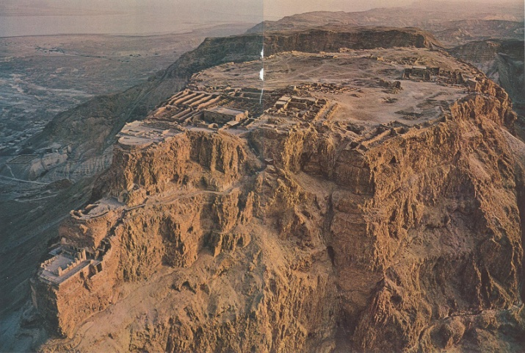
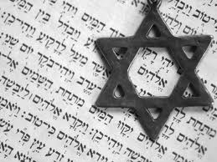
Judaism
Begins the Abrahamic tradition of text-as-law; scriptural focus on original biblical canon, called Tanakh – and the Talmud, collection of interpretations by later scholars (rabbis)
Sectarian conflicts –Ancient Judea/Israel ruled by religious law – civil wars and inter-tribal wars occurred – notable faction include Zealots, Maccabis, Sacarii – murder-suicide of of 1,000 Sacarii sectarian insurgents on Masada currently used in Israeli military training and ideology. Some recent examples of intra-religious fault lines: http://www.nytimes.com/2012/01/15/world/middleeast/israel-faces-crisis-over-role-of-ultra-orthodox-in-society.html
Masada ruins, and Symbol of the faith, (Star of David) over page from scripture

Slide 4
Judaism – Wars
Inter-faith conflicts –wars with pre-modern empires (Egypt, Rome, Parthia, etc.), persecution campaigns in Europe and elsewhere, modern struggles with Muslims
Conversion is rare; Judaism is an ethnicity as well as a religion – most believe the ethnic identity passes from mother (not father) to child
Just War Tradition: 1)“obligatory wars” –mandated by God – necessary to seize territory God promises to his “Chosen People”. These should be ethnocidal (Deuteronomy 20: “do not leave alive anything that breathes”). Immediate self-defense is also obligatory.

Slide 5
Judaism and War
2) “discretionary wars” – traditionally, religious leaders and local “judges” (tribal elites) had to approve these– checking power of kings/generals. Even then, several rules: always leave an avenue for escape – especially for civilians in sieges, offer peace before fighting, young people just beginning family life must not fight, no destroying food trees. And, if the opponent concedes, pays tribute and respects Jewish law, no war. Maimonedes: [i]f they agree to make peace and accept the seven commandments of Noah, not one soul may be killed.”
3) Broader rules: 1) the goal of Jewish practice must be peace: “swords into plowshares…Nation shall not lift up sword against nation…” (Isaiah) 2) “pekuah nefesh” and “rodef” – in response to an immediate lethal threat to oneself or others, one can kill, or violate any other rule – except prohibitions against incest, rape and praying to false gods/denying the true god (contemporary examples: medically necessary abortions, defensive war)
Notes:
o

Slide 6
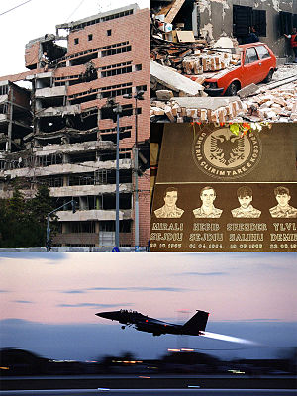
Christianity – Modern Just Wars
Just war theory has evolved considerably. Modern view:
Jus ad bellum: Force may be used only to correct a grave, public evil, [it] must be initiated by a political authority within a political system that allows distinctions of justice. War must not be waged for purely self-interested, material reasons, or when disproportionate force would be required for success. Even if these conditions are met, it must be a last resort.
Jus in bello: distinction between civilians and soldiers, use of force must be proportionate, minimize risks to non-combatants, the minimum amount of force should be used. Prisoners should be treated decently.
Possible paradigmatic case for modern just war theory: NATO’s Kosovo Campaign

Slide 7
Christianity – Pre-Modern Just War
Crusades: backed by great moral thinkers of the age: Thomas Aquinas, Bridget of Sweden, Catherine of Siena, John of Capistrano, Francis of Assisi, sanctioned by the Papacy from 1098-~1580. Horowitz (2009) argues that they continued long after their strategic and economic utility was demonstrably negative.
In 1208, calling for a crusade against the Cathars, Pope Innocent III summoned "knights of Christ . . . to wipe out the treachery of heresy and its followers by attacking the heretics with a strong hand and an outstretched arm, that much more confidently than you would attack the Muslims because they are worse than them.”
“The just war theory prevailing for most of the last two centuries — that violence is an evil which can in certain situations be condoned as the lesser of evils — is relatively young…. it has rejected two premises that underpinned all medieval just wars, including crusades: first, that violence could be employed on behalf of Christ's intentions for mankind and could even be directly authorized by him; and second, that it was a morally neutral force…. (Riley-Smith 2000)

Slide 8
Islam - Conflicts
Sectarian conflicts – since collapse of the singular Caliphate (750), Sunnis lacked a unified clerical hierarchy. Shi’i have a hierarchical clerical bureaucracy, headquartered in Qom, Iran. The first sectarian war – Fitna – happened about 25 years after the Prophet’s (PBUH) death. Modern examples: Iraq (2003-present), Iran-Iraq War, Lebanese Civil War, some aspects of Pakistan, Afghan conflicts
Intra-sect fighting. Many Sunni fights over dynastic rights to the Caliphate and religious doctrine (including fundamentalism/literalism). Egypt-Saudi rivalry in the mid 20th century, and Taleban insurgency in Pakistan are examples.
Inter-faith fighting – Muslims recognize Jesus as a prophet, but believe his teachings, and those of Abraham and Moses (Jewish prophets) are subordinate to the Quran. Early wars of Muslim expansion were fought against local polytheists, Jews (Arabia), and Christians in the Western Roman (Byzantine) Empire (Syria, Armenia, Egypt), polytheistic Mongols, as well as Hindus (North India). Notable modern examples: Indo-Pakistan and Arab-Israeli wars and the wars against the “Barbary Pirates”

Slide 9
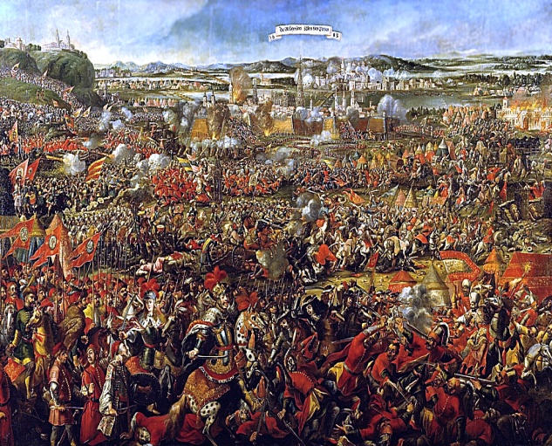
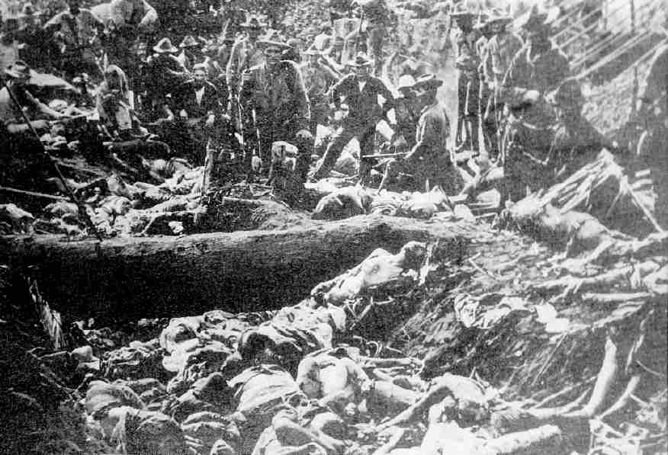
Islam and War
Battle of Vienna – Turkish declared a jihad, 1683. US soldiers posed with Moro bodies after the Battle of Bud Dajo, Philippines (1906) a.k.a. the Moro Crater Massacre – only 6 out of 900-1,000 Moros survived
No unified, global hierarchy (like medieval Catholic Church), so many debates about which war-related hadith are legitimate, and which supercede which (later trump older) – no consensus
Quran: “slay those who ascribe divinity to aught beside God wherever you may come upon them… Yet if they repent, and take to prayer, and render the purifying dues [pay taxes], let them go their way: for, behold, God is much forgiving…” (9:5)
Quran on offensive war: “if they withdraw from you and fight not, and instead give you assurances of peace, then God has opened no way for you against them.” (4:90)

Slide 10
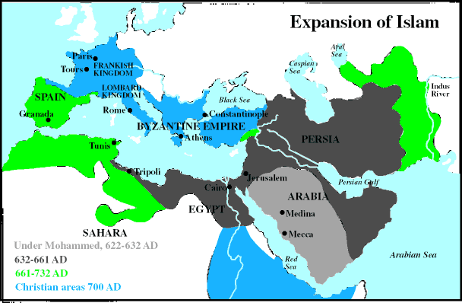
Islam and War - 2
Classical thinking: 3 houses – “house of war” (dar ul harb), “house of Islam” (dar ul Islam) – when Caliphs wanted peace, the added “the house of treaties” dar al-ahd
Mainstream classical thought: consistent with most international norms – no killing Muslims, rebelling against Muslim rulers, poisoning wells, allowances for safe conduct, no killing women, children, noncombatants, deliberate destruction of property, no using fire as a weapon, should abide by legal agreements
Jihad? Yes – it’s in the Quran – No, it’s not clear how to conceptualize/apply it – some wars are holy, but application depends on context and doctrine came long after the Quran was written. See:
Cook, D. (2009). Islamism and Jihadism: The Transformation of Classical Notions of Jihad into an Ideology of Terrorism. Totalitarian Movements & Political Religions, 10(2), 177-187.

Slide 11
Confucianism and Conflict
The ultimate authority on Earth is the Emperor – but even he is accountable – Heaven can punish him and his subjects. A bad emperor loses the “Mandate of Heaven” and may be made to step aside – including via rebellion.
A virtuous leader never needs to fight; morality and desire to avoid shame keeps order, not the fear of punishment - laws and coercion should not be needed. (Legge)
A. Iain Johnston identifies Confucian strategic culture: 1) Avoid and reject war 2) Cultivate, bargain with or appease the enemy 3) Use force as a last resort, defensively (1996)
The Le Dynasty Confucian altar near Hue in Vietnam – the most important religious site in modern Vietnam. The Emperor would come to sacrifice animals and make offerings to Heaven for a good harvests and luck. You can see that people still make offerings of incense and flowers.

Slide 12
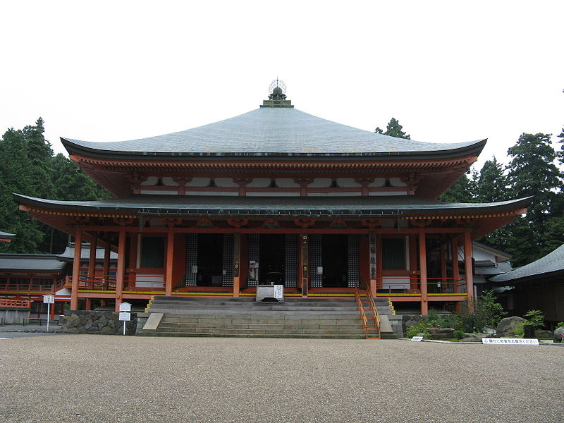
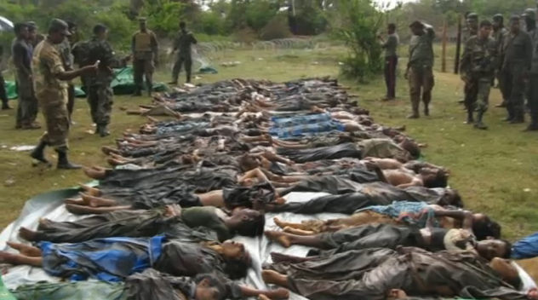
Buddhism and War
Buddhism’s commitment to non-violence may be limited – stories about the Buddha in the Pali canon show he did not condemn all military actions. Kings who sacrificed their spiritual purity to fight in the least violent way earn sad praise. Also, some sects believe that prior sins, can be washed away with meditation, withdrawal from the world. Military men can hope for retirement and salvation. Fatalism about death and suffering can help integrate Buddhism into a warrior ideology.
Tamil bodies from the Sri Lankan Civil War (1983-2009) – UN declared “credible evidence” of war crimes, as the Buddhist state military crushed ethnic insurgents (mostly Hindu). 80,000-100,000 died – the people below were allegedly killed when the government shelled a hospital
From the the 10th century until the warlord Nobunaga attacked it in 1571, Enryaku-ji Monastery in Japan produced armies warrior-monks that marched on the capital , joined in civil wars, and fought rival monasteries

Slide 13
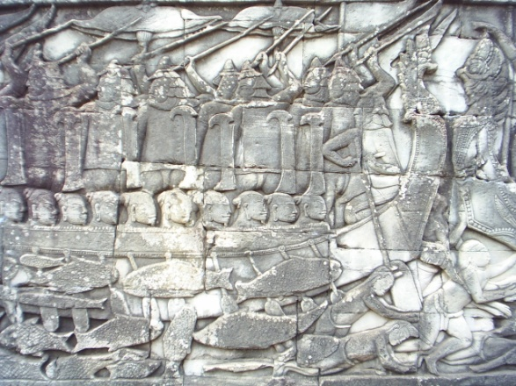
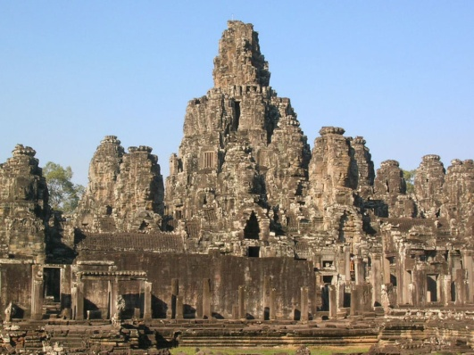
Hindu Rules of War
Battlefield conduct: no hiding weapons, no barbed poisoned or fire weapons, no attacking fleeing opponents, no killing surrendering soldiers, or disarmed ones. No combat between well-armed officers and poorly armed foot soldiers. Looting is allowed, but only of moveable objects.
Civil/Military distinction: no harming innocent bystanders, people working near the battlefield, or diplomatic envoys, and no killing Brahmin priests (Manusmriti). The Rig Veda forbids killing the sick, old, women, children, or ambassadors.
An anecdote in the Ramayana discusses a hypothetical WMD, and the god advises his younger brother not to use it because it will kill civilians indiscriminately. Similar story in the Rahabharata; except he refrains because it is a disproportionate escalation from conventional war.
Hinduism has co-existed with other religions and evolved syncretic practices. Angkor Tom temple in Cambodia has both Buddhist and Hindu features. It features a huge mural commemorating a naval battle between the Khmer and the Cham, who shared their religion

Slide 14
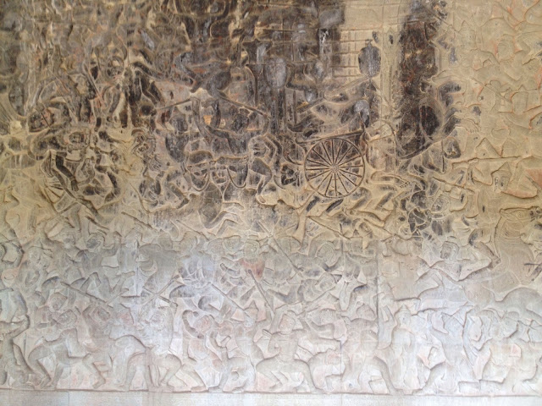
Hinduism and War
War metaphors very common in Hindu myths – in the founding myth, a god persuades a prince he must fight a battle even though it means killing some of his relatives
Dharma Yuddha requires compliance with the dharma (way of life/religion) of the warrior caste, including an obligation to fight and self-sacrifice to protect one’s people.
However, some Hindu texts (Nitisara) give justifications for unrighteous warfare in extremis
A mural from the Angkor complex – it shows a Hindu Khmer (Cambodian) king fighting a huge battle against a regional rival

Slide 15
Hinduism and War
Has rules for warriors and a law of war. Phases of conflict bargaining: 1) Negotiation (sama) 2) Offer gifts to appease the enemy (dana) 3) A veiled threat (bheda) 4) Use of force (danda)
Righteous war (Dharma Yuddha) distinguished from un-righteous war (Kutta or Adharma Yuddha). Righteous wars must include a formal declaration of war, fighting without thought of reward, an end to fighting at sunset (to collect casualties)
Justifications for war: self-defense, maintenance of peace or balance of power, legitimate expansion (associated with certain religious rites), protecting people from oppression, theft of a wife

