Slide 1
The Art and Craft of Writing As Portrayed in Film
OLLI Fall 2022
Week 4: Story and Reality(cont.)
Film: “Adaptation” (2002)

Slide 2
Course Overview
Week 1: Teaching and Writing (Part 1) “The Wife”
Week 2: (Part 2) ”Wonder Boys”
Week 3: Story and Reality (Part 1: Readers) “Misery”
Week 4: (Part 2: Authors) “Adaptation”
Week 5: (Part 3: Characters) “Stranger Than Fiction”
Week 6: Forging the Manuscript ”Genius”
Week 7: Finding the Author’s Authentic Voice (Part 1) “Little Women”
Week 8: (Part 2) “Finding Forester”

Slide 3
Today’s Film: “Adaptation” (2002)
Screenplay: Charley and Donald Kaufman, based on the non-fiction book The Orchid Hunter by Susan Orlean
Director: Spike Jonze
Principle Cast
Nicolas Cage—Charley and Donald Kaufman (identical twins)
Meryl Streep—Susan Orlean
Chris Cooper—John Laroche
Cara Seymour—Amelia Kavan
Brian Cox—Robert McKee
Ron Livingston—Marty Bowen
Maggie Gyllehaal—Caroline Cuningham

Slide 4
“Adaptation”
Let’s watch the film
(Content Warning—Extreme Self-Disclosure)

Slide 5
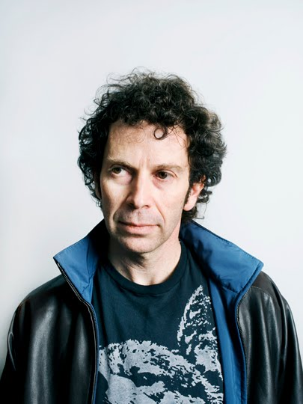
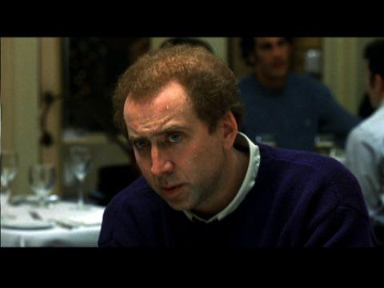
“Adaptation” (2000) WHO’S REAL?
Nicolas Cage—Charley Kaufman

Slide 6
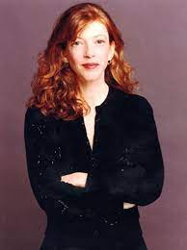
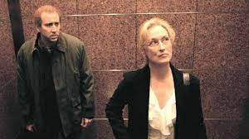
“Adaptation” (2000) WHO’S REAL?
Meryl Streep—Susan Orlean

Slide 7
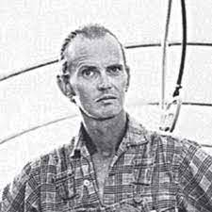
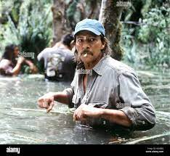
“Adaptation” (2000) WHO’S REAL?
Chris Cooper—John Laroche

Slide 8
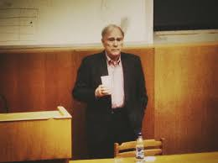
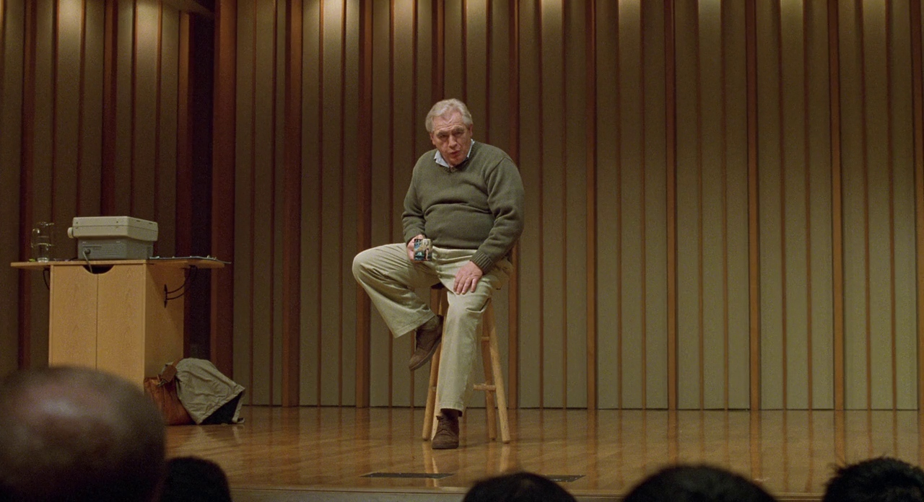
“Adaptation” (2000) WHO’S REAL?
Brian Cox—Robert McKee

Slide 9
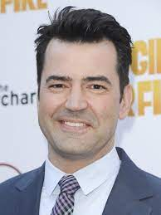
“Adaptation” (2000) WHO’S REAL?
Ron Livingston—Marty Bowen

Slide 10
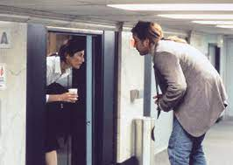
“Adaptation” (2000) WHO’S REAL?
Themselves—Cast and crew of “Being John Malkovich”

Slide 11
What does “Adaptation” say about the Art and Craft of Writing?
Five things (at least!)

Slide 12
What does “Adaptation” say about the Art and Craft of Writing?
1. There are no rules
Whatever works, works.
Whatever doesn’t, doesn’t.

Slide 13
What does “Adaptation” say about the Art and Craft of Writing?
1A. There are, however, some Principles
Motivation, Conflict, Action, Character Arc, Resolution,
and the much-maligned “Story Structure”
Ignore these at your own risk.

Slide 14
What does “Adaptation” say about the Art and Craft of Writing?
“It's always wrong of course to say that you can't do this or you can't do that in fiction. You can do anything you can get away with, but nobody has ever gotten away with much.”
–Flannery O’Connor

Slide 15
What does “Adaptation” say about the Art and Craft of Writing?
2. No matter how successful your last project was, the next project starts with a blank page.
Writer’s Block is an omnipresent hazard.
Nobody is immune.
You may be able to generate over a thousand words a day, but until you know where you’re going, you aren’t writing; you’re just typing.
( “Wonder Boys” was a great example)

Slide 16
What does “Adaptation” say about the Art and Craft of Writing?
3. A killer ending (especially in a screenplay) will make up for a host of sins.
It’s easy to put down a novel that drags, so if you’re not on top of your game, many readers won’t get to the end.
A film is different. Film viewers tend to stick around and watch it to the end, at least more so than readers do.
The ending is where meaning resides. People generally remember endings more than that stuff in the middle.

Slide 17
What does “Adaptation” say about the Art and Craft of Writing?
4. Stories where nothing happens and no one changes are NOT set in the real world.

Slide 18
What does “Adaptation” say about the Art and Craft of Writing?
In the real world, real people:
Rob banks
Give away all of their money to charity
Plot to overthrow democracy
Fall in love
Run billion-dollar con games
Go to the Moon
Commit murder
Raise children, some with special needs
Wake up to find their country invaded
Wake up to a global pandemic. . .

Slide 19
What does “Adaptation” say about the Art and Craft of Writing?
5. If you want to write a serious, critically acclaimed screenplay, avoid the following:
Guns
Sex
Drugs
Chase Scenes
Car Crashes
Gory Deaths
Voice-Over Narration
Deus ex Machina endings

Slide 20
What does “Adaptation” say about the Art and Craft of Writing?
5A. But note that this screenplay contains:
Guns
Sex
Drugs
Chase Scenes
Car Crashes
Gory Deaths
Voice-Over Narration
A Deus ex Machina ending

Slide 21
How Did The Screenplay Do?
Nominated Best Adapted Screenplay by:
Academy Award
Golden Globe Awards
Las Vegas Film Critics Society
London Film Critics Circle

Slide 22
How Did The Screenplay Do?
Won Best Screenplay or Best Adapted Screenplay from:
Boston Society of Film Critics
British Academy Film
Chicago Film Critics Association
Critics’ Choice Movie Awards
Golden Derby Awards
International Online Cinema Awards
National Board of Review
New York Film Critics Circle
Online Film & Television Association
Online Film Critics Society
PEN Center USA West Literary Awards

Slide 23
What does “Adaptation” say about the Art and Craft of Writing?
So the real Lesson Number 5 is:
Irony is your friend.

Slide 24
“Adaptation” as an example of writing
What do you think?

