Slide 1


What do you know about advance care planning?...
Notes:
Introduce – AIDET
Program Review – Carle PCP offices now have the Respecting Choices program. You may schedule a Free visit with an ACP facilitator at your PCP office.
The Self-Determination Act requires us to ask to ask about ADs when someone arrives at the ED or is admitted to the hospital, but these are terrible times!
ACP is the concept of starting the conversation earlier; normalizing the topic. That’s the overall purpose of our time together today.

Slide 2
QUESTION 1
When you plan ahead for future healthcare decisions it is called…
Advance Care Planning
Mapping
Finishing Well

Slide 3
ANSWER
Advance Care Planning
  Advance Care Planning is the more up to date term that represents this type of planning (some people call it End of Life planning).
  Advance care planning is for all adults.
  It is thinking and talking about future healthcare decisions if you had a sudden event, like a car accident or illness, and could not make your own decisions. A person close to you, called an agent, would need to make choices for you.
  Planning ahead will help your agent understand your goals and values, and then make decisions for you, if needed.

Slide 4
QUESTION 2
I only need to think or do Advance Care Planning when I’m really sick or injured.
True
False

Slide 5
ANSWER
False
  Accidents or sudden serious illness can happen at any age.
  If you don’t have an advance directive, doctors will turn to those who are closest to you to make medical decisions on your behalf, and those people may struggle to make decisions if they don’t know what you want.

Slide 6
QUESTION 3
True
False
I do not need to hire an attorney to do my Advance Directive.

Slide 7
ANSWER
True
  You do not need an attorney to complete an Advance Directive.
  Advance Directive forms are available from many sources. Often they can be completed without professional help.
  You can ask your primary care provider’s office or other healthcare facility for the forms.

Slide 8
QUESTION 4
When I name a health care agent in my Advance Directive, I lose my ability to make my own healthcare decisions.
True
False

Slide 9
ANSWER
False
  As long as you can speak for yourself, you are in control and make your own health care decisions.
  Your agent can only speak for you if you are no longer able to speak for yourself, or you have said that you want them to take the lead in speaking for you now.

Slide 10
QUESTION 5
Once I have an Advance Directive, I can file it away and forget about it.
True
False

Slide 11
ANSWER
False
  You should inform those who matter to you about your advance directive and provide them copies.
  You should think of your advance directive as an ongoing document. It should be reviewed periodically (at least every Decade or when a major life event happens like Diagnosis, Decline in Health, Death, Divorce) to be sure the information is still correct.
  Your advance directive also needs to be easily accessible during a medical emergency, so it should be stored in an unlocked drawer or file cabinet.

Slide 12
QUESTION 6
True
False
Medicare covers certain types of Advance care planning.

Slide 13
ANSWER
True
  Medicare covers certain advance care planning discussions with your health care professional.
  Carle also offers free ACP services to the community. Most Carle PCPs offer 1:1 visits with a trained facilitator.
  For those without a Carle PCP or an office without a facilitator, individuals can join a Carle ACP Class through Zoom (live internet sessions) by registering on carle.org.

Slide 14
QUESTION 7
Decisions involved in the Advance Care Planning process can include…
Formulating my goals, values, and things that are important to me
Choosing who can make care decisions for me when I cannot
Choosing or refusing (if I want to): tests, procedures, medicines, and life-sustaining treatment
All of the above

Slide 15
ANSWER
All of the above
  It is important to consider all of these types of decisions which can be made collectively or one step at a time.
  It is important to reflect upon your experiences, think about what you’ve learned from your past, and how that can help you choose what you want and don’t want.

Slide 16
QUESTION 9
If I don’t complete a Healthcare Power of Attorney form, my children can do it for me.
True
False

Slide 17
ANSWER
False
  No one can complete a Healthcare Power of Attorney form on behalf of another person – no matter what. The form must be signed by the person to whom it belongs.

Slide 18
QUESTION 10
The best way to document advance care plans in writing is….
Healthcare Power of Attorney
Living Will
Sticky note

Slide 19
ANSWER
Healthcare Power of Attorney
  The Illinois Healthcare Power of Attorney form allows you to clearly communicate many healthcare choices, including naming a person who can make healthcare decisions for you. This person will only make decisions if you cannot make them for yourself.
  This form helps everyone involved in your care understand and honor your wishes. It can be updated in the future as needed.

Slide 20
QUESTION 11
A main difference between Advance Care Planning and Advance directives includes:
The transfer of your thoughts and decisions about healthcare into written documents
Nothing, they mean the same thing
One is for pets and one is for people

Slide 21
ANSWER
The transfer of your thoughts and decisions about healthcare into written documents
  After doing some Advance Care Planning steps, it’s important to write down your goals, values, and preferences.
  There are many ways to do this, but it is recommend that you use a document called an advance directive – such as a Healthcare Power of Attorney Form.

Slide 22
QUESTION 12
If I’m a healthcare agent for someone and they become incapacitated, part of my role is:
To make decisions about their finances and/or pay their bills
Be their voice regarding medical procedures or treatment when needed
Become their full-time at home caregiver

Slide 23
ANSWER
Be their voice regarding medical procedures or treatment when needed
  Part of the role of being a Healthcare Agent is to make decisions regarding medical procedures or treatments when needed.
  The Healthcare Agent role doesn’t include making financial decisions or becoming a caregiver.

Slide 24
QUESTION 13
Sharing with others my personal definition of a “Good Day” is important because:
It helps others understand people or activities that I value.
It helps others understand what brings meaning and purpose to my life.
It helps others see the individual that I am, not the disease or illness within me.
All of the above

Slide 25
ANSWER
All of the above
  All the above answers are correct as they each play a role as to why it is important to share your personal definition of a “Good Day” with others.

Slide 26
QUESTION 14
Good qualities of a Healthcare agent include…
Willing to accept the role as your Healthcare Agent
Willing to talk to you about your goals, values, and preferences
Willing to follow your decisions - even if they may not agree with them
All of the above

Slide 27
ANSWER
All of the above
  All of these are good qualities to look for in selecting a Healthcare agent. Additionally, someone who can make decisions in difficult moments is also beneficial as it can be a lot of information to take in and think about at one time.

Slide 28
QUESTION 15
Choosing to stop or continue medical treatment in a situation of severe permanent brain injury with little chance of recovery is ….
An important part of my Goals of Care
Something I don’t need to think about
Something my doctor will decide for me

Slide 29
ANSWER
An important part of my Goals of Care
  There is one particular decision every person should think about as part of their Goals of Care.
    Imagine this situation: a sudden event (such as a car accident or illness) left you unable to communicate (severe permanent brain injury). You are receiving all the care needed to keep you alive. The doctors believe there is very little chance that you will recover the ability to know who you are or who you are with.
  It’s important to think ahead of time if you’d want to continue medical treatment or stop medical treatment. In either case, you will still get the care you need to keep you comfortable.
  It’s important that your Healthcare Agent be able to honor this choice for you!

Slide 30
QUESTION 16
Examples of cultural beliefs and spiritual needs may include ….
Music, meditation, prayer
Certain clergy persons involvement
Accepting or declining certain medical treatments not in alignment with your practices/traditions
All of the above

Slide 31
ANSWER
All of the above
  All answers are correct. These are examples of helpful information for your healthcare providers to know so they can help provide you the care you want.

Slide 32
QUESTION 17
It’s natural to have some fears or worries about future healthcare decisions
True
False

Slide 33
ANSWER
True
  It’s 100% normal to have concerns, fears, worries, or questions about your future healthcare decisions. It’s important to acknowledge these feelings and seek out guidance. Most commonly we hear concern about the ability to make changes later (which is easily done) and inaccurate conception that a person loses control over making their own decisions by completing these forms. (which isn’t so).

Slide 34
QUESTION 18
If an adult has not identified a HCPOA and is not able to express their own wishes, a Surrogate Decision Maker is determined by the state of Illinois.
True
False

Slide 35
ANSWER
True
  This is known as the Illinois Healthcare Surrogate Act.
  It includes a list of prioritized decision makers.
  If you don’t complete a HCPOA to identify a healthcare agent, one will be appointed when needed per the list in the Illinois Healthcare Surrogate act.
    Order of Surrogate decision maker priority:
        Court-appointed Guardian (of the person)
        Spouse (partner by civil union, but not live-in boyfriend or girlfriend)
        Adult Child(ren)
        Parent
        Adult sibling(s)
        Adult grandchild(ren)
        Close friend
        Legal Guardian of your estate

Slide 36
QUESTION 19
Good online Advance Care Planning resources include:
The Conversation Project.org
Prepare for your Care.org
Begin the Conversation.org
AARP.org
All of the above

Slide 37
ANSWER
All of the above
  All of the above sources have helpful information regarding ACP.

Slide 38
QUESTION 20
TRICKY!
Which documents specifically help with designating my finances and personal affairs?
Healthcare Power of Attorney
Financial Power of Attorney
Living Will
Last Will and Testament
Answers B and D

Slide 39
ANSWER
Answers B and D:
Financial Power of Attorney
Last Will and Testament
  A Financial POA (answer B) allows a person to name an individual to oversee their finances and make financial decisions on their behalf.
  A Last Will and Testament (answer D) expresses a person's wishes as to how their property (estate) is to be distributed after their death and as to which person (executor) is to manage the property until its final distribution.
  It is highly recommended you see an attorney for assistance with both of these document types.

Slide 40
QUESTION 21
Which one of the following terms doesn’t have the same meaning as the rest?
Healthcare Power of Attorney
Healthcare Agent
Next of kin
Healthcare proxy

Slide 41
ANSWER
Next of kin
  A, B, and D, are official terms used to refer to the individual(s) who can make medical decisions on your behalf when needed. Next of kin is referred to as a closest living relative. A closest living relative and the official medical decision maker are not always the same person and that’s ok.

Slide 42
QUESTION 22
I can complete advance directive documents without anyone knowing.
True
False

Slide 43
ANSWER
False
  Both the Healthcare power of attorney document and the Living Wil document must be witnessed.
  The Living Will document requires two witnesses.

Slide 44
QUESTION 23
A POLST form (Provider Order for Life Sustaining Treatment) could never ever be revoked, changed or updated after being completed:
True
False

Slide 45
ANSWER
False
  By law, the POLST form can be modified or revoked to allow patients to change treatment decisions as their disease progresses. It is advisable to have a discussion with your provide should you want to make changes

Slide 46
QUESTION 24
A Living Will and a POLST (Provider Order for Life Sustaining Treatment) are the same thing.
True
False

Slide 47
ANSWER
False
  There are many differences, but one main difference is that a Living Will is an Advance Directive while a POLST is a medical order. They serve and achieve different purposes.
  A Living Will allows an individual to broadly declare should they have an incurable, irreversible, terminal medical condition that they would not want medical treatments to delay their death.
  Whereas, the POLST addresses the specific medical situation of cardiopulmonary resuscitation (CPR) as well as other medical treatment options related to breathing, feeding, and comfort supports

Slide 48
QUESTION 25
If I want to decline CPR, I should talk to and complete a POLST (Provider Order for Life Sustaining Treatment) form with my provider.
True
False

Slide 49
ANSWER
True
  It is incredibly important to have a POLST discussion with your provider. They can review how the POLST can be applied to your care including if you want to decline CPR. Your provider will need to review the POLST information with you before you sign the form. They too will sign the form.

Slide 50
QUESTION 26..LAST ONE!
Outside of the hospital, a completed POLST (Provider Order for Life Sustaining Treatment) form is required if I do not want CPR.
True
False
I’m not Sure

Slide 51
ANSWER
True
  In a medical crisis, emergency medical service (EMS) personnel must initiate cardiopulmonary resuscitation (CPR) and other life support measures unless they have medical orders to the contrary.
  POLST forms are medical orders so they are followed by EMS personnel in accordance with protocol, but the EMS must see the form in order to properly follow it (verbal instructions from family will not suffice).
  The POLST will also be followed by other healthcare professionals upon arrival at a hospital. However, the POLST form is a voluntary form and one cannot be ‘required’ or ‘forced’ to complete it.

Slide 52

Advance Care Planning Basics
Notes:
So today we’re going over some basic concepts of introductory ACP. Now, if at the end you feel that you would like to take this work beyond the introductory level, we will provide resources for you to do that.
Today using the Trivia questions you might have heard some key concepts of ACP come up such as:
What advance care planning truly means in current times
Suggested qualities of a good healthcare agent
How your own experiences, values, and beliefs may impact the HC choices you make (now and future)
Help you consider at least one possible future health care decision (what if scenario)
Talk about how you can transfer your wishes to a plan called an advance directive
Suggested ways to share that plan

Slide 53

2000
The ACP Discussion Evolves over the Lifetime
2005
1st ACP Discussion
HCPOA
Completed
2007
2nd ACP Discussion
HCPOA
Reviewed
2010
3rd ACP Discussion
Living Will (optional)
2013
Later Season of Life
2016
2020
“POLST form”
Optional
Revisiting the topic is GOOD!
6
Notes:
ACP occurs over time. It involves thoughtful conversations, asking questions, and sharing with others. Our thoughts and wishes change as we age and as our health changes; thus the discussion needs to evolve with us as well.
ADs are (or should be) the written results of ACP. These are able to be updated/ re-written as needed.
Timeline shows an example of how this can happen over one’s lifetime.
The purple dots are ACP conversations and the blue dots are advance directives. The dates are arbitrary and don’t mean anything.
You start with a simple conversation/presentation (like this one) and possibly complete a HCPOA form to name an agent. Later in life your health changes and more questions/discussions occur as appropriate. In the final season of life, one might want a POLST form completed to have a “Do Not Resuscitate”
HCPOA completion is not required – but it’s important to remember: If an individual does not have a written power of attorney document, then an IL law called the “IL Healthcare Surrogate Act” dictates who will speak for us when we are unable to speak for ourselves and this individual may not be who we want it to be and that can be concerning to us.

Slide 54
Basic parts to think about:
Choose an Appropriate Agent
Explore Experiences & Beliefs
Define a Good Day
Evaluate your Goals for Care
Share what you decided
Notes:
If Short on time just stay on this slide vs going through slides individually:
Key concepts of Advance Care planning discussions encourage us to….read key points from slide).
SAY:
Choose Agent: One of the most important decisions we encourage all adults to make is choosing someone now who would make future decisions for you if you were ill or injured and unable to make decisions for yourself or communicate your wishes. This person would only make decisions if you had a sudden event and could not make your own decisions.”
Experiences: Many of us know or have known of someone who was in a medical situation where they were unable to communicate for themselves. It’s important to stop and reflect on what you learned from that situation that you would desire to apply to your own life.
Living Well: In addition to our past experiences, it’s also helpful to think about the activities we engage in that are important to us, that give our life meaning. The valuable part here is to think about if you were having a good day determine what would happen on that day..Who you would talk to, what you would do.
Goals for Care: There is one decision that every adult should think about. We call it the ‘Imagine if’ scenario and it involves considering choosing to stop or continue medical treatment in a situation of severe permanent brain injury with little chance of recovery which is an important part of your Goals for Care.
Share: Lastly after doing all of this it is important to share any decisions with those who matter most to you – including any named agents and HC providers.
In addition to our past experiences, it’s also helpful to think about the activities we engage in that are important to us, that give our life meaning.
If you were having a good day, what would happen on that day? Who would you talk to? What would you do?
Notes:
Be prepared with examples — those things that give life meaning may change over time. For example an active 28-year-old may love training for triathlons and may not be able to imagine a serious illness or injury. Someone in their 60s may value walking the dog and being an active swimmer, and someone in their 90s may love being independent and being able to watch their favorite sitcoms and visit with the younger generation. Each of those life experiences require different levels of activity and participation, and all can bring great satisfaction (quality of life).
And there are differences among people. One person may say, life is only worth living if he can fish or play golf and all that entails (being outside, walking, being mobile, communicating wishes), while someone else’s greatest joy may be in listening to classical music or being able to read (sedentary, does not require ability to walk or talk; this may mean the person is okay with being in bed most of their life, but they are satisfied with their life). Or, what’s acceptable to one person may not be acceptable to another.

Slide 55
Advance Directive Forms
Notes:
There is no one standard form that has to be used in the state of IL. Lawyers draft up their versions, other versions can be printed off the internet, but today we will review Carle’s version.

Slide 56
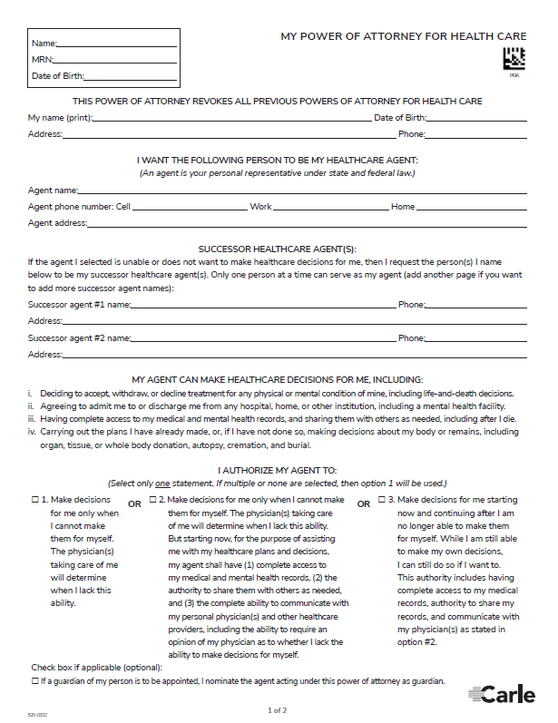
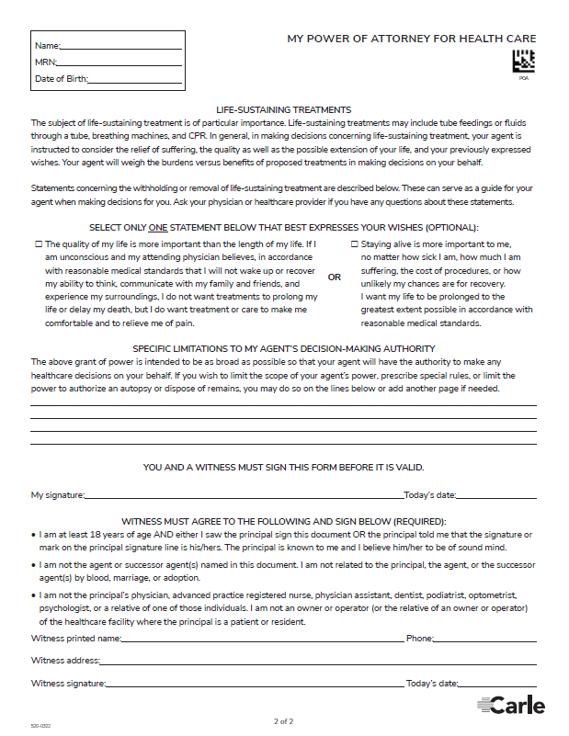
Power of Attorney for Health Care (Carle Version):
Basic Purpose:
Appoint someone to make healthcare decisions when not able.
Notes:
So we condensed the state form into a 2 page document.
NOTE: the Carle version has a place to put a sticker or patient identifiers on each page. This is very important to help us get the document into the correct medical record.
*PLEASE put patient sticker on EVERY PAGE!!!
Patients may bring in forms from a lawyer’s office that may be 7-10 pages long or other forms off the internet.
No matter what style is brought in, be sure ALL pages have 2 patient identifiers.

Slide 57
Power of Attorney for Health Care (Carle Version):
1. Identifiers
Basic Purpose:
Appoint someone to make healthcare decisions when not able.
2. Agent Info
3. Signature & Date
4. Witness Signature, Contact & Date
Notes:
Carle form has place for sticker / patient identifiers on all pages.
Required pieces:
Identifiers:
Top left corner has box for Name, MRN and DOB. Patient sticker use or write legibly.
Patient info section - Person’s legal name, address, & DOB. Phone number strongly encouraged.
Agent Info:
Agent’s name. Relationship to patient also helpful if available (ex. daughter, mother, friend, etc)
Contact info strongly preferred – not helpful if unable to contact the person. Close address acceptable (Street name, City, State, Alternate phone number if direct unavailable)
Individual’s Signature & Date:
Person’s own signature & date signed. A surrogate cannot complete HCPOA form on individual’s behalf. If unable to sign their name, can make a “mark” to best of their ability. Can sign in presence of a witness or after having already signed confirm with the witness that is their signature on the signature line.
Witnessing:
Witness is attesting they:
watched or confirmed the signature on the line, a
are familiar with the individual and believe them to be of sound mind,
are an adult, not an agent named in the document, not related to the individual or agent named in the document
not the individuals direct provider (see form for list) and not themselves or a relative of an owner/operator of the care facility where the individual receives care
witness signs it themselves, including contact information and date witnessed
Optional Pieces:
Successor Agents
If primary agent selected is unable or unwilling to act then, “back up” agents can be appointed (in respective order on form).
2. Limitations to agent(s) authority
Agent authority is meant to be broad, there is ability to limit. Ex: no authority to authorize blood transfusions, authorize autopsy, burial/cremation of remains.
3. When agent(s) may be used
There are two options, if both or neither option is section then option 1 is used.
Option 1(left): agent can make decision only when individual unable
Option 2 (right): agent can make decisions starting now and after individual no longer able. Includes complete access to medical records. Individual can still make decisions if able.
4. Life-sustaining treatment preference
There are two options, one speaks to more to quality of life, the other to length of life.
Options 1(left): person would not want treatments to delay their death if they were in a situation where they were unconscious and it was believed by their attending physician that they would not wake up or recover ability to think/communicate/experience surroundings.
Option 2 (right): person wants their life prolonged to the greatest extent possible no matter the cost, the suffering, or how unlikely the chances for recovery are.
May look cumbersome, but really it's not complicated. It’s worth it. I cannot tell you how many situations I have been in where an individual has not had this done and the chaos that has ensued.

Slide 58
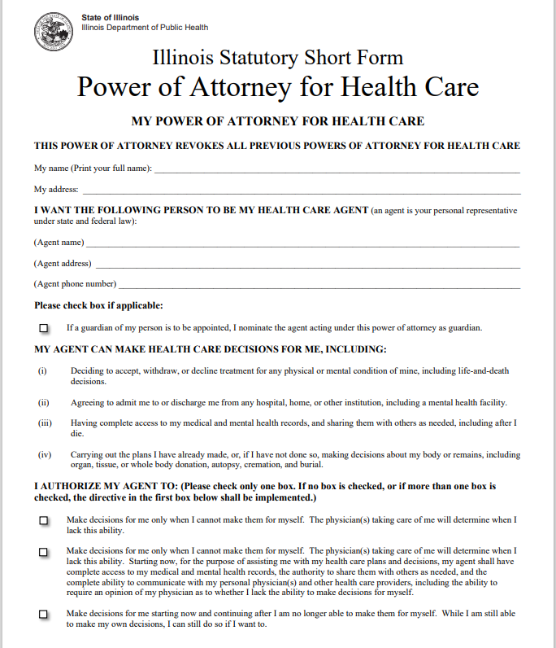
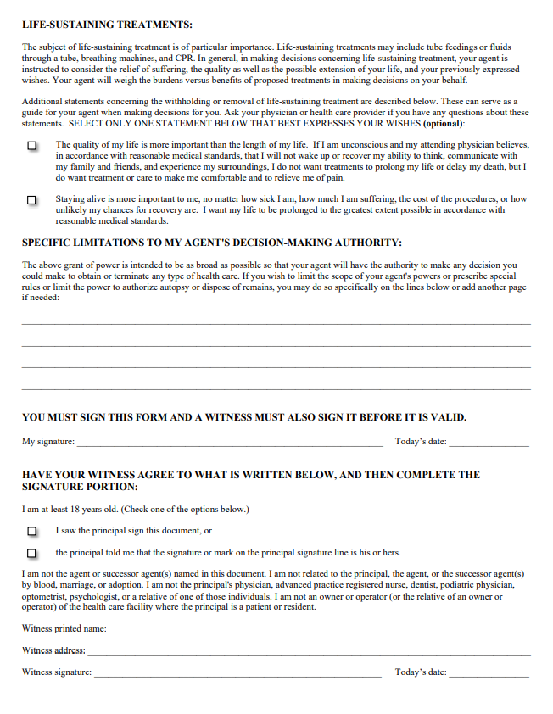

Power of Attorney for Health Care (State Version):
1 of 3
2 of 3
3 of 3
Notes:
This is a view of the state’s version of the Power of Attorney for Healthcare. This can be printed off the IDPH website and found numerous other places.
Unfortunately the design of this form is not ideal for encouraging proper completion nor for getting it into the medical record.
So we took the state form and redesigned it into a more user-friendly and EMR friendly version.

Slide 59
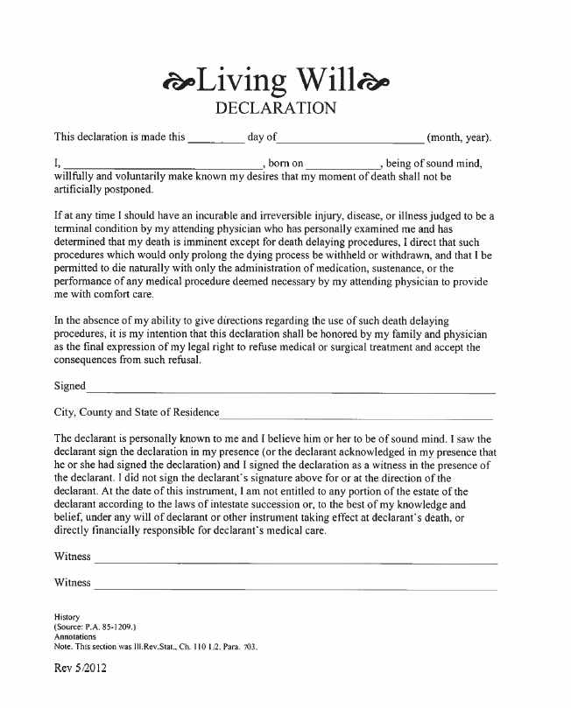
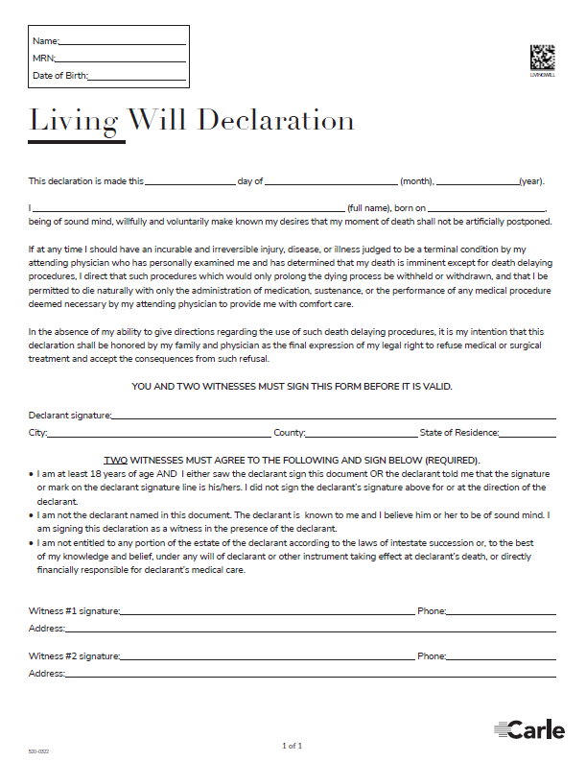
Living Will:
State Version
Carle Version
Basic Purpose:
Expresses pts desire that certain medical interventions be withheld and/or withdrawn in a terminal situation.
Notes:
Carle form has place for sticker but please place sticker (or 2 patient identifiers) on any style LW that is brought to the clinic.
Two witnesses required.
ALL lines must contain information.

Slide 60
Living Will:
State Version
Carle Version
Basic Purpose:
Expresses pts desire that certain medical interventions be withheld and/or withdrawn in a terminal situation.
1. Identifiers
2. Signature & Address
3. Witnesses Signatures (x2)
Notes:
Carle form has place for sticker / patient identifiers.
Carle Living Will:
Notice the box in the top left for pt Name, MRN, and DOB. Patient name and the date of completion go in the first paragraph of the form.
Patient Signature & address – patient signs and includes their full address
Witnesses – biggest area of error. Typically only get one witness, or no witness. LW needs two for validity. Witness contact information recent added and optional, signatures required.

Slide 61
Advance directives must be signed by a specific witness (or two) to be valid:
Witnesses must meet the criteria printed on the form above the witness signature line. Most errors are seen with witnessing. Witness cannot be an agent or a family member by blood, marriage, or adoption.
Ex: Mary names Tracy (daughter) as her agent and then Tracy signs as the Witness. (No! – witness cannot be the agent)
Ex: Mary isn’t naming Ralph (brother) as her agent or successor agent, so she will have him sign as the Witness on her HCPOA form because it’s convenient. (No! – Ralph is related “by blood” as her brother.)
Ex: Mary will have her daughter be her agent and a friend from church sign as the Witness. (Yes! – no conflicts noted)
While practicing social distancing some ideas include:
Call your local bank to ask if a notary is available. Use the drive through.
Ask a neighbor if they’re willing to sign as a witness. Use the front door/porch to leave and retrieve the forms.
Notes:
IL requires one witness on the HCPOA form but two witnesses on the Living Will. A notary is not required but certainly can be used.
Reading the criteria over the witness signature is critical. Most forms get returned to patients because they did not obtain a proper witness.
Read examples on the slide about witnesses.

Slide 62
Links to Specific Forms:
ACP for Every Adult:
  This information is viewable on our Carle.org ACP page.
  https://carle.org/Patients-Visitors/Advance-Care-Planning
Healthcare Power of Attorney Form (Carle):
  This fillable document can be downloaded from our Carle.org ACP page.
  https://carle.org/Patients-Visitors/Advance-Care-Planning.
Living Will form (Carle):
  This fillable document can be downloaded from Carle.org ACP page.
  https://carle.org/Patients-Visitors/Advance-Care-Planning.
IL DPH Advance Directive forms:
  Download the IDPH (IL State) AD forms by searching for “advance directives” on their website: www.dph.Illinois.gov.
  Or, use the following link to go directly to a list of their forms list: https://dph.illinois.gov/topics-services2fhealth-care-regulation2fnursing-homes2fadvance-directives%23forms-forms-advance
Notes:
We can email out the information on this slide if requested.
We simply want to advise that we will provide you with a follow-up summary and resources to continue the work of Advance Care Planning.

Slide 63
ACP Online Resources:
Carle Advance Care Planning
https://carle.org/Patients-Visitors/Advance-Care-Planning
The Conversation Project
https://theconversationproject.org/
Begin the Conversation
http://www.begintheconversation.org/
PREPARE
https://prepareforyourcare.org/welcome
Good End of Life
http://www.goodendoflife.com/
Engage with Grace
http://engagewithgrace.org/
Honoring Choices – Pacific Northwest
https://www.honoringchoicespnw.org/about/
Go Wish
http://www.gowish.org/
AARP – Prepare to Care
https://www.aarp.org/caregiving/prepare-to-care-planning-guide/
Notes:
We can email out the information on this slide if requested.
We simply want to advise that we will provide you with a follow-up summary and resources to continue the work of Advance Care Planning.

Slide 64

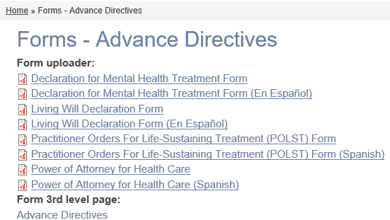
IDPH (IL State) Advance Directives
The following Advance Directive forms are available from the State’s website:
Find forms by typing “advance directives” in the search bar.
HCPOA
Living Will
POLST
Other Languages and Forms also
Notes:
If you would prefer to use the state of IL Advance Directive forms, they can be found on the IDPH website. Typing “advance directive” into the search bar is the easiest way to locate the page.
IDPH website to forms list if want to pull up while presenting: https://dph.illinois.gov/topics-services2fhealth-care-regulation2fnursing-homes2fadvance-directives%23forms-forms-advance

Slide 65

Advance Care Planning is a beautiful and precious gift to give your family!
“Advance Care Planning: Laurelea Shares Her Story”
by Sunnybrook Hospital
https://www.youtube.com/watch?v=Jza-91GwN2Q
Notes:
Though we are not going to take the time today to view this YouTube video, we want you to know that YouTube has many helpful and encouraging videos about the importance of ACP. Simply search “advance care planning”

Slide 66
Thank you!
ACP@carle.com or 217-326-9040
Greg Scott, MS, RN, PHRN, TNS, Paramedic
RN Manager, Faith Community Health
Danna Williamson, MSN, RN, NPD-BC
Faith Community Nurse
Faithcommunityhealth@carle.org
Please let us know, if:
You would like a Carle Advance Directive packet sent to you.
You would like a 1:1 visit with an Advance Care Planning Facilitator.

